Slide 1
Session-based Volunteer Recommendation via Graph Attention Network
Taurai Muvunza
April 21, 2022
TBSI, SIGS
Recommendation system

Slide 2
Agenda
GNN
Data
Results

Slide 3
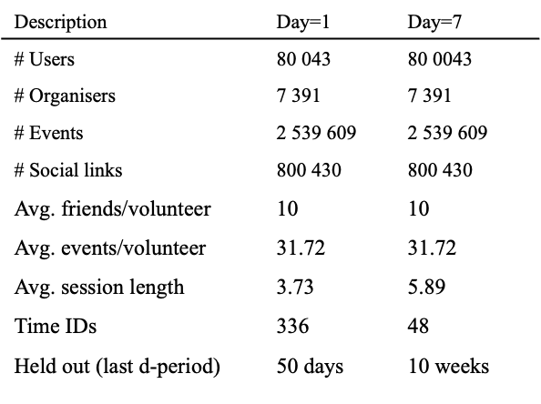
Data

Slide 4
Results
 | Recall@10 | NDCG
Day=1 | 0.99795 (@20) | 0.97756
Day=1 | 0.99730 | 0.97756
Day=7 | 0.98930 | 0.95611
ItemKNN | 0.67531 | TBA ☺

Slide 5
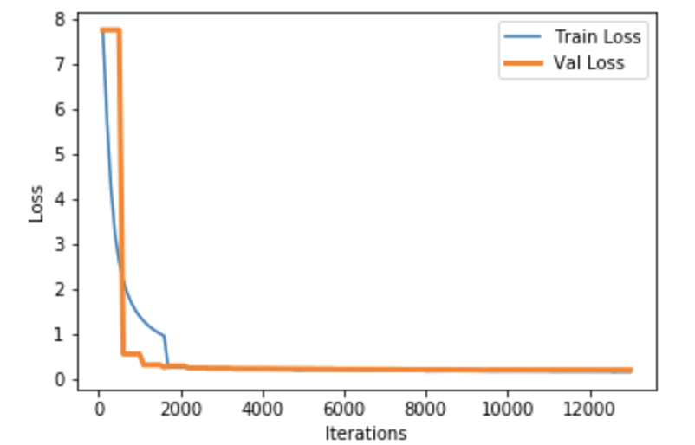
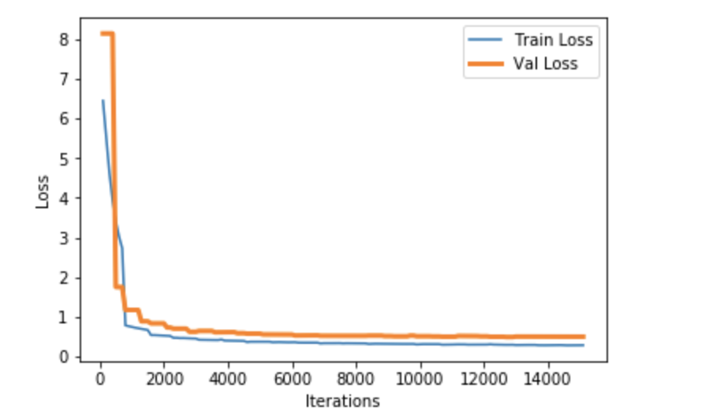
Results: Train/Validation Loss
1 day window
7 day window

Slide 6
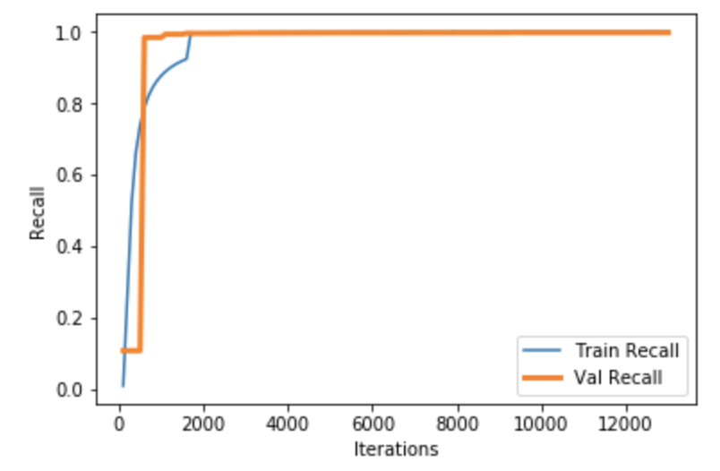
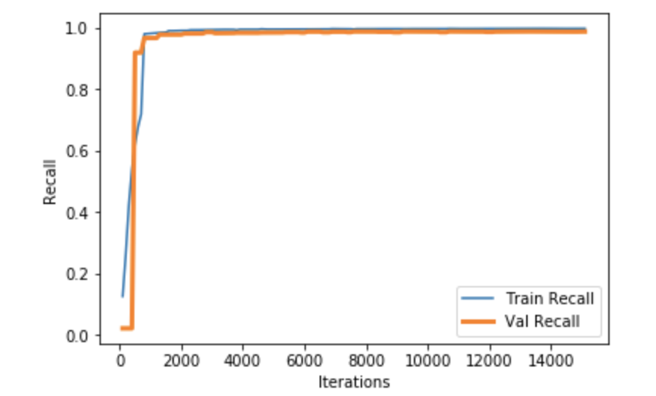
Train and Validation Recall
1 day window
7 day window

Slide 7
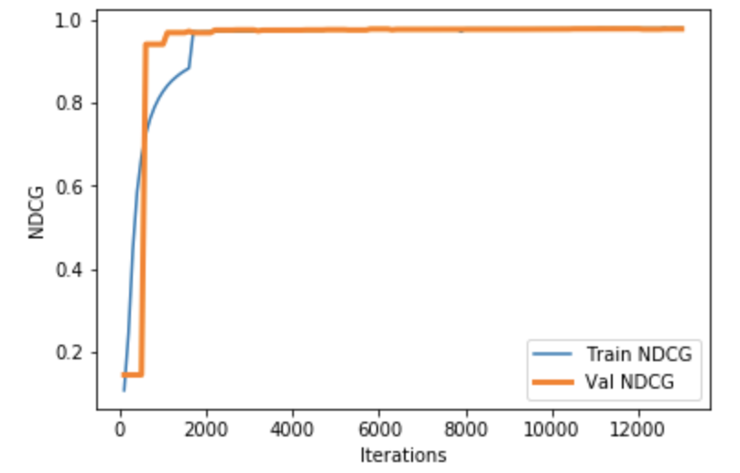
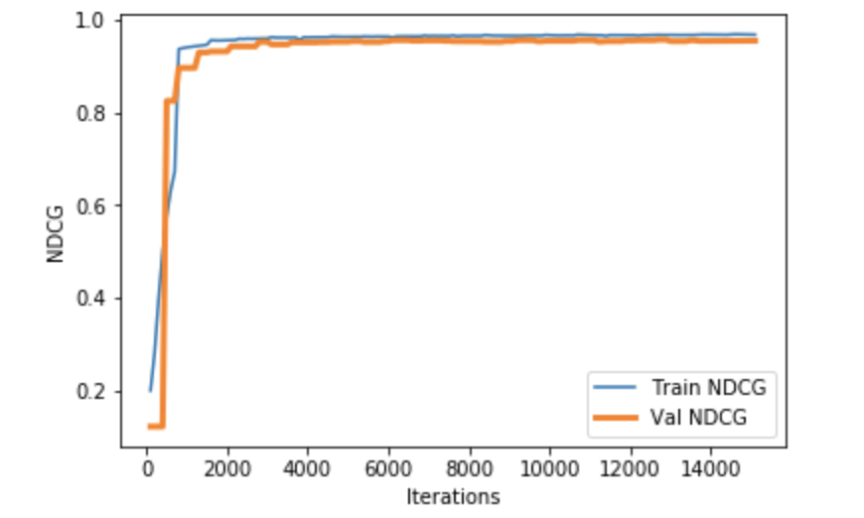
Train and Validation Recall & NDCG
1 day window
7 day window

Slide 8
Statistics
Description | Day=1 | Day=7
# Users | 80 043 | 80 0043
# Organisers | 7 391 | 7 391
# Events | 2 539 609 | 2 539 609
# Social links | 800 430 | 800 430
Avg. friends/volunteer | 10 | 10
Avg. events/volunteer | 31.72 | 31.72
Avg. session length | 3.73 | 5.89
Time IDs | 336 | 48
Held out (last d-period) | 50 days | 10 weeks

