Slide 1
Session-based Volunteer Recommendation via Graph Attention Network
Taurai Muvunza
April 14, 2022
TBSI, SIGS
Recommendation system

Slide 2
Agenda
GNN
Data
Results

Slide 3
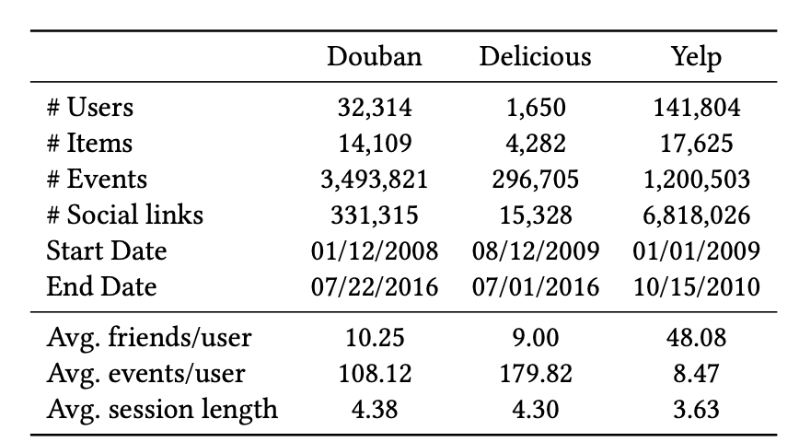
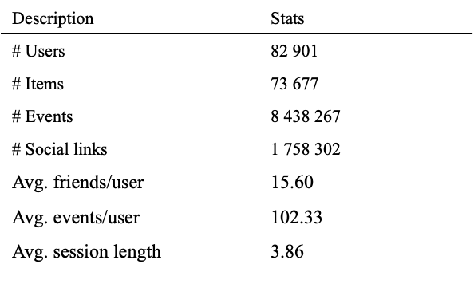
Data: Song et al (2019)

Slide 4
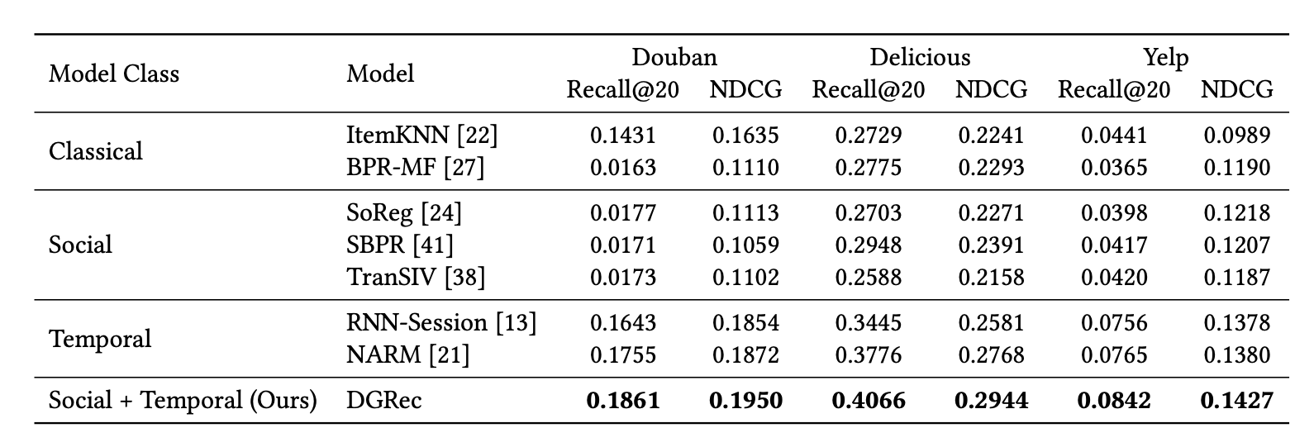
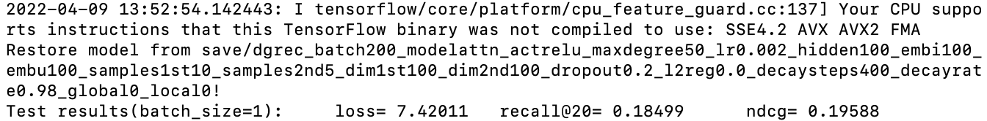
Results
Song et al (2019)
Experiment: based on paper,
Training time: 24h02min on MAC CPU 16G
 | Recall@20 | NDCG
DGRec | 0.18499 (-0.0011) | 0.19588 (+0.0008)

Slide 5
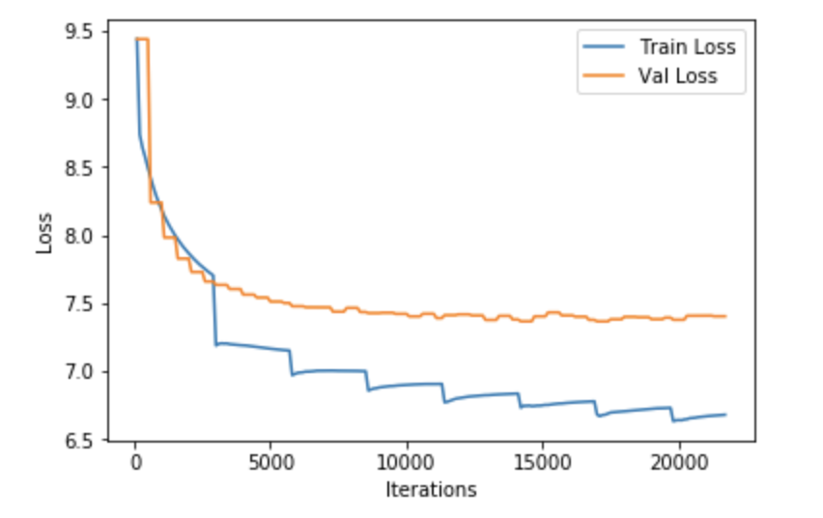
Results: Train/Validation Loss

Slide 6
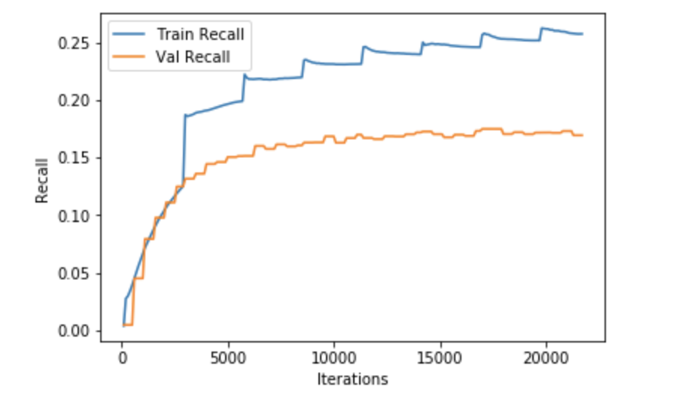
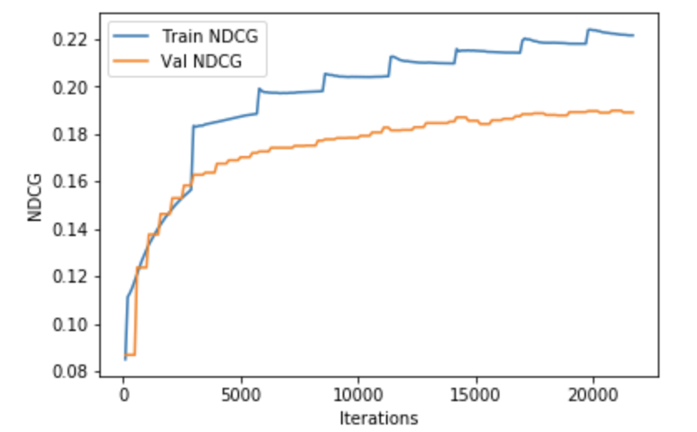
Train and Validation Recall & NDCG

Slide 7
Statistics
Description | Stats
# Users | 82 901
# Items | 73 677
# Events | 8 438 267
# Social links | 1 758 302
Avg. friends/user | 15.60
Avg. events/user | 102.33
Avg. session length | 3.86

