Slide 1
Progress Report
Experimental Results p1
Shutong Chen, 2022/4/7

Slide 2
Experimental Setups
Dataset: old data (2020/02~2020/10) + new data (2021/02~2022/02); take Nanshan for example in this report; Preprocessing: filter out those volunteers only participate once.
Graph Construction: Aggregate co-participation relationship within 14d in a snapshot graph (although the average frequency of participation is 23d/p, 14d is for the balance of the number of snapshots and the scale of each snapshots), length of sliding time window is 7d. Result in total 84 snapshots.
SHS detection: AP_Greedy algorithm, running once on each snapshots for top-50 spanners. Reserve those appears in the results of at least 2 snapshots.

Slide 3
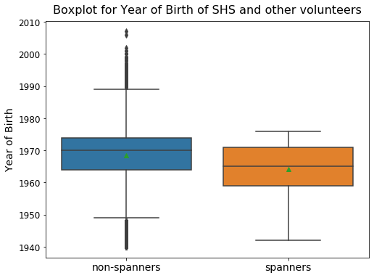
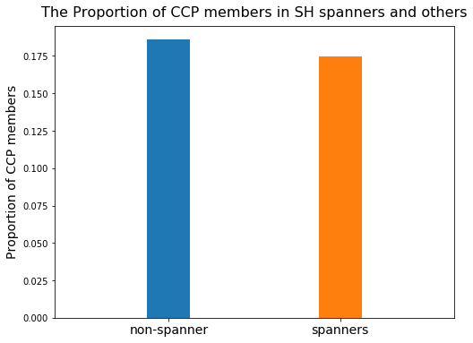
Experimental Results
For the first 67 snapshots (at this time the algorithm haven’t finish running), in total 1477 SHS are detected, 733 reserved.
Profile Features:

Slide 4

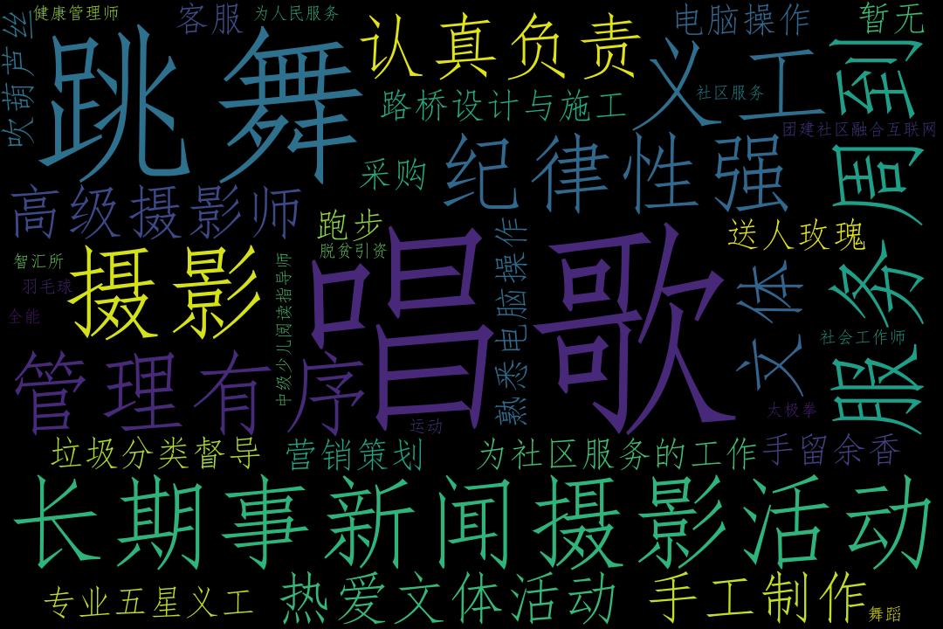
all users
SHS

Slide 5
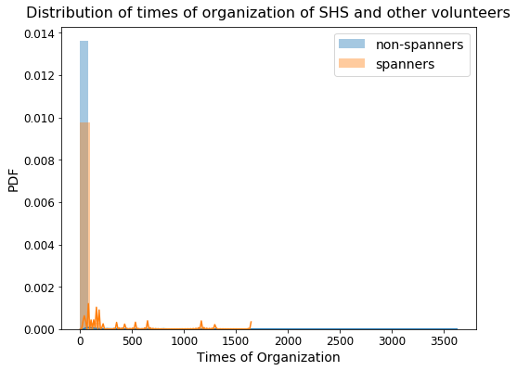
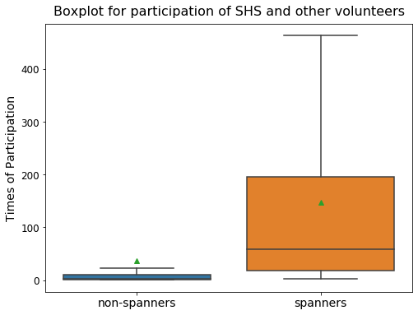
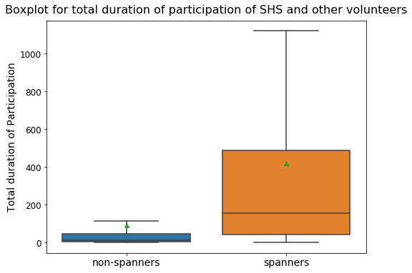
Experimental Results
Participation:

