Slide 1
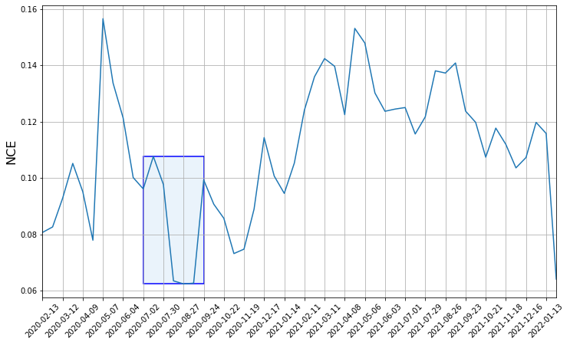
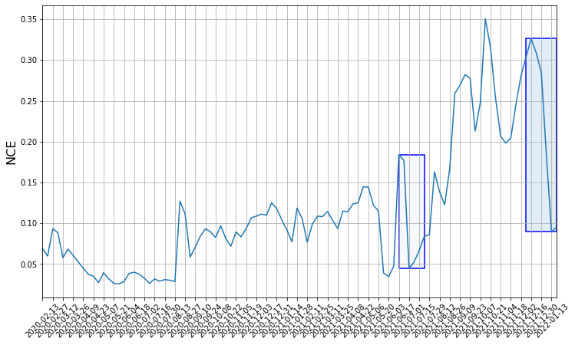
C-NCE: Community Distribution NCE
P(C=c|U) is the probability of given user u belongs to community c at given time step. P(u) is the probability of choosing user (u) from all users (U).
C-NCE in Nanshan (Max duration=6, min duration =2,window=14)
C-NCE in Futian (Max duration=6, min duration =2, window=7)

Slide 2
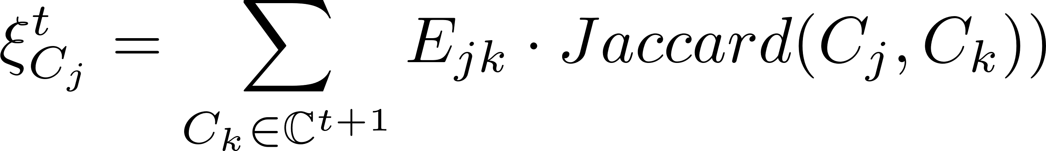
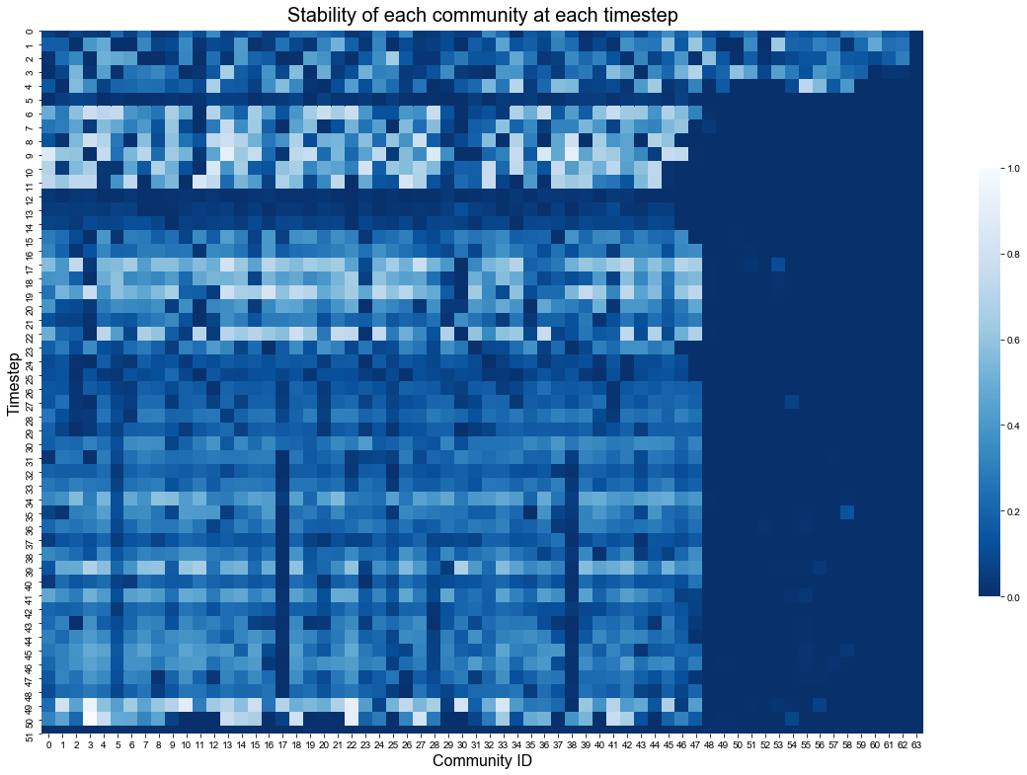
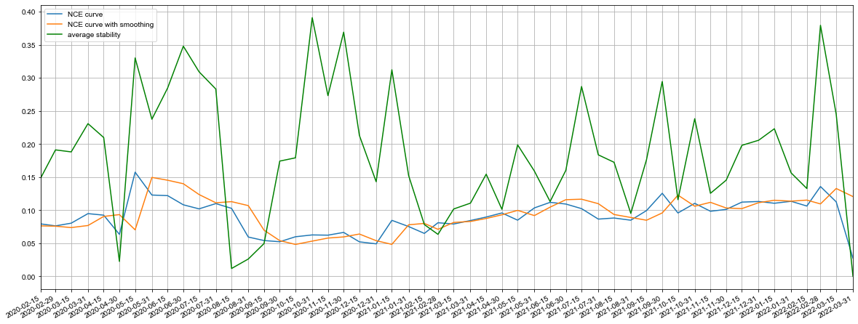
Stability over time

Slide 3
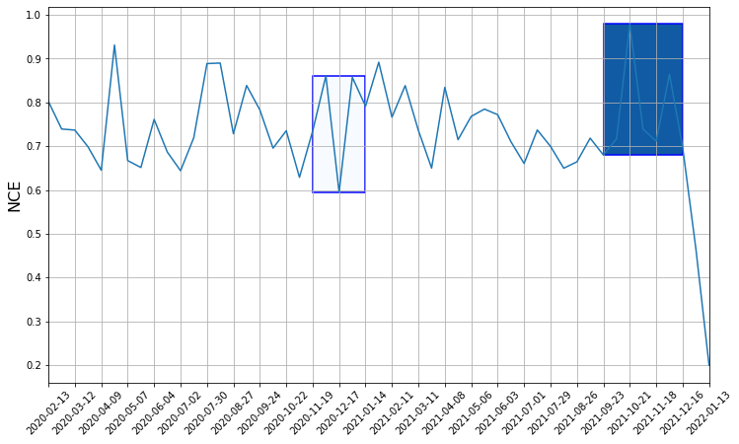
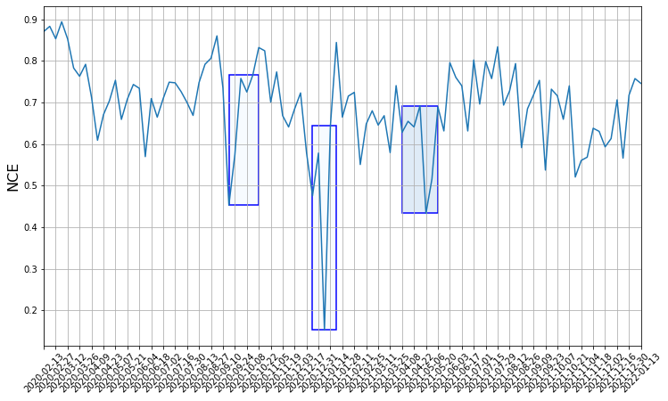
S-NCE: Community Matching NCE
P(C’=c’|C) is the probability of given community c at t matching to community c’ at t+1. Suppose E is the evolution net matrix, then P(C’=c’|C) is actually Ecc’.
S-NCE in Nanshan (Max duration=6, min duration =2)
S-NCE in Futian (Max duration=6, min duration =2)

Slide 4
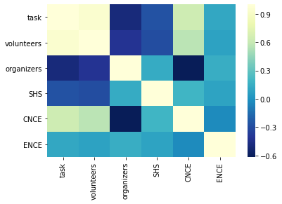
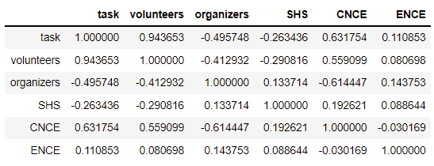
NCE Analysis in Nanshan
C-NCE has positive correlation with the number of tasks and volunteers, meaning that when the number of tasks/volunteers increase, the system becomes unstable. C-NCE also is positively correlated to the number of SHS.
S-NCE (E-NCE) has lower correlation with these factors, and is positively correlated to the number of organizers and tasks.

Slide 5

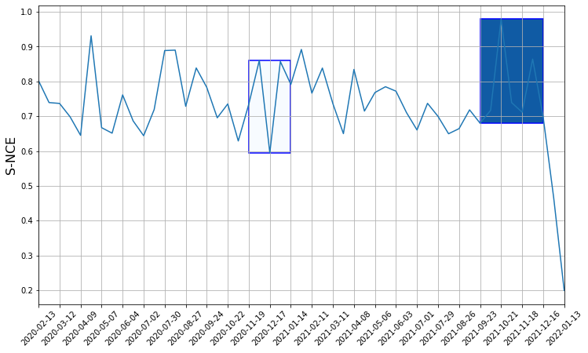
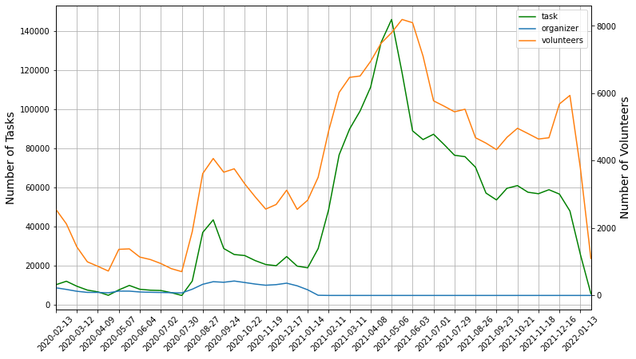
For C-NCE, only one interval [2020-7-2 ~ 2020-9-24]; for S-NCE, two intervals [2020-11-19~2021-1-14], [2021-9-23~2021-12-16].
The C-NCE interval corresponds to the first increase of tasks/volunteers in 2020 summer. The S-NCE intervals correspond to the plateau of task/volunteer curve after two peaks.
Generally, the trend of C-NCE is similar to task/volunteers, except for early in 2020, may be influenced by other factors.

Slide 6
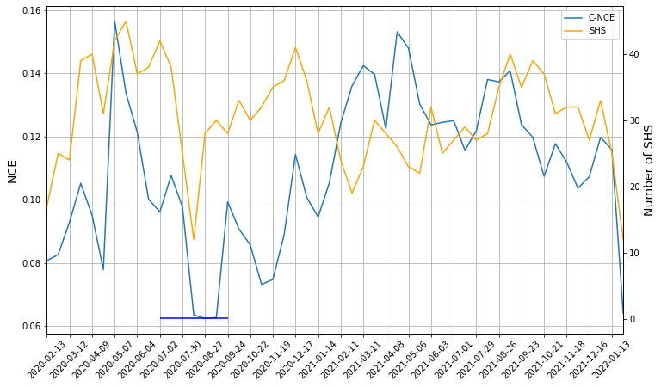
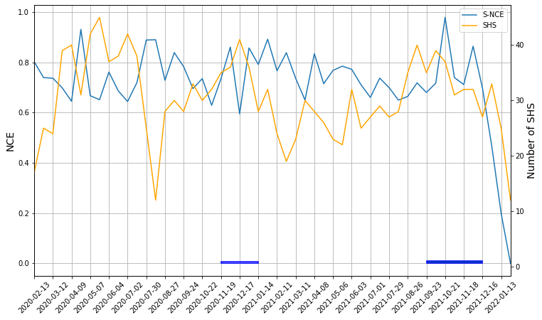
NCE and SHS
NCE and the total number of SHS:
For C-NCE, the trend is similar to the number of SHS, while for S-NCE, it shows negative correlation with SHS, meaning when the number of SHS reduces, the splits and merges of communities also reduce.

Slide 7
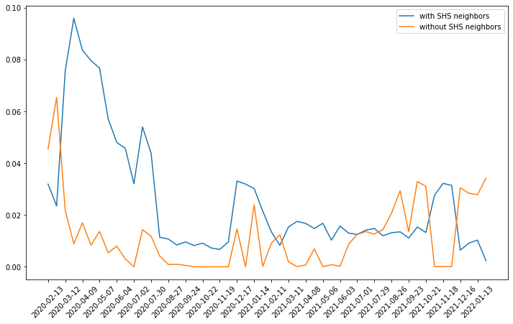
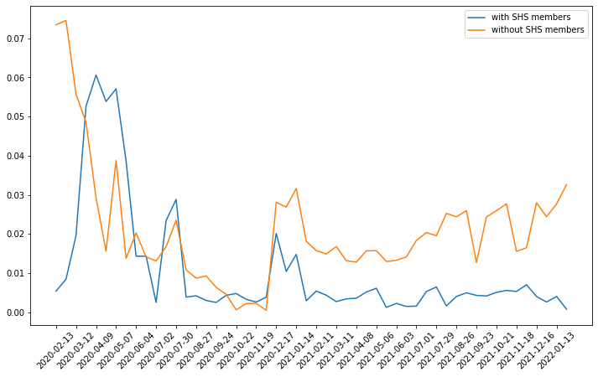
NCE and SHS
C-NCE of different sets of communities: 1. w/o SHS neighbors; 2. w/o SHS as community members
While C-NCE of communities with SHS neighbors is generally larger, possibly the connecting with SHS causes volunteers to shift between communities or have more connection to different communities and increase the C-NCE.
The analysis of relation between SHS and community evolution should involve more districts and quantities.

