Slide 1


Learning to Route Among Specialized Experts for Zero-Shot Generalization
Presenter: Jingyun Yang
2024/04/10

Slide 2

Background
﻿The availability of performant pre-trained language models has led to a proliferation of fine-tuned “expert” models that are specialized to a particular task or domain.
Many of these expert models are created through parameter-efficient fine-tuning (PEFT) techniques.
  ﻿Specialized PEFT modules can be easily shared due to their small size.
Large-scale language models (LLMs) are now being treated as “general-purpose” AI systems that can perform any task without any task-specific training or adaptation.
  ﻿LLMs often exhibit strong zero-shot generalization.

Slide 3
Background
The allure of general-purpose language models and the proliferation of specialized PEFT-based models raises a natural question:
  Can we leverage a large collection of specialized modules to improve zero-shot generalization of a base language model?
﻿Such an approach would provide:
  a path to decentralized development of generalist language models
  ﻿a way to recycle the widespread effort and compute already being expended to create specialized models.

Slide 4
Problem Setting
﻿Assume that individual contributors take a base model and perform PEFT on their specific task of interest.
﻿Assume a PEFT method introduces modules throughout the model.
﻿Contributors only share their trained parameters (e.g., PEFT modules), not the dataset used for fine-tuning.
﻿Aim to use the collection of PEFT modules to improve zero-shot performance on unseen task instead of held-in tasks.
Notes:
﻿for example, as discussed further in Section 3, LoRA (Hu et al., 2021) introduces a low-rank update at every linear layer in the model. We refer to each of these updates as a “module”.

Slide 5
Challenges
﻿While the experts are trained independently, we must determine a way to make them function together to improve performance on unseen tasks.
﻿We aim to expend as little additional compute as possible, which precludes methods that involve substantial training after the expert modules are created.
﻿In zero-shot evaluation, the model needs to determine routing solely from information in a single input example.
  ﻿differs from past works that assume access to a target-task training dataset in order to transfer knowledge from a collection of specialized models.

Slide 6
Related work
Aim to choose a single specialized model based on properties of the input query.
﻿Route to a single expert model by comparing an embedding of the input query to the average embedding of datapoints used to train each expert.
﻿Leverage an external general-purpose LLM (e.g. GPT-4) and choose which model to route to by formulating a textual query that asks which model to use
﻿Route among generalist models by training a classifier to predict which model would produce the highest-reward generation according to an auxiliary reward model.
Notes:
﻿(e.g. “I have a French model and an English model. Which model should I use for the query: combien p`ese une pomme?”).

Slide 7
Related work
﻿Routing among LLMs
﻿Merging expert models
  ﻿﻿weighted averaging of model parameters to create an expert that generalizes to unseen datasets.
  ﻿assumes access to a validation set for hyper-parameter tuning.
﻿Multitask fine-tuning for zero-shot generalization
  ﻿a base model is fine-tuned on a multitask mixture of datasets
  ﻿assumes access to all datasets at once
Notes:
﻿In our work, we instead focus on routing among specialized models.
﻿rely on simultaneous data access.

Slide 8
Goal
Post-Hoc Adaptive Tokenwise Gating Over an Ocean of Specialized Experts (PHATGOOSE)
  Recycle the PEFT modules from individual contributors to improve zero-shot generalization without requiring significant extra work or simultaneous access to the contributors’ datasets.
  Learn a per-token and per-module routing strategy can achieve better zero-shot generalization than a routing strategy that picks a single expert model for all tokens.
﻿﻿PHATGOOSE achieves these goals by having contributors train a task-specific gate and then using the parameters of each gate to perform discrete top-k routing.
﻿Goal in this work
  enable individual contributors to collectively improve zero-shot generalization capabilities of a model by sharing specialized PEFT modules.

Slide 9
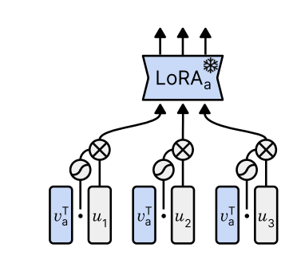
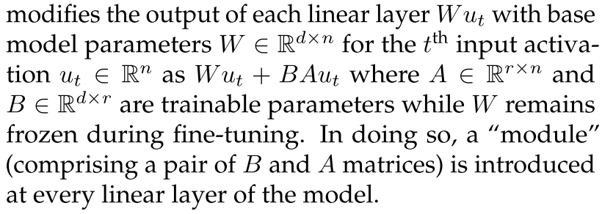
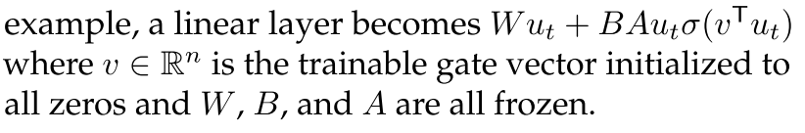
Framework
﻿the contributor adds a sigmoid gate layer in front of each PEFT module and trains the gate with all other parameters fixed for 100 steps using the same dataset and objective that was used to train the PEFT module.
﻿In the LoRA
﻿﻿contributors perform PEFT using LoRA ﻿due to its popularity and widespread use.

Slide 10
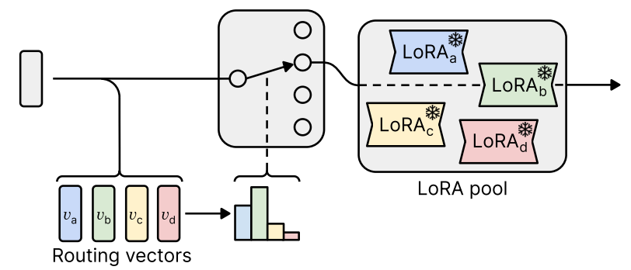
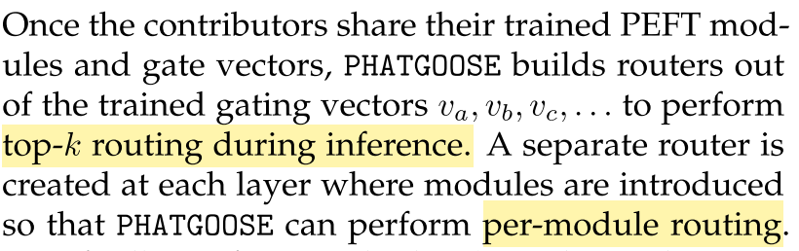
Framework
﻿﻿﻿standardize both the gating vectors and a given activation for the purpose of routing.
﻿assign each module a score by computing the cosine similarity between the standardized activation and its ﻿routing vector.
﻿route the activation to the modules with the k highest scores and rescale their output by their softmax-normalized weights.
﻿﻿

Slide 11

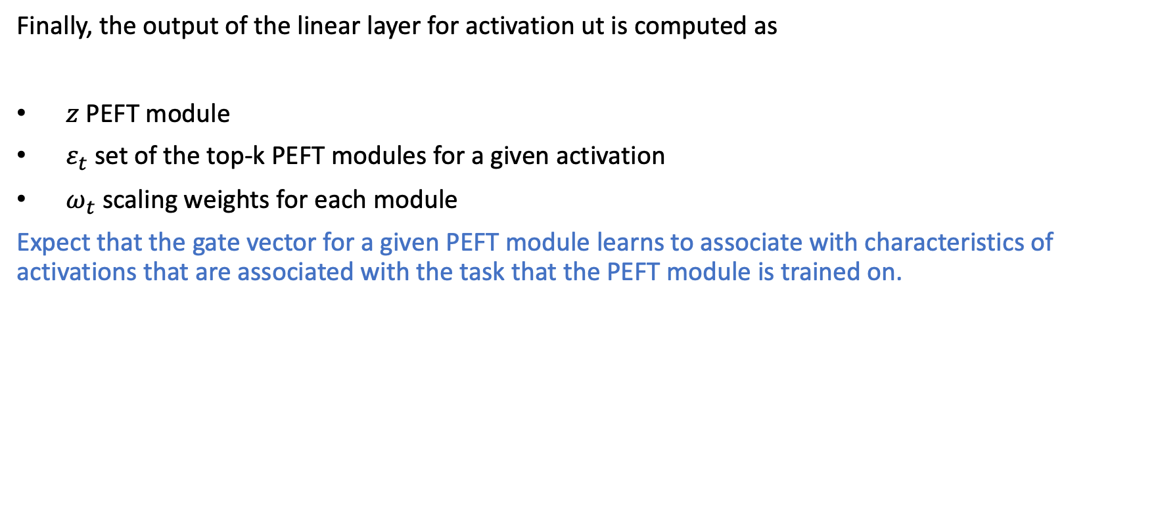
Framework
Finally, the output of the linear layer for activation ut is computed as
$z$﻿﻿﻿﻿ PEFT module
$ε_{t}$ ﻿set of the top-k PEFT modules for a given activation
$ω_{t}$ ﻿scaling weights for each module
﻿Expect that the gate vector for a given PEFT module learns to associate with characteristics of activations that are associated with the task that the PEFT module is trained on.

Slide 12
Experiment
Two dataset collections for creating pools of expert modules to route among:
  T0 Held-In: the set of 36 held-in prompted datasets and tasks
  FLAN: ﻿ a total of 166 specialized models with a zero-shot prompting format
﻿Three zero-shot generalization benchmarks for evaluation
  ﻿T0HO: use the same held-out datasets used to evaluate T0
  ﻿BIG-bench Hard: ﻿a collection of 23 datasets on ﻿which state-of-the-art models performed significantly ﻿worse than humans
  ﻿BIG-bench Lite: ﻿ a collection of 24 diverse datasets that are meant as a lightweight proxy for the full BIG-Bench benchmark.
The baseline methods including Retrieval, Average Activation, Merged Experts, Multitask, Oracle and Best Individual.

Slide 13
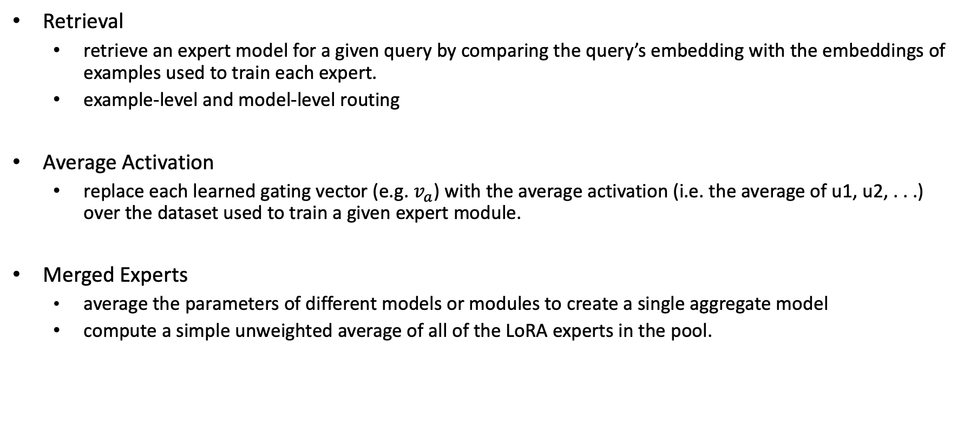
Experiment
Retrieval
  ﻿retrieve an expert model for a given query by comparing the query’s embedding ﻿with the embeddings of examples used to train each expert.
  ﻿example-level and model-level routing
Average Activation
  replace each learned gating vector (e.g. $v_{a}$) with the average activation (i.e. the average of u1, u2, . . .) over the dataset used to train a given expert module.
﻿Merged Experts
  ﻿average the parameters of different models or modules to create a single aggregate model
  ﻿compute a simple unweighted average of all of the LoRA experts in the pool.
Notes:
﻿token- and module-level like PHATGOOSE

Slide 14
Experiment
﻿Multitask
  ﻿requires simultaneous access to each expert’s dataset
  ﻿this work used publicly available models
    ﻿For the T0 Held-In datasets pool, compare the T0-3B model which was trained on the same collection of datasets
    ﻿For FLAN, the model trained on the most similar dataset mixture is FLAN-T5 XL
﻿Oracle
  choose the specialized expert from the pool with the highest performance on a given evaluation dataset.
  ﻿not zero-shot and serve as an upper bound on the performance of retrieval-style approaches.
﻿Best Individual
  ﻿﻿﻿find the single expert with the highest average performance across all evaluation datasets.
  ﻿serve as the best-case performance of a degenerate routing scheme that always chooses the same expert for all inputs.
Notes:
﻿token- and module-level like PHATGOOSE

Slide 15
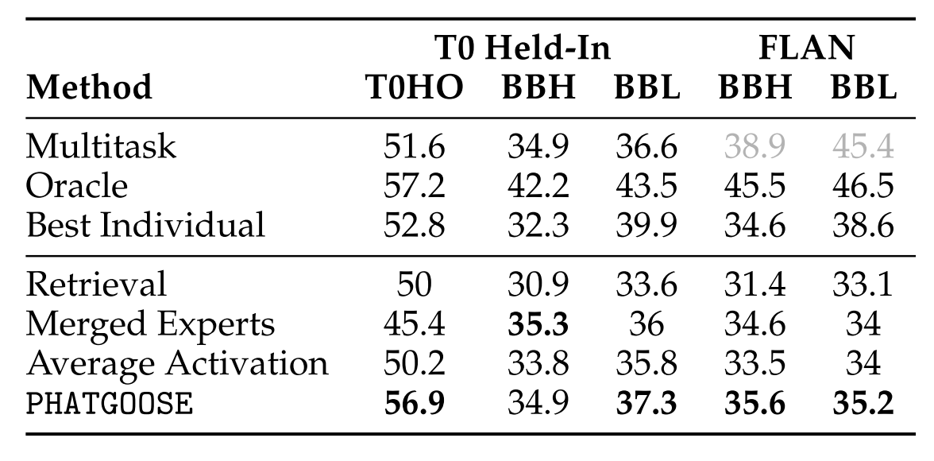
Results
PHATGOOSE generally performs best among methods that satisfy the problem setting and can match or exceed the performance of explicit multitask training or non-zero- shot baselines (“Oracle” and “Best Individual”).

Slide 16
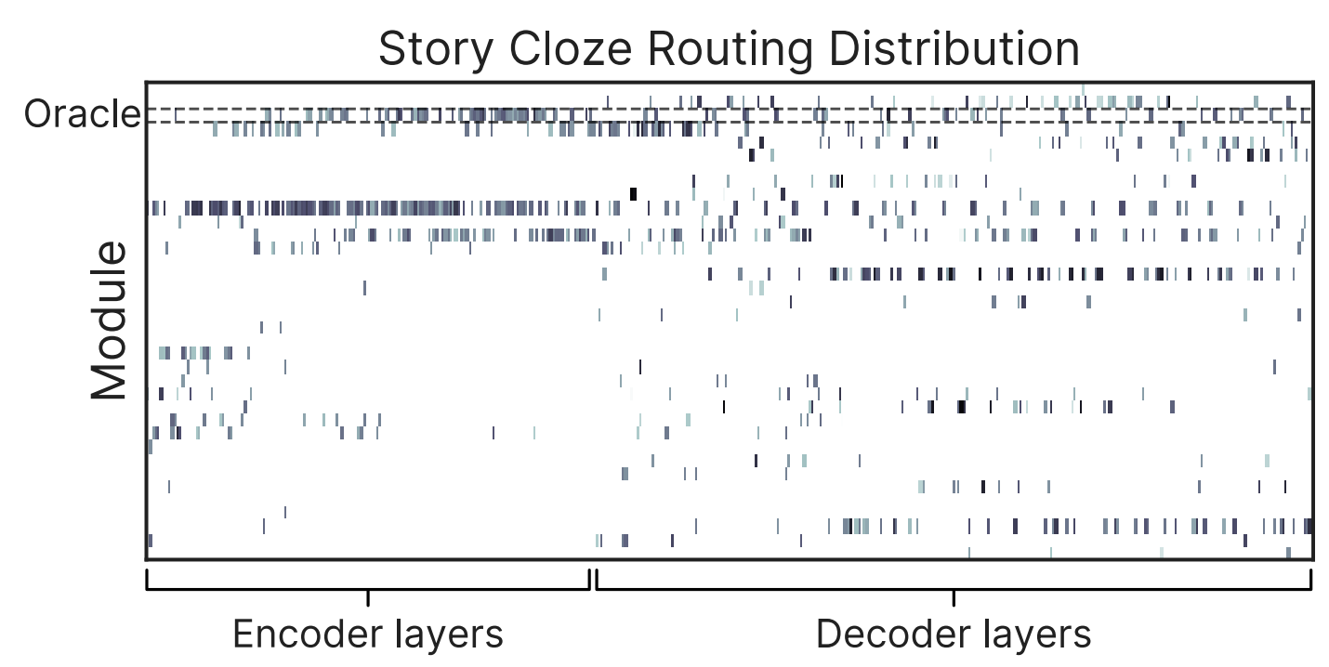
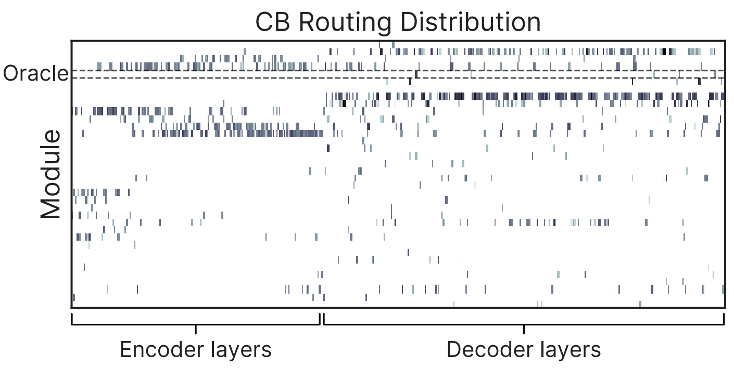
Results
﻿Routing distributions produced by PHATGOOSE for Story Cloze and CB (from T0HO).
﻿The Oracle router’s chosen module is highlighted by dashed lines.
On Story Cloze, PHATGOOSE chooses the Oracle module in the encoder but uses diverse experts in the decoder but nevertheless matches Oracle performance.
On CB, PHATGOOSE almost never uses the Oracle module and produces significantly better performance by using a wide range of modules.
﻿This could be attributed to PHATGOOSE’s capability to effectively combine the capabilities of multiple experts, thereby enhancing generalization.

Slide 17
Contribution
﻿PHATGOOSE provides a way to recycle expert modules created through parameter- efficient training to improve zero-shot generalization of a base model.
﻿PHATGOOSE generally outperforms other methods that learn post-hoc routing strategies among specialized modules and frequently matches or outperforms explicit multitask training.
﻿PHATGOOSE can learn performant routing strategies that differ from a simple Oracle strategy that routes to the module that attains the best performance on a given task.

Slide 18
Thanks

