Slide 1
LORA: LOW-RANK ADAPTATION OF
LARGE LANGUAGE MODELS
< Paper Reading >
Group: Meta Transfer Learning
Lead: Xuechao Chen
Supervisor: Yang Li
March 13, 2024
Hu, Edward J., et al. "LoRA: Low-Rank Adaptation of Large Language Models." International Conference on Learning Representations. 2022.

Slide 2
Content
Introduction
Approach
Experiment
Conclusion
Research Background
Review Comments
Future Research
Industrial Meaning
Private Investigation

Slide 3
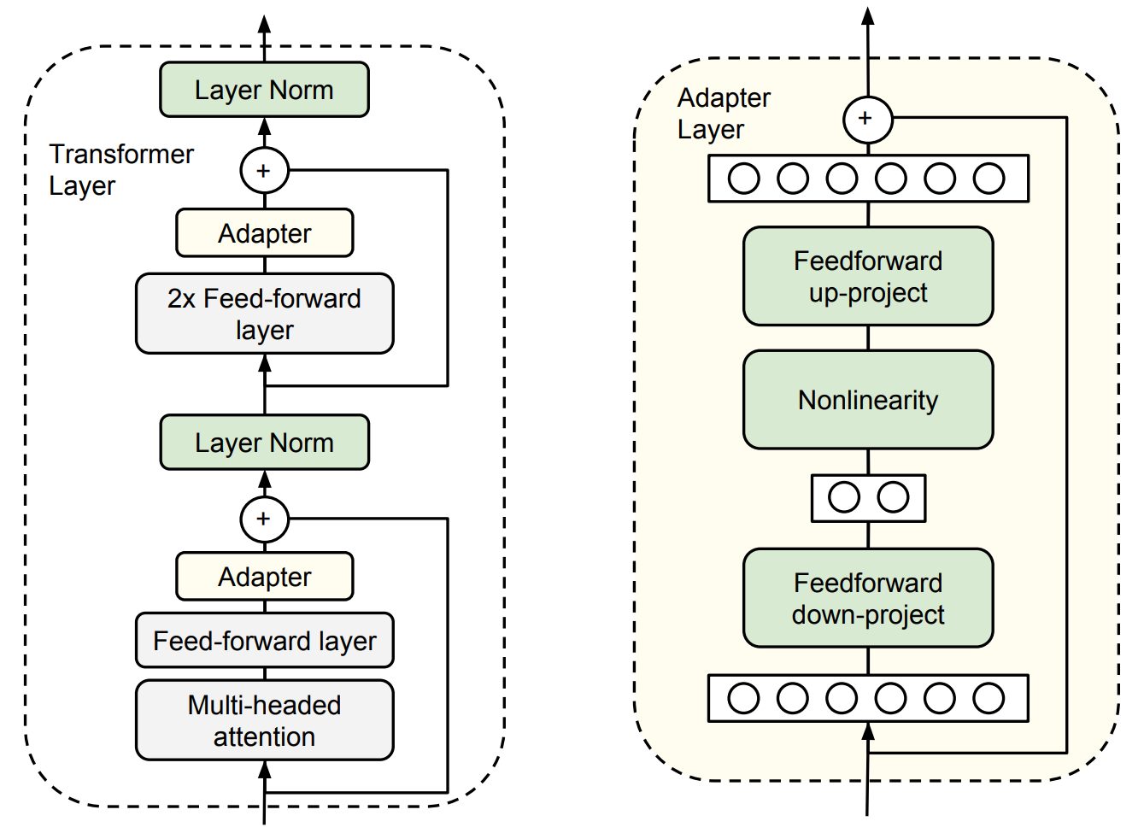
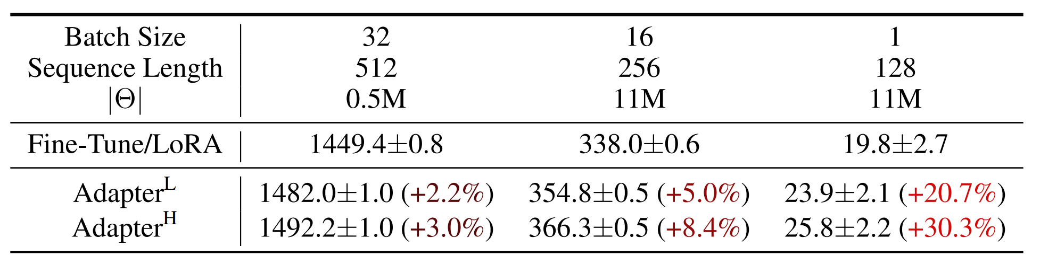
Introduction
Generally, transfer learning has two steps: pre-train and finetune.
As the pre-trained models becomes larger and larger, full fine-tuning, which retrains all model parameters, becomes less feasible.
Some solutions try to solve this by adapting only some parameters or learning external modules for new tasks but introduce inference latency.
Pre-train
Task
Finetune
Houlsby, Neil, et al. "Parameter-efficient transfer learning for NLP." International conference on machine learning. 2019.

Slide 4
Introduction
They hypothesize that the change in weights during model adaptation has a low “intrinsic rank”, leading to their proposed Low-Rank Adaptation (LoRA) approach.
LoRA allows to train some dense layers in a neural network indirectly by optimizing rank decomposition matrices of the dense layers’ change during adaptation, while keeping the pre-trained weights frozen.
They summarize their contributions as:
  A pre-trained model can be shared and used to build many different small LoRA modules for different tasks.
  LoRA makes training more efficient and lowers the hardware barrier.
  Simple linear design allows to merge the trainable matrices with the frozen weights when deployed, introducing no inference latency.
  LoRA is compatible with many prior methods.
Li, Chunyuan, et al. "Measuring the intrinsic dimension of objective landscapes." arXiv preprint arXiv:1804.08838. 2018.
Aghajanyan, Armen, Luke Zettlemoyer, and Sonal Gupta. “Intrinsic dimensionality explains the effectiveness of language model fine-tuning.” arXiv preprint arXiv:2012.13255. 2020.

Slide 5
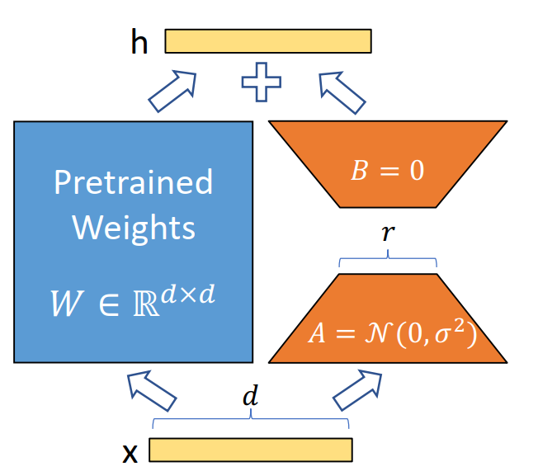



Approach
Weight updates change to
Forward pass changes to:
Scale by . They simply set α to the first r they try and do not tune it.
Inference:
They limit the study to only adapting the attention weights for downstream tasks and freeze the MLP modules.

Slide 6
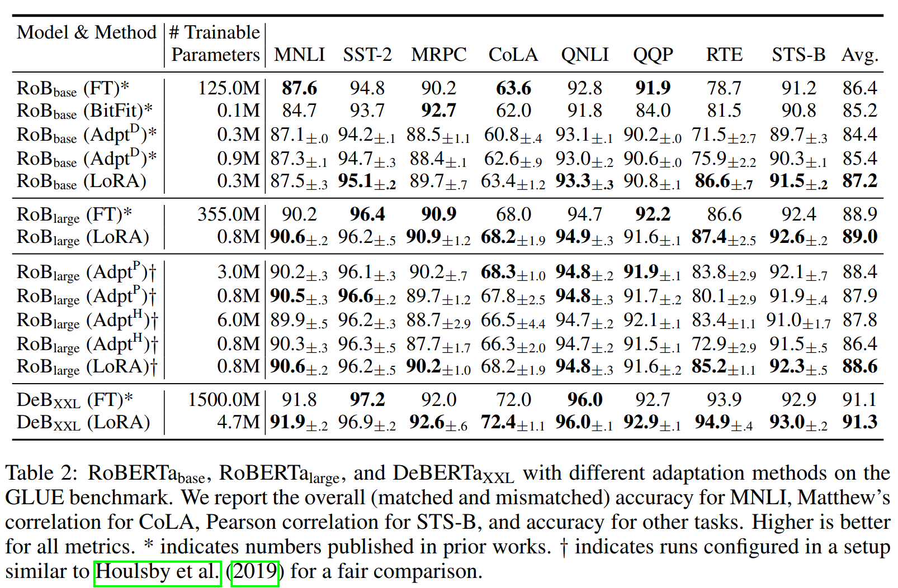
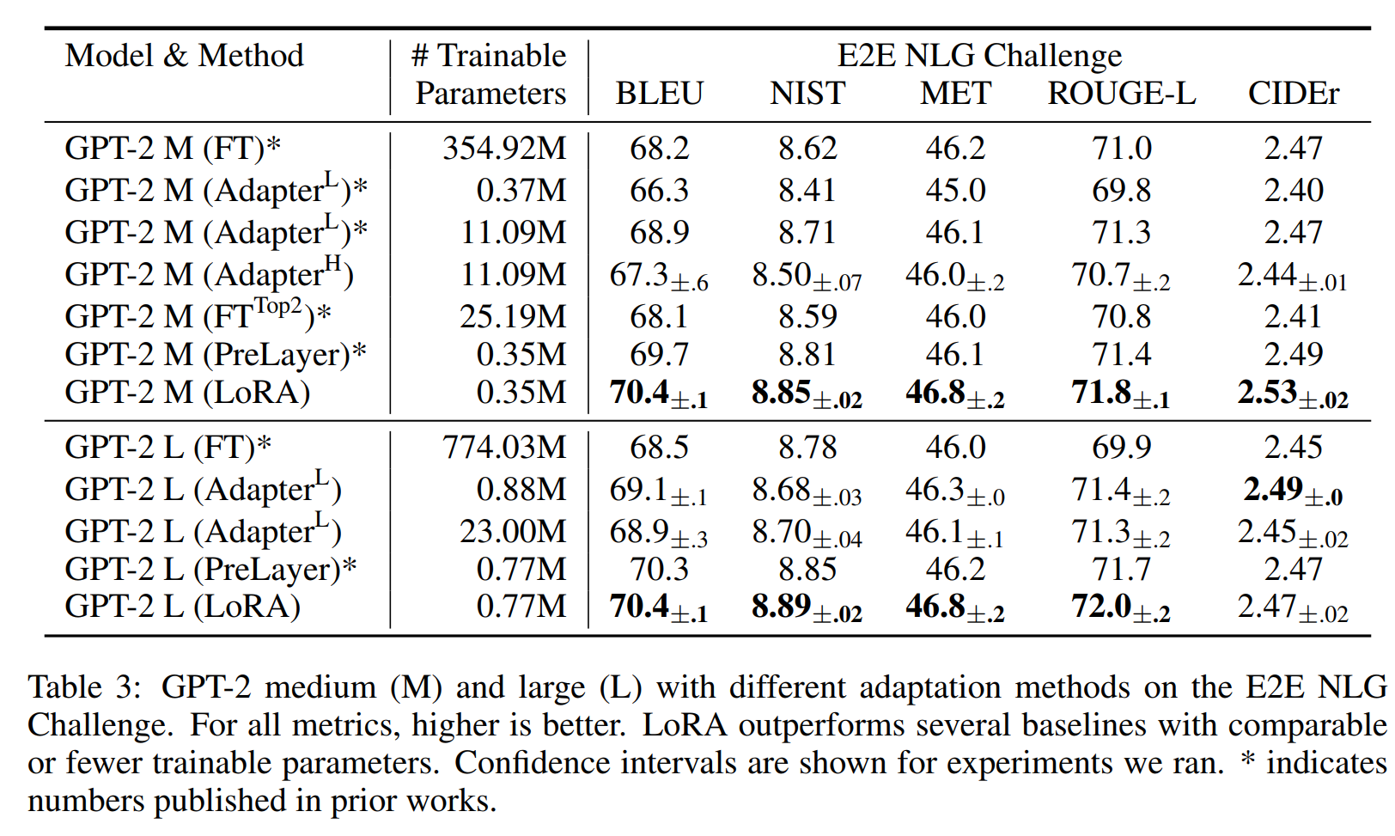
Experiment

Slide 7
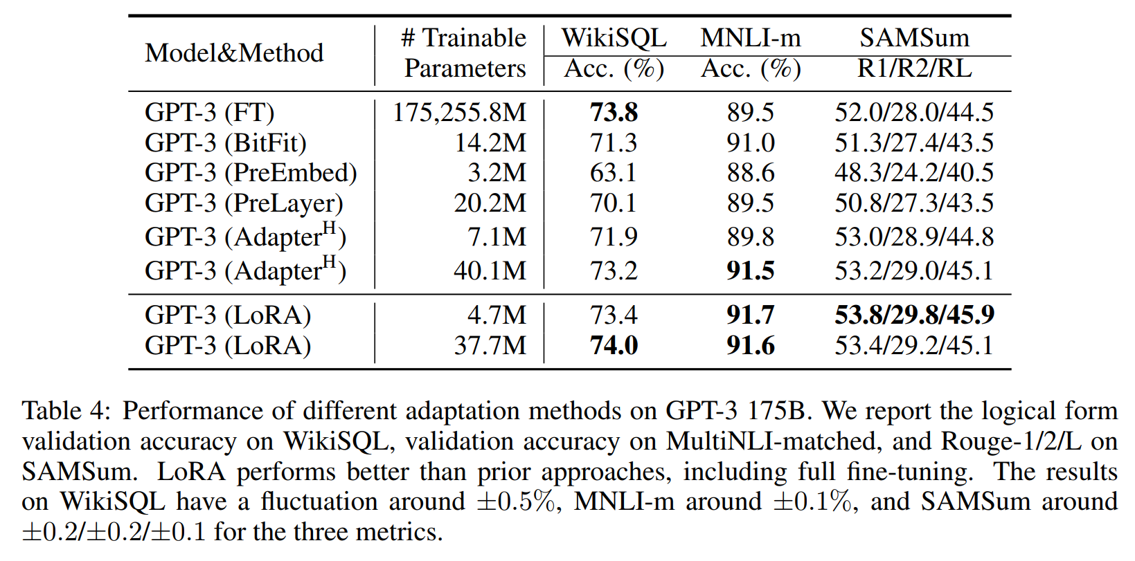
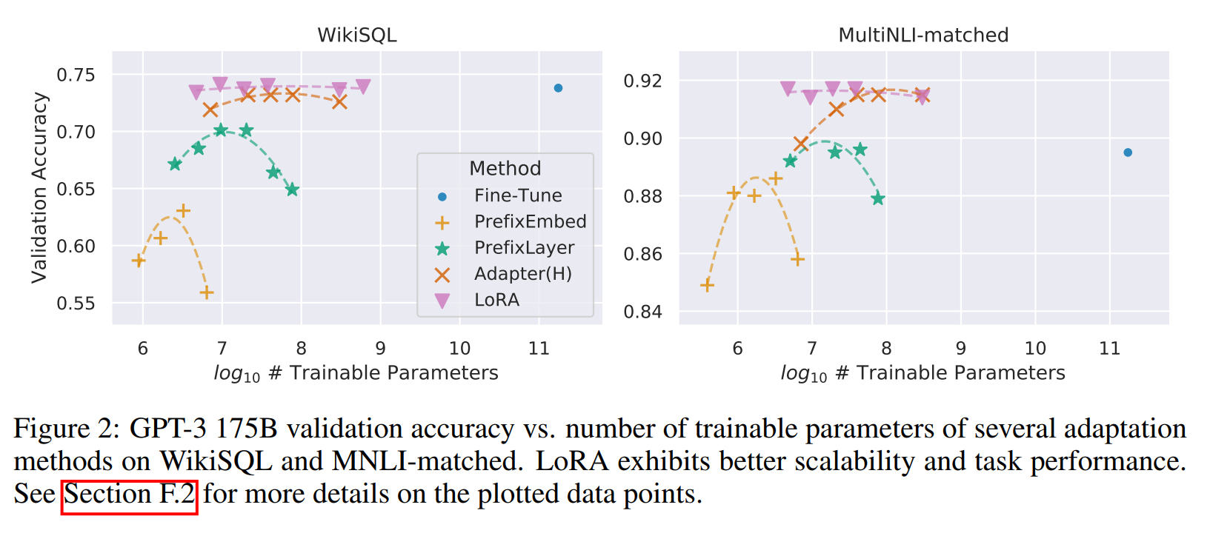
Experiment

Slide 8
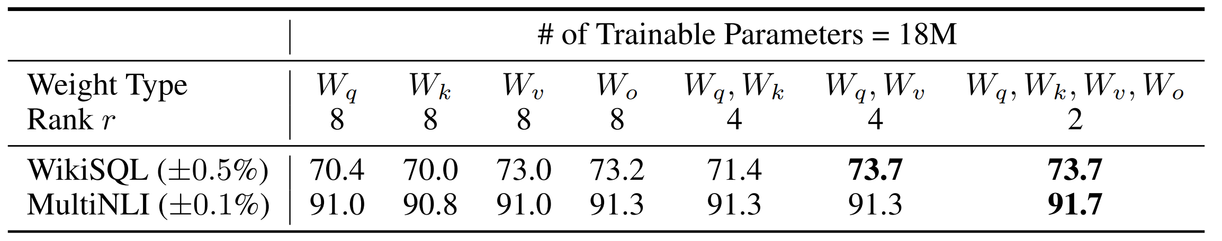
Experiment
Given a parameter budget constraint, which subset of weight matrices in a pre-trained Transformer should be adapted to maximize downstream performance?

Slide 9
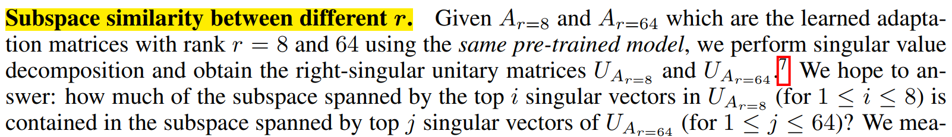
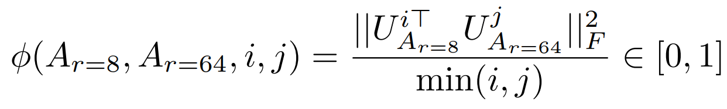
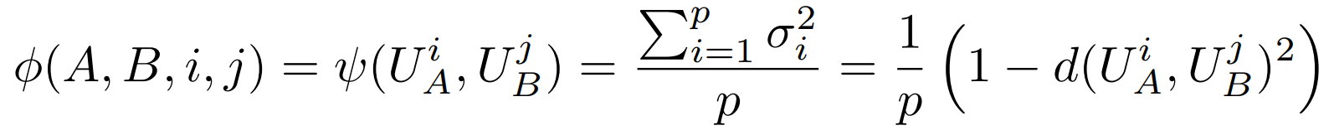
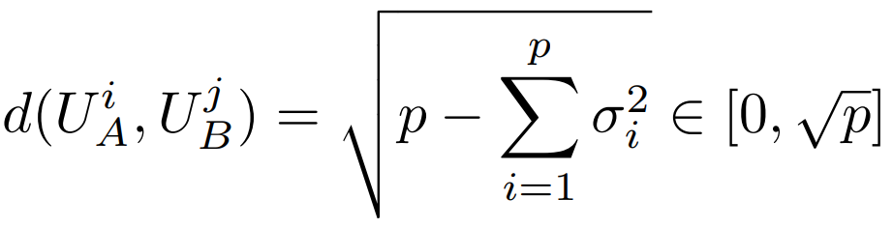
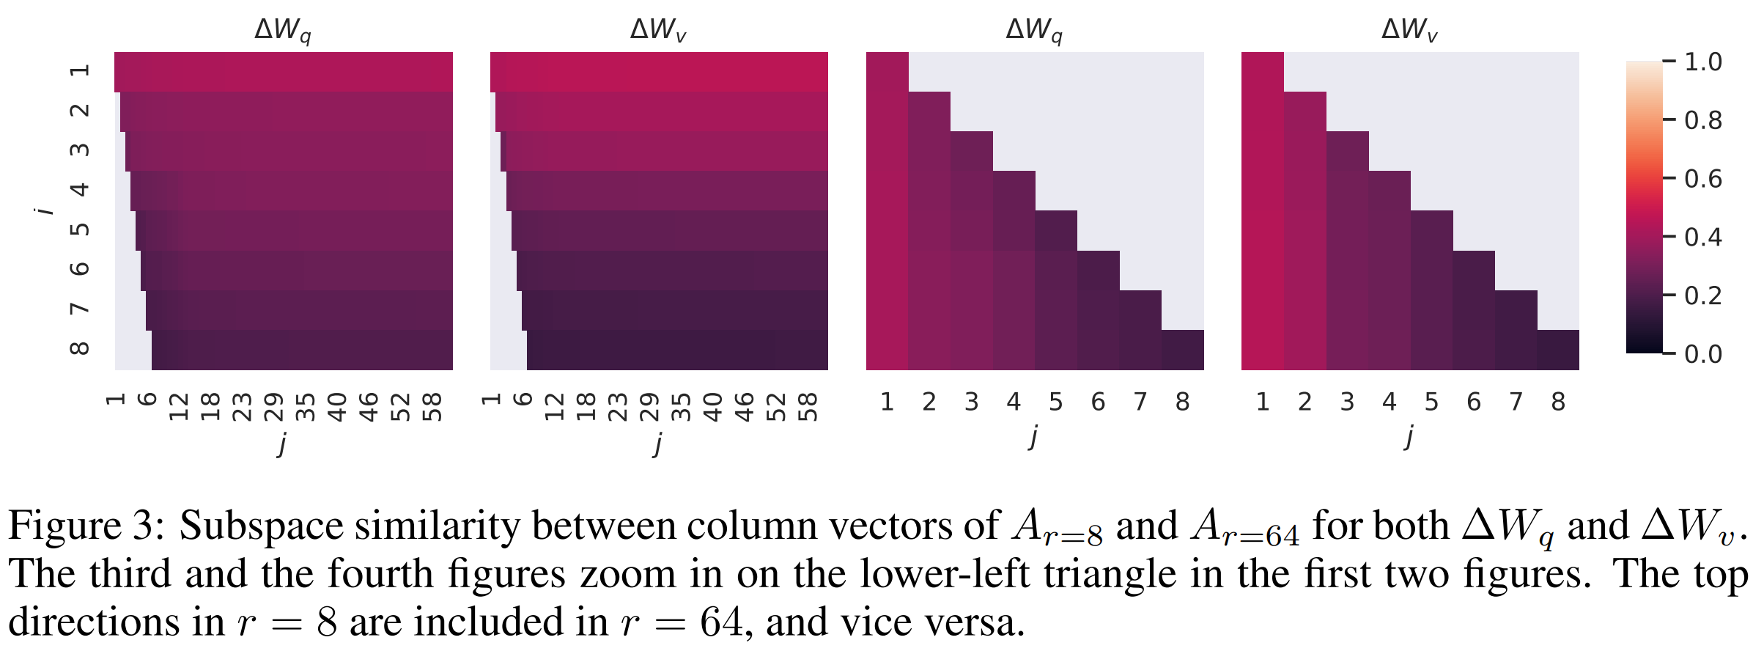
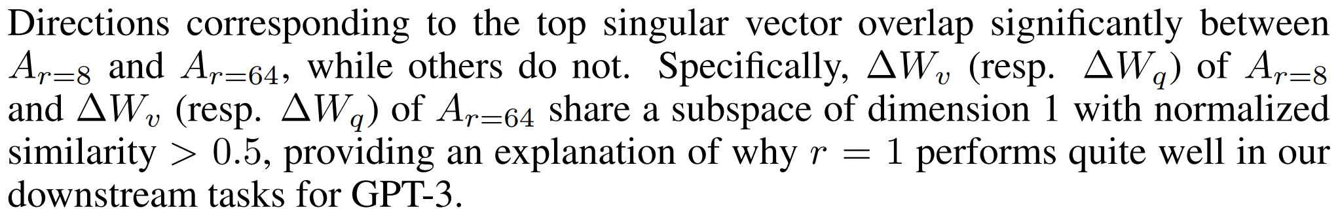
Experiment
Is the “optimal” adaptation matrix ∆W really rank deficient? If so, what is a good rank to use in practice?
Grassmann distance (standard Projection Metric) (1 represents a complete overlap of subspaces and 0 a complete separation.) :
Jihun Ham and Daniel D. Lee. "Grassmann discriminant analysis: a unifying view on subspace-based learning." In ICML. 2008.

Slide 10
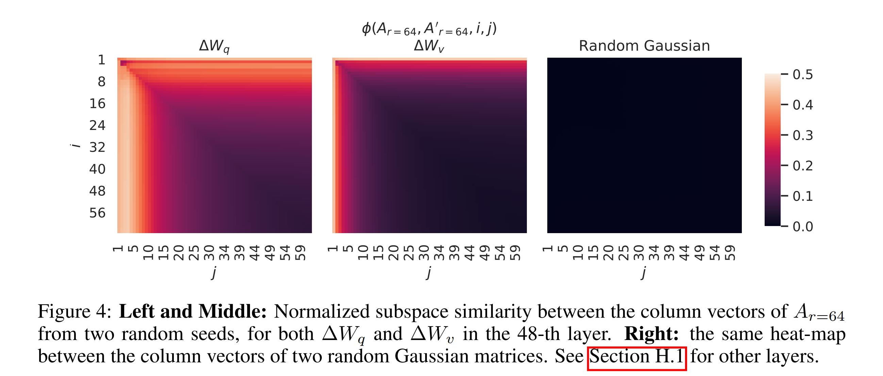
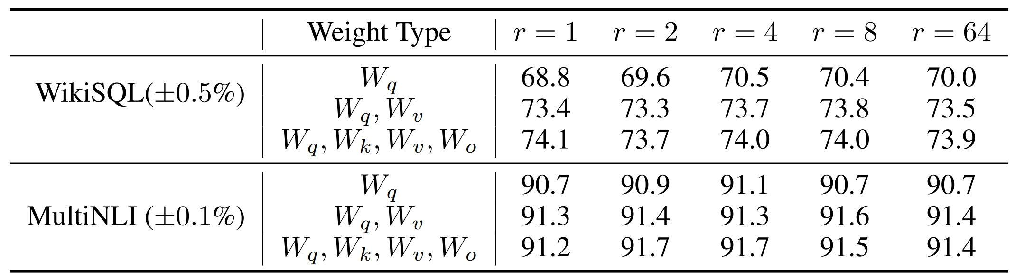
Experiment
Is the “optimal” adaptation matrix ∆W really rank deficient? If so, what is a good rank to use in practice?
Table shows that, LoRA already performs competitively with a very small r. This suggests the update matrix ∆W could have a very small “intrinsic rank”.
∆Wq appears to have a higher “intrinsic rank” than ∆Wv.

Slide 11
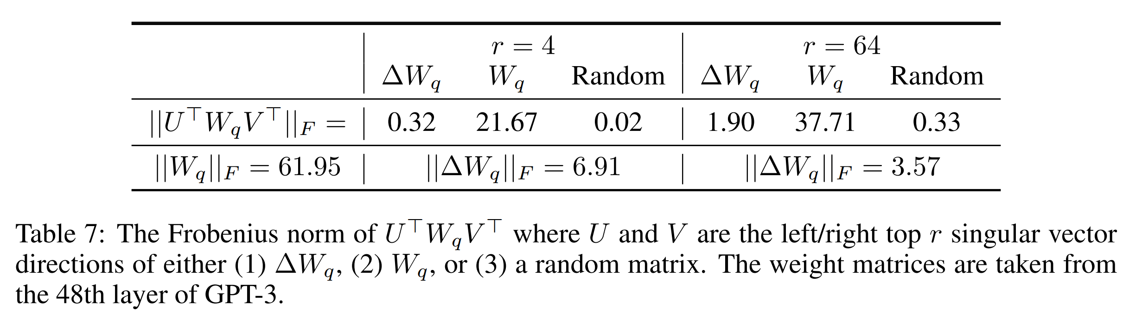
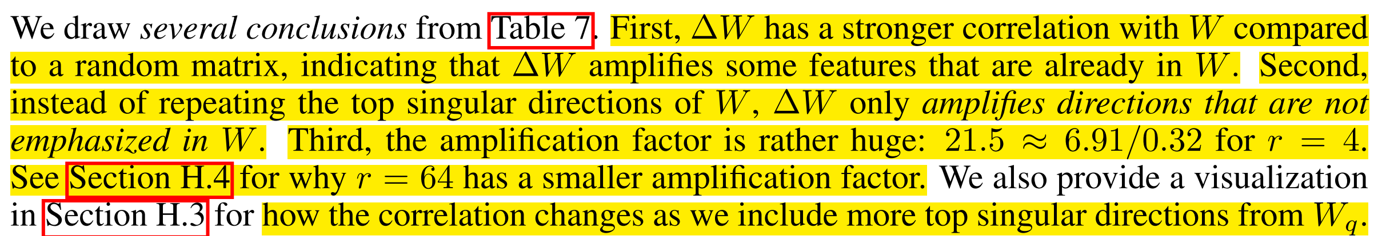
Experiment
What is the connection between ∆W and W ? Does ∆W highly correlate with W ? How large is ∆W comparing to W ?
Frobenius norm measures the “size” of matrix by calculating the square root of the sum of the squares of all the matrix entries.

Slide 12
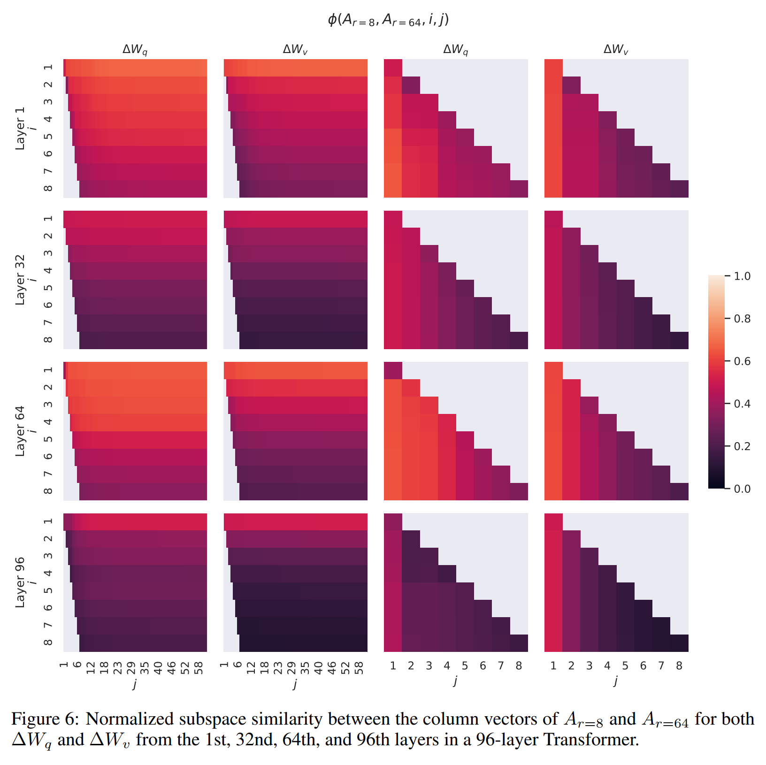
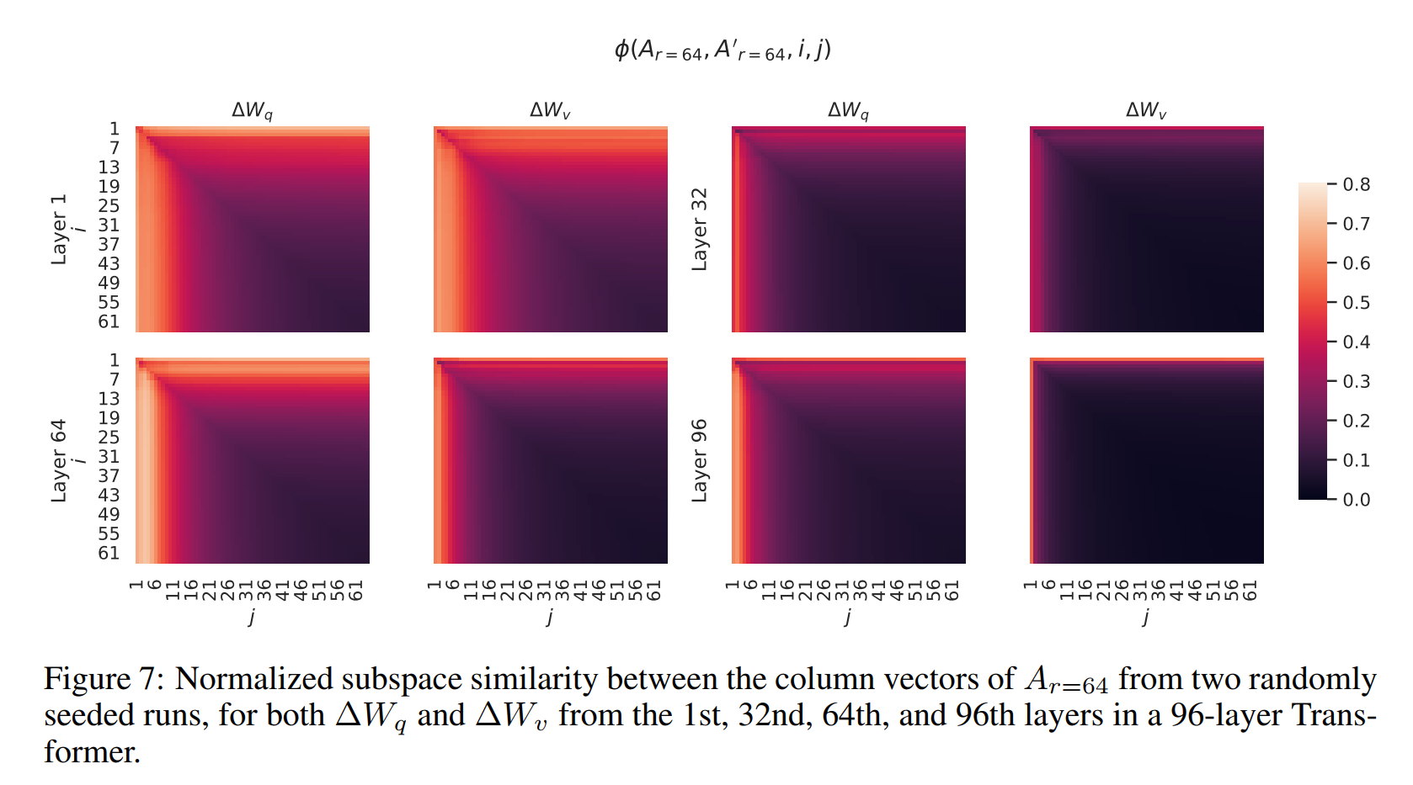
Experiment

Slide 13
Discussion White Board

Slide 14
Discussion White Board

