Slide 1
Task-customized masked autoencoder via mixture of cluster-conditional experts
Authors: Zhili Liu et al. (HKUST)
Reporter: Xuechao Chen
8/30/2023

Slide 2
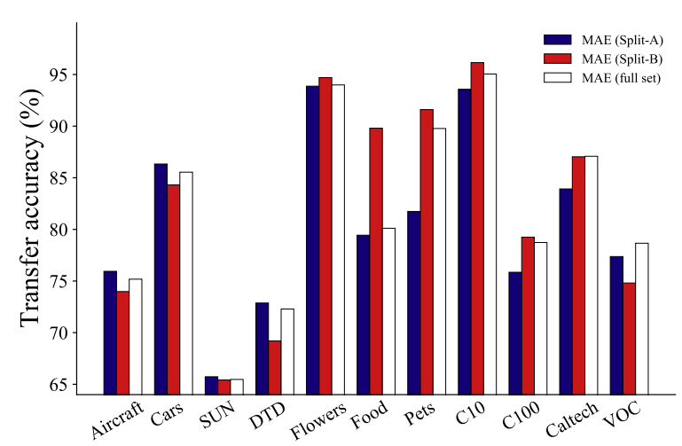
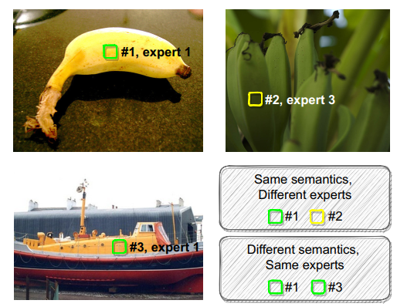
Introduction
Motivation: When the various downstream tasks have data distributions different from the pre-training data, the semantically irrelevant pre-training information might result in negative transfer, impeding MAE’s scalability.
  MAE: Masked Autoencoders (He, Kaiming, et al. "Masked autoencoders are scalable vision learners." CVPR. 2022.)
  Pre-training dataset ImageNet-1k is divided into two splits.
  Split-A mainly contains inanimate objects (such as cars and airplanes).
  Split-B primarily involves organisms (such as plants and animals).

Slide 3
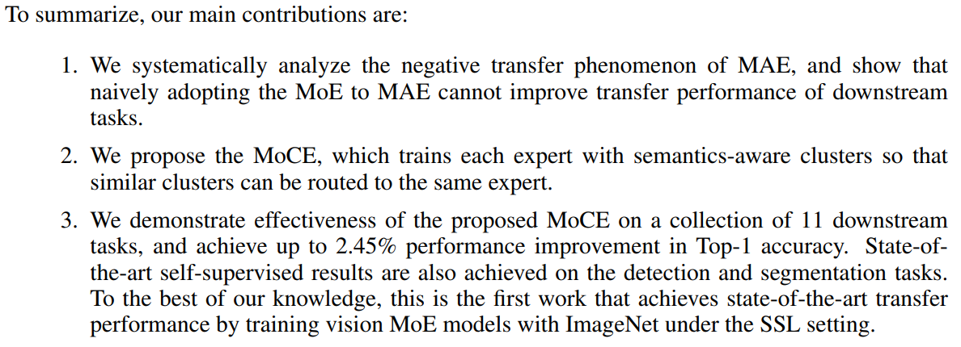
Introduction
Their contributions

Slide 4
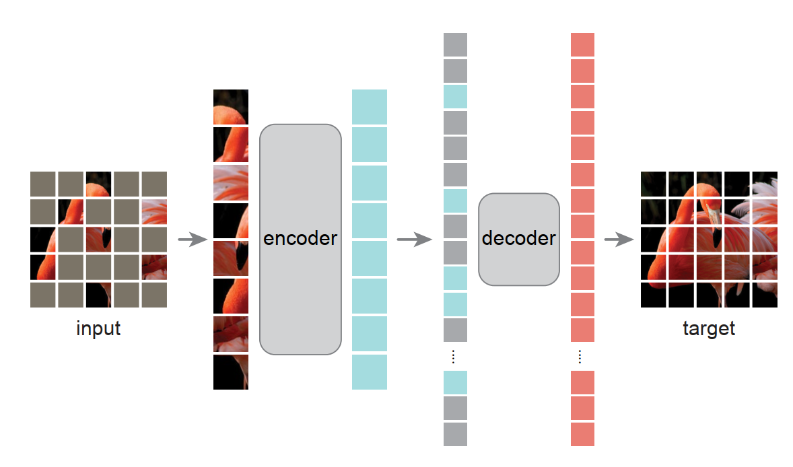
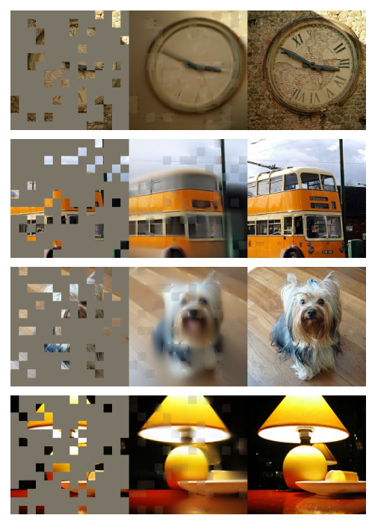
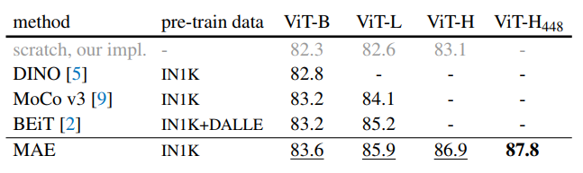
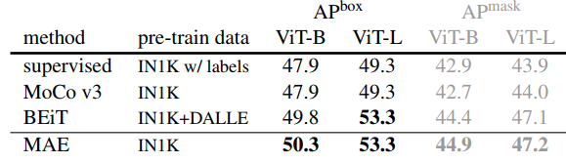
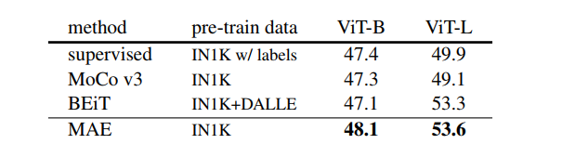
Related Work
He, Kaiming, et al. "Masked autoencoders are scalable vision learners." CVPR. 2022.
  Associate discriminative tasks with generative tasks to perform human-like learning.
  Why Transformers? To learn global-wise characters of an object.
  Transfer learning experiments shows the strong scalability.

Slide 5
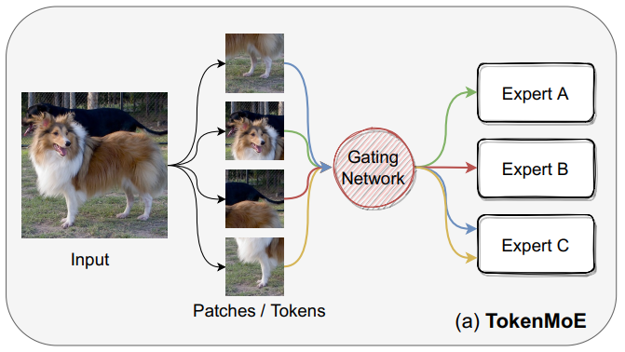

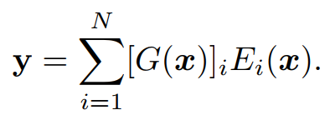
Related Work
Riquelme, Carlos, et al. "Scaling vision with sparse mixture of experts." Advances in Neural Information Processing Systems. 2021.
  TokenMoE converts several transformer blocks to Mixture of Expert (MoE) blocks by expanding the MLP layer N times, each of them is considered as an expert E.

Slide 6
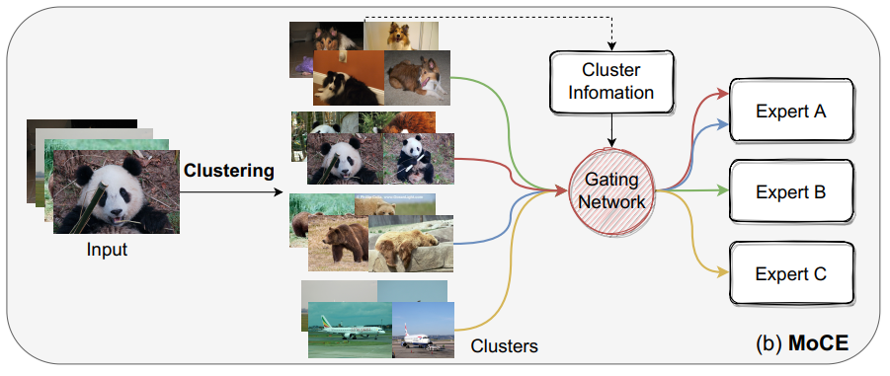
Method
Overview
  Introduce data clustering to MAE pretraining.

Slide 7






Method
Data Clustering
  Take a pre-trained MAE model to produce image features
  The learnable cluster centroids are represented as
  The assignment of feature to clusters is computed as
  The posterior distribution of clustering is
  Training objective is
  H is the entropy function. is the m-dimensional vector of all ones.
  Optimizing strategy: Sinkhorn-Knopp algorithm (Marco Cuturi. Sinkhorn distances: Lightspeed computation of optimal transport. NeurIPS. 2013.)

Slide 8

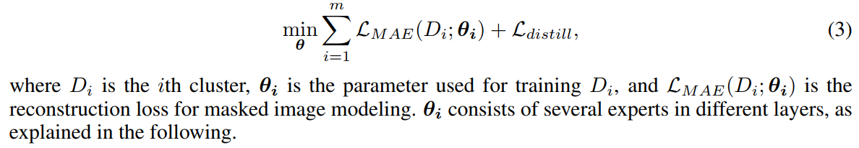
Method
Architecture
  The whole network is trained on the full ImageNet data, with each expert trained by images from selected clusters decided by the MoCE gates’ routing results.
  They further adopt a distillation loss , which is defined as the ℓ2 distance between the features generated by the whole network and each expert.
  Loss function:

Slide 9

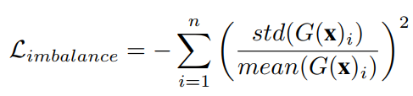
Method
Gate Design
  As in the TokenMoE, they replace several MLP layers in the ViT with layers equipped with MoE gates.
  In MoCE, they route tokens from images of the same cluster to the same expert.
  The MoCE gate output can thus be written as
  For practical implementation, the imbalance loss is calculated over the samples in a batch. The imbalance loss penalizes on the negative variance of the gate confidence:

Slide 10

Method
Deployment for downstream tasks
  They feed images for the downstream task through the pre-trained MAE model and collect all the image features as F.
  The assignment of downstream images to the clusters is then computed as
  They select the largest cluster with assigned downstream images, and use the corresponding experts (a sub-model of the whole MoCE model) for deployment.

Slide 11
Experiments
Settings
  They set K = 1 of the Top K gating.
  The number of experts is 8 and the number of clusters is 256.
  They utilize the officially released 1600-epoch pre-trained MAE model and continue to train for an extra 200 epochs.
  They continue to train a 1600-epoch pre-trained MAE for 200 epochs with total ImageNet as our baseline, and is denoted as MAE* in Table 1.

Slide 12
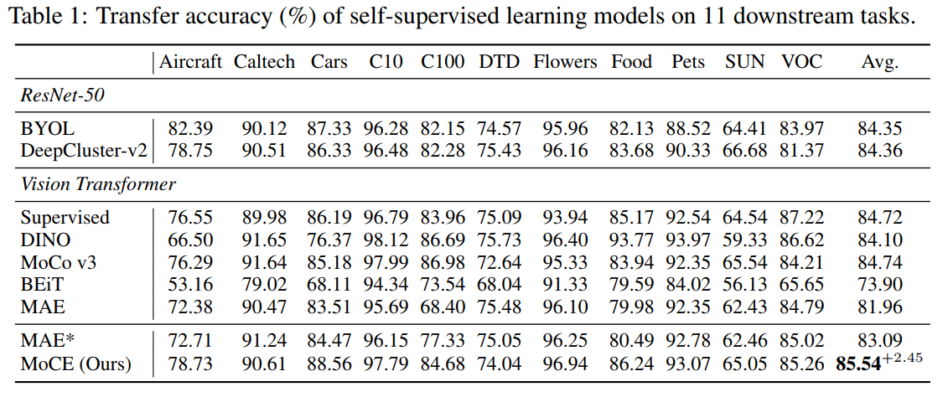
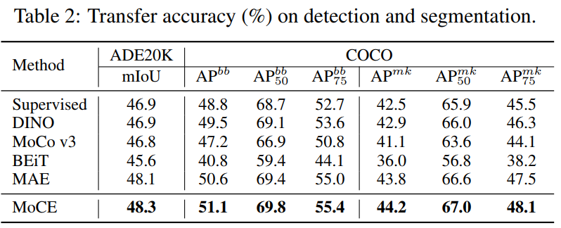
Experiments
Classification
Detection and Segmentation

Slide 13
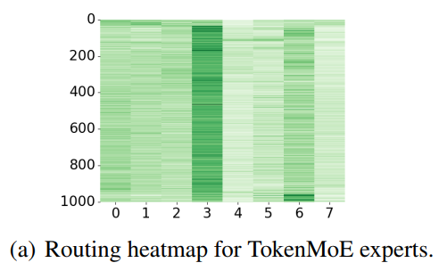
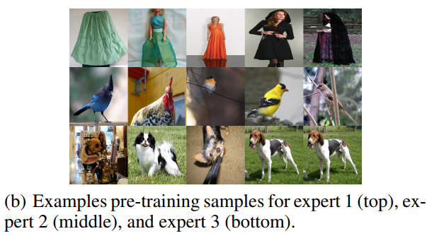
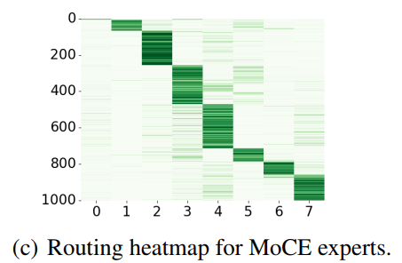
Experiments
Expert samples
Routing heatmap

Slide 14
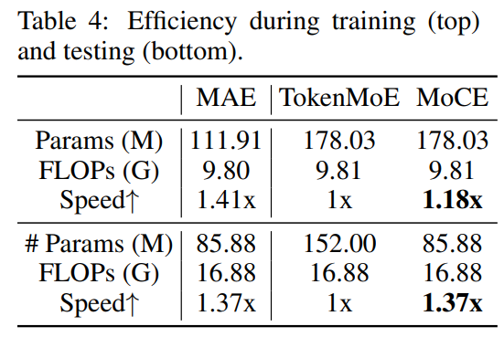
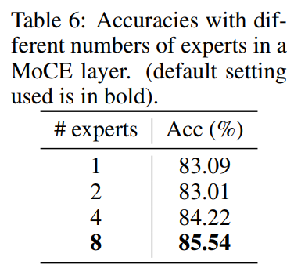
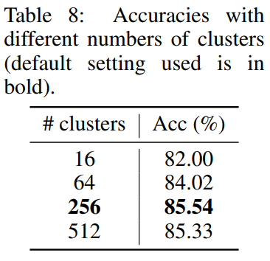
Experiments
Other results

