Slide 1
Paper notes

Slide 2
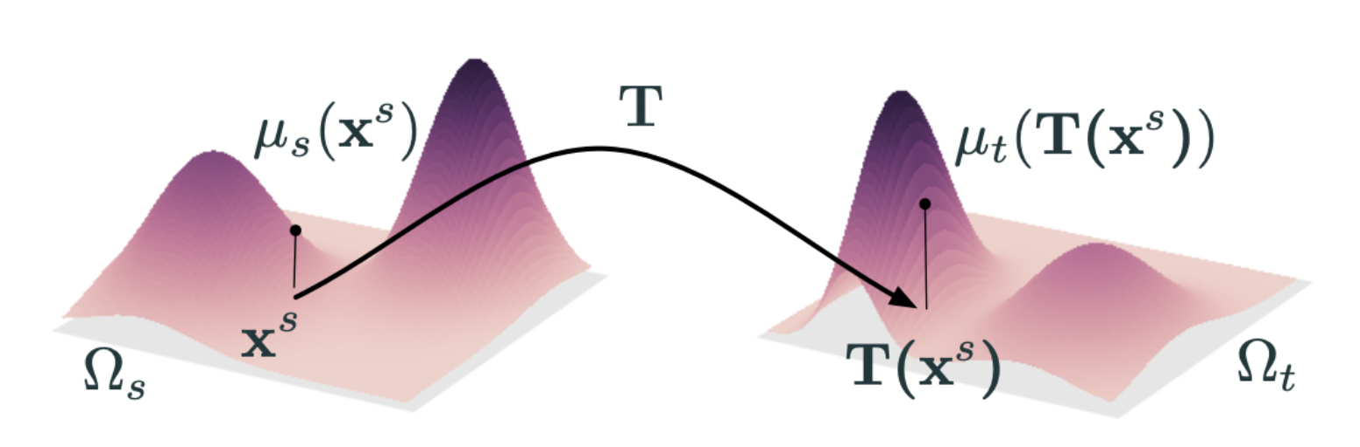
What is the optimal transport problem?
将存储在A地N个仓库的物资转移到B地M个仓库中，供需货物量相同，寻找最优运输策略使得运输成本cost最小。

Slide 3
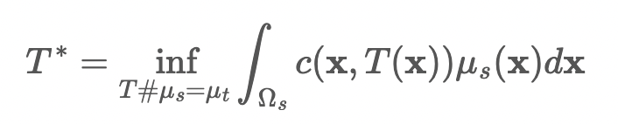
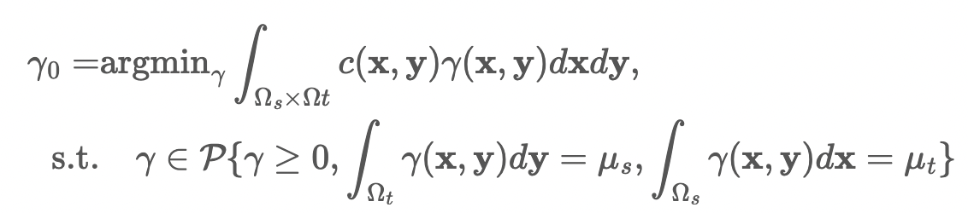
Monge形式
Kantorovich 形式

Slide 4
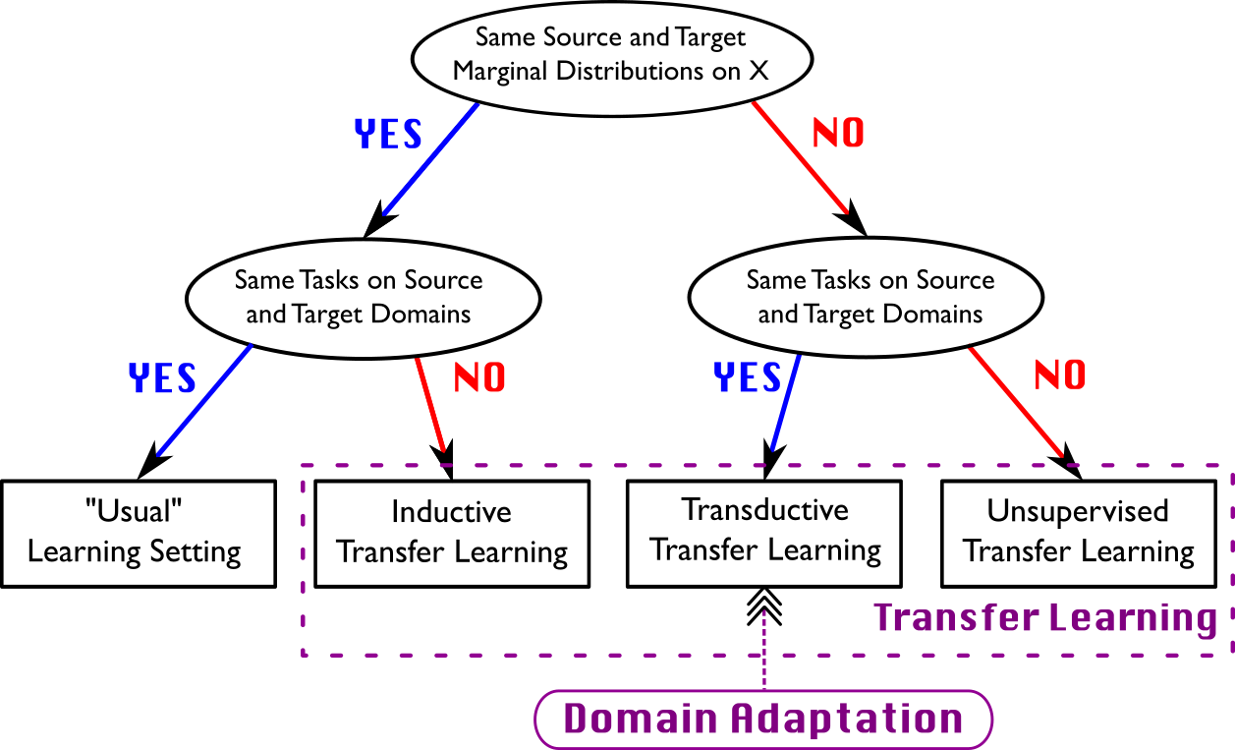
What is domain adaptation?
定义：
Domain adaptation aim at learning from a source data distribution a well performing model on a different (but related) target data distribution.
属于Transductive Transfer Learning，即Ts=Tt，Ds≠Dt，包括Homogeneous Domain Adaptation和Hetergeneous Domain Adaptation，前者Xs=Xt，P(Xs)≠P(Xt)，后者Xs≠Xt

Slide 5
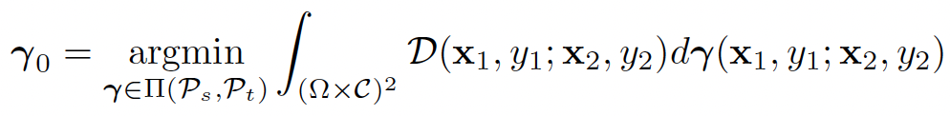

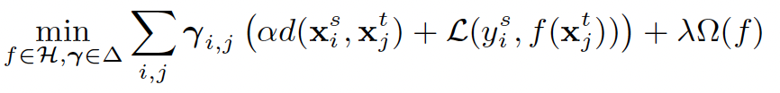
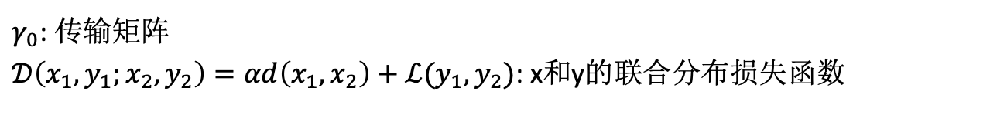

How to use optimal transport to solve the domain adaptation problem in the original JDOT paper?
$γ_{0}$: 传输矩阵
$𝒟\left(x_{1},y_{1};x_{2},y_{2}\right)=αd\left(x_{1},x_{2}\right)+ℒ(y_{1},y_{2})$: x和y的联合分布损失函数
目标: $f$

Slide 6
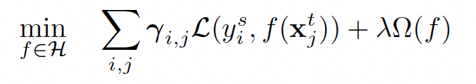
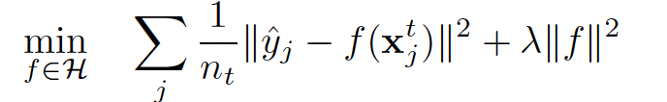

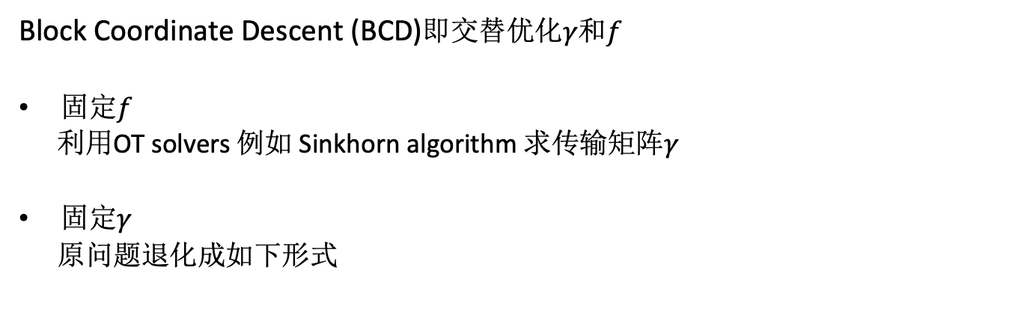
Block Coordinate Descent (BCD)即交替优化$γ$和$f$
固定$f$
利用OT solvers 例如 Sinkhorn algorithm 求传输矩阵$γ$
固定$γ$
原问题退化成如下形式
for regression problems which regard 𝐿 as the squared loss
$f(x_{j}^{t})$需要去不断接近带权重的$y_{i}^{s}$，权重由传输矩阵$γ$确定
Notes:
F拟合的是假想的最优解，怎么确定得到的f的真实准确率？

Slide 7
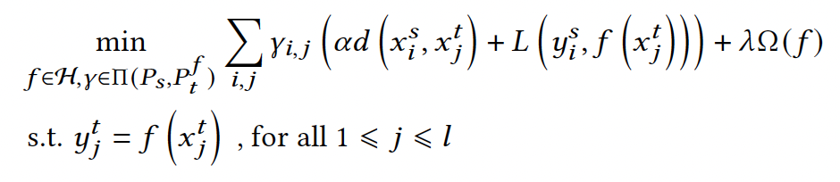
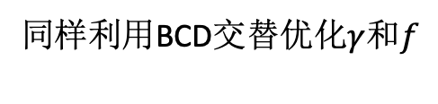
What is the improvement of Zihao's paper compared to the original JDOT?
Semi-Supervised Joint Distribution Optimal Transport
同样利用BCD交替优化$γ$和$f$

Slide 8
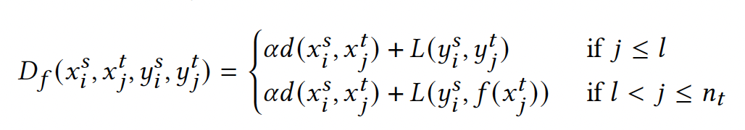
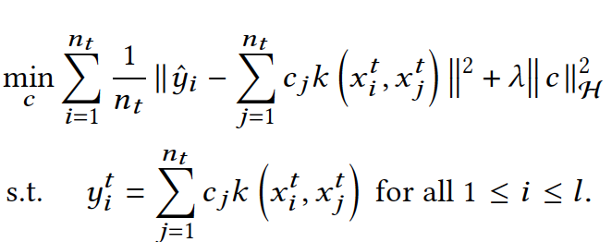
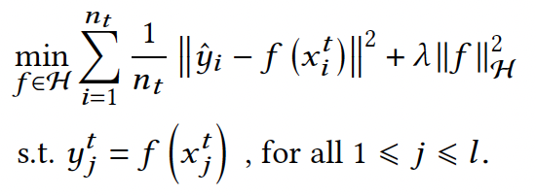




固定$f$,使用Sinkhorn algorithm算法求解OT问题
固定$γ$
引入核方法
Lagrangian Function
and KKT conditions

Slide 9
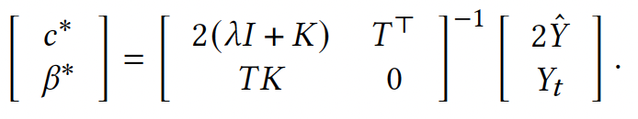
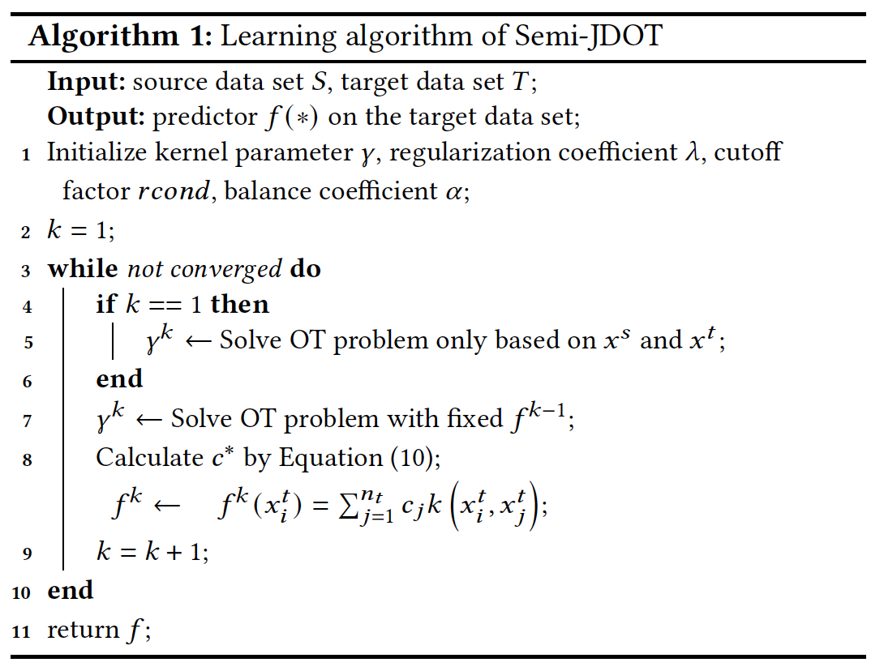
一阶导数等于0

