Slide 1
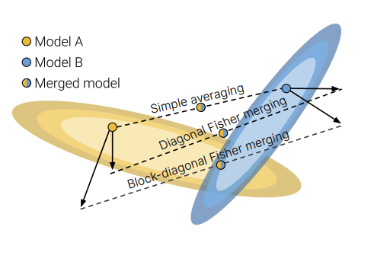
Merging by Matching Models in Task Parameter Subspaces
Xiangyu Chen 0515
Reading Group
task subspace: can indeed refer to a lot of things (input/output/feature/parameter spaces)
Notes:
Task Parameter Subspaces

Slide 2
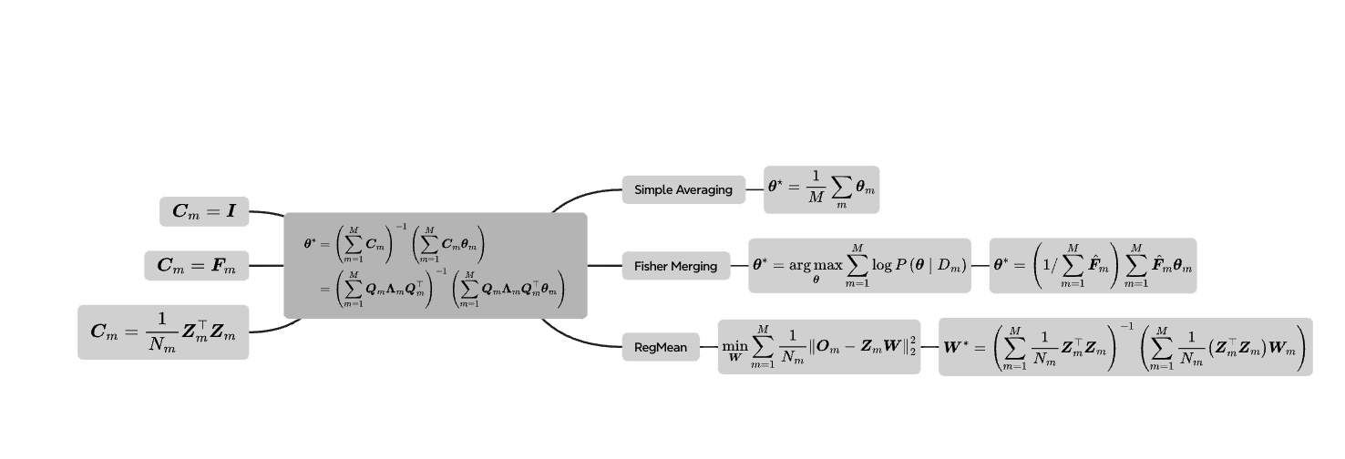
Overview

Slide 3
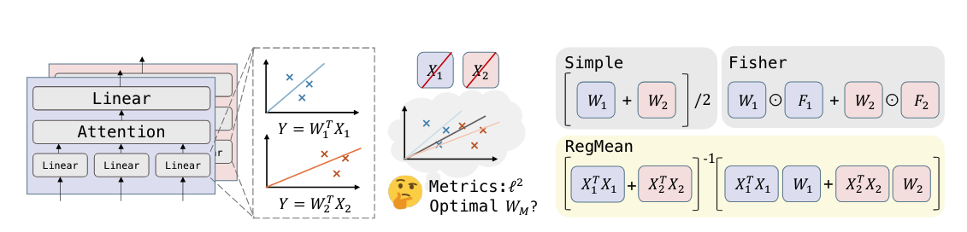
Introduction
Model merging aims to tackle this problem by combining specialized models into a single model that retains the individual models’ capabilities. Compared to multitask learning, merging does not require simultaneous access to the individual-task datasets.
To match models in their task parameter subspace, merging methods upweight each model in its task parameter subspace, which aims to ensure that the task-relevant components of a given model will not be washed out after the models are combined. Fisher merging, RegMean and simple parameter averaging all perform merging in this way and differ only in their choice of taskparameter subspace.
Uses the conjugate gradient method to solve a given linear system, MaTS (Matching Modelsin their Task Subspace) flexibly supports different merging objectives and initializations (which can impact convergence speed). K-FAC introduce a merging method where a model’s task parameter subspace is based on a block-diagonal(BFM) approximation of the Fisher information matrix.

Slide 4
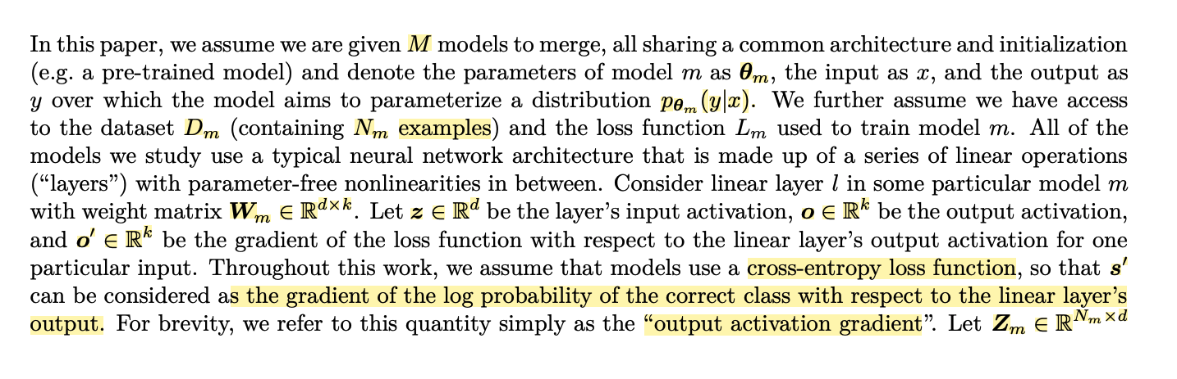
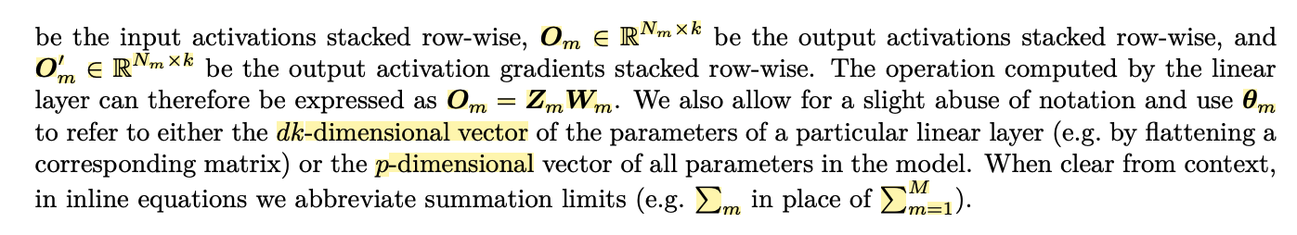
Background

Slide 5
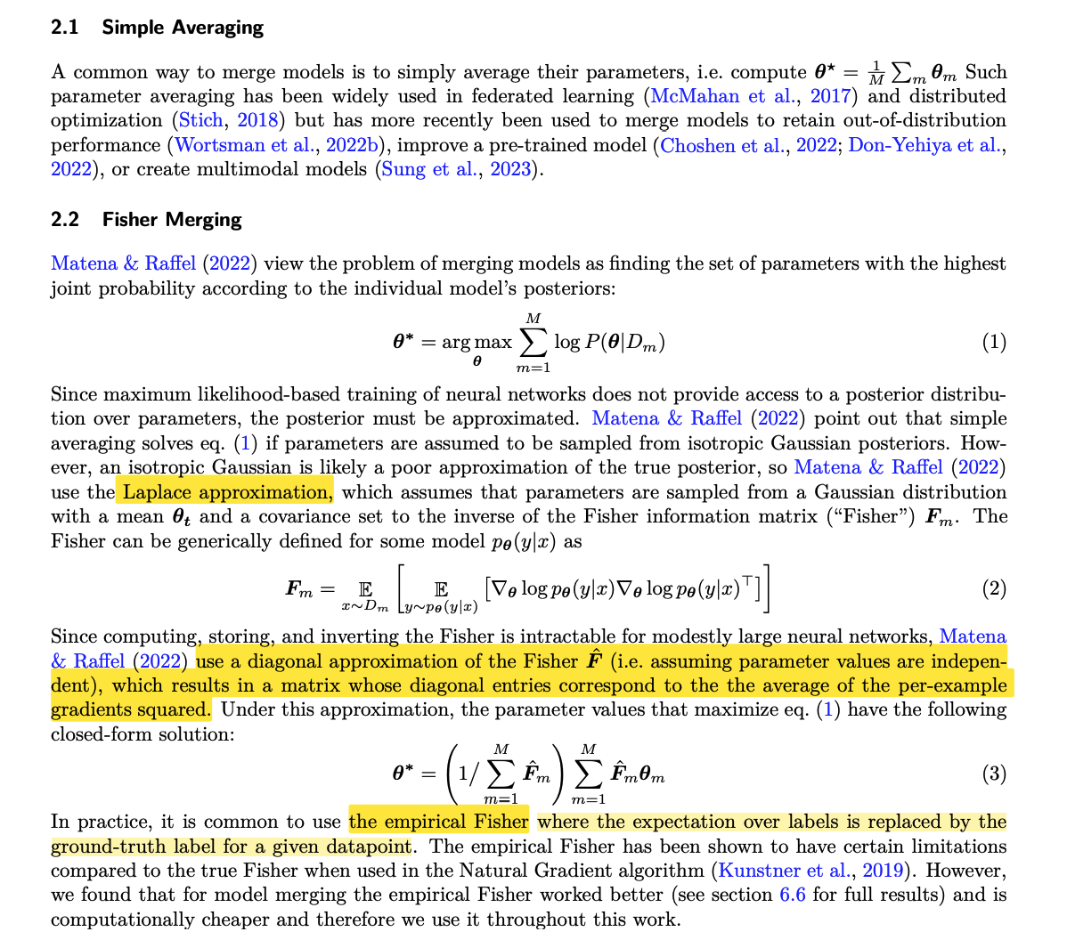
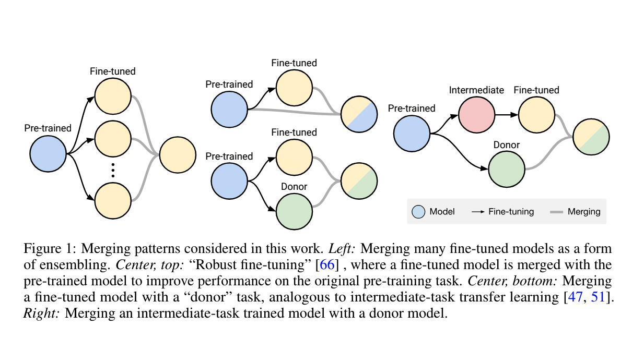
Background
2.1 Simple Averaging
2.2 Fisher Merging
Merging Models with Fisher-Weighted Averaging NIPS 2022
Notes:
Merging Models with Fisher-Weighted Averaging

Slide 6
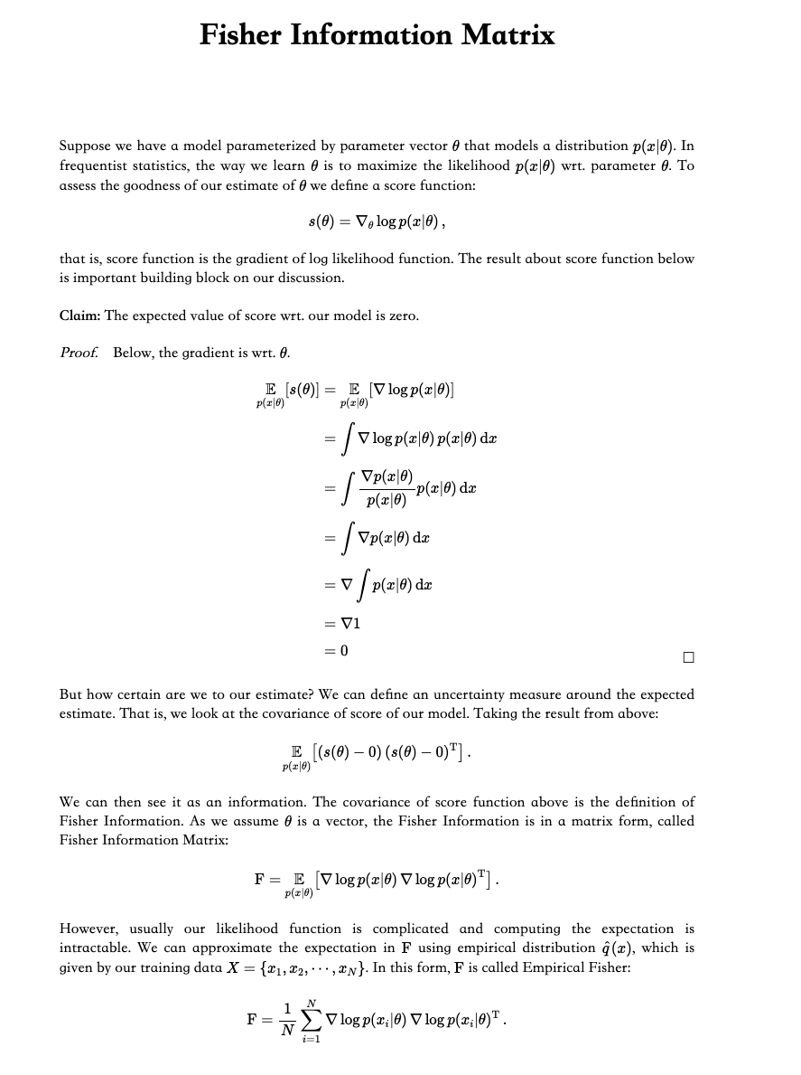
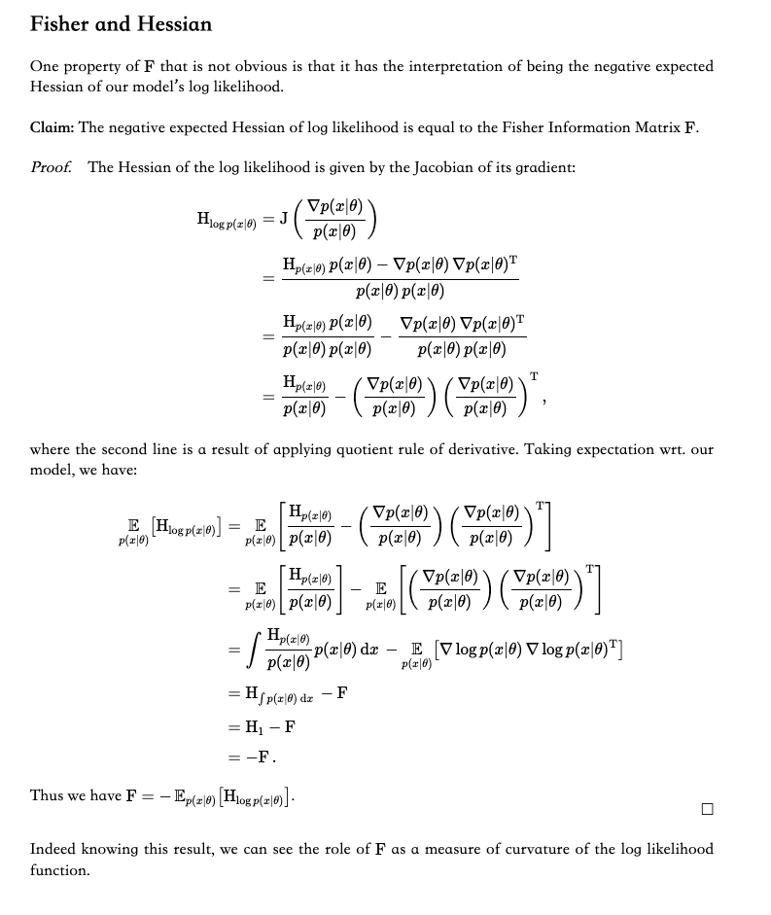
Preliminary: Fisher Information Matrix
Notes:
A tutorial on Fisher information

Slide 7
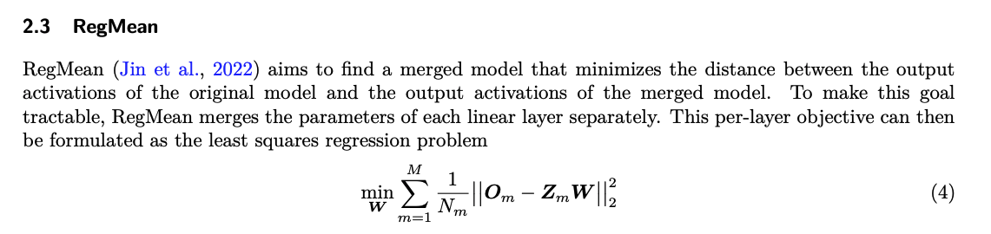
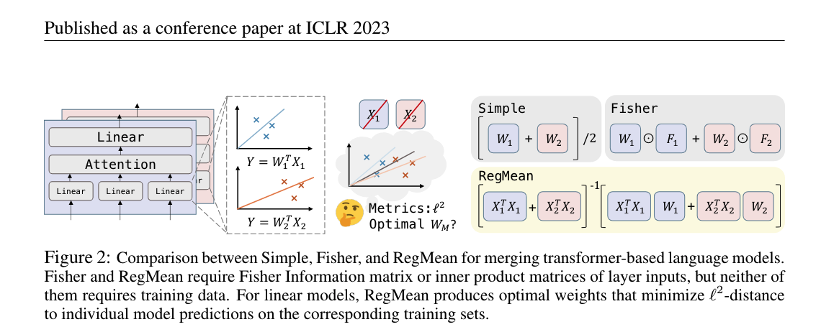
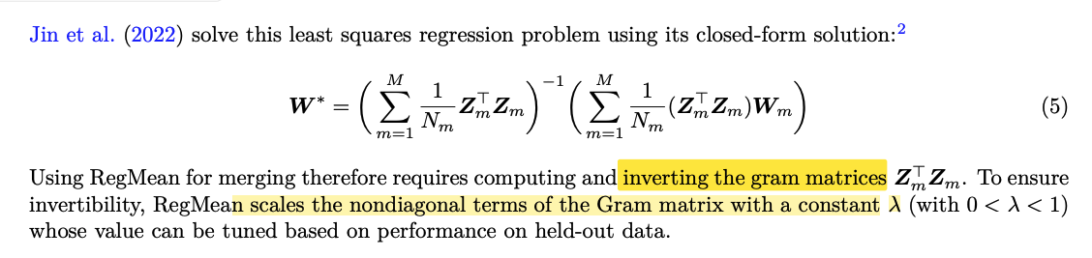
Background
2.3 RegMean
DATALESS KNOWLEDGE FUSION BY MERGING WEIGHTS OF LANGUAGE MODELS ICLR 2023
Notes:
考虑不同模型的数据分布以及调整权重的重要性
https://arxiv.org/pdf/2212.09849

Slide 8
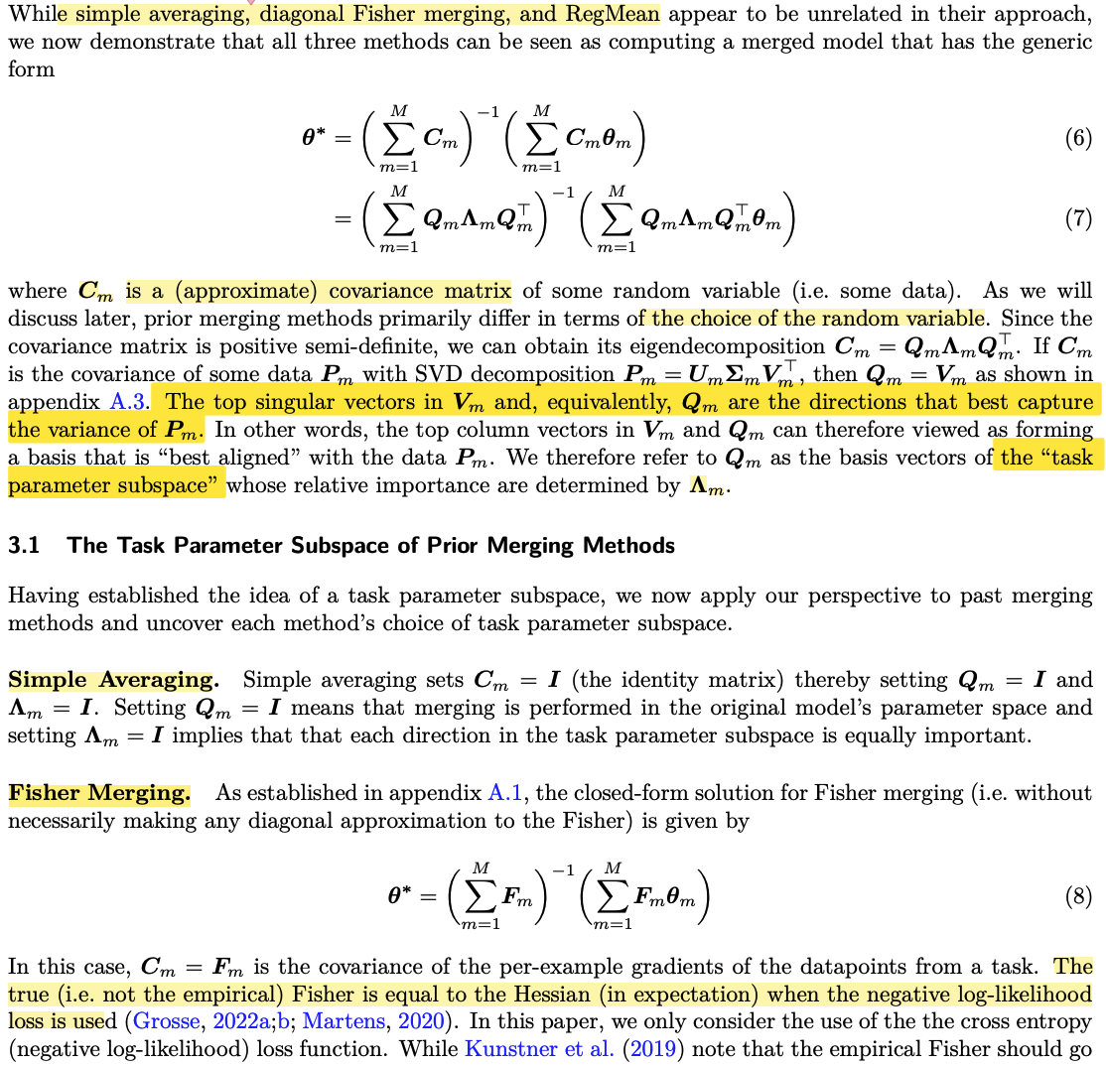
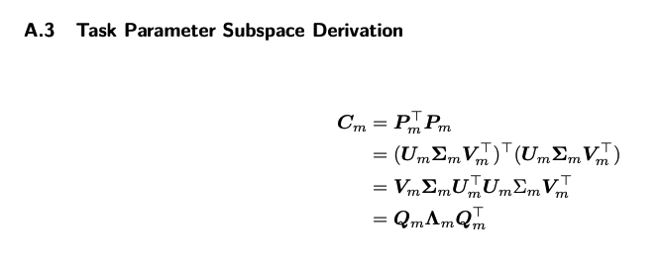
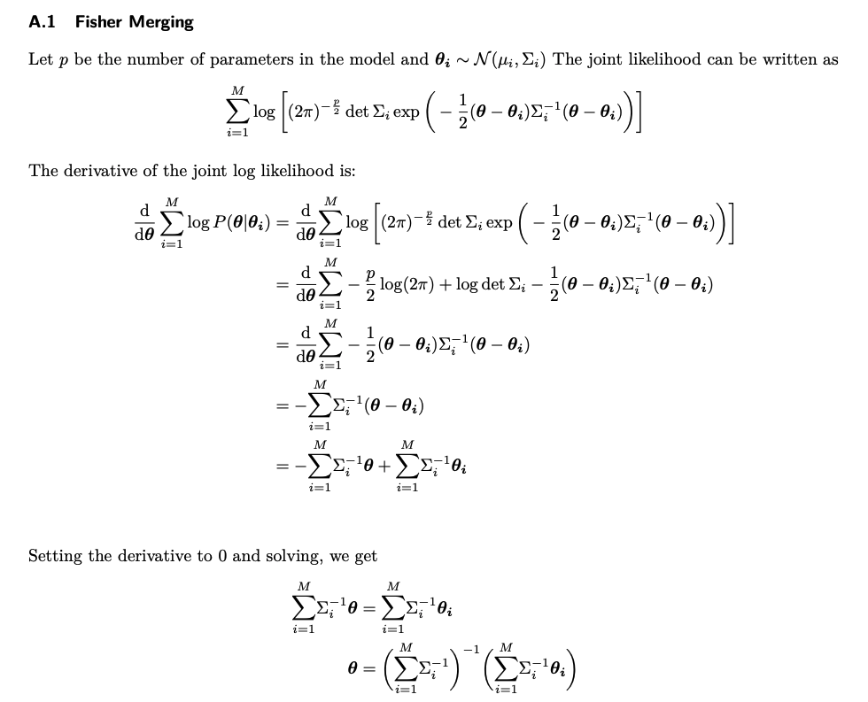
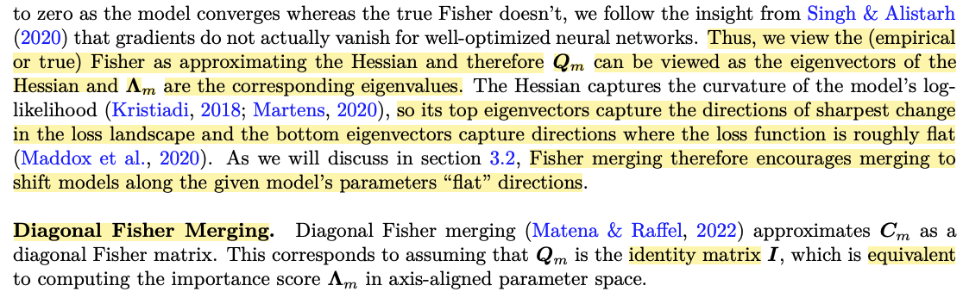
Matching Individual Models in their Task Parameter Subspace

Slide 9
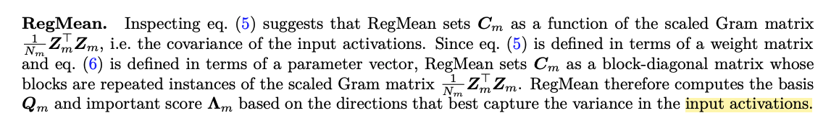
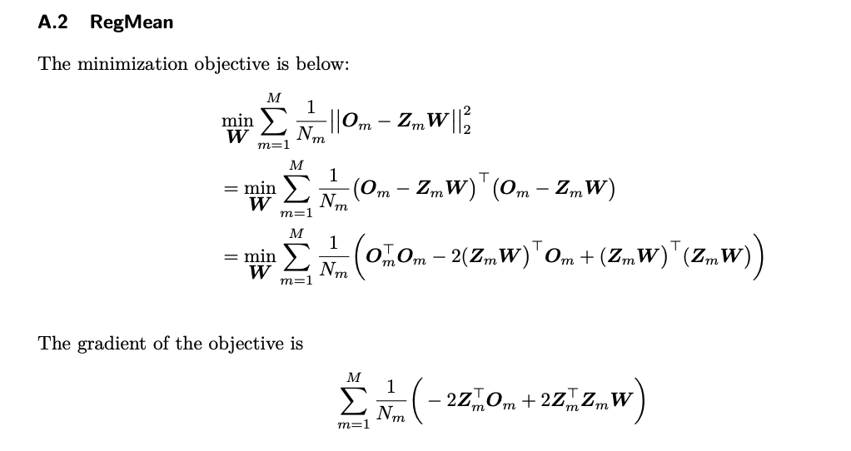
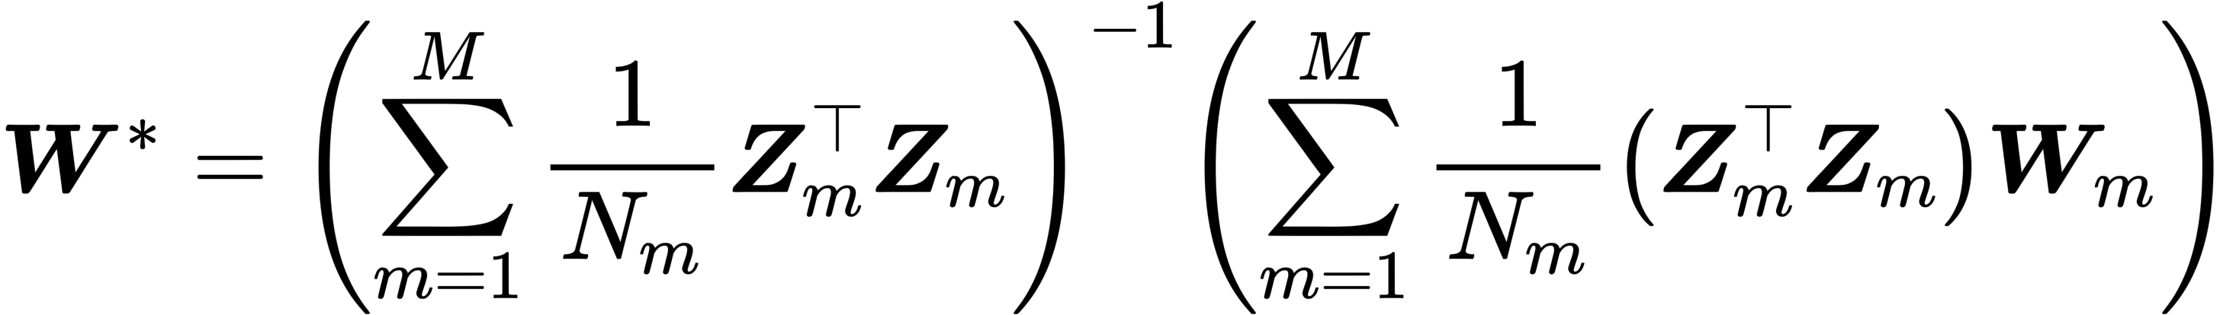
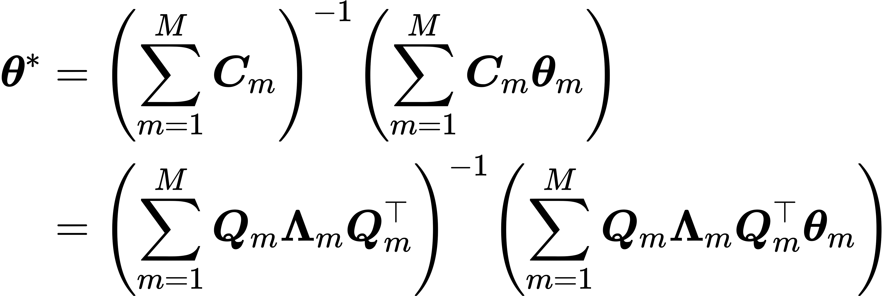
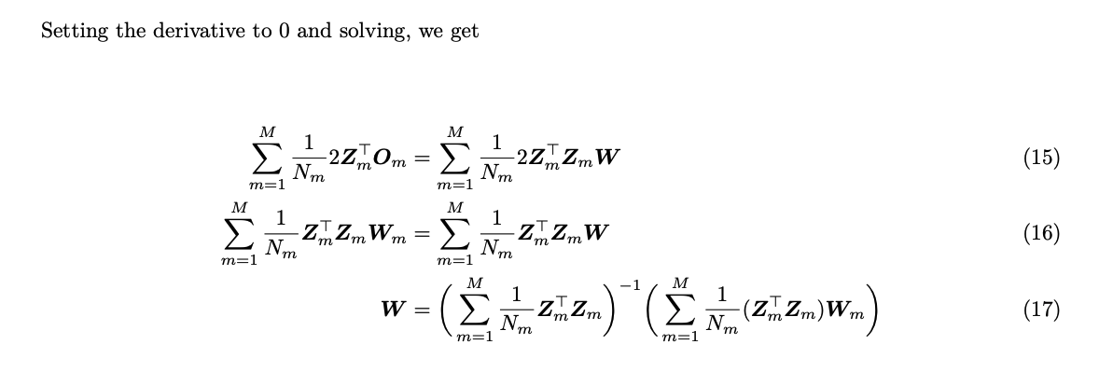
The Task Parameter Subspace of Prior Merging Methods

Slide 10
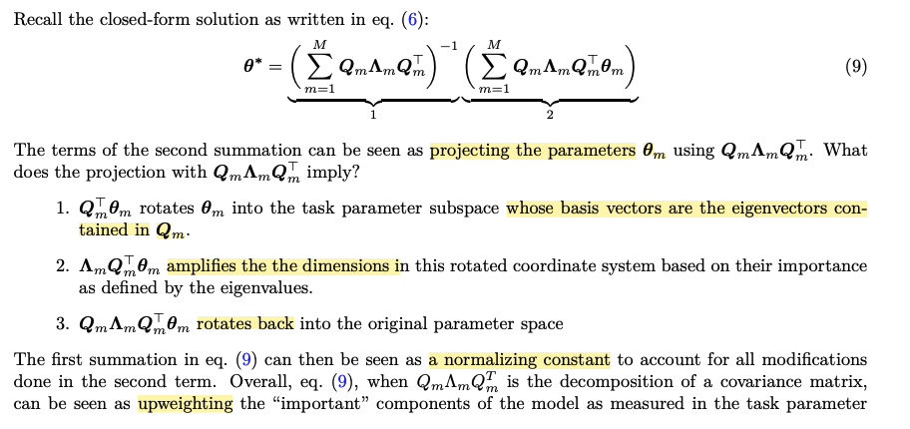
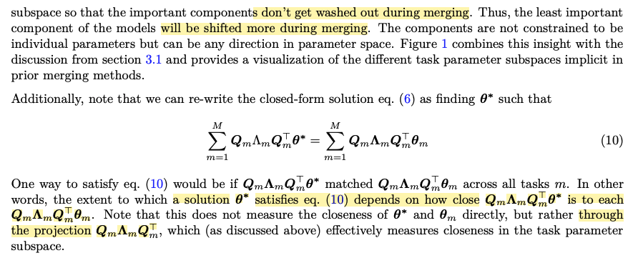
Matching in Task Parameter Subspace
Notes:
3blue1brown

Slide 11
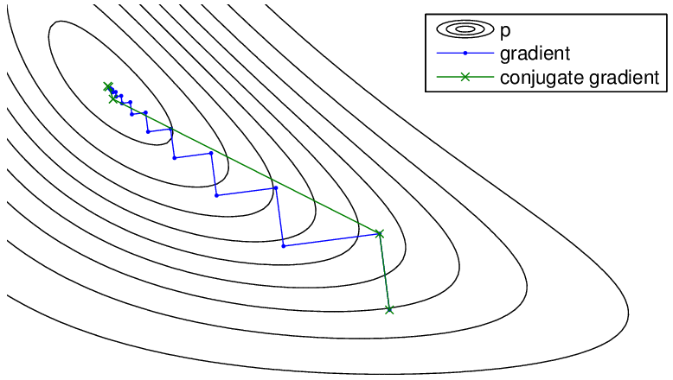
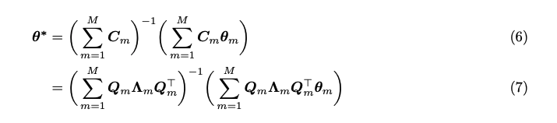
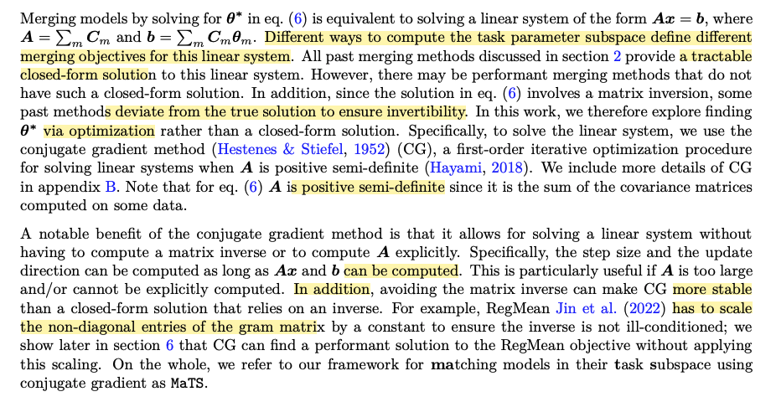
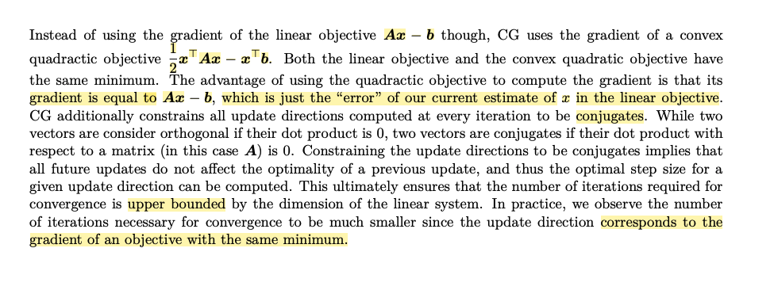
Merging via the Conjugate Gradient Method
Notes:
the conjugate gradient method for inverting a sum of Kroneckerproducts
https://en.wikipedia.org/wiki/Conjugate_gradient_method

Slide 12
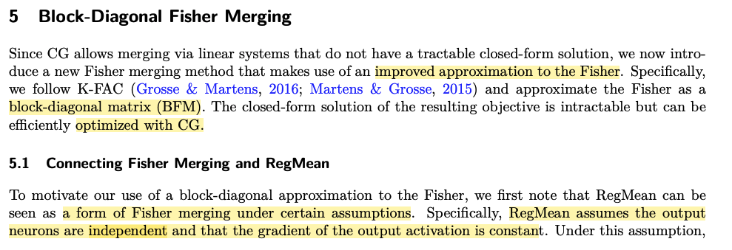
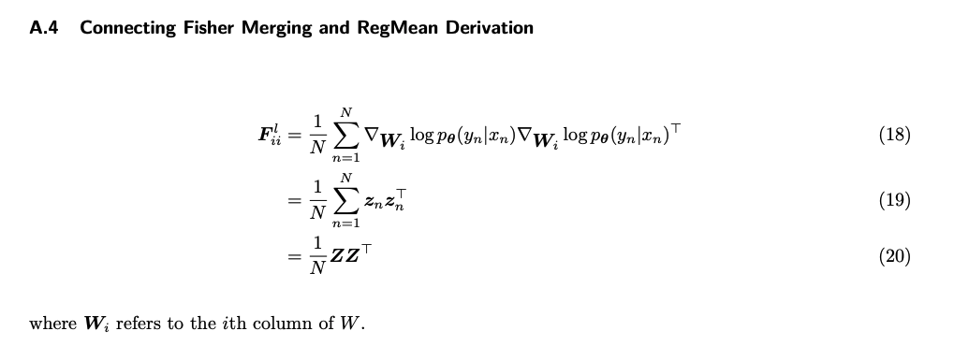
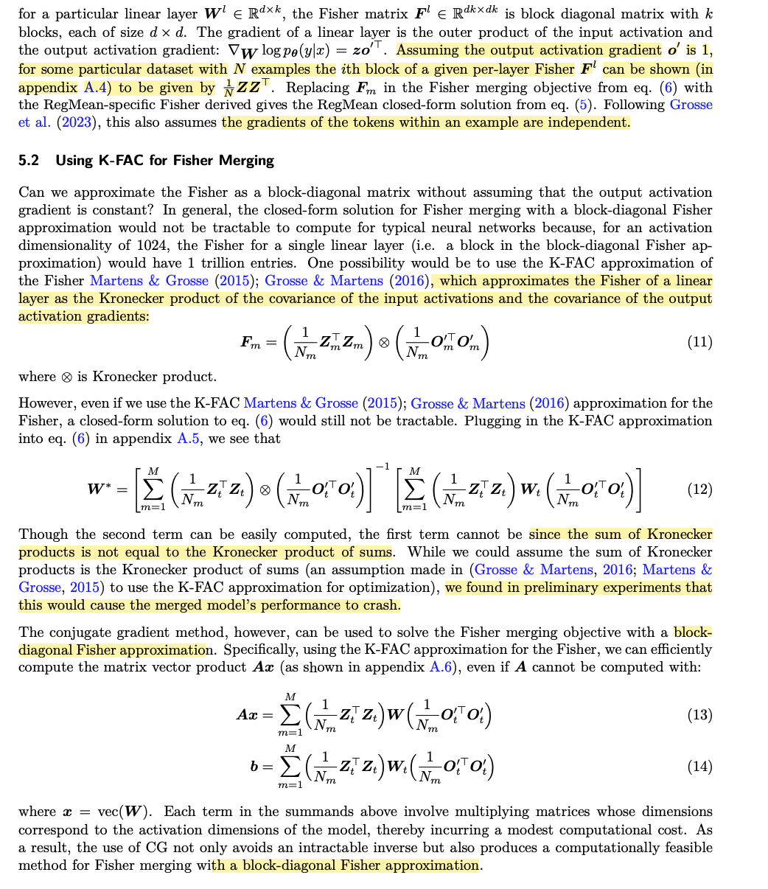
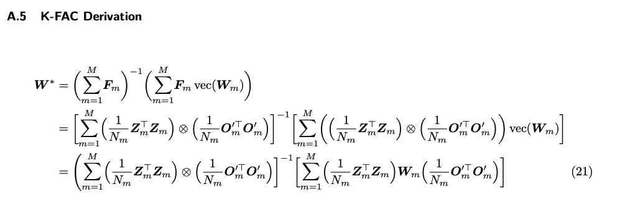
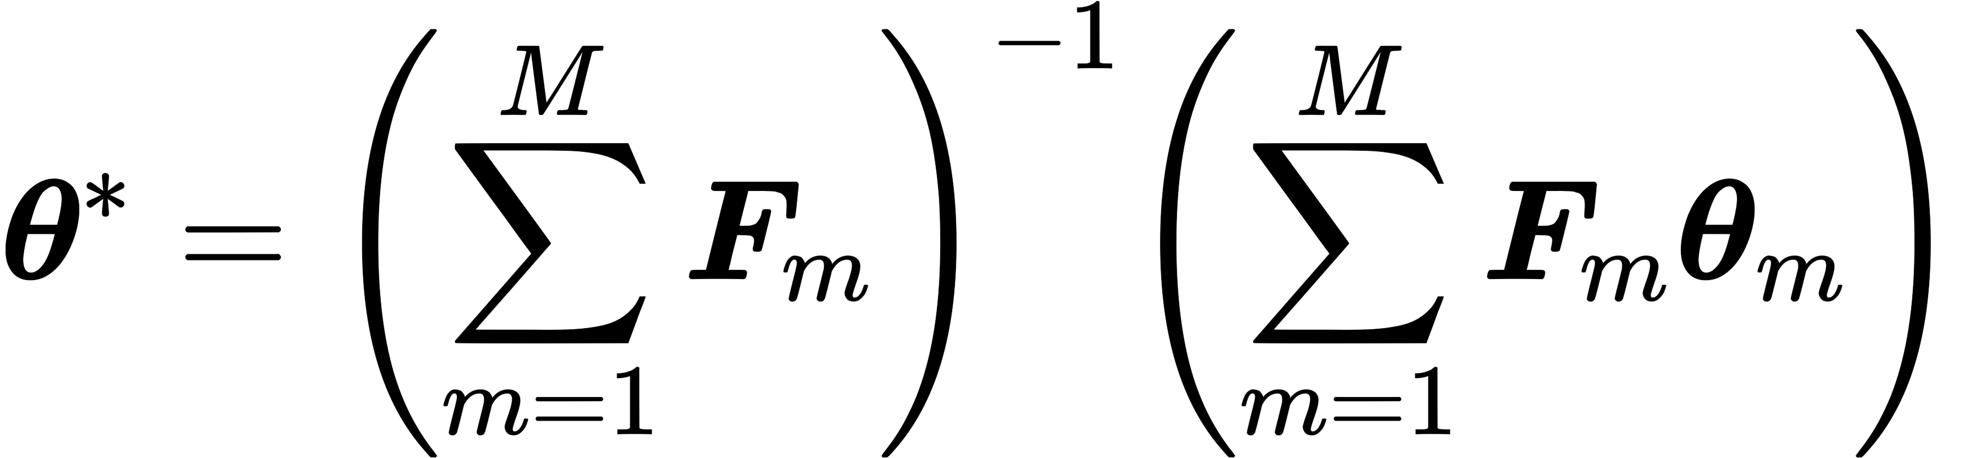
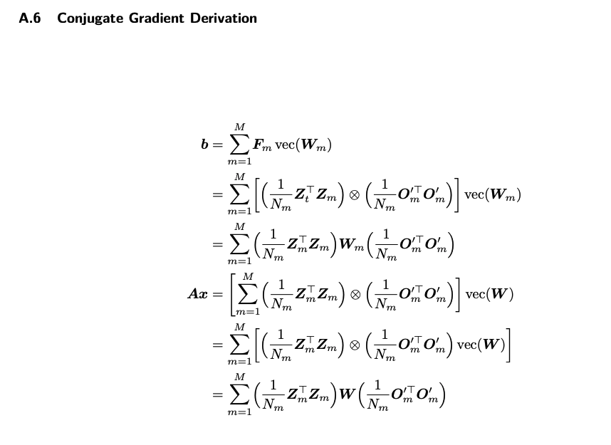
5 Block-Diagonal Fisher Merging（BFM）

Slide 13
Experiments: Baselines
Simple Averaging averages the parameter values of the models being merged.
Ensembling ensembles the predicted probabilities from the model to merge. Note that this does not result in 1 model, but in M models.
Task Arithmetic (Ilharco et al., 2022) introduces a task vector for a particular task as the difference between the fine-tuned parameters (found after training on the task) and the original pre-trained parameters. To construct the merged model, Task Arithmetic adds the scaled sum of the task vectors for all tasks to the pretrained model’s parameters. Task Arithmetic introduces the hyperparameter λ to rescale the summed task vectors.
TIES-Merging (Yadav et al., 2023) improves upon task arithmetic by removing interference between the task vectors. Specifically, TIES zeros out entries in a given task vector that have low magnitude and resolves sign conflicts across different task vectors. Similar to Task Arithmetic, TIES-Merging also uses a hyperparameter λ to scale the task vectors after removing interference.
Diagonal Fisher Merging (Matena & Raffel, 2022) performs Fisher Merging with a diagonal approximation to the Fisher, as described in section 2.2). To better distinguish between different approxi-mations of the Fisher, we call this method Diagonal Fisher Merging (DFM).
RegMean (Jin et al., 2022) solves a linear system to match activations between the merged model and the original models. In practice, RegMean scales the non-diagonal terms of the Gram matrix with a hyperparameter λ for numerical stability when computing the inverse. Note that RegMean can only be applied to linear layers since a closed-form solution does not exist otherwise.
Multitask training (where a model is trained on all the tasks jointly) is included wherever appropriate and can be considered as a loose upper bound on the performance of a merged multitask model.

Slide 14
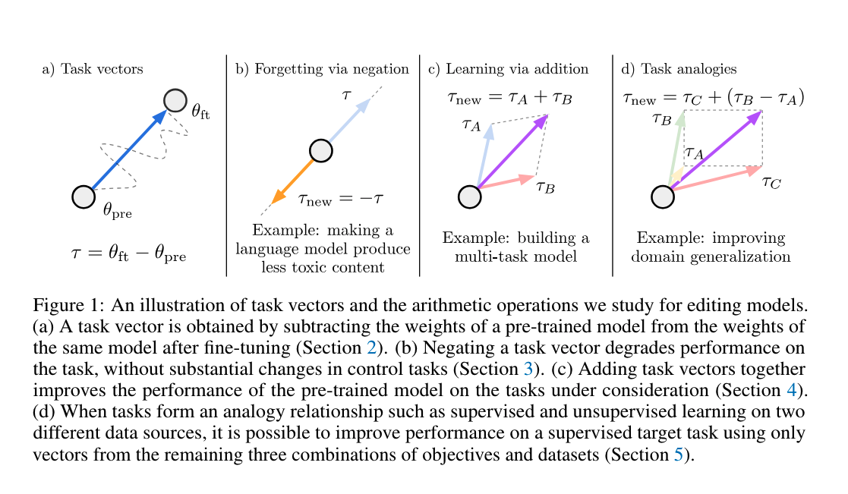
Task Arithmetic
Task Arithmetic (Ilharco et al., 2022) introduces a task vector for a particular task as the difference between the fine-tuned parameters (found after training on the task) and the original pre-trained parameters.
To construct the merged model, Task Arithmetic adds the scaled sum of the task vectors for all tasks to the pretrained model’s parameters.
Task Arithmetic introduces the hyperparameter λ to rescale the summed task vectors.
Editing Models with Task Arithmetic ICLR 2023 poster

Slide 15
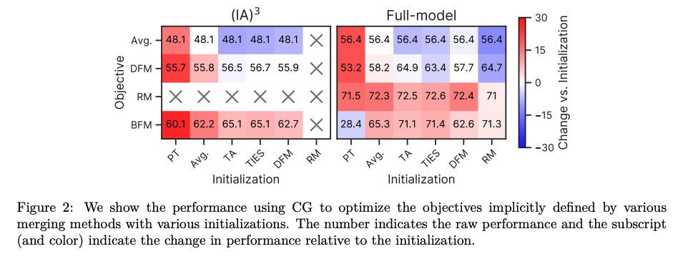
Result: Conjugate Gradient Initializations and Objectives

Slide 16
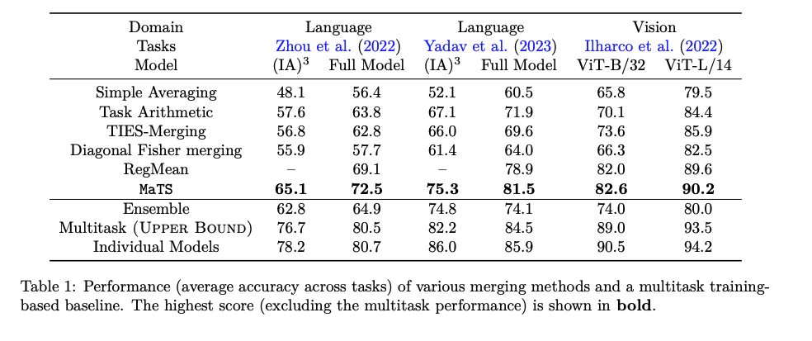
Result: Multitask Models
MaTS outperforms all other methods, often by a significant margin.
Note that none of the methods (including MaTS) match the multitask trainingbased baseline, suggesting that there still remains room for improvement when merging many individual-task models to create a multitask model.

Slide 17
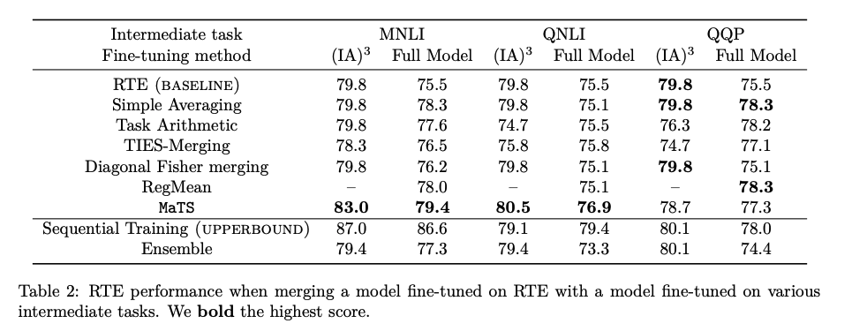
Result: Intermediate-Task Training
Intermediatetask training (Phang et al., 2018; Pruksachatkun et al., 2020) involves first fine-tuning a model on an intermediate task before fine-tuning it on a target downstream task in hopes of improving performance.
Overall, we find that MaTS often outperforms all baselines with the exception of intermediate-task merging with QQP, where most methods fail to provide a major improvement (perhaps because QQP is not a particularly effective intermediate task for RTE).

Slide 18
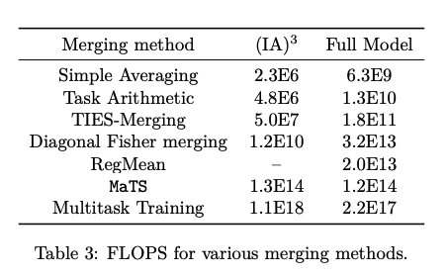
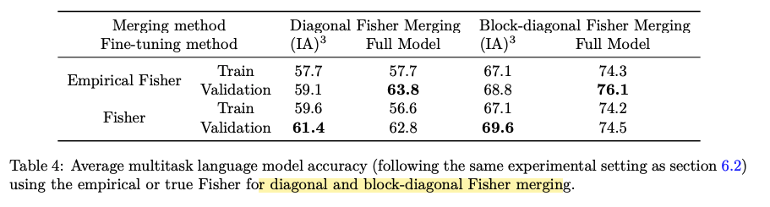
Result: Cost and Computing the Fisher
MaTS in the setting from section 6.2 only takes about 11 minutes on a single NVIDIA A6000 GPU.
Results are shown in table 4, where we confirm that the overallperformance is best when using the empirical Fisher computed on the validation set.

Slide 19
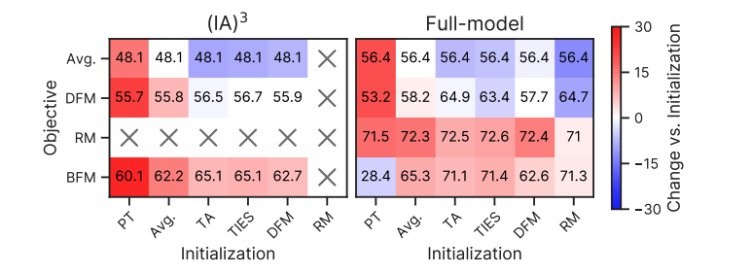
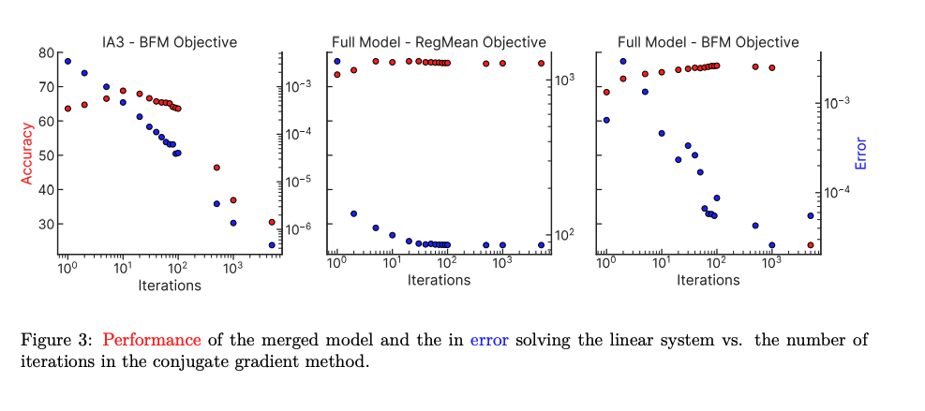
Discussion
One notable finding is that using the block-diagonal Fisher merging (BFM) objective did not provide the best performance in the full-model fine-tuning setting despite the fact that we might expect it to provide the most reliable notion of a “task parameter subspace”among methods we consider.
First, we consider whether a better initialization could yield better performance with BFM. Specifically, since using a task vector-based initialization with the RegMean objective in MaTS performed well, we considered using the solution found by this recipe as an initialization for an additional round of MaTS using the BFM objective. In the experimental setting of section 6.2, adding an additional round of BFM-basedmerging increased the average performance across tasks from 72.5 to 73.5, outperforming all other methods. This result further emphasizes the importance of the choice of initialization in MaTS and also hints at the possibility of improved performance via multiple rounds of merging.
Separately, we experimented with whether optimizing the BFM-based objective would benefit from more iterations of CG. However, when increasing the maximum number of iterations from 100 to 5K, we observed that the average performance could drop significantly and include graph in appendix G. We hypothesize this is due to numerical instability of the gradients.
More broadly, however, our results generally suggest that improved approximations of the Fisher could improve the performance of Fisher merging-based methods.

Slide 20
Related Work
Loss Landscape
  One common assumption for merging models is that the models lie in a “basin” of low loss in parameter space. There have been many past works focused on finding simple (not necessarily linear) paths of low loss between two models.
  Past work has also aimed to analyze the structure of the loss landscape and try to directly learn a subspaceof low loss.
Fisher
  K-FAC (Martens & Grosse, 2015) approximatesthe Fisher for linear layers as the Kronecker product of the covariance of the input activations and thecovariance of the output activations.
Additional Applications of Model Merging
  merging modelsfor intermediate task-training, generalizing better to out-of distribution shifts, and combining modality-specific models into a multimodal model
  inaccuracies in model merging stemming from gradient mismatches in different models

Slide 21
Conclusion
We propose MaTS, a framework that connects past merging methods by viewing merging as matching individual models in their task parameter subspace.
In general, using MaTS requires solving a linear system, so we propose using the conjugate gradient method which enables solving linear systems that would otherwise be intractable to solve.
To explore a merging objective that has no tractable closed-form solution, we develop a variant of Fisher merging that makes a block-diagonal approximation of the Fisher.
Experimentally, we show that MaTS achieves state-of-the-art results in merging to create multi-task models from individual-task language and vision models and in intermediate-task merging.
Our work provides a new perspective on model merging and motivates future work on improved methods for estimating a model’s task parameter subspace.

Slide 22
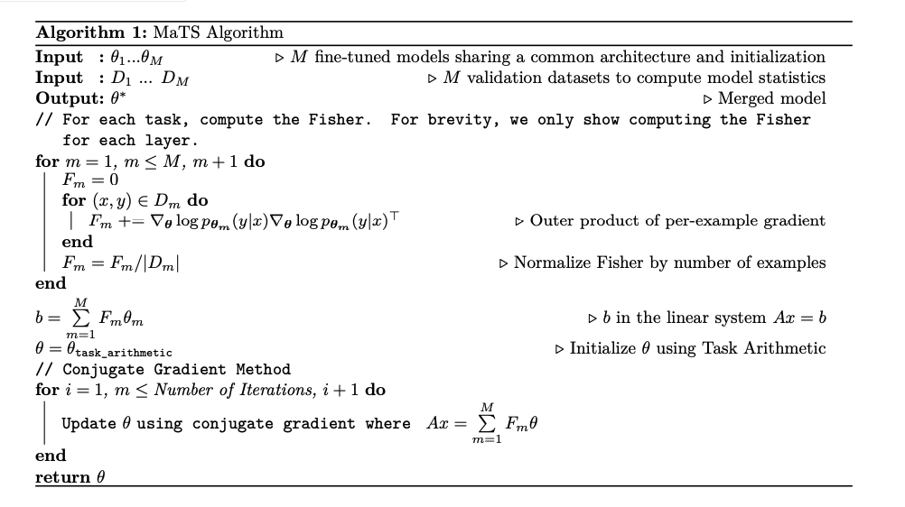
Algorithm in the (IA)3 setting
In the full-model setting, the outerproduct of the gradients is replaced with the outer product of the input activations

Slide 23
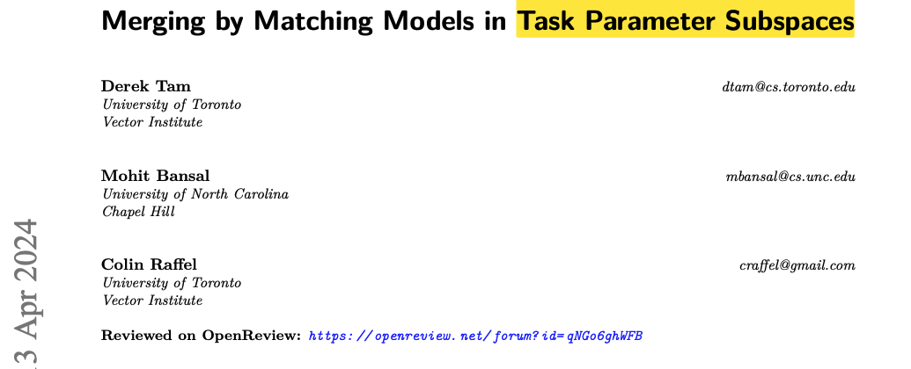
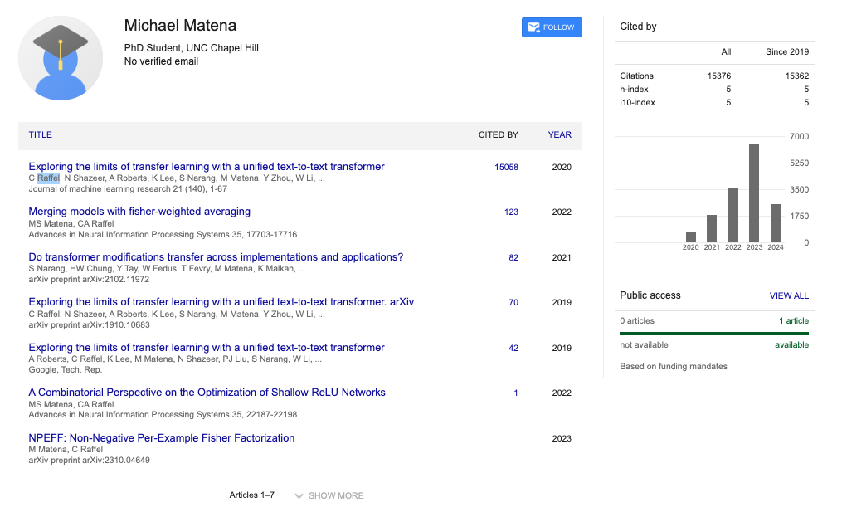
1. Merging Models with Fisher-Weighted Averaging NIPS 2022
2. DATALESS KNOWLEDGE FUSION BY MERGING WEIGHTS OF LANGUAGE MODELS ICLR 2023
Notes:
1. Job talk;
2.

Slide 24
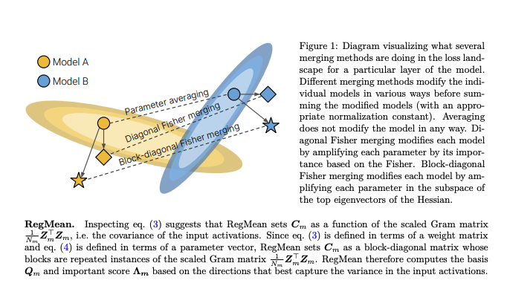
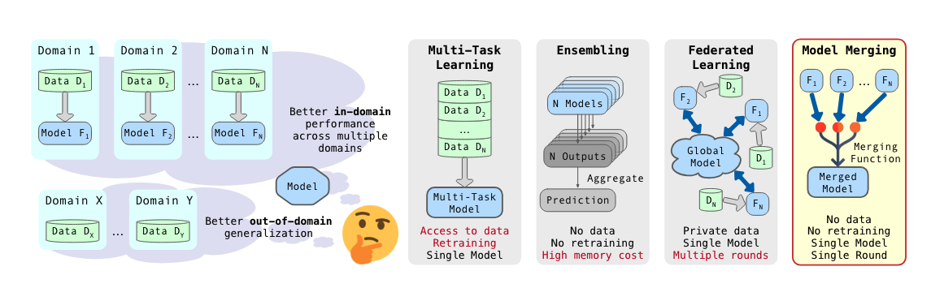

Slide 25
Ref
1. Merging Models with Fisher-Weighted Averaging NIPS 2022
2. DATALESS KNOWLEDGE FUSION BY MERGING WEIGHTS OF LANGUAGE MODELS ICLR 2023

