Slide 1
A Brief Research in Semantic Segmentation with Multisource
段抒彤

Slide 2
approach
  adversarial learning based
  self-training based
special strategy
  entropy minimilation
  two network

Slide 3
self-training based
Pseudo Label Rectification via Co-teaching and Decoupling for Multi-source Domain Adaptation in Semantic Segmentation
FDA: Fourier Domain Adaptation for Semantic Segmentation

Slide 4
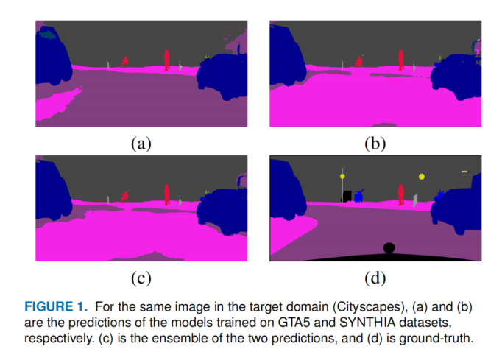
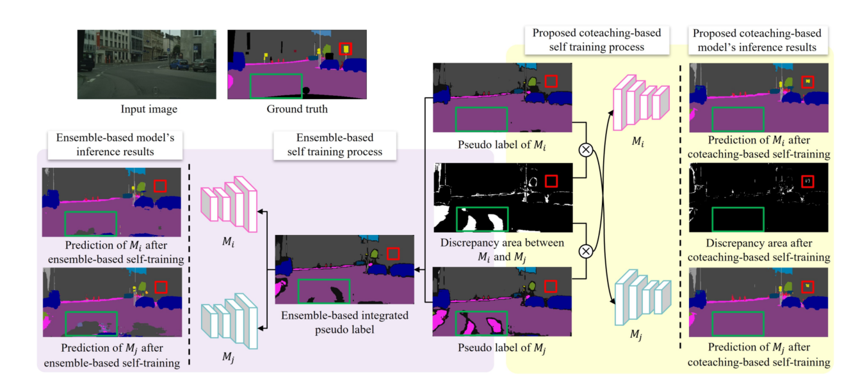
Pseudo Label Rectification via Co-teaching and Decoupling for Multi-source Domain Adaptation in Semantic Segmentation
propose a novel self-training method for MUDA
includes pseudo label-oriented coteaching and pseudo label decoupling that are attempted for the pseudo label rectification-based MUDA for semantic segmentation
Notes:
一般在基于自训练的方法中，会在多个源域上训练模型，生成对未标记样本的预测，并将具有高置信度的预测设为伪标签。然后，利用伪标签对未标记的目标域进行监督学习。但一方面，不正确的伪标签会降低模型的性能，另一方面，当错误预测的置信度较高时，可以忽略正确的预测。比如如左图所示，a、b分别是两个模型生成的伪标签，c是他们集成的标签，d是groundtruth.即使a和d十分相近了，但由于b的置信更高，所以在集成的时候也不认为a是对的。
因此这篇论文提出了一种面向伪标签的协同教学，两个模型通过交换两个伪标签来补充相互错误。同时，提出了伪标签解耦方法对伪标签进行修正，仅在两个模型的预测不同时交换伪标签，以防止模型被不正确的伪标签过度拟合。

Slide 5
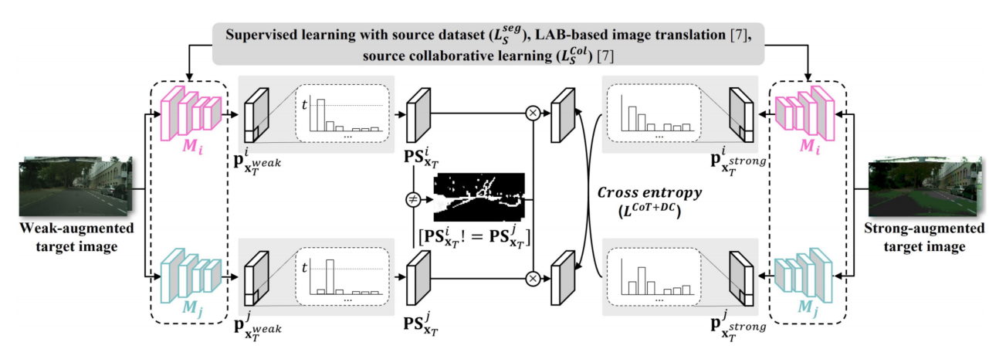
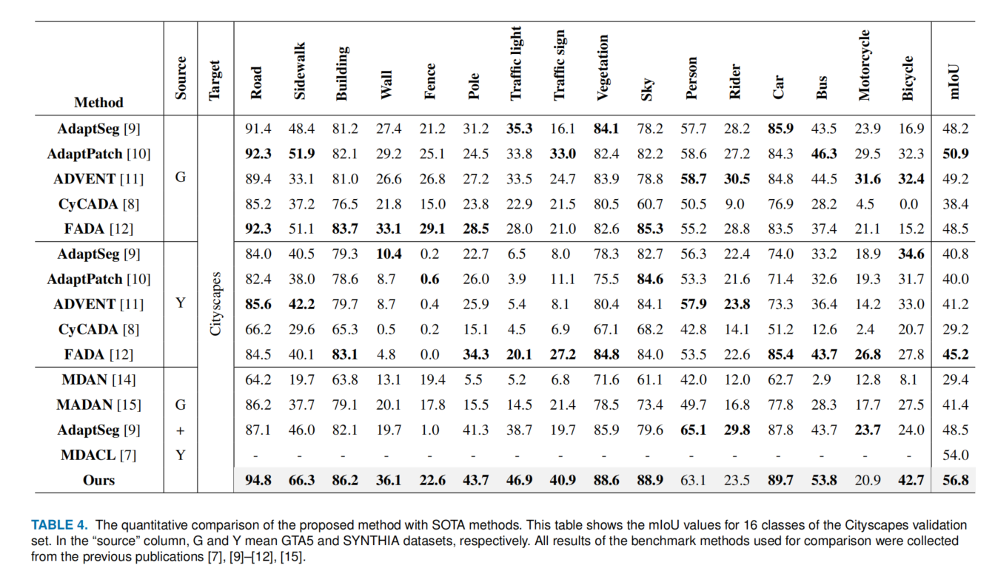
Pseudo Label Rectification via Co-teaching and Decoupling for Multi-source Domain Adaptation in Semantic Segmentation
pseudo label-oriented coteaching trains multiple models by using pseudo labels from the peer model without any integration of pseudo labels.
pseudo label decoupling method is proposed for rectification of pseudo labels, which updates the models with two pseudo labels only if they disagree.
Notes:
它会对target生成两种增强数据，弱增强的数据用来得到预测的标签，强增强的数据用来计算交叉熵。这给出了一致性正则化效应，使模型对扰动数据进行了一致的预测

Slide 6
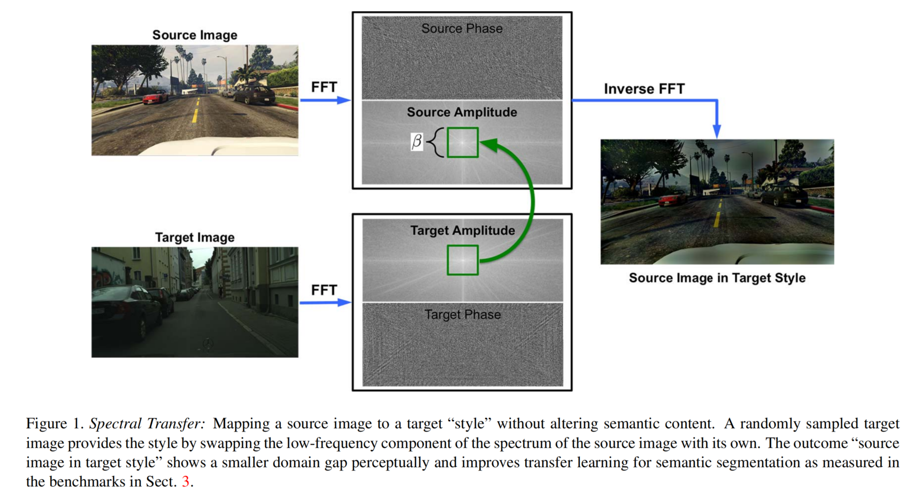
FDA: Fourier Domain Adaptation for Semantic Segmentation
a simple method for unsupervised domain adaptation, whereby the discrepancy between the source and target distributions is reduced by swapping the low frequency spectrum of one with the other.
One simply computes the (Fast) Fourier Transform (FFT) of each input image, and replaces the low-level frequencies of the target images into the source images before reconstituting the image for training, via the inverse FFT (iFFT), using the original annotations in the source domain.
Notes:
这篇论文它提出了在训练前，通过交换两个域的低频谱的方法，来减少源分布和目标分布之间的差异。
它探索了一个假设，即对源和目标分布之间的低水平统计量的简单对齐就可以提高UDA的性能，而不需要在语义分割的主要任务之外的训练。
可以看到这个图所示：简单地计算每个输入图像的（快速）傅里叶变换（FFT），并通过重建训练图像的逆FFT（iFFT）将目标图像的低频率，利用源域的原始注释进行训练。

Slide 7
adversarial learning based
feature level: extract multiple level features
  Learning to Adapt Structured Output Space for Semantic Segmentation
  A Local–Global Framework for Semantic Segmentation of Multisource Remote Sensing Images (not adversarial learning)
image level: image style transfer
  DAugNet: Unsupervised, Multisource, Multitarget,and Life-Long Domain Adaptation for Semantic Segmentation of Satellite Images
  MDANet: Unsupervised, Mixed-Domain Adaptation for Semantic Segmentation of Remote Sensing Images

Slide 8
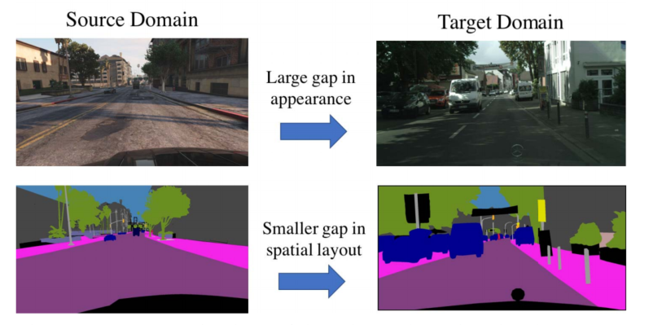
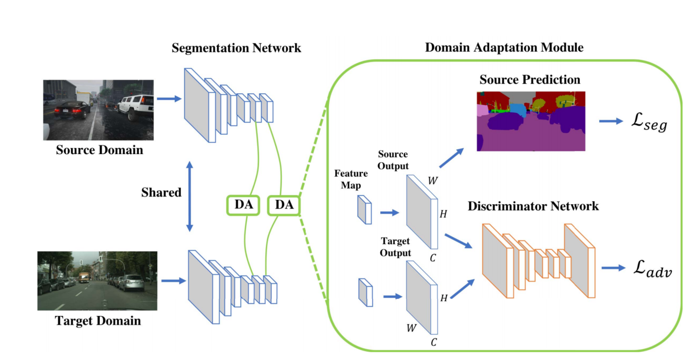
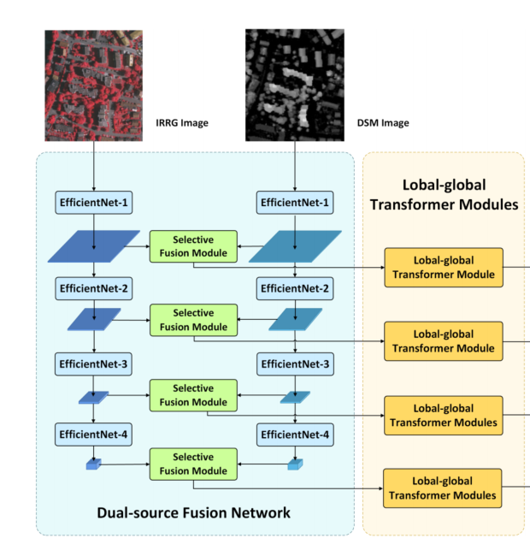
feature level: extract multiple level features
Learning to Adapt Structured Output Space for Semantic Segmentation
Considering semantic segmentations as structured outputs that contain spatial similarities between the source and target domains, we adopt adversarial learning in the output space.
A Local–Global Framework for Semantic Segmentation of Multisource Remote Sensing Images
The dual-source fusion network is an encoder designed to extract features from multiple sources such as spectra, synthetic aperture radar, and elevations, which selective fuse features from multiple sources and reduce the interference of redundant features.
Notes:
一些研究发现，虽然图像在外观上可能非常不同，但它们的输出是结构化的，并且有许多相似之处，如空间布局和局部环境。
左边这篇论文认为语义分割就是为源域和目标域之间空间相似性的结构化输出，因此在输出空间中采用对抗学习，将误差从输出标签反向传播到特征级。然而，一个值得关注的问题是，较低级别的特征可能不能很好地适应，因为它们远离较高级别的输出标签。为了解决这个问题，论文构建了一个多层对抗网络，以有效地在分割模型的不同特征层次上执行输出空间域的自适应。为了解决这个问题，我们开发了一个多层次的策略，通过在分割模型的不同特征层次上结合对抗性学习。
右边这篇论文提出了DFNet，是一种新型的双源特征融合结构，利用两种efficientNet-B2模型提取这两种图像的多层特征，并通过中间的SFM模块融合各层次的特征。这样可以有效地利用右边图像所反映的邻域间的空间信息，减少左边图像中阴影造成的不准确预测，并从多源图像中充分捕获纹理细节和空间特征。

Slide 9
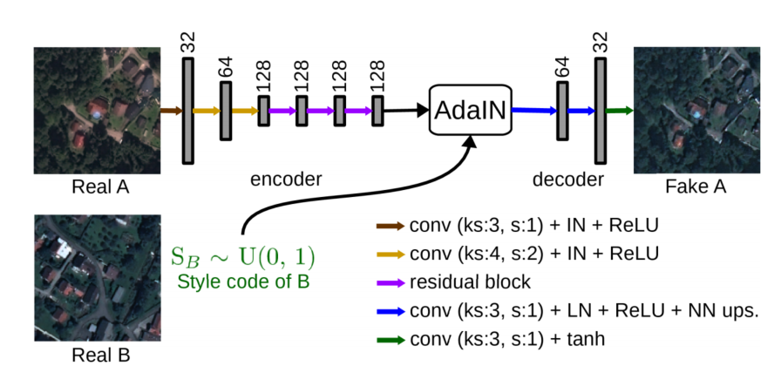
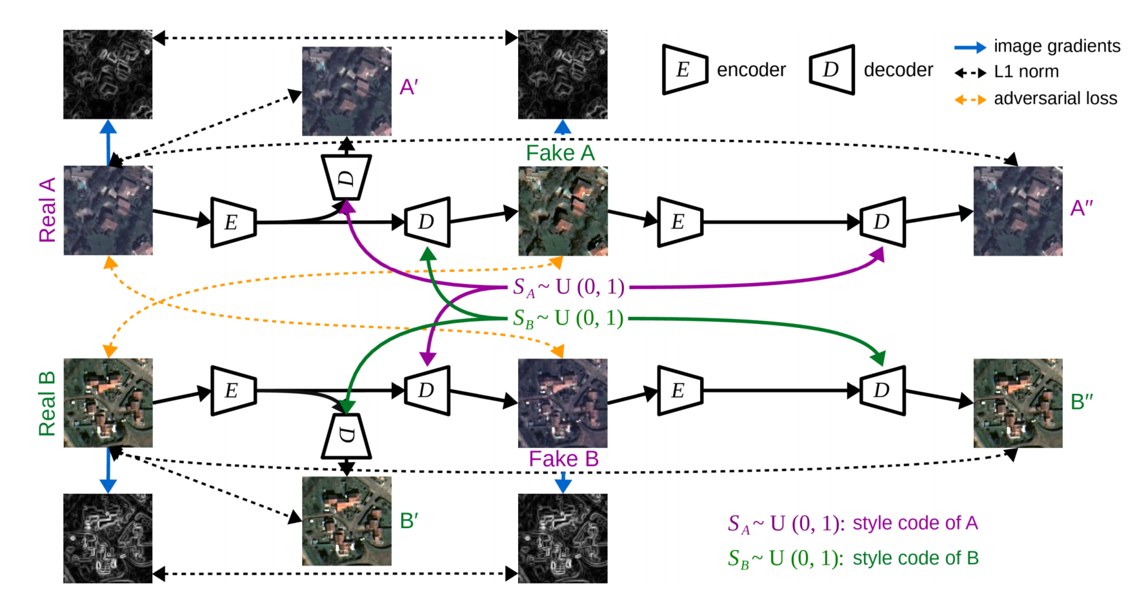


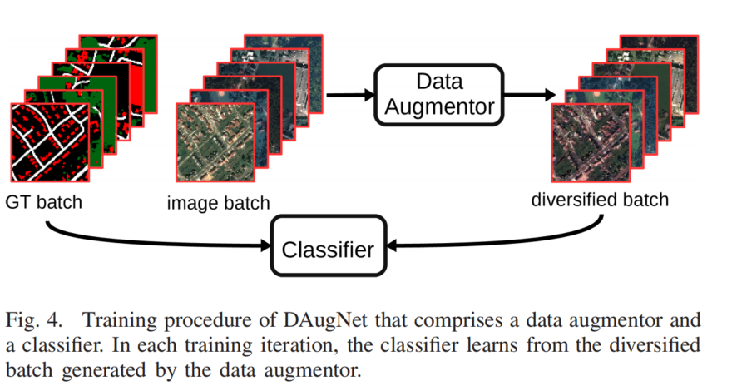
image level: image style transfer
  DAugNet: Unsupervised, Multisource, Multitarget,and Life-Long Domain Adaptation for Semantic Segmentation of Satellite Images
proposed training pipeline consists of two stages. In the first stage, we learn how to stylize each domain like any other using only one encoder, one decoder, and one discriminator.
in the second stage, we train DAugNet that is composed of the data augmentor and a classifier.
Notes:
这篇论文提出了一种可以通过一个编码器、一个解码器和一个鉴别器在多个域之间执行风格转换的方法，由于网络的数量是恒定的，而不管域的数量，这个方法可以跨多个域进行样式转移，即使逐步添加新的域。这部分是无监督的，使用了对抗性学习的方法。
其中生成器的损失函数除了本身的损失值之外，还新加了以下几个。一个是对fakeA用fakeB的style重建得到的A”和A的损失值cross，一个是对编码后的A用A本身的样式转换后的A’和A的损失值self，最后就是fakeA和A的纹理特征的损失值edge。它将这几个的和作为生成器最终的损失值。
它还提出了由数据增强器和分类器组成的新型DAugNet。在DAugNet的每次训练迭代中，数据增强器被冻结，并通过将该批中的每个补丁随机样式化为一个随机选择的域，使从源域采样的一批补丁多样化。然后将多样化的批处理提供给分类器。该域可以在源域和目标域中随机选择。因此，当训练DAugNet时，分类器会从所有源域和目标域的数据中学习。

Slide 10
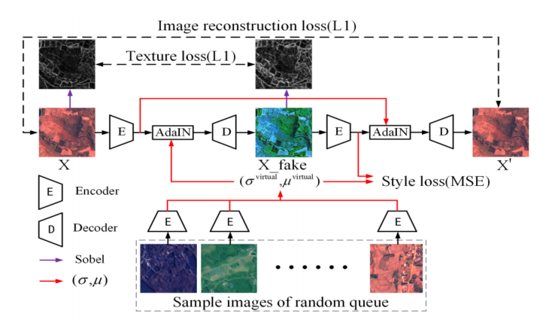
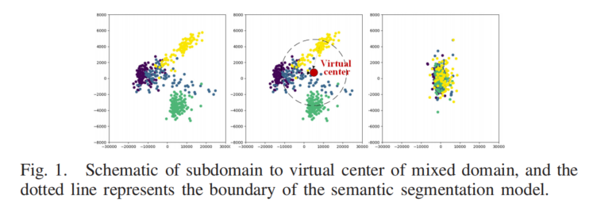
MDANet: Unsupervised, Mixed-Domain Adaptation for Semantic Segmentation of Remote Sensing Images
image level: image style transfer
proposed a novel and concise method, a lightweight and self-supervised network mixed-DA network (MDANet)
for the adaptation of patch images of multisource and multitarget domains and for reducing the distribution differences of different patch images by projecting them onto the virtual center of a mixed domain.
Notes:
在domain adaptation里，传统的想法就是对源域和目标域有一个精确划分，但这篇论文它将源域和目标域的样本图像（即一组图像补丁）视为一个混合域。假设混合域服从于一个分布，希望能够自动学习该分布的虚中心，然后将补丁图像从子域投影到虚拟中心，间接减少了每个子空间的分布差异。
这篇论文它提出了一个轻量级和自我监督的网络MDANet，通过将不同域的补丁图像投影到混合域的虚拟中心来减少不同补丁图像的分布差异
在style transfer这部分和上篇论文的方法比较类似。

Slide 11
entropy minimization
ADVENT: Adversarial Entropy Minimization for Domain Adaptation in Semantic Segmentation
Unsupervised Domain Adaptation for Semantic Segmentation via Low-level Edge Information Transfer
FDA: Fourier Domain Adaptation for Semantic Segmentation

Slide 12
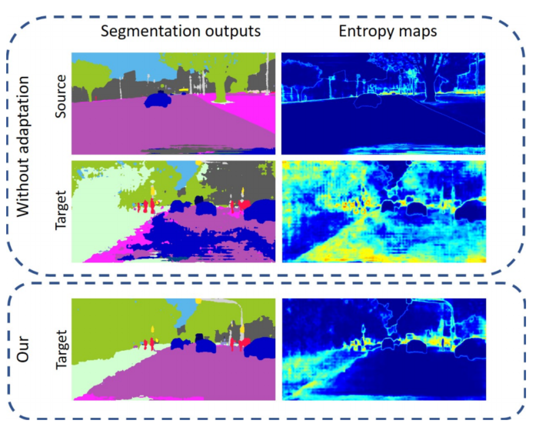
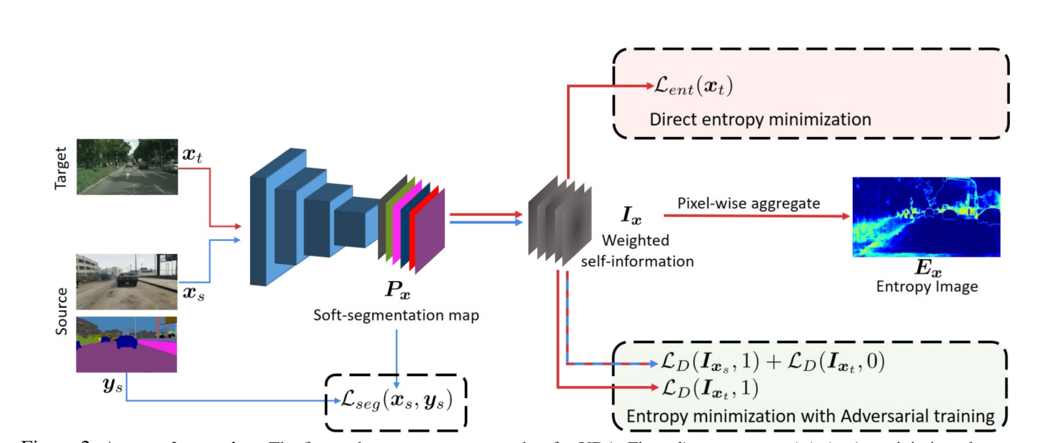



ADVENT: Adversarial Entropy Minimization for Domain Adaptation in Semantic Segmentation
entropy minimization
start from a simple observation: models trained only on source domain tend to produce over-confident(i.e., low-entropy) predictions on source-like images and under-confident(i.e., high-entropy) predictions on target-like ones.
propose two approaches: direct entropy minimization using an entropy loss and indirect entropy minimization using an adversarial loss.
During training, we jointly optimize the supervised segmentation loss Lseg on source samples and the unsupervised entropy loss Lent on target samples.
Notes:
论文发现只在源域上训练的模型往往对类源图像的预测会低熵，而对类目标图像的预测则会高熵。如图所示，来自源域的场景的预测熵图看起来像边缘检测结果，只有沿着对象边界有高熵激活。而对目标图像的预测则不太确定，导致噪声非常大，高熵输出。因此论文认为，减小源和目标之间的域差距的一种可能的方法是通过对目标预测施加高预测确定性（低熵）约束。为此，我们提出了两种方法：使用熵损失的直接熵最小化和使用对抗性损失的间接熵最小化。第一种方法对独立的像素级预测施加低熵约束，在训练过程中，共同优化了源样本的监督分割损失Lseg和目标样本的无监督熵损失ent。而后者的目标是根据加权自信息来全局匹配源分布和目标分布。

Slide 13
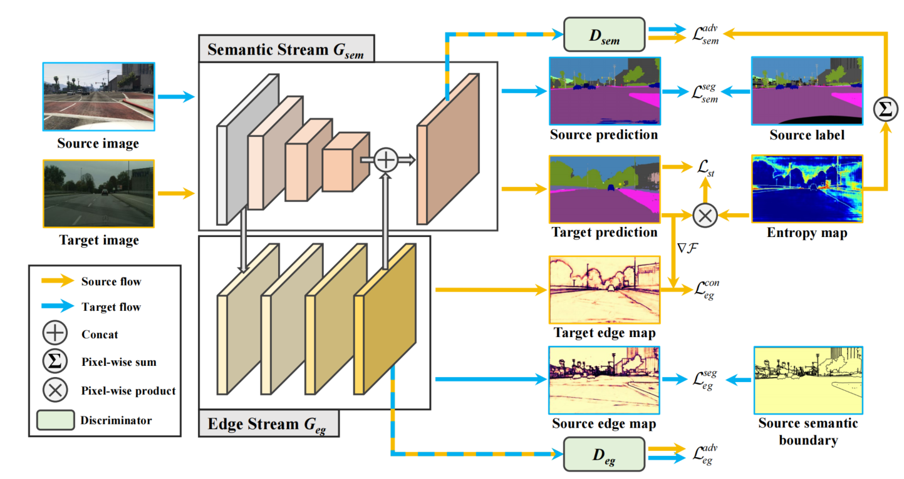
Unsupervised Domain Adaptation for Semantic Segmentation via Low-level Edge Information Transfer
entropy minimization
Notes:
这篇论文就在语义分割模块使用了熵最小化约束

Slide 14
two network
Unsupervised Domain Adaptation for Semantic Segmentation via Low-level Edge Information Transfer
False Negative Reduction in Semantic Segmentation under Domain Shift using Depth Estimation

Slide 15
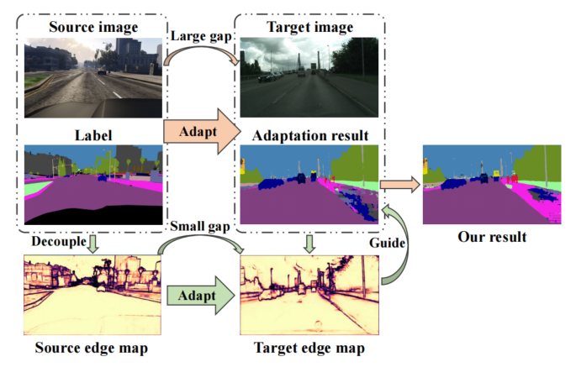
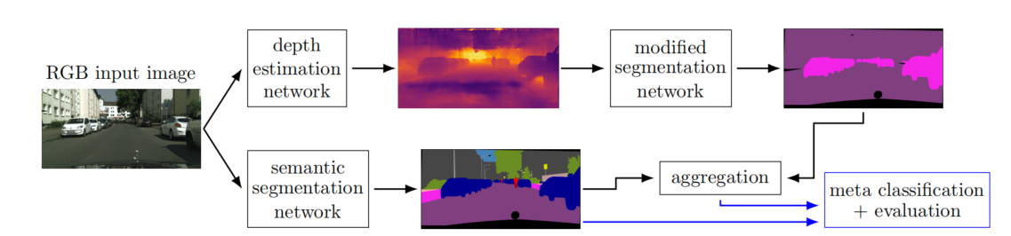
False Negative Reduction in Semantic Segmentation under Domain Shift using Depth Estimation
two network
Unsupervised Domain Adaptation for Semantic Segmentation via Low-level Edge Information Transfer
the goal of depth estimation is to obtain a representation of the spatial structure of a given scene, which can help to bridge domain gaps
infer a depth heatmap via a modified segmentation network which generates foreground-background masks, operating in parallel to a given semantic segmentation network.
the large domain gap between source and target domains in the high-level semantic features makes accurate adaptation difficult
present the first attempt at explicitly using low-level edge information to guide the transfer of semantic information
Notes:
左边这篇论文引入了深度估计以减少前景物体的假阴性。它除了进行通常的语义分割外，还并行进行了前景背景分割。其中深度估计的目标是获得给定场景的空间结构的表示，这有助于弥合域差距。所得到的深度热图被传递到一个改进的分割网络，以预测前景-背景分割。
右边这篇论文：
以往的特征级对抗性学习方法只考虑对高级语义特征的自适应模型。然而，在高级语义特征中，源域和目标域之间的域差距很大，使得准确的适应变得困难。这篇论文尝试显式地使用具有较小域间间隙的低级边缘信息来指导语义信息的传输并行进行了边缘分割。提出了一种语义-边缘域自适应架构，利用独立的边缘流来处理边缘信息，从而在目标域上生成高质量的语义边界。

Slide 16
thanks

