Slide 1
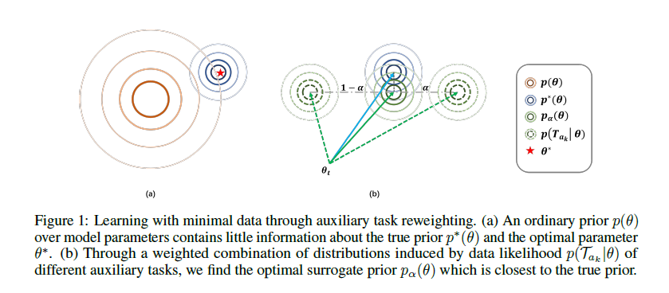
Paper: Auxiliary Task Reweighting for Minimum-data Learning
Notes:
先单个transfer然后选择整合+蒸馏
Baseline: multi-task learning

Slide 2




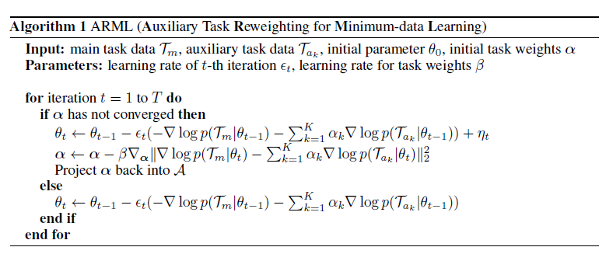
Paper: Auxiliary Task Reweighting for Minimum-data Learning
→
→
→
Notes:
先单个transfer然后选择整合+蒸馏
Baseline: multi-task learning

