Slide 1
Adversarial Discriminative Domain Adaptation
思路：把分布不同的源域和目标域的数据，映射到一个特征空间中，使其在该空间中的距离尽可能近，即可直接用源域的分类器对目标域进行分类
和生成对抗网络相比，域适应问题免去了生成样本的过程，直接将目标域中的数据看作生成的样本。因此，生成器的目的发生了变化，不再是生成样本，而是扮演了一个特征提取（feature extractor）的功能：如何从源域和目标域中提取特征，使得判别器无法区分提取特征是来自源域，还是目标

Slide 2
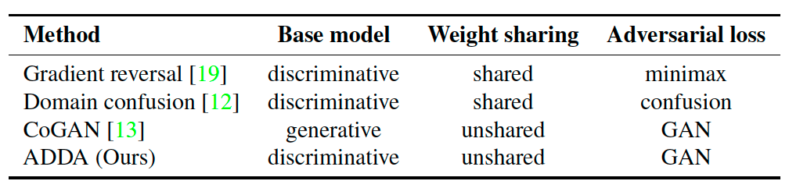
Whether to use a generative or discriminative base model
Whether to tie or untie the weights (symmetric/asymmetric)
Which adversarial learning objective to use

Slide 3
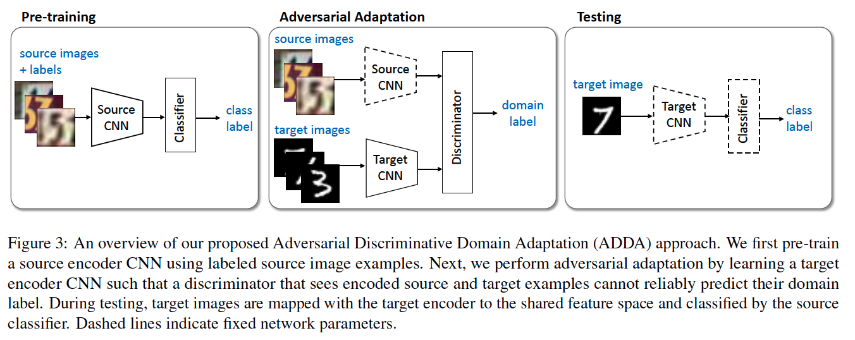
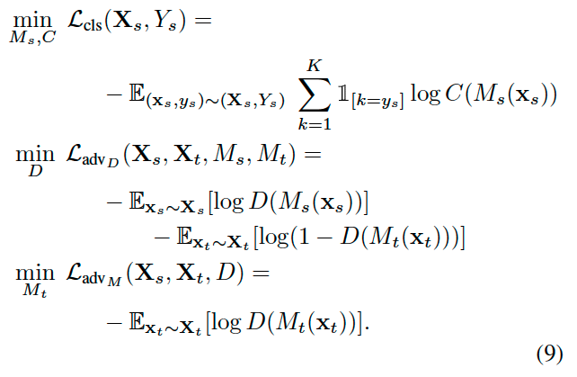
Ms
Mt
D
Mt
C
Ms
C

Slide 4
Adversarial domain adaptation

Slide 5
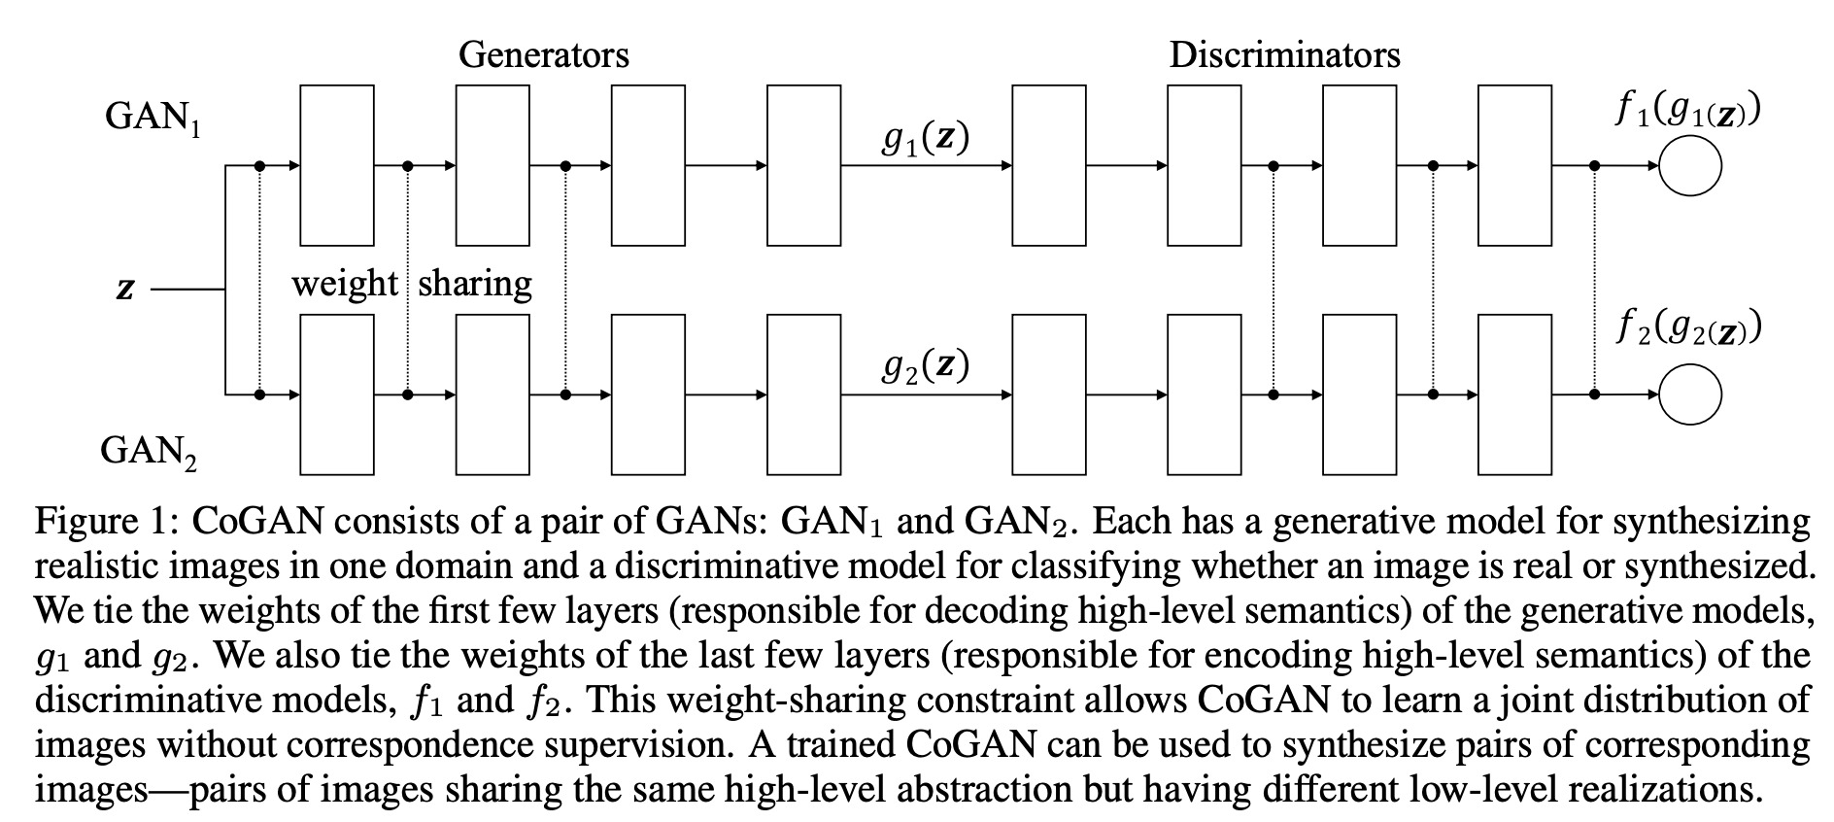
通过与判别器的对抗，生成器将源域和目标域数据在数据空间或者特征空间对齐
判别器作用在数据空间
  Coupled generative adversarial networks (CoGAN)
  Pixel-level domain transfer
  Learning from simulated and unsupervised images through adversarial training
  Unsupervised pixel-level domain adaptation with generative adversarial networks
  ...

Slide 6
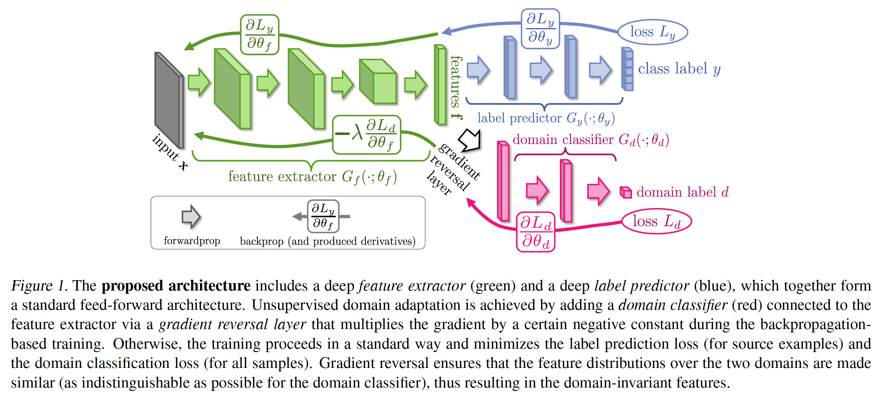
判别器作用在特征空间
  Unsupervised domain adaptation by backpropagation (DANN)
  Adversarial discriminative domain adaptation (ADDA)
  …

