Slide 1


Adversarial discriminative domain adaptation
Eric Tzeng, CVPR 2017
Presenter: LIU Hanbing

Slide 2

Content
Background
Methodology
  Generalized adversarial adaptation
  Adversarial discriminative domain adaptation (ADDA)
Experiments
Conclusion

Slide 3
Background
Data bias or domain shift
  Definition: Training dataset’s distribution is different from testing dataset
  Problem: do not generalize well to novel datasets and tasks
  Solution: fine-tune (expensive and time-consuming)
Notes:
When training deep neural networks, there is a common problem called data bias or domain shift which means training dataset’s distribution is different from testing dataset. Due to this phenomenon, models trained on one large dataset do not generalize well to new datasets and tasks. The typical solution is to further fine-tune these networks on target datasets.

Slide 4
Background
Domain adaptation
  map both domains into a common feature space
Adversarial adaptation methods
  minimize an approximate domain discrepancy distance through an adversarial objective with respect to a domain discriminator
Notes:
Domain adaptation methods attempt to reduce the harmful effects of domain shift. It map both domains into a common feature space. One type of domain adaptation is adversarial adaptation methods.

Slide 5
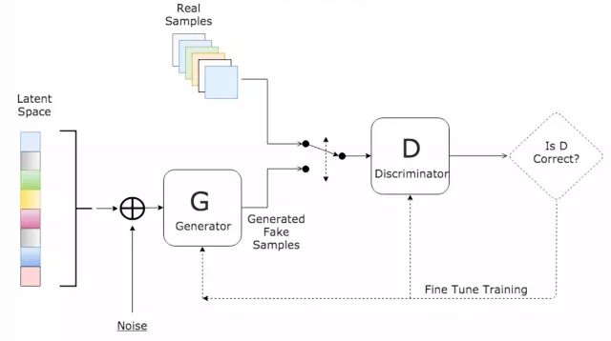
Generative adversarial networks (GAN)
Generator: generate fake data which distribution is as close as real data
Discriminator: distinguish fake data from real data
Notes:
GAN consists of a generator and a discriminator

Slide 6
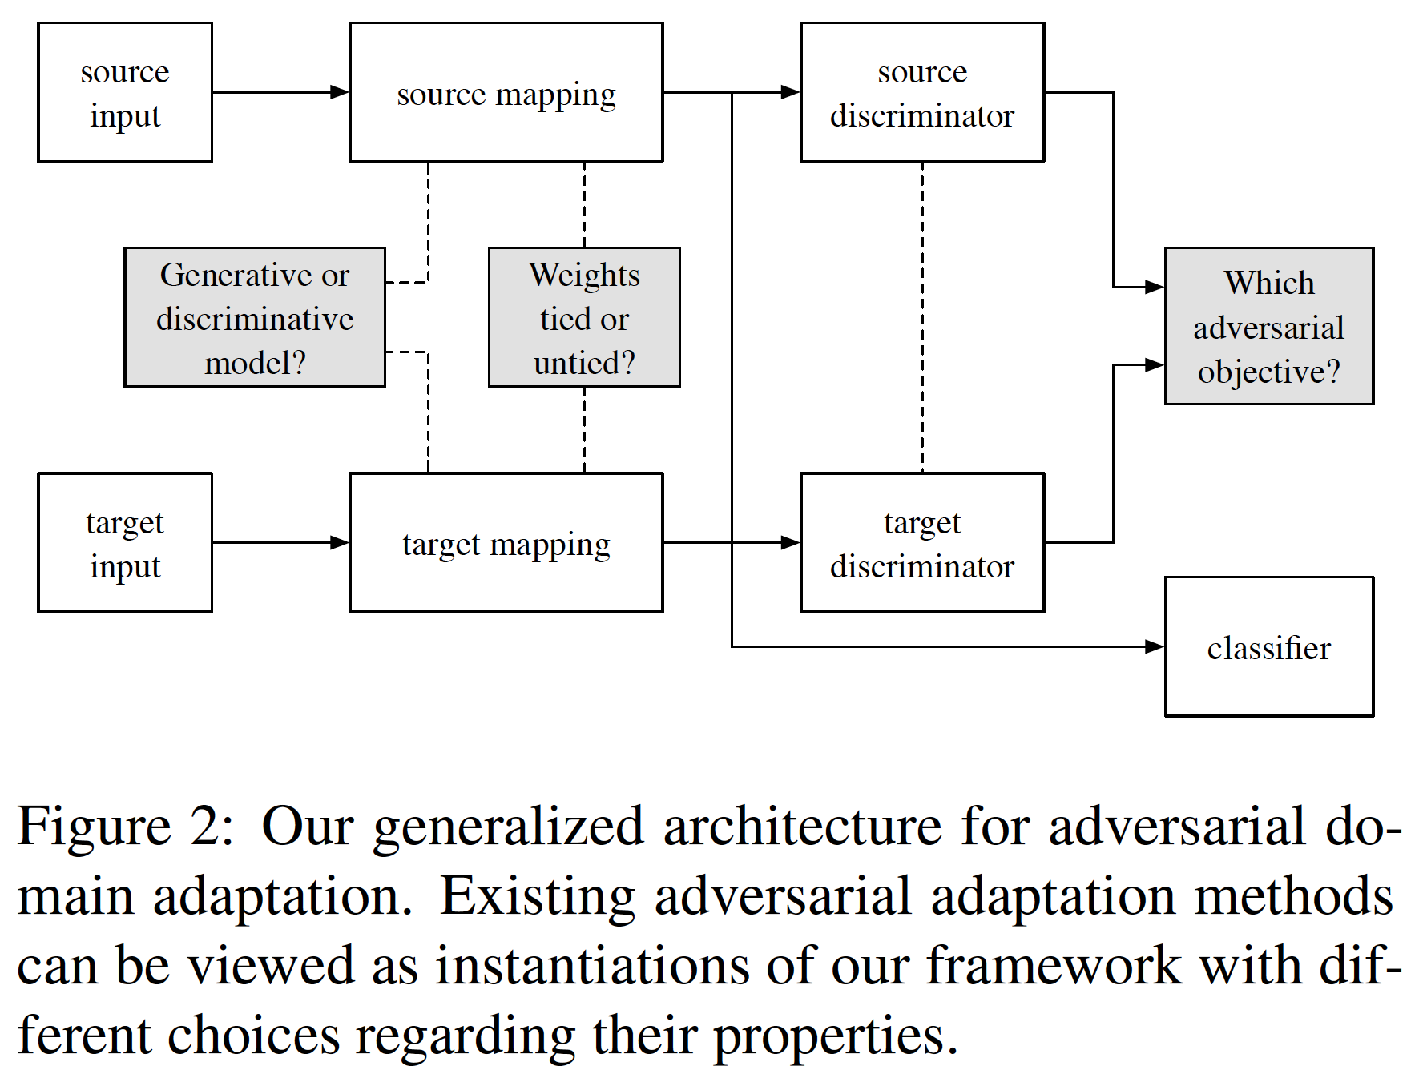
Methodology
Propose a novel unified framework for adversarial domain adaptation
whether to use a generative or discriminative base model
whether to tie or untie the weights
which adversarial learning objective to use
Notes:
each algorithm makes different design choices such as whether to use a generator, which loss function to employ, or whether to share weights across domains.

Slide 7
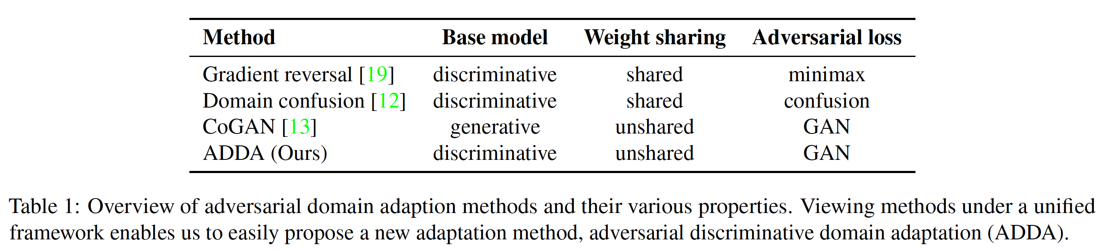
Methodology
Discriminative - discriminative adaptation tasks
Untying weights - more flexible
GAN loss - similar to the original GAN setting
Notes:
Discriminative base model: it doesn’t require to generate convincing in-domain samples.
Untying weights: it allows more domain specific feature extraction to be learned.
The benefit of this unified framework for adversarial domain adaptation is that it allow us to effectively figure out the difference and similarities between the existing approaches and we can directly find the potential improvement of new adaptive methods.

Slide 8
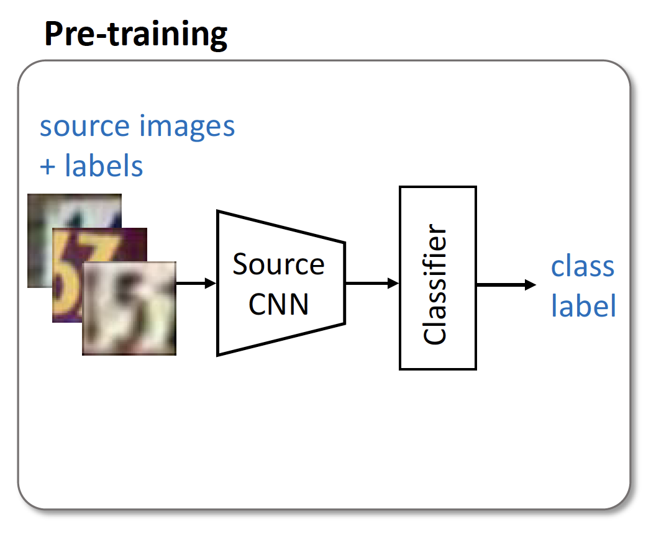
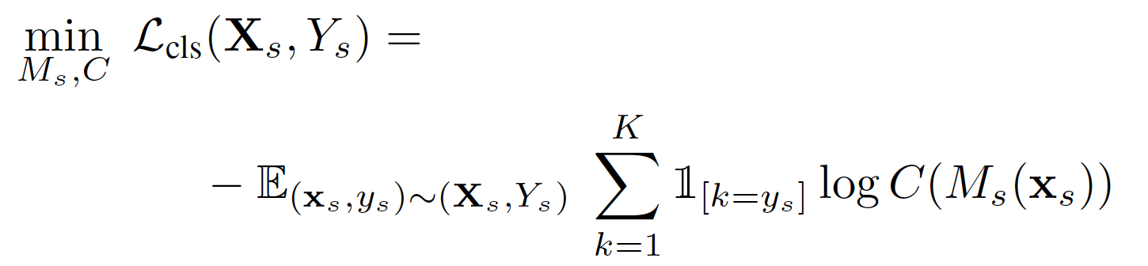
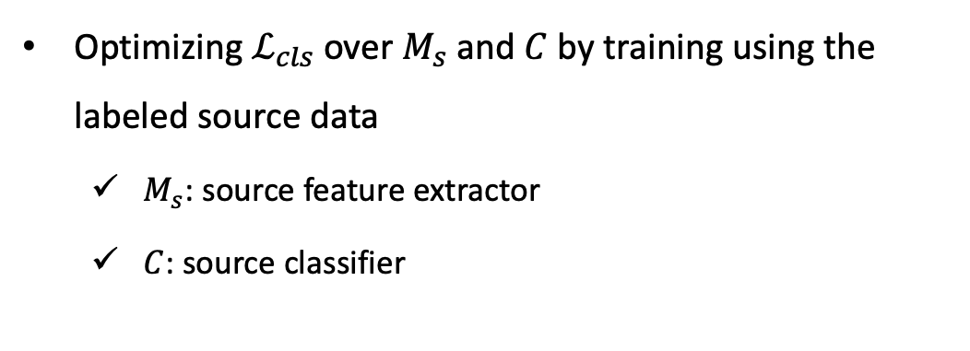
ADDA
Optimizing $ℒ_{cls}$ over $M_{s}$ and $C$ by training using the labeled source data
  $M_{s}$: source feature extractor
  $C$: source classifier
Notes:
After the framework is determined, firsly we optimizing

Slide 9
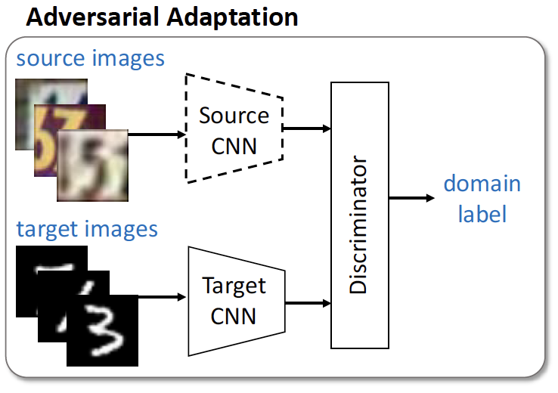
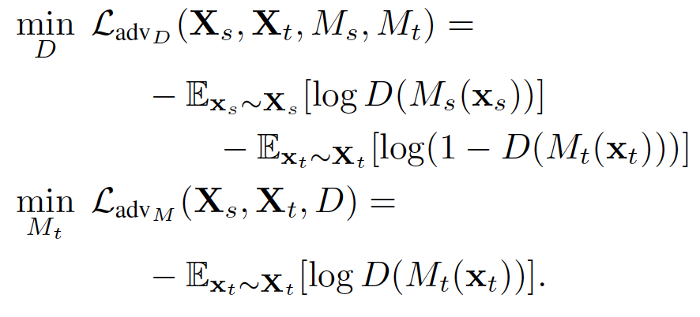
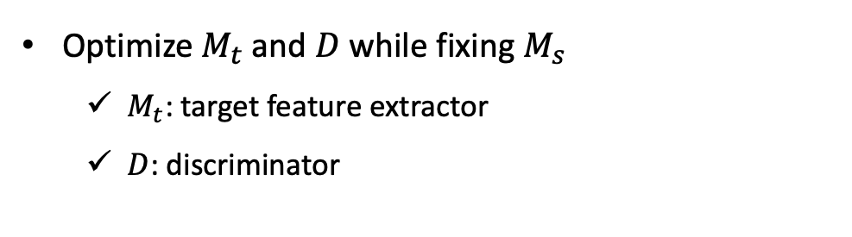
ADDA
Optimize $M_{t}$ and $D$ while fixing $M_{s}$
  $M_{t}$: target feature extractor
  $D$: discriminator
Notes:
After source model is trained, it enters the adversarial adaptation step.

Slide 10
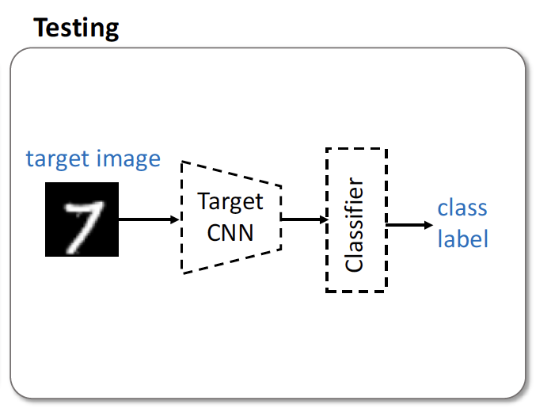
ADDA
Target images are mapped with the target encoder to the shared feature space and classified by the source classifier

Slide 11
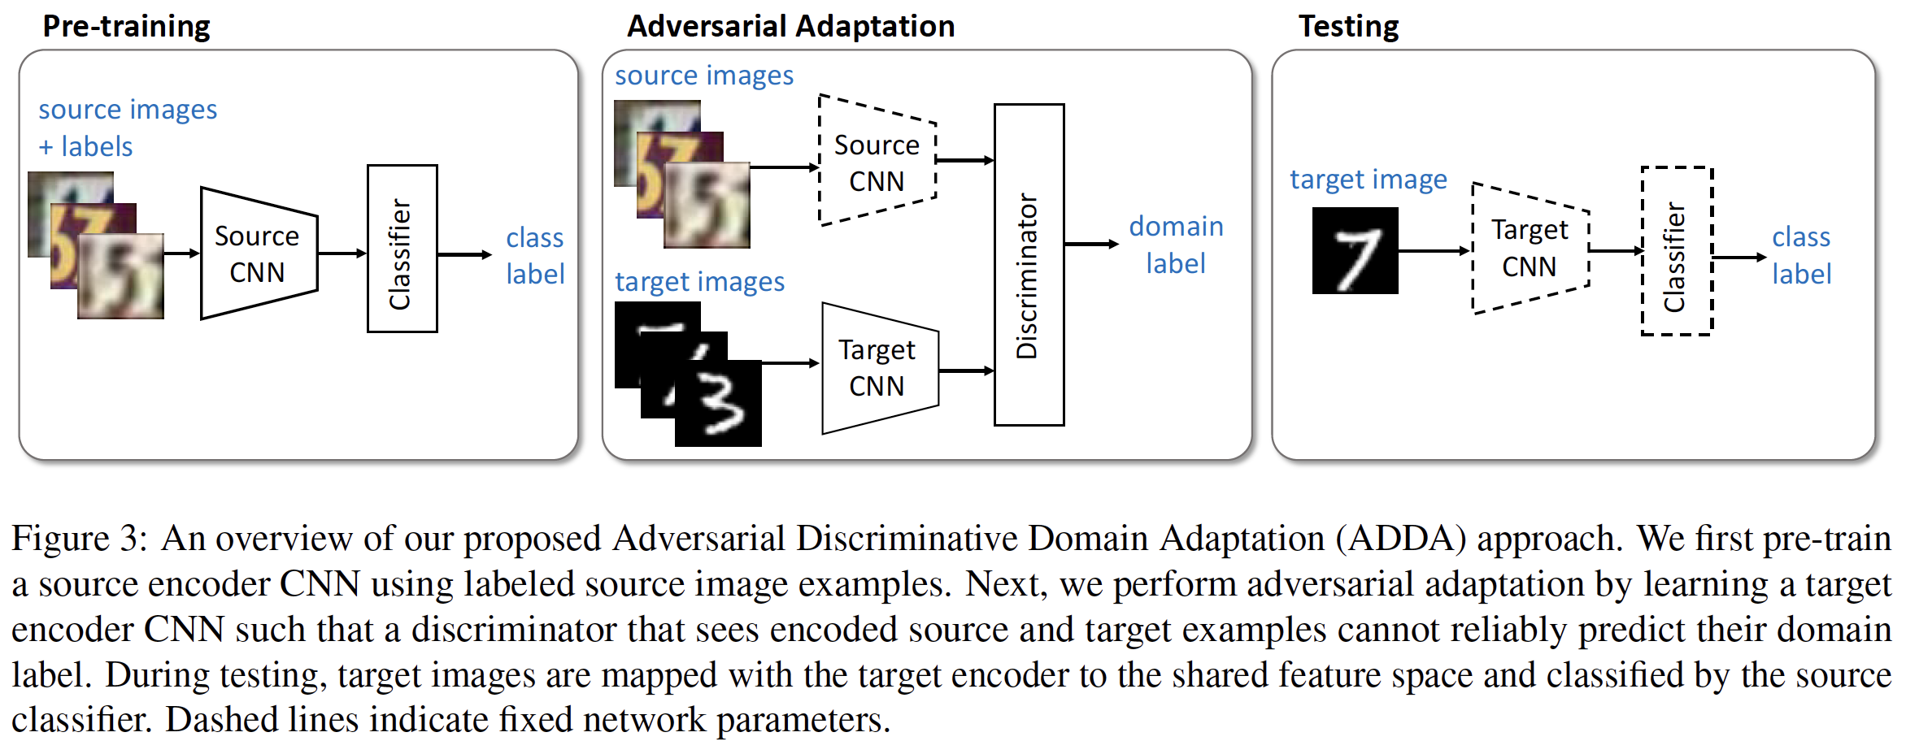
ADDA

Slide 12
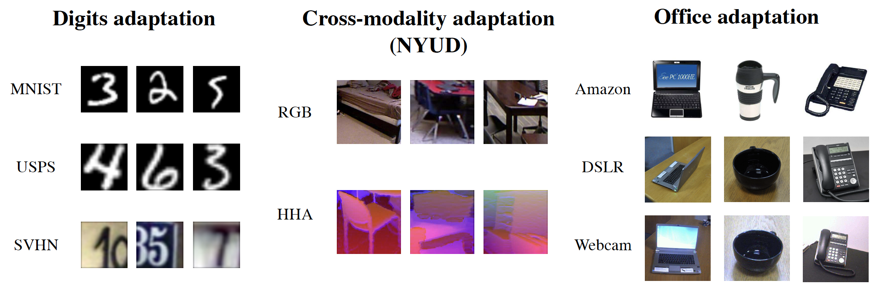
Experiments
Three digits datasets of varying difficulty: MNIST, USPS, and SVHN digits datasets
Cross-modality adaptation: the task of adaptation between RGB and depth images
Real-world adaptation tasks: Office visual domain adaptation dataset

Slide 13
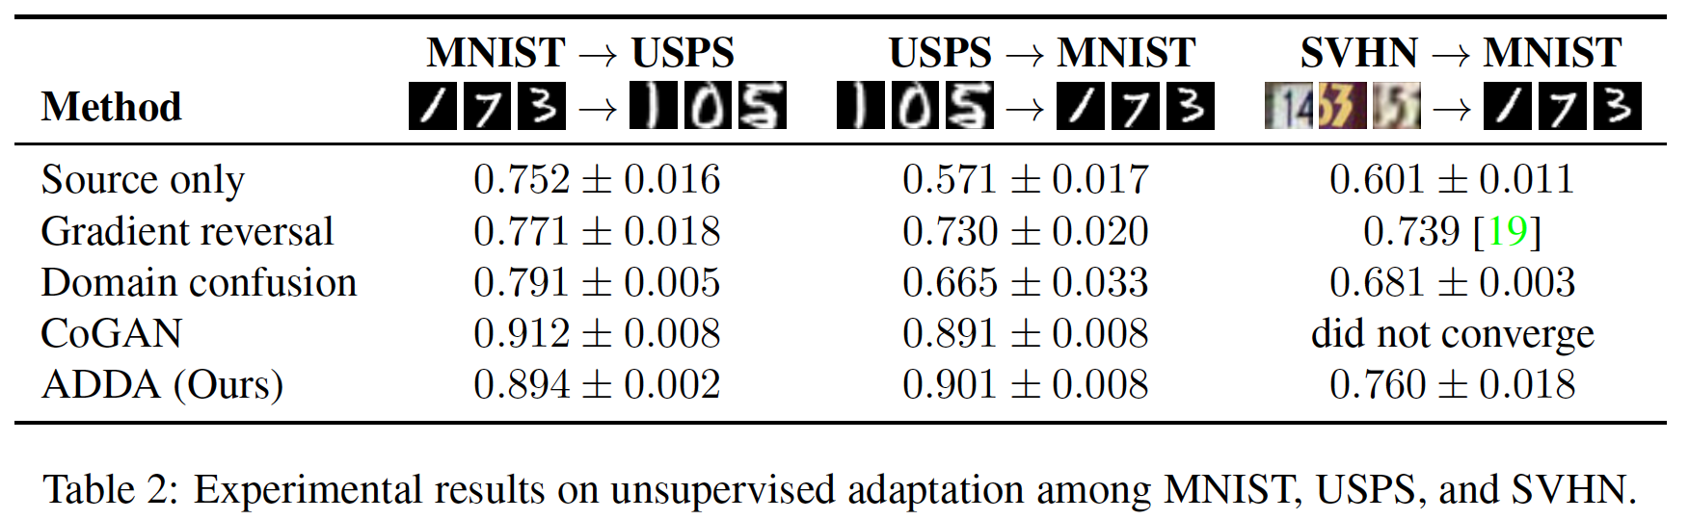
Experiments
Notes:
The paper considers adaptation in three directions

Slide 14
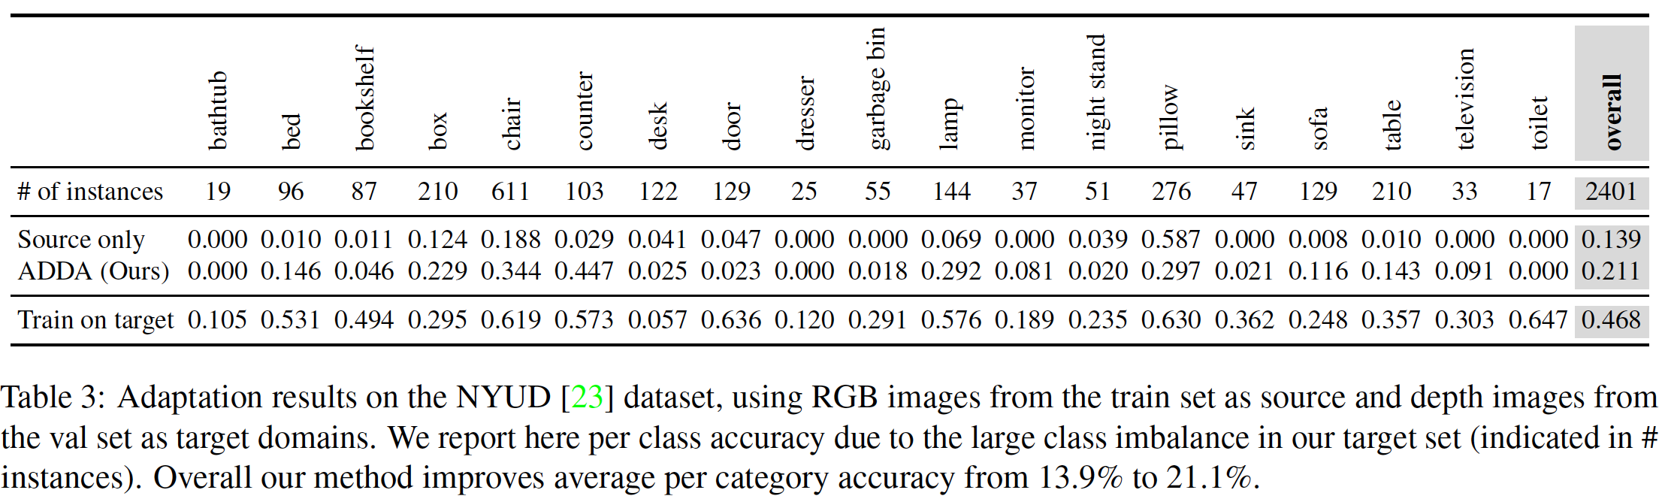
Experiments

Slide 15
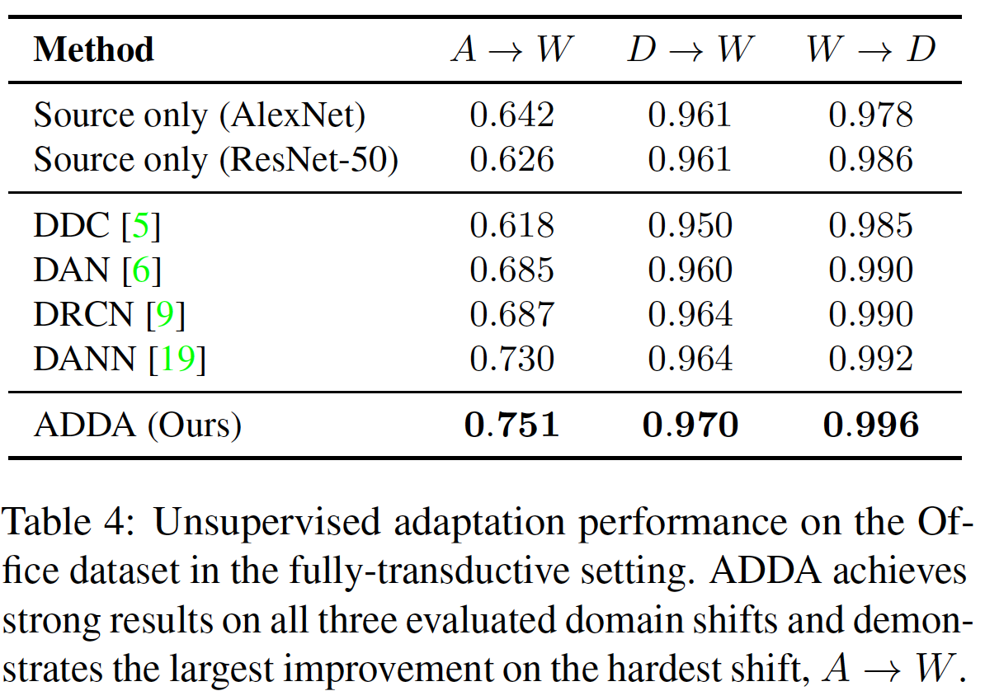
Experiments

Slide 16
Conclusion
Proposed a unified framework for unsupervised domain adaptation
Propose a new adaptation method, ADDA
Experiments on standard domain adaptation tasks as well as a difficult cross-modality object classification task

Slide 17
Thank you for listening!

