Slide 1
A Geometric Analysis of Neural Collapse with
Unconstrained Features
2023.06.21
Presenter: Yanru Wu

Slide 2
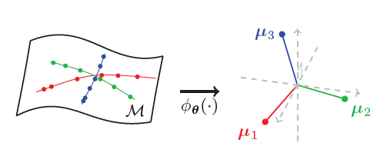
Background
Neural Collapse
• Variability Collapse: cross-example within-class variability of last-layer features collapses to zero, as the individual features of each class themselves concentrate to their isolated class-means.
• Convergence to Simplex Equiangular Tight Frame (ETF): the class-means centered at their global mean are not only linearly separable, but are actually maximally distant and located on a sphere centered at the origin up to scaling
• Convergence to Self-duality: the last-layer linear classifiers, living in the dual vector space to that of the class-means, are perfectly matched with their class-means.
• Simple Decision Rule: the last-layer classifier is behaviorally equivalent to a Nearest Class-Center decision rule.

Slide 3
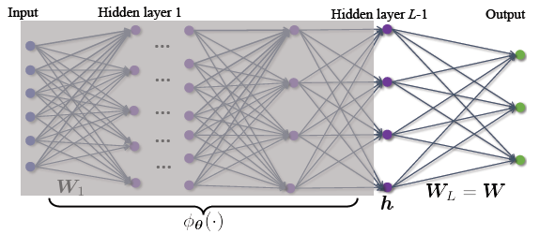
Background
Unconstrained Feature Model
In the last-layer, features are modeled as free optimization variables (hence unconstrained features) along with the last-layer classifiers
The model simplifies the study of last-layer features, enabling us to analyze the interaction between them and the last-layer classifiers, while still left with a highly nonconvex training loss.
Key Question: Whether Simplex ETFs (i.e.,NC) are global solutions to the nonconvex loss (e.g. least- squared, cross-entropy … )?
  Proved by recent work with extra assamptions
  or different constraints on the weights and
  features introduced
  Limitations: (1) only characterizing optimality
  conditions is not enough to explain the empirical
  convergence of iterative algorithms to NC; (2) the
  problem formulations differ from those typically
  used in practice
Notes:
which deploy norm regularization (i.e., weight decay) on the weights, rather than enforcing constraints, for the ease of optimization

Slide 4
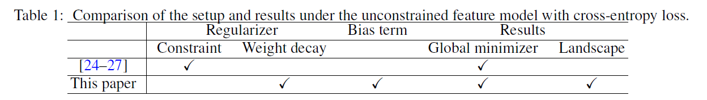
Contributions
Benign Global Landscape. For the unconstrained feature model, we provide the first result showing that a commonly used, regularized cross-entropy loss is a strict saddle function.
Efficient, Algorithmic Independent, Global Optimization. The benign global landscape implies that any method that can escape strict saddle points (e.g. stochastic gradient descent) converges to a global solution that exhibits NC.
Cost Reduction for Practical Network Training. Moreover, the universality of NC implies that there is no need of training the last-layer classifiers since the weights can be simply fixed as a Simplex ETF throughout the training process. On the other hand, since NC happens whenever d ≥ K, this implies that we can choose the feature dimension d comparable to the number of classes K, reducing the feature dimension for further computational benefits.
Notes:
In other words, every critical point is either a global solution (corresponding to Simplex ETFs) or a strict saddle point with negative curvature, so that there is no spurious local minimizer on the optimization landscape
This result supports our empirical observation that practical overparameterized networks always converge to Simplex ETF solutions with a diverse choice of optimization algorithms.
Our experiments demonstrate that such a strategy achieves on par performance with classical training methods, leading to substantial cost reductions on both memory and computation.

Slide 5
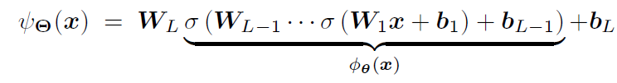

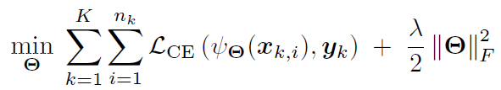



Problem Setup
→ Unconstrained Feature Model

Slide 6
Problem Setup
Discussion
• Weight Decay on W and H
• Treating the Last-layer Features as Optimization Variables

Slide 7
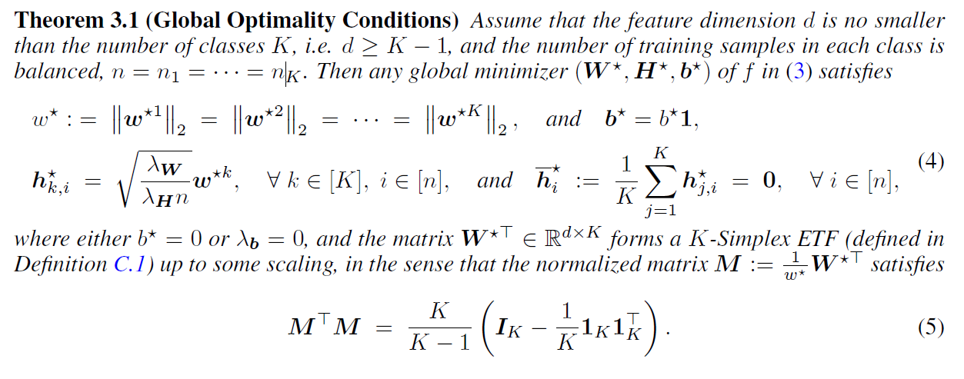
Main Theoretical Results

Slide 8
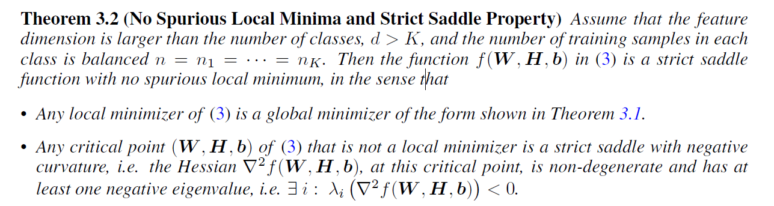
Main Theoretical Results

Slide 9


Experiments
Metrics for Measuring NC During Network Training

Slide 10
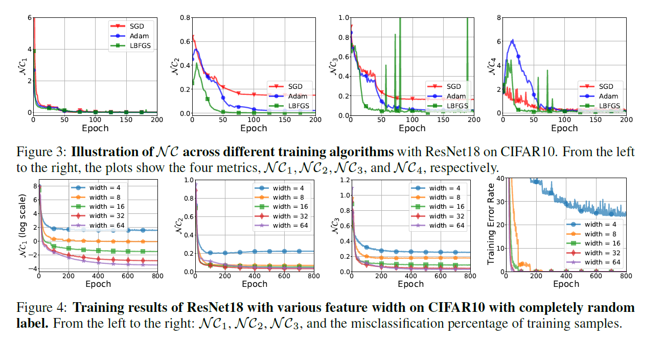
Experiments

Slide 11
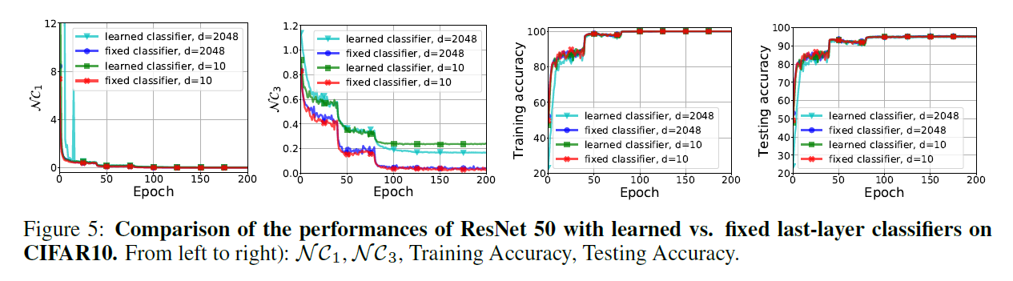
Experiments

Slide 12
Thank you!

