Slide 1
Max-Affine Spline Insights into Deep Network Pruning
Zhao Zixi
2023.08.16

Slide 2
Contribution
Extend the spline theory into a specific area(DN Pruning)
Propose a partition-based metric to quantify the evolution of the partition boundaries during training
Derive an efficient pruning strategy

Slide 3
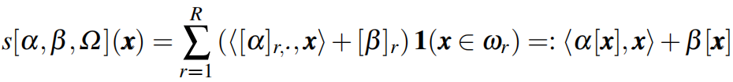
Method (1)
Spline Approximation
· A spline function approximation consists of
· a partition Ω of the input space
· a simple local mapping on each region of th partition
x
Ω

Slide 4

Method (2)
Max-Affine Spline Functions
· It is completely determined by its parameters α and β without needing to specify the partition
(a₁, b₁)
(a₂, b₂)
(a₃, b₃)
(a₄, b₄)

Slide 5
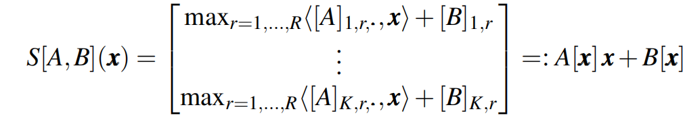
Method (3)
Max-Affine Spline Operators
· By concatenating K independent max-affine spline functions to get MASOs

Slide 6

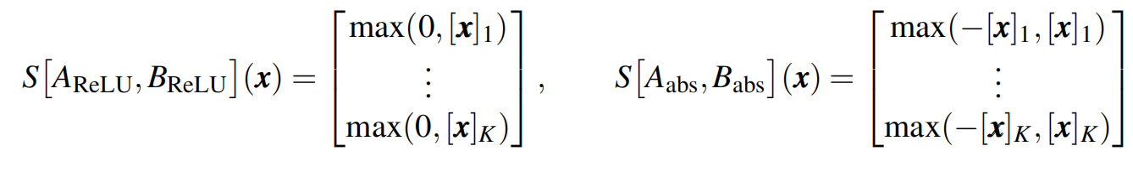
Method (4)
Deep Networks are Compositions of Spline Operators
DN Operators and Layers are MASOs
The ReLU and absolute value activation operators written as MASOs:

Slide 7
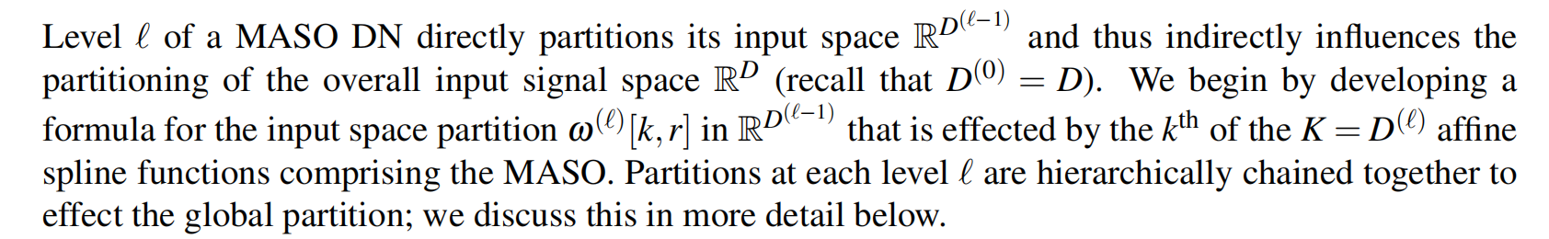
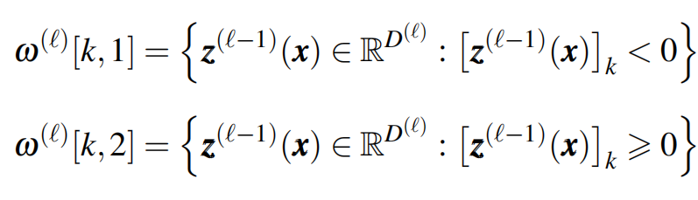
Method (5)
Multiscale Spline Partition Induced by a DN
Using not matched but rather orthogonal templates to improve the performance
· For example, the partition for a ReLU spline can be denoted as:

Slide 8
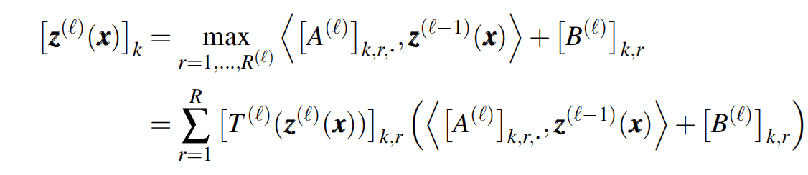
Method (6)
How to Get the Partition
First rewrite the layer calculation S[A,b](x):
Here， is a selection matrix whose k^{th} row comprises a 1-hot selection vector that maximizes [z^{(l)}(x)]_{k} in the k^{th} ouput dimension. Then, we can get the partition:

Slide 9
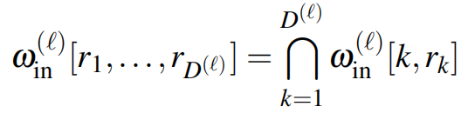
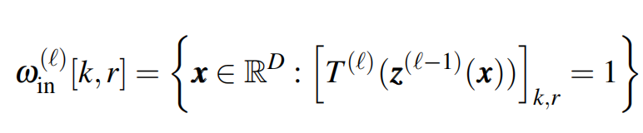
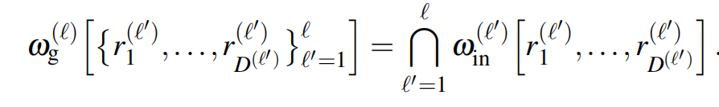
Method (7)
Local Partition in the Input Signal Space
The overall partitioning is simply the intersection of the partitions effected by each of the k = 1,...,D^{(l)} ouput dimensions:
where,
Global Partition in the Input Signal Space

Slide 10
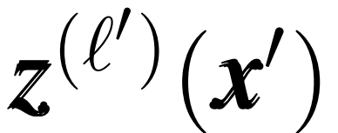
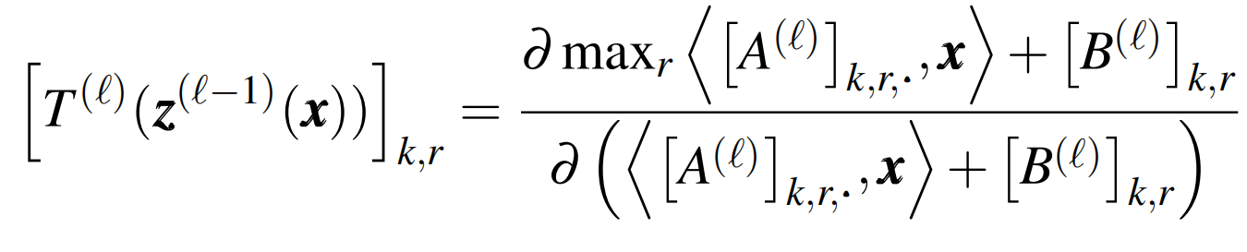
Method (8)
Local Partition in the Input Signal Space
First, sample the overall input signal space to create a collection of inputs {x’}
Second, pass each {x’} through the DN until the desired level l to compute the layer outputs
as well as the selection matrices：
Third, label each {x’} by the region that is selected by selection matrices based on
The finer the sampling of the input space, the more accurate the estimate of the partition region
boundaries.

Slide 11
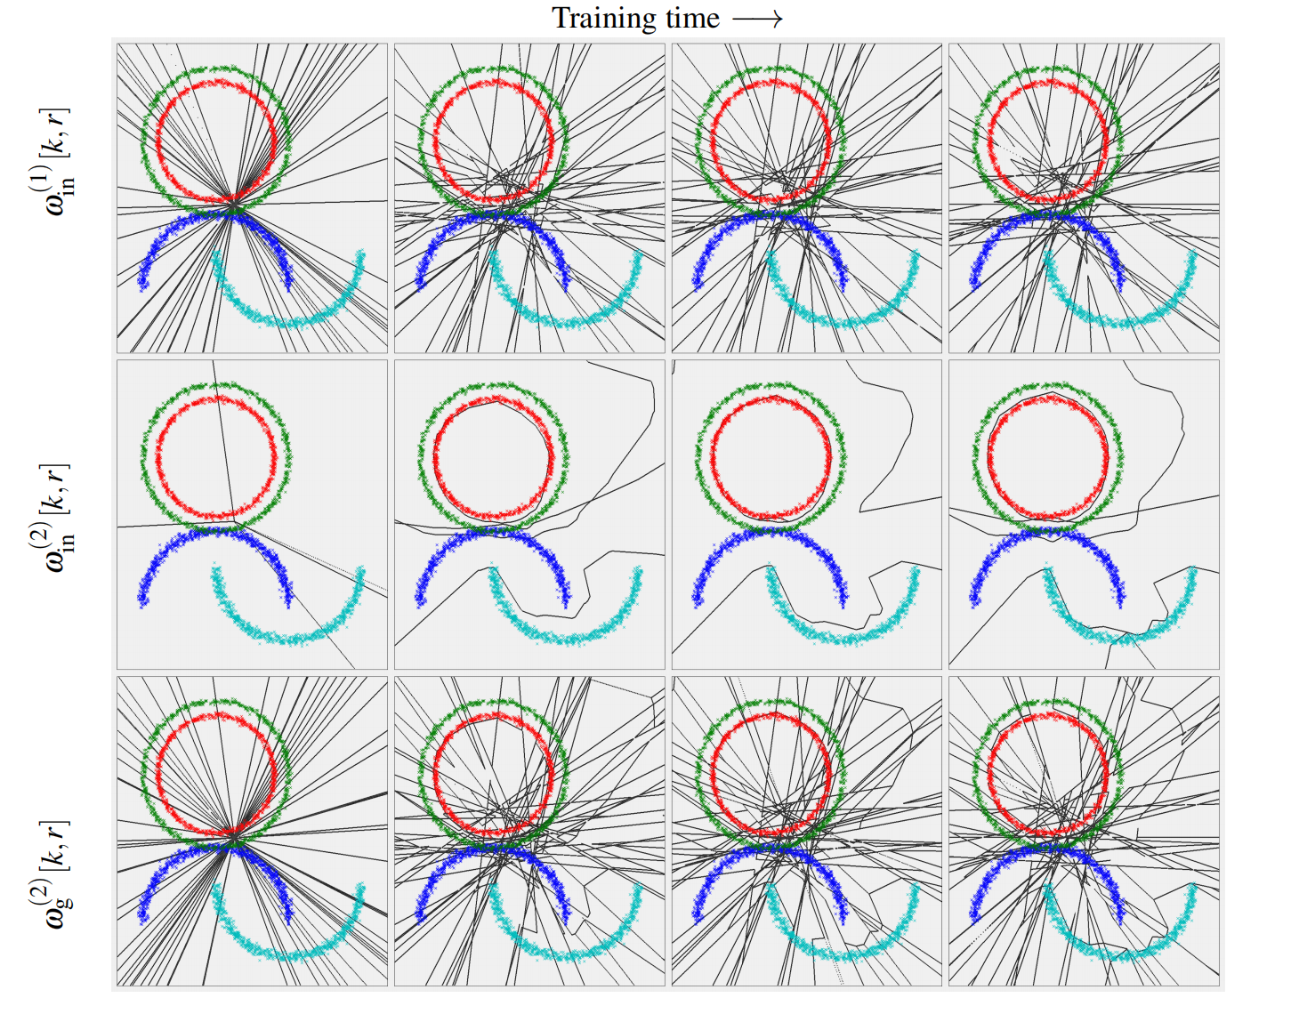

Slide 12


Method (9)
Network Pruning
First, train a large model with more parameters than the desired final DN
Second, pruning this overly large trained DN
Third, fine-tuning the pruned model to adjust the remaining parameters and restore as best as possible the performance lost during the pruning step
The pruning strategy as the application of a mask onto the layer’s parameters as
where and

Slide 13
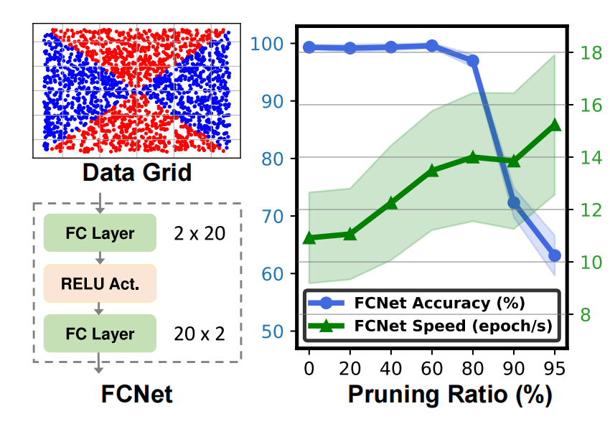
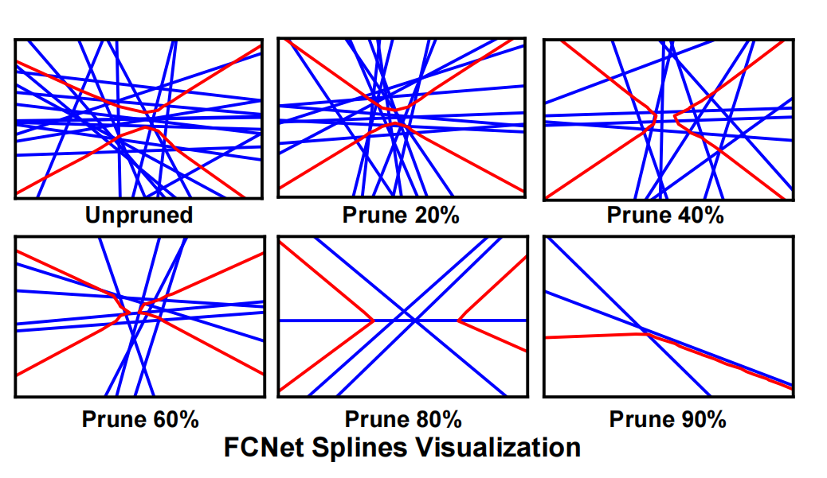
Method (10)
Visualization of Deep Network Pruning From a Spline Perspective
The internal weights of the layers are paired with their input space partition
Pruning impacts those weights and/or nodes directly, this will offer us new ways to study pruning in DNs’ input space

Slide 14
Method (11)
Spline Early-bird Tickets Detection
Early-Bird (EB) tickets:
A method to draw winning ticket sub-networks from a large model very early during training
Winning ticket sub-networks：A sub-network that can achieve the same accuracy as the original network
Limitation of EB: Need to define a priori pruning technique
Early-bird phenomenon in the spline trajectory:
Only consider the evolution of the DN input space partition during training

Slide 15
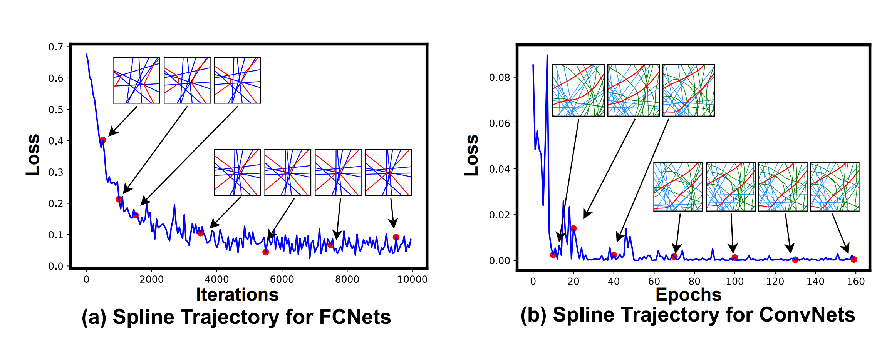
Early-bird phenomenon in the spline trajectory:

Slide 16
Method (12)
Spline Early-bird Tickets Detection
Quantitative distance between input space partitions
The DN input space has an associated binary code based on which side of the subdivision
trajectories the regions lie
Given a large collection of data points, we can assign each datum
the code of the region it lies in
The proposed metric:
The hamming distance between the codes of each datum observed at two consecutive
training steps
01
00
11
10

Slide 17
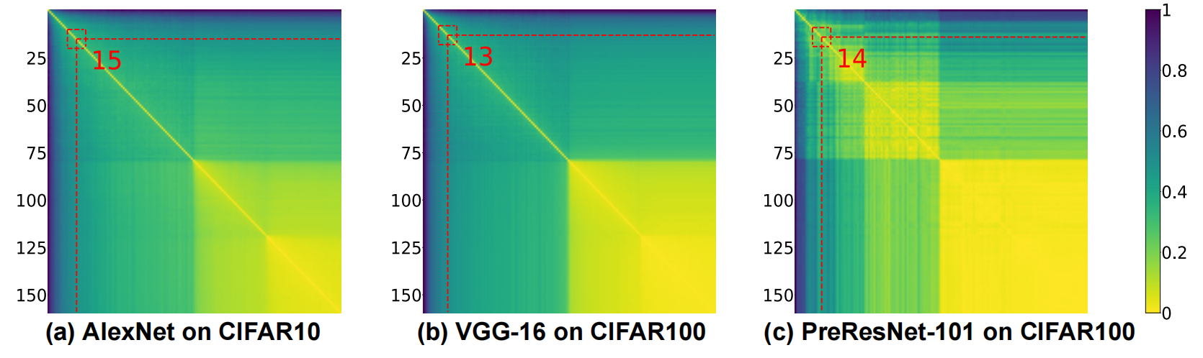
Method (13)
Spline Early-bird Tickets Detection
Visualize the Hamming Distance of the DN Partition between 160 Consecutive Epochs

Slide 18
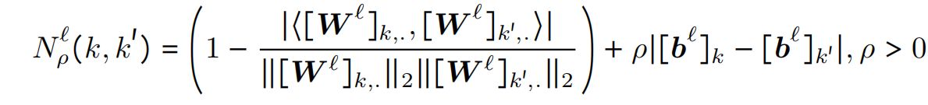
Method (14)
Spline pruning policy
Remove the redundant regions of input space partition:
Not all the input space partition regions and boundaries are relevant since not all affect the
final decision boundary
Redundancy measure function:
If two units have biases and slope vectors proportional to each other, then one can effectively remove one of the two units without altering the layer input space partition

Slide 19
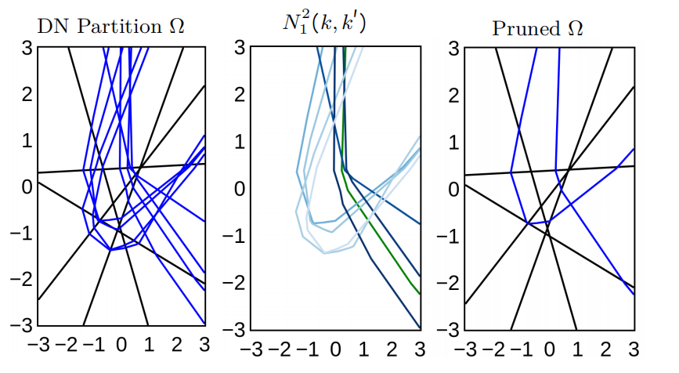
Method (15)
Spline pruning policy
Redundancy measure function:

Slide 20
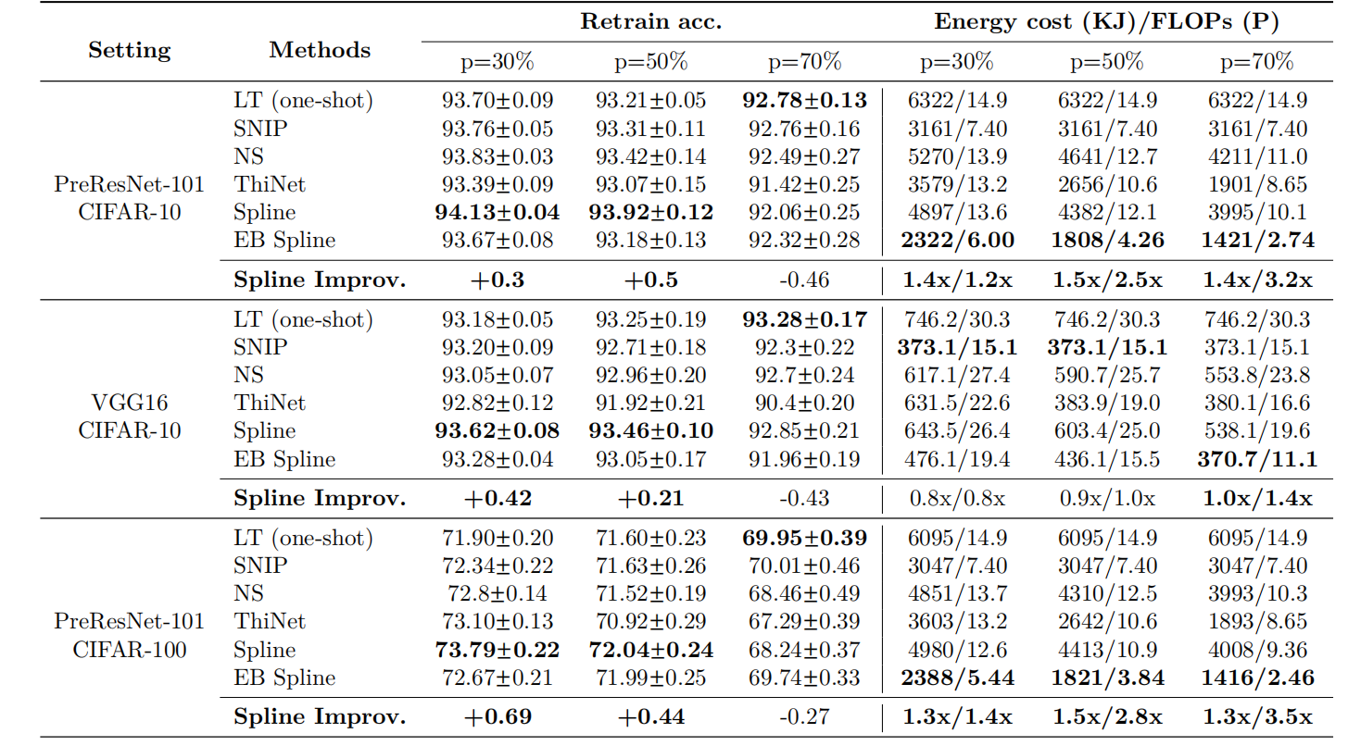
Experiments

