Slide 1
Mad Max: Affine Spline Insights into Deep Learning &
SplineCam: Exact Visualization and Characterization of Deep
Network Geometry and Decision Boundaries
Zhao Zixi
2023.07.05

Slide 2
Contribution(1)
Mad Max
A large class of DNs are a composition of MASOs (max-affine spline operators)
DNs are template matching machines
The partition of the input space induced by a MASO
SplineCam
A scalable enumeration method that computes the DN’s input space partition and decision boundary
Development SplineCam that directly visualize a DN’s input space partition, compute partition statistics and sample from the decision boundary

Slide 3
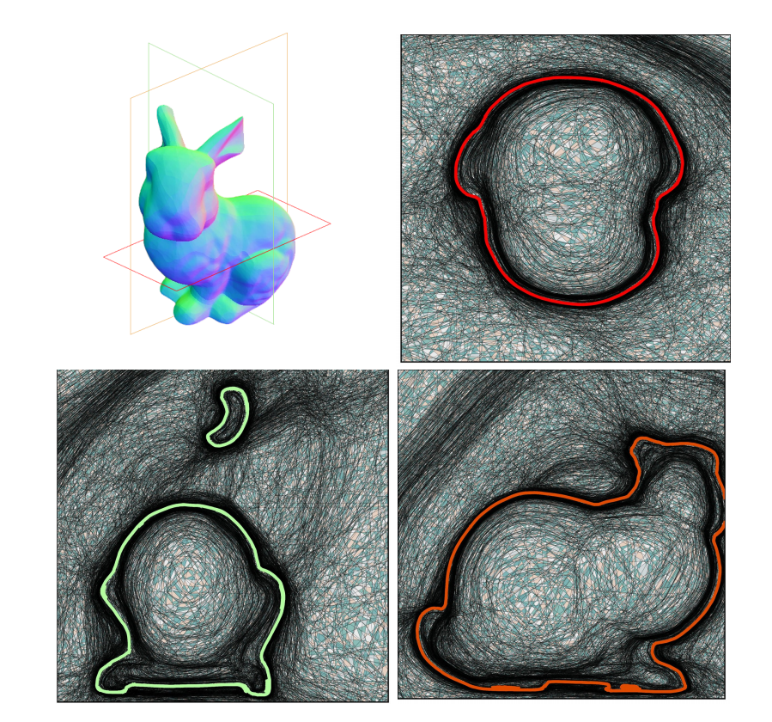
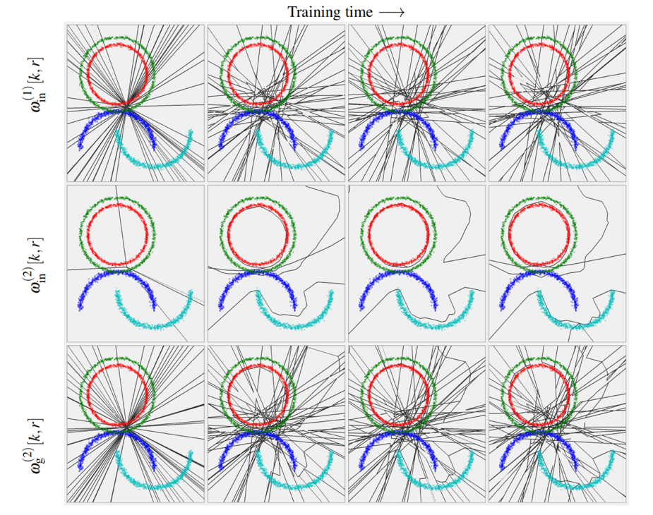
Contribution(2)

Slide 4
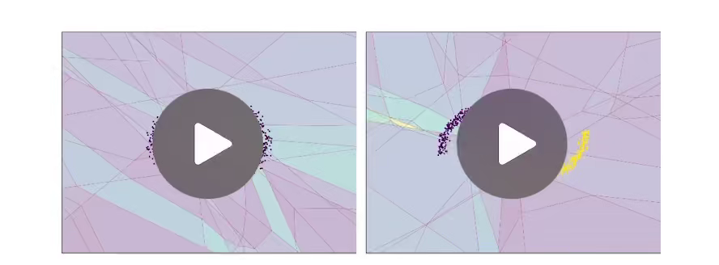
Contribution(3)

Slide 5
Mad Max: Affine Spline Insights into Deep Learning

Slide 6
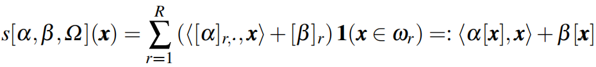
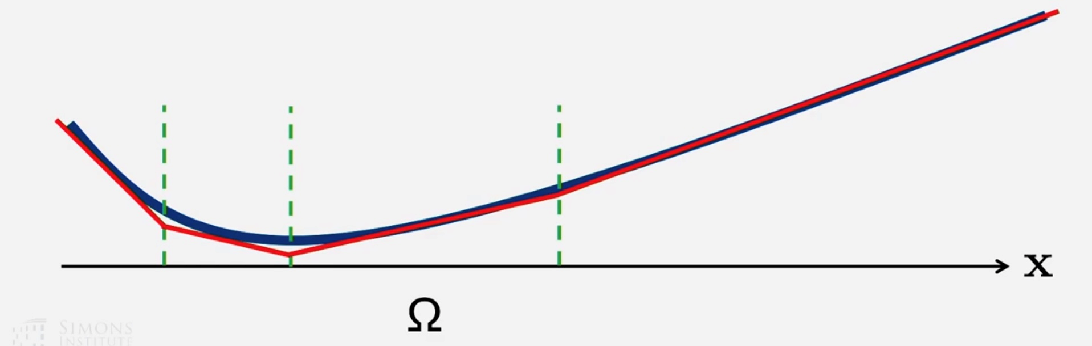
Introduction(1)
Spline Approximation
· A spline function approximation consists of
· a partition Ω of the input space
· a simple local mapping on each region of th partition

Slide 7

Introduction(2)
Max-Affine Spline Functions
· It is completely determined by its parameters α and β without needing to specify the partition
(a₁, b₁)
(a₂, b₂)
(a₃, b₃)
(a₄, b₄)

Slide 8
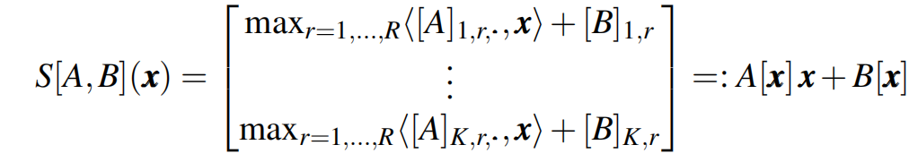
Introduction(3)
Max-Affine Spline Operators
· By concatenating K independent max-affine spline functions to get MASOs

Slide 9

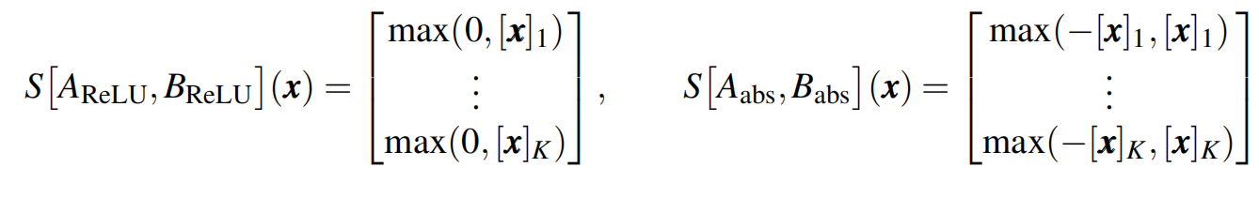
Method(1)
Deep Networks are Compositions of Spline Operators
DN Operators and Layers are MASOs
The ReLU and absolute value activation operators written as MASOs:

Slide 10
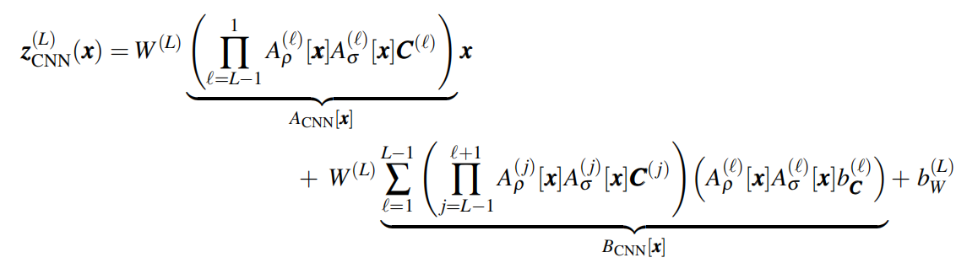
Method(2)
Example: CNN Affine Mapping Formula
c
c
c
c

Slide 11
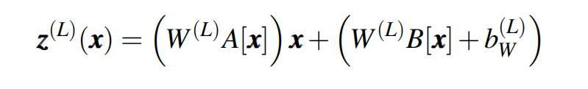
Method(3)
Deep Networks are Template Matching Machines
The c^{th} element of z^{(L)}(x) equals the inner product between the signal x and the matched filter for the c^{th} class, which is contained in the c^{th} row of the matrix W^{(L)}A[x]
Hierarchical Template Matching:
If every layers are not only piecewise-affine and convex but also nondecreasing,then the DN is globally a MASO

Slide 12
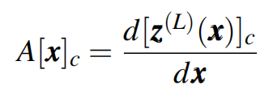
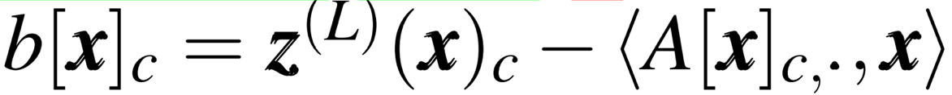
Method(4)
Deep Networks are Template Matching Machines
Given a signal x, the signal-dependent template for class c is given by:
Then the bias term can be computed as:

Slide 13
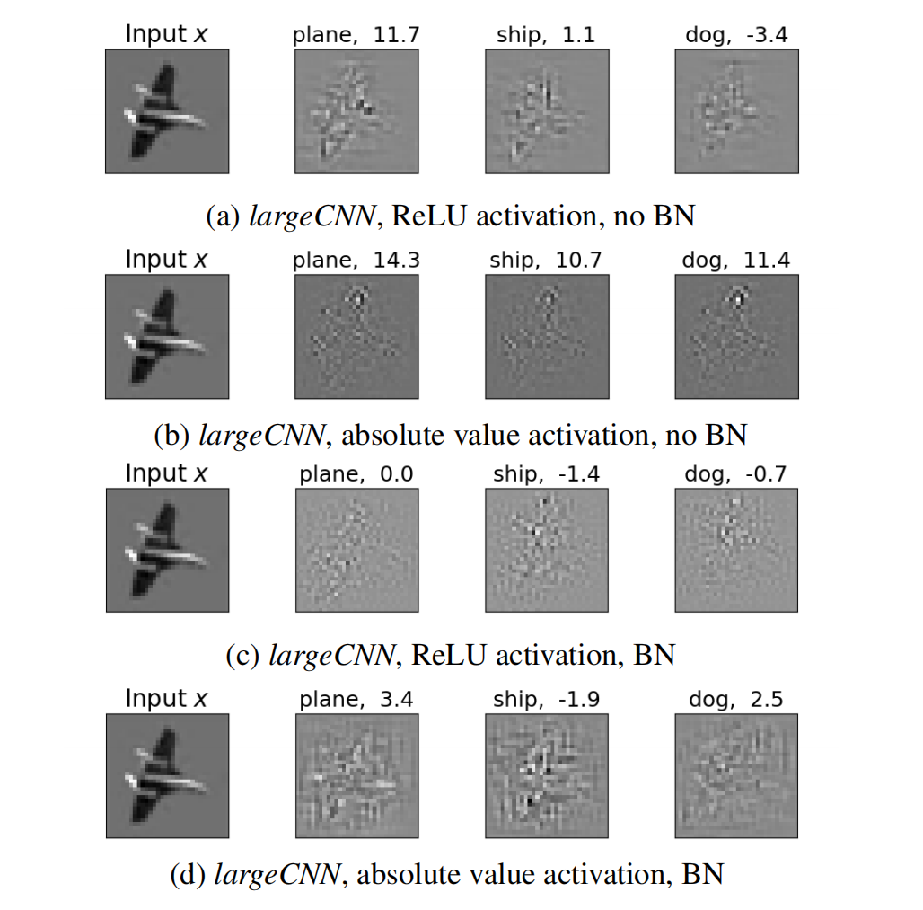
Experiments (1)
Visualization of the signal-dependent, matched filter templates generated by the largeCNN architecture employing max pooling, either ReLU or absolute value activation function, and batch normalization (BN) or not (see Section 5.4 for more details) in a classification task with the CIFAR10 dataset.
To the right of the input image x of class ‘airplane’ we depict the three induced templates for the classes ‘plane,’ ‘ship,’ and ‘dog.’ The color map for the templates maps black to large negative values, grey to zero, and white to large positive values. Above each of the templates, we indicate the inner product between x and the corresponding template.

Slide 14
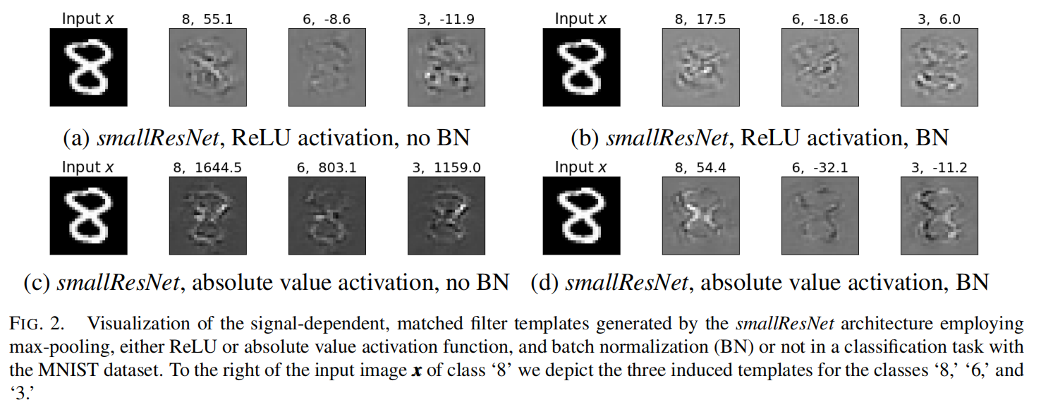
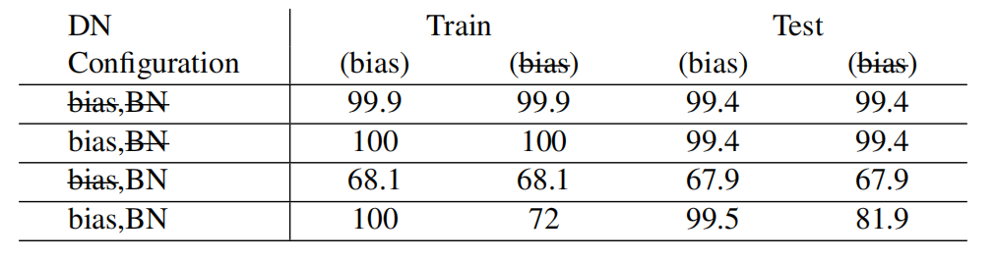
Experiments (2)

Slide 15
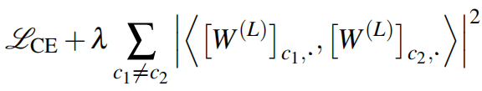
Method(5)
Boosting DN Performance via Orthogonal Templates
Using not matched but rather orthogonal templates to improve the performance
Add to the standard cross-entropy loss function a term that penalizes non-zero off diagonal entries in the matrix W(L)(W(L))^{T}
The parameter λ controls the tradeoff between cross-entropy minimization and orthogonality preservation

Slide 16
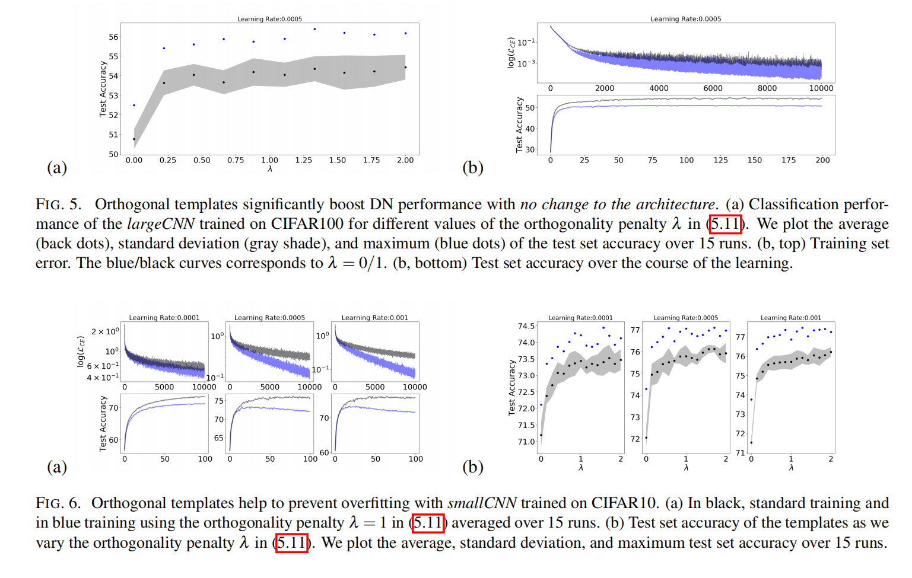
Experiments (3)

Slide 17
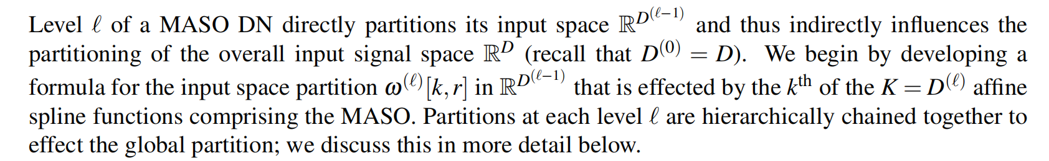
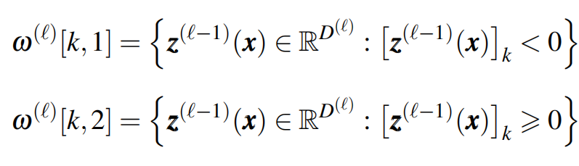
Method (6)
Multiscale Spline Partition Induced by a DN
Using not matched but rather orthogonal templates to improve the performance
· For example, the partition for a ReLU spline can be denoted as:

Slide 18
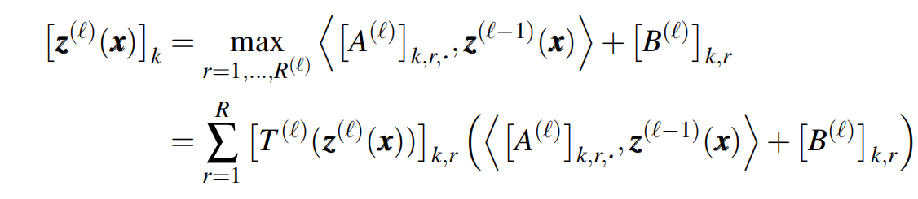
Method (7)
How to Get the Partition
First rewrite the layer calculation S[A,b](x):
Here， is a selection matrix whose k^{th} row comprises a 1-hot selection vector that maximizes [z^{(l)}(x)]_{k} in the k^{th} ouput dimension. Then, we can get the partition:

Slide 19
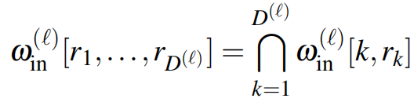
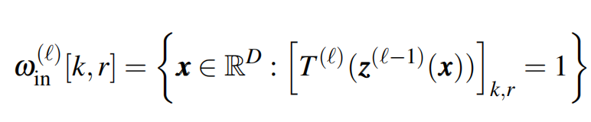
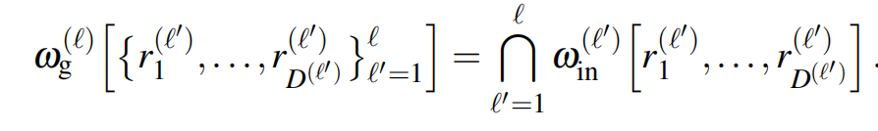
Method (8)
Local Partition in the Input Signal Space
The overall partitioning is simply the intersection of the partitions effected by each of the k = 1,...,D^{(l)} ouput dimensions:
where,
Global Partition in the Input Signal Space

Slide 20
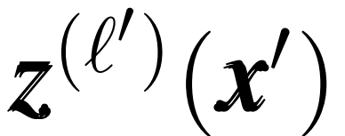
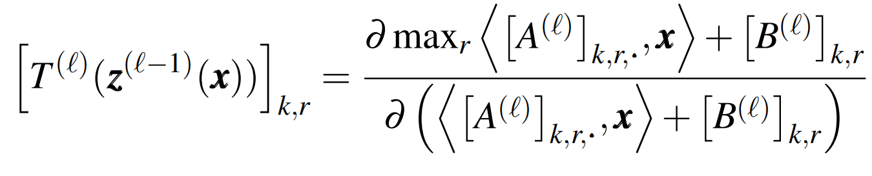
Method (9)
Local Partition in the Input Signal Space
First, sample the overall input signal space to create a collection of inputs {x’}
Second, pass each {x’} through the DN until the desired level l to compute the layer outputs
as well as the selection matrices：
Third, label each {x’} by the region that is selected by selection matrices based on
The finer the sampling of the input space, the more accurate the estimate of the partition region
boundaries.

Slide 21
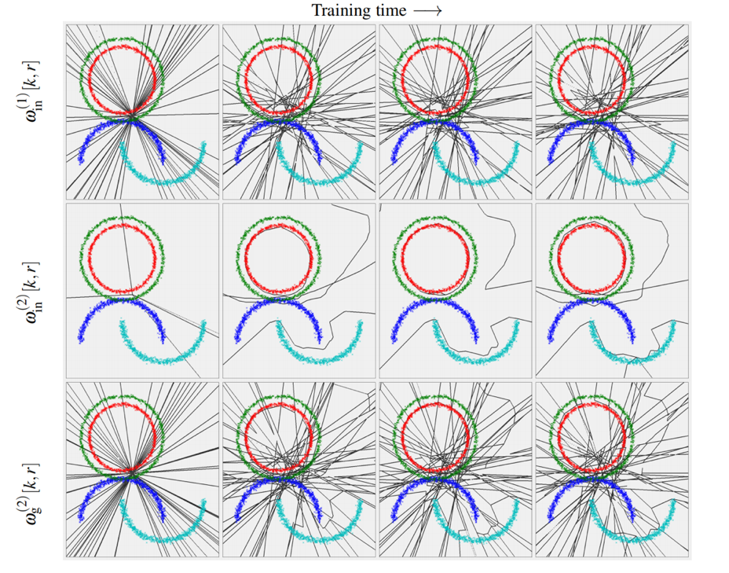
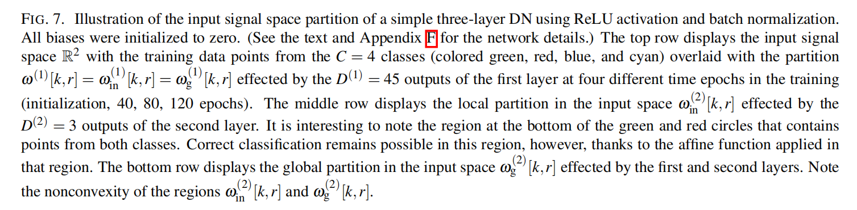
Experiments (4)

Slide 22
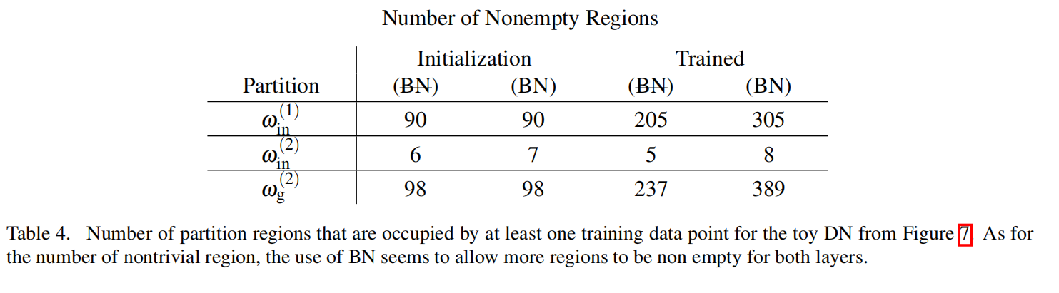
Experiments (5)

Slide 23
SplineCam: Exact Visualization and Characterization of Deep
Network Geometry and Decision Boundaries

Slide 24
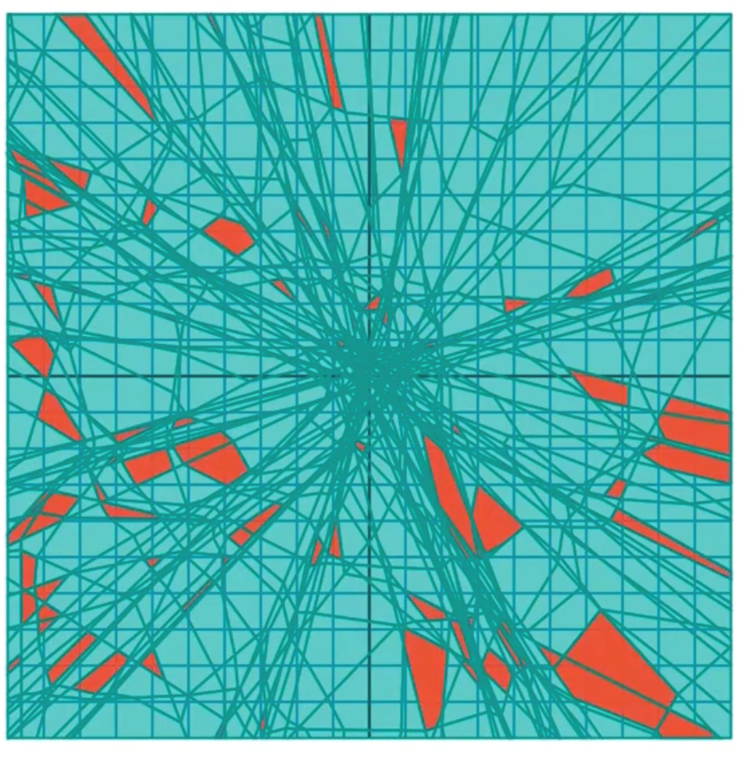
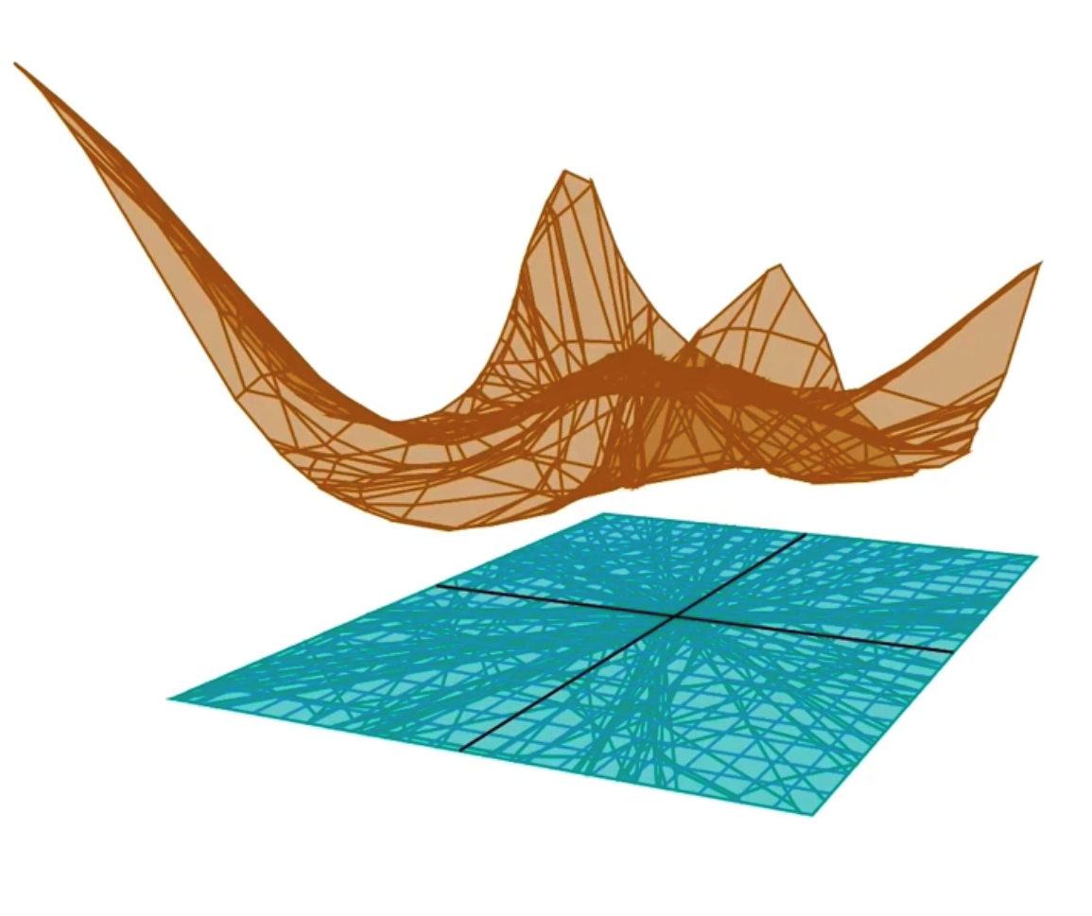
Introduction(1)
DNs partition the input space into linear regions and affinely map input vectors from any given region to the input

Slide 25
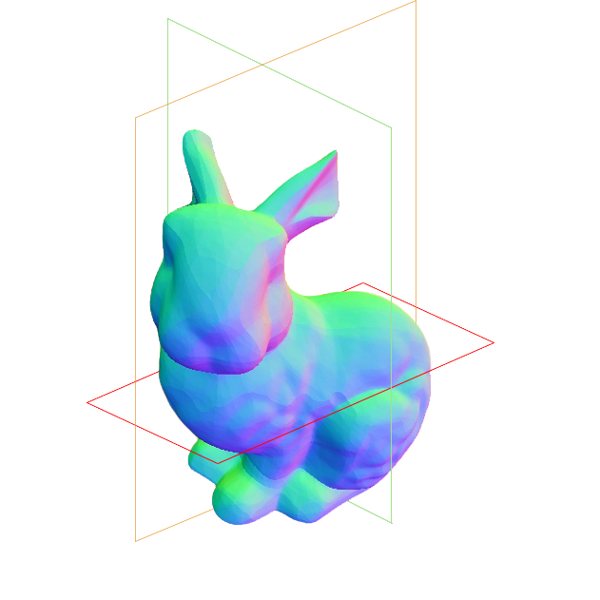
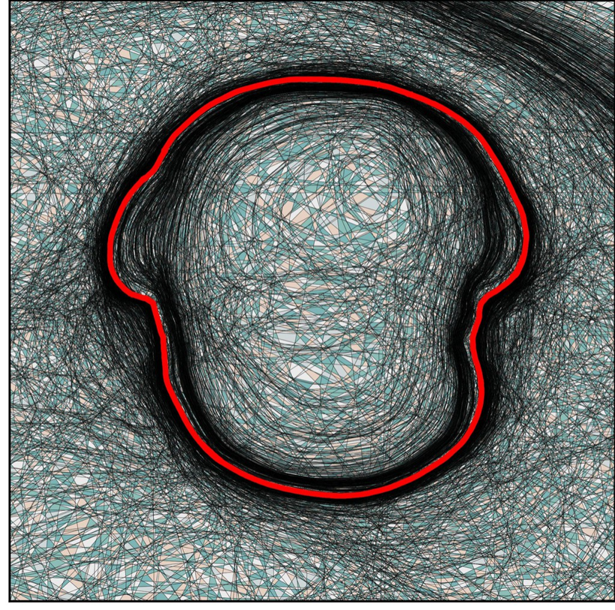
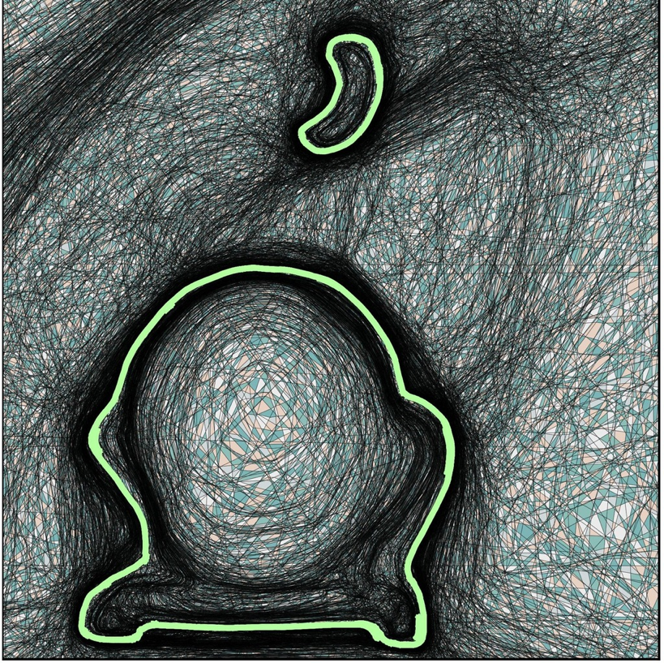
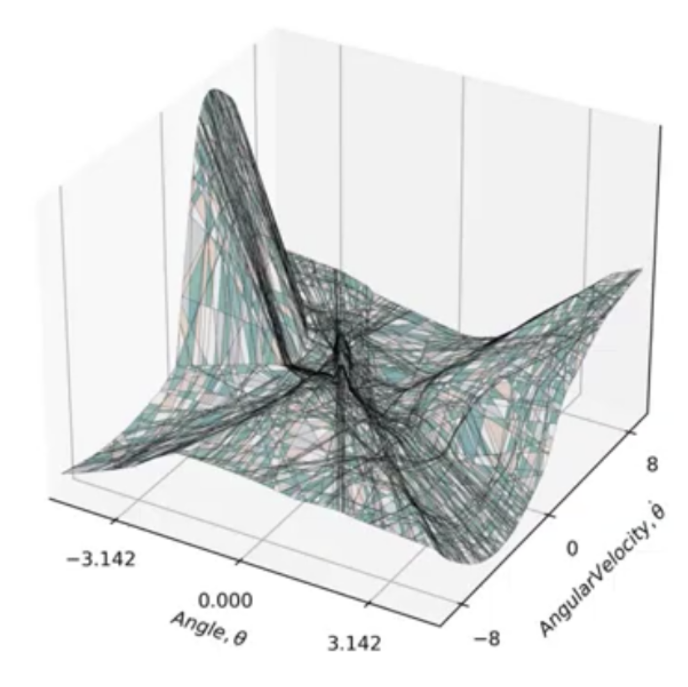
Introduction(2)
SplineCam exactly computes the partition on 2D subspaces of the input space

Slide 26
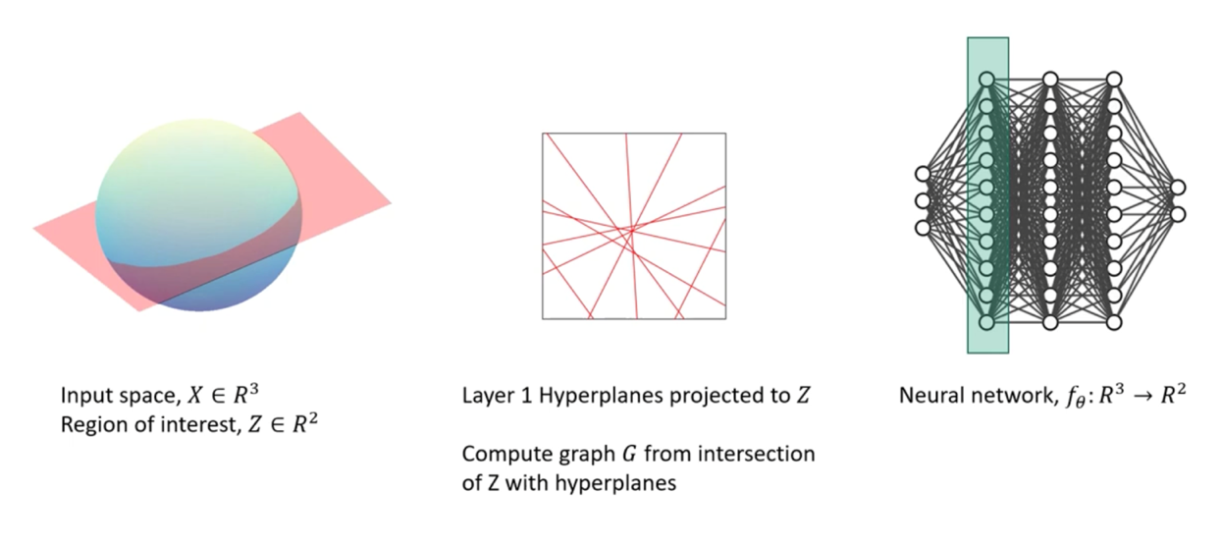
Method(1)

Slide 27
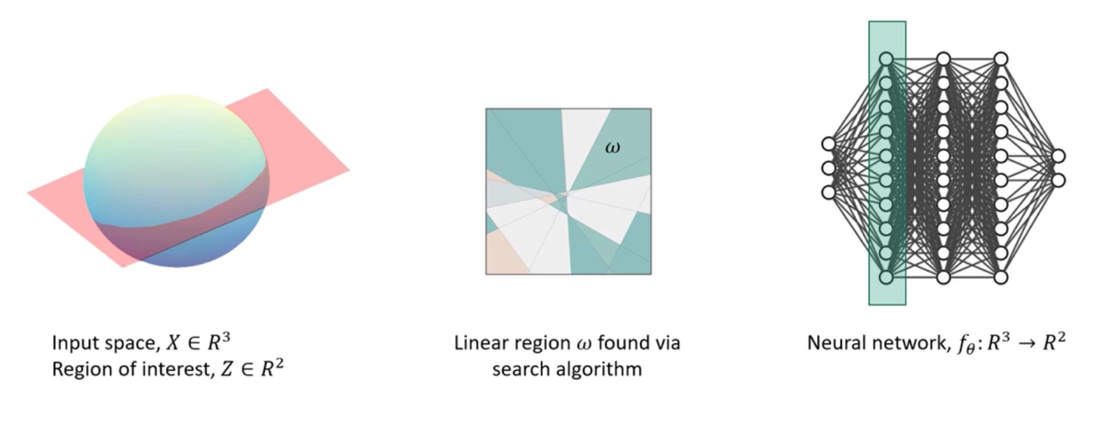
Method(2)

Slide 28
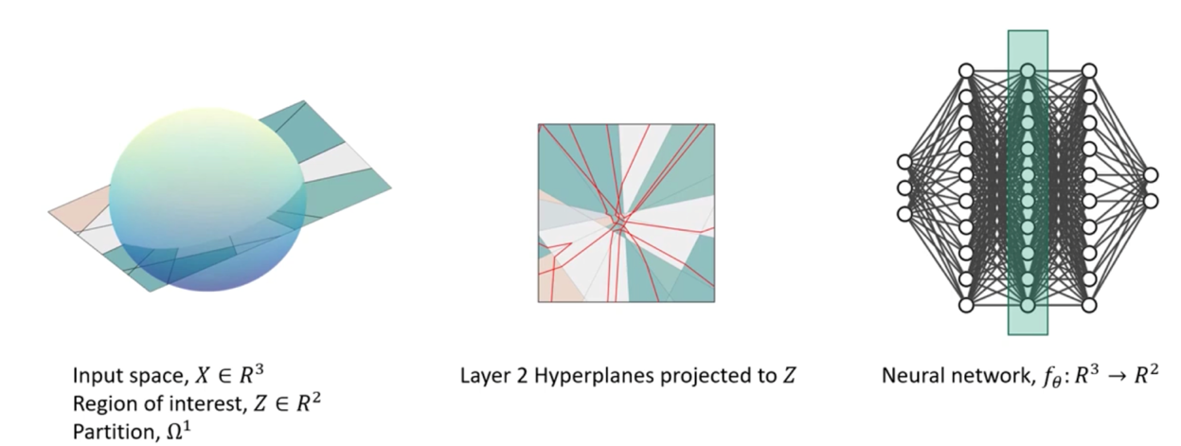
Method(3)

Slide 29
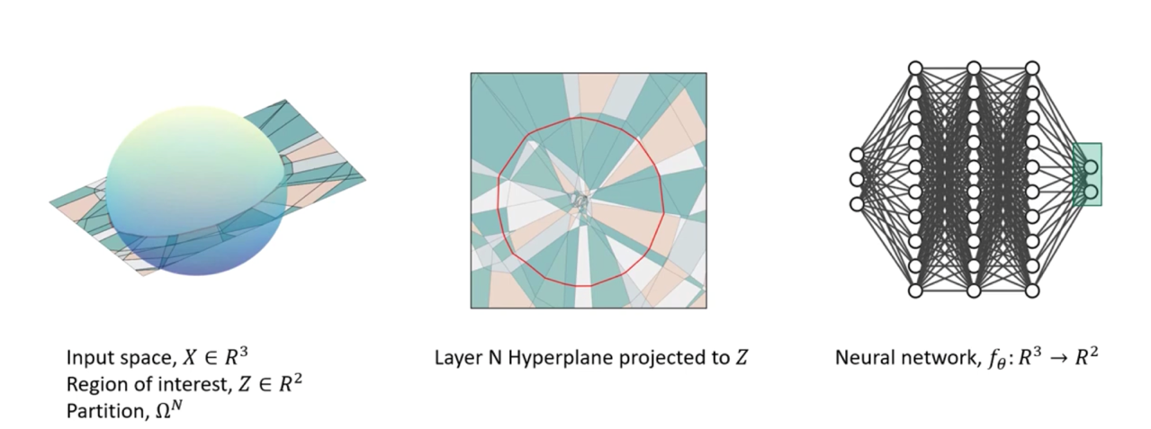
Method(4)

Slide 30




Method(5)
Computation of Partition
A framework to back-project to R^{S} a hyperplane
where
Given a hyperplane it can be projected onto the tangent space of region ω ∈ Ω as,
The decision boundary is the hyperplane =

Slide 31
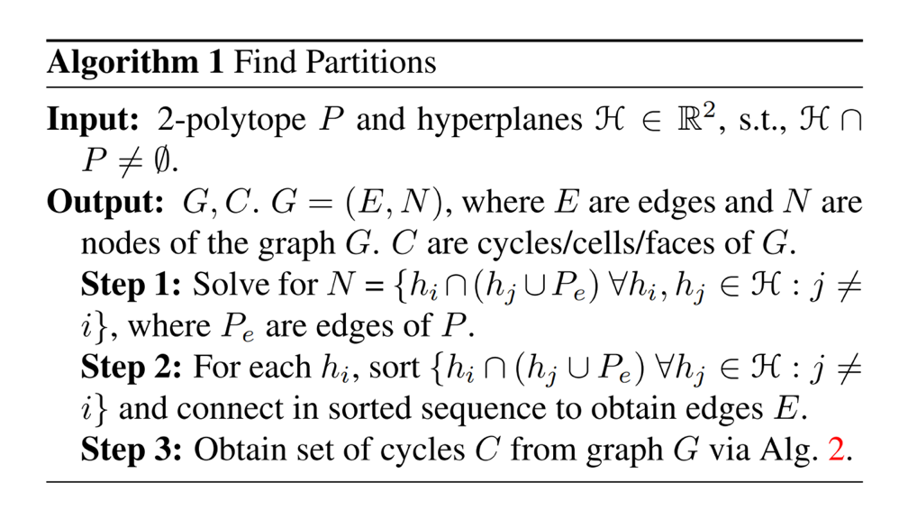
Method (6)
Computation of Partition
Denote the partition in the input space formed by the composition of layers 1 to l as Ω^{l}
Use Algorithm 1 on each region in Ω¹ to obtain Ω²
Repeat this for all layers up to l = L.

Slide 32
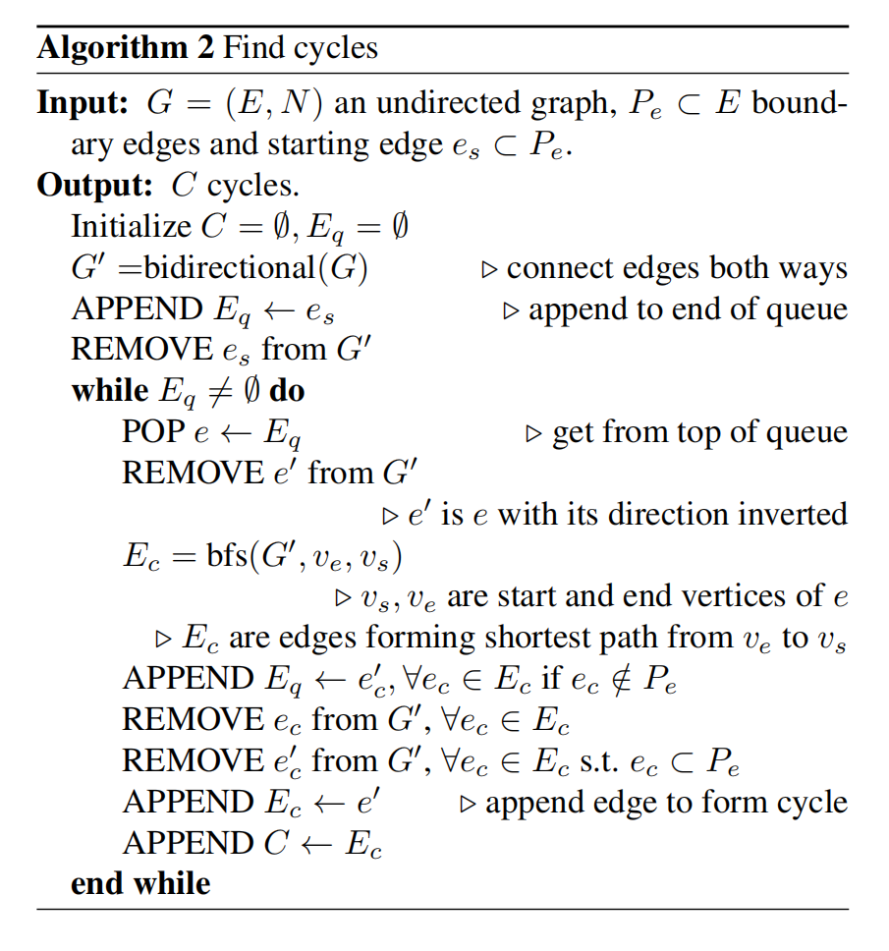
Method (9)
Computation of Cycle
To find all the cycles in the graph, we select a boundary edge e_{s} (blue arrow), do a breadth-first search (BFS) to find the shortest path through the graph between vertices of es and obtain the corresponding cycle. The edges obtained via BFS are enqueued and the search is repeated. Each non-boundary edge is allowed to be traversed twice, once from either direction

Slide 33
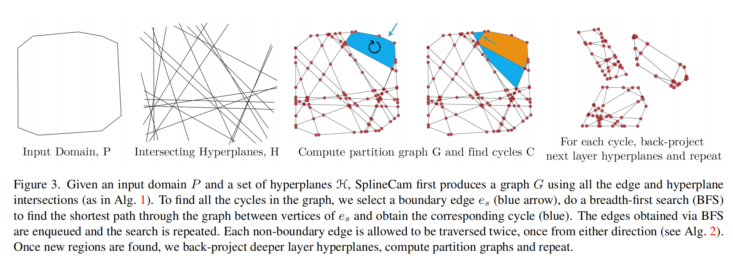
Method (9)
Computation of Cycle

Slide 34
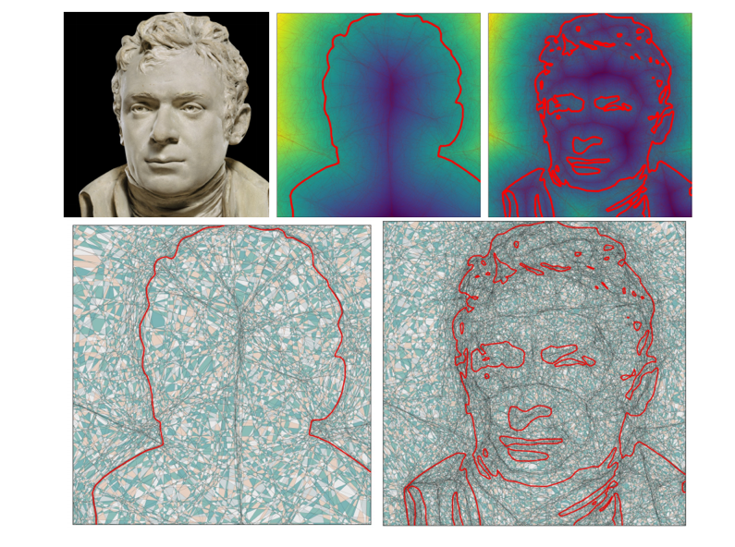
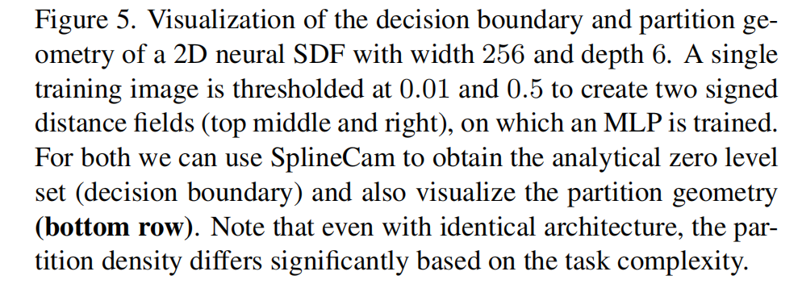
Experiments (1)
Decision Boundary of Signed Distance Functions

Slide 35
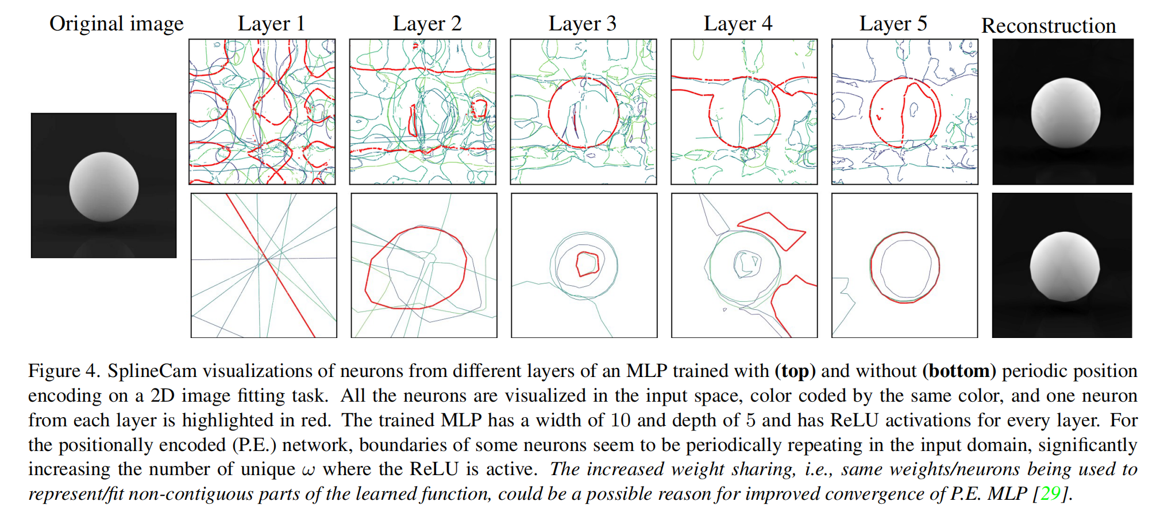
Experiments (2)
The Effect of Positional Encoding on INR Geometry

Slide 36
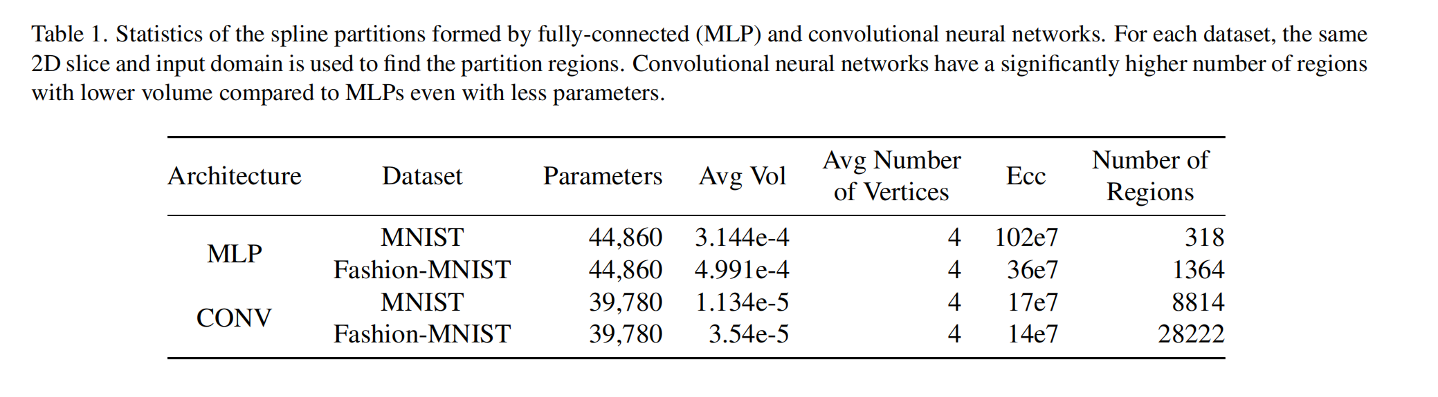
Experiments (3)
Impact of Architecture on Partitions Properties

Slide 37
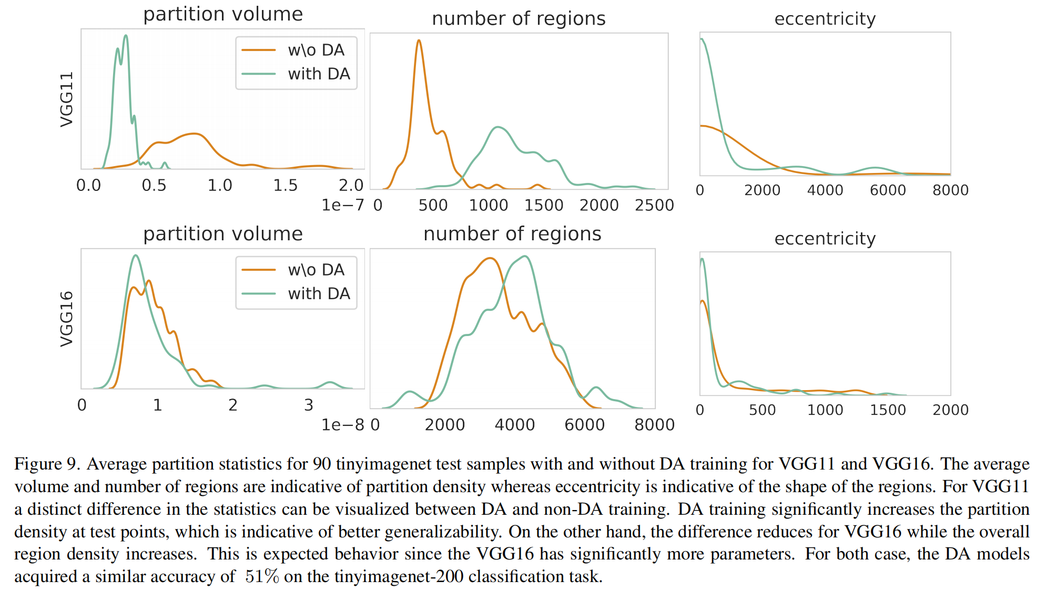
Experiments (4)
Data-Augmentation

