Slide 1
Test-time Adaptation in the Dynamic World with Compound Domain Knowledge Management
Zhao Zixi
2023.05.10

Slide 2
Introduction
Test-time adaptation(TTA)
· Why TTA?
· The target data is unavailable
· Unseen domains are different from the target domain used in pre-training
· How?
· Adaptation to the target domain is conducted during the testing phase
· Pseudo label, unsupervised loss, entropy minimization

Slide 3
Motivation (1)
Catastrophic forgetting
Error accumulation and model failure (overfitting)
Dynamic domain changes (weather,locations)
Previous works only focus on adapting to the current domain while ignoring previous adaptations

Slide 4
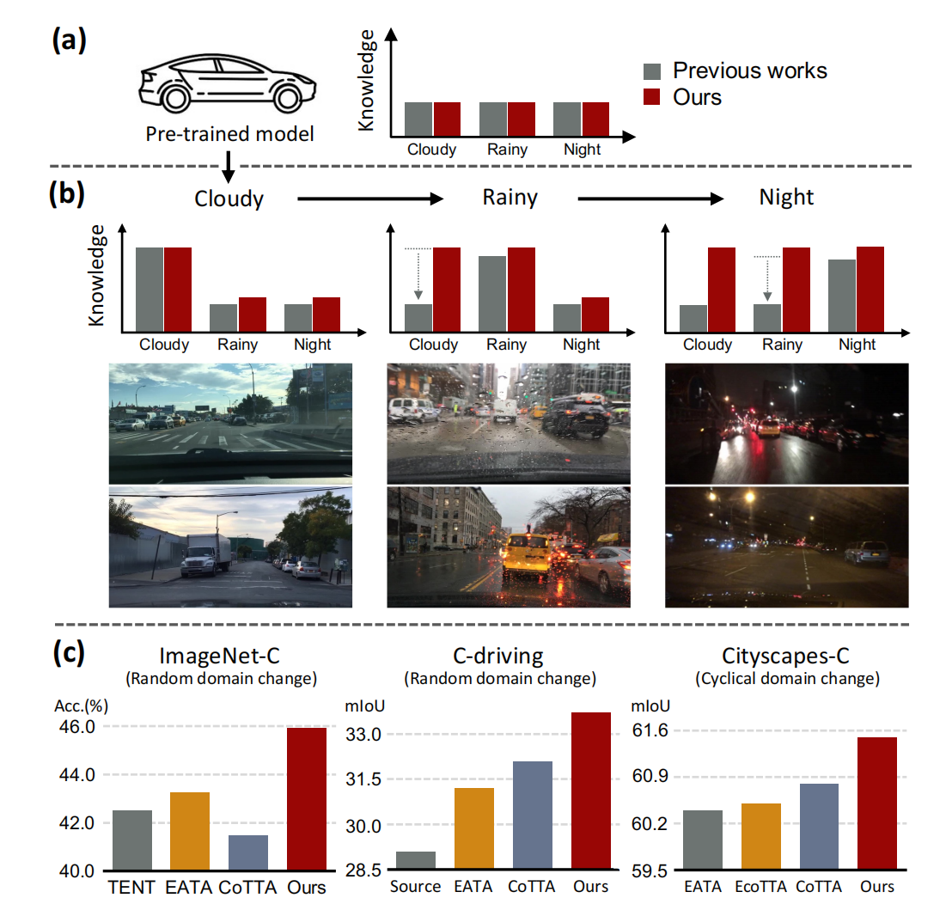
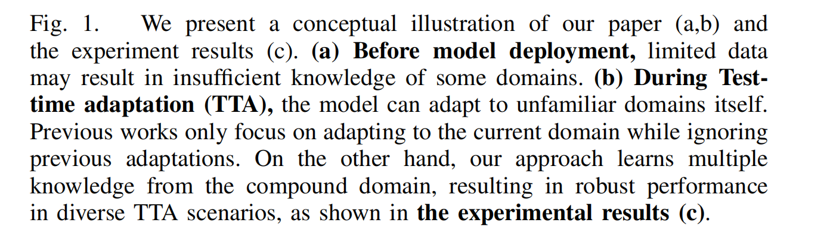
Motivation (2)

Slide 5
Contribution
A robust TTA framework with compound domain knowledge management
Compound domain knowledge means specific modules consisting of BN layers
Novel regularization
Modulates the adaptation rates using domain-similarity
between the source and the current target domain

Slide 6
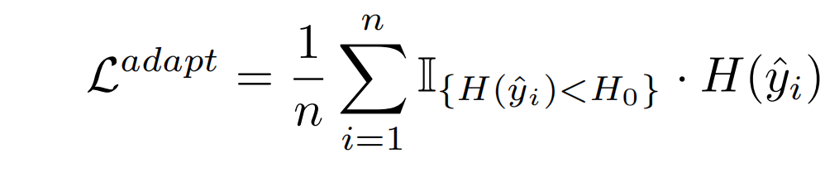
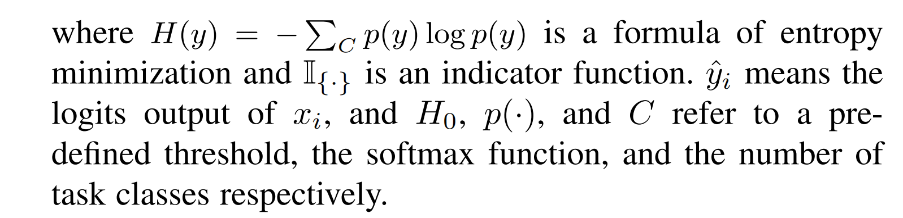
Method (1)
Baseline Model: EATA
Only update the parameters Θ of batch normalization (BN) layers
Adaptation loss: sample filtering L^{adapt}

Slide 7
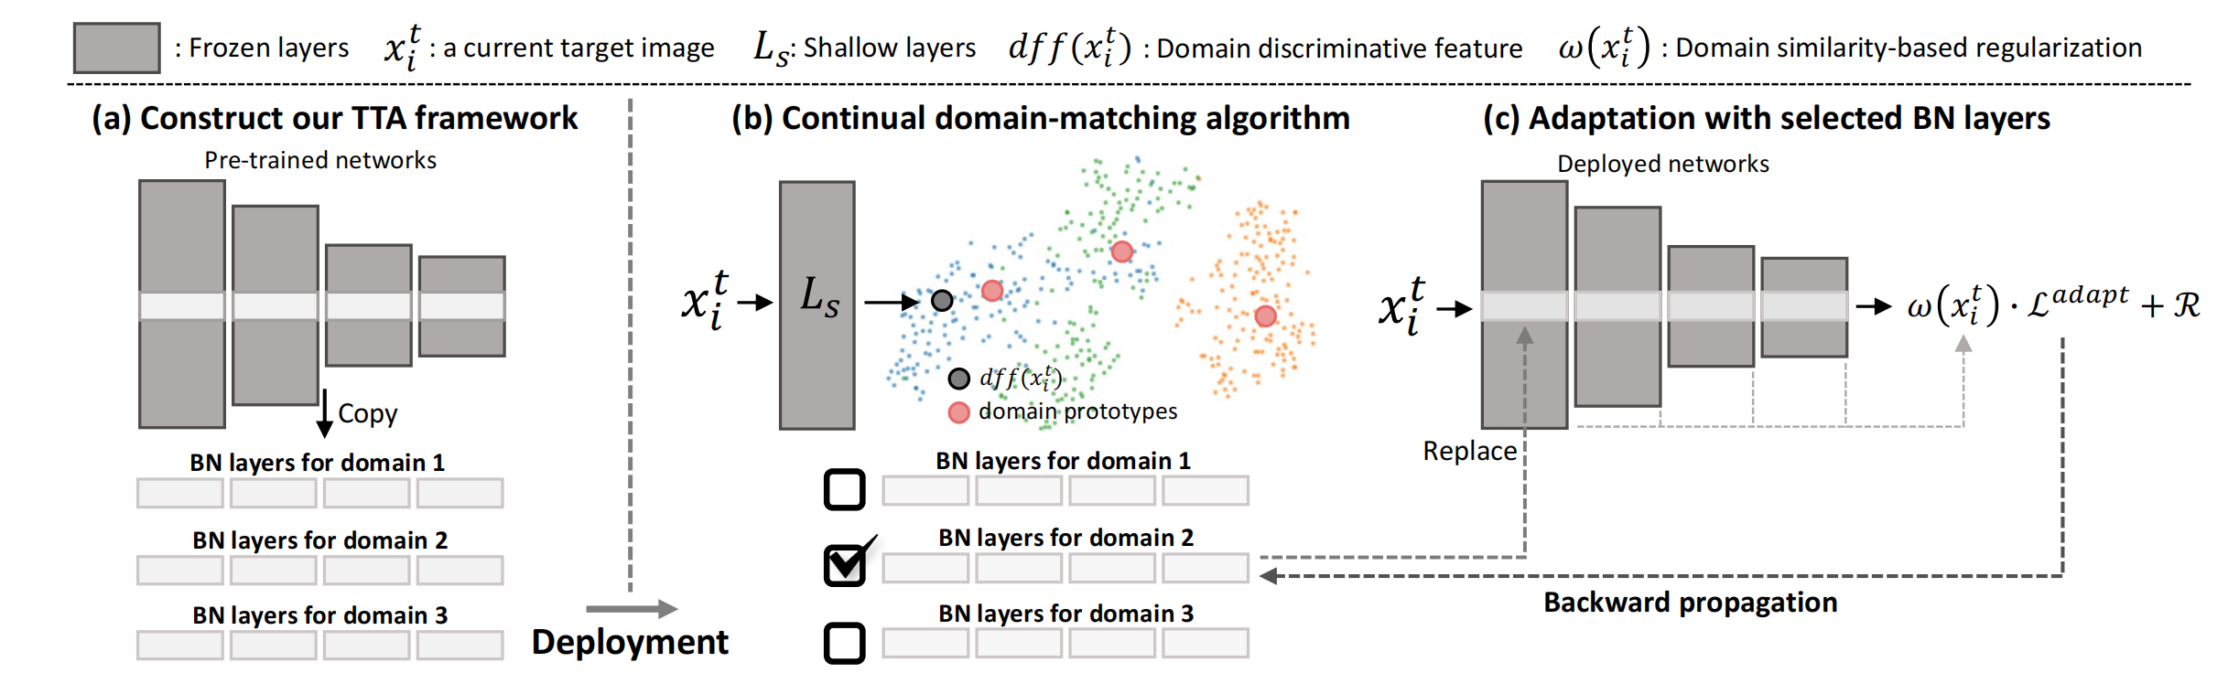
Method (2)
TTA Framework for Compound Domain Knowledge

Slide 8
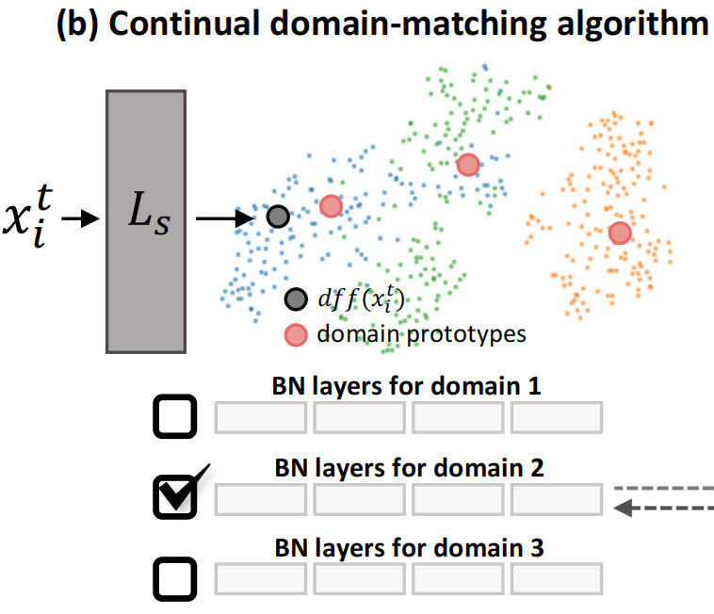
Method (3)
Continual Domain-matching Algorithm
Domain distinctive features (ddf)
Convolutional feature statistics of the shallow layers can indicate the type of domain

Slide 9
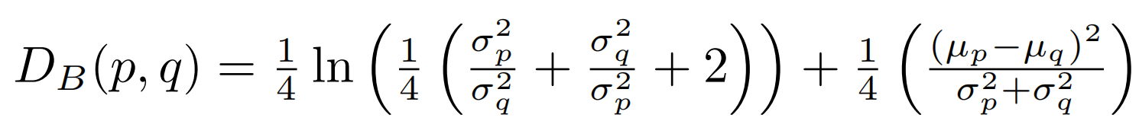
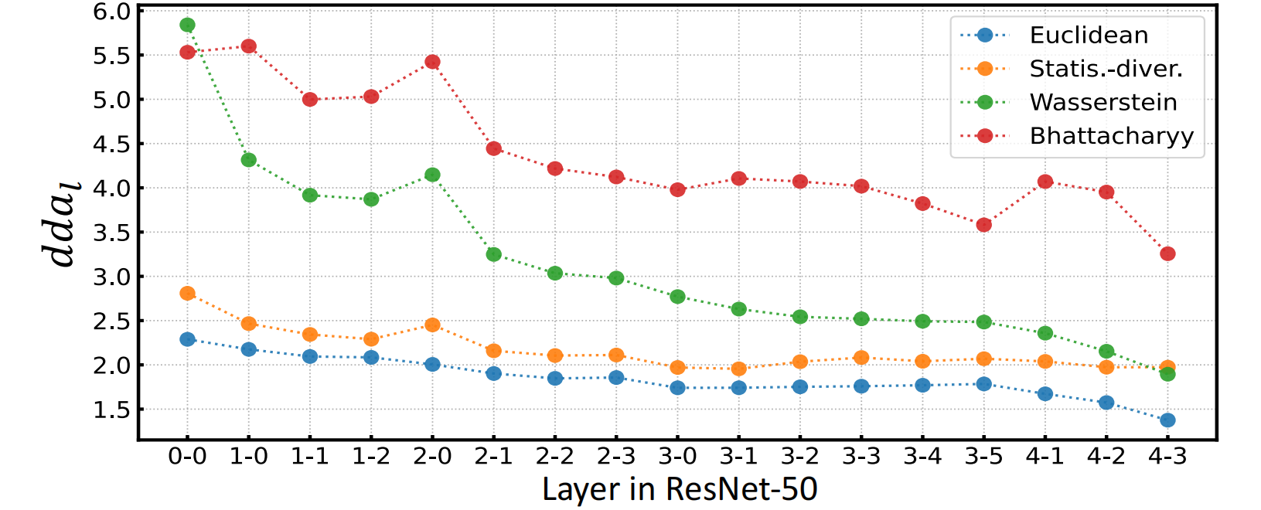
Method (4)
Continual Domain-matching Algorithm
Distance function: Bhattacharya function

Slide 10
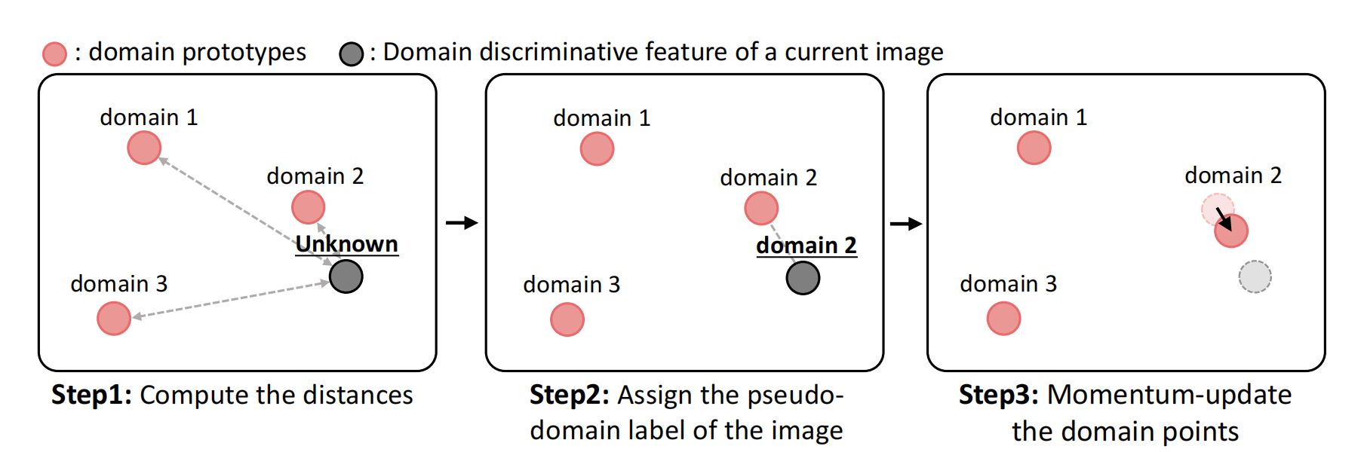
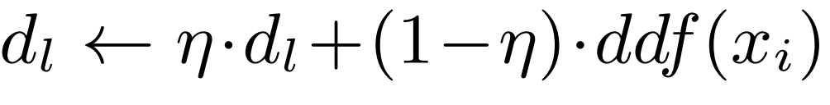
Method (5)
Continual Domain-matching Algorithm

Slide 11
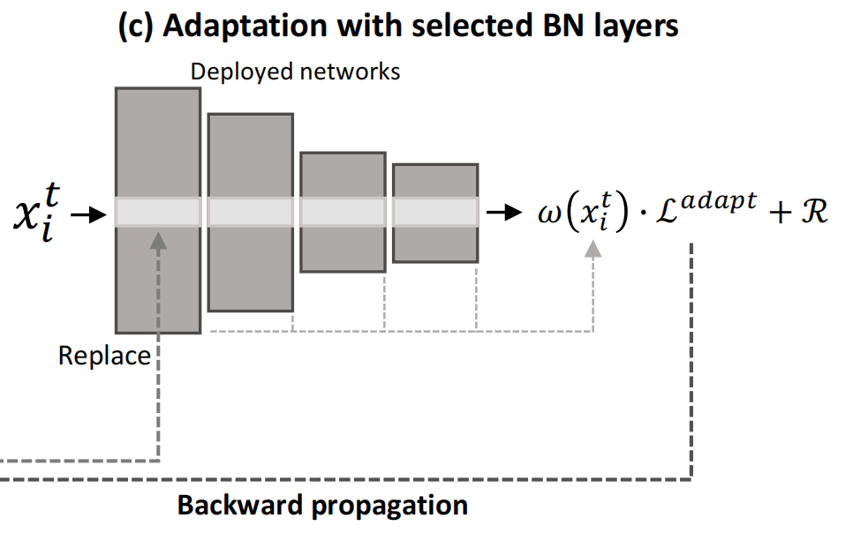
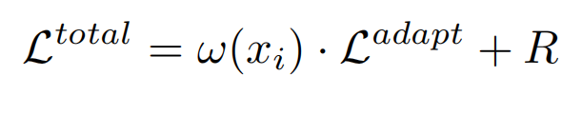
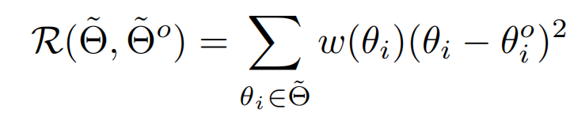
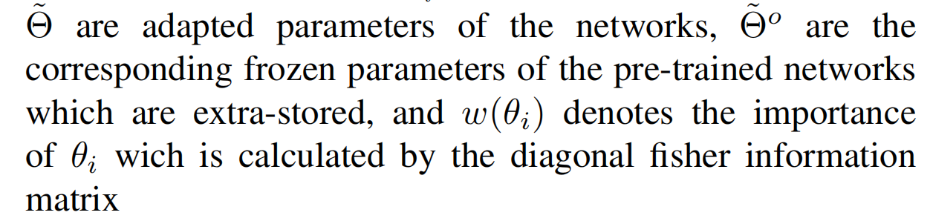
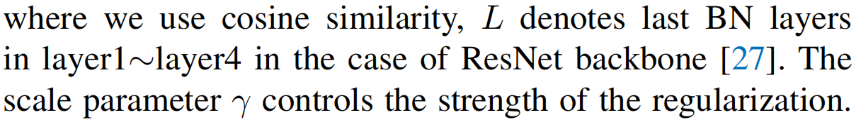
Method (6)
Domain Similarity-based Regularization

Slide 12
Experiments (1)
Classification Experiments
Source domain: ImageNet
Target domain: ImageNet-C
15 diverse sub-target types of 4 main categories (Noise, Blur, Weather, and Digital)
Ten diverse sequences in Table ten diverse sequences in Table I
Two notable sequences among the ten sequences in Table II

Slide 13
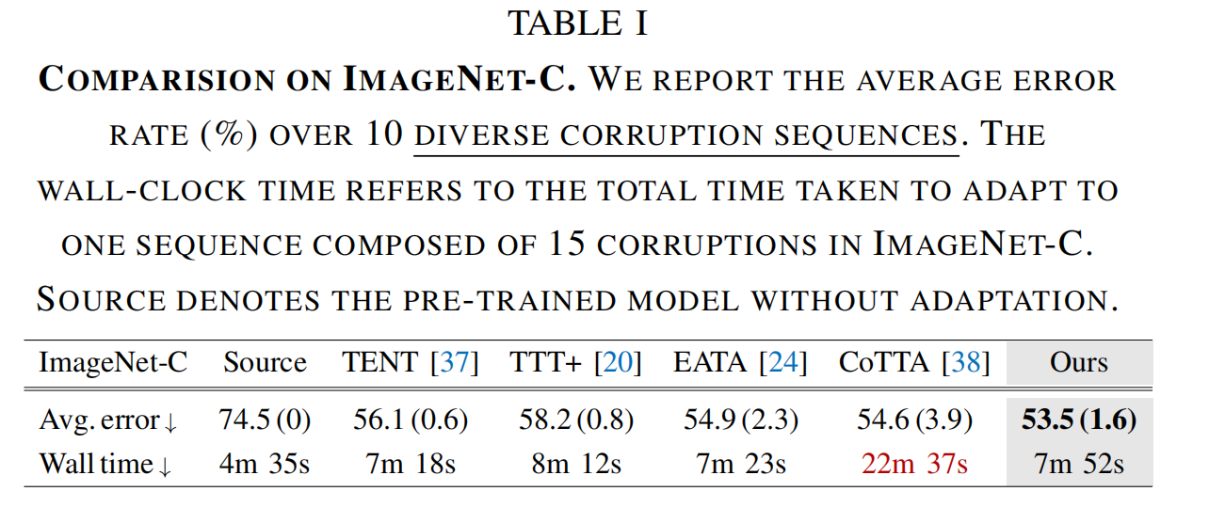
Experiments (2)
Classification Experiments

Slide 14
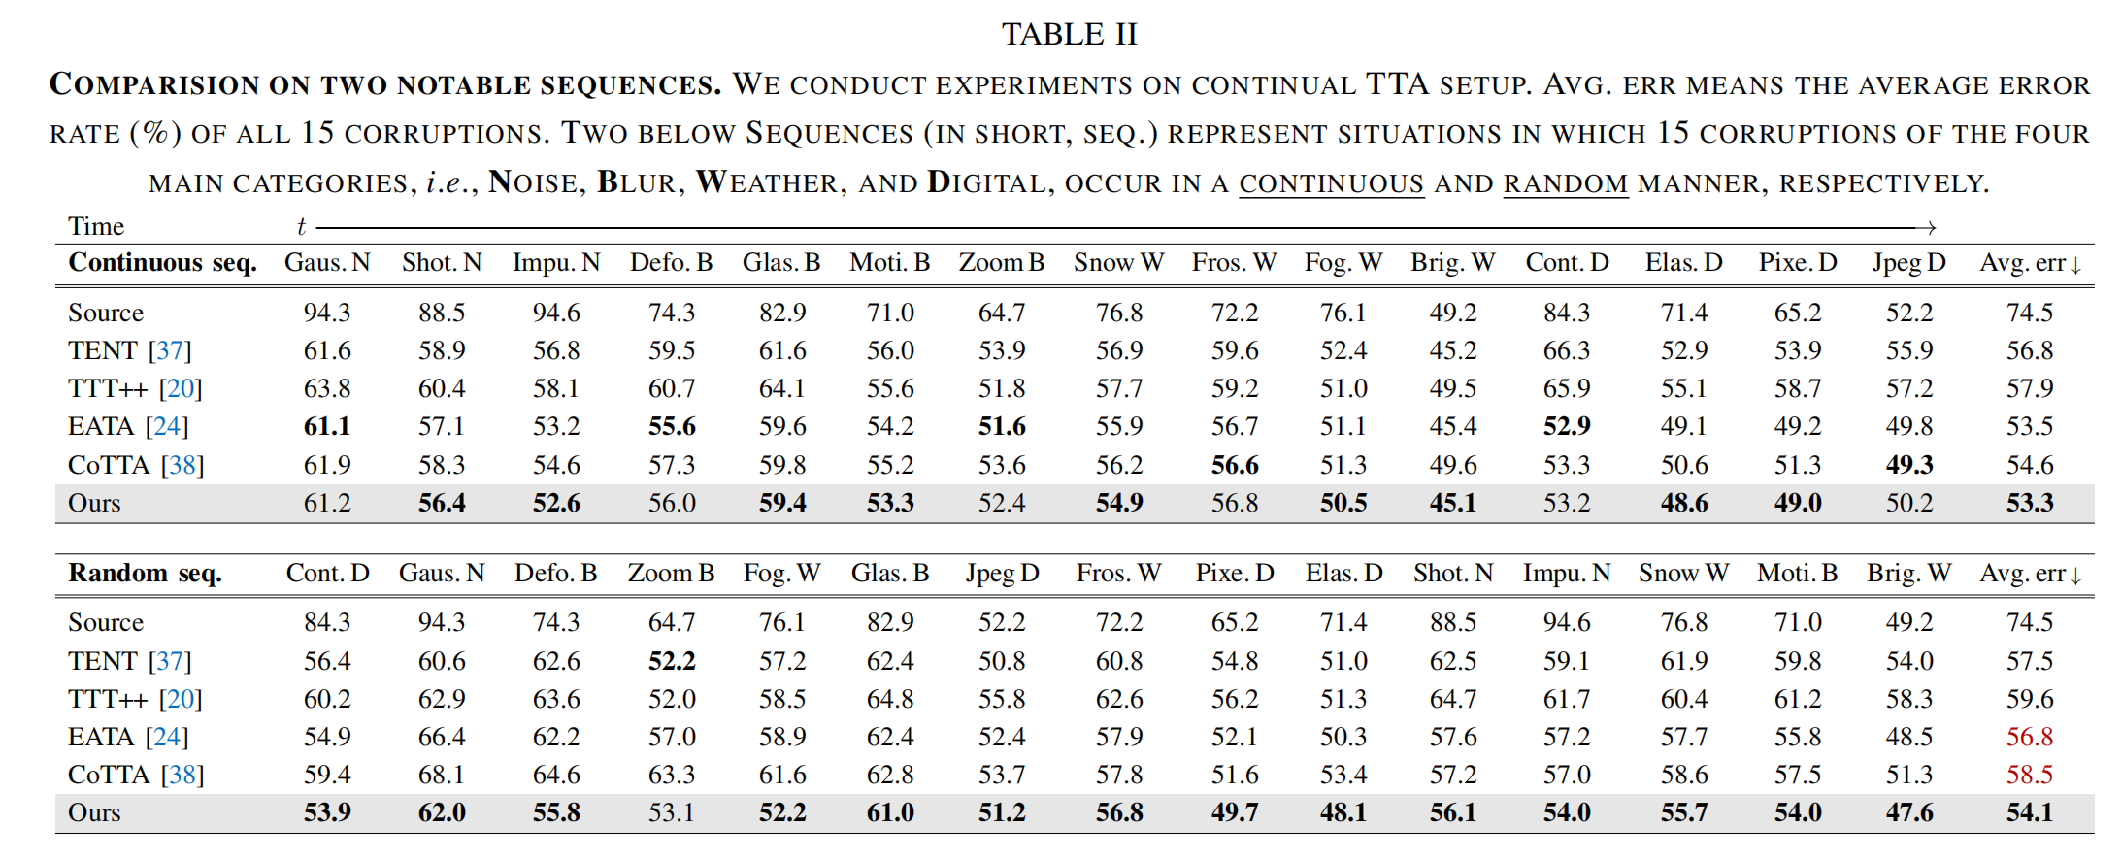
Experiments (3)
Classification Experiments

Slide 15
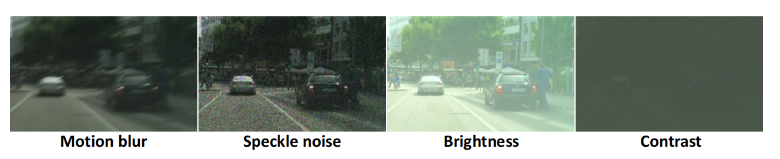
Experiments (4)
Segmentation Experiments
Source domain: GTA5, Cityscapes
Target domain: C-driving, Cityscapes with corruption
C-driving: separated by weather attributes (i.e., cloudy, rainy, and snowy) or time_x0002_of-day
attributes (i.e., daytime, twilight, and night)
Cityscapes with corruption: motion blur, speckle noise , brightness, and contrast

Slide 16
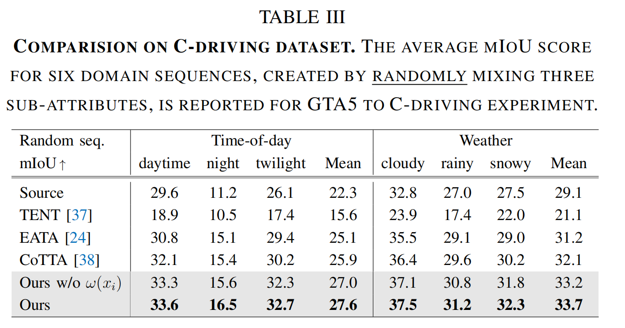
Experiments (4)
Segmentation Experiments
GTA5 to C-driving
six domain sequences made by randomly mixing the order of three sub_x0002_attributes

Slide 17
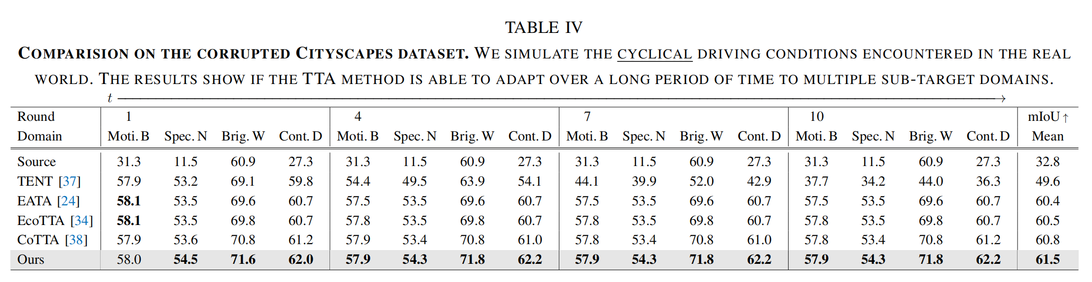
Experiments (5)
Segmentation Experiments
Cityscapes to Cityscapes with corruption

Slide 18
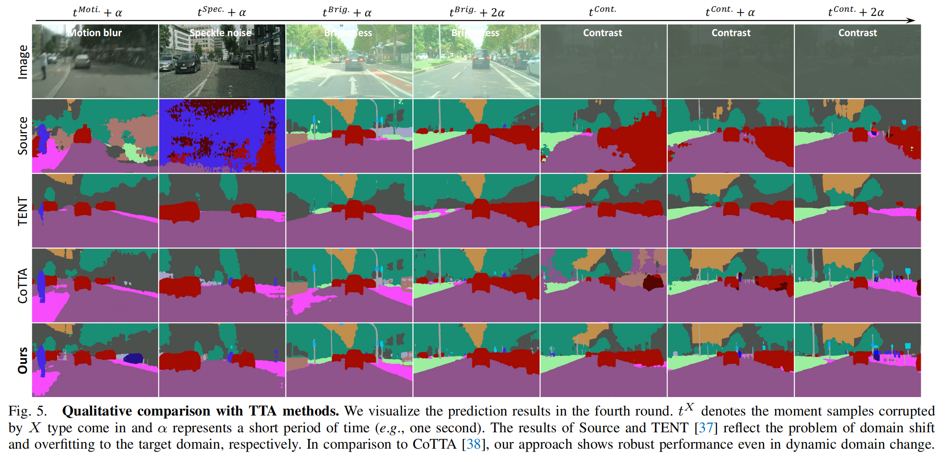
Experiments (5)

Slide 19
Conclusion
A robust TTA framework with compound domain knowledge management
Improved TTA performance in diverse dynamic TTA scenarios
Novel regularization
The adaptation rates utilizing domain-similarity between the current sub-target and the
source domain can prevent overfitting

