Slide 1
2C Reading Group
Collaborative filtering in Recommending System
一脸丧气什么也没做出来的 王立晨

Slide 2
Approaches
Collaborative filtering
Content-based filtering
Hybrid recommender systems
Multi-armed bandit problem

Slide 3
Dataset
The Netflix Prize
<user, movie, date of grade, grade>
The MovieLens
<user, movie, date of grade, grade>

Slide 4
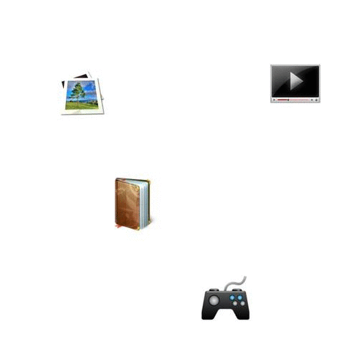
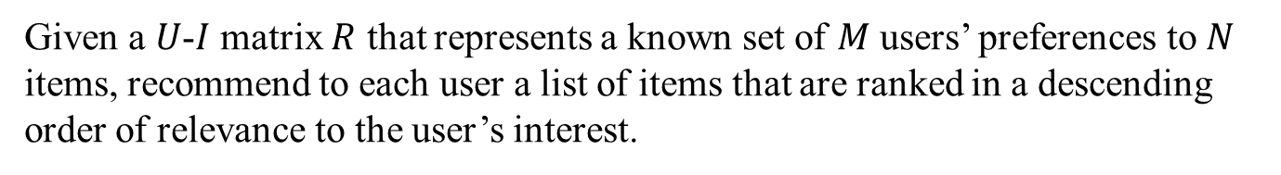
Collaborative filtering
Given a $U$-$I$ matrix $R$ that represents a known set of $M$ users’ preferences to $N$ items, recommend to each user a list of items that are ranked in a descending order of relevance to the user’s interest.

Slide 5
Memory-based
Compute the similarity between users or items.
Model-based
Bayesian networks, clustering models, singular value decomposition, latent Dirichlet allocation…
Hybrid
Combination of memory based and model based model
Context-aware collaborative filtering

Slide 6
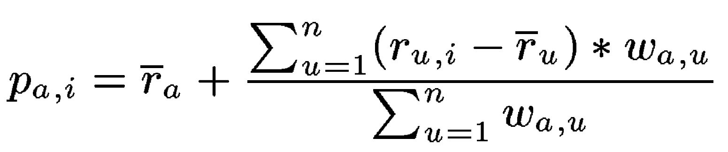
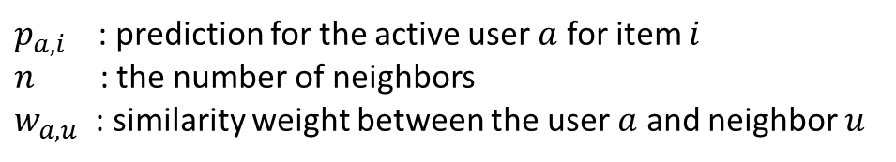

Memory-based
User/item-oriented neighborhood model
$p_{a,i}$ : prediction for the active user $a$ for item $i$
$n$ : the number of neighbors
$w_{a,u}$ : similarity weight between the user $a$ and neighbor $u$
$$ρ=\frac{\sum_{i∈\{I\left(i\right)∩I\left(a\right)\}}{(r_{a,i}−{\overline{r}}_{a})(r_{u,i}−{\overline{r}}_{u})}}{σ_{a}×σ_{u}}$$
Computation of the correlation coefficient is based only on the common user support
Herlocker, Jonathan L., et al. "An algorithmic framework for performing collaborative filtering." Proceedings of the 22nd annual international ACM SIGIR conference on Research and development in information retrieval. ACM, 1999.

Slide 7

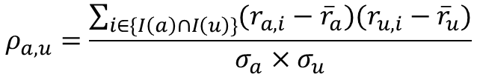
Some problems
$$ρ_{a,u}=\frac{\sum_{i∈\{I\left(a\right)∩I\left(u\right)\}}{(r_{a,i}−{\overline{r}}_{a})(r_{u,i}−{\overline{r}}_{u})}}{σ_{a}×σ_{u}}$$
Similarities based on a greater user support are more reliable
Shrunk correlation coefficient
$$s_{a,u}≜\frac{n_{a,u}}{n_{a,u}+λ_{2}}ρ_{a,u}$$

Slide 8
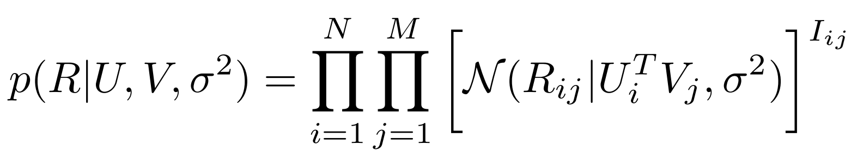
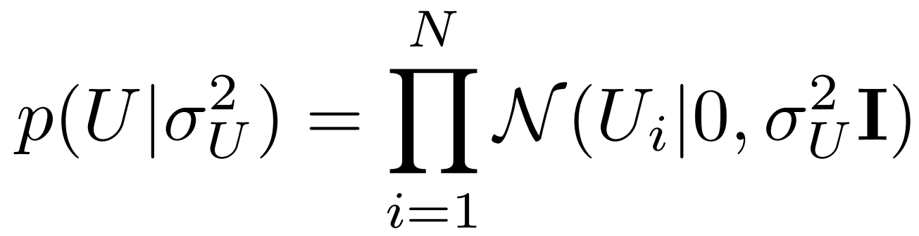
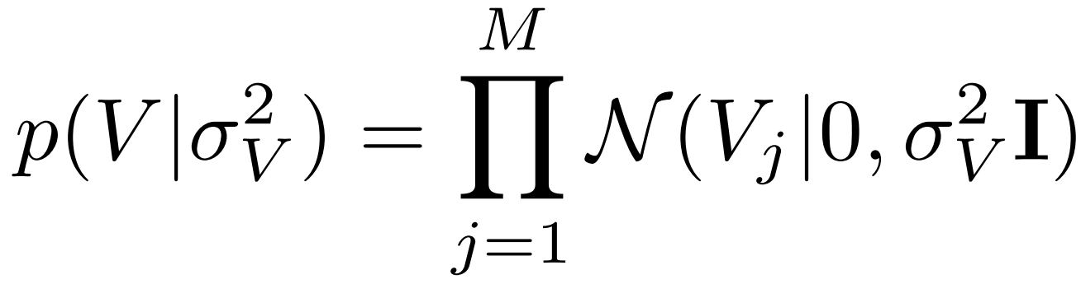
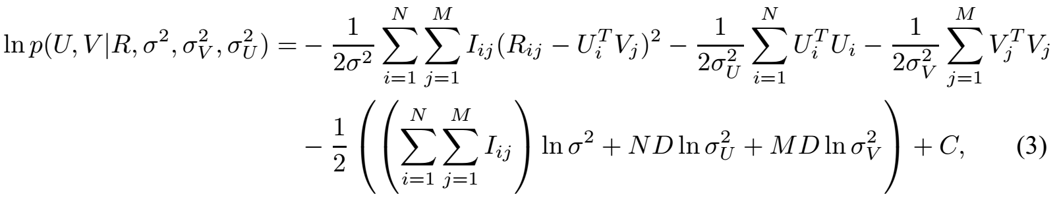
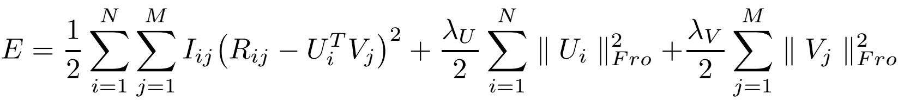

Model-based: Matrix Factorization
Basic matrix factorization model
$$r_{i,j}=U_{i}^{T}∙V_{j}$$
Probabilistic interpretation:
Mnih, Andriy, and Ruslan R. Salakhutdinov. "Probabilistic matrix factorization." Advances in neural information processing systems. 2008.

Slide 9


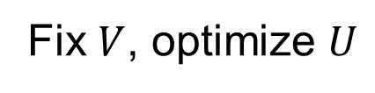
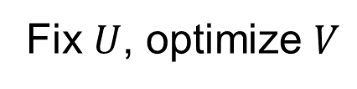
Learning algorithm
Stochastic Gradient Descent
$$U_{i}=U_{i}+γ(e_{i,j}∙V_{j}−λ∙U_{i})$$
$$V_{i}=V_{i}+γ(e_{i,j}∙U_{j}−λ∙V_{i})$$
Alternating Least Squares
Fix $U$, optimize $V$
Fix $V$, optimize $U$

Slide 10


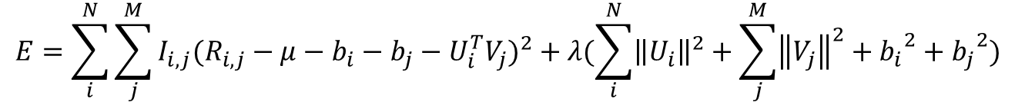
Adding Biases
$$r_{i,j}=U_{i}^{T}∙V_{j}$$
User-item iteration
Effects associated with either users or items, known as biases or intercepts, independent of any interactions.
$$b_{i,j}=μ+b_{i}+b_{j}$$
Minimizing the squared error function
$$E=\sum_{i}^{N}{\sum_{j}^{M}{I_{i,j}{(R_{i,j}−μ−b_{i}−b_{j}−U_{i}^{T}V_{j})}^{2}}}+λ(\sum_{i}^{N}{{\left\|U_{i}\right\|}^{2}}+\sum_{j}^{M}{{\left\|V_{j}\right\|}^{2}}+{b_{i}}^{2}+{b_{j}}^{2})$$

Slide 11
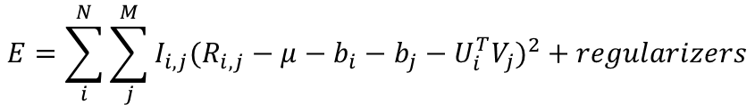

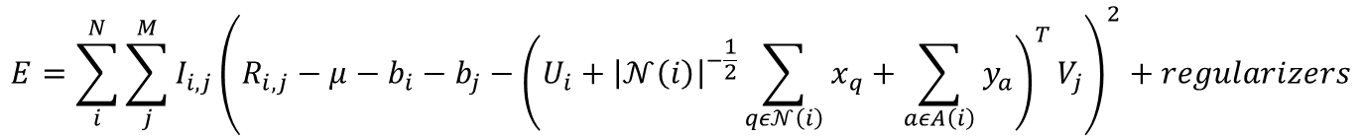
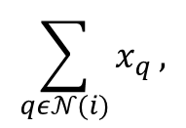

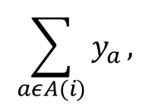
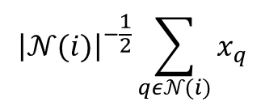
Additional input sources
Implicit feedback
$$\sum_{qε𝒩(i)}{x_{q}},$$
$${\left|𝒩(i)\right|}^{−\frac{1}{2}}\sum_{qε𝒩(i)}{x_{q}}$$
$$x_{q}∈ℛ^{k} ⇒$$
User attributes
$$\sum_{aεA(i)}{y_{a}},$$
$$y_{q}∈ℛ^{k}$$
All together
$$E=\sum_{i}^{N}{\sum_{j}^{M}{I_{i,j}{(R_{i,j}−μ−b_{i}−b_{j}−U_{i}^{T}V_{j})}^{2}}}+regularizers$$
$$E=\sum_{i}^{N}{\sum_{j}^{M}{I_{i,j}{\left(R_{i,j}−μ−b_{i}−b_{j}−{\left(U_{i}+{\left|𝒩\left(i\right)\right|}^{−\frac{1}{2}}\sum_{qε𝒩\left(i\right)}{x_{q}}+\sum_{aεA\left(i\right)}{y_{a}}\right)}^{T}V_{j}\right)}^{2}}+regularizers}$$

Slide 12
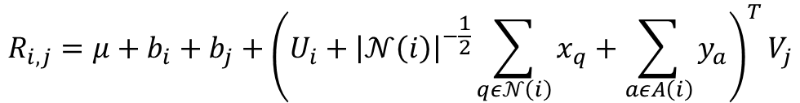
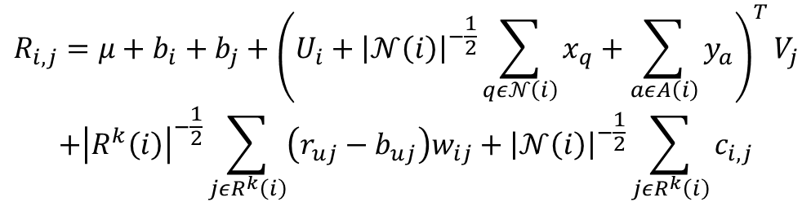
Combination with Memory-based methods
Neighborhood model
SVD
$$R_{i,j}=μ+b_{i}+b_{j}+{\left(U_{i}+{\left|𝒩\left(i\right)\right|}^{−\frac{1}{2}}\sum_{qε𝒩\left(i\right)}{x_{q}}+\sum_{aεA\left(i\right)}{y_{a}}\right)}^{T}V_{j}$$
All together
$$R_{i,j}=μ+b_{i}+b_{j}+{\left(U_{i}+{\left|𝒩\left(i\right)\right|}^{−\frac{1}{2}}\sum_{qε𝒩\left(i\right)}{x_{q}}+\sum_{aεA\left(i\right)}{y_{a}}\right)}^{T}V_{j}$$
$$+{\left|R^{k}\left(i\right)\right|}^{−\frac{1}{2}}\sum_{jεR^{k}\left(i\right)}{\left(r_{uj}−b_{uj}\right)w_{ij}}+{\left|𝒩\left(i\right)\right|}^{−\frac{1}{2}}\sum_{jεR^{k}\left(i\right)}{c_{i,j}}$$
Koren, Yehuda. "Factorization meets the neighborhood: a multifaceted collaborative filtering model." Proceedings of the 14th ACM SIGKDD international conference on Knowledge discovery and data mining. ACM, 2008.

Slide 13
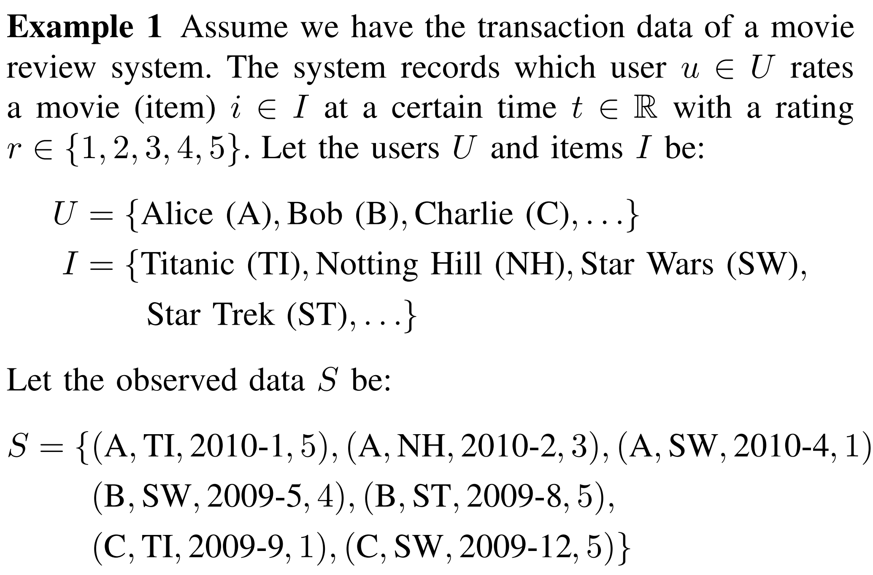
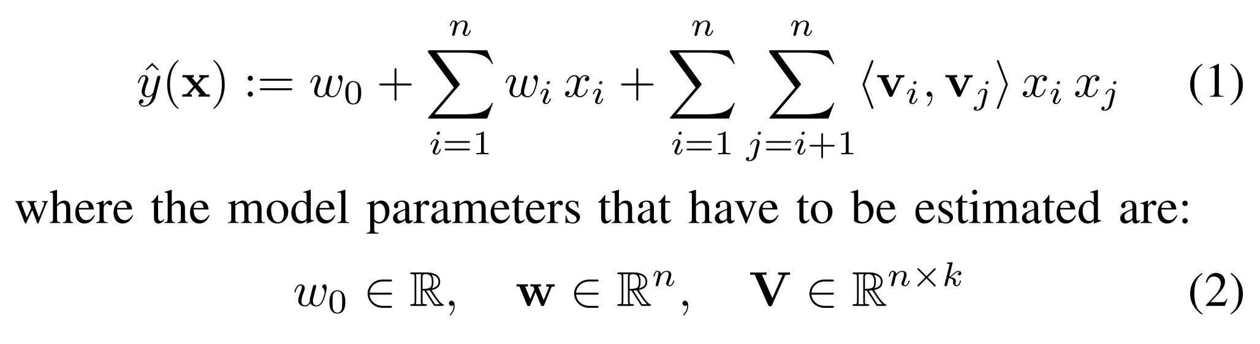
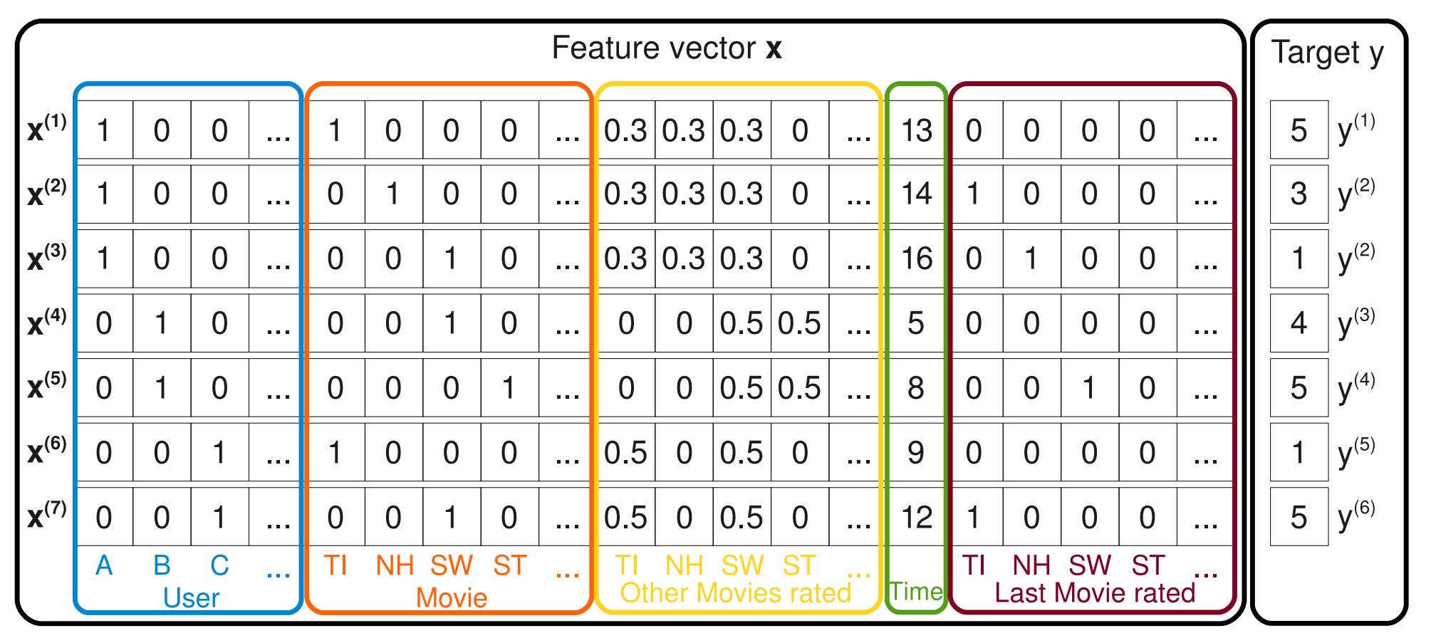
To be a little bit more beautiful
Factorization Machines
Rendle, Steffen. "Factorization machines." Data Mining (ICDM), 2010 IEEE 10th International Conference on. IEEE, 2010.

Slide 14
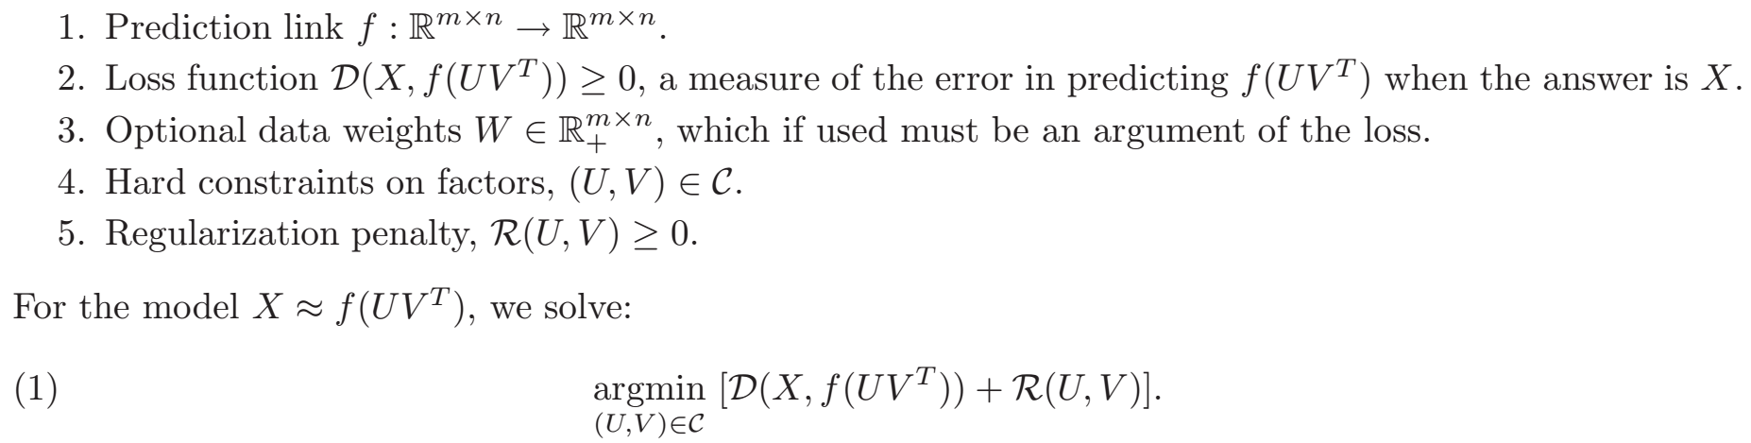
Other works to incorporate side information
Collective Matrix Factorization
Singh, Ajit P., and Geoffrey J. Gordon. "Relational learning via collective matrix factorization." Proceedings of the 14th ACM SIGKDD international conference on Knowledge discovery and data mining. ACM, 2008.

Slide 15
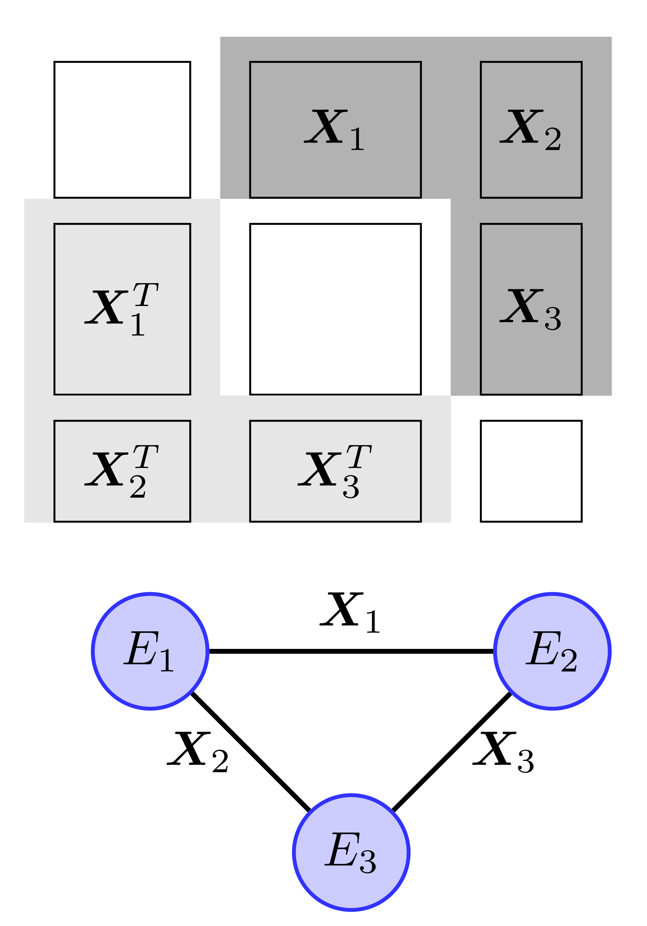
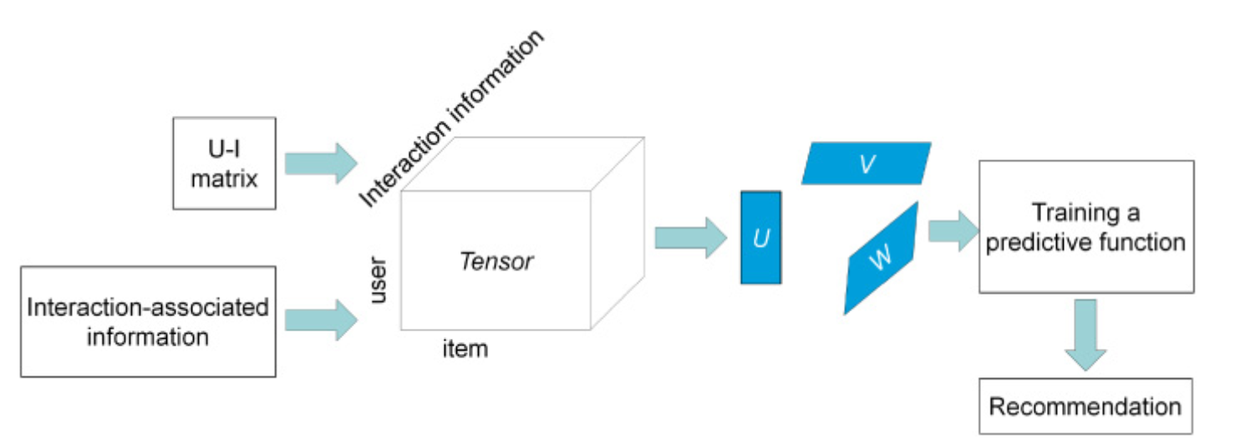
Generation
Bouchard, Guillaume, Dawei Yin, and Shengbo Guo. "Convex collective matrix factorization." Artificial Intelligence and Statistics. 2013.
Kolda, Tamara G., and Brett W. Bader. "Tensor decompositions and applications." SIAM review 51.3 (2009): 455-500.

Slide 16
Interesting work
Social network: follow, trust …
Tag information: short textual labels that users assign to the items
Geotags: location information
Multimedia Content: images and videos
Reviews and Comments: sentiment dimension

