Slide 1
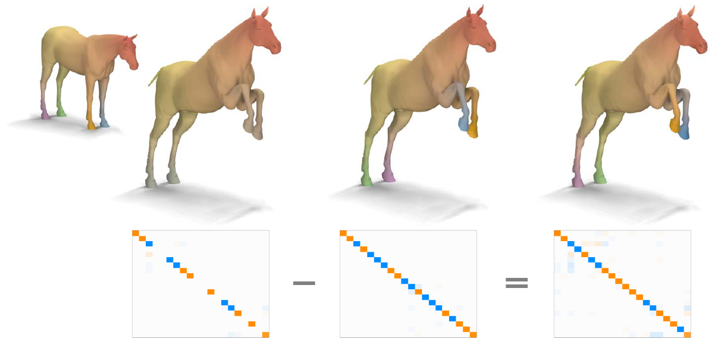
Functional maps: A Flexible Representation of Maps Between Shapes
Maks Ovsjanikov¹ Mirela Ben-Chen² Justin Solomon²
Adrian Butscher² Leonidas Guibas²
¹LIX, Ecole Polytechnique ²Stanford University
SIGGRAPH 2012
Presenter Yunhai@VCC
Notes:
Development of functional maps：http://www.lix.polytechnique.fr/~maks/
-

Slide 2
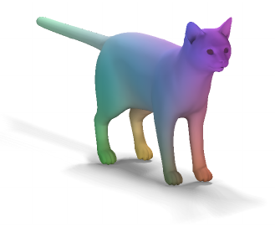
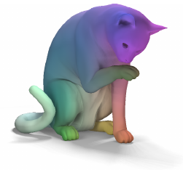
Introduction
Shape matching 形状匹配
Rigid (rotation + translation)
Non-rigid (pairings of points or regions)
   Correspondence
Notes:
针对整个形状的刚性变换：旋转+平移
非刚性变换：点对点或区域对区域的对应关系

Slide 3
Correspondence
The space of correspondences is exponential
Isometric matching: still a QAP (NP-hard)
No map continuity or global consistency
Notes:
大多数非刚性变换 是通过离散的对应关系来表达
- 等构同距假设：一张纸上两点的距离，在弯曲后不会改变
大多数不会是等构同距：皮肤的拉伸
离散对应关系需要大量空间储存，很难表达连续变换

Slide 4
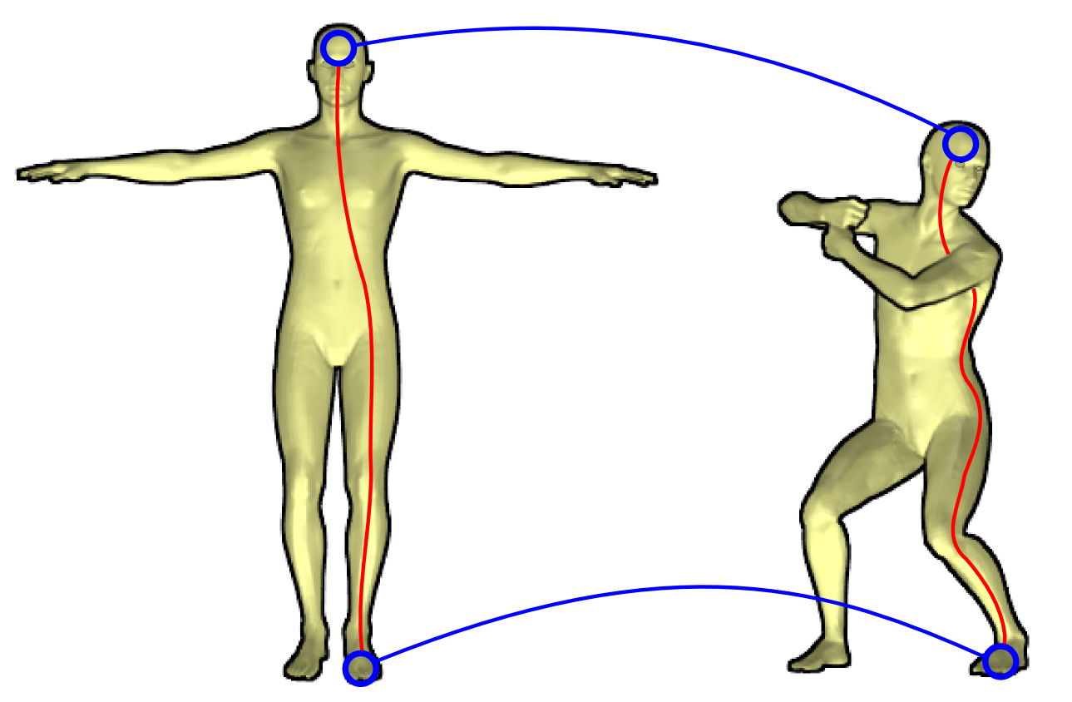
Correspondence
D_{p}
D_{π(p)}
dist(p,q)
dist(π(p), π(q))
D_{q}
D_{π(q)}

Slide 5
This paper
Mappings between functions on the shapes, generalizes the notion of correspondence
Inference and manipulation of maps

Notes:
Generalization: every integer number is a real number, but every real number is not necessarily an integer
论文的主题： 将点对点的对应关系 泛化 到 两个形状上函数之间的映射

Slide 6
Overview
Functional map representation
Properties (basis, continuity, linearity, …)
Inference (obtain a point-to-point map)
Applications
  Shape matching
  Map improvement
  Shape collections
  Segmentation transfer

Slide 7

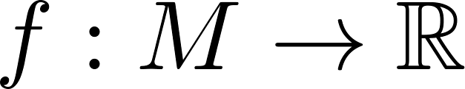
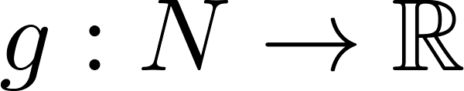
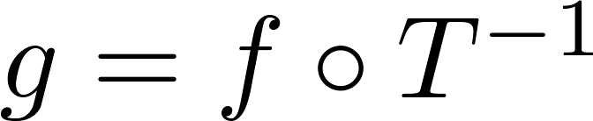


Functional map representation
Bijective mapping
  Manifolds M and N
  T induces a transformation for functions
Given scalar function
We obtain with
Notes:
如何用Functional map 表达pointwise mapping
M，N是两个manifold （流形）
T：是从M到 N双映射—指定一个点对点的对应关系
那么T同时也可以诱导函数映射
Example：f是流形M上的函数，它对应在N上的函数g，可以表达成先找到y在M上对应的点，再计算 f(T^-1(y))

Slide 8

Functional map representation
Bijective mapping
  Manifolds M and N
  T induces a transformation for functions
Given scalar function
We obtain with
Induced transformation
Generic space of real-value functions
T_{F} ：从M的函数空间到N的函数空间的变换
Notes:
诱导变换： TF：是从M的函数空间到N的函数空间的一个变换

Slide 9
Functional map representation
T can be recovered from T_{F}
  Use an indicator function f(a) = 1
T_{F} is a linear map between function spaces
Notes:
给定T_{F} ，我们可以反推出点对点映射 T
ｆ是一个指示函数 for any a in M,
define f_a(x) =1 if x==a otherwise f_a(x) = 0 ,
then T_{F} (f) (y) =g(y) =f T⁻¹(y) = 0 whenever T⁻¹(y) !=a, or 1 otherwise
We’ve found a bijective mapping from a to y
T_{F} F(f) 是函數空間的線性影射:

Slide 10
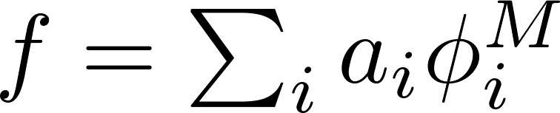
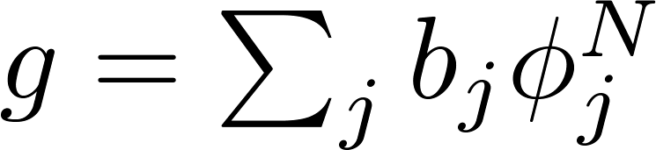
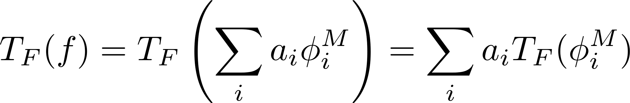
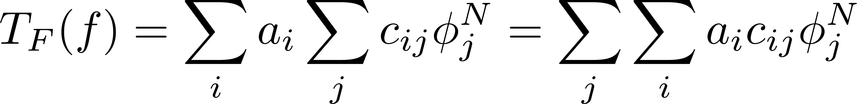
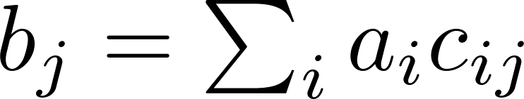

Functional map representation
M and N have sets of basis functions （基函数）
Then, and
So, we can write T_{F} in terms of the bases
用基变更矩阵C来表达T_{F}
C is then like a change of basis matrix
Notes:
既然M N 有各自的函數空間，我們可以找到各自一組基函數phi M 和 phi N ，
所有M里的函數都可以寫作phi M 的線型組合，所有N里的函數都可以寫作phi N的線性組合
那麼T_{F} 就能用一個基变更矩阵C來表達
首先注意，变换后的M的基函数， 可以写作N的基函数的线性组合
接着，对任意一个函数f，拆分成f的基函数，系数b就可以写作矩阵C与a的乘积
T_F(\phi_i^M) = \sum_j c_{ij}\phi_j^N

Slide 11
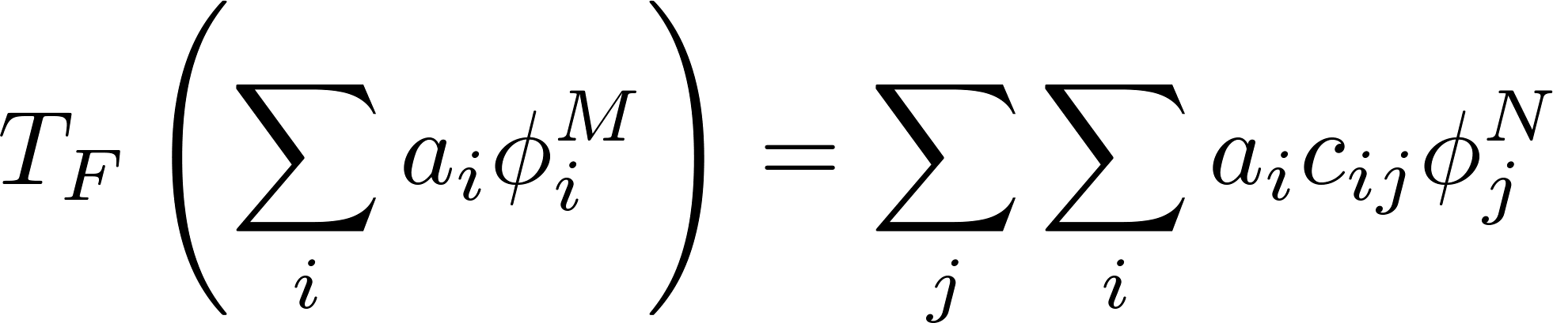
Functional map representation
Generalized linear functional mapping
Notes:
完整定义
- 如何选择基函数？

Slide 12
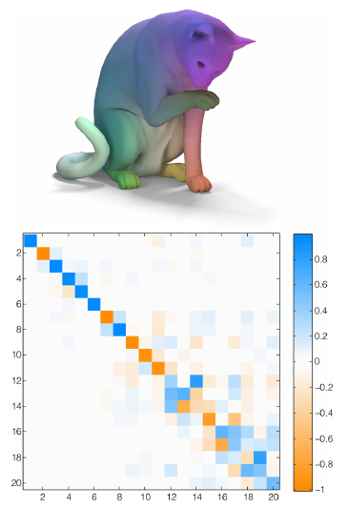
Examples of functional maps
Using Laplace-Beltrami eigenfunctions
Linear functional mapping is a 20x20 matrix
Notes:
右下脚是矩阵C的例子 在左右两边的函数空间里，我们各取了20个基函数
Near Isometric 即使姿势不同，头对应头的转换是接近isometric等距同构，所以变换矩阵是稀疏的接近对角
如果矩阵是对角的，说明我们只是将一个M的基函数，对应到了N的基函数
If the matrix is diagonal, we can think of it as the mapping between the eigenfunctions on the shapes.

Slide 13
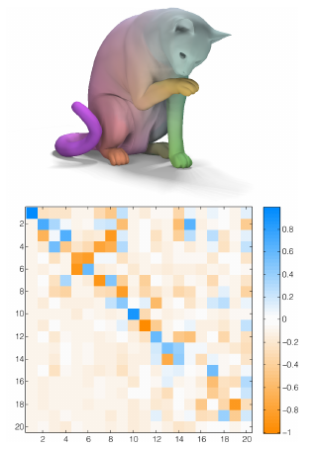
Examples of functional maps
Notes:
但是把头对应到尾巴的转换矩阵并不悉数

Slide 14
Properties: choice of basis
Example of basis
  Indicator functions  Permutation matrix
Motivation
  Reduce representation complexity
  Better suited for continuous mappings
Choose based on compactness and stability
Notes:
如何选择基函数？
使用indicator function指数函数，等于一个点对点置换矩阵

Slide 15
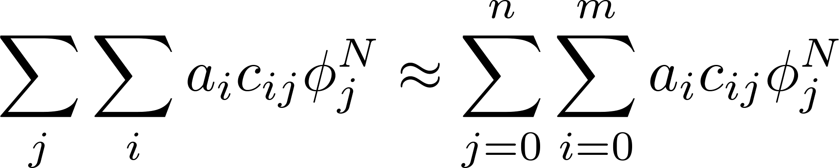
Properties: choice of basis
Compactness: most natural functions should be well approximated by a few basis elements
Stability: the space of functions spanned by all linear combinations of basis must be stable under small shape deformations
Notes:
紧凑：只用少量的基函数就能表达大多函数
稳定：在小的形状扭曲下基函数代表的空间稳定

Slide 16
Properties: choice of basis
Laplace-Beltrami eigenfunctions as the basis
Although individual eigenfunctions are unstable, space of functions spanned is “stable”

Slide 17



Laplace-Beltrami Eigenfunctions
拉普拉斯-贝尔特拉米 基函数
The Laplace-Beltrami operator is the divergence of the gradient （梯度的散度）
The Laplacian Eigenvalue problem:
Discrete Laplace-Beltrami operator:
Results in an orthonormal eigensystem

Slide 18
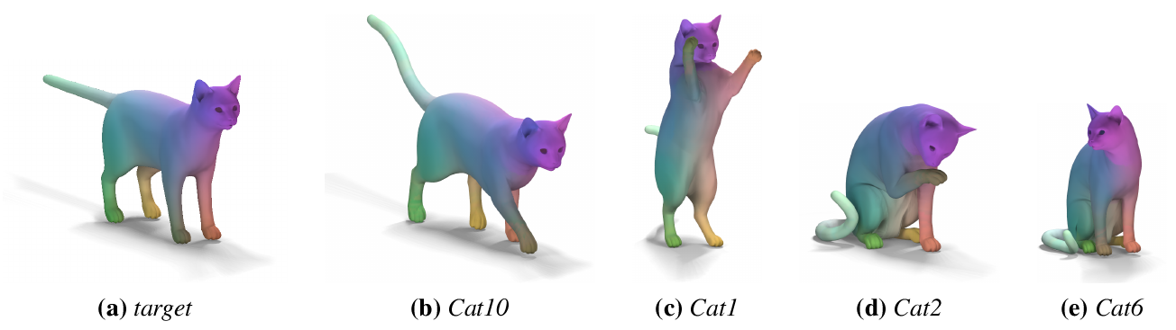
Properties: choice of basis
Compare two discretizations of the Laplace-Beltrami operator [Meyer et al. 2002]
  With and without area normalization

Slide 19
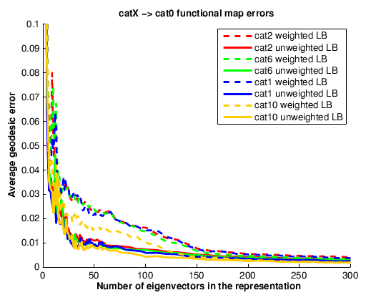
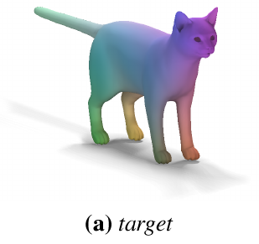
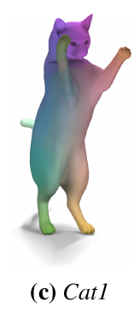
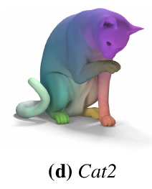
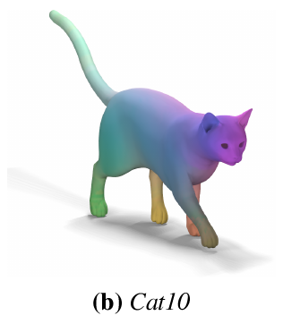
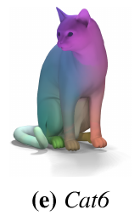
Properties: choice of basis
With a 40x40 matrix, we have 17 times memory savings over a permutation of size 27.8K
Good quality
Meshes: 27.8K points

Slide 20
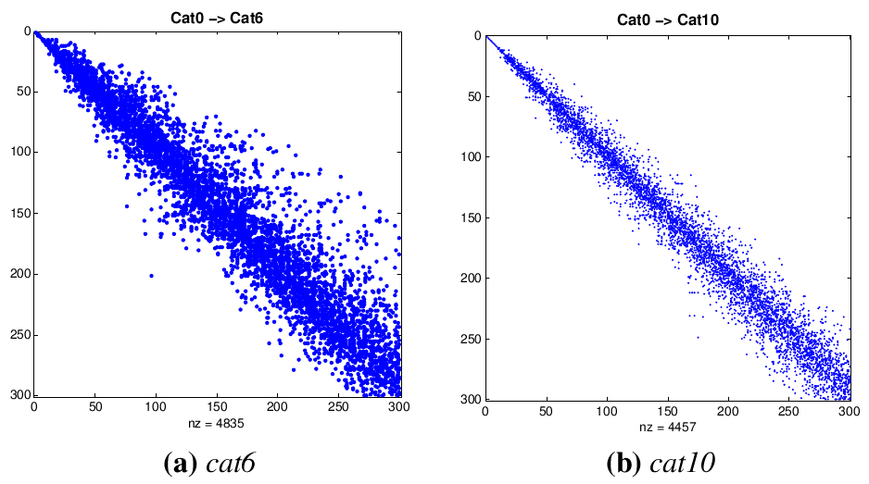
Properties: choice of basis
Plus: near-isometric maps induce sparse matrices
Notes:
if all eigenvalues are non-repeating,
C is a diagonal matrix. In practice, we observe that if T is only approximately
an isometry, the matrix C is still close to being sparse,
or funnel-shaped.
紧凑：只用少量的基函数就能表达大多函数

Slide 21

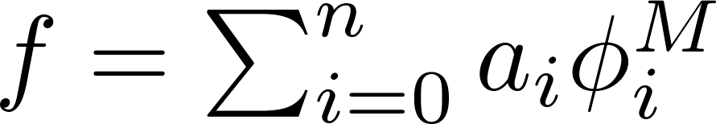
Properties: continuity
Naturally handles map continuity
Three types of continuity:
  Changes of the input function
  Image varies continuously under changes of a
  Image function
  Laplace-Beltrami is well-suited for smooth functions
  is smooth
  Representation
    Any matrix C is a functional mapping
Notes:
实现 函数的连续性
线性变换laplace基函数的悉数，得到的函数也是线性的

Slide 22
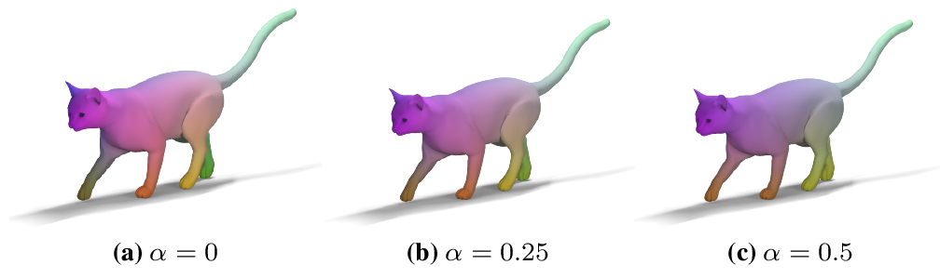
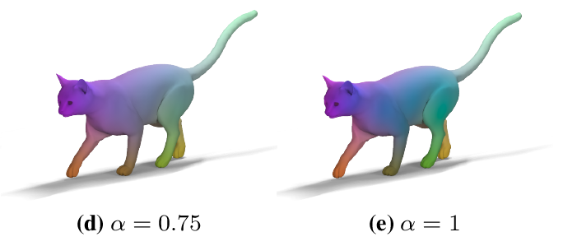
Properties: continuity
Mapping obtained using an interpolation between two maps: C = αC₁ + (1- α)C₂
Notes:
Direct and symmetric shape matching

Slide 23
Properties: linearity of constraints
在functional 空间里，许多形状匹配的约束是线性的
Descriptor preservation, e.g., f(x) = κ(x)
  Function pres. implies approximate desc. pres.
Landmark point correspondences
  Use f(x) that is distance function to the landmark
Segment correspondences
  Also distance functions or indicator functions
Notes:
Diffeomorphism or smooth mapping function
Functional map有很多好的性质：首先
在functional 空间里，许多形状变换的约束是线性的
特征点的维持
landmark点的对应关系： 将函数f定义为从x到所有landmark的距离
- 部分/区域的对应关系

Slide 24



Properties: operator commutativity
算子的交换
W.r.t. linear operators on the shapes
  E.g., symmetry
An example
  C is a map between a man and a woman
  R_{F} ,S_{F} is the map the left hand to right hand on the woman and man, respectively
  Man ->Woman, Woman left->Woman right Man left -> Woman right
  Man left -> Man Right Man -> Woman Man Left -> Woman Right
Notes:
性质二：算子可交换
举个例子

Slide 25
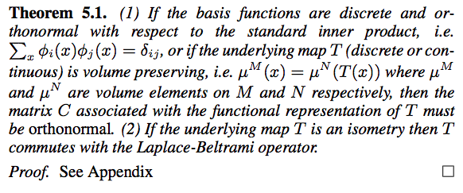
Properties: regularization constraints
矩阵C的 归一化约束
Not every matrix C is a point-to-point map
It is most meaningful to consider orthonormal or nearly-orthonormal functional matrices
Notes:
性质三：矩阵C的 归一化约束

Slide 26
Map inversion and composition
映射的反演与合成
Finding an inverse of a map that is not a bijection can be challenging
In the functional case, an inverse is given simply by the inverse of the matrix C
A good approximation is the transpose of C
Composition becomes matrix multiplication

Slide 27
Functional map inference
学习两个shape之间的Functional Map
Construct a large system of equations
Each equation is one constraint
Constraint for function preservation
Find the matrix C that satisfies the constraints
In fact, we will need many constraints to obtain C in a least-squares sense
Thus, we need candidate point-to-point or segment-to-segment correspondences
Notes:
从形状数据中学习Functional Map

Slide 28
Map refinement and conversion
矩阵C 的优化
Refine C and convert to a point-to-point map
For each point x is the source embedding
Find closest point x’ in the target embedding
Find the optimal C by minimizing Σ|Cx – x’|
Iterate this procedure
Similar to spectral matching [Jain et al. 2007]
Differences
  Good initial estimate C
  “Mixing” across eigenvectors

Slide 29
Applications: shape matching
形状匹配算法
Compute Laplace-Beltrami eigenfunctions
Compute shape descriptors (WKS)
Compute segment correspondences
Add constraints into a linear system and solve
Refine the solution C
Obtain point-to-point correspondences

Slide 30
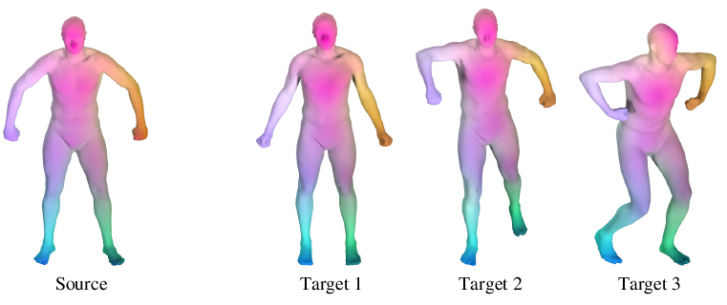
Applications: shape matching
Applied on the benchmark of Kim et al. 2011
Examples of correspondences obtained

Slide 31
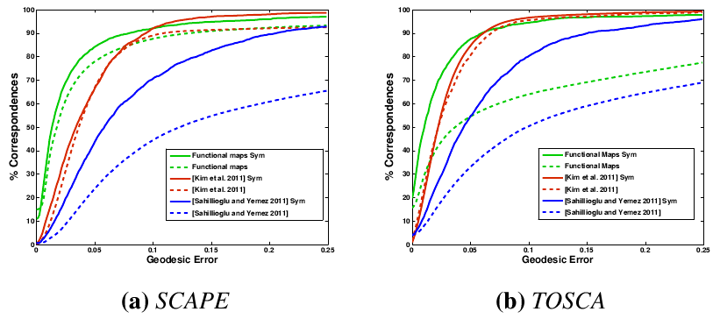
Applications: shape matching
Correspondence results on two datasets

Slide 32
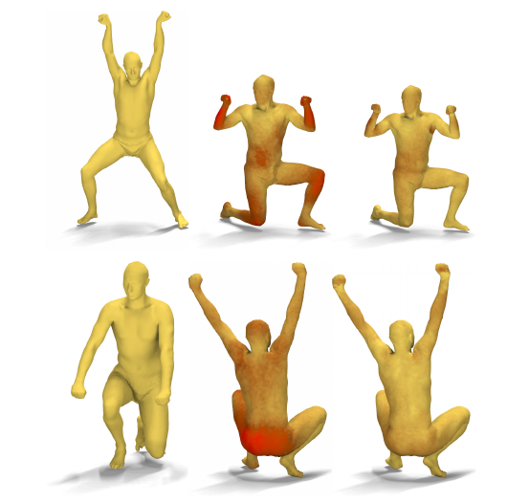
Applications: map improvement
Color shows location of errors
Notes:
将其他方法计算出的点对点对应关系进行优化，用functional map表达，加归一与约束，再重新转化为T

Slide 33
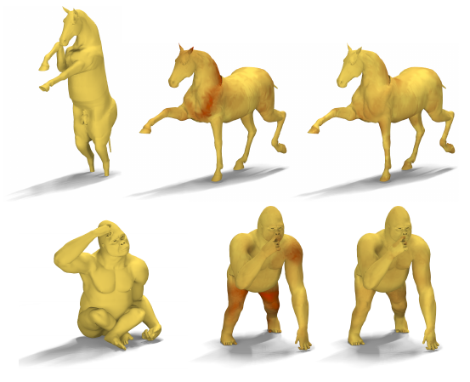
Applications: map improvement
Color shows location of errors

Slide 34
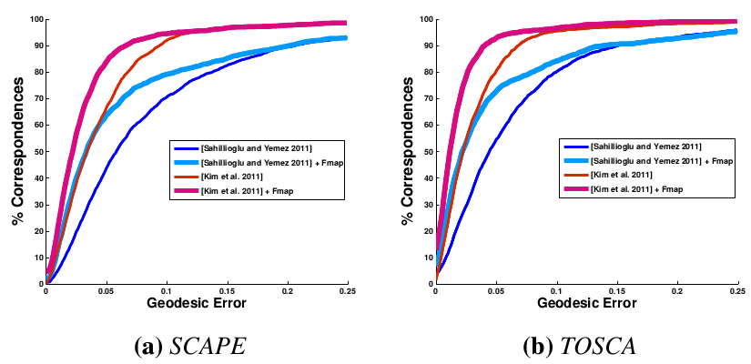
Applications: map improvement
Evaluation on the benchmark

Slide 35
Later development based on functional maps

Slide 36
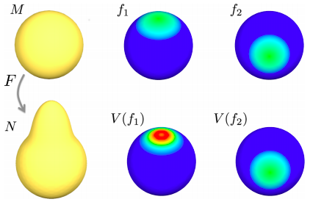
Shape Difference
Shape difference operator V encodes how much f is distorted by F
Notes:
http://geometry.stanford.edu//papers/roabcg-mbeisdv-2013/roabcg-mbeisdv-2013.pdf

Slide 37
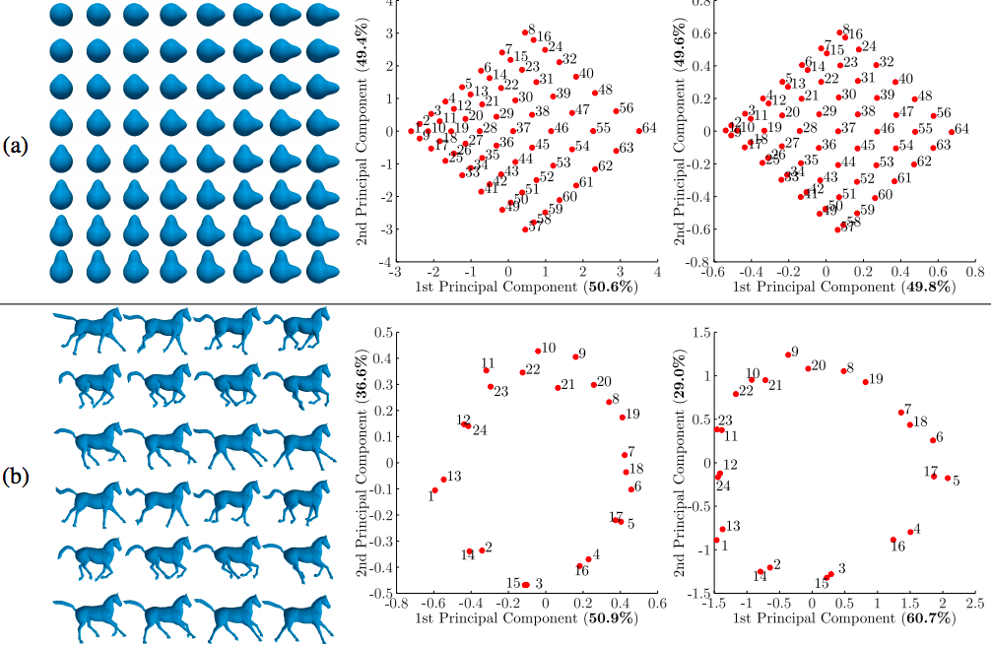
Shape Difference
Exlores the variabilities in a shape collection
Notes:
Inner product (*) of two functions are preserved under functional map
Shape difference = linear operator that aligns the inner products in two space for any pair of functions

Slide 38
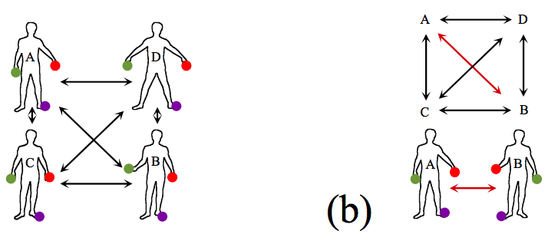
Consistent Shape Maps
Cycle consistency：any composition of maps between two shapes should be independent of the path chosen in the network
Notes:
replace a “bad” pairwise map with the composition of a few “good” maps between shapes
A. Nguyen, M. Ben-Chen, K. Welnicka, Y. Ye, and L. Guibas, An Optimization Approach to Improving Collections of Shape Maps, Computer Graphics Forum (Proceedings of SGP 2011), 2011, 30(5): 1481-1491.

Slide 39
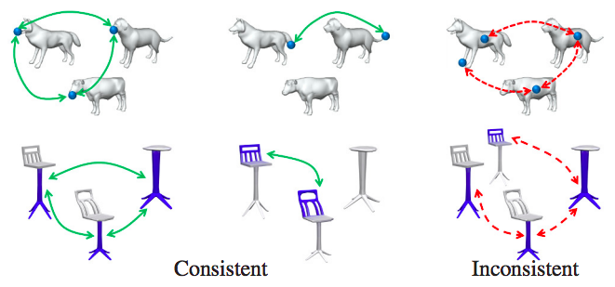
Consistent Shape Maps
Notes:
replace a “bad” pairwise map with the composition of a few “good” maps between shapes
A. Nguyen, M. Ben-Chen, K. Welnicka, Y. Ye, and L. Guibas, An Optimization Approach to Improving Collections of Shape Maps, Computer Graphics Forum (Proceedings of SGP 2011), 2011, 30(5): 1481-1491.

Slide 40
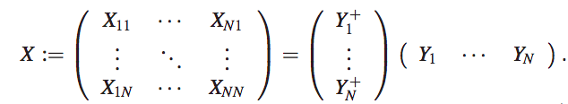
Functional Map Network
X_{ij}: functional map from shape S_{i} to S_{j}
A consistent functional map network can be decomposed into row orthogonal matrices:
a latent functional space L
Notes:
Functional map network: Xij:
The rows of Y = (Y1, · · · ,YN) essentially describe a latent functional space L, such that Yi represents the map from each functional space Fi to this latent space, and Y + i characterizes the inverse

Slide 41
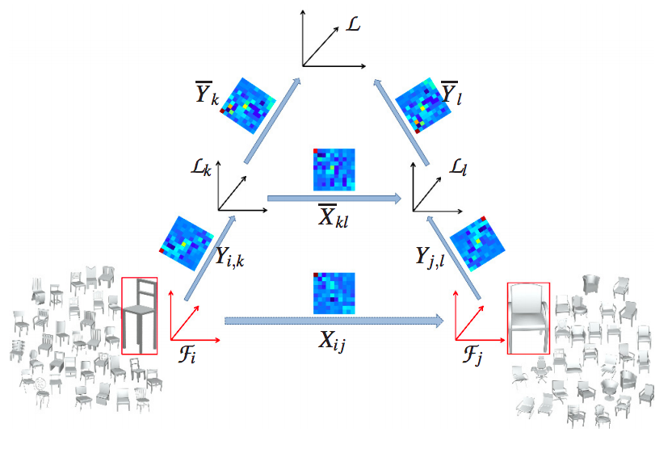
Functional Map Network

Slide 42
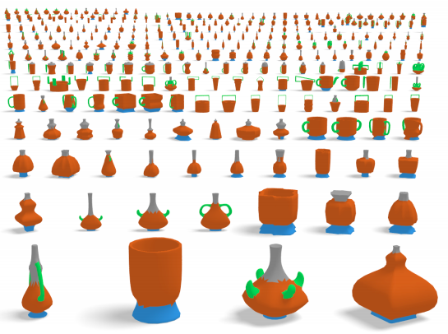
Joint Object Segmentation

Slide 43
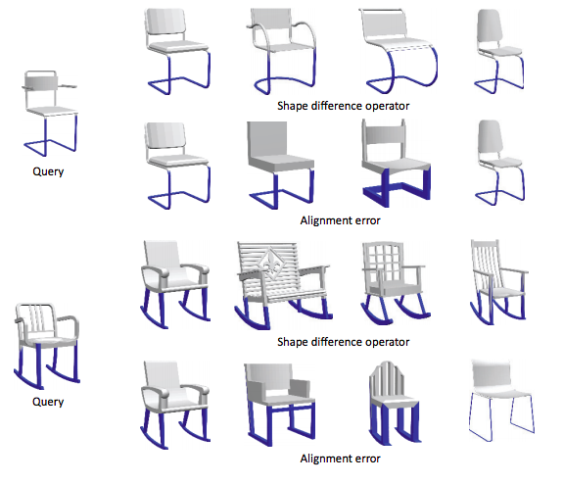
Shape Query by ROI

Slide 44
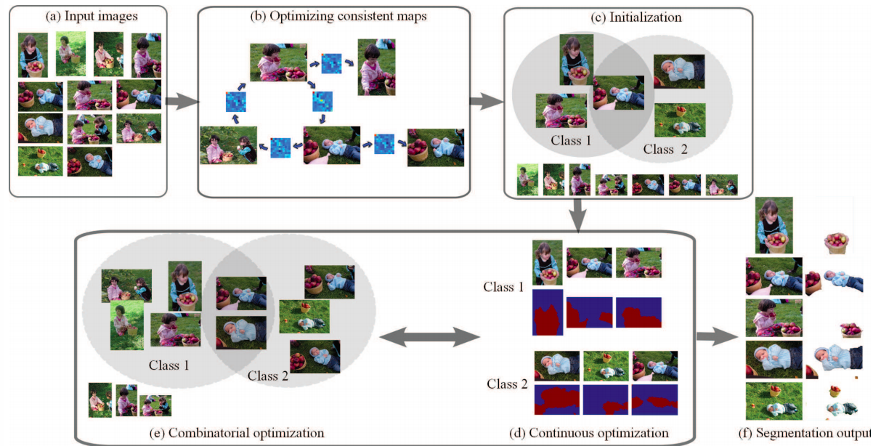
Joint Image Segmentation

Slide 45
Relation to ACE
Consistent functional map network finds the shared components among a collection of images as low-dimensional subspaces of the functional spaces of these images
“Note that this idea is similar to the functional representation we derived [ACE], except that the consistent functional map network considers the transition maps between shapes that are deterministic , while we consider stochastic maps between random variables.”
Notes:
寻找图片集函数空间共同的低维子空间，
Consistent functional map network is to formulate the shared components as low-dimensional subspaces of the functional spaces of
images
…Note that this idea is similar to the functional representation we derived [ACE], except that the consistent functional map network considers the transition maps between shapes that are deterministic
278 maps, while we consider stochastic maps between random variables.

