Slide 1
Computational Topology for Data Analysis
Chapter1: Basic Topology
July 5, 2022

Slide 2
Outline
Topological space
Metric space
Map, homeomorphism, and homotopy
Manifold
Morse function
Gradient vector field
Handlebodies

Slide 3
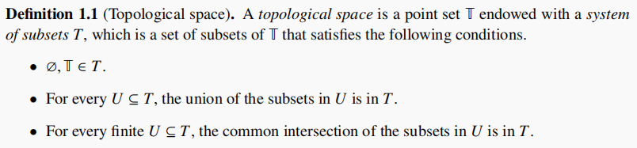

Topological space
Connectivity: a topology specifies how the points are connected by listing out what points constitute a neighborhood(open set).

Slide 4

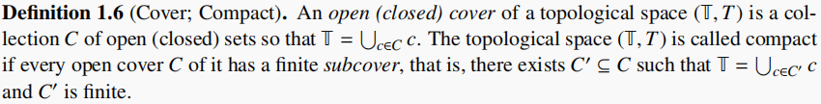
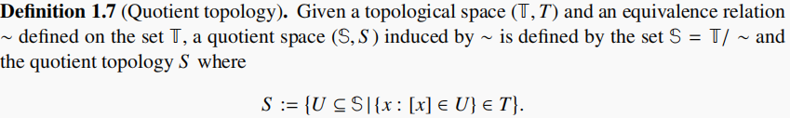
Topological space

Slide 5
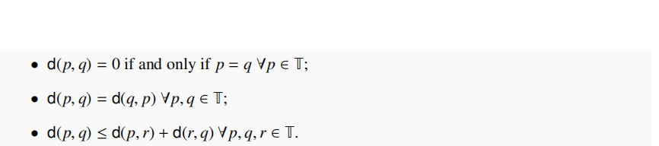
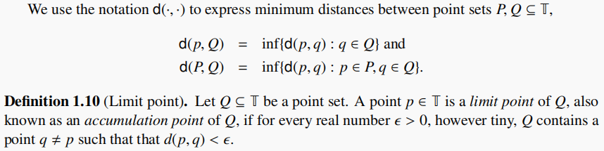
Metric space

Slide 6
Metric space

Slide 7
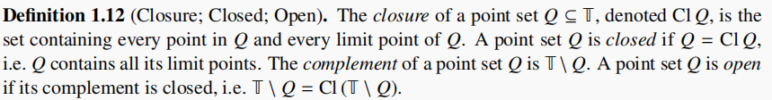


Metric space
In Euclidean space,we define:

Slide 8
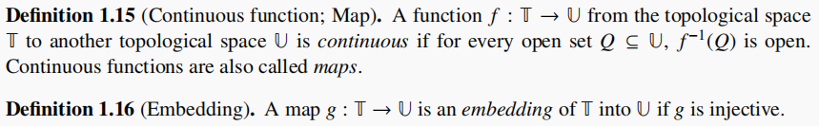
Map, homeomorphism, and homotopy
Definition(inclusion): a injective map from a set to another set.

Slide 9
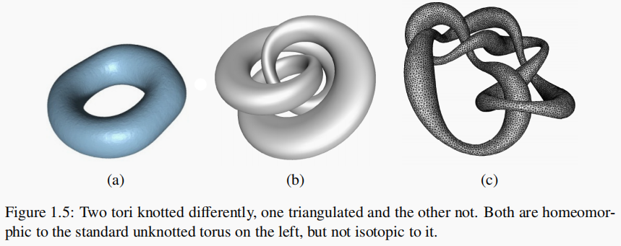
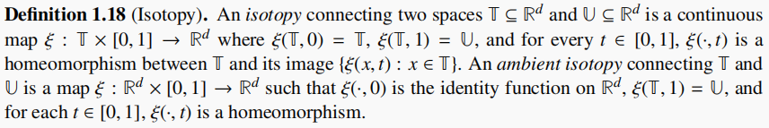
Map, homeomorphism, and homotopy

Slide 10

Map, homeomorphism, and homotopy
Homotopy preserves some form of connectivity, such as the number of connected components, holes, and/or voids.
Algebraic topology records these features using some structures like homology group.

Slide 11
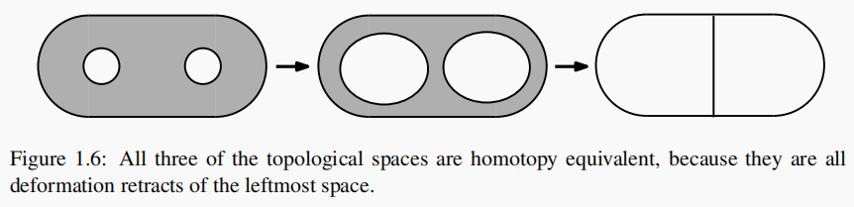
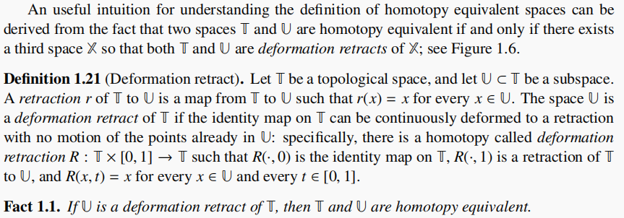
Map, homeomorphism, and homotopy

Slide 12
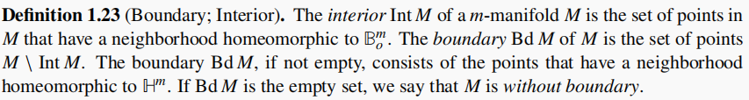
Manifold

Slide 13
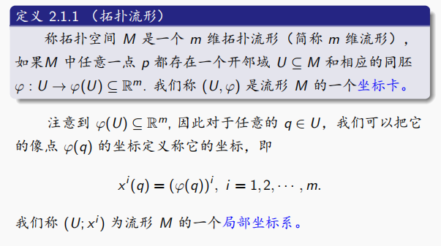
Manifold

Slide 14
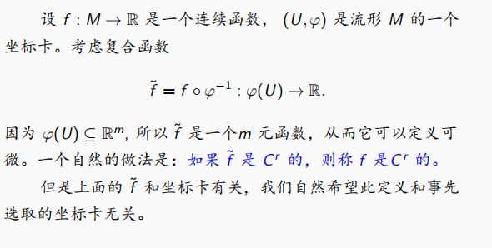
Manifold

Slide 15
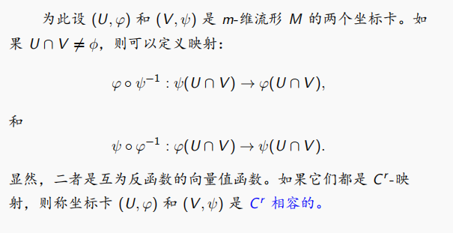
Manifold

Slide 16
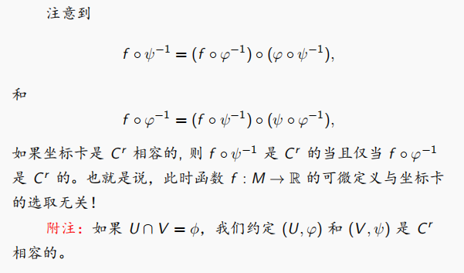
Manifold

Slide 17
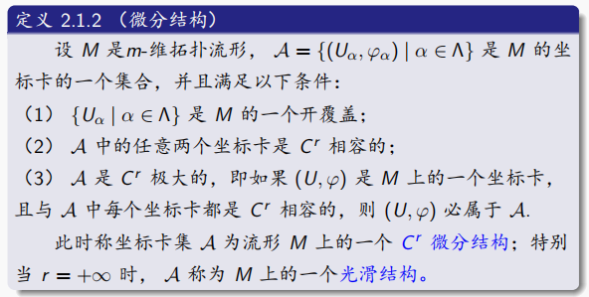
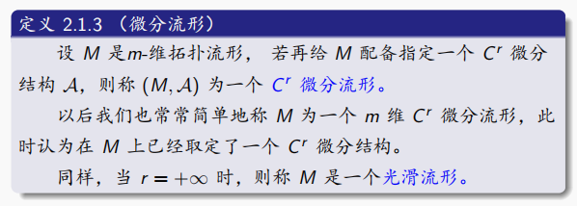
Manifold

Slide 18
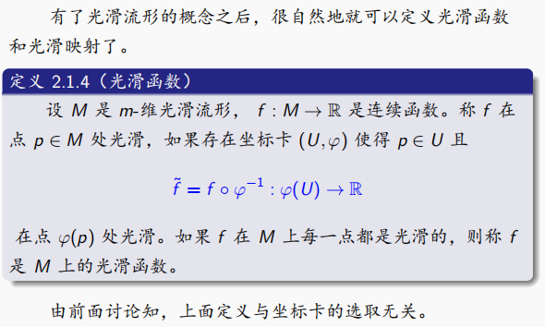
Manifold

Slide 19
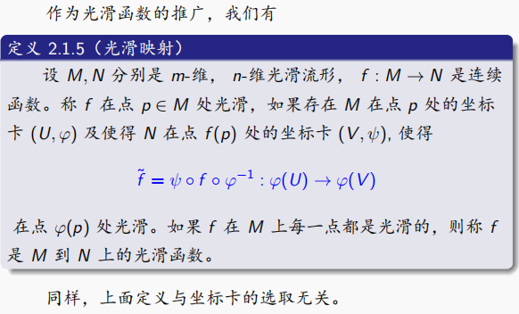
Manifold

Slide 20
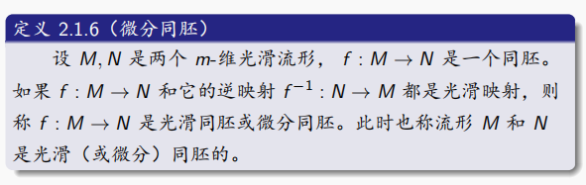
Manifold

Slide 21
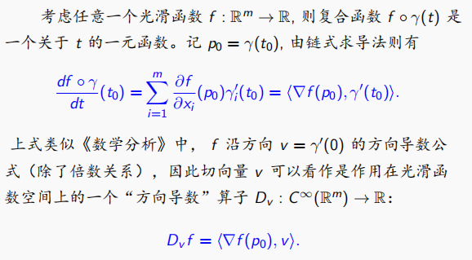
Manifold

Slide 22
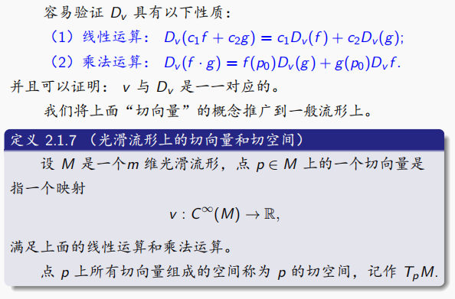
Manifold

Slide 23
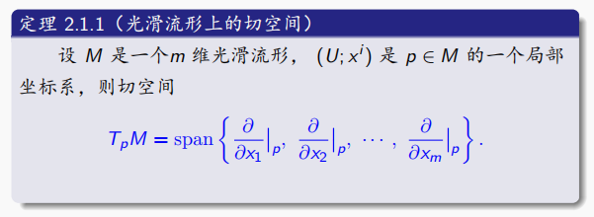
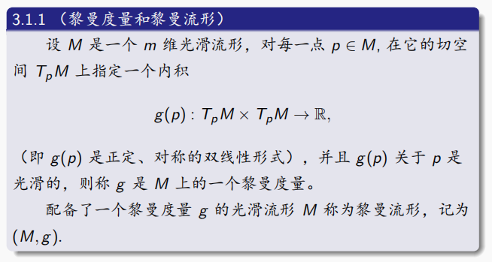
Manifold

Slide 24
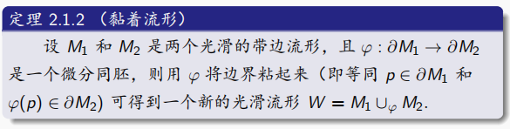
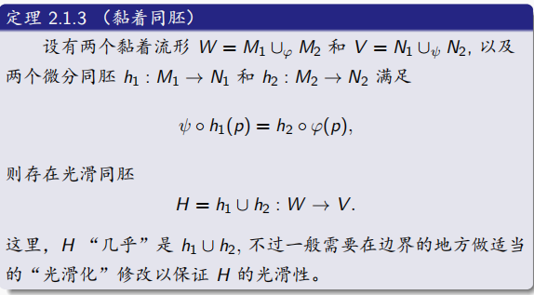
Manifold

Slide 25
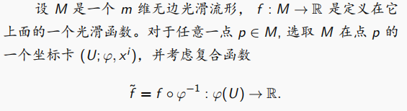
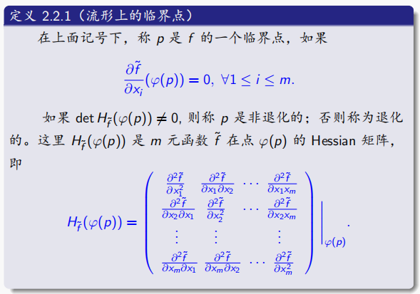
Morse function

Slide 26
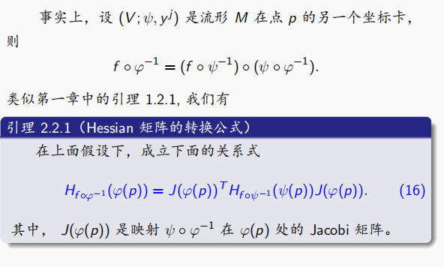
Morse function

Slide 27
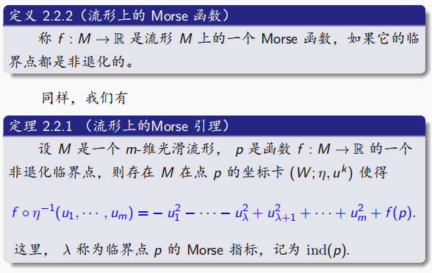
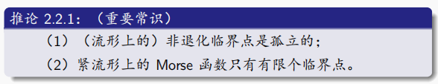
Morse function
Q

Slide 28
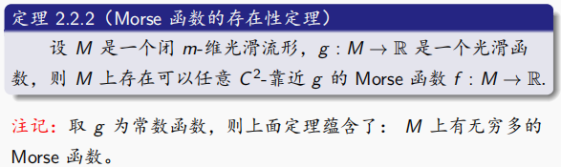
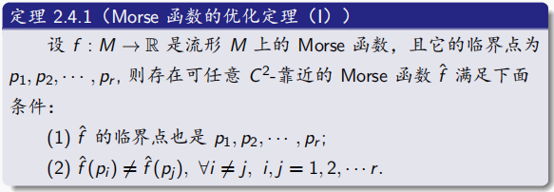
Morse function

Slide 29
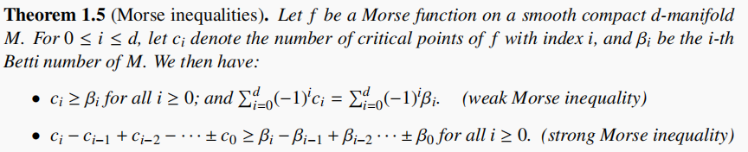
Morse function

Slide 30
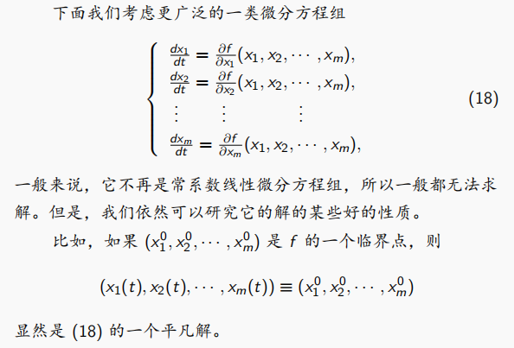
Gradient vector field

Slide 31
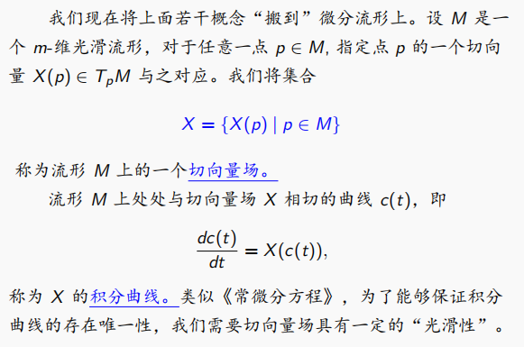
Gradient vector field

Slide 32
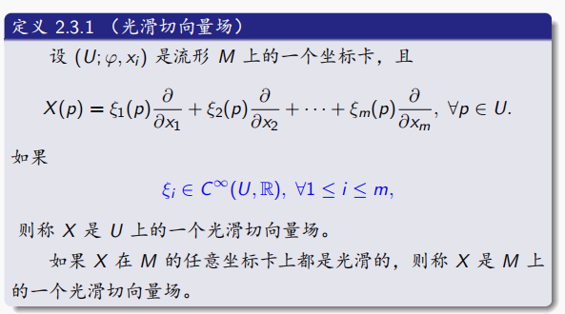
Gradient vector field

Slide 33
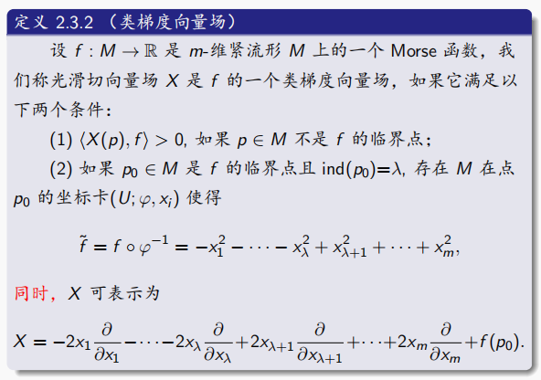
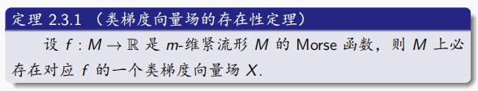
Gradient vector field

Slide 34
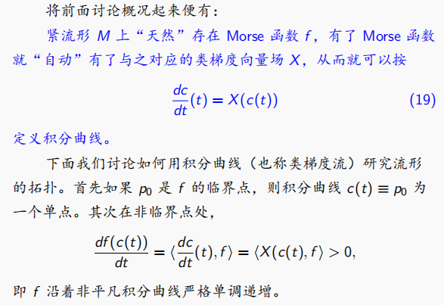
Gradient vector field

Slide 35
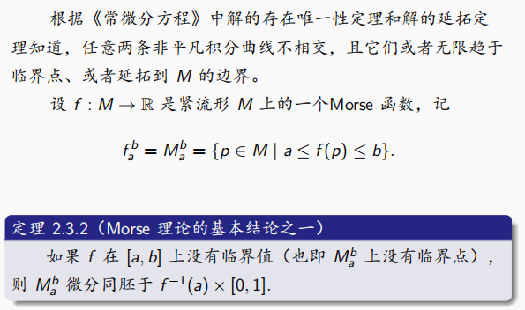
Gradient vector field

Slide 36
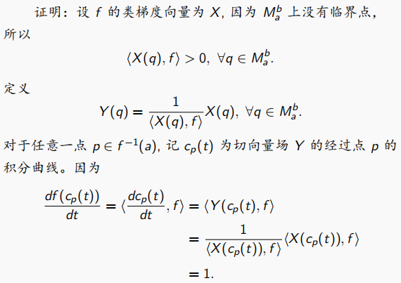
Gradient vector field

Slide 37
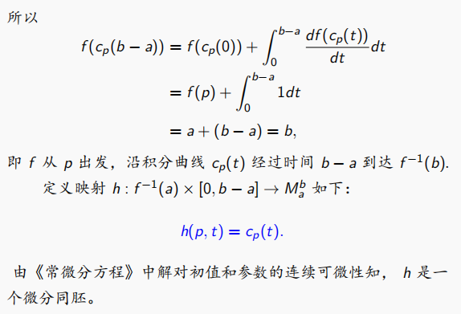
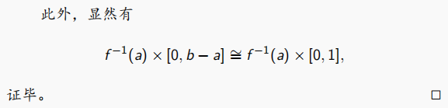
Gradient vector field

Slide 38
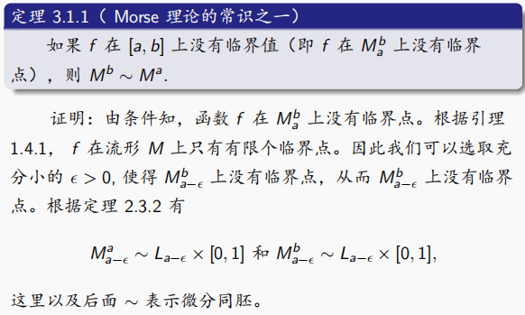
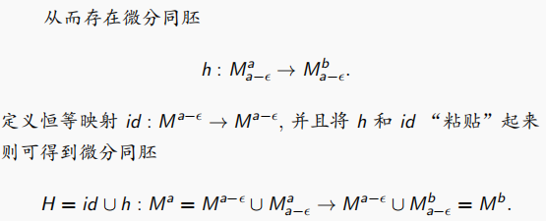
Gradient vector field

Slide 39
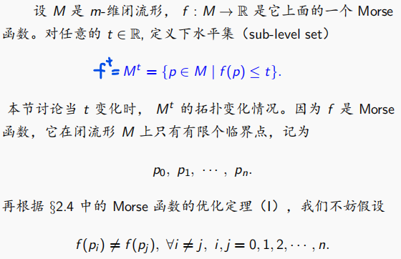

Handlebodies

Slide 40
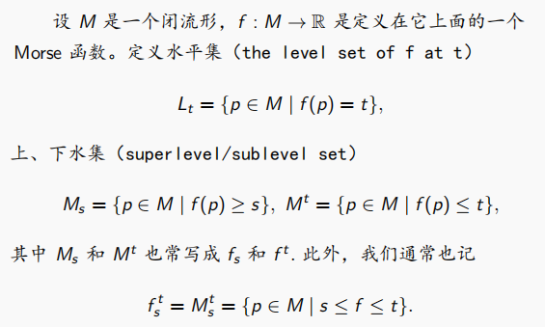
Handlebodies

Slide 41
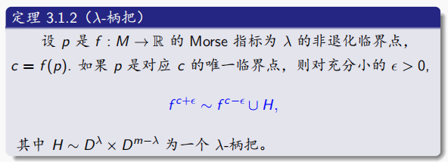

Handlebodies

Slide 42
Handlebodies
例子：M为竖放的环面，f为高度函数，考虑其柄把分解。

Slide 43


Handlebodies

Slide 44

Handlebodies

Slide 45

Handlebodies

Slide 46

Handlebodies

Slide 47

Handlebodies

Slide 48

Handlebodies

