Slide 1


Topological Data Analysis Enhanced Pedestrian Group Detection and Trajectory Prediction
Zixi Zhao
Advisor: Prof. Yang Li
Nov. 2024

Slide 2
Outline
Introduction
Related Work
Methodology
Experiment
Schedule

Slide 3
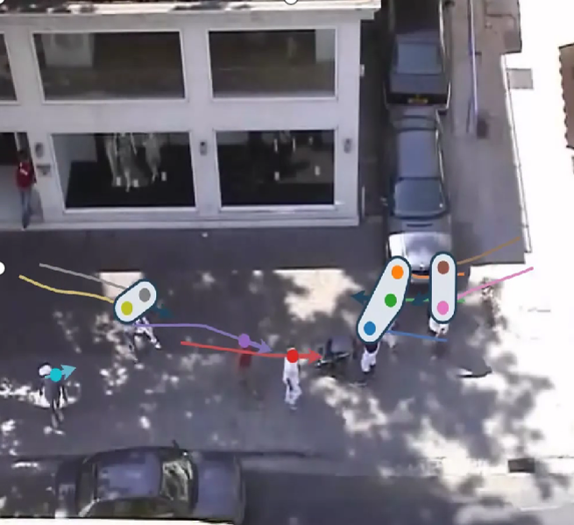
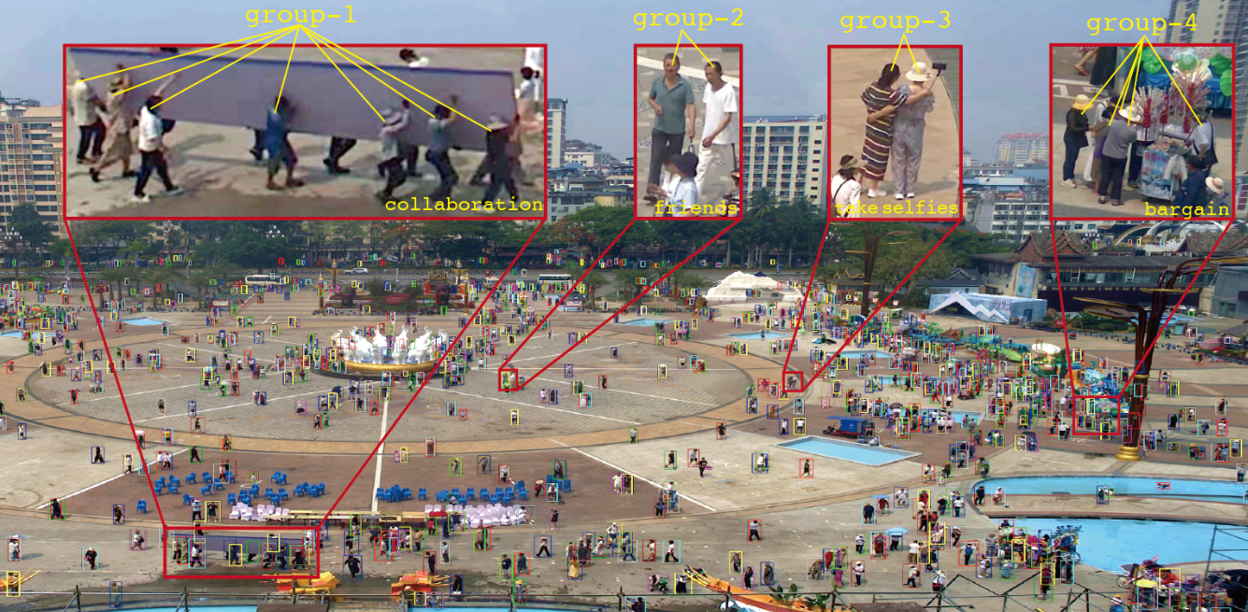
Introduction: Background
Pedestrian Trajectory Prediction:
Predicting future paths based on historical movement.
Complexity involves individual behaviors and interactions.
Collaborative movement: up to 70% of pedestrians move in groups.
Notes:
Pedestrian trajectory prediction is an important research area focused on predicting
where individuals are likely to move based on their past behavior.
However, this task is complex because it’s not just about individual movement—pedestrians interact with each other and their environment.
A common behavior is collaborative movement, where people often form groups,
often share the same destination or influenced by social interactions.
In fact, research shows that up to 70% of people in a crowd move in groups,
making it crucial to accurately model these collective dynamics in order to predict movement more effectively.

Slide 4
Introduction: Motivation
Limitations:
Many existing methods focus mainly on individual behaviors, and struggling with group coherence.
Lack of ability for modeling high-order social topology structures.
Opportunity:
Leverage topological data analysis (TDA) to enhance the understanding of high-order group structures.
Dynamic community detection and stability across snapshots.
Notes:
“Current models largely focus on individuals, which leads to challenges in representing the group dynamics that naturally emerge in crowded settings.
Furthermore, These traditional models often have difficulty in maintaining group coherence,
which means they struggle to properly capture the true underlying patterns of pedestrians trajectory.
This brings some opportunity for improvement:
the existing models haven’t fully leveraged topological data analysis (TDA) to enhance the understanding of high-order group structures.
Additionally, dynamic community detection methods can benefit from stability,
as relationships between pedestrians tend to change smoothly.
.”

Slide 5
Introduction: Research Goal
Integrate TDA to enhance trajectory prediction.
Capture both human-level and group-level topological features. Ensure topological consistency across snapshots.
Develop a plugin model for trajectory prediction.
Improve prediction accuracy, particularly in complex environments.
Notes:
The goal of our research is to fill this gap by integrating topological data analysis into pedestrian trajectory prediction.
Specifically, we want to capture both human-centric topological features and higher-order structures, while maintaining topological consistency across time.
Our approach will develop a plugin model that can be easily added to existing frameworks.
By leveraging TDA, we aim to enhance the model’s ability to represent complex crowd behaviors
and, ultimately, improve the accuracy of pedestrian movement predictions—
especially in challenging, crowded environments where traditional methods may fall short.

Slide 6
Outline
Introduction
Related Work
Methodology
Experiment
Schedule

Slide 7
Related Work: Pedestrian Trajectory Prediction
Early Works: Used hand-crafted functions to model attractive and repulsive forces.
CNN-Based Advances: Leveraged CNNs to model social interactions:
Social-LSTM: Introduced social pooling to consider neighbors.
Graph-Based Methods: Represent pedestrians as nodes and relationships as edges: GCNs, GATs amd Transformers used for interaction modeling.
Generative Approaches: Social-GAN and Social-Attention
With High-Dimensional Features: HighGraph and GP-Graph
Notes:
In early research, pedestrian trajectory prediction relied on hand-crafted functions to describe interactions like attraction and repulsion between individuals. As methods evolved, convolutional neural networks (CNNs) were introduced to better capture social dynamics. Models like Social-LSTM used a social pooling mechanism to include the impact of neighboring pedestrians.
Recent research has moved towards graph-based approaches, representing pedestrians as nodes and their interactions as edges. Graph Convolutional Networks (GCNs), Graph Attention Networks (GATs), and Transformers have been used effectively to model these relationships. Generative models like Social-GAN and Social-Attention also add complexity by using max-pooling and attention mechanisms to handle social behaviors.
More recent approaches, like HighGraph and GP-Graph, focus on capturing high-dimensional information. These models represent complex group dynamics and higher-order relationships.

Slide 8
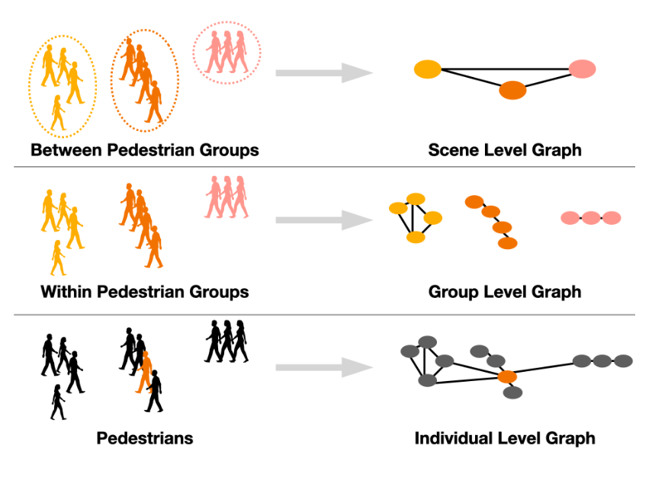
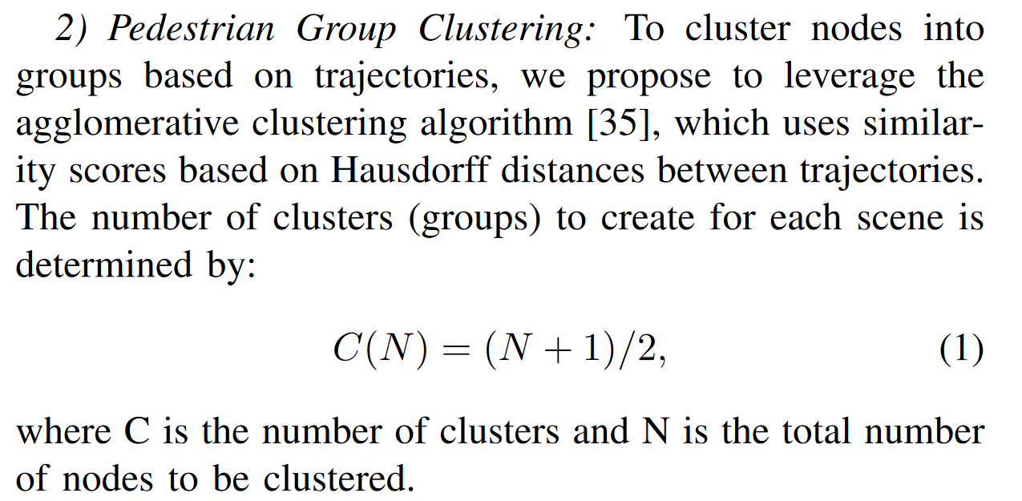
Related Work: Pedestrian Group Detection
Grouptron: Dynamic Multi-Scale Graph Convolutional Networks for Group-Aware Dense Crowd Trajectory Forecasting
Non-Learnable: Groups are determined based on past trajectories
Fixed Group Count: The number of groups remains constant
Notes:
There are some previous works on Pedestrian Group Detection, all of them are based on the past trajectories.For eaxmple, Grouptron.
However, there are key limitations with this approach. First, it is not learnable—groups are based on historical trajectories of pedestrians, which means the model lacks the adaptability to learn from new situations dynamically. Second, the number of groups is fixed, which makes it difficult for the method to handle complex, changing situations effectively, such as when group sizes vary or new groups form. These limitations highlight the need for more flexible, adaptive models in dynamic environments."

Slide 9
Outline
Introduction
Related Work
Methodology
Experiment
Schedule

Slide 10
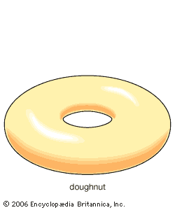
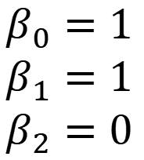
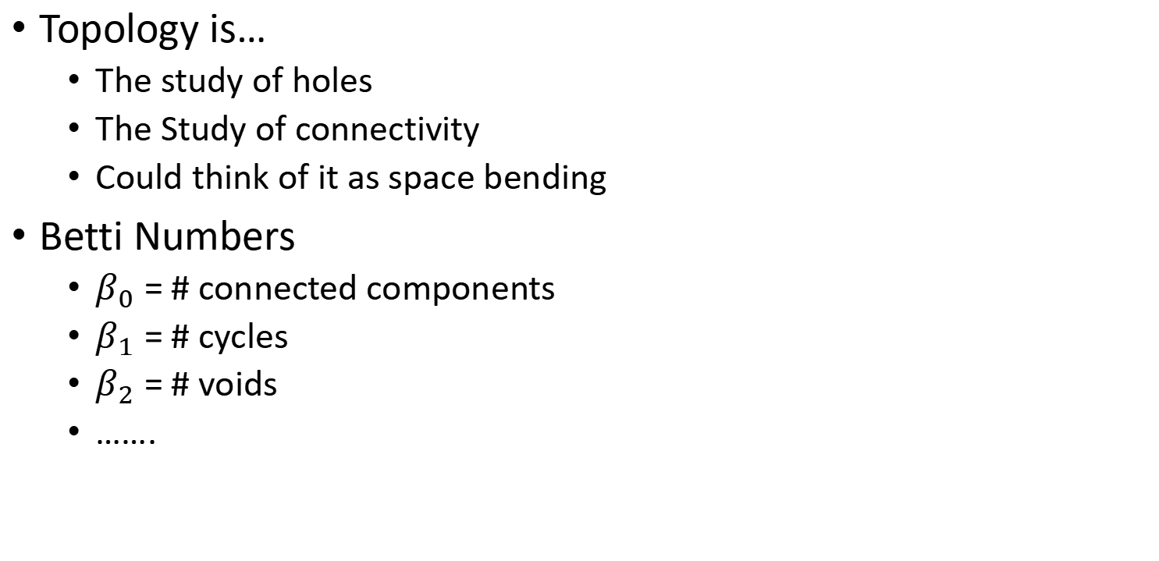
Methodology:Topological Data Analysis
Topology is…
  The study of holes
  The Study of connectivity
  Could think of it as space bending
Betti Numbers
  $β_{0}$ = # connected components
  $β_{1}$ = # cycles
  $β_{2}$ = # voids
  …….
$$β_{0}=1$$
$$β_{1}=1$$
$$β_{2}=0$$

Slide 11
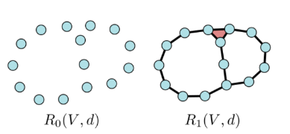
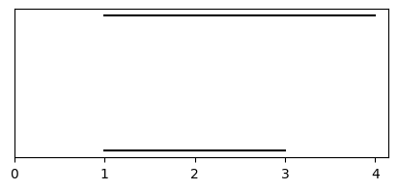
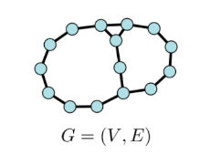
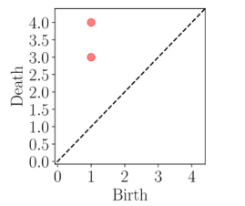
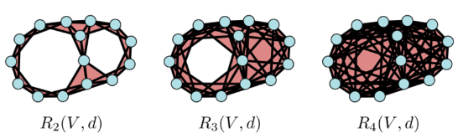
Methodology: Rips Filtration on Graphs
Persistence Barcode
Persistence Diagram
Capture topological features by building simplicial complexes as parameters (shortest path distance) increase.

Slide 12
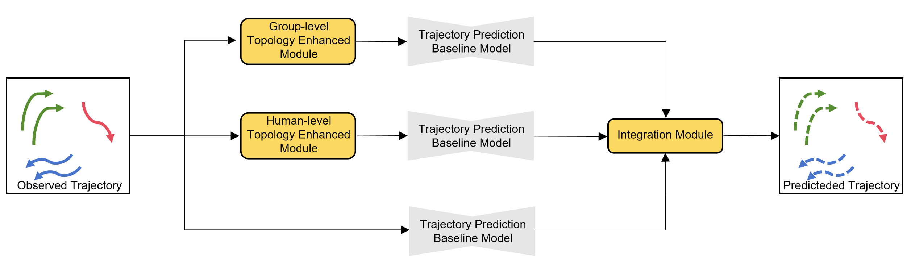
Methodology: Model Architecture
  Three Branches:
  Baseline Model: Previous trajectory prediction model.
  Group-Level Module: Captures high-order dynamics of group interactions.
  Human-Level Module: Models individual behaviors using topological data analysis.
Notes:
Let's start by looking at the overall framework of our proposed pedestrian trajectory prediction model, as illustrated in Figure 4.1. This architecture is designed to improve the accuracy of trajectory forecasting by integrating two main types of modules: the group-level topology-enhanced module and the human-level topology-enhanced module.
These observed pedestrian trajectories are processed through three parallel branches. The first branch is the baseline trajectory prediction model, which could be any standard pedestrian prediction framework. The second branch is the group-level module, which aims to capture the high-order group interactions that happen within the crowd. The third is the human-level module that focuses on individual behaviors, using topological data analysis to better understand these patterns.
Finally, we have the integration module that fuses the intermediate predictions from each branch. This fusion leads to a final, comprehensive output that better reflects both individual and group dynamics, resulting in more accurate and socially-aware trajectory forecasts."

Slide 13


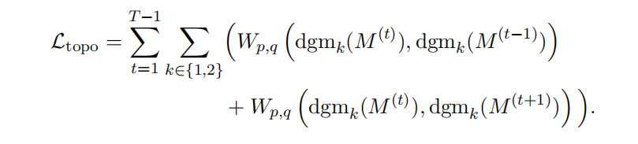
Methodology: Group-level Module
Graph Construction: Creates a dynamic graph from pedestrian trajectories.
Feature Extraction and Community Clustering: Uses Graph Convolutional Network (GCN) to learn features and clusters in the feature space to form community networks .
Temporal Consistency: calculate the Wasserstein distance between the PD(by WRCF) at the current snapshot and the PDs before and after:
Notes:
The Group-Level Topology Enhanced Module starts by constructing a dynamic graph from pedestrian interactions observed over time. 、
This graph is then fed into a Graph Convolutional Network (GCN),
which is used to learn high-level features that capture the relationships between different pedestrians.
After extracting these features, the module performs clustering in the learned feature space
—these clusters represent groups of pedestrians who interact more closely. By doing this, we are able to dynamically group pedestrians based on their evolving behaviors.
To maintain consistency in the representation of these groups over time,
we apply a temporal consistency mechanism.
This method involves using Weighted Rips Complex Filtration (WRCF) to derive persistence diagrams from the community clusters. By comparing these persistence diagrams across consecutive time steps, we enforce stability, which helps in accurately tracking the evolution of group behaviors.
This approach not only helps in identifying meaningful group interactions but also ensures that the model's understanding of group dynamics remains stable, even as the relationships evolve. This enhances the prediction accuracy and provides a more realistic model of crowd behavior.

Slide 14
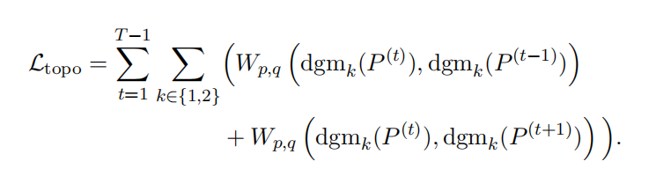
Methodology: Human-level Module
No clustering, directly uses pedestrian point cloud snapshots P(t).
Feature Extraction: Employs Vietoris-Rips Complex Filtration (RIPS) to extract features.
Temporal Consistency: Calculate the Wasserstein distance between the PD(by RIPS) at the current snapshot and the PDs before and after:
Notes:
The Human-Level Topology Enhanced Module captures detailed individual movement dynamics, offering a more granular understanding of pedestrian behavior. Unlike the group-level module, this module directly analyzes pedestrian point clouds without relying on clustering.
Using Vietoris-Rips Complex Filtration (RIPS) to capture the key topological features.
We then apply the same consistency constraint by comparing persistence diagrams across time steps.
This module complements the group-level analysis,
ensuring both group and individual dynamics are represented, leading to more accurate and nuanced trajectory predictions

Slide 15
Outline
Introduction
Related Work
Methodology
Experiment
Schedule

Slide 16
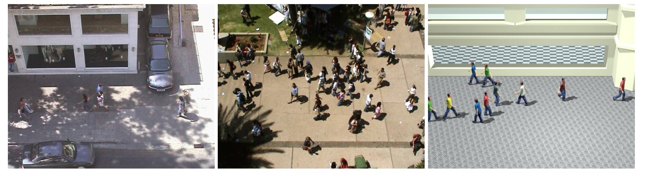
Experiment: ETH & UCY Pedestrian Datasets
Scenes:
ETH: Includes scenes like "ETH" and "HOTEL".
UCY: Includes "UNIV", "ZARA1", and "ZARA2".
Key Features:
Diverse Crowd Scenarios: Varying densities and interaction types.
Real Human Movements: Annotated trajectories of individuals.
Notes:
The most commonly used pedestrian trajectory datasets are ETH and UCY,
which have become foundational in this field of research. T
hese datasets consist of real-world trajectory data collected in various crowded scenes.
The ETH dataset includes scenes like 'ETH' and 'HOTEL', while the UCY dataset features scenes such as 'UNIV', 'ZARA1', and 'ZARA2'.
One of the key features of these datasets is the diversity in human movement and interaction types,
allowing researchers to benchmark the accuracy and robustness of their models.
The annotated trajectories serve as a rich source for testing new prediction frameworks, especially those focusing on modeling social interactions effectively."

Slide 17
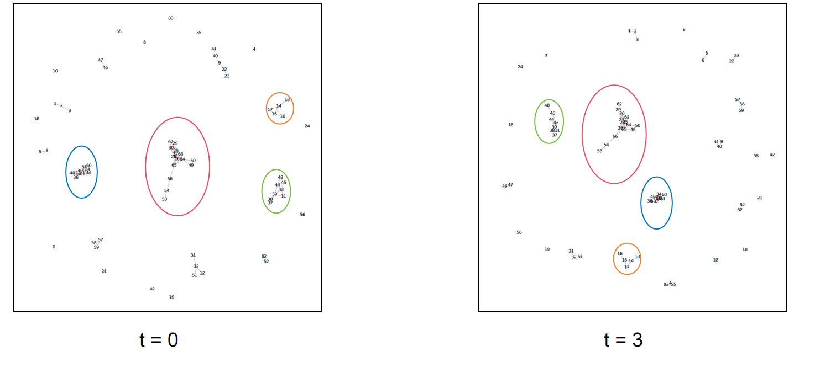
Experiment: Pedestrians Group Detection
Data Annotation:
Previous datasets lack pre-annotated group data.
Manual annotation performed on students001 and students003 datasets.
Annotated first 20 frames for analysis
Notes:
In our experiments, we faced a challenge with existing datasets such as ETH and UCY,
as they do not have pre-annotated group labels.
To overcome this, we manually annotated the first 20 frames of two representative datasets: students001 and students003.
It is a common standard to use the first eight frames as input and then predict the subsequent twelve frames.
The Annotation result is shown in this Figure

Slide 18
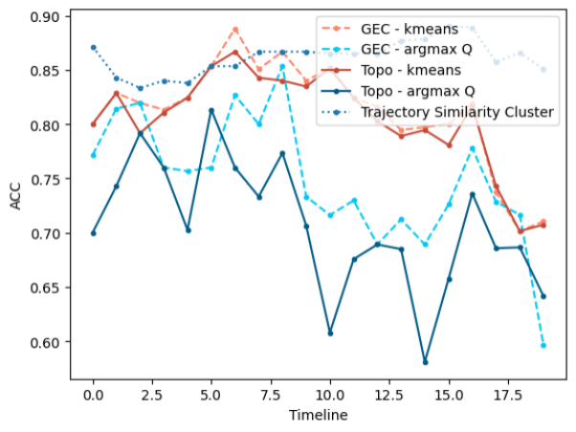
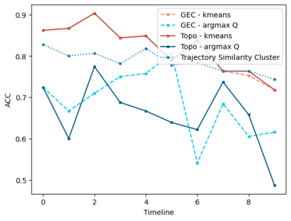
Experiment: Pedestrians Group Detection
Clustering Approach:
Traditional method is based on trajectory similarity
Experimental Results:
Topology-based approach outperformed traditional on some datasets.
Underperformance noted in datasets with imbalanced cluster sizes.
students001
students003
Notes:
Our experiments compared traditional methods for pedestrian group detection—
based on trajectory similarity—with our proposed topology-based approach.
In our experiments, the topology-based method outperformed traditional methods in some datasets,
but it underperformed in datasets with uneven cluster sizes.
This limitation was largely due to the final k-means clustering step, which struggles to handle imbalanced clusters.
Moving forward, we suggest replacing k-means with a clustering method that better accommodates imbalanced distributions.
Additionally, using Euclidean distances as edge weights in the pedestrian graph construction could help retain more detailed relational information.

Slide 19
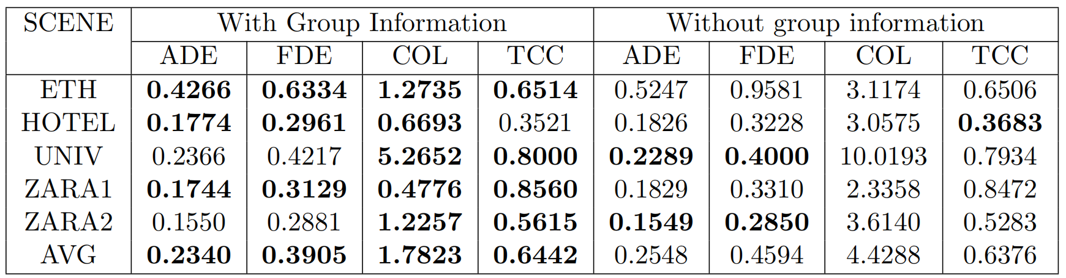
Experiment: Topological Information Integration
Improved Accuracy:Higher-Dimensional information leads to lower Average Displacement Error (ADE) and Final Displacement Error (FDE).
Future Focus: Leverage both group and individual topological features.
Notes:
In this study, we explored the integration of topological information into trajectory prediction models.
we assessed how adding grouping information affects accuracy.
The results showed that including group dynamics significantly improved prediction accuracy,
reducing Average and Final Displacement Errors. Moreover,
it also reduced the probability of collisions across datasets like ETH, HOTEL, and ZARA1, contributing to safety prediction.
These findings highlight the value of incorporating higher-dimensional topological features in predicting pedestrian trajectories,
Future Focus: Leverage both group and individual topological features

Slide 20
Outline
Introduction
Related Work
Methodology
Experiment
Schedule

Slide 21
Schedule
Integrate TDA to enhance trajectory prediction.
Capture both human-level and group-level topological features. Ensure topological consistency across snapshots.
Develop a plugin model for trajectory prediction.
Improve prediction accuracy, particularly in complex environments.

Slide 22
Thanks

