Slide 1
Inter-Departmental Ticket Processing Time Prediction using Multi-Task Learning
Keywords : Ticket Processing, Text and Data mining, MTL (Multi-Task Learning), Advanced applications
Reporter：Xinyu Yang Date：12/04/2024

Slide 2
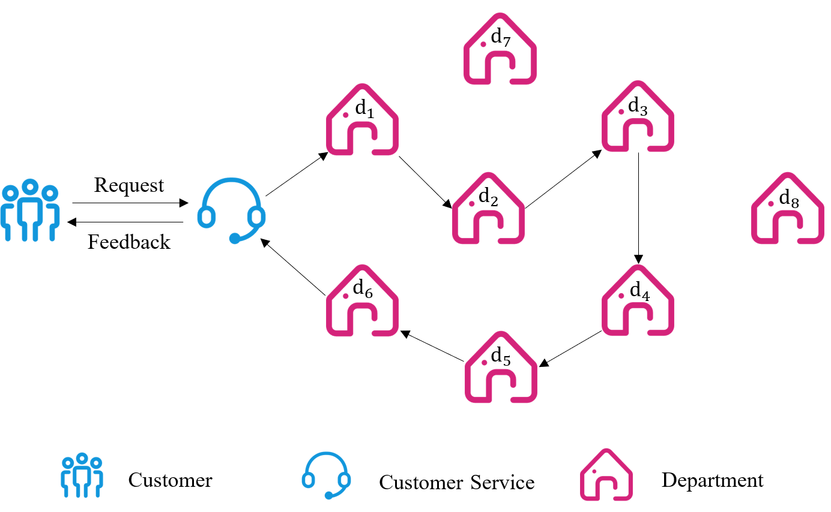
Research Background
The total processing time t is the time from when the ticket is received until the final result is returned.
Since discrepancies between predicted and actual department sequences can cause errors, we directly predict the total processing time t.

Slide 3

Research Background
Customer Service and Performance: Good customer service drives satisfaction, loyalty, and company success.
Customer Service in Government and Non-Profits: Efficiently addressing public needs builds trust and satisfaction.
Response Time Prediction: Predicting response times improves satisfaction and efficiency by reducing delays.

Slide 4

Related Work
1.Time Prediction for Customer Service
Borg et al. (2020) used Random Forest to predict email response times, improving efficiency, but without involving multiple departments, unlike our task.
Haw et al. (2022) applied machine learning models (neural networks, AdaBoost, random forest) to predict ticket resolution times, enhancing customer service, but without predicting ticket flow paths.

Slide 5

Related Work
2. Time Prediction for Traffic Trajectory Modeling
Traffic trajectory modeling predicts movement patterns and travel times using machine learning, similar to predicting department flow paths in customer service. Models like MTNet, TrajForesee, TrajBERT, and DRPK focus on predicting traffic trajectories, but our task involves department flow, not physical routes.

Slide 6
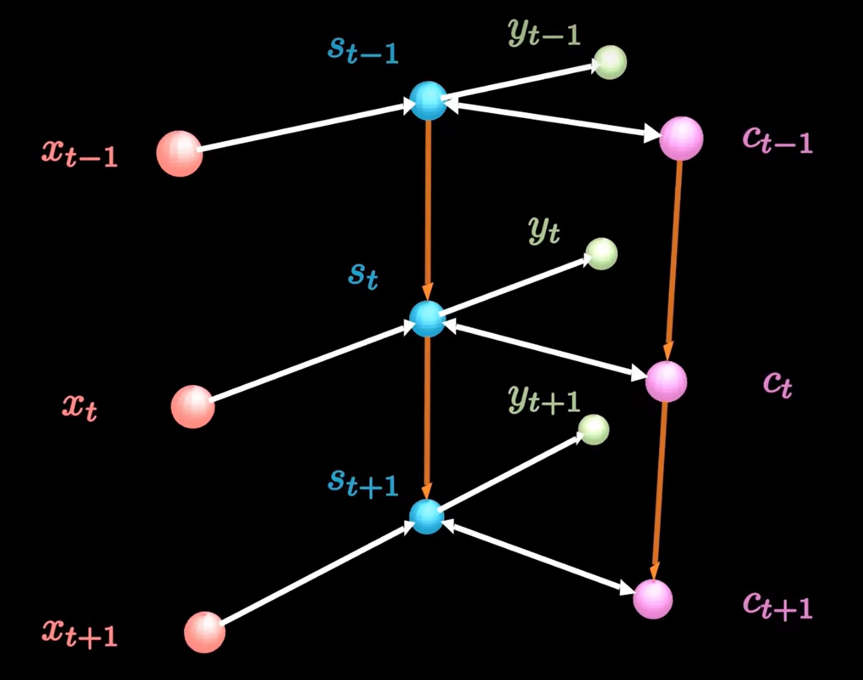
Related Work
3. LSTM-related Models
LSTM networks address issues in RNNs, making them effective for time series prediction.
Altché et al. (2017) combined LSTM with additional layers for better predictions.
Li et al. (2019) added attention mechanisms to improve LSTM’s performance.
Cao et al. (2024) proposed a hybrid LSTM-Transformer model, inspiring our approach for real-time predictions.

Slide 7

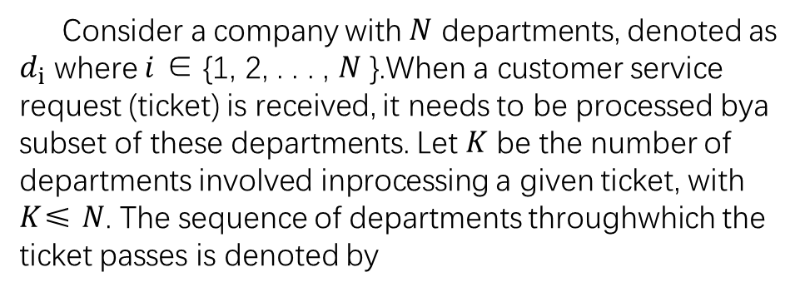
Problem Formulation
Consider a company with $N$ departments, denoted as $d_{i}$ where $i$ ∈ {1, 2, . . . , $N$ }.When a customer service request (ticket) is received, it needs to be processed bya subset of these departments. Let $K$ be the number of departments involved inprocessing a given ticket, with $K$≤ $N$. The sequence of departments throughwhich the ticket passes is denoted by

Slide 8




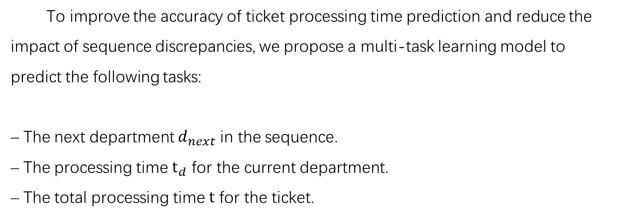





Problem Formulation
To improve the accuracy of ticket processing time prediction and reduce the
impact of sequence discrepancies, we propose a multi-task learning model to
predict the following tasks:
– The next department $d_{next}$ in the sequence.
– The processing time $t_{d}$ for the current department.
– The total processing time $t$ for the ticket.
$$d_{next}$$
predict
？
$$t_{d}$$
$$t_{1}$$
$$t_{2}$$
predict
$$t_{3}$$
whole sequences
$$t$$

Slide 9
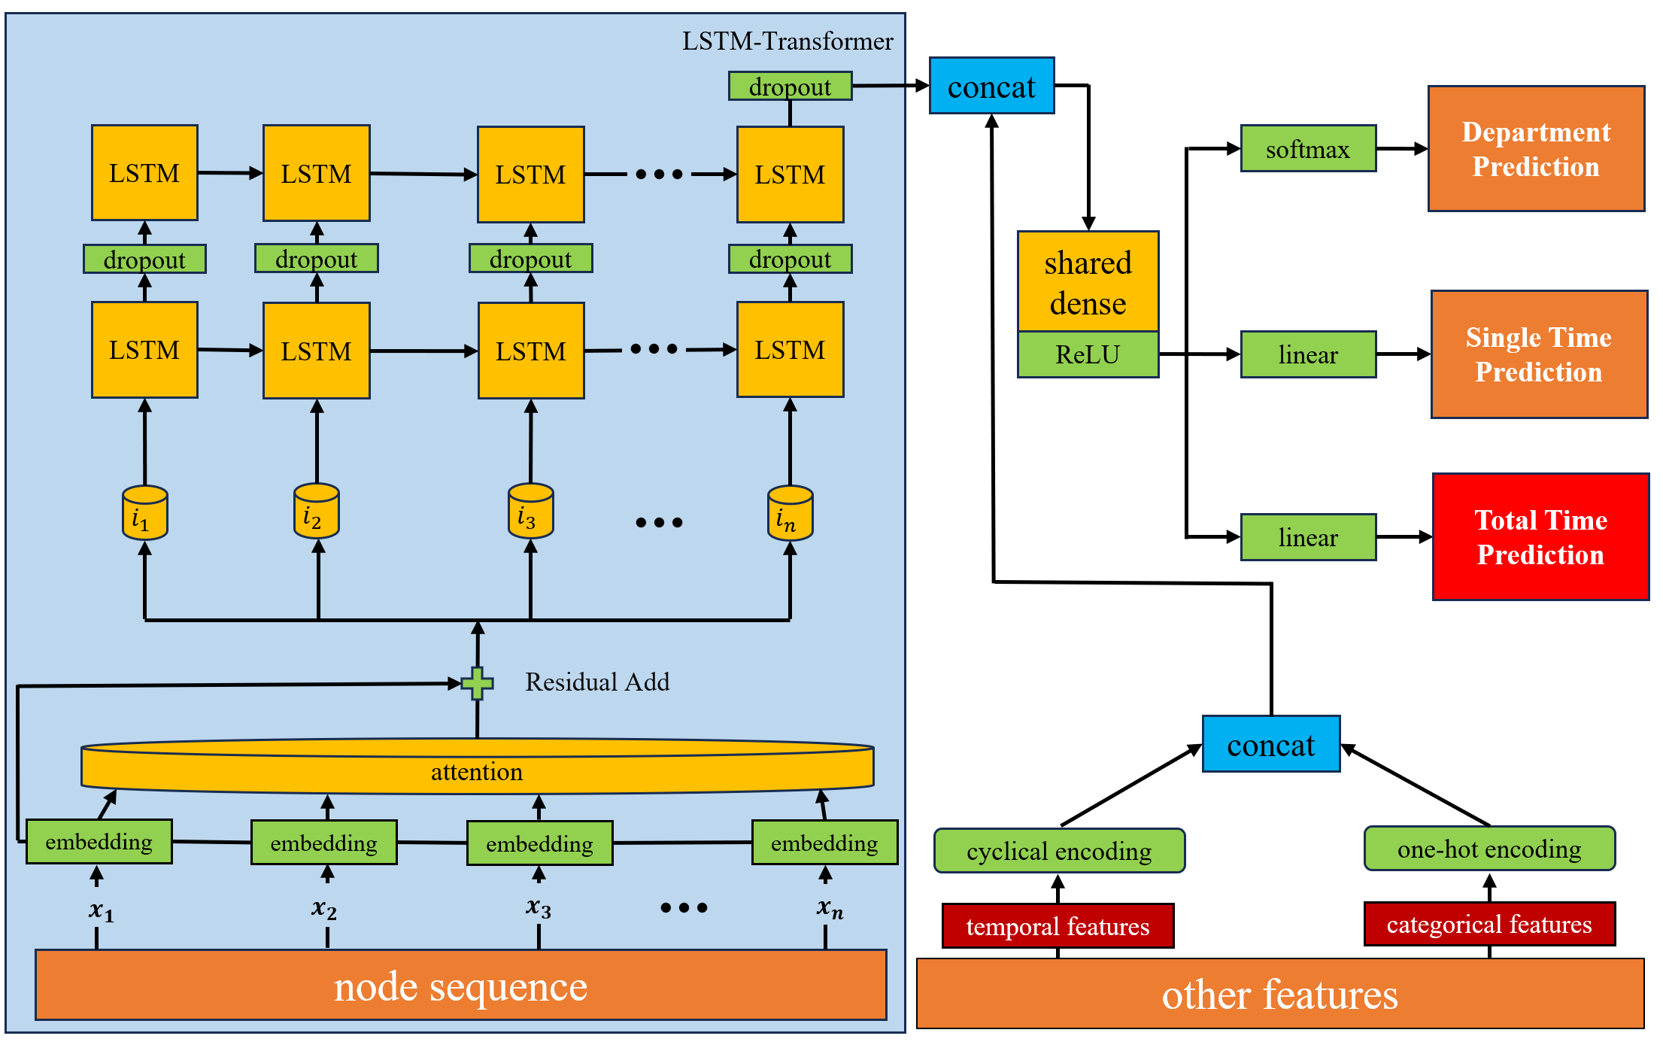

Proposed Method
$$input$$

Slide 10

Proposed Method
$$output$$

Slide 11

Proposed Method
$$attention layer$$

Slide 12

Proposed Method
$$LSTM layer$$

Slide 13

Proposed Method
$$featured embedding$$

Slide 14
Proposed Method

Slide 15
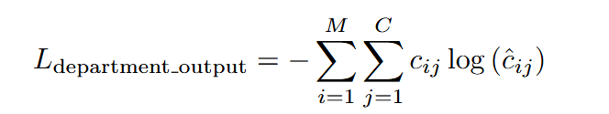
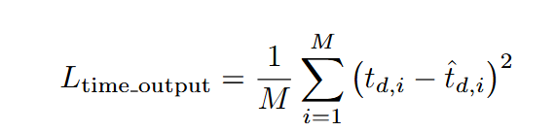
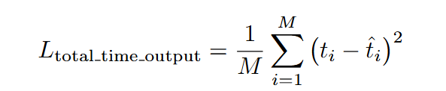
Proposed Method

Slide 16

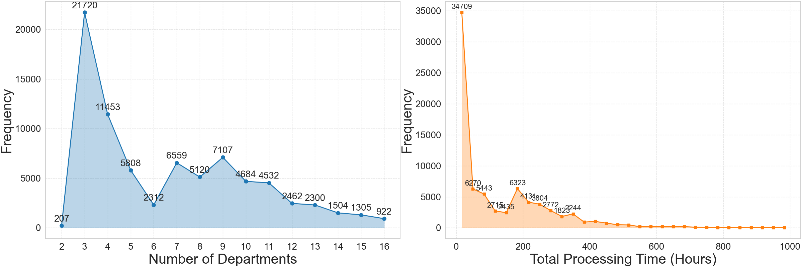
Experiment and Results
The dataset contains 88,000 valid customer demand records from Shenzhen (July 2022 to October 2024).
Ticket Transfers: Most tickets require 3 to 5 transfers. Tickets with more than 16 transfers were removed.
Dataset Split: The data was split into training, validation, and test sets (8:1:1 ratio).
Features: 9 categorical features (encoded using one-hot or target encoding) and 3 temporal features (encoded with cyclic encoding).
Processing Time: Most tickets take 0 to 400 hours to process, but some outliers exceed 500 hours, impacting the average processing time.

Slide 17
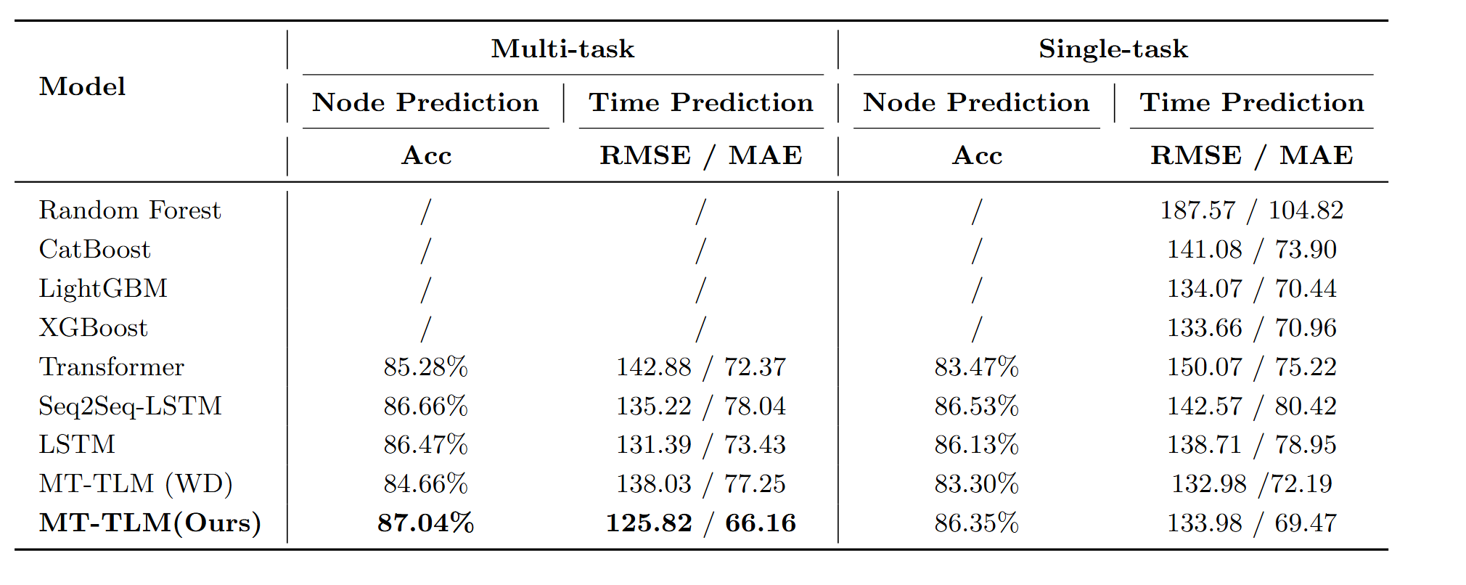
Experiment and Results
Ensemble models struggled, and Transformers underperformed compared to LSTM models, which achieved 86% accuracy.
In multi-task settings, deep learning models generally performed better, except MT-TLM (WD). Multi-task learning reuses knowledge and reduces labeling costs, while multi-objective optimization improves performance.

Slide 18
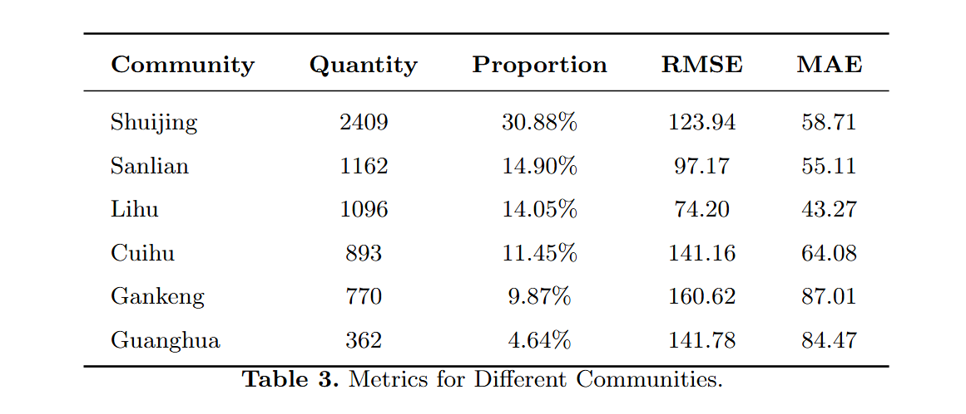
Experiment and Results
The dataset comes from 68 communities, but it's imbalanced—6 communities contribute over 5% of the data, while 62 contribute less than 2%. We focused on the 6 larger datasets to assess the model’s ability, aiming to improve its stability and accuracy with imbalanced data.

Slide 19
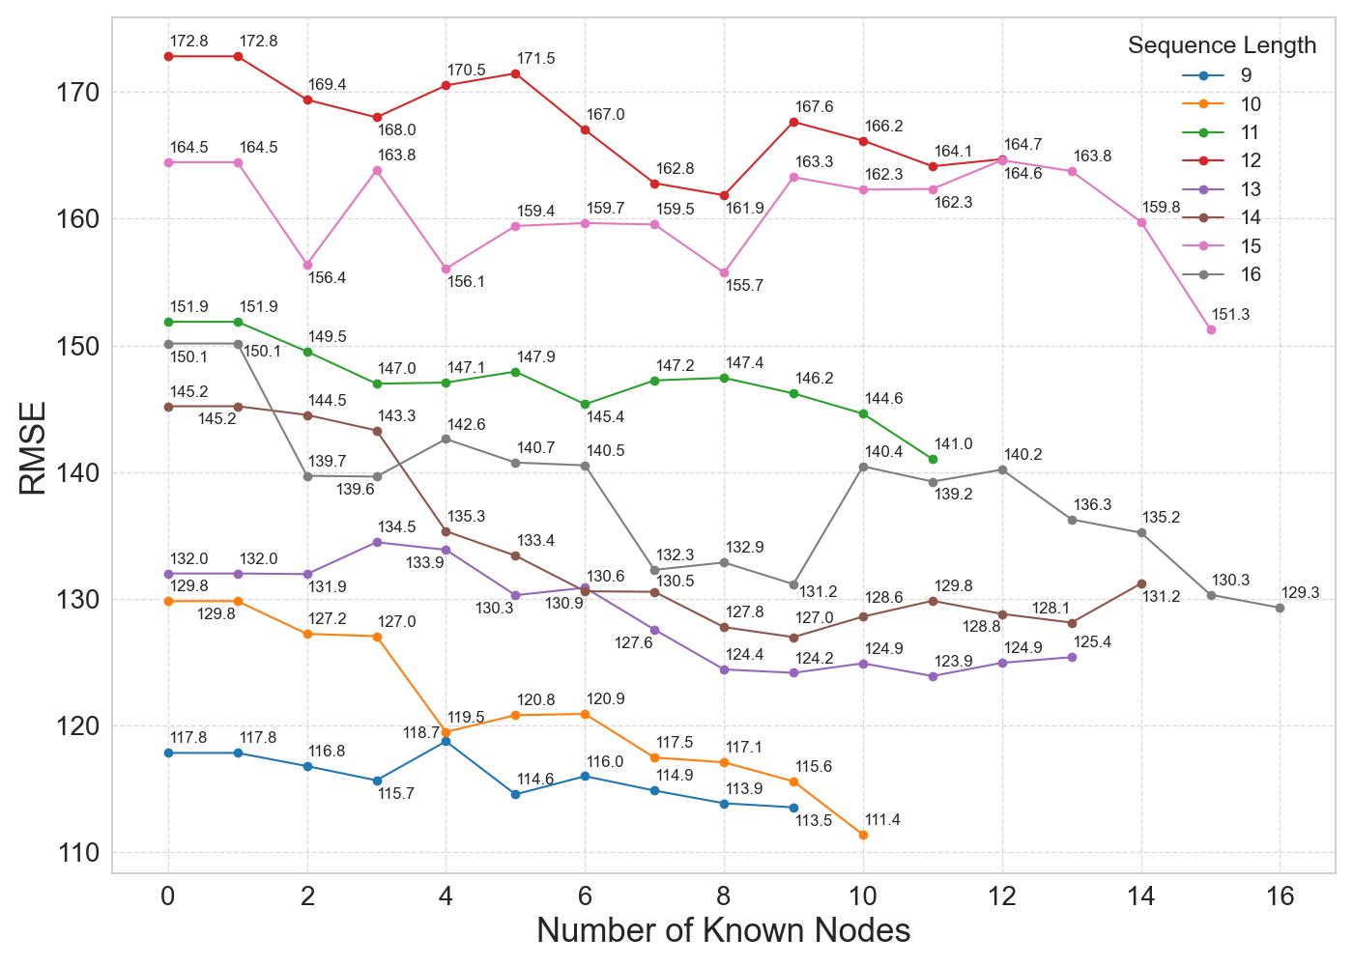
Experiment and Results
As the number of known nodes increases, RMSE decreases and prediction accuracy improves, showing the importance of context in sequence prediction. The model performs better with more initial nodes, helping it make more accurate predictions. This is valuable in real-world scenarios.

Slide 20
Conclusion
The MT-TLM, combining LSTM and Transformer with a self-attention mechanism in a multi-task learning framework, predicts ticket flow more accurately in real-time. It improves user experience, retention, and offers insights for business optimization.
Future research should address data imbalance with augmentation or synthetic data, and explore multi-task learning models focused on complex department relationships. We hope MT-TLM will thrive in real-world applications and inspire further innovation in customer service systems.

Slide 21
Thanks for listening!
Q&A
Reporter：Xinyu Yang Date：12/04/2024

