Slide 1


SNNs
Simplicial Neural Networks
Reporter: Zhang Sihong
Date: 2024.11.20
Notes:
Hello everyone, today I will be sharing a paper on Simplicial Neural Networks, a work published in 2020 at NeurIPS.

Slide 2


目 录
CATALOGUE
Introduction
Methods
01
02
Experiments
Conclusion
03
04
Notes:
I will share the main content of this paper in four sections:
First, I provide a brief introduction to the background of SNNs. Then, I will focus most of the time on the methods section. Next, I will quickly go through the experiments section, and last I will give a short conclusion.

Slide 3

01
PART ONE
Introduction
Notes:
Let’s start with the introduction.

Slide 4

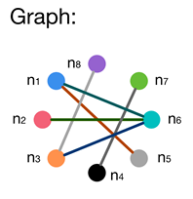
PART 01
Introduction
Graph neural networks (GCNNs) -----proven to be an effective tool when applied to datasets organized in irregular graph structures in order to learn better interactions in them.[1]
Graph is intrinsically limited to modeling pair-wise relationships, which omit the information in higher-dimension spaces.
To leverage higher-order relationship information in datasets:
Induce hypergraphs, where edges, referred to as hyperedges, can connect two or more vertices;
Represents higher-order relationships as simplices or complexes.
Fig1: graph and hypergraph (with hyperedges)
[1] M. M. Bronstein et al., “Geometric Deep Learning: Going beyond Euclidean data,” IEEE Signal Processing Magazine, vol. 34, no. 4, pp. 18–42, 2017.
Notes:
Graph neural networks (GNNs), an extension from basic convolutional neural networks(CNNs), have proven to be an effective tool when applied to datasets organized in irregular graph structures enabling the better learning of interactions within them. However, while more flexible than grids, graphs are intrinsically limited to modeling pairwise relationships, which overlooks the information in higher-dimension spaces.

Slide 5

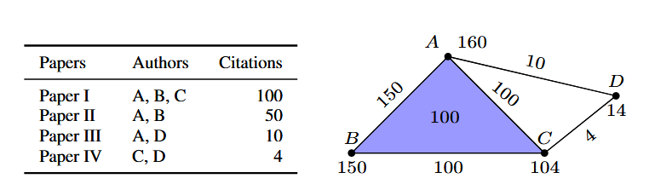
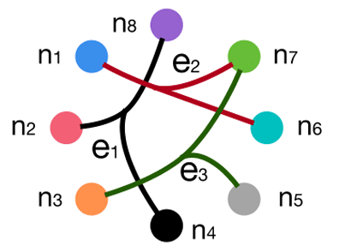
PART 01
Introduction
Graph neural networks (GCNNs) -----proven to be an effective tool when applied to datasets organized in irregular graph structures in order to learn better interactions in them.
Graph is intrinsically limited to modeling pair-wise relationships, which omit the information in higher-dimension spaces.
To leverage higher-order relationship information in datasets:
Induce hypergraphs, where edges, referred to as hyperedges, can connect two or more vertices[2];
Represents higher-order relationships as simplices or complexes.
Fig1: graph and hypergraph (with hyperedges)
Fig2: use simplicial complex to represent coauthership on the left
[2] Y. Feng et al., “Hypergraph Neural Networks,” in Proceedings of the AAAI Conference on Artificial Intelligence, vol. 33, 01, 2019.
Notes:
To analyze and leverage higher-order relational information in datasets, researchers have proposed methods representing datasets as hypergraphs, where edges, referred to as hyperedges, can connect two or more vertices. Another method is to view the higher-order relationships as simplices, which is the focus of the paper we are discussing today. Simplicial Neural Networks views the entire dataset as a topological space. It represents the data using simplices or complexes, and leverages this perspective to construct Simplicial Neural Networks (SNNs) for analyzing higher-order relationship information within the dataset.

Slide 6
PART 01
Introduction
Inspired by Hodge–de Rham theory[3], the neural network extended from GCNNs, was designed for the data living on simplicial complexes, namely Simplicial Neural Networks.
SNNs can be used on analyzing datasets with higher order relationships and datasets sensitive to its topological structures, such as social networks, biological networks (like brain structural/ functional networks, protein interactions[5], gene expression), and communication networks (like transportation networks, electricity networks)
[3] I. Madsen and Jørgen Tornehave, From Calculus to Cohomology: de Rham Cohomology and Characteristic Classes, Cambridge University Press, 1997.
Notes:
Inspired by Hodge–de Rham theory[6], this approach enables researchers to better handle scenarios that require consideration of high-dimensional relationships, such as social networks, biological networks (like brain structural/ functional networks, protein interactions, gene expression), and communication networks (like transportation networks, electricity networks).

Slide 7
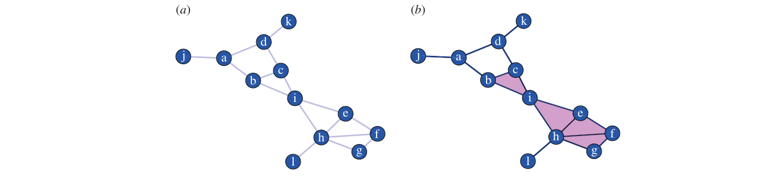
PART 01
Introduction
Inspired by Hodge–de Rham theory[3], the neural network extended from GCNNs, was designed for the data living on simplicial complexes, namely Simplicial Neural Networks.
SNNs can be used on analyzing datasets with higher order relationships and datasets sensitive to its topological structures, such as social networks, biological networks (like brain structural/ functional networks[4], protein interactions, gene expression), and communication networks[5] (like transportation networks, electricity networks)
Fig3: Complex can be used to study the brain networks[4].
[4]Petri G, Expert P, Turkheimer F, Carhart-Harris R, Nutt D, Hellyer PJ, Vaccarino F. 2014 Homological scaffolds of brain functional networks. J. R. Soc. Interface 11: 20140873.
Notes:
In this image, we see how simplicial complexes are applied to social and biological networks. For instance, in social networks, complex relationships between users—such as groups, communities, and interactions—can be represented as simplicial complexes, where vertices represent individuals and higher-order simplices capture group dynamics. Similarly, in brain networks, brain regions can be represented as vertices, and interactions between multiple regions are captured by simplices, which model the high-dimensional relationships in neural activity and connectivity.

Slide 8
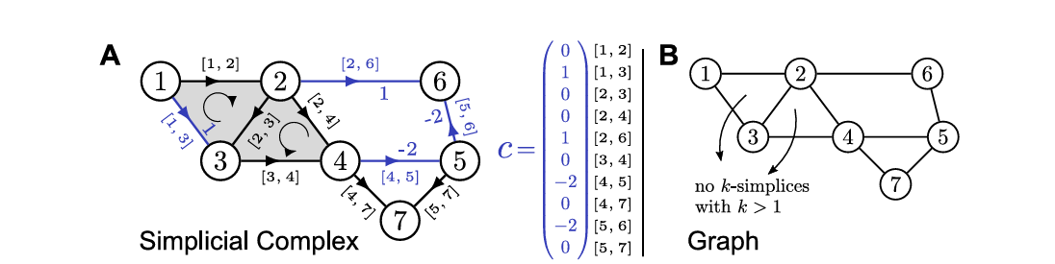
PART 01
Introduction
Inspired by Hodge–de Rham theory[3], the neural network extended from GCNNs, was designed for the data living on simplicial complexes, namely Simplicial Neural Networks.
SNNs can be used on analyzing datasets with higher order relationships and datasets sensitive to its topological structures, such as social networks, biological networks (like brain structural/ functional networks[4], protein interactions, gene expression), and communication networks[5] (like transportation networks, electricity networks)
Fig4: Complexes can be used to study communication networks[5].
[5]Schaub, Michael T., et al. "Random walks on simplicial complexes and the normalized Hodge 1-Laplacian." SIAM Review 62.2 (2020): 353-391.
Notes:
This image illustrates the application of simplicial complexes in communication networks, such as transportation and electricity networks. In transportation networks, cities and transportation routes are represented as vertices, and higher-order simplices capture interactions between multiple cities, such as transportation hubs or connections. Similarly, in electricity networks, power stations, transmission lines, and substations are modeled as simplicial complexes, where higher-order simplices represent interactions between different components of the network, helping to capture the complex and interdependent nature of the system.

Slide 9
02
PART TWO
Methods
Notes:
So, how do we achieve this? The proposed Simplicial Neural Networks (SNNs) are built upon the concept of simplicial convolution. To explain the methods behind SNNs clearly, I will first:

Slide 10
PART 02
Methods
Quick review of GCNN:
The proposed SNNs are designed based on the notion of simplicial convolution. This section is organized as follows:
Review the framework construction process in GNN, drawing an analogy to the development of SNNs.
Introduce simplicial complexes, simplicial Laplacian, and simplicial convolutions in sequence.
Notes:
review the framework construction process in Graph Neural Networks (GNNs), drawing an analogy to the development of SNNs. Then, I will introduce simplicial complexes, the simplicial Laplacian, and simplicial convolutions in sequence.

Slide 11
PART 02
Methods
Quick review of GCNN:
Analysis of data
Laplacian
Convolution
Graph: G=<V, E>
V: set of vertices
E: set of edges
degree matrix
edge matrix
eigenvector matrix
filter
point data
Incidence matrix
Notes:
I summarized the key steps of Graph Convolutional Networks (GCNs) as follows:
Analyze the properties of the data and establish an appropriate mathematical representation.
Use the Laplacian operator to process data on the graph.
Construct convolutional kernels based on the Laplacian operator.
The data object in GCN is a graph, which is typically represented as an ordered pair of vertex and edge sets.
The Laplacian operator is a fundamental operator on graphs that expresses relationships between nodes. The standard Laplacian matrix is defined as L=D−A, where D is the degree matrix and A is the adjacency matrix of the graph.
Convolution is an operation for aggregating information, defined differently depending on the context. In GCN, convolution is defined as , where U is the eigenvector matrix of L, and g(Λ) is the filter.
In this paper, the authors fully adopt this approach. They start by analyzing the organizational structure of the data as simplicial complexes and then progressively construct the simplicial Laplacian and simplicial convolution.

Slide 12
PART 02
Methods
Simplicial complexes：
simplex
simplicial complex
p-chain
p-chain group
boundary operator
homology group
p-cochain
cochain group
coboundary map
cohomology group
Notes:
The first concept to introduce is the simplicial complex, which serves as the organizational structure of our data. In Topological Data Analysis (TDA), we have already studied some related concepts.
To analyze higher-order relationships in graph and overcome the traditional graphs’ pairwise relationship representation limits, simplicial complexes are introduced.
A simplicial complex K is a collection of simplex under certain constrains. First, for any simplex in K, all its faces should be in K. Second, if simplex σ, σ′ ∈ K, then either σ ∩ σ′ = ∅ or σ ∩ σ′ is in both σ and σ′ .
If K is a simplicial complex, then denote all the p-simplices in K as Kp. Roughly speaking, vertices are 0-simplices of a simplicial complex K, and edges are the 1-simplices of K. Apart from that, simplicial complexes K can have higher-dimensional components like triangles called 2-simplices, tetrahedrons called 3-simplices and so forth.
If σ is a face of τ , then τ is a coface of σ. The concepts of simplex, p-simplex, faces and cofaces, and simplicial complex are the same in topological data analysis (TDA), thus I will not elaborate them in detail one by one.
When studying graphs or datasets with higher-order relationships, each simplex carries associated data. Naturally, we are concerned with the topological properties of functions defined on simplices. To this end, the paper introduces concepts such as p-cochains (corresponding to p-chains), coboundary maps (corresponding to boundary operators) and cohomology groups (corresponding to homology groups). （剩下的讲稿看打印/pad）

Slide 13
PART 02
Methods
Simplicial Lapacian：
classic graph incidence matrix
every column is an edge of K
The kernel of the k-Laplacian is isomorphic to the k-(co)homology of its associated simplicial complex.[6]
This means that for a p-simplex in , the Laplacian considers the adjacent (p-1)-simplex and p-simplex.
classic graph Laplacian
[6]Schaub, Michael T., et al. "Random walks on simplicial complexes and the normalized Hodge 1-Laplacian." SIAM Review 62.2 (2020): 353-391.

Slide 14

PART 02
Methods
Simplicial Convolution：
convolutional layer
The Fourier transform of real p-cochains on a simplicial complex with Laplacians
convolution
a function with small support
parameterized by learnable weights
some nonlinearity and bias
eigencochains of ordered by eigenvalues:
For any cochains and , the convolution of them is defined as:
a normalized eigendecomposition
represent
represent

Slide 15
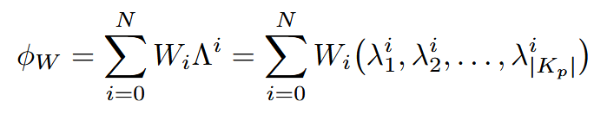
PART 02
Methods
Simplicial Convolution：
simplicial convolutional layer
(with input p-cochain and weights )
(for some yet unspecified )
To ensure locality property of convolution, limit to be a low-degree polynomial in
(for small )

Slide 16
03
PART THREE
Experiments
Notes:
That’s all about the method part. The performance of SNNs are evaluated in the task of missing data imputation task on a coauthership complex dataset describing coauthership using complexes with missing data.

Slide 17
PART 03
Experiments
Missing data imputation task: important in statistics and machine learning[7][8];
GCNNs have proved to be a powerful tool for this task[9];
Evaluate the performance of SNNs on this task with data living on higher-order dimensions on simplicial complexes.
[7] Roderick J A Little and Donald B Rubin. Statistical Analysis with Missing Data. USA: John Wiley & Sons, Inc., 1986. ISBN: 0471802549.
[8] Fulufhelo Nelwamondo, Shakir Mohamed, and Tshilidzi Marwala. “Missing Data: A Comparison of Neural Network and Expectation Maximisation Techniques”. In: Current Science 93 (May 2007).
[9] Indro Spinelli, Simone Scardapane, and Aurelio Uncini. “Missing data imputation with adversarially-trained graph convolutional networks”. In: Neural Networks 129 (2020), pp. 249260.
Notes:
As many real-world datasets contain missing values, missing data imputation is an important problem in statistics and machine learning. Leveraging the structure underlying the data, GNNs have recently proved to be a powerful tool for this task. Extending this view to higher-dimensional structure, we evaluate the performance of SNNs in imputing missing data over simplicial complexes.

Slide 18
PART 03
Experiments
Data:
A coauthership complex (CC):
a paper with k authors is represented by a (k-1)-simplex.
add sub-simplices: collaborations among subsets of authors
(hypergraph with hyperedges would miss that)
cochains: the number of citations attributed to the given collaborations of k authors;
sampled CC1 and CC2 from the Semantic Scholar Open Research Corpus[10]
(a dataset of over 39 million research papers with authors and citations)
Fig5: use simplicial complex to represent coauthership on the left
[10] Waleed Ammar et al. “Construction of the Literature Graph in Semantic Scholar”. In: NAACL. 2018. URL: https : / / www . semanticscholar . org / paper / 09e3cf5704bcb16e6657f6ceed70e93373a54618.
Notes:
The data is the coauthership complex where a paper with k authors is represented by a (k − 1)-simplex. The added subsimplices of the (k − 1)-simplex are interpreted as collaborations among subsets of authors—a natural hierarchical representation that would be missed by the hypergraph representation of papers as hyperedges between authors.
The (k − 1)-cochains are given by the number of citations attributed to the given collaborations of k authors.
We sampled two coauthorship complexes—CC1 and CC2, see Table 2 for statistics—from the Semantic Scholar Open Research Corpus , a dataset of over 39 million research papers with authors and citations.

Slide 19
PART 03
Experiments
Methods:
typical pipeline for this task:
missing values are artificially introduced by replacing a portion of the values with a constant.
minimize the L-1 norm over known citations.
task: imputing missing citations on the k-cochains (for k=0,1,2):
replacing a portion (10%, 20%, 30%, 40%, 50%)
constant (the median of known citations)
trained SNNs made of
layers: 3 with 30 convolutional filters of degree N = 5
Notes:
We evaluated the performance of the SNNs on the task of imputing missing citations on the k-cochains (for k = 0, 1, 2) of the extracted coauthorship complexes. As in a typical pipeline for this task, missing values are artificially introduced by replacing a portion of the values with a constant. Specifically, given a fixed coauthorship complex, missing data is introduced at random on the k-cochains at 5 rates: 10%, 20%, 30%, 40%, and 50%.
The SNN is given as input the k-cochains on which missing citations are substituted by the median of known citations (as a reasonable first guess) and is trained to minimize the L1 norm over known citations. We trained SNNs made of 3 layers with 30 convolutional filters of degree N = 5.

Slide 20
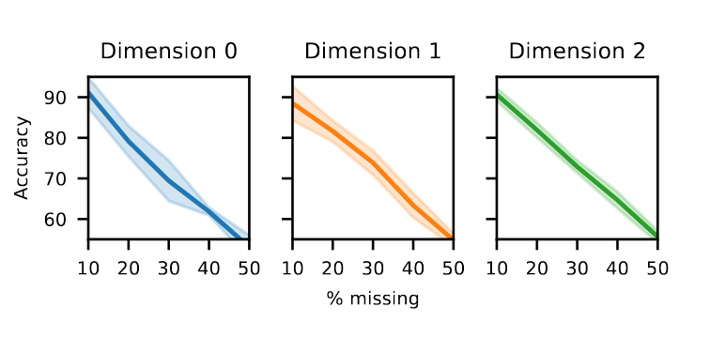
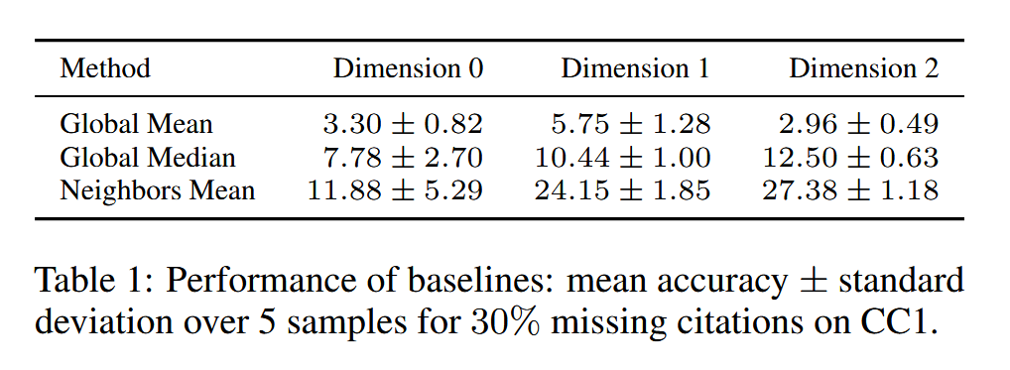
PART 03
Experiments
Results:
Figure 6: Performance of SNNs. Mean accuracy ± standard deviation over 5 samples in imputing missing citations on CC1.
Notes:
The result shows the mean accuracy of the SNN in inputing missing citations on CC1.
Overall, SNN demonstrates exceptional performance in tasks involving missing data completion, achieving high accuracy across 0-2 simplices. Additionally, when comparing SNN with baseline methods under scenarios with 30% missing data, SNN significantly outperforms all baseline approaches in terms of accuracy.

Slide 21
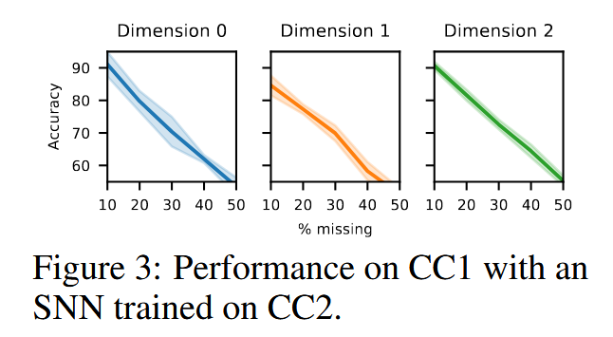
PART 03
Experiments
Results:
Evaluated how accurately an SNN trained on one coauthorship complex can impute missing citations on a different complex
When imputing citations on CC1, a SNN trained on CC2 is almost as good as one trained on CC1 (compare Figures 2 and 3)
Coauthorship complexes share a similar structure, and the same process underlies the generation of citations across coauthorship complexes
Fig7: performance on CC1 with an SNN trained on CC2
This demonstrated that our filters transfer across complexes!
Notes:
Then we evaluated how accurately an SNN trained on one coauthorship complex can impute missing citations on a different complex. We found that when imputing citations on CC1, a SNN trained on CC2 is almost as good as one trained on CC1. We expect this result as coauthorship complexes share a similar structure, and the same process underlies the generation of citations across coauthorship complexes. This demonstrated that that the filters transfer across complexes.

Slide 22
04
PART FOUR
Conclusion
Notes:
In conclusion:

Slide 23
PART 04
Conclusion
This literature:
designed a mathematical framework of neural networks for data living on simplicial complexes
provided results on its performance in the task of imputing missing data
The method it mentioned mainly focused on designing the convolutional kernel of the neural networks’ layer
Notes:
This literature designed a mathematical framework of neural networks for data living on simplicial complexes, provided results on its performance in the task of imputing missing data, and the method it mentioned mainly focused on designing the convolutional kernel of the neural networks’ layer.

Slide 24
PART 04
References
[1] M. M. Bronstein et al., “Geometric Deep Learning: Going beyond Euclidean data,” IEEE Signal Processing Magazine, vol. 34, no. 4, pp. 18–42, 2017.
[2] Y. Feng et al., “Hypergraph Neural Networks,” in Proceedings of the AAAI Conference on Artificial Intelligence, vol. 33, 01, 2019.
[3] I. Madsen and Jørgen Tornehave, From Calculus to Cohomology: de Rham Cohomology and Characteristic Classes, Cambridge University Press, 1997.
[4]Petri G, Expert P, Turkheimer F, Carhart-Harris R, Nutt D, Hellyer PJ, Vaccarino F. 2014 Homological scaffolds of brain functional networks. J. R. Soc. Interface 11: 20140873.
[5]Schaub, Michael T., et al. "Random walks on simplicial complexes and the normalized Hodge 1-Laplacian." SIAM Review 62.2 (2020): 353-391.
[6]Schaub, Michael T., et al. "Random walks on simplicial complexes and the normalized Hodge 1-Laplacian." SIAM Review 62.2 (2020): 353-391.
[7] Roderick J A Little and Donald B Rubin. Statistical Analysis with Missing Data. USA: John Wiley & Sons, Inc., 1986. ISBN: 0471802549.
[8] Fulufhelo Nelwamondo, Shakir Mohamed, and Tshilidzi Marwala. “Missing Data: A Comparison of Neural Network and Expectation Maximisation Techniques”. In: Current Science 93 (May 2007).
[9] Indro Spinelli, Simone Scardapane, and Aurelio Uncini. “Missing data imputation with adversarially-trained graph convolutional networks”. In: Neural Networks 129 (2020), pp. 249260.
[10] Waleed Ammar et al. “Construction of the Literature Graph in Semantic Scholar”. In: NAACL. 2018. URL: https : / / www . semanticscholar . org / paper / 09e3cf5704bcb16e6657f6ceed70e93373a54618.

Slide 25

Zhang Sihong
email: zhangsih24@mails.tsinghua.edu.cn
Thanks!

