Slide 1

IN THE FUTURE
Compositional Exemplars for In-context Learning（ICML，2023）
Autor: Jiacheng Ye,Zhiyong Wu ,Jiangtao Feng,Tao Yu,Lingpeng Kong
Shuhan Huang

Slide 2

Category
Background
01
Related Work
02
Proposed Model
03
Experiment and Analysis
04
Conclusion
05

Slide 3

01 Background

Slide 4

Background（1/2）
01
Background：
LLMs have demonstrated exceptional in-context learning (ICL) capabilities, where the model learns to perform an unseen task through prompts consisting of input-output examples, without requiring any parameter updates. The performance of ICL largely depends on the quality of the selected context examples.
在此填充内容
Motivation：
Previous selection methods were mostly based on simple heuristic algorithms, yielding relatively suboptimal performance,because such methods often overlook the interactions and relationships between these examples (e.g., ignoring redundancy, which results in many identical or similar context examples). Given the input length limitations of LLM prompts, selecting high-quality, diverse context examples is therefore a critical objective for this task.
Contributions：
The CEIL model was designed to utilize the DPP algorithm to model the probability of context example subsets and employ a contrastive learning strategy for retrieval.
Training: A contrastive learning strategy is employed to refine the embeddings of each context example and training instance, ensuring that the "good" subsets of training instances have a higher probability of being retrieved compared to the "poor" subsets.
Inference: The learned DPP module is used to perform Maximum A Posteriori (MAP) inference.

Slide 5

02 Related Work

Slide 6
Related Work（1/1）
02
In-context Learning：The methods are divided into learning-free and learning-based approaches.
Learning-free：Heuristic evaluation metrics for ICL capabilities, such as diversity and entropy, have been proposed. However, these methods typically rely on human expertise and task-specific design,Sometimes it just selected based on diversity or similarity, leading to suboptimal performance.
Learning-based: Rubin et al. proposed training a single-example scorer using contrastive learning and signals from a language model (LM) inferencer. Research by Shi and Lei et al. explored multi-channel ICL, which generates multiple responses from different subsets of examples and then aggregates them. However, this approach is inefficient and time-consuming.

Slide 7

03 Proposed Model

Slide 8
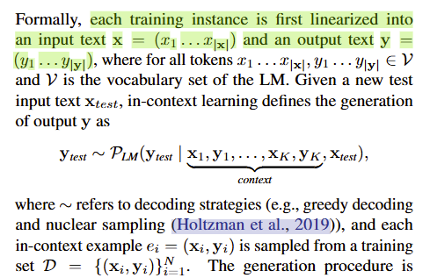

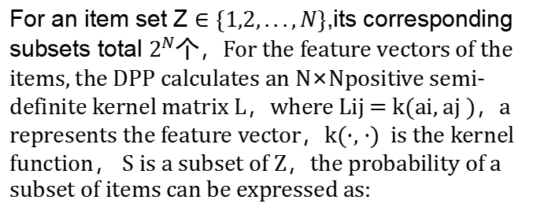
Proposed Model（1/3）
03
In-context Learning
Determinantal Point Processes
For an item set Z $∈\{1,2,...,N\}$,its corresponding subsets total $2^{N}个$，For the feature vectors of the items, the DPP calculates an N×Npositive semi-definite kernel matrix L，where Lij = k(ai, aj )，a represents the feature vector，k(·, ·) is the kernel function， S is a subset of Z，the probability of a subset of items can be expressed as:
As the number of item features increases, the probability of sets containing the item also increases. At the same time, as the similarity between two items increases, the probability of a set containing both items decreases. This aligns well with the goal of retrieving more diverse and rich context examples.

Slide 9
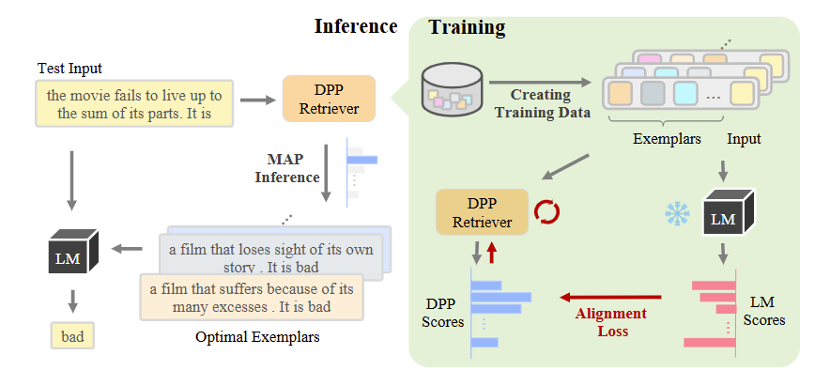


Proposed Model（2/3）
03
Relevance and diversity are two important metrics for evaluating context examples. However, the DPP algorithm ignores relevance. Therefore, the authors modified the algorithm for adding the kernel functiong.It helps to evaluate the relevance quality of the selected examples .
To balance the importance of relevance and diversity for different inputs, a parameter 𝜆 is introduced for control.
CEIL does not independently retrieve each context example; instead, it models the entire sample set by learning their joint probability using conditional DPP. This model is further trained with contrastive loss to align with the LM score. During inference, for a given test input, the learned DPP retriever obtains the optimal example set through MAP inference. Throughout this process, the black-box LM is frozen.

Slide 10


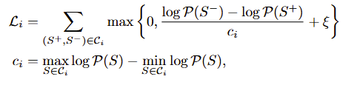

Proposed Model（3/3）
Training
03
Since the context examples for each training instance do not have ground-truth labels, traditional maximum likelihood methods cannot be used to learn the parameters. Therefore, a contrastive learning framework is adopted.
First, n relevant context examples are pre-computed with DPP algorithm. Then, 𝑀context subsets are generated by random sampling and combining these examples, which are then paired with the input
Inference
The retrieved context examples are scored using the LLM, resulting in scores sij
The MAP algorithm is used to obtain context examples that simultaneously ensure both diversity and relevance (using a greedy strategy).
Contrastive Loss：The LLM score and DPP preferences are fully utilized and aligned to select the optimal subset.

Slide 11

04 Experiment and Analysis

Slide 12
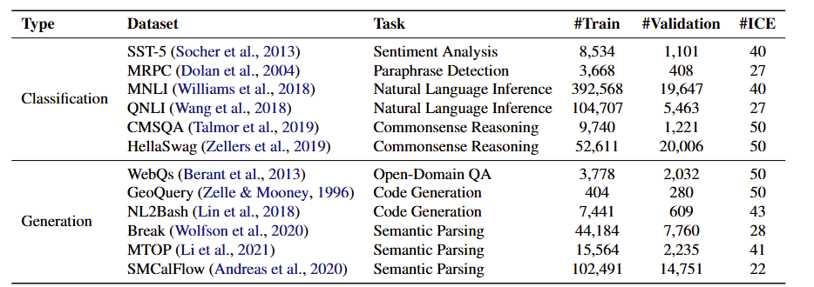
Expriments（1/3）
04
Datasets
Implemental details
LLM: GPT-Neo (2.7B)
Evaluation metrics:
Acc (classification); EM (generation)
Tasks：classification and Generation
Classification task: The answer generation process involves providing the context examples and corresponding options to the LLM, then selecting the answer using the maximum likelihood method.
Generation task: A greedy strategy is used for decoding.
The number of retrieved context examples is limited to less than 50.

Slide 13
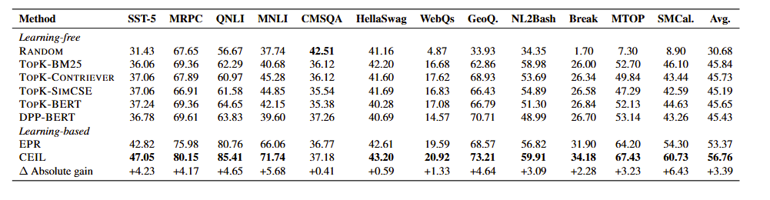
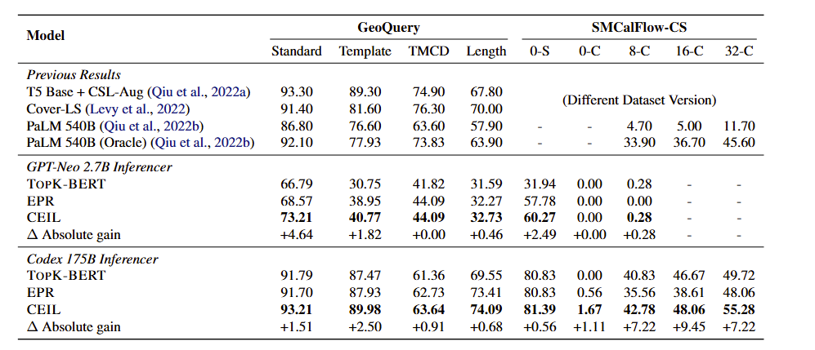
实验（2/3）
04
Comparable Experiment：
Analysis：
Comopsitionality
As seen in Table 2, with the increase in the number of context examples, the performance improvement also increases, indicating that CEIL has successfully retrieved combined context examples, leading to enhanced performance. In the inference phase, the LM in CEIL has not seen the combined examples, whereas in the training phase, it is trained with the combined context examples.

Slide 14
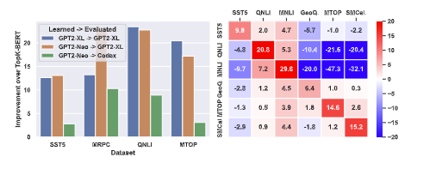
Experiments（3/3）
04
Transferability
Transfer across LMs
In the inference phase, it can be observed that the transferred retriever performs better on the MRPC dataset than the specially trained retriever. This suggests that, in addition to learning from the target LM, it may bring additional knowledge (such as the compositional features of natural language).
Transfer across datasets
It was found that almost all retrievers NLI tasks such as QNLI and MNLI, achieved better performance than TOPK-BERT. However, for other individual input tasks, we only found that retrievers trained on similar tasks/datasets (e.g., code generation and semantic parsing) exhibited transferability.

Slide 15
06 Conclusion

Slide 16
Conclusion（1/1）
06
The combinatorial learning discussed in this paper:
Conclusion：
In this paper, the authors redefine context example selection as an end-to-end optimization problem and propose CEIL, which uses DPP to model the probability of entire subsets of context examples. Through a contrastive learning framework, CEIL learns to select better context examples. Through Experiments,The retriever learned in CEIL also demonstrates surprising transferability across LMs and datasets, as well as composability for combination tasks.
From a model design perspective：In the training phase, the concept of combination is integrated by combining the input with context examples, and bias correction is performed through a contrastive learning approach to select higher-quality context examples. This validates the generalization ability of the model trained with combined examples in unseen scenarios.
Interpretability：The superior performance of the model is explained by evaluating its composability and transferability.

Slide 17

Thanks！
Shuhan Huang

