Slide 1
P3P: Pseudo-3D Pre-training for Scaling 3D Self-supervised Learning
Xuechao Chen
Supervisor: Yang Li
Year 2024

Slide 2
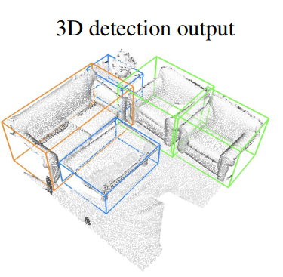
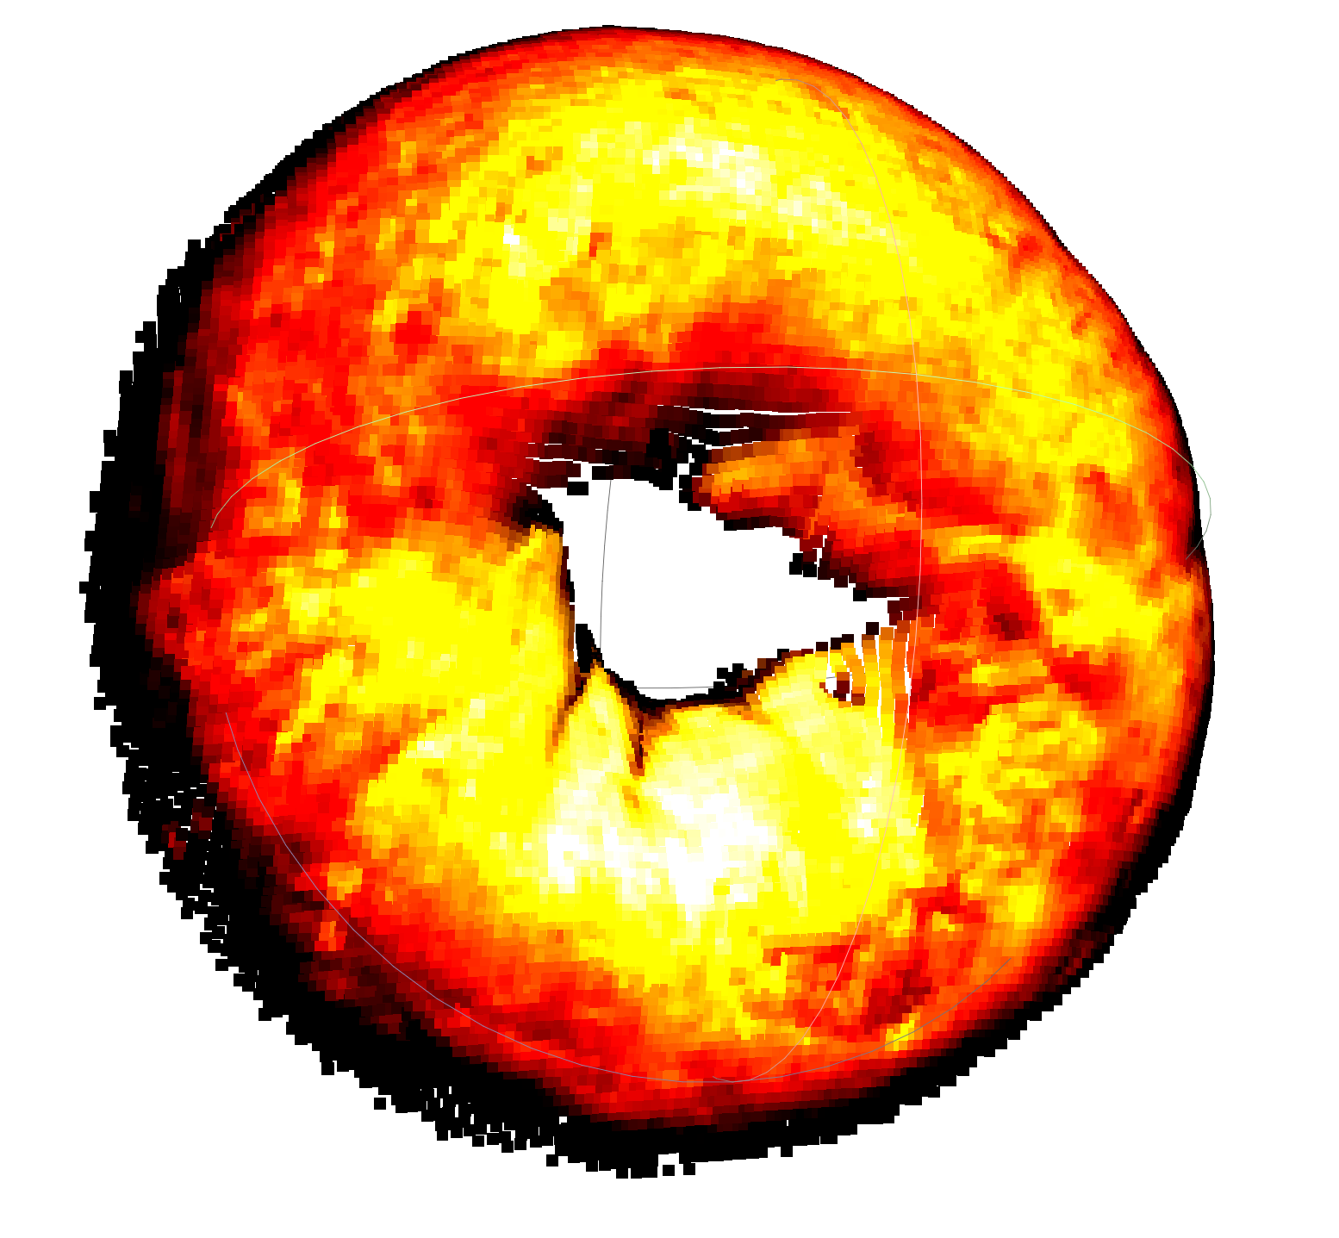
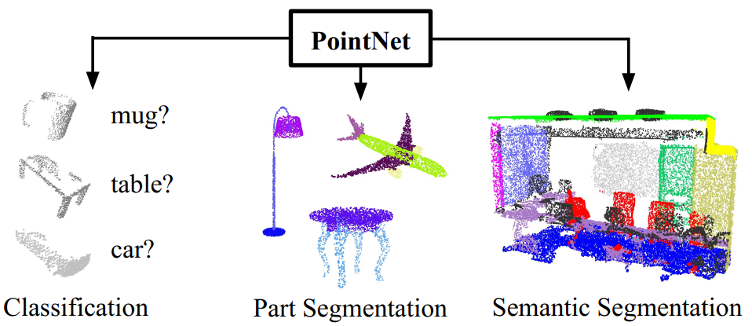
Background
RGB-D based AD
Transfer Learning
Pre-train
Downstream
Qi, Charles R., et al. "Deep hough voting for 3d object detection in point clouds." proceedings of the IEEE/CVF International Conference on Computer Vision. 2019.
Qi, Charles R., et al. "Pointnet: Deep learning on point sets for 3d classification and segmentation." Proceedings of the IEEE conference on computer vision and pattern recognition. 2017.

Slide 3
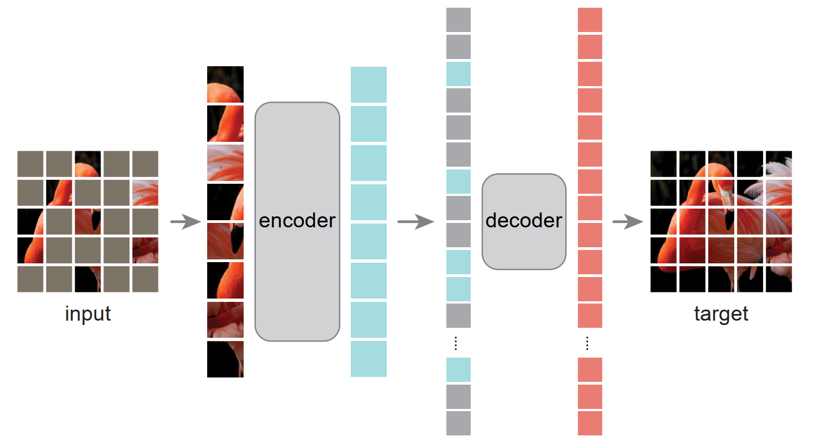
Background
Masked Autoencoder (MAE) pre-training
  Strong scalability for downstream tasks, e.g., few-shot, classification, segmentation, detection.
He, Kaiming, et al. "Masked autoencoders are scalable vision learners." CVPR. 2022.

Slide 4
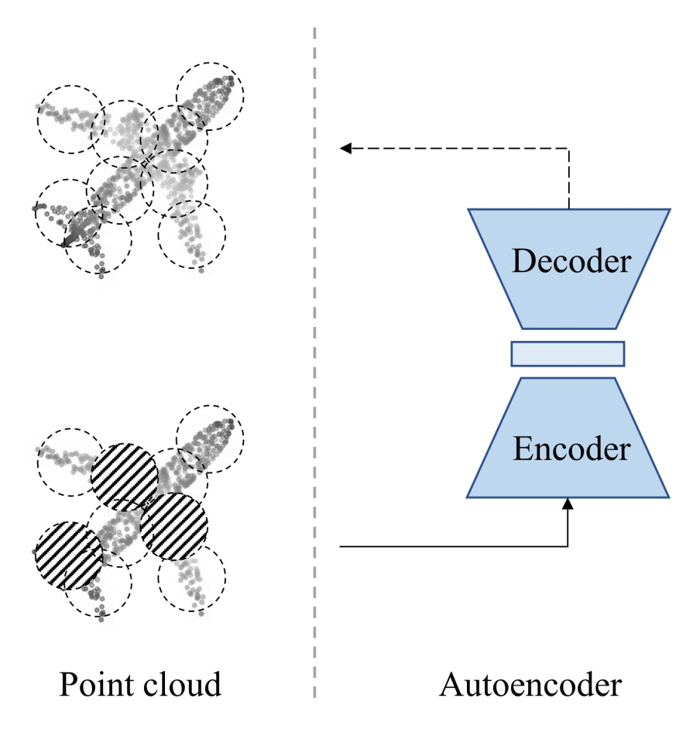
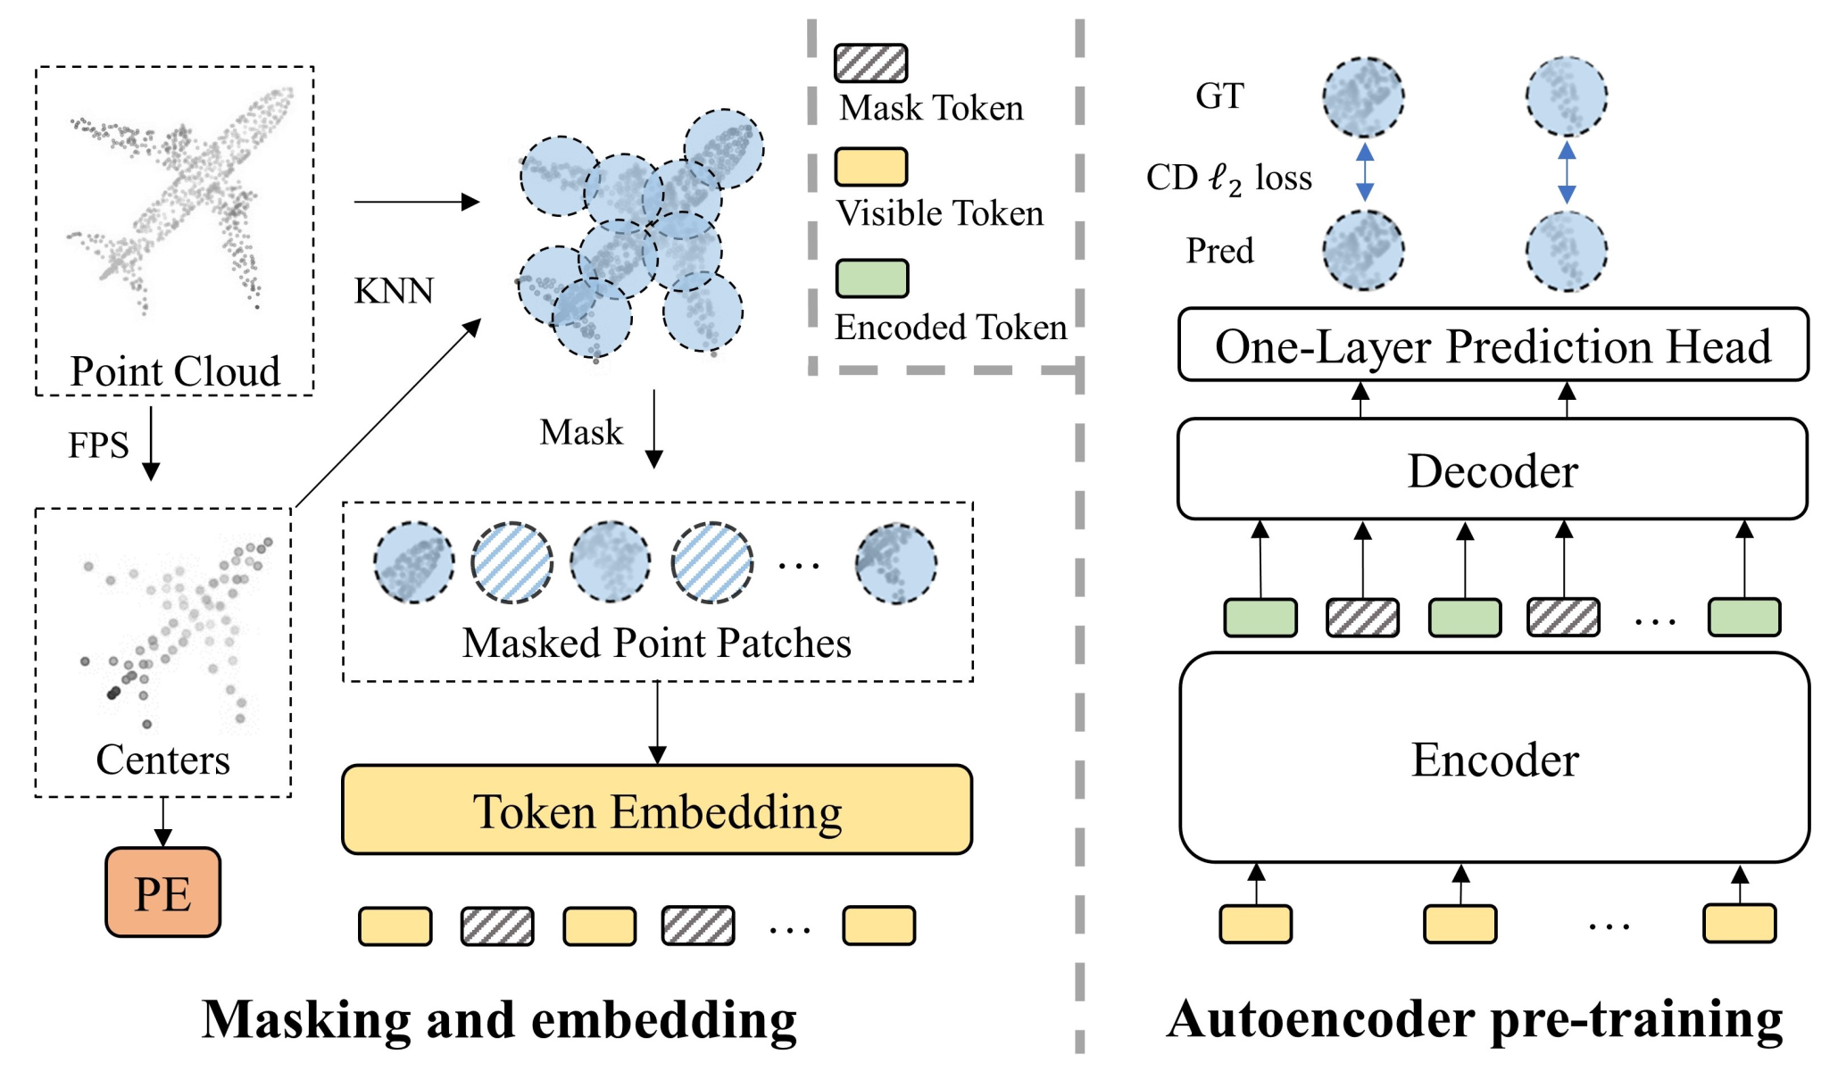
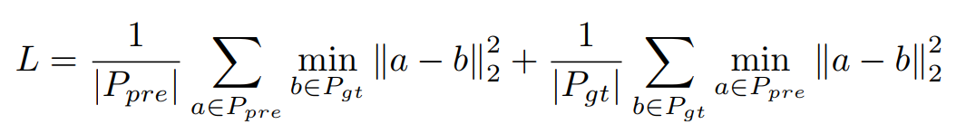
Background
Pang, Yatian, et al. "Masked autoencoders for point cloud self-supervised learning." ECCV. 2022.

Slide 5
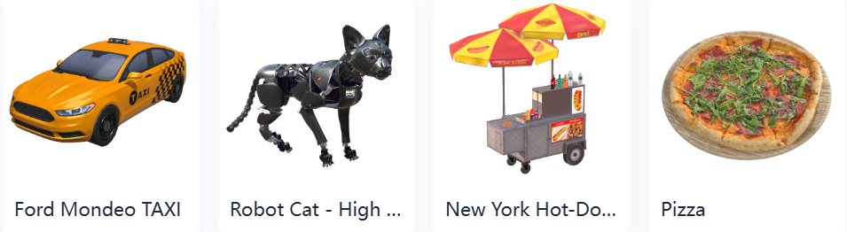
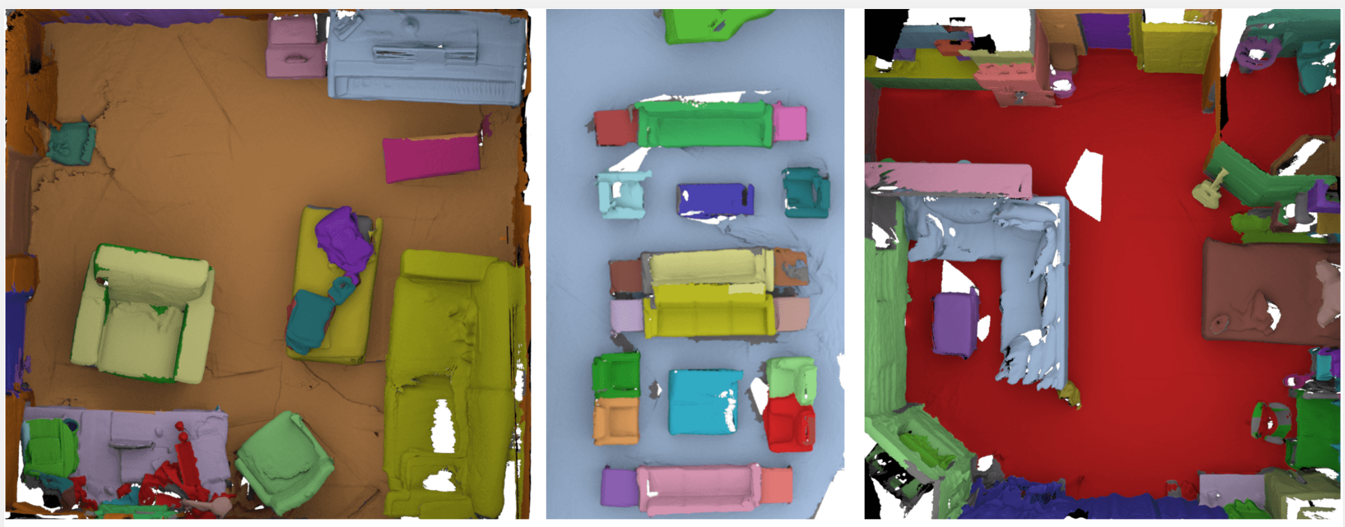
Background
Challenge 1: Data Scalability
  Pre-training corpora 1: 3D objects, e.g., ShapeNet (synthetic 50k), Objaverse (reconstructed and synthetic 800k).
  Pre-training corpora 2: 3D scenes, e.g., ScanNet (reconstructed 1.5k), Structured3D (synthetic 21k).
  Barrier: The cost in reconstructing 3D objects or scenes from multi-view RGB/RGB-D scans.
Challenge 2: Model Efficiency
  Point-based model requires FPS and KNN to embed features, whose time complexity is O(N^2).
Chang, Angel X., et al. “Shapenet: An information-rich 3d model repository.” arXiv preprint arXiv:1512.03012. 2015.
Deitke, Matt, et al. "Objaverse: A universe of annotated 3d objects." CVPR. 2023.
Dai, Angela, et al. "Scannet: Richly-annotated 3d reconstructions of indoor scenes." CVPR. 2017.
Zheng, Jia, et al. "Structured3d: A large photo-realistic dataset for structured 3d modeling." ECCV. 2020.

Slide 6
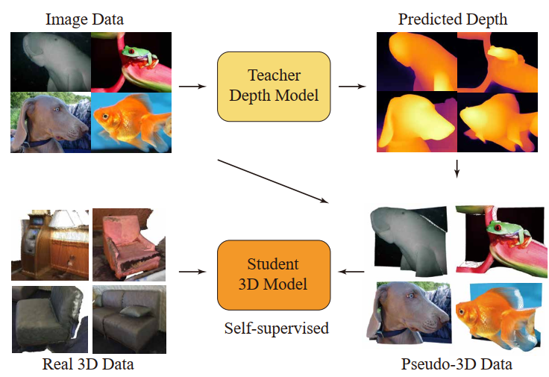
Pre-training corpora
Why not directly use RGB/RGB-D scans?
Cheapest 3D data: RGB-D scans
  ScanNet: 1500 indoor scenes
  Sampling 50k from 2.5M RGB-D scans
  Dense views harm diversity
Pseudo-3D data: lifted images
  ImageNet: 1000 categories, 1.2M samples
  least domain gap with RGB-D scans
  unlimited data size and diversity
  natural color and texture distribution

Slide 7
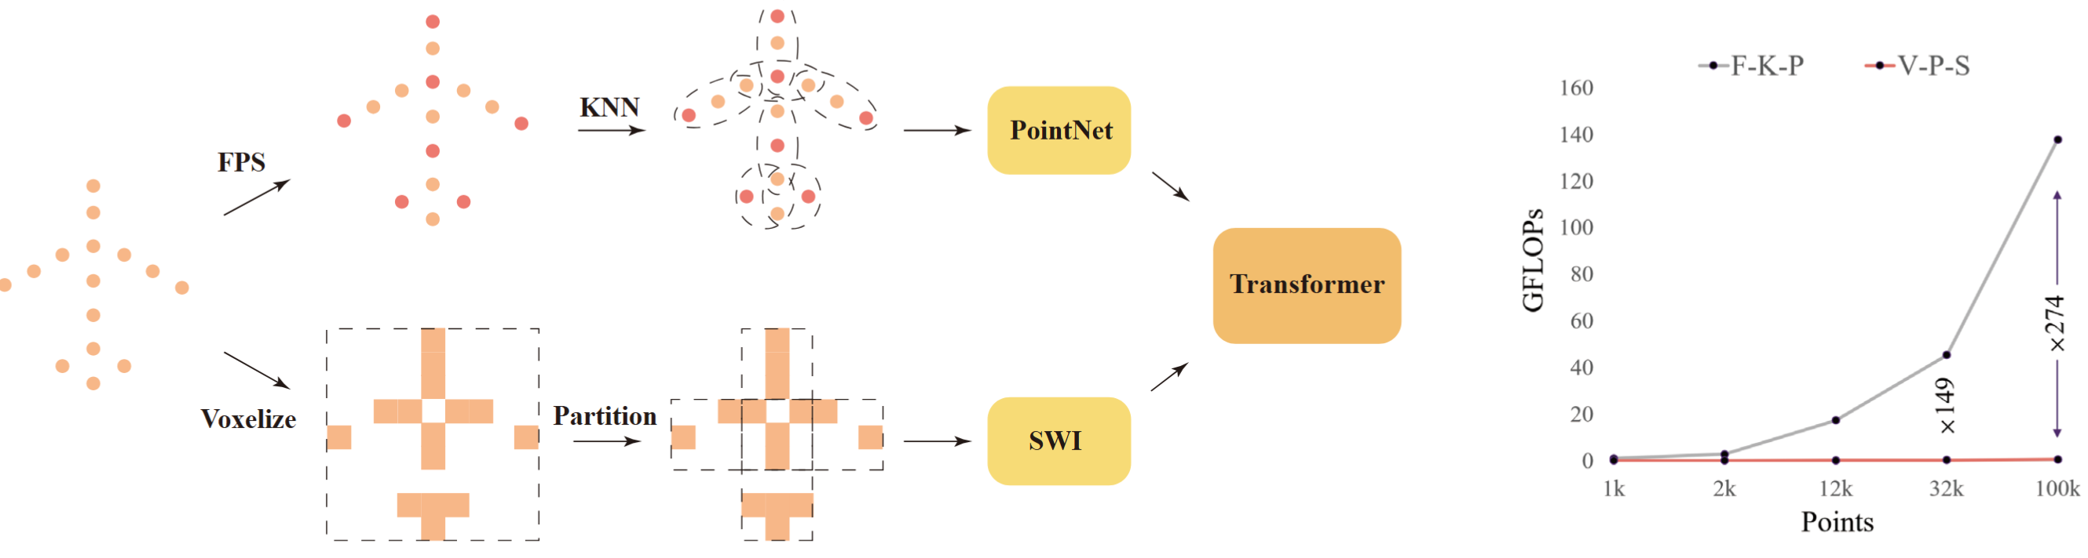
Representation for point cloud
One image: 500 × 350 = 175, 000 data points
Point-based models
  Farthest Point Sampling
  K Nearest Neighbors
  PointNet
Our voxel-based models
  Voxelization
  Patch partition
  Sparse Weight Indexing
Notes:
FPS: How many centers do we need?

Slide 8


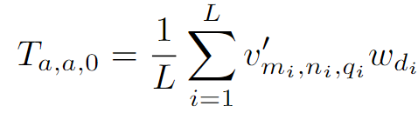
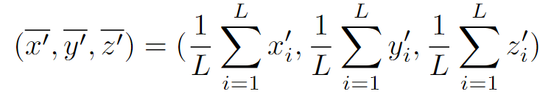
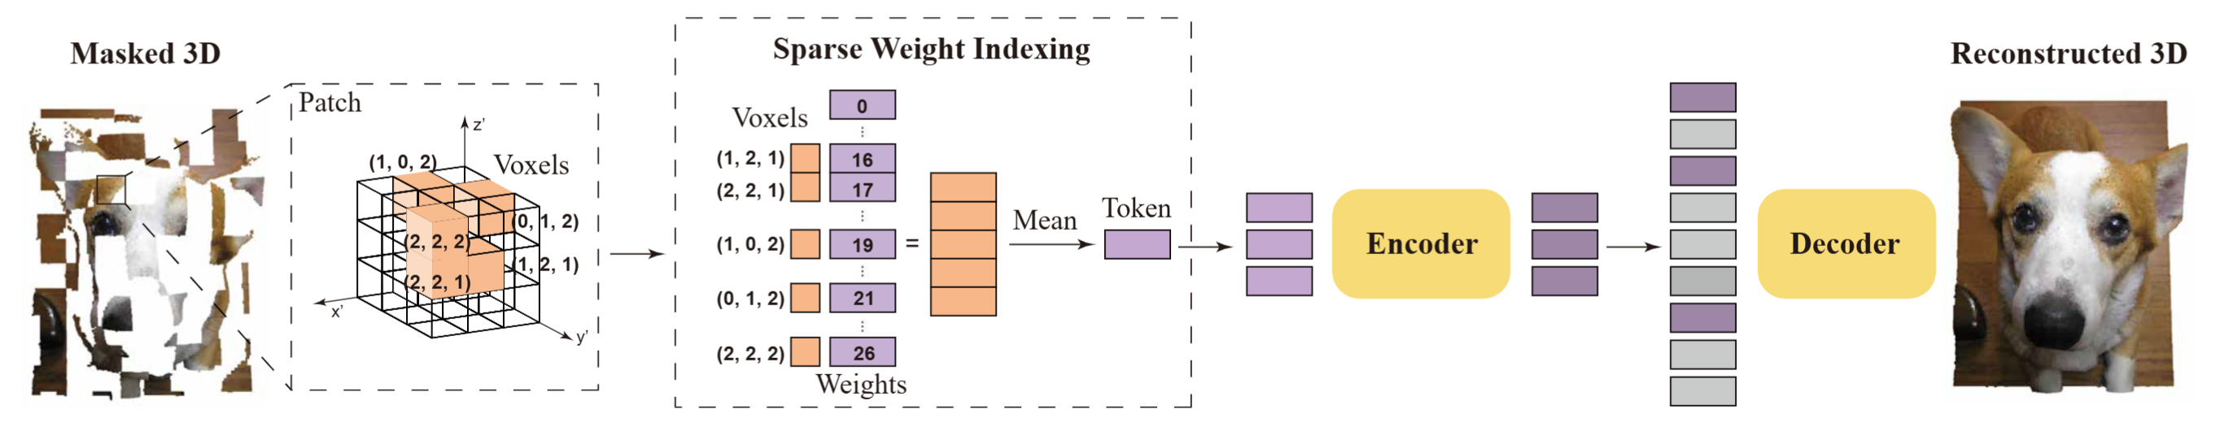
Pre-training Paradigm
Masked Autoencoders (MAE) based pre-training for 3D models
  Voxelization
  Voxel graph representation
  Sparse Weight Indexing

Slide 9
Pre-training Paradigm
Masked Autoencoders (MAE) based pre-training for 3D models
3D reconstruction target
  Chamfer Distance for x, y, z
  MSE loss for r, g, b and other features
  Occupancy

Slide 10
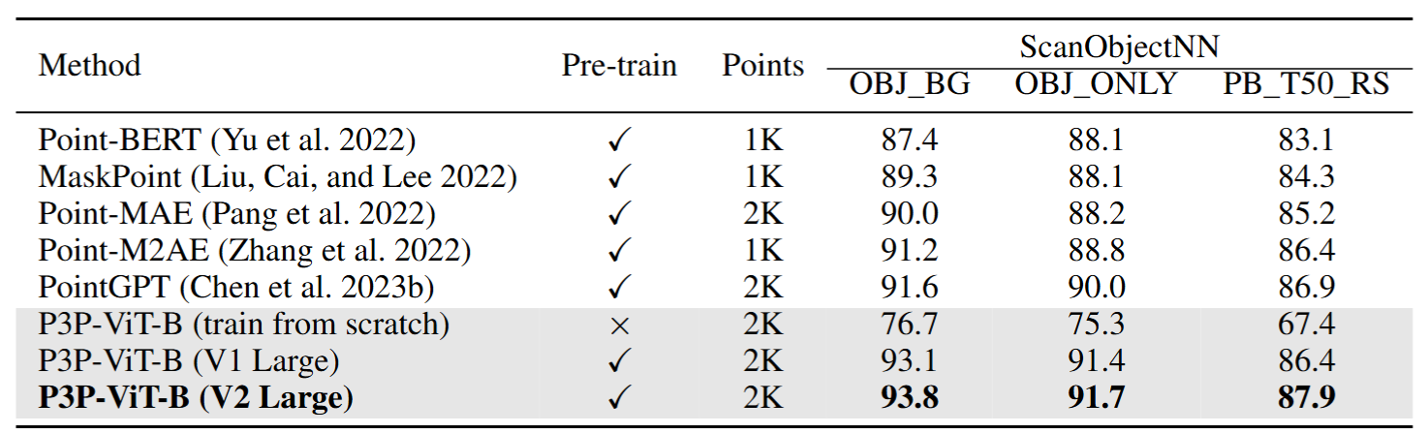
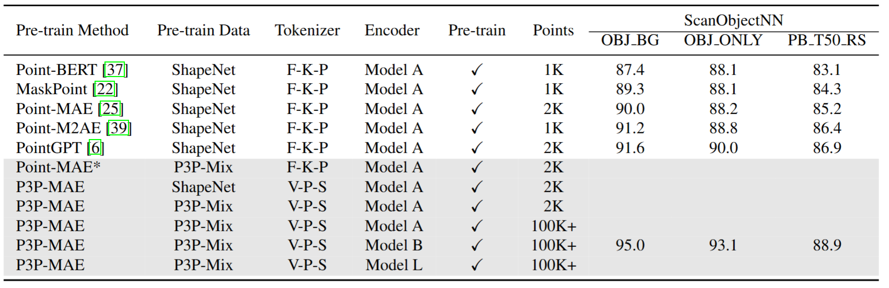
Classification
SOTA on ScanObjectNN classification (fine-tune all parameters)

Slide 11
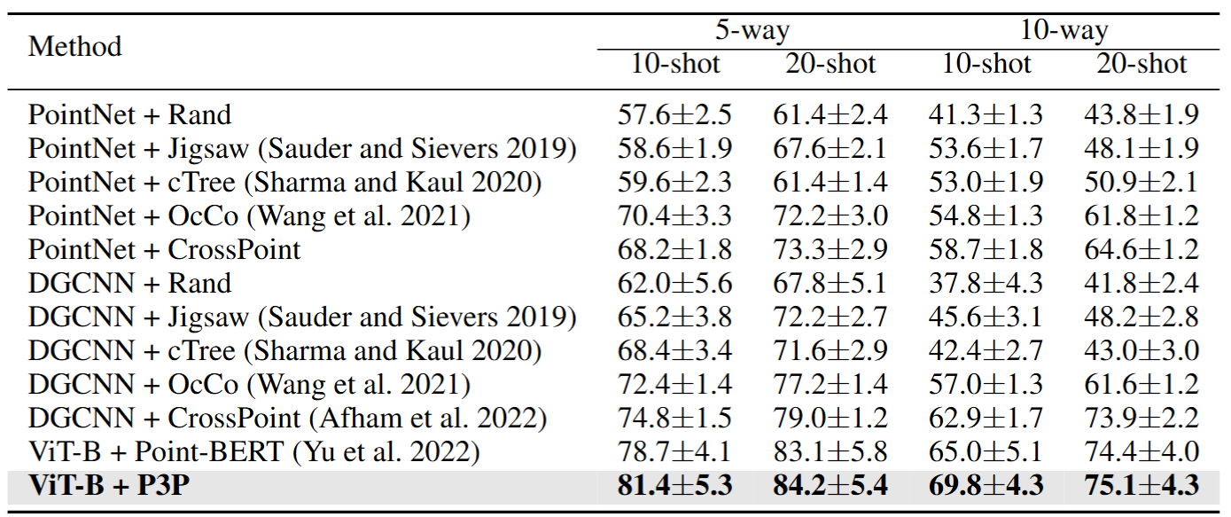
Few-shot Learning
SOTA on ScanObjectNN few-shot learning (cancel in next version)
  Highly-related previous methods have not reported
  The results are unstable for transformers: high standard errors
Notes:
Reimplementation of pointgpt

Slide 12
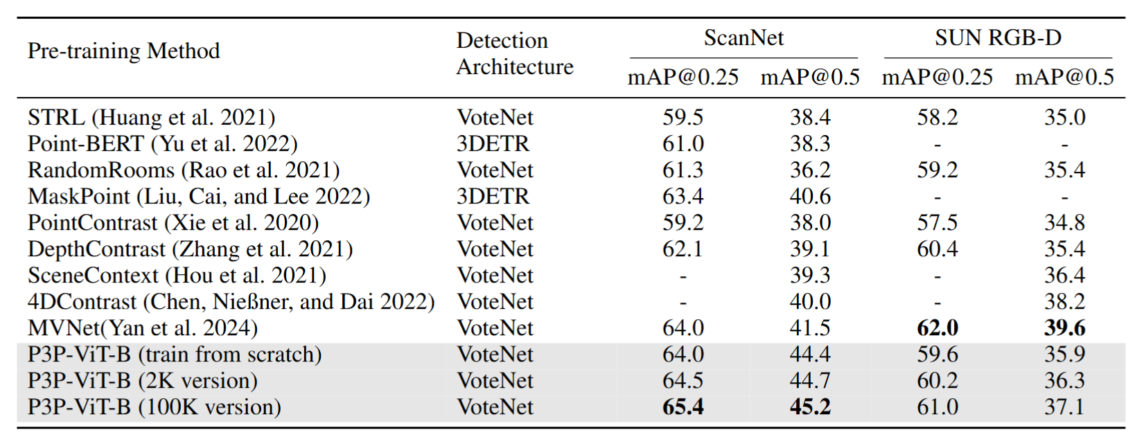
Detection
Revision needed

Slide 13
Segmentation
Waiting…

Slide 14
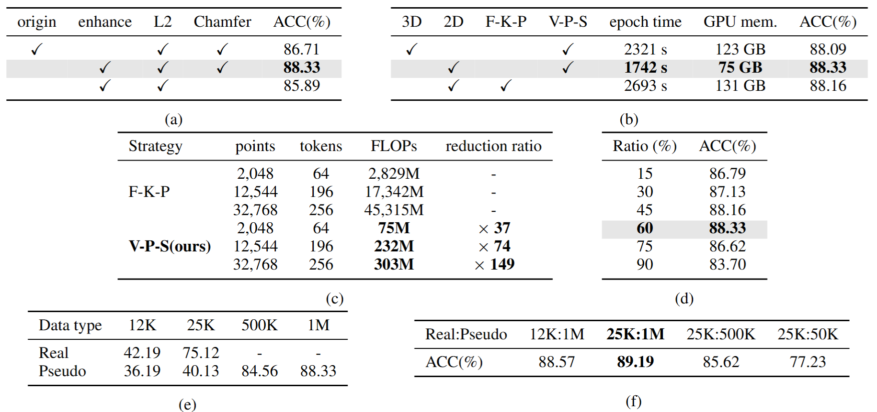
Ablation study

Slide 15
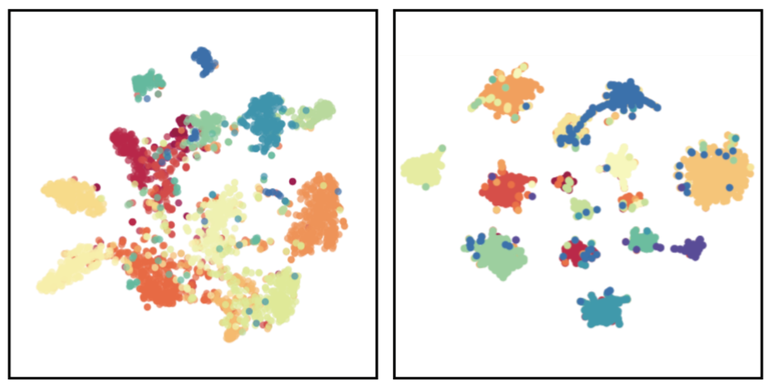
Qualitative analysis
T-SNE

Slide 16
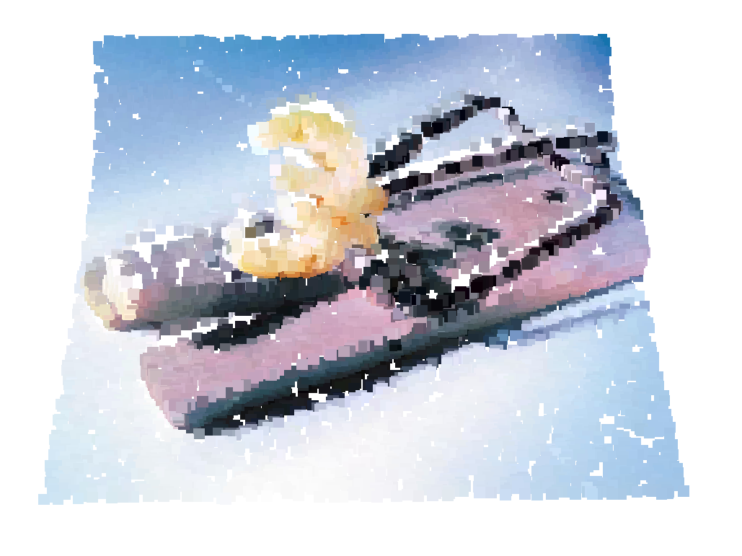
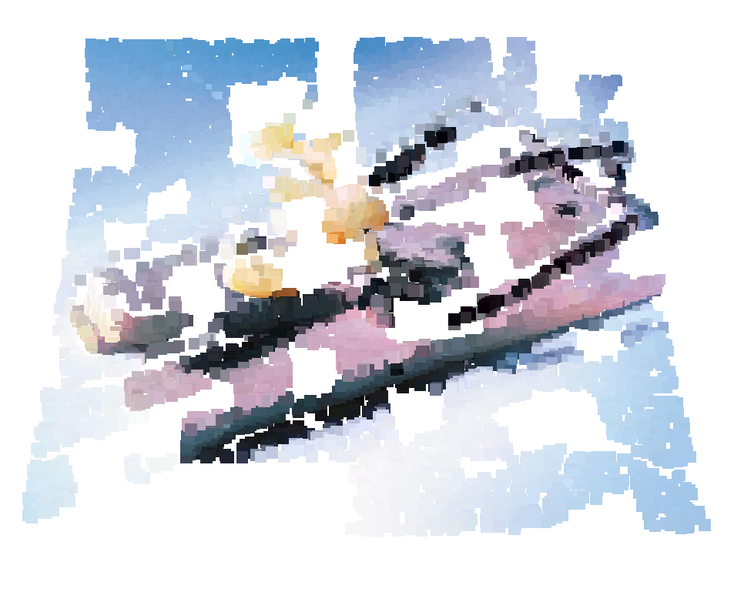
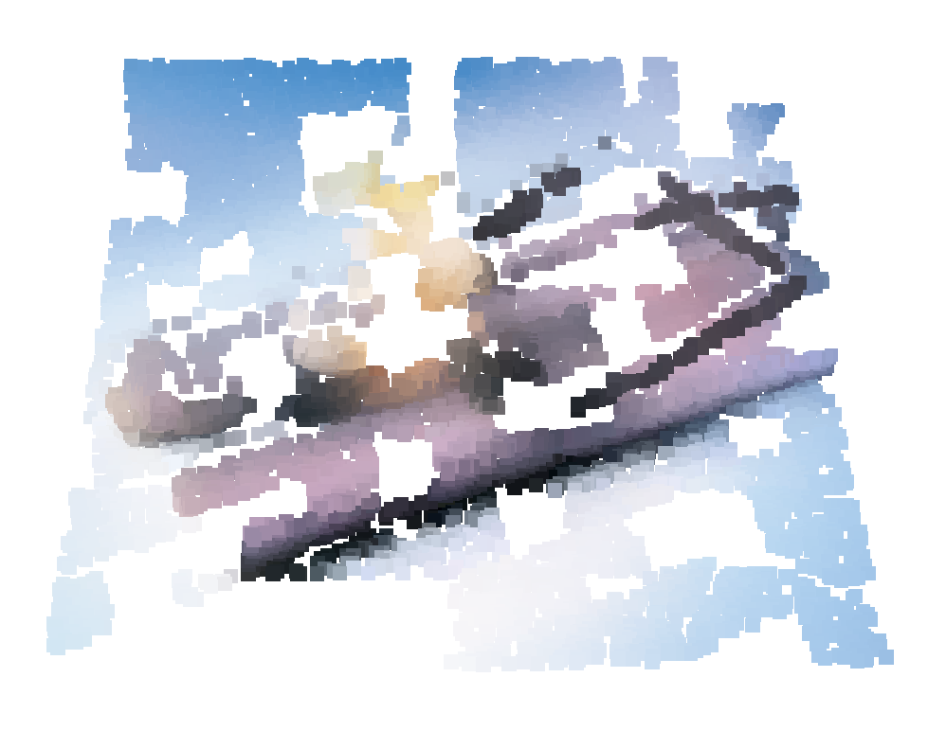
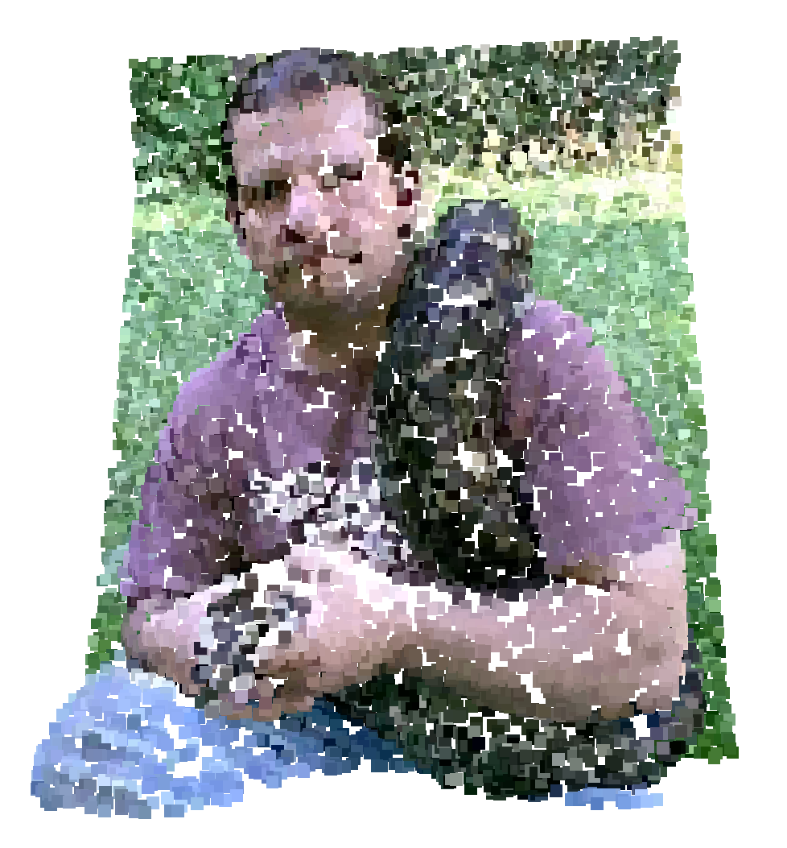
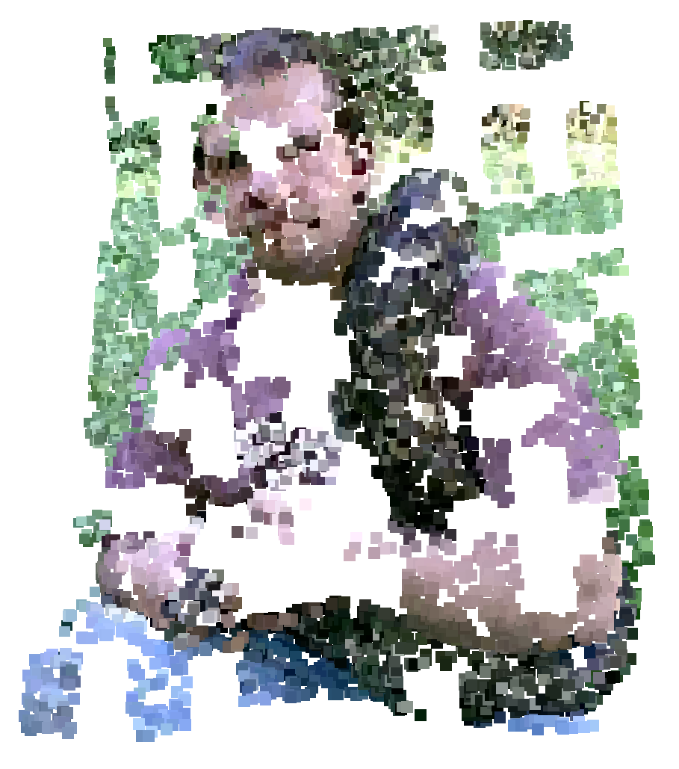
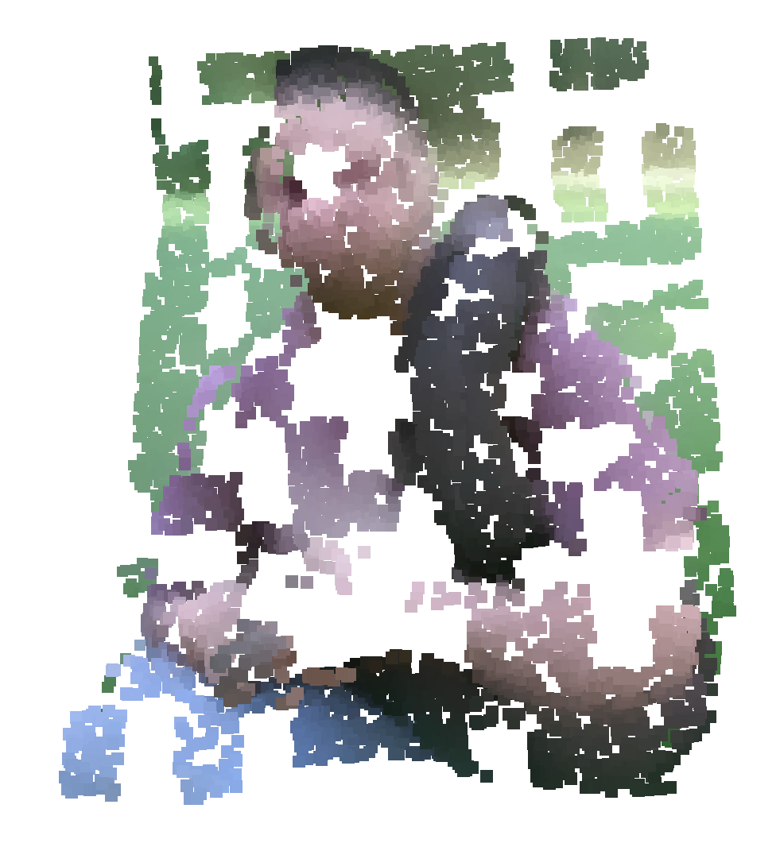
Qualitative analysis
Reconstructed target

Slide 17
P3P-CL
P3P-MAE: Pseudo-3D Pre-training for Scaling 3D Masked Autoencoders
P3P-CL: Pseudo-3D Pre-training for Scaling 3D-Language Contrastive Learning
  less contributed, maybe combine them for a journal paper
  P3P: Pseudo-3D Pre-training for Scaling 3D Self-supervised Learning

Slide 18
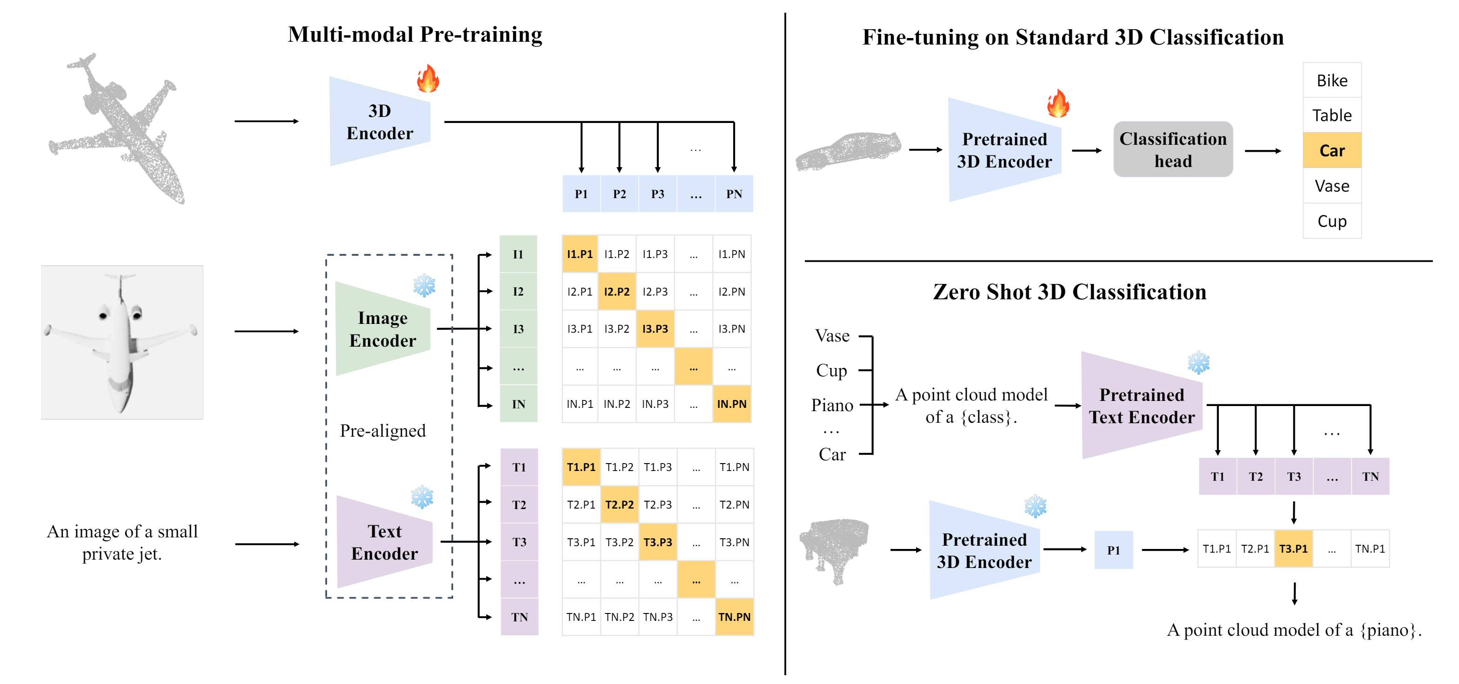
P3P-CL
Background: ULIP
Xue, Le, et al. "Ulip: Learning a unified representation of language, images, and point clouds for 3d understanding." CVPR. 2023.

Slide 19
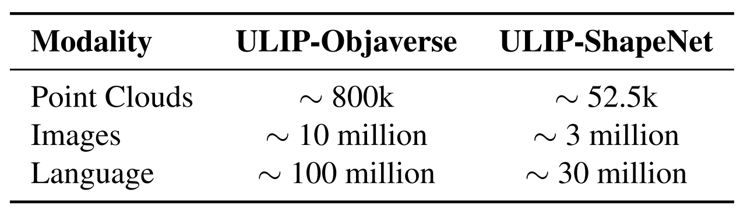
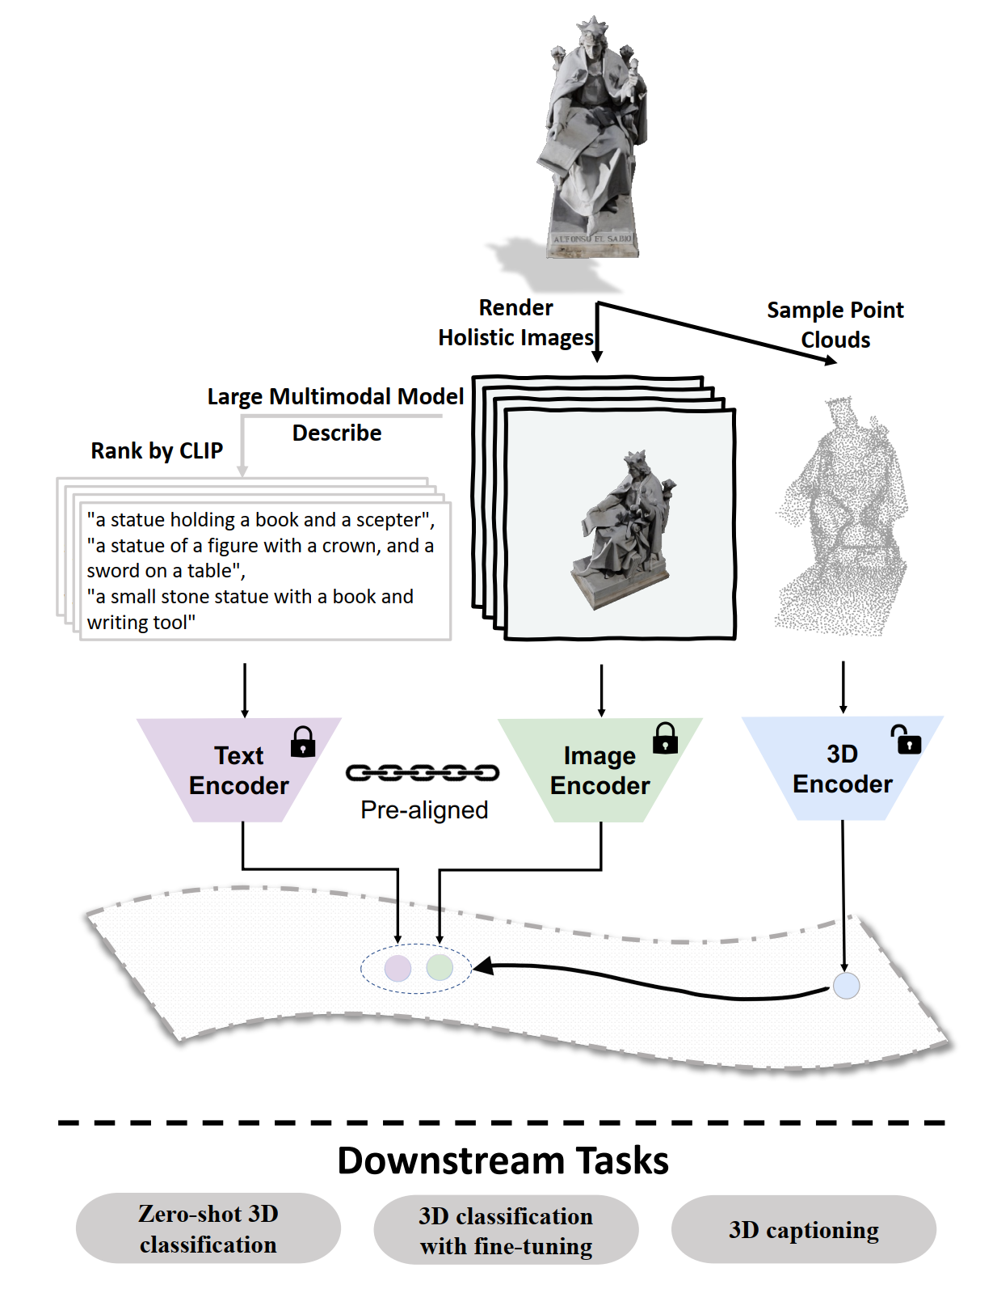
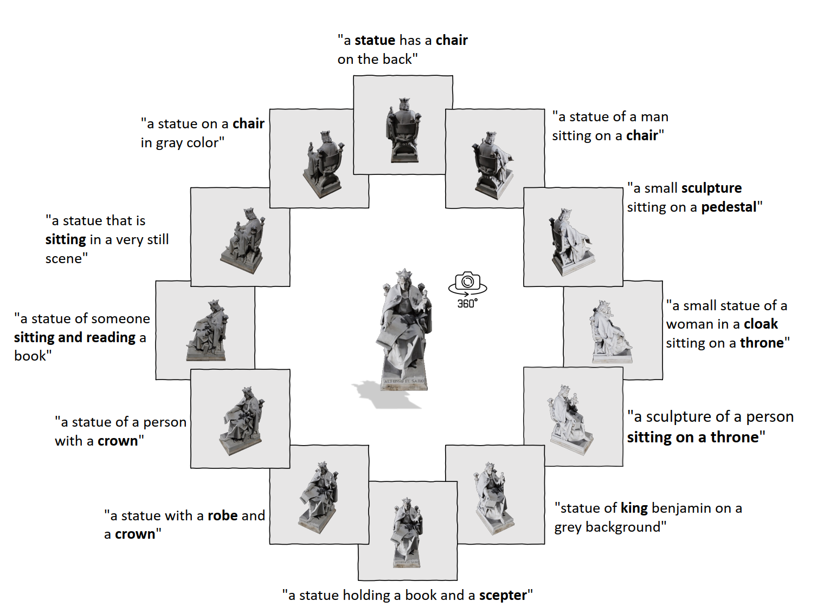
P3P-CL
Background: ULIP-2
Xue, Le, et al. "Ulip-2: Towards scalable multimodal pre-training for 3d understanding." CVPR. 2024.

Slide 20
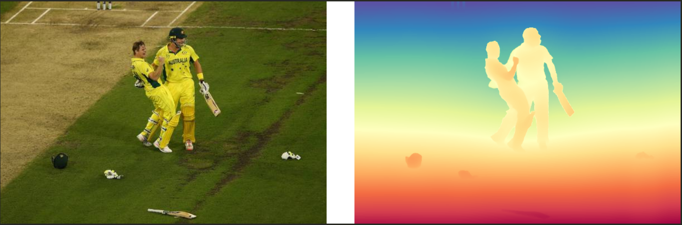
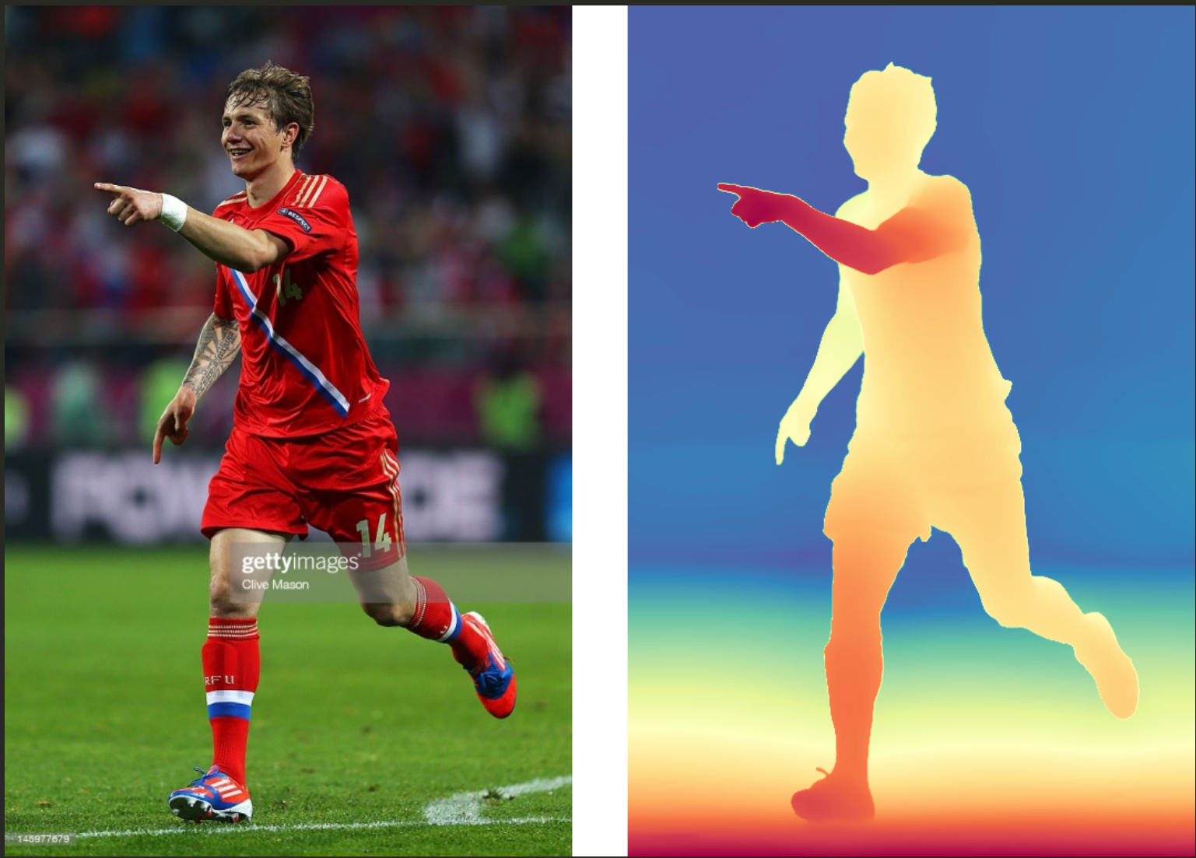
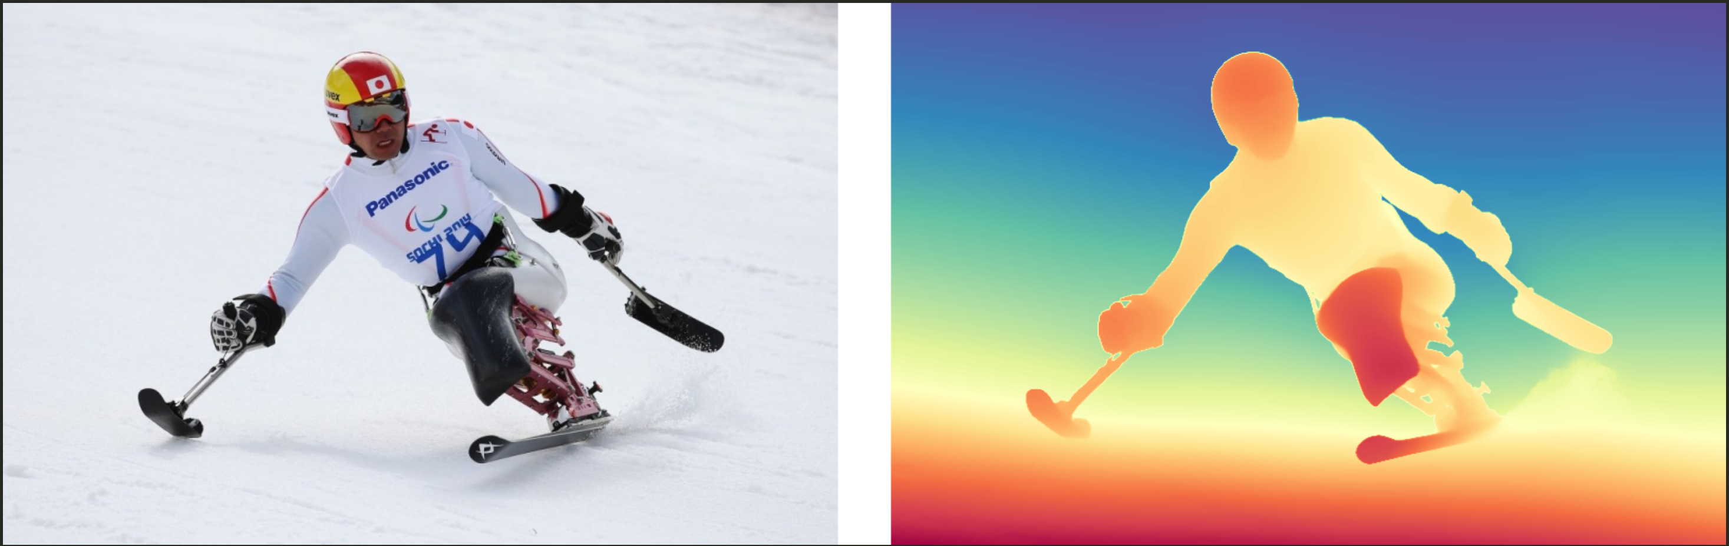
P3P-CL
cricketer and cricket player celebrate after beating cricket team to win cricket league .
Dataset
  CC3M: 3M image-text pairs
  CC12M: 12M image-text pairs
  No large RGB-D text dataset available
Baseline: ULIP based
athlete is among the athletes expected to compete
football player celebrates scoring their fourth goal during the group a match .

Slide 21
P3P-CL
Basic experiment: 3M data, BS 256, 20 epochs, 8 V100, 3 days
  class token (+) max pooling other tokens (ULIP): 1-epoch loss 7.7954, accuracy 81.82%
  class token (+) mean pooling other tokens: 1-epoch loss 7.7609, accuracy 83.88% (scratch 44.25%)
3D
3D Encoder
3D features
2D Encoder
contrastive loss
3D-2D
Image
Text Encoder
contrastive loss
3D-text
Text

Slide 22
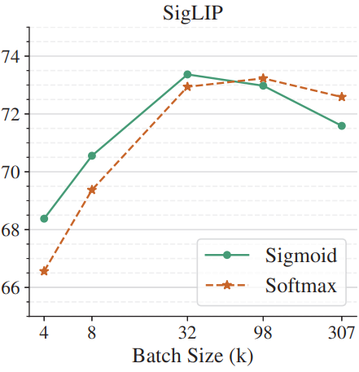
P3P-CL
Basic experiment: 3M data, BS 512, 50 epochs, 16 V100, 2 days
Result: failed converging
Bottleneck:
  Communication across GPUs
  Huge batch size needed
3D
3D Encoder
3D class token
Text Encoder
contrastive loss
3D-text
Text
Zhai, Xiaohua, et al. "Sigmoid Loss for Language Image Pre-Training." ICCV. 2023.

Slide 23
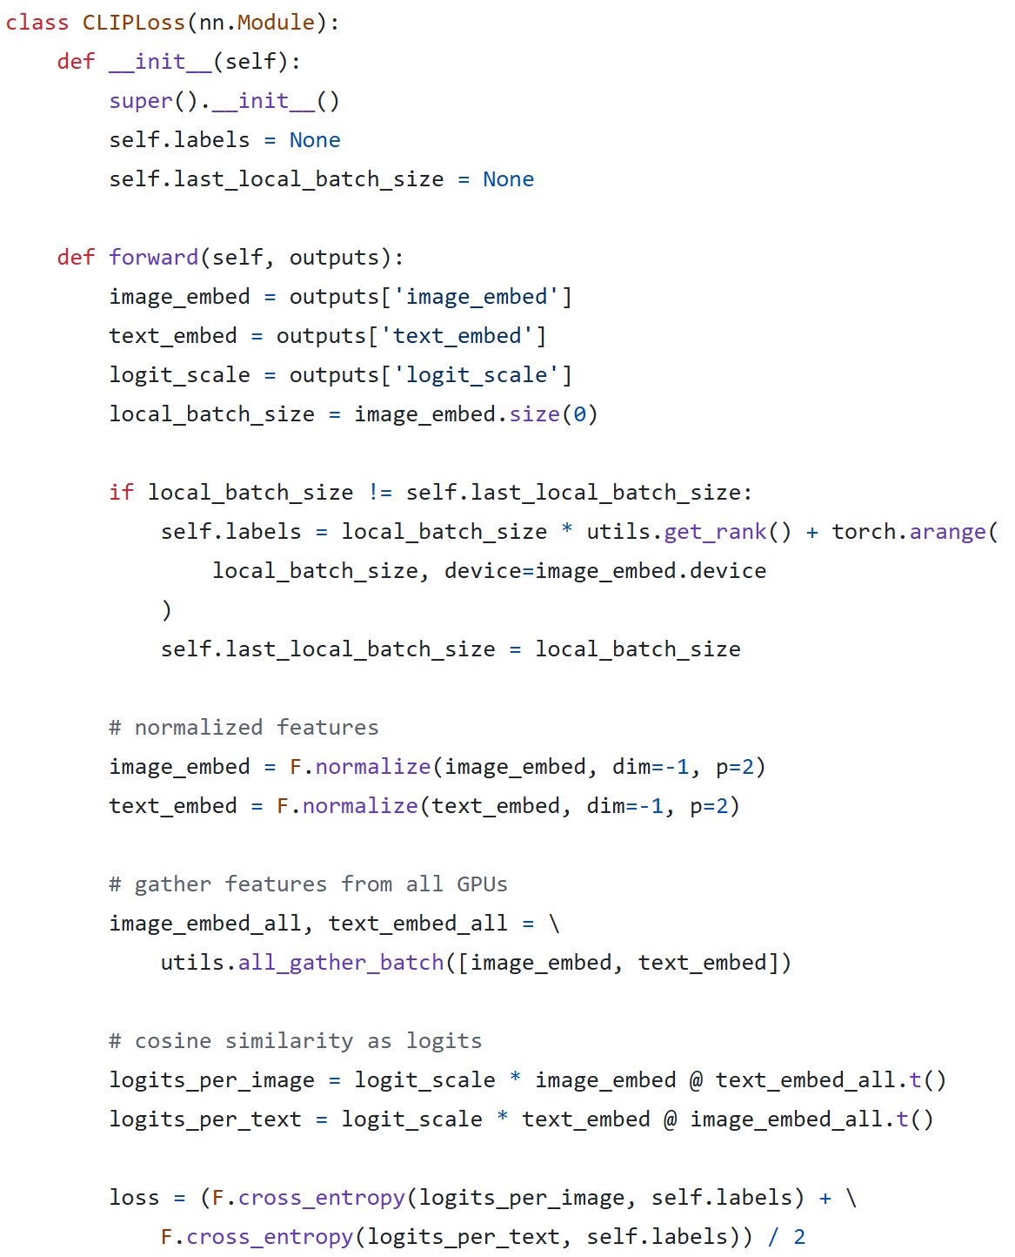
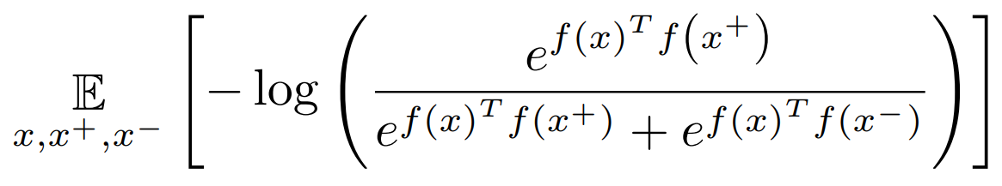
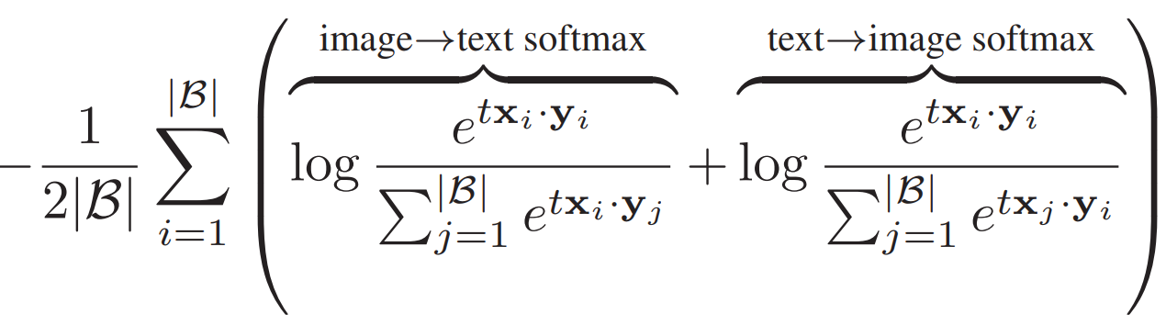
P3P-CL
Classical contrastive loss (InfoNCE¹ loss) for single-modal data
Cross-modal contrastive loss and code implementation
¹Oord, A. v. d., et al. “Representation learning with contrastive predictive coding.” arXiv preprint arXiv:1807.03748. 2018.

Slide 24
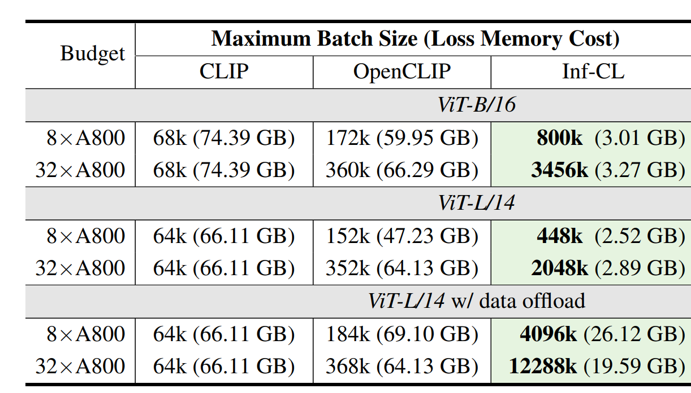
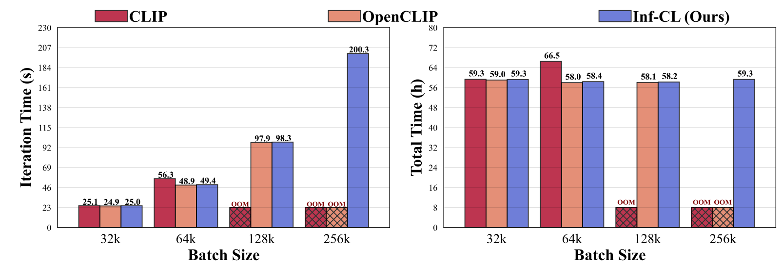
P3P-CL
Possible solution: Inf-CL
  Partition the contrastive loss calculation to arbitrary small blocks
  Hardware optimization is contributed for solving communication bottleneck
  For instance, it enables contrastive training of a CLIP-ViT-L/14 model with a batch size of 4M or 12M using 8 or 32 A800 80GB without sacrificing any accuracy.
https://github.com/DAMO-NLP-SG/Inf-CLIP
Cheng, Zesen, et al. "Breaking the Memory Barrier: Near Infinite Batch Size Scaling for Contrastive Loss." arXiv preprint arXiv:2410.17243. 2024.

Slide 25
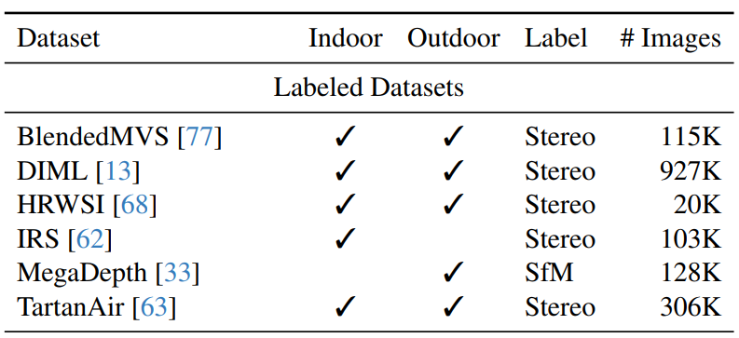
RGB-D datasets
Lack of diverse RGB-D-text pairs
Lack of diverse RGB-D data
Existing RGB-D datasets
  BlendedMVS: a variety of 113 scenes, including architectures, sculptures and small objects.
  DIML: more than 200 indoor / outdoor scenes.
  HRWSI: 21K diverse high-resolution web stereo photos
  IRS: simulate 21 indoor scenes and adjusted different configurations for them to generate over 100,000 samples.
  MegaDepth: 196 different locations reconstructed from COLMAP SfM/MVS
  TartanAir: 30 photo-realistic simulation environments in the Unreal Engine.
DIML is downloaded for further experiment
Yang, Lihe, et al. "Depth anything: Unleashing the power of large-scale unlabeled data." Proceedings of the IEEE/CVF Conference on Computer Vision and Pattern Recognition. 2024.

Slide 26
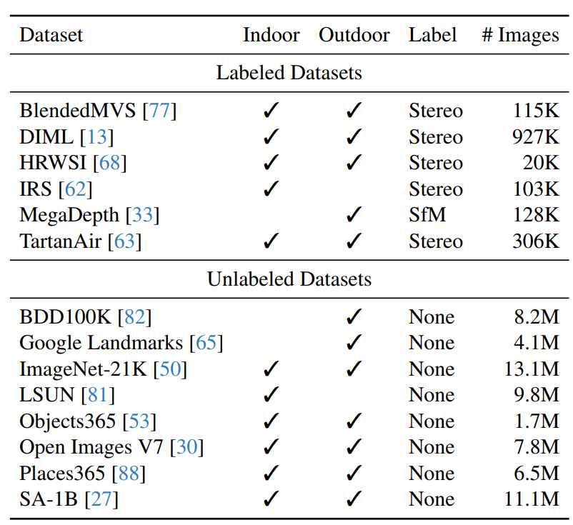
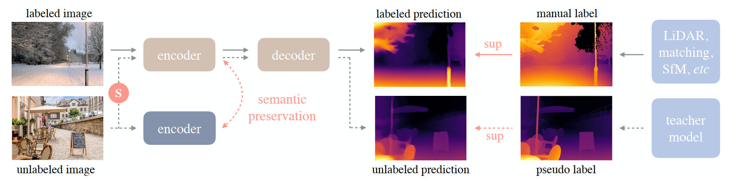
Large model for Depth estimation
Depth Anything V1: teacher-student semi-supervised learning
Yang, Lihe, et al. "Depth Anything V2." arXiv preprint arXiv:2406.09414. 2024.
Yang, Lihe, et al. "Depth anything: Unleashing the power of large-scale unlabeled data." Proceedings of the IEEE/CVF Conference on Computer Vision and Pattern Recognition. 2024.

Slide 27
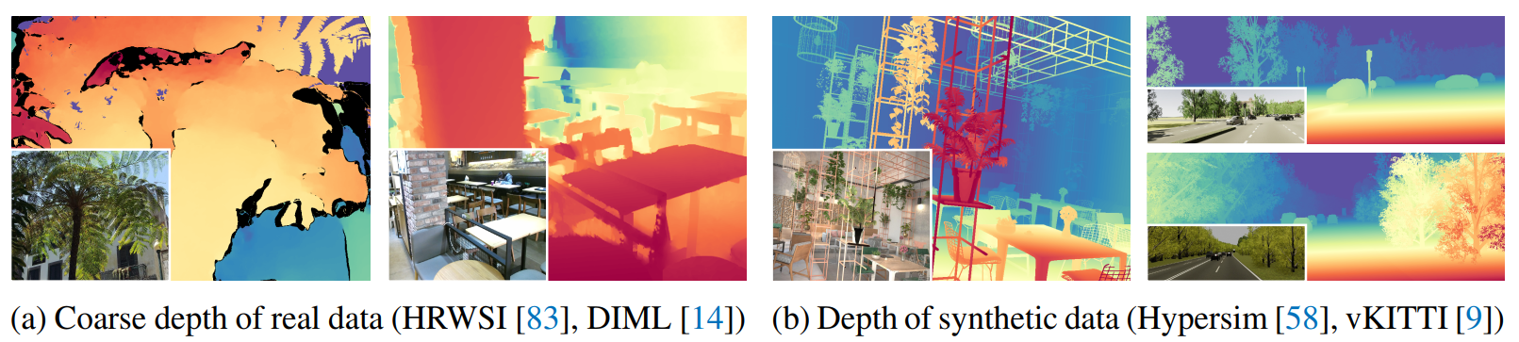
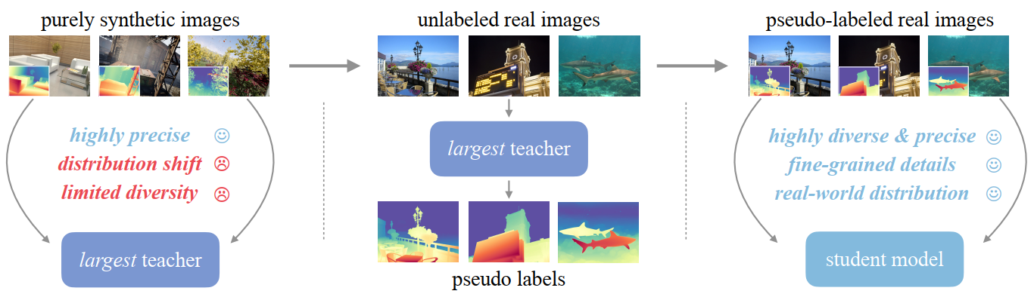
Large model for Depth estimation
Depth Anything V2: abandon real RGB-D scans due to the low depth precision
Yang, Lihe, et al. "Depth Anything V2." arXiv preprint arXiv:2406.09414. 2024.

Slide 28
Further insight of P3P
NEW RGB-D Dataset:
  Find suitable image datasets: ImageNet, CC3M, CC12M
  Automatically predicting depth for images by Depth Anything
  Pre-evaluate the datasets by P3P-MAE, P3P-CL
  Manually adjust predicted depth for images: human anotating efforts needed (core dataset contribution)
  Generally evaluate the datasets by many pre-training methods, e.g., P3P-MAE, Point-MAE, P3P-CL, ULIP, etc.
Diverse RGB-D scans benefiting:
  Depth estimation: generative algorithms, camera-based perception, 3D reconstruction, etc.
  3D pre-training: 3D perception & understanding

Slide 29
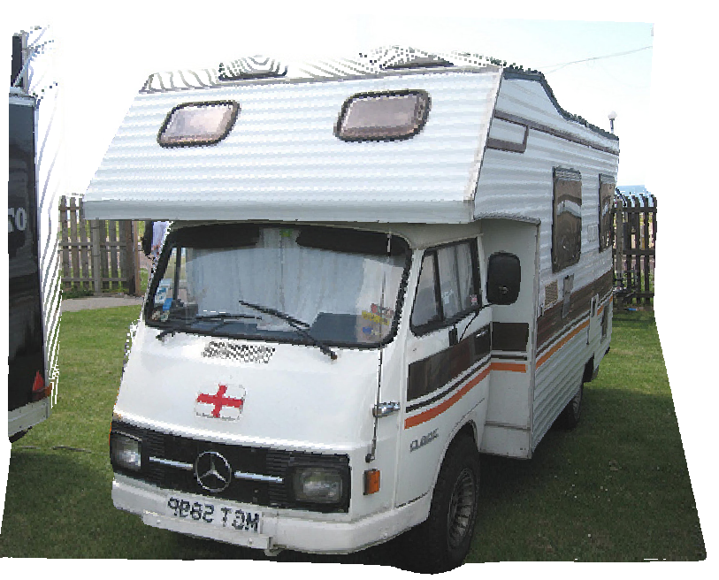
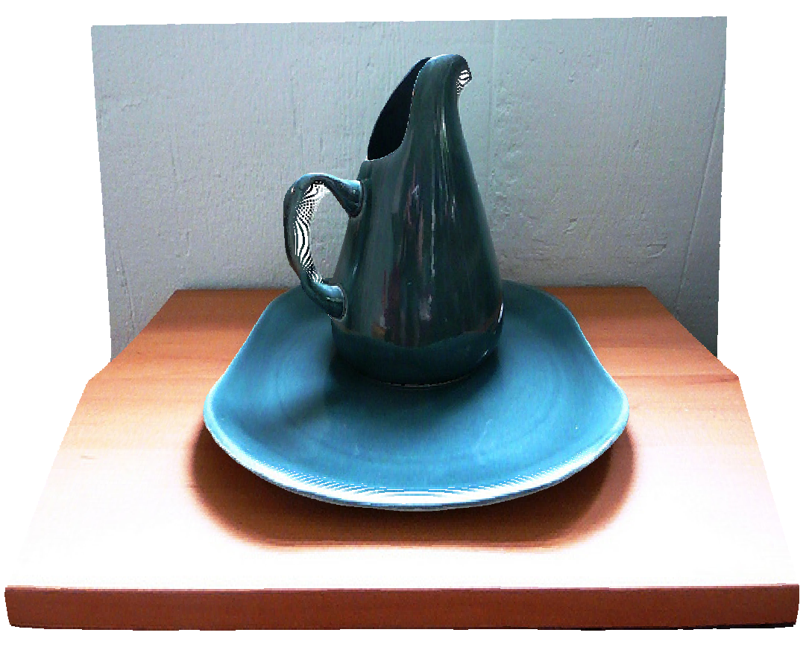
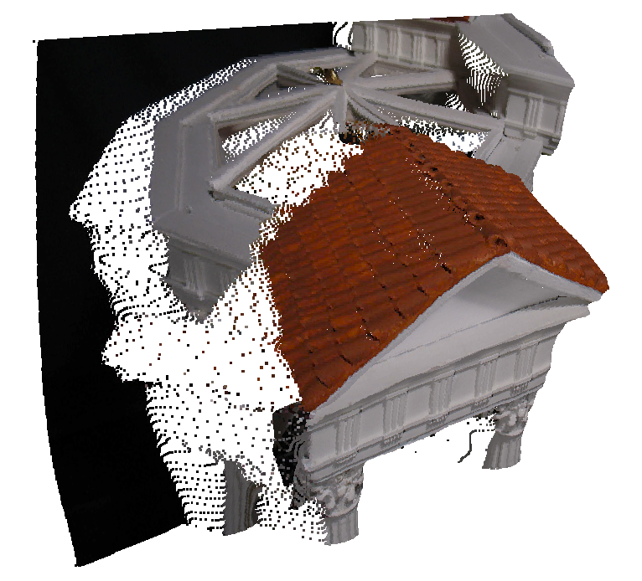
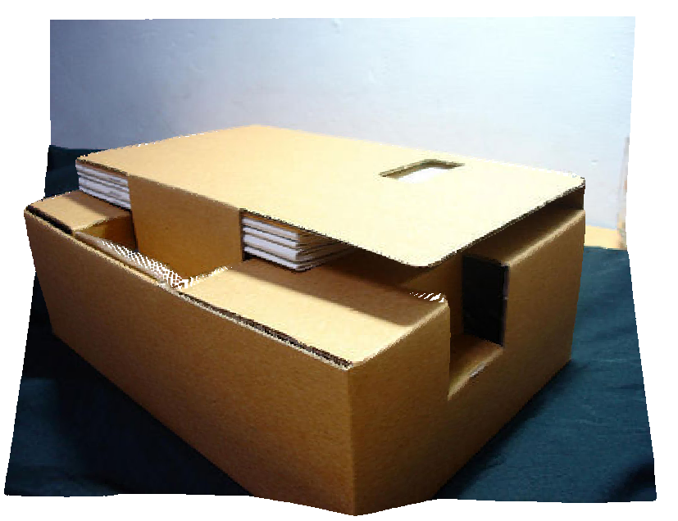
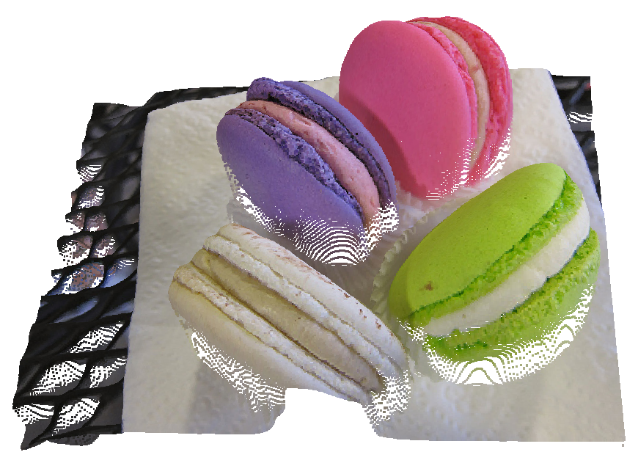
Pseudo-3D data

Slide 30
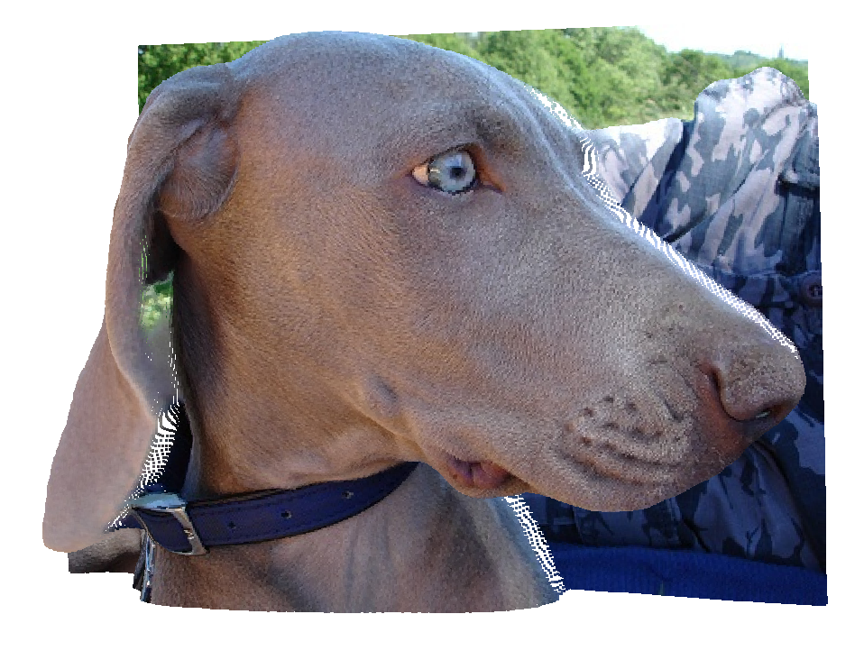



Pseudo-3D data

Slide 31
Pseudo-3D data
Remained issues of image lifting:
  Flat background: lack of depth scale (0-255)
  Extrinsic matrix of camera (camera pose, angle of view)
  Intrinsic matrix of camera (focal length)
Human effort:
  Adjust viewpoint
  Adjust depth
Developing efficient annotating tools

Slide 32
Thanks
Discussion

