Slide 1


Flemme: A Flexible and Modular Learning Platform for Medical Images
Presenter: Guoqing Zhang

Slide 2

Background
Since AlexNet competed in the ImageNet Large Scale Visual Recognition Challenge, Convolutional neural networks (CNNs) had become dominant in computer vision. In particular, the most preferred choice in medical imaging is U-Net.
﻿Following the immense success of transformers in natural language processing (NLP), treating images as sequences has garnered significant attention. Vision transformer has become a more popular way for deep image analysis tasks.
On the other hand, state space models (SSMs) have also made significant advances in sequence modeling and shown great potential in medical image segmentations.

Slide 3
Motivation
Model performance depends highly on actual training techniques and deployment.
  ConvNext demonstrates that CNNs can be "modernized" to achieve performance compatible with vision transformers.
  In real-world applications, the improvement in model performance needs to be balanced against the computational costs of training and inference.
Beyond classification and segmentation, powerful model architectures have been proposed for image reconstruction and generation.
  Applying the advanced backbones to these architectures for medical images is promising and worth anticipating.
Medical images often lack large-scale, high-quality annotations but encompass a wide range of modalities.
  It’s hard to train a general model that performs well across various medical image datasets.
  Researchers and engineers often need to manually build and test models with multiple backbones and architectures for specific tasks.

Slide 4
Goal
We want to propose an universal platform that supports the fast construction of diverse models based on different backbones and architectures for various medical image tasks.
We propose Flemme: a FLExible, and Modular learning platform for MEdical images.
  We adopt a modular design with state-of-the-art encoders and architectures for fast model construction.
  We implement a novel backbone-agnostic hierarchical architecture combining a pyramid loss for generic vertical feature fusion and optimization.
  We support flexible context encoding and allow extensions of new modules for more data types and tasks.

Slide 5
Overview
Encoder & Decoder
Model Architecture
Building blocks
SeM
(Segmentation)
Segmentation
Loss
H-SeM
(Segmentation)
convolution
CNN
ConvBlock
ResConvBlock
U-Net
DDPM
(Generation)
Base Model
Hierarchical
Base Model
…
transformer
SwinViT
AE
(Reconstruction)
Reconstruction
Loss
H-AE
(Reconstruction)
ViTBlock
SwinBlock
Swin-U
…
B inherits from A
Plus
Condition
A
B
A
B
B contains A
Multiply
SSM
VMamba
MambaBlock
Conditional CNN-based Auto Encoder
Time Step
Mamba2Block
Mamba U-Net Segmentation Model
…
Mamba-U
Diffusion Model using Swin U-Net as Noise Predictor
Context

Slide 6
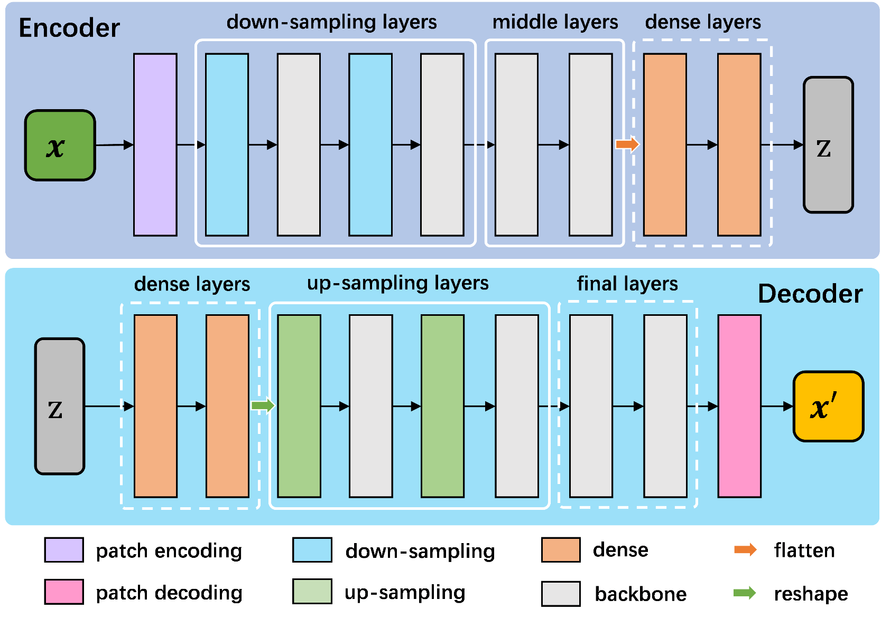
Method——Encoder and Decoder
All image encoders and the corresponding decoders following pipelines illustrated in the left figure. Components enclosed in dotted boxes indicate optional elements.

Slide 7


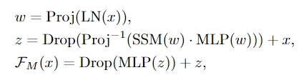



Method——Building Blocks
activation
norm
Residual Convolution
conv
drop path
activation
mlp
norm
(a)
norm
conv
$$x$$
Swin Transformer
drop path
swin-r
W-MSA
(b)
proj
Vision Mamba
swin-p
$$x$$
norm
mlp
cross scan
drop path
SSM
proj
norm
Scan merge
drop path
proj
$$x$$
(c)

Slide 8
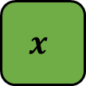

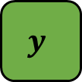
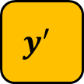
Method——Architectures (SeM)
$$z$$
$$x$$
$$y^{′}$$
Encoder
Decoder
$$y$$
Segmentation
Loss

Slide 9

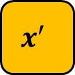

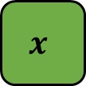
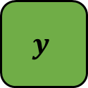
Method——Architectures (AE)
Distribution
Loss
$$μ,σ$$
$$z$$
$$x$$
$$x^{′}$$
Encoder
Decoder
$$y$$
Reconstruction
Loss

Slide 10

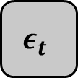


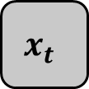


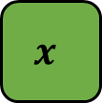
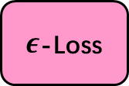
Method——Architectures (DDPM)
$$x$$
Diffusion Process
$$x_{t}$$
$$ε_{t}$$
$$x′$$
$ε$-Loss
…
$$z$$
denoising
$$x_{t}$$
Decoder
Encoder
$$ε_{t}^{′}$$
$${ x}_{t−1}^{′}$$

Slide 11
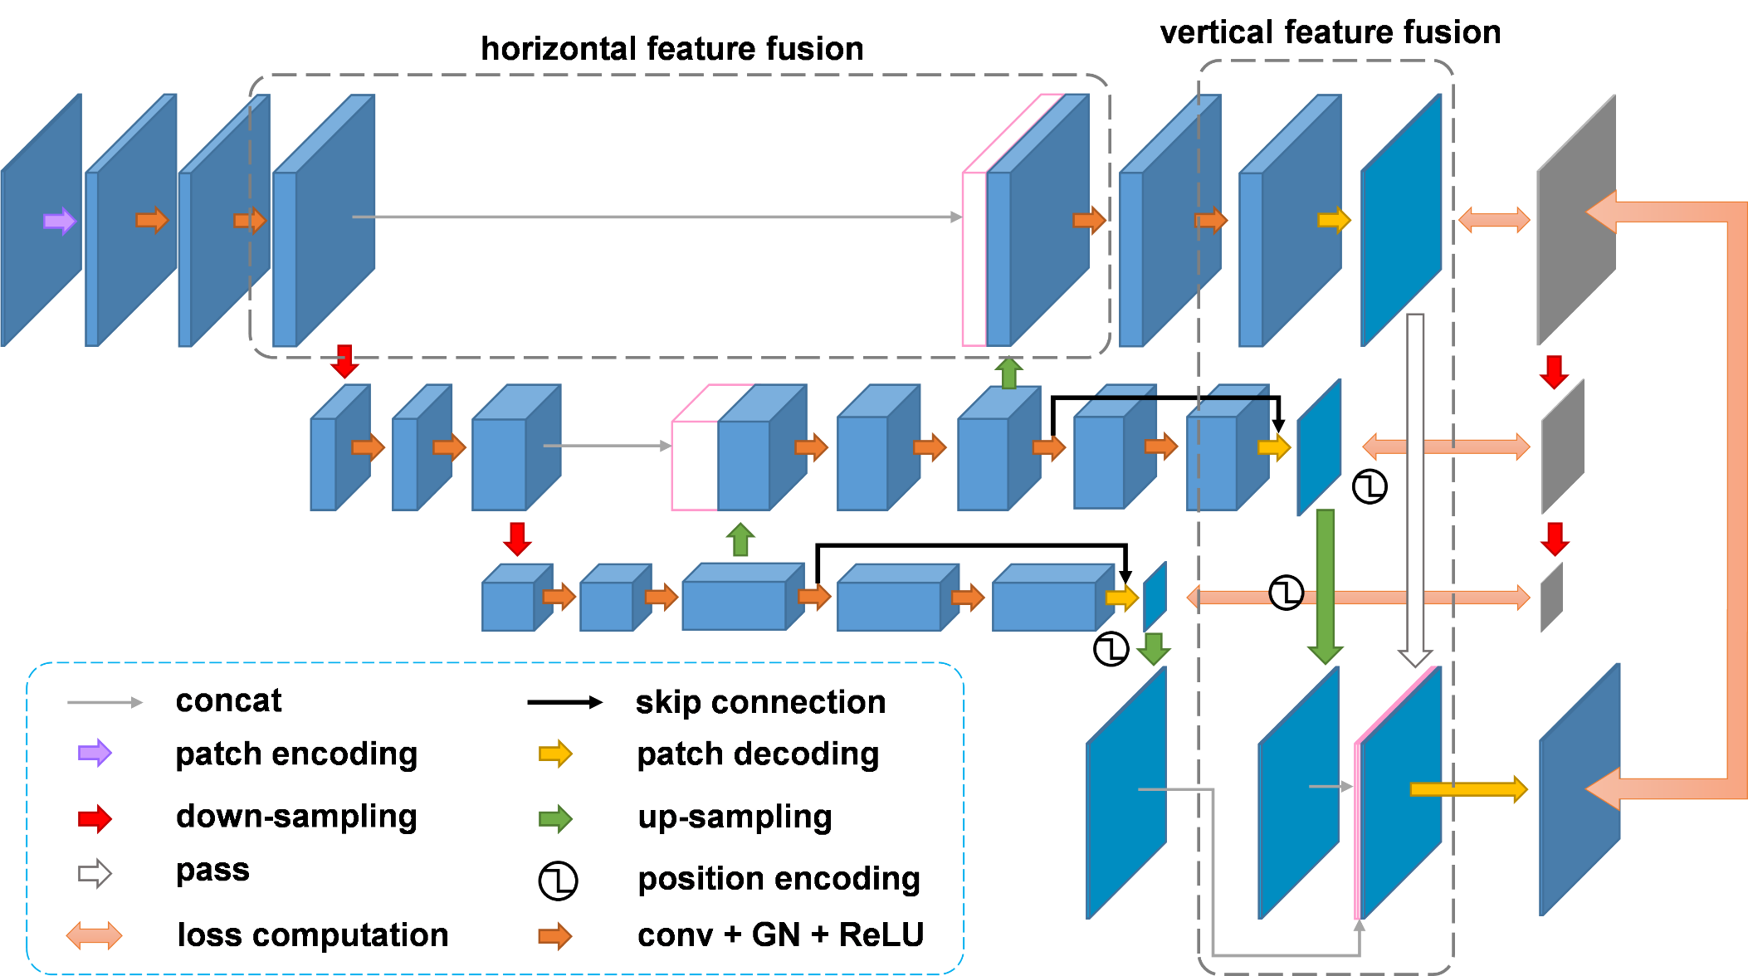
Method——U-shaped Encoders and Hierarchical Architecture

Slide 12
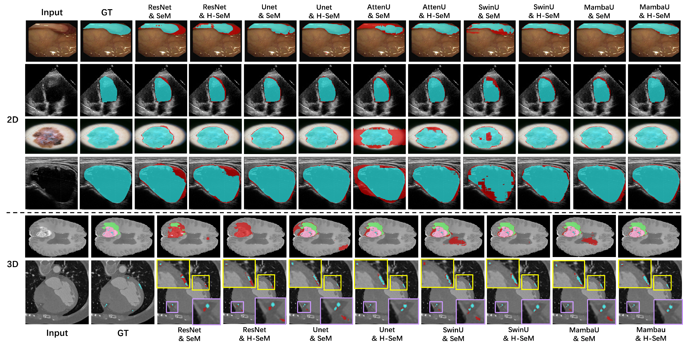
Experimental Results (Segmentation)

Slide 13
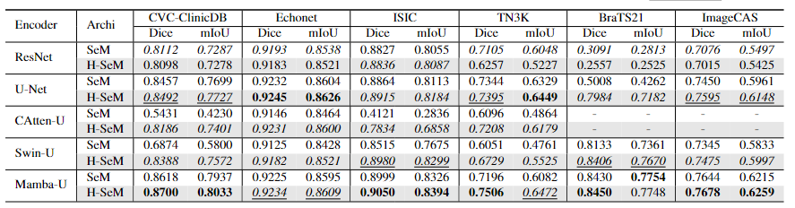
Experimental Results (Segmentation)

Slide 14
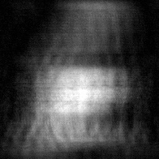
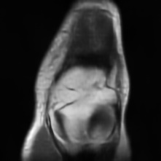
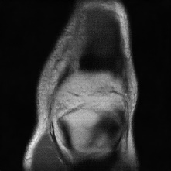
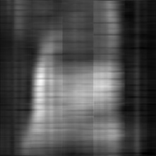
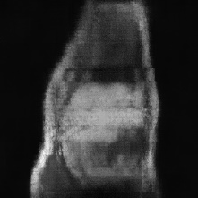

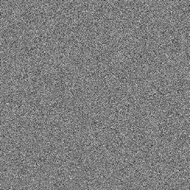
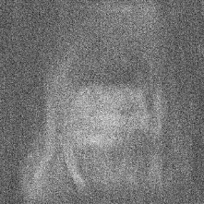
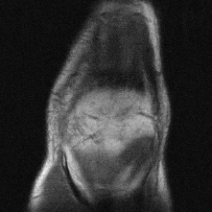
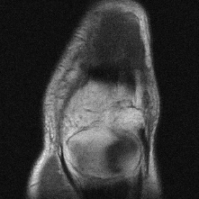
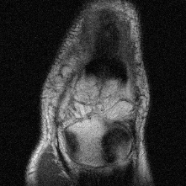
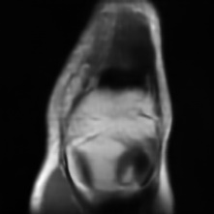
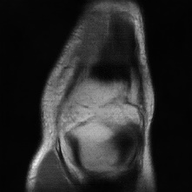
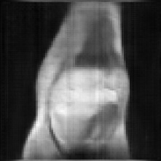

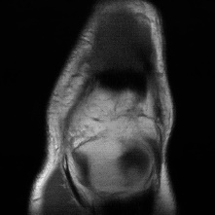
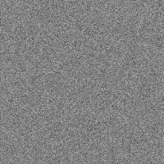
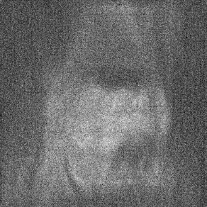

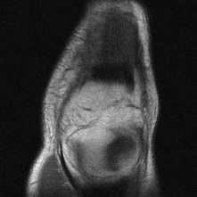
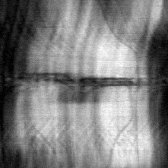
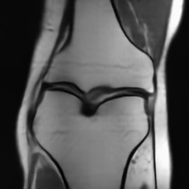
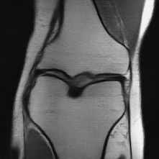
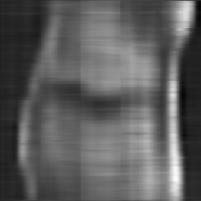
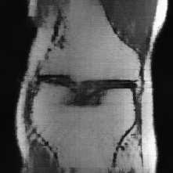
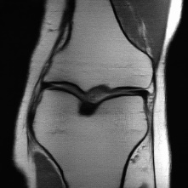
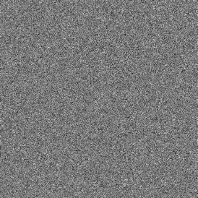
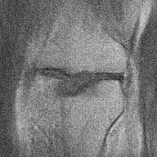
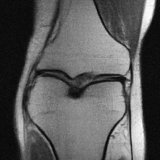
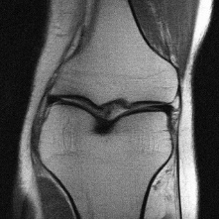
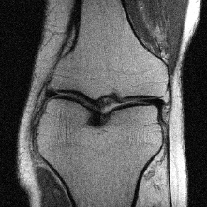


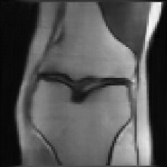
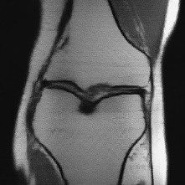


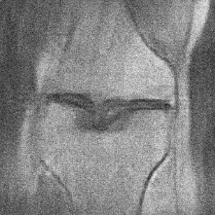


Experimental Results (Reconstruction)
ResNet
UNet
AttenU
SwinU
MambaU
ResNet
UNet
SwinU
MambaU
input
AE
DDPM (5)
H-AE
DDPM (10)
input
AE
DDPM (5)
H-AE
DDPM (10)

Slide 15
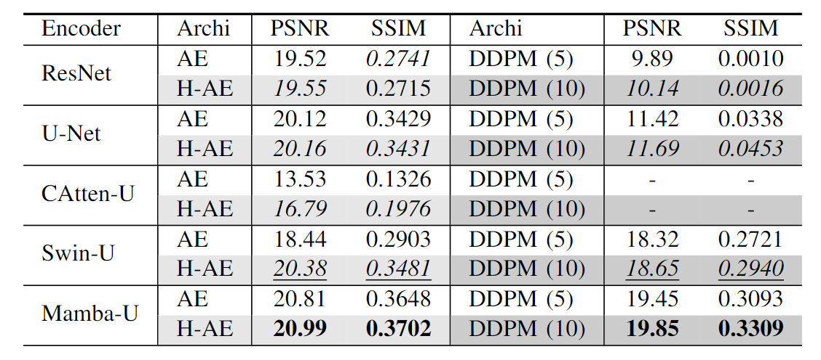
Experimental Results (Reconstruction)

Slide 16
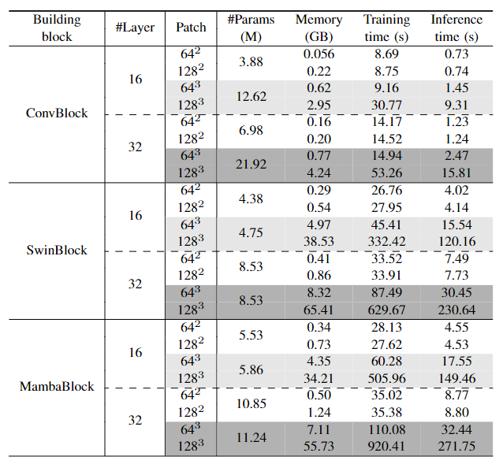
Experimental Results (Time and Space Complexity)
For 3D images, SwinBlock and MambaBlock do not experience a significant increase in the number of parameters because they process images as sequences. However, the length of sequence for 3D images increases cubically, which leads to a sudden leap in runtime and memory consumption.
The training/inference time of models using ConvBlock is 5.26× and 6.97× faster than models using SwinBlock and MambaBlock for input patches with a size of 64× When the patch size grows to 128×, it is 11.3 and 16.86× faster to train a CNN compared to training models with SwinBlock and MambaBlock under the same experimental settings.

Slide 17
Conclusion
we present Flemme, a general learning platform aiming at the rapid and flexible development of deep learning models for medical images.
  We introduce various encoders based on convolution, transformer, and SSM backbones, combining SeM, AE, and DDPM architectures to facilitate model creation for medical image segmentation, reconstruction, and generation.
  We also implement H-SeM and H-AE by employing a generic hierarchical architecture for vertical feature refinement and fusion. Extensive experiments on multiple datasets with multiple modalities showcase that this design improves model performance across different encoders.
Benefiting from the advantages of our platform in model creation and hyper-parameter control, we conduct a fair comparison and analysis of various encoders regarding runtime, memory consumption, and performance across different tasks.
  We confirm that CNNs are still playing essential roles in medical image segmentation and reconstruction, although we notice that there are notable limitations of convolution compared to sequence-modeling backbones in generation.
  We recommend SSM-based networks as the optimal choice when sufficient computational resources are available, especially for high-frequency component prediction.

Slide 18
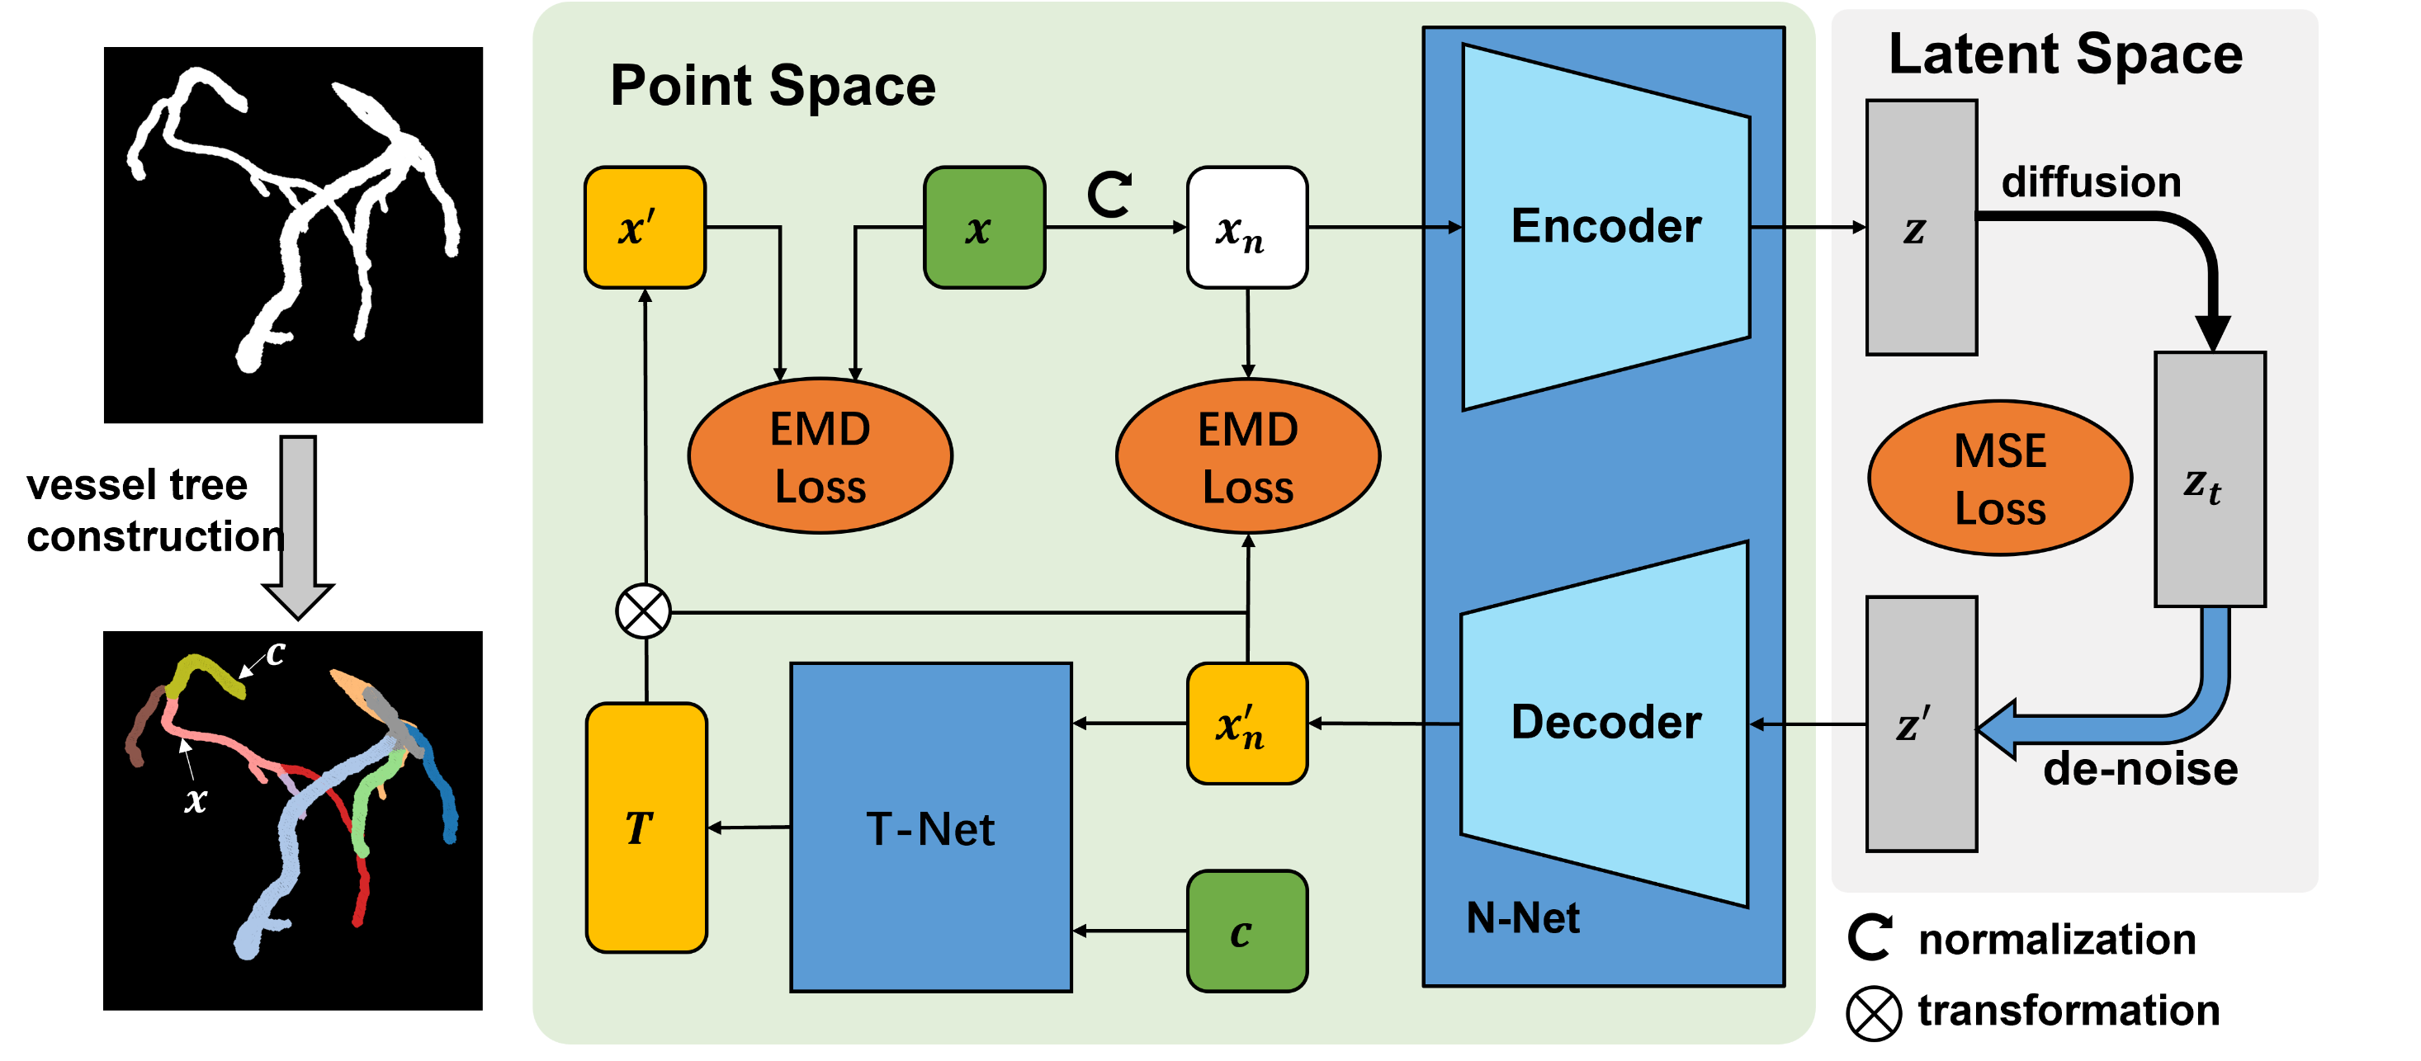
Future works——Recursive Vessel Generation

Slide 19
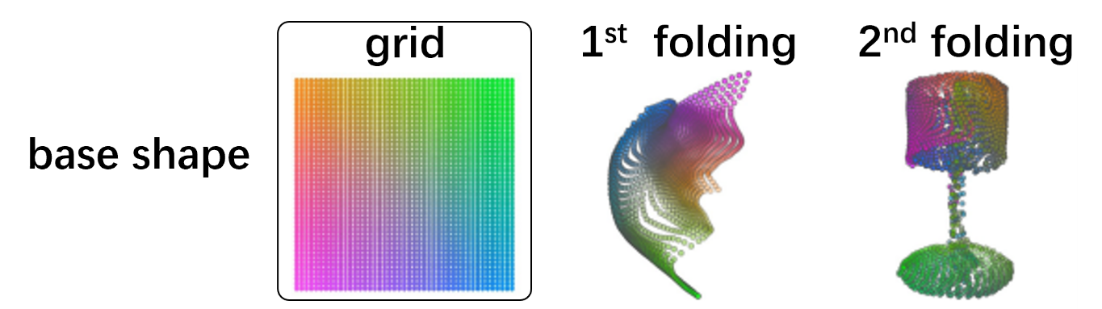
Future works——Recursive Vessel Generation
PointNet encoder with local graph features
Transformer / Mamba based Point Cloud encoder.
Folding Decoder.

Slide 20
Thanks

