Slide 1


Human knowledge-enhanced large language model chatbot for prediction of intestinal disease progression in patients with Crohn disease
Feifan He
Advised by: Prof. Yang Li
2024.10.26

Slide 2
Outline
Background
  Crohn’s Disease
  LLM
Problem
Method
Result
Notes:
1111

Slide 3
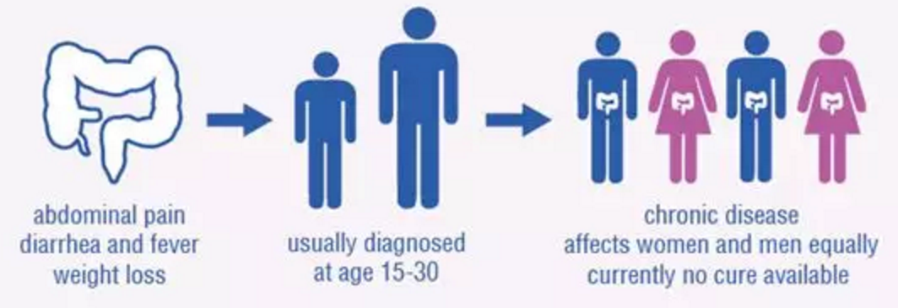
Background--Crohn's Disease
Definition : Chronic nonspecific inflammatory bowel disease of unknown etiology.
(病因不明的慢性非特异性炎症性肠病)
Feature
  More common in young adults aged 15-30 years, with prolonged disease course.
  About 70% of CD patients require at least one surgical resection in their lifetime, because of bowel damage (BD). Physical trauma, financial pressure, and mental stress caused by lifelong disabling diseases
Significance
  Active monitoring of CD benefits to improve the long-term prognosis -- pivotal in CD management
Problem
  Little consideration of the long-term risk.
  Limited time to read too many textual information.
Notes:
First, lets introduce Crohn disease. Its definition is that Chronic nonspecific inflammatory bowel disease of unknown etiology.
xxx feaure
So this makes active monitoring of CD very important. It benefits to improve the long-term prognosis.
However, there exist some problems like
:there is little consideration of the long-term risk.
In busy clinical work, doctors often find it difficult to read a large amount of textual information and consider its potential correlations within limited time.
The large language models (LLMs) that have emerged in the past two years can effectively address this issue.

Slide 4

Background -- LLM
Large language model (LLM) is a sophisticated computational model designed for natural language processing (NLP) tasks, such as language generation, translation, and summarization.
LLMs are trained on vast amounts of text data through self-supervised and semi-supervised learning processes. During training, they learn statistical relationships within the text, acquiring predictive power regarding syntax, semantics, and the inherent structures of human language. This enables LLMs to perform a wide range of NLP tasks with high accuracy and fluency.
Popular LLMs: GPT4, Claude, Gemini, Deepseek ......
Notes:
The large language models (LLMs) that have emerged in the past two years can effectively address this issue.
(LLM介绍)Large language model (LLM) is a sophisticated computational model designed for natural language processing (NLP) tasks, such as language generation, translation, and summarization.
Trained on vast amounts of text, LLMs excel at processing and analyzing large volumes of textual information, identifying complex biological patterns and associations from seemingly disorganized data, and can interact with doctors or patients in real-time.
Therefore, we try to use Large Language Model to analyze the records and assist doctors to make diagnosis.

Slide 5
Outline
Background
Problem
  Definition
  Data Structure
  Data Statistics
Method
Result

Slide 6
Problem -- Definition
Baseline Data(基线期数据):
  The initial state of the patient's current condition before disease management and treatment begins. (or think as the first visit)
Follow-up Data(随访期数据):
  After the first visit, doctors will ask for the patient’s progression anytime to check his/her state. Or the patient will revisit the doctor if his/her relapsed.These data are called follow-up data.
Adverse Outcome(不良结局):
Our problem is that:
given all kinds of records of baseline data, we need to make a prediction about whether he/she will have adverse outcome in the next three years
Baseline Data
Follow-up Data
Type | Definition
1 | new penetrating disease(肠穿透性病变)
2 | newly diagnosed stricture or obstruction(肠道狭窄/梗阻)
3 | newly apparent or progressive perianal disease(肛瘘或肛周脓肿)
4 | the need for requiring CD-related surgery(CD肠道病变相关手术)
5 | CD-related hospitalization(出现CD疾病相关的住院)
6 | escalation of medical therapy due to uncontrolled disease activity (药物治疗方案的升级)
Disease Progression
Notes:
Now，lets define our problem.
First, we give the definition of baseline data and follow-up data:(接ppt)
Next, lets see the def of adverse outcome.
Our problem is that: given all kinds of records of baseline data, we need to make a prediction about whether he/she will have adverse outcome in the next three years.

Slide 7
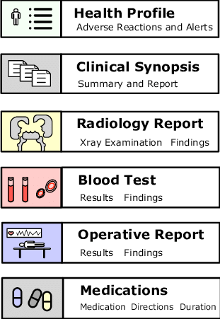
Problem -- Data Structure
Progression of his past condition
Admission records
Discharge records
CT, MR
ES (intestine(肠))
PIS (intestine(肠))
ESR (mm/h), CRP (mg/L)
Current condition
Expert Knowledge
LLM ranking
Subsequent treatment plans
Notes:
When a patient has a visit, detailed text content describing various categories of disease-related information is generated, such as past medical history, disease course records, imaging studies, laboratory tests, or endoscopic and pathological examinations(内镜和病理检查).
These texts contain descriptions of the patient’s progression of their past condition, his current condition, and subsequent treatment plans, all of which are crucial for predicting the patient’s future disease progression.
Based on doctor’s expert knowledge and LLM’s ranking of the value of various electronic medical record information, we identify the following medical texts as valuable for predicting the progression of Crohn Disease: Admission records, Discharge records, Imaging study results including CT, MR, ES (intestine), PIS (intestine)), and Laboratory indicators (ESR (mm/h), CRP (mg/L))

Slide 8
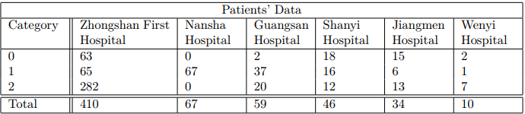
Problem -- Data Statistics
Category 0: patient didn’t have adverse outcome at baseline and during follow-up
Category 1: patient didn’t have adverse outcome at baseline but did have at follow-up
Category 2: patient did have adverse outcome at baseline
Our work: is to predict whether those patients who didn’t have adverse outcome at baseline, will develop to adverse outcome in the next 3 years.
Notes:
here is the statistics of all data. Most of our data come from Zhongshan First Hospital.
these three categories mean that: (ppt)

Slide 9
Outline
Background
Problem
Method
  Design System Prompts
  Retrieval Augmented Generation
Result

Slide 10
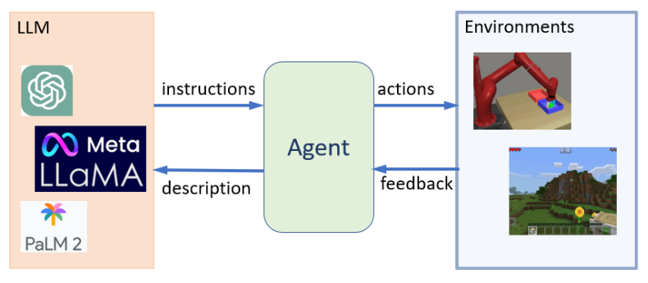
Method -- Agent
Agent
Raw LLMs are good at processing long contexts, but they lack task specificity.
A LLM agent is an advanced AI system utilizing a LLM as its core. They are developed through engineered prompts that encode personas, instructions, permissions, and context to shape responses and actions.
These agents go beyond text generation, engaging in conversations, completing tasks, reasoning, and demonstrating some degree of autonomous behavior.
Notes:
Popular large language models such as GPT-4, Gemini, and Claude are good at processing long contexts, but they lack task specificity. So if we want to use LLM to help us make medical diagnosis, we need to design an agent.
what is agent? (接ppt）
In our problem, by constructing specialized agents, we can focus on specific medical problems, thereby enhancing the effciency and accuracy of problem-solving

Slide 11
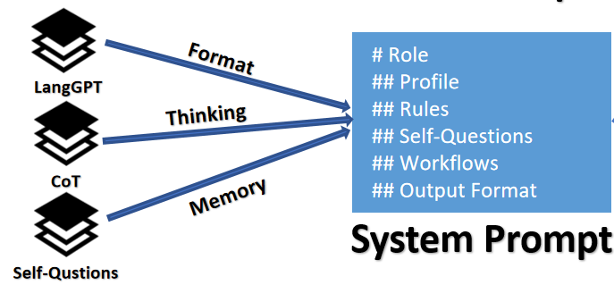
Method -- Design System Prompts
Overall Architecture
Adopt LangGPT method for constructing formatted prompts.
Incorporate CoT (chain-of-thought) technique to enhance the agent’s reasoning and decision-making capabilities.
Add a Self-Questions mechanism to “remember”.
Notes:
for a LLM agent, designing system prompts is a crucial step. It directly influences the agent’s understanding and execution of tasks.
In this study, we adopt the LangGPT method for constructing formatted prompts and incorporated the CoT (chain-of-thought) technique to enhance the agent’s reasoning and decision-making capabilities

Slide 12
Method -- Design System Prompts
LangGPT
# Role: Your_Role_Name
## Profile
- Language: English or 中文 or Other language
- Description: Describe your role. Give an overview of the role's characteristics and skills
### Skills
1.skill 1
2.skill 2
## Rules
1. Don't break character under any circumstance.
2. Don't talk nonsense and make up facts.
GPT excels at role-playing.
Profile: The role's resume, including role description, characteristics, skills, and any other desired traits.
Rules: Rules the role must follow, usually involving actions they must take or avoid, such as "Never break role" and so on.
Notes:
GPT excels at role-playing. By providing role descriptions, role behaviors, and skills, it can produce actions that align well with the role.
Therefore, LangGPT designed the Role template to help GPT better understand user intentions.
The Role template is the core of LangGPT. it primarily consists of profile, rules, workflow.
The“profile”part include
The“rules”part include the rules the role must follow.
Workflow is what we are goint to introduce next.
This formatted prompts enable the agent to better understand the task.

Slide 13
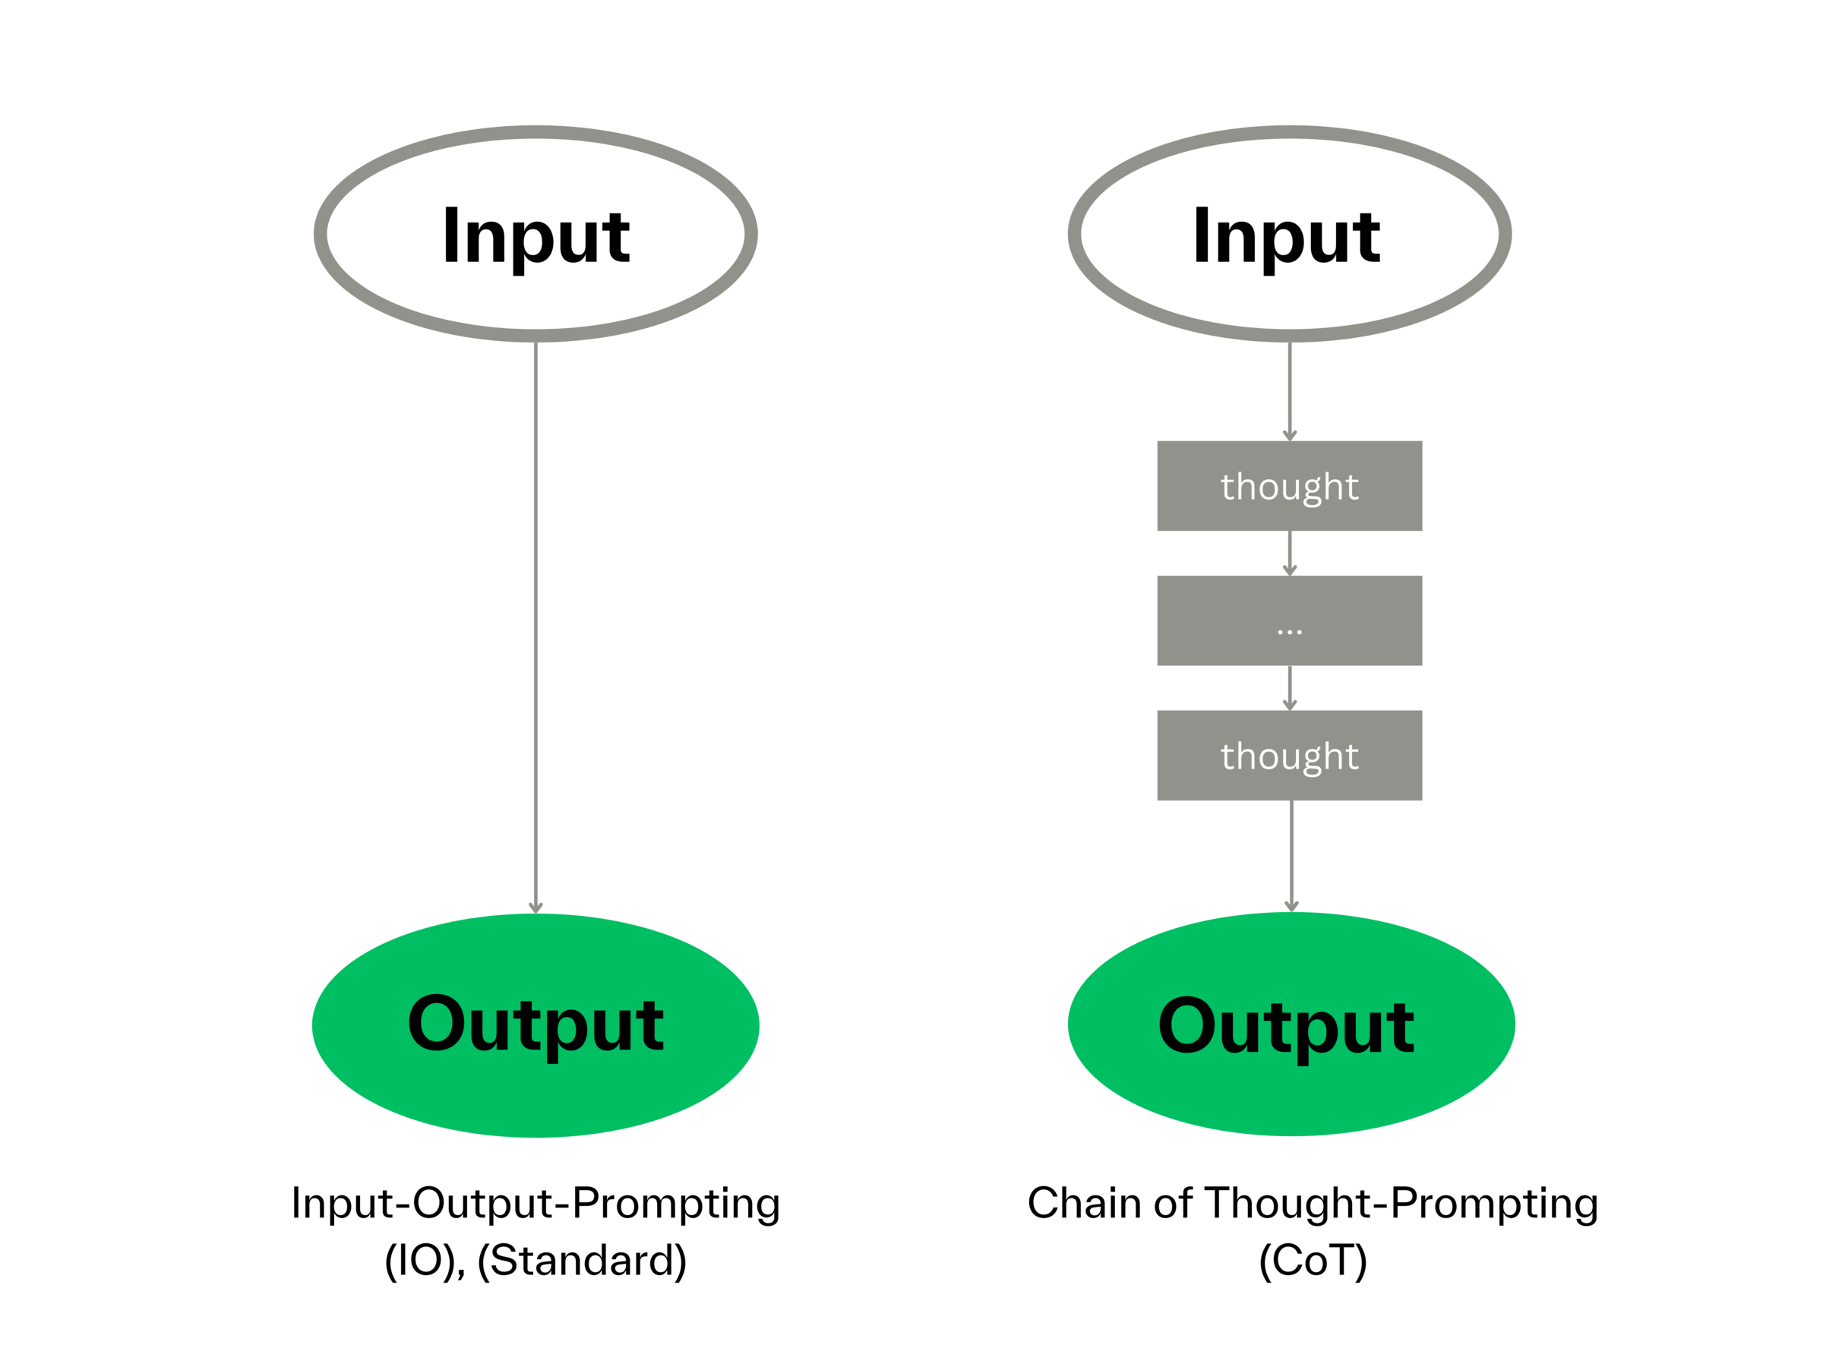
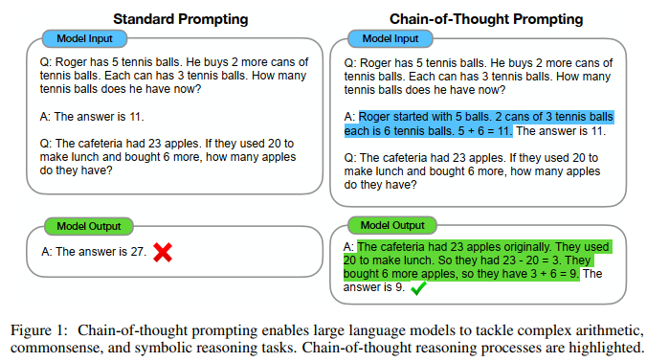
Method -- Design System Prompts
CoT(chain-of-thought)¹
Chain-of-Thought (CoT) technique is a method that mimics human reasoning by breaking down complex tasks into a series of logical steps, enabling systematic problem-solving.
1.Wei J, Wang X, Schuurmans D, et al. Chain-of-thought prompting elicits reasoning in large language models[J]. Advances in neural information processing systems, .
Notes:
What we are going to introduce is this CoT technique.
First, lets give an eye on what CoT is .
(ppt) As we can see in the right, the ordinary workflow is like given an input, LLM directly generates the output based on probability.
But if we use CoT, it will “think”before output the answer. So it’s more like human.
As we all know, determining whether a patient will experience adverse outcomes is medical diagnosis, which is a multi-step complex task. its suitable for CoT technique.

Slide 14
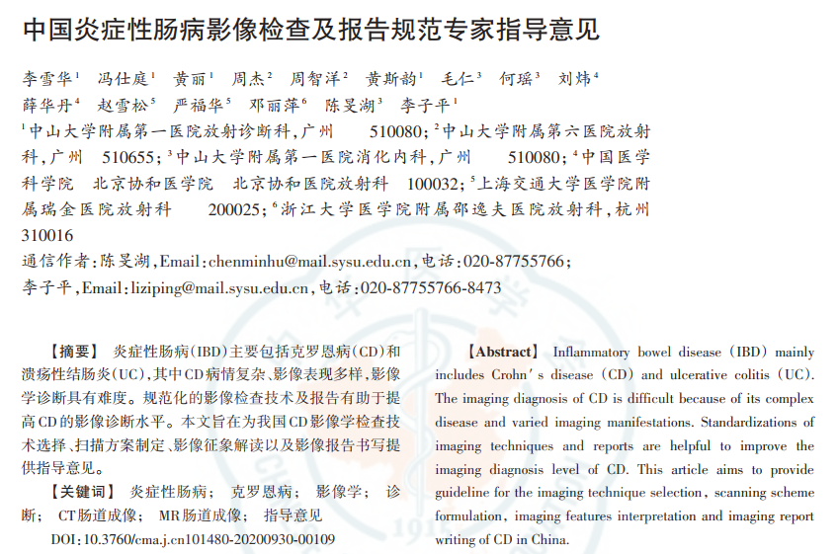
Method -- Design System Prompts
CoT(chain-of-thought)¹
medical history
medical history
admission records
diagnostic information
diagnostic information
Past disease progression
treatment course
treatment course
discharge records
discharge status
discharge status
Current condition
Thickness of intestinal wall
Thickness of intestinal wall
MR、CT
Subsequent treatment plans
Degree of intestinal stenosis
Degree of intestinal stenosis
inflammation indicators
(ESR, CRP)
disease status
Notes:
As we mention above, we select Admission records, Discharge records, MR, CT of a patient .But how to analyze all this mass of data?
We break down the diagnostic task into several steps:
First, collating medical history and diagnostic information from the admission records;
Secondly, summarizing the patient’s treatment course and discharge status based on discharge records
Then thoroughly analyzing the patient’s MR and CT images (referring to the key points summarized by professional doctors in the ”Expert guideline on imaging examination and report specification of inflammatory bowel disease in China”),
Last evaluating the inflammation indicators in the test results, supplementing the conclusions of imaging examinations;
These preliminary steps help the agent extract past disease progression, current condition descriptions, and subsequent treatment plans from the patient’s baseline medical records.
Using this information, the agent can process the data more systematically, thereby improving the accuracy and reliability of decision-making.

Slide 15
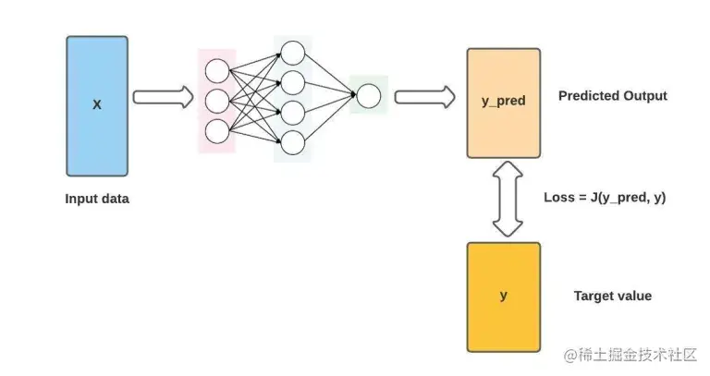
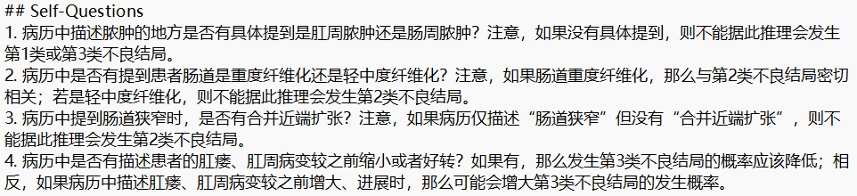
Method -- Design System Prompts
Add Self-Questions
system prompt
optimize
0/1 Prediction
if 1
Exact Type
errors occurred during the reasoning process
(such as missing knowledge, incorrect reasoning logic, etc.)
Notes:
In machine learning, neural networks is a crucial method. It can learn knowledge from training sets, store them in weight matrices, and apply it to solve specific problems. This reminds me to use this concept in our task by ”training” the agent on the training set of patients.
First, we use the system prompt to construct the first-generation agent, applying this agent to the training set to predict their adverse outcomes and generate a comprehensive prediction report.
Based on the predictions, we summarize the errors that occurred during the reasoning process (such as missing knowledge, incorrect reasoning logic, etc.), which is analogous to the ”loss function” in neural networks.
To optimize the ”loss function”, we need to store these reasoning errors in the agent’s ”memory”, similar to how knowledge is stored by updating weight matrices in a neural network.
Therefore, we design a ”Self-Questions” module, guiding the agent to extract useful information from medical records by answering questions. These questions are compiled based on the errors that the agent encountered during the training process

Slide 16
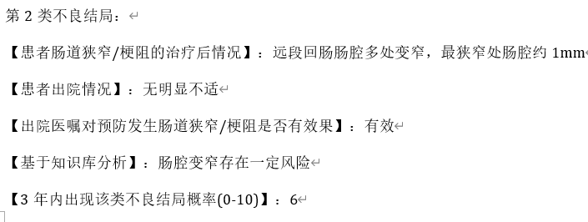
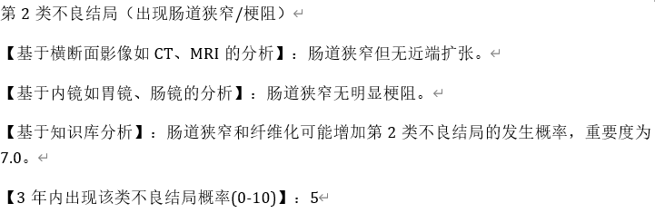

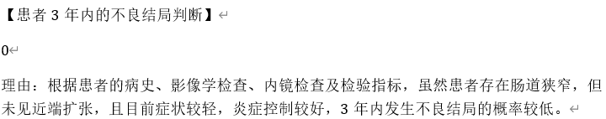
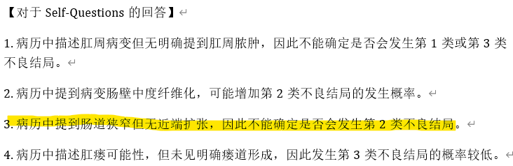
Method -- Design System Prompts
Add Self-Questions
Before
After
Notes:
We can see this example. This is a type 0 patient, which means that he will not have adverse outcome.
Before we add self-questions, the agent predicts that the agent will occur type 2 adverse outcome. This is because, when analyzing “肠道狭窄”，we should also focus on whether mention “近端扩张”.If not, then the agent should not infer that type 2 adverse outcome will happen.

Slide 17
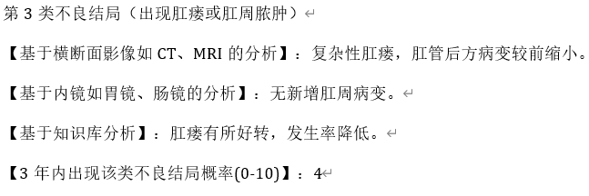
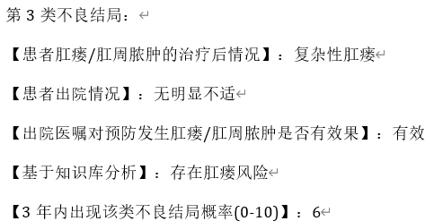


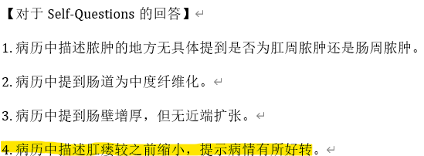
Method -- Design System Prompts
Add Self-Questions
Before
After

Slide 18
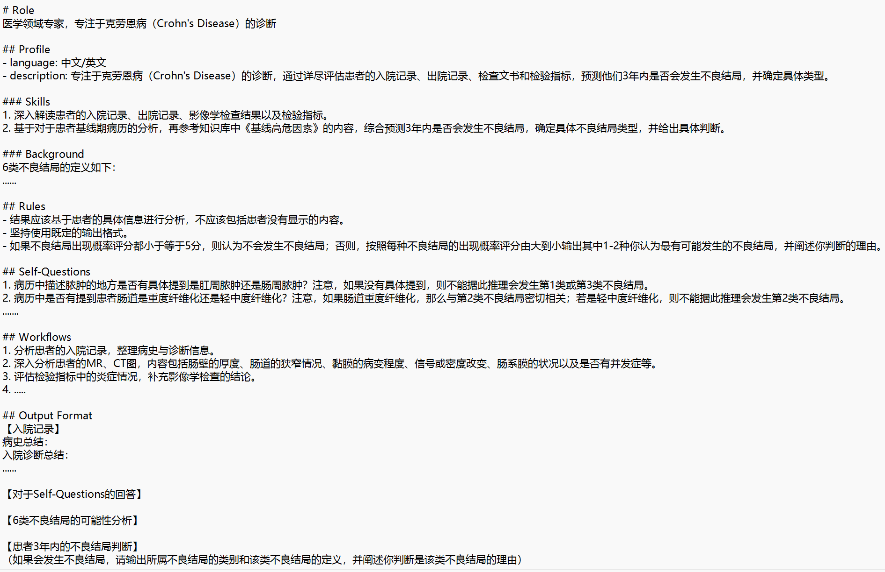
Method -- Design System Prompts
Final System Prompts

Slide 19
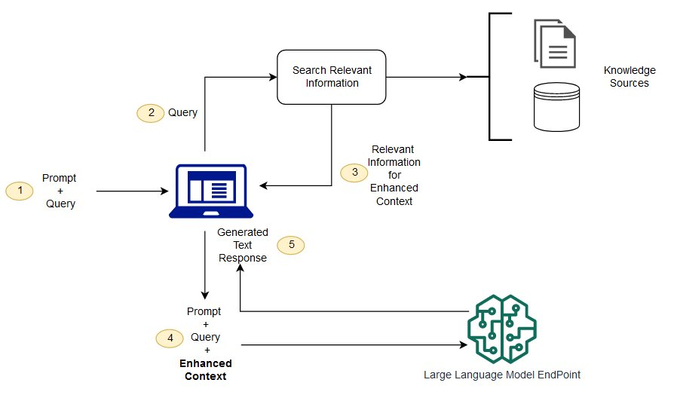
Method -- Retrieval Augmented Generation
Retrieval-Augmented Generation (RAG) is a technique that enhances generative artificial intelligence models by integrating information retrieval capabilities.
This method modifies interactions with a large language model (LLM) so that the model can respond to user queries with references to a specified set of documents, augmenting information drawn from its extensive, static training data. This enables LLMs to utilize domain-specific and up-to-date information.
Notes:
Crohn’s disease is just gradually gaining attention in the medical community, there is limited specialized knowledge available online.
Consequently, the large language model lacks comprehensive knowledge about which baseline factors are likely to lead to adverse outcomes and which are not. To this end, we want to add some extra knowledge. How? Here comes the RAG method, which is popular in LLM using.

Slide 20
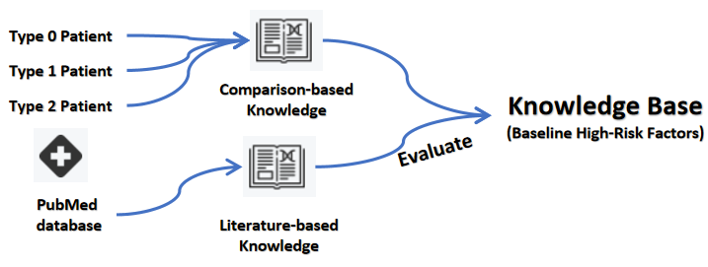
Method -- Retrieval Augmented Generation
Type 0 Patient
Select all type 2 patients, a part of type 1 and type 0 patients.
Analyze through:
  Epidemiological characteristics of the patients;
  Characteristics of the disease course;
  Significant differences in the imaging examination items
Type 1 Patient
(baseline data)
Type 1 Patient
(follow-up data)
Why Type 2 patients exhibit strictures and penetration at the baseline period, while Type 0 and Type 1 patients not
Why Type 1 patient develop adverse outcomes
Type 2 Patient
Engage 3 radiology experts and 7 gastroenterology experts to rate the high-risk factors
Using a 5-category scale based on their experience (-2: Unreliable; -1: Less Reliable; 0: Indeterminate; 1: More Reliable; 2: Reliable)
Conduct a search in the PubMed database from 2004.01-2024.01.
Using terms: Crohn disease , adverse outcome, intestinal disease progression......
Notes:
Therefore, we supplement the knowledge of ”Baseline High-Risk Factors” by introducing an external knowledge base to aid the agent in making better judgments.
a. 患者的流行病学特点；b.患者的疾病病程的特点；c. 患者接受的影像学检查项目有无明显差异
First, conduct a search.....The doctors read these articles and summarize the important factors.
We construct another agent specifically for extracting baseline high-risk factors by comparing different patients.
The high-risk factors extracted through above two contain several overlapping elements and factors with low clinical significance. Directly incorporating all these high-risk factors into the knowledge base will significantly interfere with the agent’s judgment.Therefore,

Slide 21
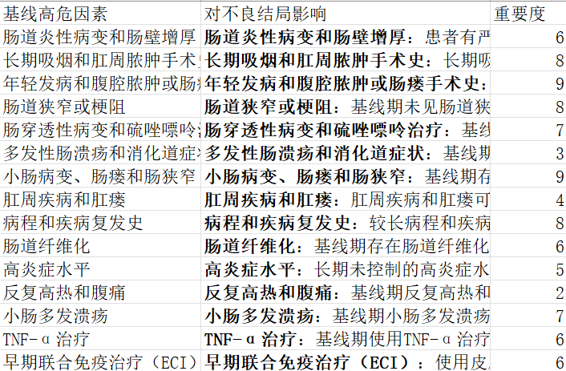
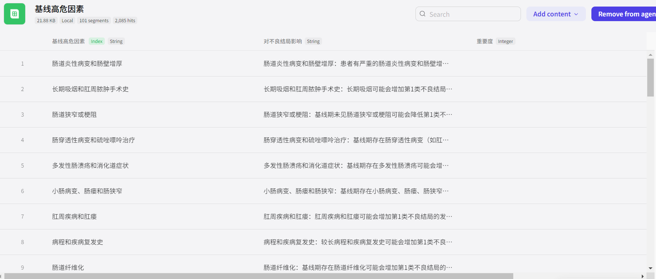
Method -- Retrieval Augmented Generation
The Knowledge Base

Slide 22
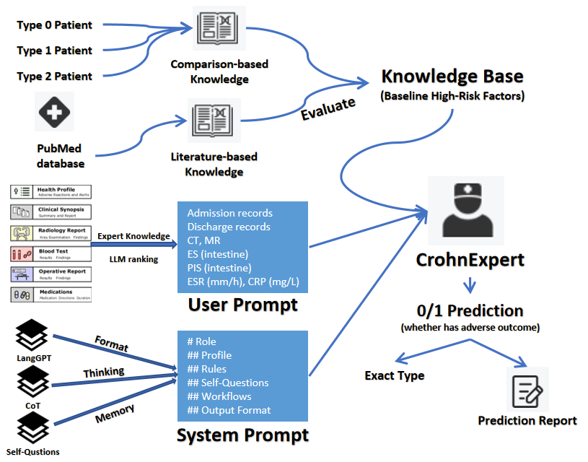
Method
Overall Architecture

Slide 23
Outline
Background
Problem
Method
Result

Slide 24
Result(boostrap)
Training Set: the 63 category 1 patients and 65 category 0 patients from Zhongshan First Hospital .
Test Set: the 60 category 1 patients and 37 category 0 patients from Guangsan, Shanyi, Jiangmen, and Wenyuan hospitals are used as the test set.
Model
  We select GPT-4omini, Gemini1.5-Pro, and GPT-4o(128k) as the foundational large language model for the agent and design three versions of the agent:
Three versions of agent:
  V1: The system prompt includes only basic role introduction, task description, and the definition of adverse outcomes;
  V2:Building on V1, the system prompt incorporates a complete Chain of Thought (CoT)
  V3:Building on V2, the system prompt introduces the knowledge base ”Baseline High-Risk Factors”

Slide 25
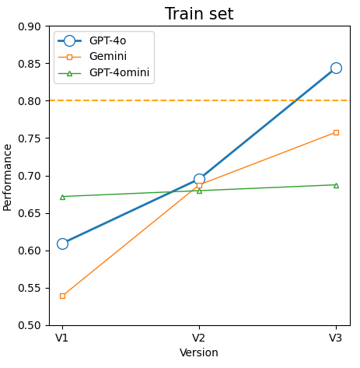
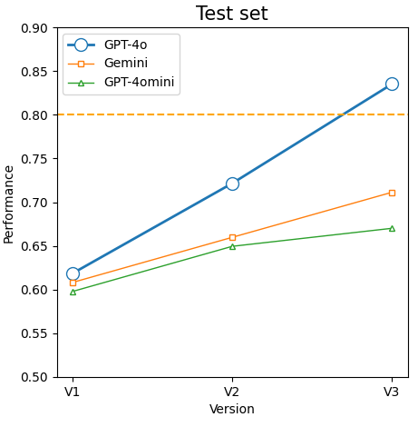
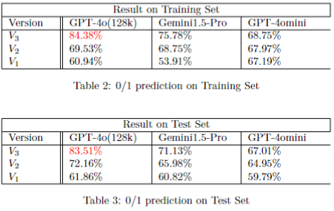
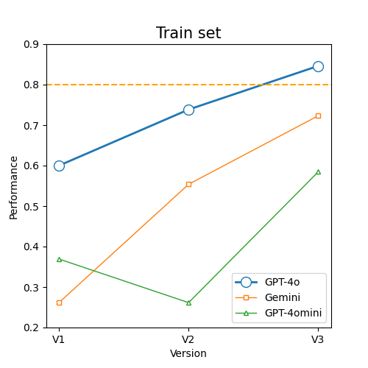
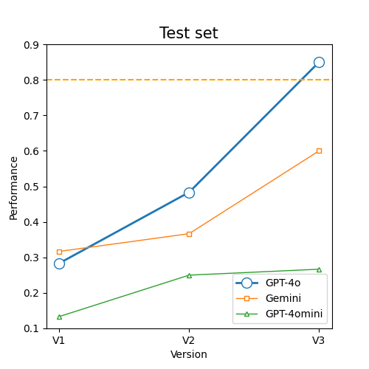
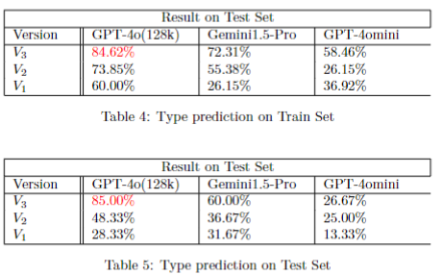
Result
Notes:
We test the accuracy of the agent’s 0/1 predictions regarding whether patients will experience adverse outcomes within the next three years.
The best performance is achieved by the agent based on the GPT-4o(128K) model with V3 prompts, which reaches an accuracy of 84.38% on the training set and 83.51% on the test set. This meets clinical usage standards and holds significant medical implications.
For type prediction, the best performance is achieved also by the agent based on the GPT-4o(128K) model with V3 prompts, which reaches an accuracy of 84.62% on the training set and 85.00% on the test set.
We observe that, for agents based on Gemini1.5-Pro and GPT-4o(128K) , the accuracy improve as the system prompt version progress from V1 to V3. This demonstrates the effectiveness of the Chain of Thought (CoT) technique and "Baseline High-Risk Factors" knowledge base in enhancing agent's predictive capabilities.
However, for the agent based on the GPT-4omini model, the accuracy doesn't consistently improve as the prompt version advanced from V1 to V3. Upon analyzing the data, we find that the agent frequently predicts patients labeled as 0 (no adverse outcome) to be 1 (adverse outcome). We speculate that this is due to the limited reasoning abilities of GPT-4omini, adding more reasoning steps and additional knowledge can not always enhance its predictive performance. Besides, in medical diagnostics, the benefits of making a "disease present" prediction often outweigh those of a "disease absent" prediction. Therefore, the agent tends to predict that some patients labeled as 0 will experience adverse outcomes.

Slide 26
THANK YOU
Q & A

