Slide 1


How Collaboration Patterns Evolve
In Crisis Response?
Anping Zhang
zap21@mails.tsinghua.edu.cn
Advisor: Prof. Yang Li
Shenzhen Key Laboratory of Ubiquitous Data Enabling, Tsinghua University
Sep. 2024

Slide 2
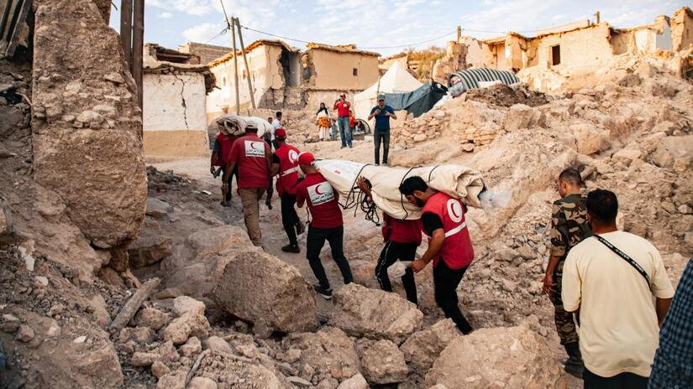


Collaborations in Volunteer Activities
Introduction | Methodology | Results | Conclusion
Emergence Response
Community Bonding
Teamwork
Enhanced collaboration usually leads to greater retention and increased effectiveness, enabling a swifter response to crises and improved organizational agility.

Slide 3
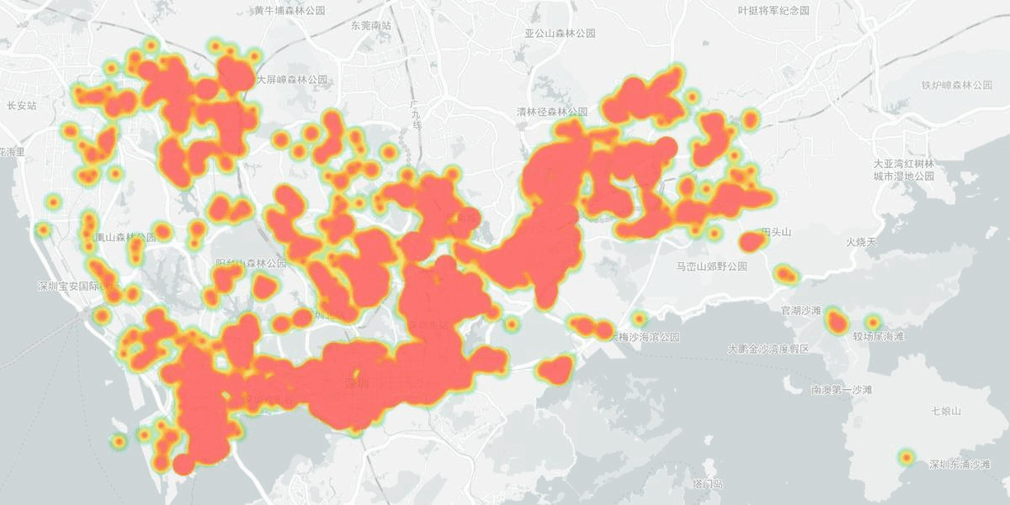
“Shenzhen Pioneers” Volunteering Platform
Introduction | Methodology | Results | Conclusion
Time Period
2020.2.14 – 2023.9.30
User ID
361114 Users in Total
Issuer ID
25278 Issuer in Total
Dataset
Tasks
Issued 1207304 Tasks
Records
Heatmap of volunteer activities
More than 6.6 million volunteering records
Zhang, Anping, et al. "Optimising self-organised volunteer efforts in response to the COVID-19 pandemic." Humanities and Social Sciences Communications 9.1 (2022).

Slide 4
Collaborations Among Volunteer Groups
Introduction | Methodology | Results | Conclusion
Spatial-temporal
and Non-pairwise
It’s effective to present collaboration in terms of topology!

Slide 5
Research Questions
Introduction | Methodology | Results | Conclusion
How to quantify collaboration patterns from a large-scale dynamic volunteering activities?
What are the (spatial-temporal) factors for collaborations?
Is the collaboration pattern critical for the collective effectiveness of volunteers?

Slide 6
Methodology
Introduction | Methodology | Results | Conclusion
Background on topological data analysis
Zigzag Persistence

Slide 7

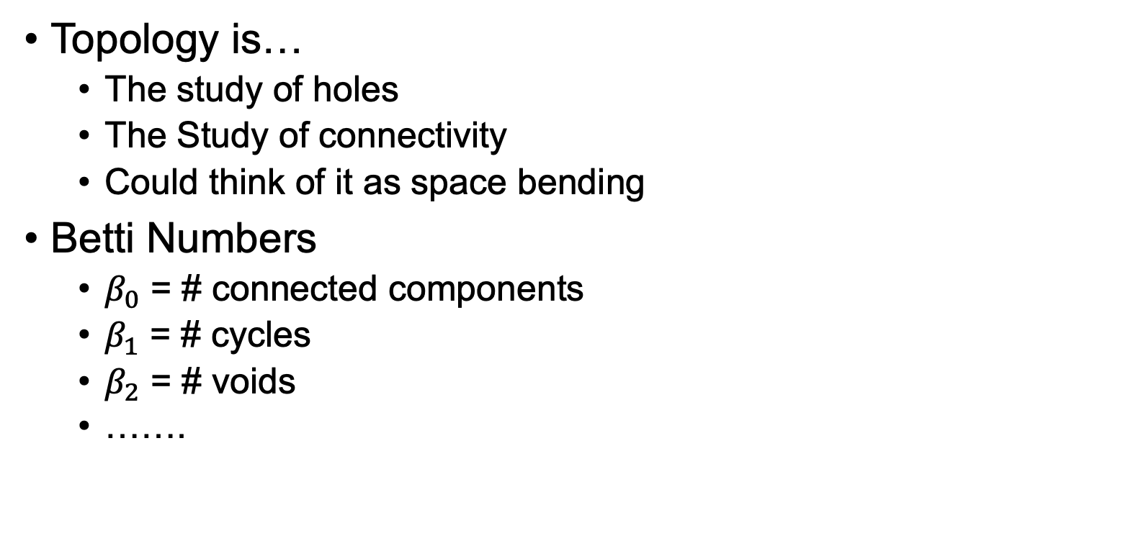
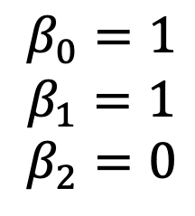
Topological Data Analysis
Introduction | Methodology | Results | Conclusion
Topology is…
  The study of holes
  The Study of connectivity
  Could think of it as space bending
Betti Numbers
  $β_{0}$ = # connected components
  $β_{1}$ = # cycles
  $β_{2}$ = # voids
  …….
$$β_{0}=1$$
$$β_{1}=1$$
$$β_{2}=0$$
Michael Moor. “TOPOLOGICAL REPRESENTATION LEARNING”. SNAP Seminar, 22 April 2022, Stanford University

Slide 8
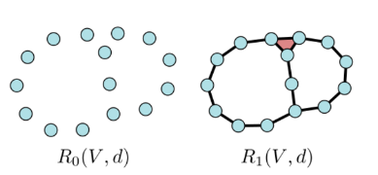
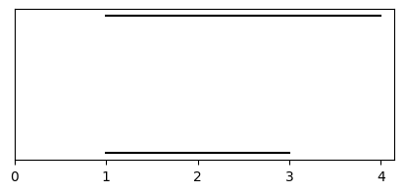
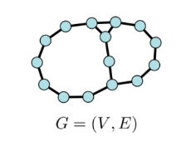
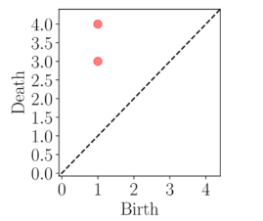
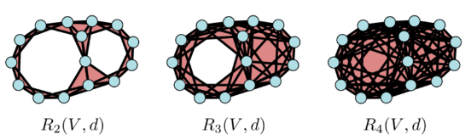
Rips Filtration on Graphs
Introduction | Methodology | Results | Conclusion
Pros: inclusions only go one way.
Persistence Barcode
Persistence Diagram
Capture topological features by building simplicial complexes as parameters (shortest path distance) increase.
Myers, Audun, et al. "Temporal network analysis using zigzag persistence." EPJ Data Science 12.1 (2023): 6.

Slide 9
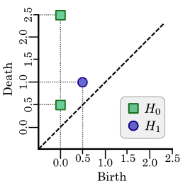





Zigzag Persistence on Graphs
Introduction | Methodology | Results | Conclusion
$$∞$$
2
2
3
3
1
1
0
4
0
4
$$K_{0,1}$$
$$K_{1,2}$$
$$K_{0}$$
$$K_{1}$$
$$K_{2}$$
Cons: Able to track edge addition and removal, suitable for temporal graphs!
2
2
3
2
3
3
1
1
1
0
4
0
4
0
4

Slide 10
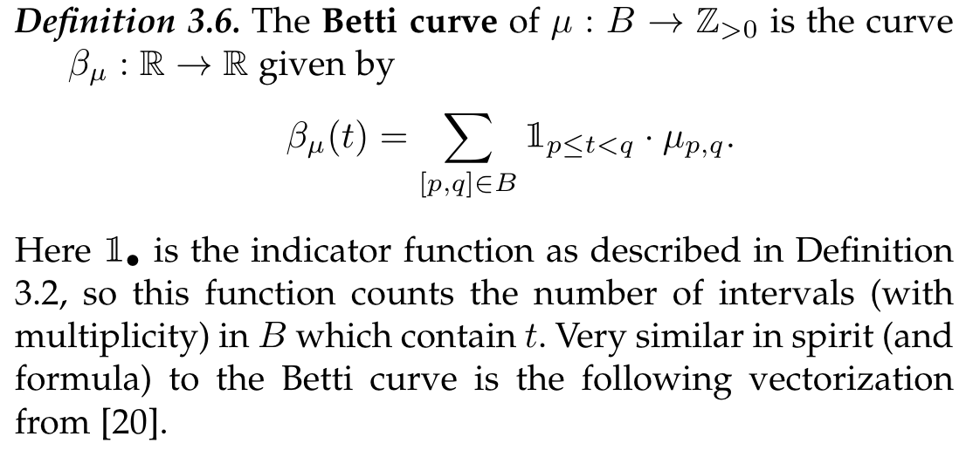
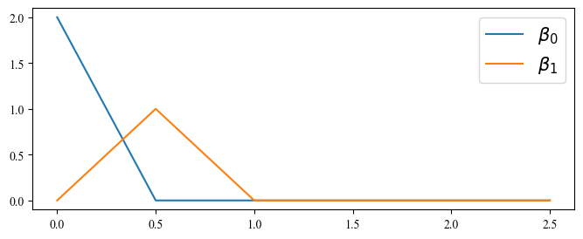
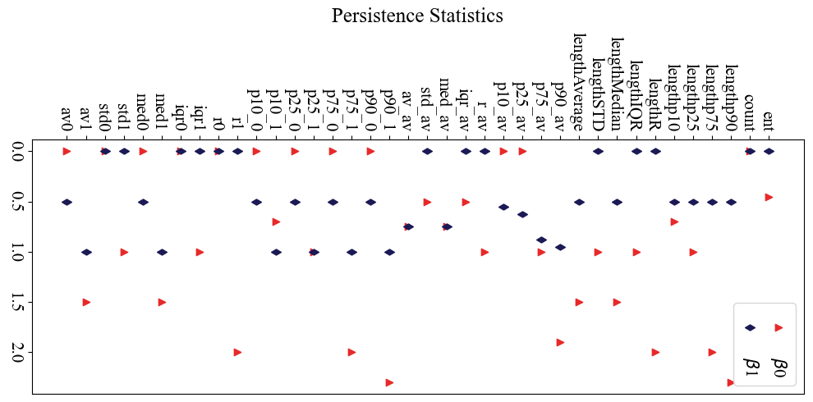
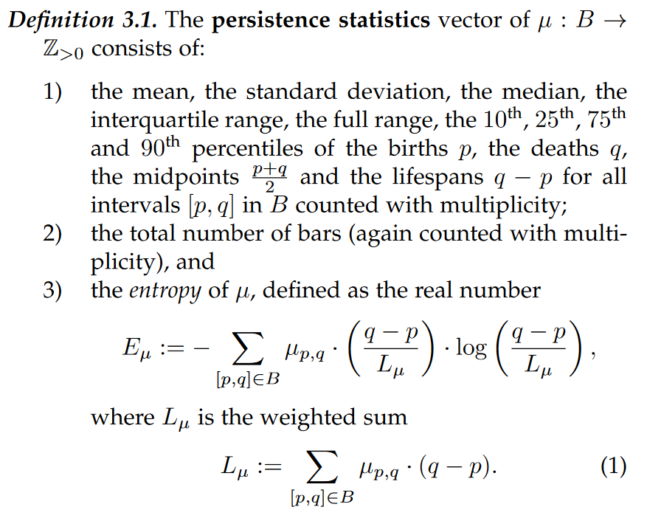
Feature Vectorization
Introduction | Methodology | Results | Conclusion
Betti Curve
Persistence Diagram
Persistence Statistics
Ali, Dashti, et al. "A survey of vectorization methods in topological data analysis." IEEE Transactions on Pattern Analysis and Machine Intelligence (2023).

Slide 11
Zigzag Persistence-based Framework
Introduction | Methodology | Results | Conclusion
Notes:
Zigzag怎么用的

Slide 12
Results
Introduction | Methodology | Results | Conclusion
Temporal evolution of volunteer collaboration patterns to the COVID-19 pandemic.
Regional Differences on Volunteer Collaboration Patterns.
Topological patterns can reflect external perturbations.

Slide 13
Pandemic Effects
Introduction | Methodology | Results | Conclusion
2021 Apr – 2021 Jul
Pandemic Waves
In Shenzhen
2022 Oct – 2023 Jan
Nationwide
Reopening
During the pandemic, high-dimensional collaborations emerged more frequently between volunteer groups.
However, after the pandemic, groups tended to prefer completing tasks individually.

Slide 14
Regional Difference Influence: Point-of-interest Correlation
Introduction | Methodology | Results | Conclusion
Point-of-interest of 72 Streets
POI Type | Yuanling Street | Pinghu Street | …
Science/Culture & Education Service | 256 | 662 | …
Transportation Service | 267 | 900 | …
Governmental Organization & Social Group | 103 | 462 | …
Medical Service | 90 | 876 | …
Residential Area | 25 | 187 | …
Accommodation Service | 19 | 550 | …
Industrial Park & Business Office Building | 38 | 339 | ...
POI Data crawling from GAODE: https://lbs.amap.com/api/webservice/guide/api/search

Slide 15

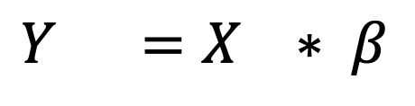


Point-of-interest Effects
Introduction | Methodology | Results | Conclusion
Persistence
Feature
POI
Matrix
$$Y =X ∗ β$$
$$72∗38$$
$$72∗7$$
$$7 ∗38$$
Residential areas and areas with more educational institutions exhibited tighter collaboration patterns, while industrial regions showed fewer high-dimensional collaborations.
Ali, Dashti, et al. "A survey of vectorization methods in topological data analysis." IEEE Transactions on Pattern Analysis and Machine Intelligence (2023).

Slide 16

Is the collaboration pattern critical for global/system effectiveness?
Introduction | Methodology | Results | Conclusion
Goal: Simulates volunteer collaboration behavior and investigate how cross-community collaboration correlates to the system effectiveness.
Generate Tasks
and Agents on
a Shenzhen map
Agent (User)
participate in tasks
Agents (Organizer)
organize tasks
Reset Tasks
System Effectiveness
Dynamic Collaboration Graphs
Fig. Simulation Pipeline

Slide 17
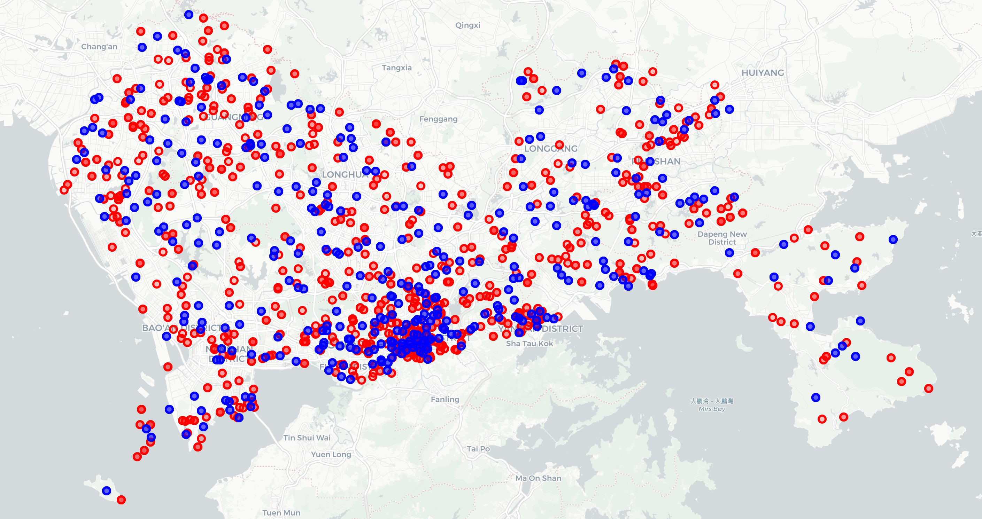
Simulation Settings -- Agents
Introduction | Methodology | Results | Conclusion
Parameter
  home location : agent‘s position (lat, lon)
  Home street: 72 streets from Pioneers
  If organizer: percentage p
Action
  Organizers’ Action
  Participants’ Action
System perturbation settings:
  Add and remove agents periodic at some timestep
Fig. Generate Agents and tasks (red: agents, blue: tasks)

Slide 18
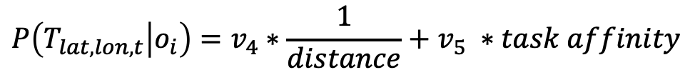
Simulation Settings – Agents Actions
Introduction | Methodology | Results | Conclusion
The probability of organizer $o_{i}$ to organize a task with task type t located at (lat, lon)​ is:
$$P\left(T_{lat,lon,t} | o_{i}\right)=v_{4}∗\frac{1}{distance}+v_{5} ∗task affinity$$
$$P\left(T_{lat,lon,t} | u_{i}\right)=v_{1}∗\frac{1}{distance}+v_{2} ∗task affinity+v_{3} ∗collaborative propensity$$
Distance: distance between the selected task and agents’ home location
Task affinity: agents task type preference (sampling task type distribution from real data)
Collaborative propensity: number of agents already selected tasks that user $u_{i}$ collaborated before

Slide 19
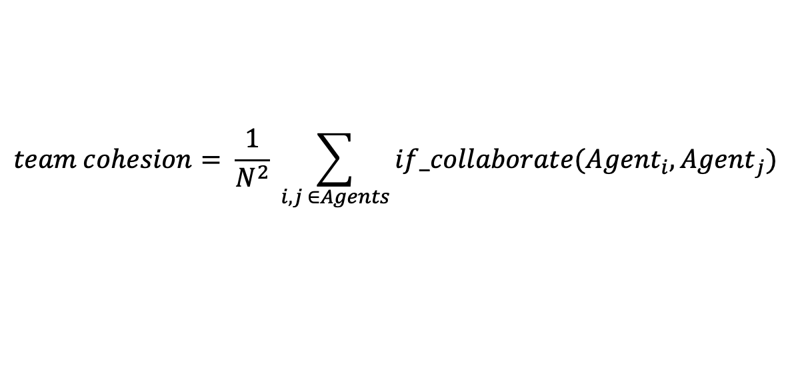
System Effectiveness (E)
Introduction | Methodology | Results | Conclusion
Given a task T with task type t located at (lat,lon), the effectiveness can be computed as follows:
$$E\left(T_{lat,lon,t}\right)=team size ∗team cohesion ∗team familiarity$$
Where:
Team size (N): the number of agents participate in this task
Team cohesion: the normalized number of pairwise collaborations within the team before
Team familiarity: the average number of participation times in the task type t within the group (initialized from real data and increasing with the iteration of the simulation)
$$team cohesion= \frac{1}{N^{2}} \sum_{i,j ∈Agents}{if_collaborate({Agent}_{i}, {Agent}_{j})}$$
Guimera, Roger, et al. "Team assembly mechanisms determine collaboration network structure and team performance." Science 308.5722 (2005): 697-702.

Slide 20
Simulation Results
Introduction | Methodology | Results | Conclusion
Collaboration patterns respond to these external perturbations and show a strong correlation with the system’s overall effectiveness

Slide 21
Conclusion
Introduction | Methodology | Results | Conclusion
We quantified and analyzed dynamic collaboration networks in social network via a novel topological data analysis-based framework.
We demonstrated the existence of higher-order community collaborations in Shenzhen during the COVID-19 pandemic and analyzed the influence of the pandemic and regional factors.
We discovered pandemic and regional factors affect collaboration patterns
Further simulation results showed that collaboration patterns are correlated with system effectiveness and can reflect external perturbations. (as a way measure and facilitate system effectiveness)

Slide 22
Thanks

