Slide 1
Transferability Weighted Finetuning in Medical Image Segmentation
shutong duan
2023/11/02

Slide 2
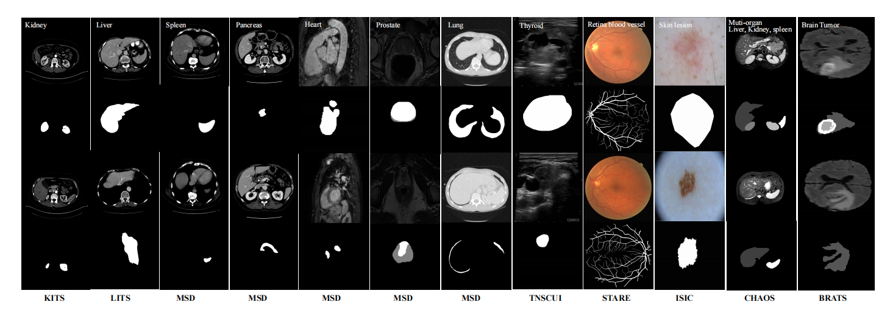
Medical Image Segmentation
Introduction
aims to make anatomical or pathological structures changes in more clear in images
X-ray, Computed Tomography (CT), Magnetic Resonance Imaging (MRI) and ultrasound have become four important image assisted means
difficult to acquire sufficient training data for diverse practical scenarios

Slide 3
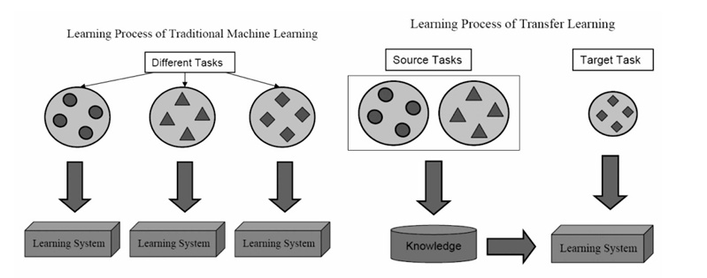
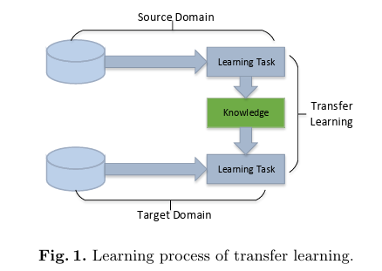
Transfer Learning
Introduction
a useful learning tool to improve the performance on target tasks with the help of related source tasks (models)
especially when only few labeled target data are available for supervision
try to transfer the knowledge from the source domain to the target domain

Slide 4
Transferability Estimation
Introduction
Transferability estimation is the problem of quantitatively estimating how easy it is to transfer knowledge learned from one task to another without training on the target task

Slide 5

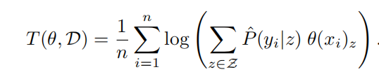
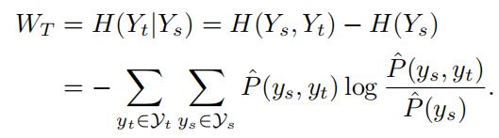


Analytical Transferability Metrics
Methodology
LEEP¹
defined by the average log-likelihood of the expected empirical predictor
HScore²
an information-theoretic approach through solving a HGR maximum correlation problem
OTCE³
characterizes transferability as a combination of domain difference and task difference,and evaluates them in a unified framework
[1]. Cuong V Nguyen, Tal Hassner, Cedric Archambeau, and Matthias Seeger, “Leep: A new measure to evaluate transferability of learned representations,” in International Conference on Machine Learning, 2020.
[2]. Yajie Bao, Yang Li, Shao-Lun Huang, Lin Zhang, Lizhong Zheng, Amir Zamir, and Leonidas Guibas, “An information-theoretic approach to transferability in task transfer learning,” in 2019 IEEE International Conference on Image Processing (ICIP). IEEE, 2019, pp. 2309–2313.
[3]. Yang Tan, Yang Li, and Shao-Lun Huang, “Otce: A transferability metric for cross-domain cross-task repre_x0002_sentations,” in Proceedings of the IEEE conference on computer vision and pattern recognition (CVPR), June 2021, pp. 15779–15788.

Slide 6
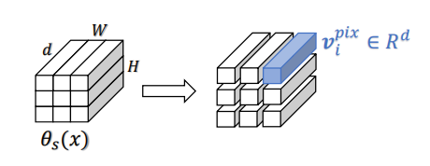

Adaptation Method
Methodology
from global feature map to pixel-wise feature
[1]. Tan, Yang, Yicong Li, Yang Li and Xiao-Ping Zhang. “Efficient Prediction of Model Transferability in Semantic Segmentation Tasks.” 2023 IEEE International Conference on Image Processing (ICIP) (2023):

Slide 7
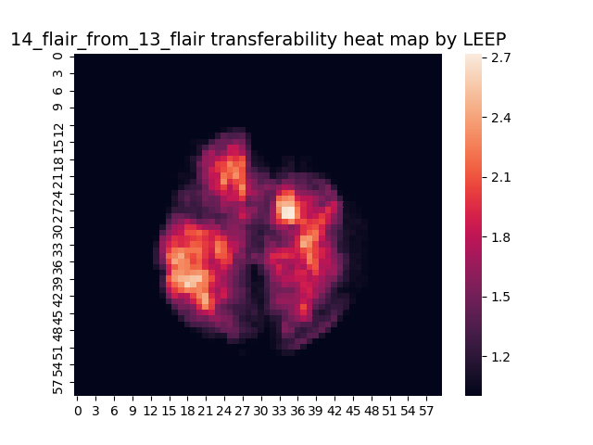


Transferability Weighted Map
Methodology
for LEEP, HScore
for OTCE
pixel-wise transferability reveals the hardness of transfer at a local area
[1]. Tan, Yang, Yicong Li, Yang Li and Xiao-Ping Zhang. “Efficient Prediction of Model Transferability in Semantic Segmentation Tasks.” 2023 IEEE International Conference on Image Processing (ICIP) (2023):

Slide 8
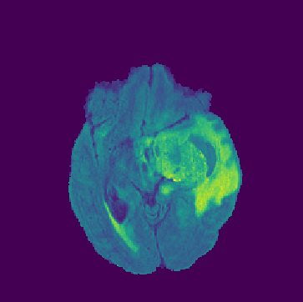
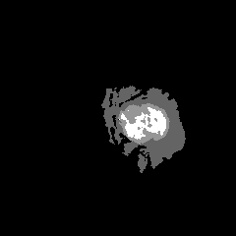
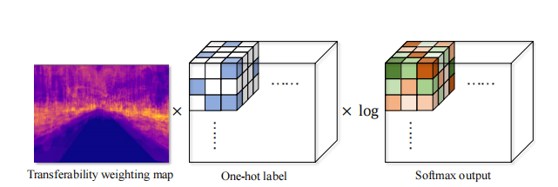
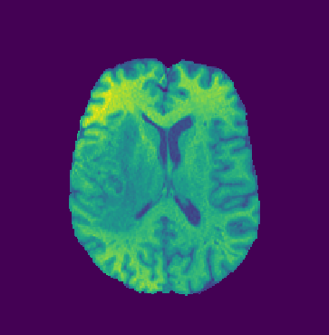
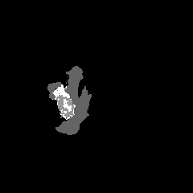
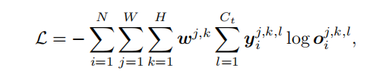
Transferability Weighted Finetuning
Methodology
use transferability weighted map as a weighting coefficient to encourage the neural network to focus on the low-transferability regions during the finetuning phase.
[1]. Tan, Yang, Yicong Li, Yang Li and Xiao-Ping Zhang. “Efficient Prediction of Model Transferability in Semantic Segmentation Tasks.” 2023 IEEE International Conference on Image Processing (ICIP) (2023):

Slide 9
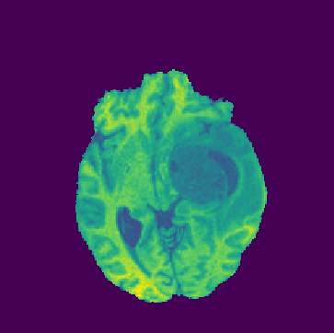
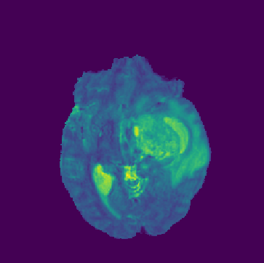
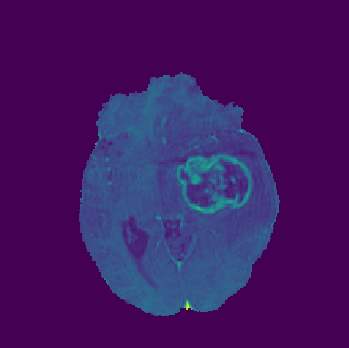
experiments
dataset:FeTS2021 for brain tumor segmentation
4 modalities
  T1-weighted (T1)
  T2-weighted (T2)
  Fluid-Attenuated Inversion Recovery (FLAIR)
  T1-Weighted Contrast-Enhanced (T1CE)
3 labels:
  edematous tissue (ED)
  enhancing tumor (ET)
  necrotic tumor core (NCR)
model: a classic 2D U-Net

Slide 10
experiments
the groundtruth dice of different task
TASK | 13-T2 | 14-T2 | 17-T2 | 18-T2 | 13-T1 | 14-T1 | 17-T1 | 18-T1 | 13-FLAIR | 14-FLAIR | 17-FLAIR | 18-FLAIR
Dice | 0.508 | 0.533 | 0.383 | 0.497 | 0.423 | 0.501 | 0.316 | 0.374 | 0.521 | 0.578 | 0.374 | 0.478
Comparison of the effect of transfer different source tasks to the target task using transferability weighted fine-tuning
 | 13-T2 | 14-T2 | 17-T2 | 18-T2 | 13-T1 | 14-T1 | 17-T1 | 18-T1 | 13-FLAIR | 14-FLAIR | 17-FLAIR | 18-FLAIR | groundtruth
13-T1 | 0.351 | 0.304 | 0.317 | 0.314 |  | 0.426 | 0.340 | 0.331 | 0.363 | 0.364 | 0.311 | 0.318 | 0.423
14-T1 | 0.441 | 0.488 | 0.443 | 0.416 | 0.524 |  | 0.481 | 0.516 | 0.381 | 0.398 | 0.429 | 0.473 | 0.501
14-T2 | 0.557 |  | 0.519 | 0.538 | 0.431 | 0.505 | 0.466 | 0.488 | 0.469 | 0.482 | 0.485 | 0.521 | 0.533
14-Flair | 0.568 | 0.590 | 0.536 | 0.552 | 0.504 | 0.559 | 0.521 | 0.531 | 0.591 |  | 0.565 | 0.588 | 0.578
17-T2 | 0.398 | 0.408 |  | 0.445 | 0.320 | 0.384 | 0.319 | 0.398 | 0.375 | 0.396 | 0.341 | 0.365 | 0.383
18-Flair | 0.466 | 0.483 | 0.483 | 0.504 | 0.421 | 0.451 | 0.436 | 0.428 | 0.512 | 0.530 | 0.529 |  | 0.478

Slide 11
experiments
The effect of whether or not to use transferability weighted finetuning on the effectiveness of transfer
target task | 13-t1 | 14-t1 | 14-t2 | 14-flair | 17-t2 | 18-flair
w/ map | 0.336 | 0.454 | 0.497 | 0.555 | 0.377 | 0.477
w/o map | 0.328 | 0.424 | 0.485 | 0.545 | 0.355 | 0.459
The effect of whether or not to use transferability weighted finetuning on the effectiveness of same modality transfer
target task | 13-t1 | 14-t1 | 14-t2 | 14-flair | 17-t2 | 18-flair
w/ map | 0.366 | 0.507 | 0.538 | 0.581 | 0.417 | 0.524
w/o map | 0.363 | 0.480 | 0.530 | 0.567 | 0.394 | 0.498
groundtruth | 0.423 | 0.501 | 0.533 | 0.578 | 0.383 | 0.478
demonstrate the effectiveness of transferability-weighted finetuning
transfer between same modality is found to be easier and most effective, rather than transfer between same partition

Slide 12
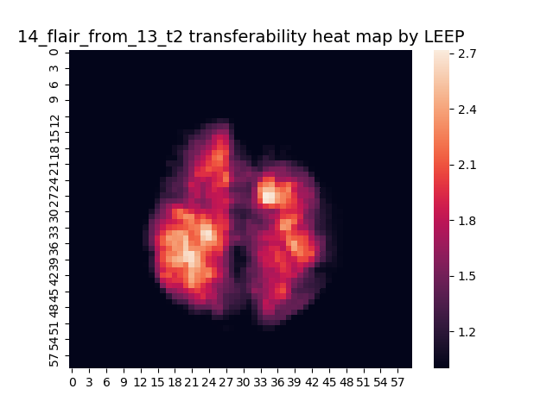
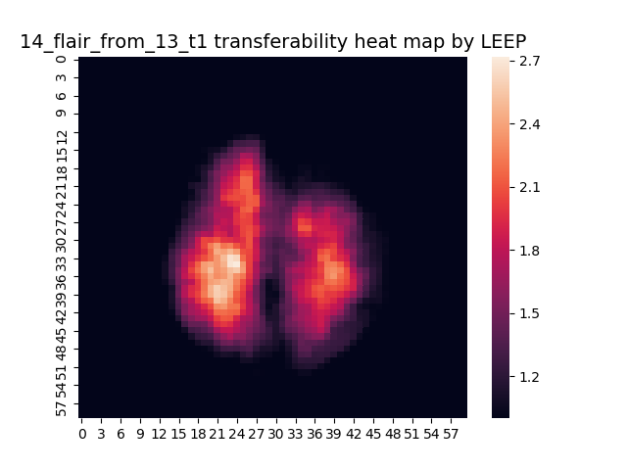
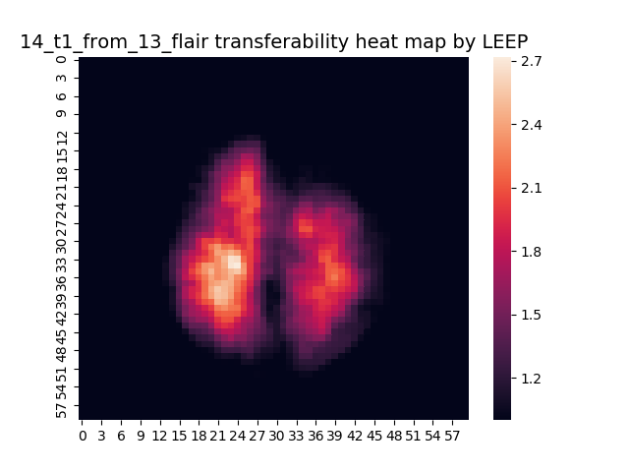

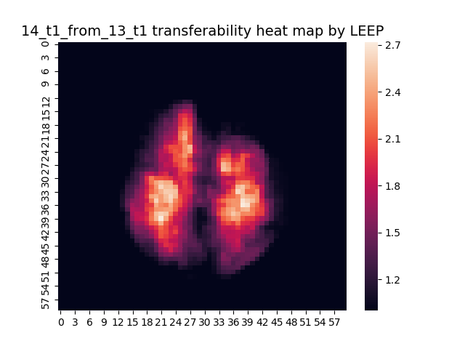
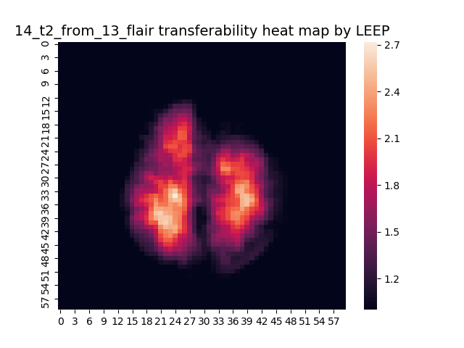
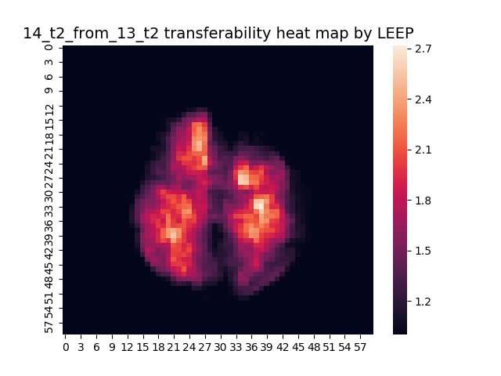

experiments
show the great transferability difference due to different modalities
the more spotty the heatmap is, the more similar the two tasks are.

Slide 13
conclusion
propose a flexible adaptation method to generalize existing transferability metrics to work on segmentation data
propose a transferability-weighted finetuning method to improve the transfer accuracy for a given source-target task pair
apply the proposed method on medical image segementation and verify its validity, and find the most applicable scenarios for it

