Slide 1


Selecting the Best Sequential Transfer Path for Medical Image Segmentation
Jingyun Yang
2023/11/16

Slide 2

Background
Sufficient annotated training samples are required for training while the labeling process of medical images is tedious and time-consuming.
Transfer learning has been widely investigated to address the problem.
Large-scale public medical datasets are often limited in their inclusion of diverse medical images and types of diseases and lesions.
There exist some datasets that closely align with the target dataset in terms of pathological features but fall short in volume.
Notes:
Directly transferring from such source domains can lead to poor model convergence, causing negative transfer

Slide 3
Background
Recent work showed that sequential knowledge acquisition could indeed facilitate the learning process of target tasks within the realm of continual learning.
  How to apply the sequential transfer learning pipeline in medical image segmentation?
Existing methods measure the task-relatedness between source and target datasets.
  Previous works focused on classification and regression tasks without fully considering the properties of medical image segmentation.
  Need inference time for feature extraction to compute the transferability, causing the consumption of computing resources.
Notes:
Catastrophic Forgetting
Model Complexity
model is expected to learn continuously and adapt to new data dynamic environments where the nature of the data changes over time, or when it's impractical to train a model on all possible data beforehand.
Elastic Weight Consolidation (EWC)

Slide 4
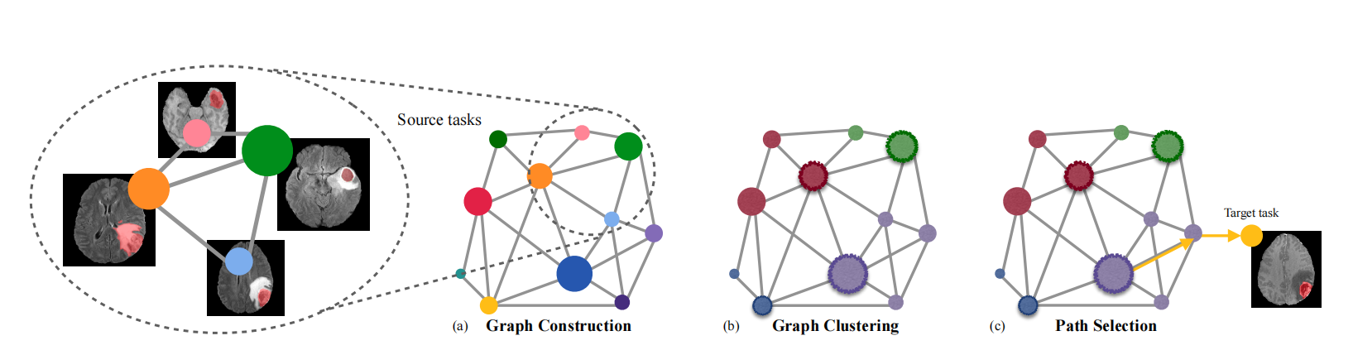
Framework
Use the task affinity metric to quantitatively predict the transfer performance of source tasks.
Employ graph clustering and set the representatives for each cluster.
Select the optimal sequential transfer path toward the target task.
Notes:
To decrease the exhaustive traversal of all path combinations

Slide 5
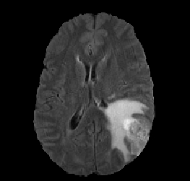
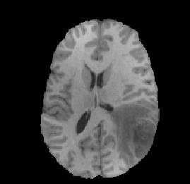


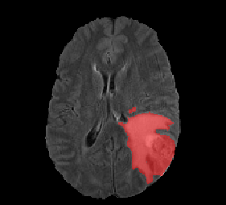
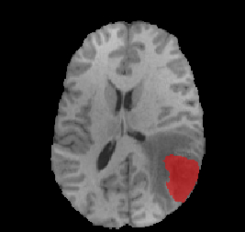
Task Affinity
Image Similarity Analysis
Label Similarity Analysis
Task Affinity Estimation

Slide 6




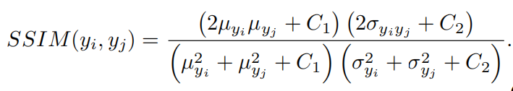
Task Affinity
Given a pair of task (i,j), :
  Image Similarity Analysis on images X_i and images X_j:
  ,where are distributions of images after dimension reduction using PCA.
  The image similarity between the sample pair is measured by the Wasserstein distance.
  Calculate the wasserstein distance of the distribution with voxels in a sample pair comprised of samples in the dataset X_i and X_j.
  Label Similarity Analysis on labels Y_i and labels Y_j:
  The structural similarity (SSIM) score is often used to evaluate the visual similarity between two voxels, to quantify the similarity of task objectives:
  Calculate the SSIM scores in a sample pair comprised of samples in the dataset Y_i and Y_j.

Slide 7

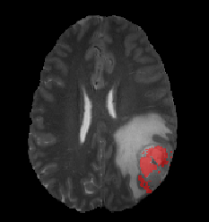
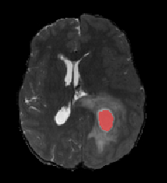
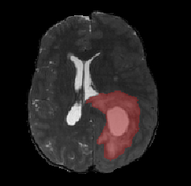
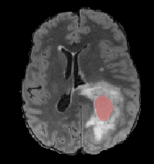
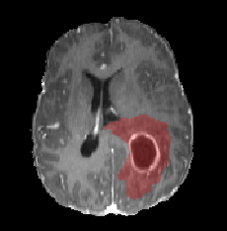
Task Affinity
Then we calculate the task affinity metric and set the edges accordingly:
01-t2-NCR
18-t2-NCR
01-t2-NCR
18-t2-ED
Edge: 0.1567
Edge: 0.3965
01-t2-NCR
18-flair-NCR
01-t2-NCR
18-t1ce-ED
Edge: 0.3071
Edge: 0.6091

Slide 8
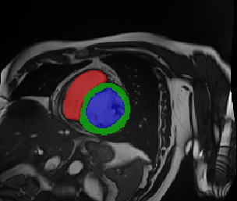
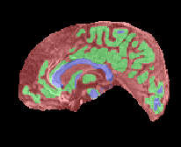
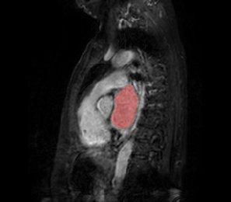
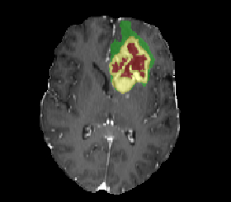
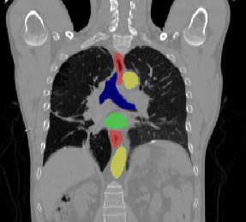
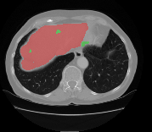
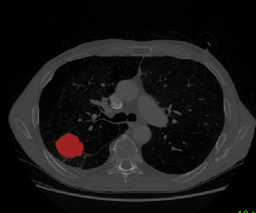
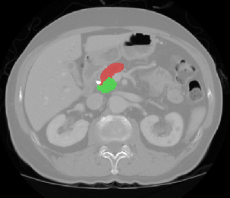
Task Affinity
Feature Similarity Analysis for MRI
Feature Similarity Analysis for CT
Notes:
（左心房，右心房，心肌）（前列腺）（心脏）（脑瘤）
（主动脉，气管，食管，心脏）（肝）（肺）（胰腺实质，胰腺肿块）
AlexNet pre-trained on ImageNet and fine-tune on 15xN medical images
VGGNet pre-trained on ImageNet and fine-tune on 15xN medical images (CT graph)

Slide 9

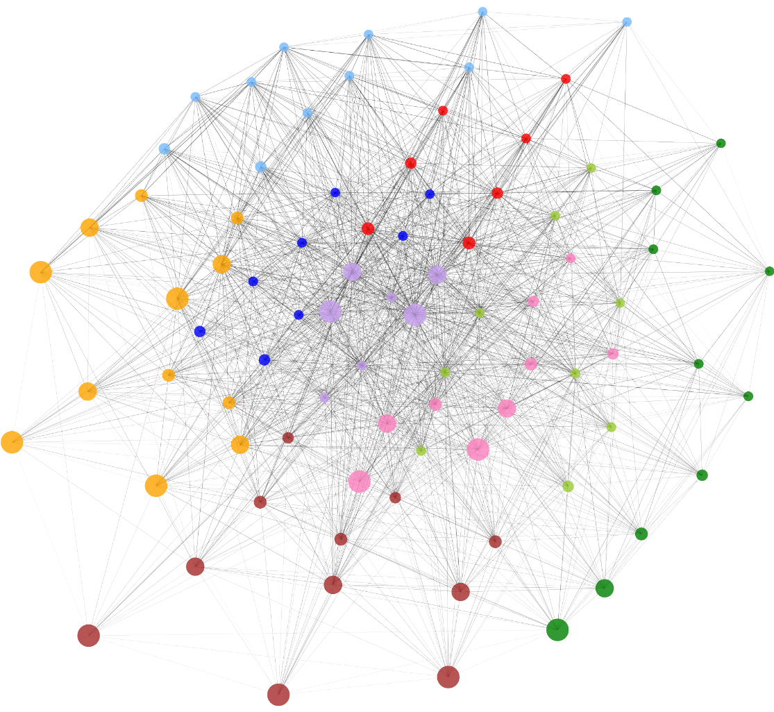
Graph Construction
To decrease the exhaustive traversal of all path combinations while preserving the efficiency of sequential transfer, we do graph clustering.

Slide 10
Graph Construction
To decrease the exhaustive traversal of all path combinations while preserving the efficiency of sequential transfer, we do graph clustering.
For transfer learning to work effectively, the source data should be inclusive of sufficient information and have the information accessible.
  Within each cluster, we choose one node to be the representative based on the amount of sample size it holds.

Slide 11


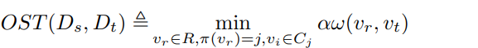

The Optimal Sequential Transfer Path
Given a target task, we define it as a new node v_t.
The goal is to select the optimal sequential transfer path P for v_t with an initial source node v_0 from the representatives set R and intermediate source nodes from the same cluster as v_0.
Minimize the transfer cost from Source domain to Target domain.
When path length = 2:
Notes:
where we select one initial source node $v_r\in R$ and one intermediate source node $v_i\in C_{\pi(v_r)}$.

Slide 12
Experiments
Source Task
  Dataset: FeTS 2022 dataset
    Institute: 01,18,04,21,06,13,20.
    Modality: T1, T2, FLAIR and T1ce modalities.
    Segmentation task: enhancing tumor (ET), edematous tissue (ED), necrotic tumor core (NCR).
Target task
  Dataset: FeTS 2022
    Institute: 16.
    Modality: T1, T2, FLAIR and T1ce modalities.
    Segmentation task: enhancing tumor (ET), edematous tissue (ED), necrotic tumor core (NCR).
  Dataset: WMH
    Institute: VU Amsterdam (A), NUHS Singapore (S), and UMC Utrecht (U).
    Modality: FLAIR.
    Segmentation task: white matter hyperintensities.
  Dataset: iSeg-2019
    Modality: T1 and T2.
    Segmentation task: whiter matters (WM), gray matters (GM), and cerebrospinal fluid (CSF).

Slide 13
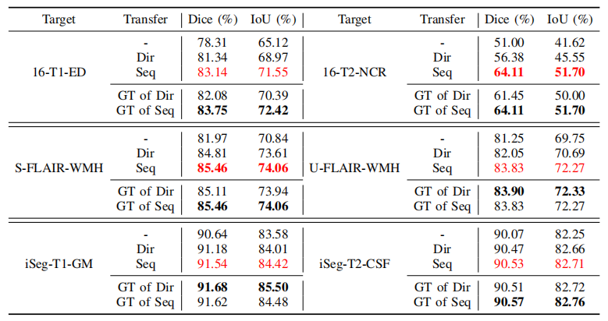
Experiments
Compare with baseline transfer and source model selection methods.
  Train from scratch on the target task.
  Sequential transfer on our selected optimal sequential transfer path.
  Direct transfer from the initial source task of the optimal sequential transfer path.
  The best transfer performance among all source models, called ground truth (GT).

Slide 14
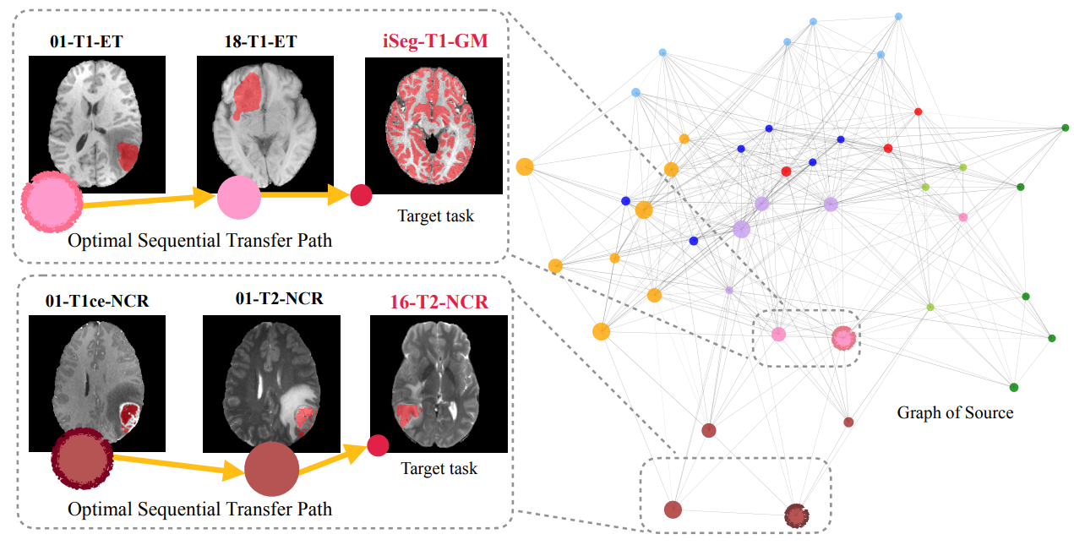
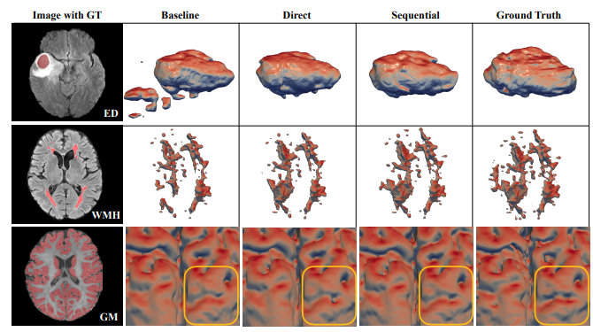
Experiments
The selected optimal sequential transfer paths for target tasks.
A 3D visualization of transfer methods performance.

Slide 15
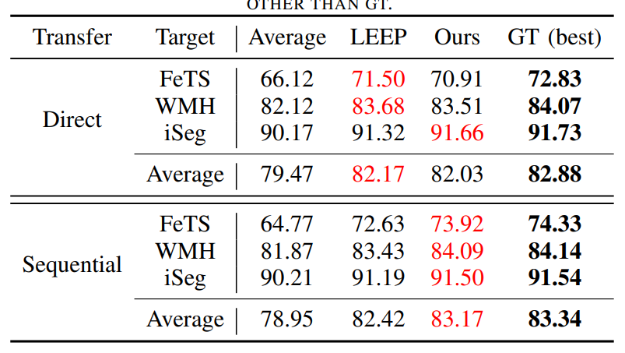
Experiments
Direct Transfer learning:
  Average transfer accuracy of all direct transfer source models.
  Use LEEP to select the best direct transfer source model.
  Use task affinity to select the best direct transfer source model.
  Ground truth.
Sequential Transfer learning:
  Average transfer accuracy of all sequential transfer source models.
  Use LEEP to select the best sequential transfer source model.
  Use OST path selection strategy to select the best sequential transfer source model.
  Ground truth.

Slide 16
Contributions
We successfully apply a sequential transfer learning pipeline tailored for medical image processing tasks to improve the transfer performance on the target tasks with leveraging diverse source tasks.
We propose a graph-based optimal sequential transfer path selection strategy to identify and engage with the most beneficial source tasks, thereby ensuring an effective transition sequence in the transfer learning process.

Slide 17
Further Research
We will extend our exploration to include datasets with a broader range of anatomical regions and more medical imaging modalities, such as CT and PET, among others.
We will evaluate the effectiveness of transfer paths with varying lengths.
We will determine whether a direct transfer or a sequential transfer is more efficient and assess the optimal length of these transfer paths.

Slide 18
Thanks for your listening

