Slide 1
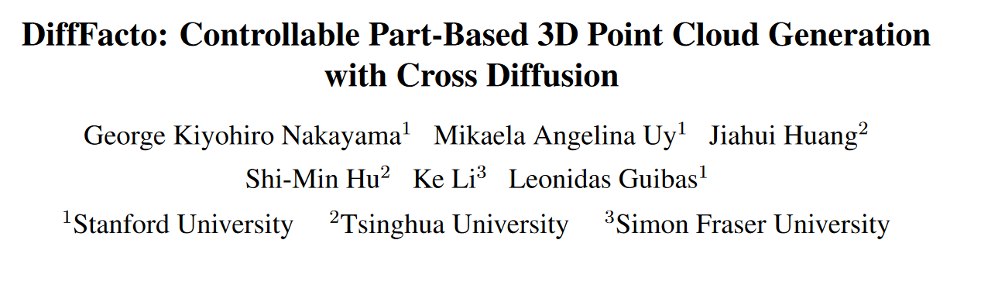
ICCV 2023

Slide 2
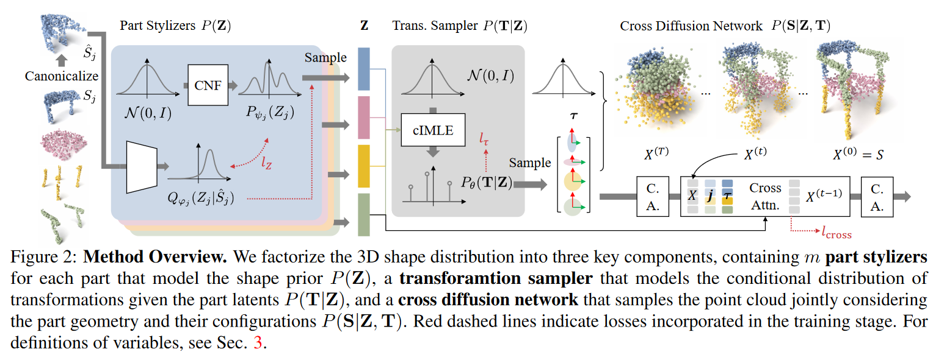
Method

Slide 3
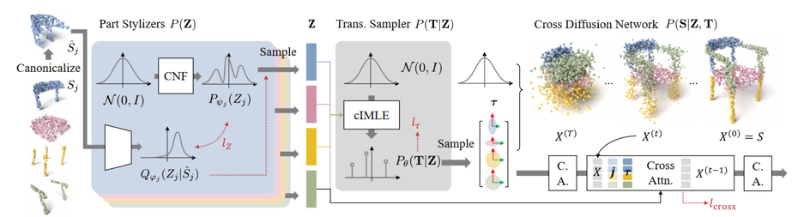
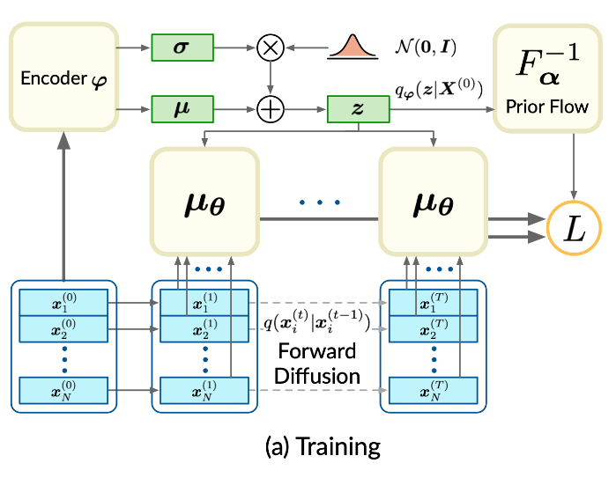

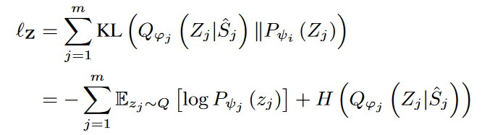
part stylizers
canonicalize
continuous normalizing flow (CNF)
S. Luo and W. Hu, Diffusion Probabilistic Models for 3D Point Cloud Generation

Slide 4


Transformation Sampler

Slide 5
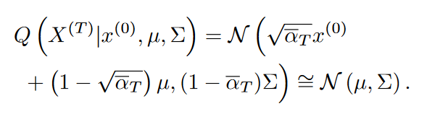
cross diffusion network
Generalized Forward Kernel
Cross-attention Network
The input to each cross attention layer attends to m tokens each being the concatenation of (zj, τj, j, t), for j = 1, ..., m.
This design allows a point x(t) to be informed of both the global shape through the m tokens and the local part by concatenating the coordinate x(t) with its corresponding part label and transformation, enabling us to capture and generate more plausible and holistic shapes

Slide 6
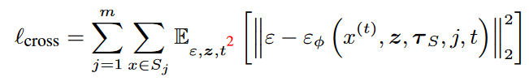

cross diffusion network
part styles
timestep
transformations
semantic label

Slide 7
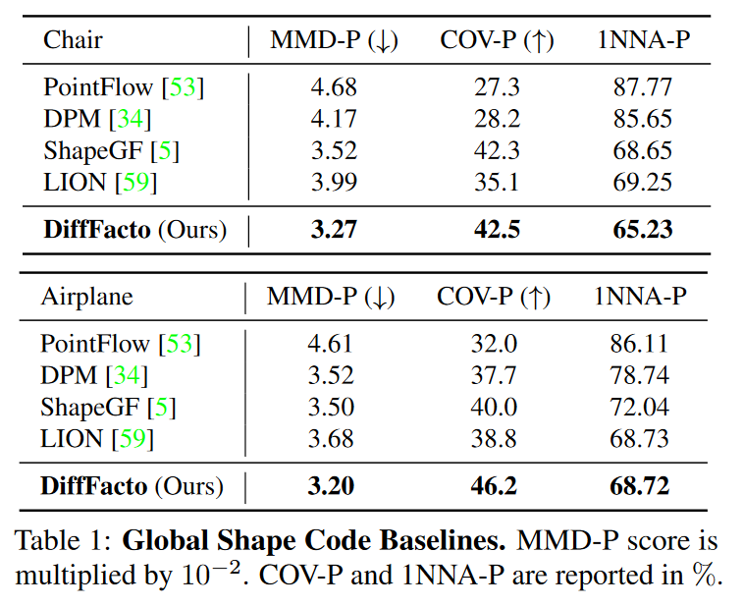
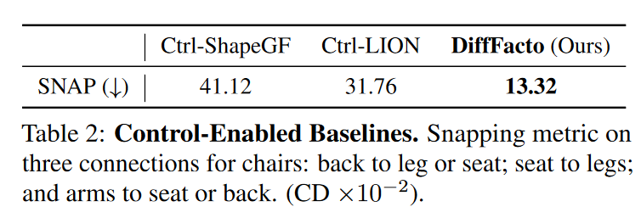
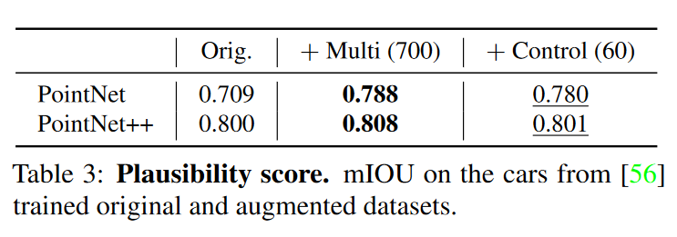
Results
Intra-part Score
Inter-part Score: measures local connectivity, given as the Chamfer distance (CD) between the Nsnap-closest points between connected parts.
Plausibility: use them for data augmentation would improve the segmentation score of part segmentation networks.
Human Study

