Slide 1


Causality Analysis
Ke Zhang
Tsinghua-Berkeley Shenzhen Institute

Slide 2

Overview of Today’s Report
Graphic Causality Model
Granger Causality Test
Identification Methods

Slide 3


Causation
Causation or Correlated?
counter-factual component: what would happen if no flame applied.
Intermediate variable： whether we are wearing protective gloves or not to make the rag get burned
causal inference will be to make the causal premises as weak and general as possible
Burn

Slide 4
Overview of Today’s Report
Graphic Causality Model
Granger Causality Test
Identification Methods

Slide 5
Causal Graphical Model
Assumptions:
There is some directed acyclic graph G representing the relations of causation among our variables.
The joint distribution of the variables obeys the Markov property on G.
The joint distribution has all of the conditional independence relations implied by the causal Markov property, and only those conditional independence relations.
.

Slide 6
Overview of Today’s Report
Graphic Causality Model
Granger Causality Test
Identification Methods

Slide 7
Granger Causality
Causality:
Causality measures the dependence of different variables. The change of causal variables can influence the change of consequence variables.
Granger Causality^{[1]}:
The prediction results towards Y are better if given previous information of variable X and variable Y than only given previous information of Y. This means X is the Granger causal variable to Y.
[1] Granger, C. W. (1969). Investigating causal relations by econometric models and cross-spectral methods. Econometrica: journal of the Econometric Society, 424-438.

Slide 8
Theoretical Method
Hypothesis Test:
H₀ : X is not the Granger causal variable to Y.
(u): $Yt=a0 +\sum_{i=1}^{p}{aiYt−i+\sum_{i=1}^{q}{biXt−i+\text{c}\text{t}} }$
(r): $Yt=a0 +\sum_{i=1}^{p}{aiYt−i+\text{c}\text{t}}$
a_{i} and b_{i} are constant values, p and q are maximal lag value, c_{t} is white noise.
Two regressive functions are used to predict Y_{t}. Compare two results and show whether X is helpful to get better results.
[1] Granger, C. W. (1969). Investigating causal relations by econometric models and cross-spectral methods. Econometrica: journal of the Econometric Society, 424-438.

Slide 9
Theoretical Method
Two regressive functions have residual sum squares that present as RSS_{u} and RSS_{r}.
$F= \frac{{RSSr −RSSu}/q}{{RSSu}/{(n−p−q−1)}}\sim F(q,n−p−q−1)$
RSS_{u} and RSS_{r} can form F distribution and thus we can generate the hypothesis test problem.
If p-value is smaller than significance value, we can reject H₀, and if p-value is larger, we will accept H₀.
[1] Granger, C. W. (1969). Investigating causal relations by econometric models and cross-spectral methods. Econometrica: journal of the Econometric Society, 424-438.

Slide 10
Example
Graphical relations between different variables through Granger causality test.
E
A
C
F
B
D
G

Slide 11
Overview of Today’s Report
Graphic Causality Model
Granger Causality Test
Identification Methods

Slide 12
Identify Causal Effects
Confounding :
U
X
Y
We want to find the causal effect of X on Y.
Indierect dependence between X and Y created by common cause U, which confounds the causal effect.
We use identification strategy to deconfound the effect.

Slide 13
Identify Causal Effects
Back-door Criterion^{[6]}:
A back-door path is an undirected path between X and Y with an arrow into X, like X←U→Y.
A set of conditioning variables or controls S satisfies the back-door criterion.
  S blocks every back-door path between X and Y.
  No node in S is a descendant of X.
Pr$(Y |do(X=x))=\sum_{s}{Pr(Y|X=x,S=s)Pr(S=s) }$
[6] Shalizi, C. (2013). Advanced data analysis from an elementary point of view..

Slide 14
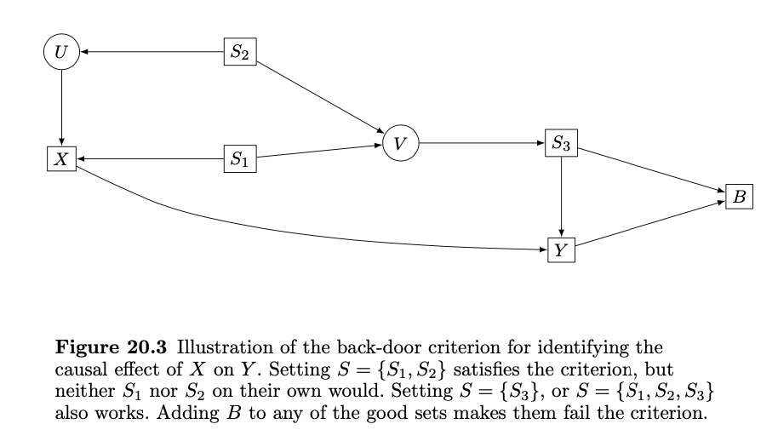
Identify Causal Effects
Back-door Criterion^{[6]}:
[6] Shalizi, C. (2013). Advanced data analysis from an elementary point of view..

Slide 15
Identify Causal Effects
Entner Rules:
If there is a set of controls S such that X is independent to Y |S, then X has no causal effect on Y. ( All the ways from X to Y are backdoor ways and S can block the effects.)
If there is a W ∈ W and a subset S of the W, not including W, such that (i) W is not independent to Y|S, but (ii) W is dependent to Y|S,X, then X has an effect on Y. X would be a collider on paths between W and Y , so conditioning on X would activate those paths.
[6] Shalizi, C. (2013). Advanced data analysis from an elementary point of view..

Slide 16

Identify Causal Effects
Front-door Criterion^{[6]}:
A set of variables M satisfies the front-door criterion:
  M blocks all directed paths from X to Y.
  There are no unblocked back-door paths from X to M.
  X blocks all back-door paths from M to Y.
Pr$(Y |do(X=x))= \sum_{m}{ Pr(M=m |X=x) \sum_{x′}{Pr(Y |X=x′)Pr(X=x′)}}$
[6] Shalizi, C. (2013). Advanced data analysis from an elementary point of view..

Slide 17
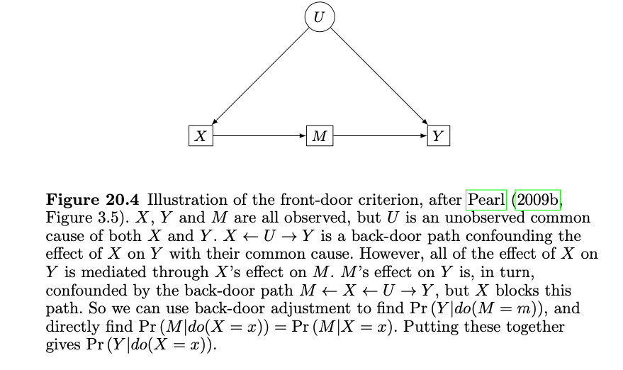
Identify Causal Effects
Front-door Criterion^{[6]}:
[6] Shalizi, C. (2013). Advanced data analysis from an elementary point of view..

Slide 18
Example
Graphical relations between different variables through Granger causality test.
E
A
C
F
B
D
G

Slide 19
Example
Final Results:
E
A
E
A
C
F
C
F
B
B
D
D
G
G

Slide 20
Thank you
Notes:
Thank you for you time and guidance!

