Slide 1


Transfer Learning by Adaptive Merging of Multiple Models
Medical Imaging with Deep Learning (MIDL 2019)
Spotlight Paper

Slide 2

Outline
Introduction
Related Works
Method
Experiments
Pros & Cons

Slide 3
Introduction
MIDL 2019, Day 3: Presentation by Robin Geyer
Video Link: https://www.youtube.com/watch?v=OQUZOBB2cNo
Motivation: If pre-trained models from several related tasks are available, it would be desirable to transfer their combined knowledge by automatic weighting and merging.
Contribution: T-IMM (Transfer Incremental Mode Matching), a method to leverage several pre-trained models, which extends the concept of Incremental Moment Matching from lifelong learning to the transfer learning setting.

Slide 4
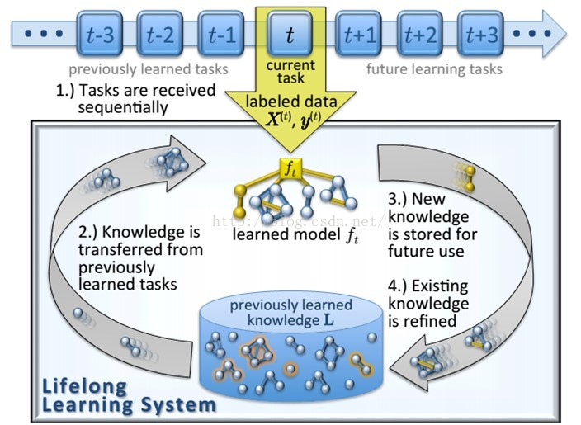
Related Work: Life-long Learning (LL)
Catastrophic Forgetting: When tasks are learned sequentially, performance typically decreases significantly on earlier tasks.

Slide 5
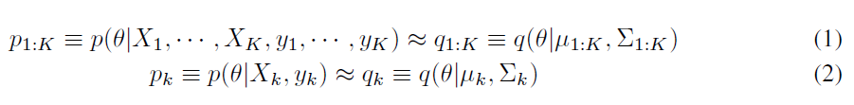
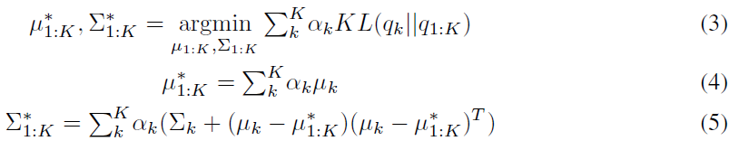

Related Work: Incremental Moment Matching (IMM)
Mean-based Incremental Moment Matching (mean-IMM)
Notes:
Target: Find optimal miu和sigma
Theta: parameter vector
Equally weighted: alpha

Slide 6
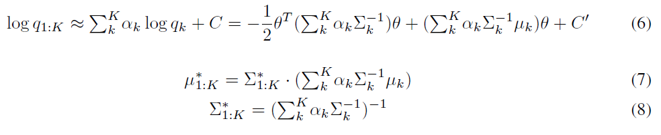
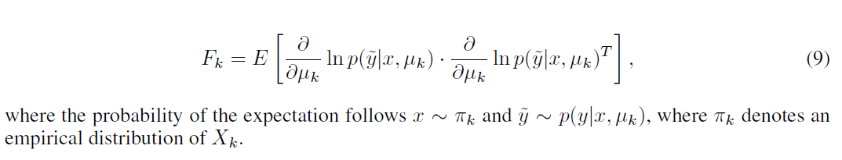
Related Work: Incremental Moment Matching (IMM)
Mode-based Incremental Moment Matching (mode-IMM)
Notes:
(6)Laplacian approximation

Slide 7

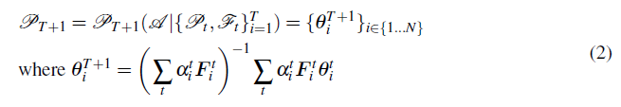
Method: T-IMM
Partition: parameters used for fusion & task-specific parameters
Mixing coefficients:
Fused parameters of the new model T +1:
Notes:
Partition
layer-specific, adaptive merging of models

Slide 8



Method: T-IMM
Equally weighted IMM Transfer (IMM):
Adaptation stage (T-IMM)
Fine tuning stage (T-IMM)
Notes:
选取合适的alpha

Slide 9
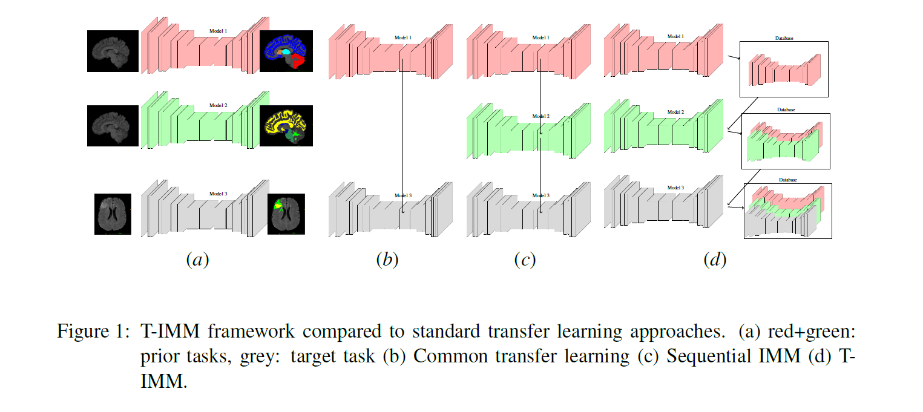
Method: T-IMM

Slide 10
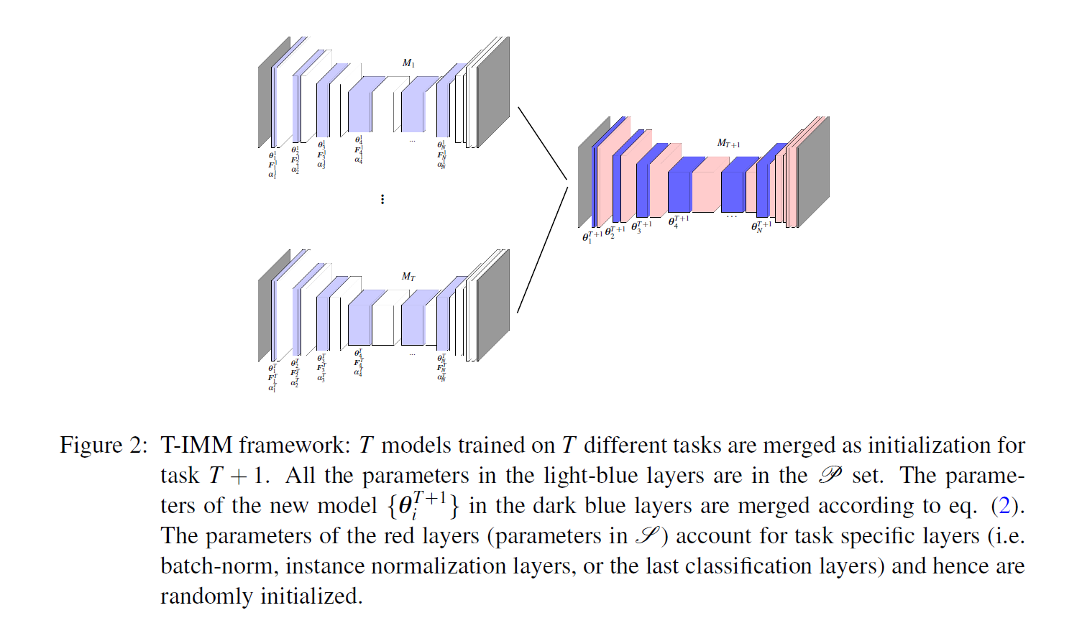
Method: T-IMM

Slide 11
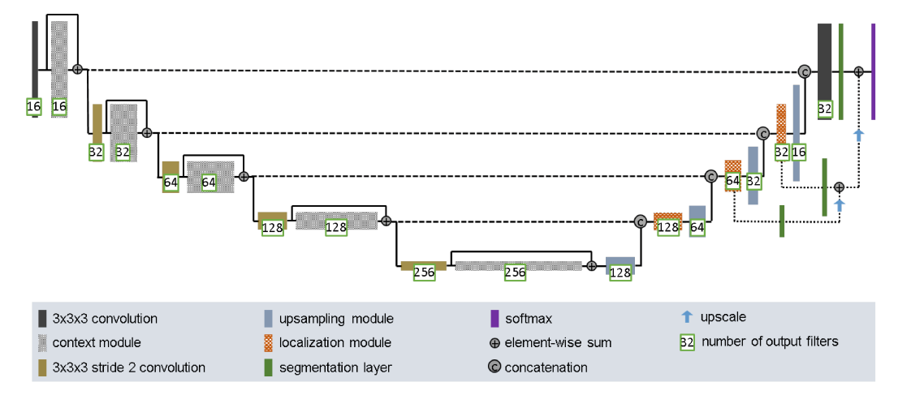
Experiments
NN architecture:
Notes:
Each context module is in fact a pre-activation residual block with two 3×3×3 convolutional layers and a dropout layer (pdrop = 0.3) in between.
Upsampling modules: first upsampling the low resolution feature maps, which is done by means of a simple upscale that repeats the feature voxels twice in each spatial dimension, followed by a 3×3×3 convolution that halves the number of feature maps.
A localization module consists of a 3×3×3 convolution followed by a 1×1×1 convolution that halves
the number of feature maps.
Seg layer: used as a means to speed up convergence by “encouraging” earlier layers of the network to produce good segmentation results. Conv 1x1x1

Slide 12
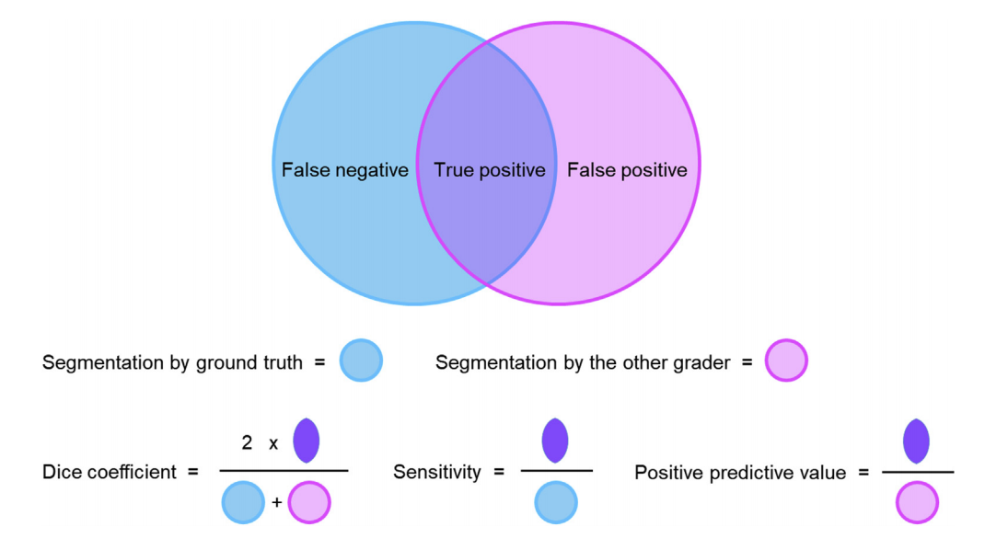
Experiments
Metric: Dice Coefficient (DC)

Slide 13
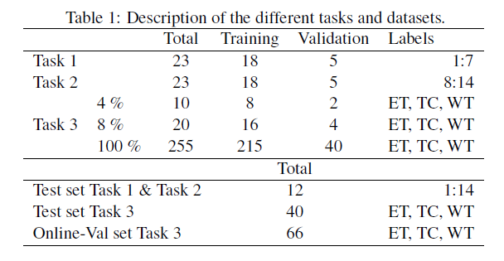
Experiments

Slide 14
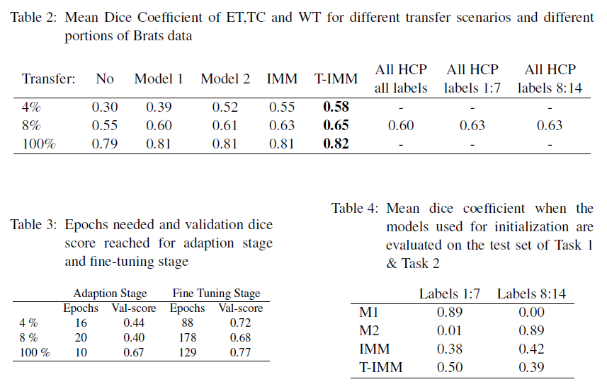
Experiments

Slide 15
Pros
Proposed a novel approach for finding appropriate mixing ratios at the layer scale for multi-model merging.
The multi-stage method, namely adaptation and fine-tuning, is easier to train compared with single-stage training.

Slide 16
Cons
Little comparisons to other SOTA transfer learning methods besides IMM.
In the 100% case, there’s only a marginal improvement over existing methods.
Only conducted experiments on three tasks and one test dataset (Brats).
No comparison with the multi-task learning methods.

Slide 17
Thanks for listening!

