Slide 1
Author2Vec: Learning Author Representations by Combining Content and Link Information
Presenter: Calvin Chan

Slide 2
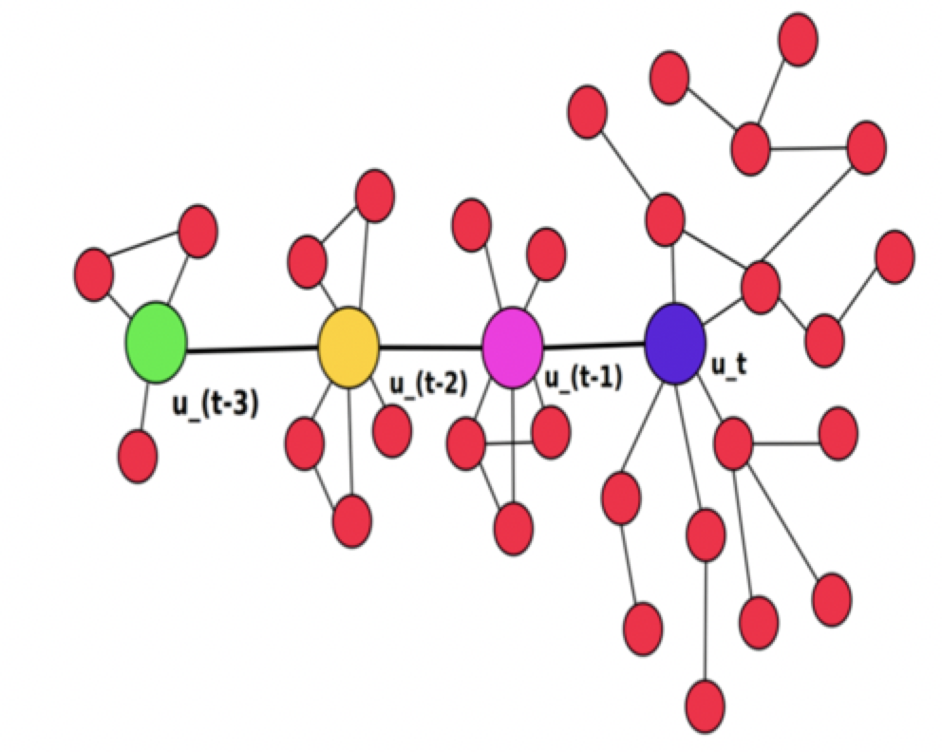
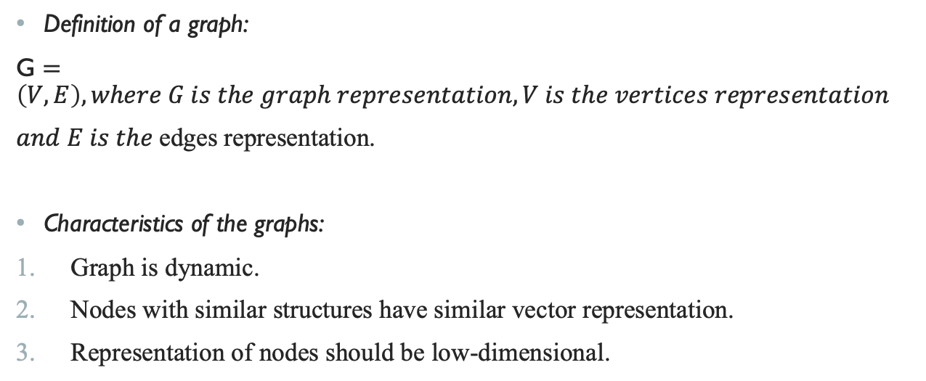
Pre-knowledge(Deepwalk)
Definition of a graph:
G $=\left(V,E\right), where G is the graph representation, V is the vertices representation$
$and E is the$edges representation.
Characteristics of the graphs:
Graph is dynamic.
Nodes with similar structures have similar vector representation.
Representation of nodes should be low-dimensional.

Slide 3
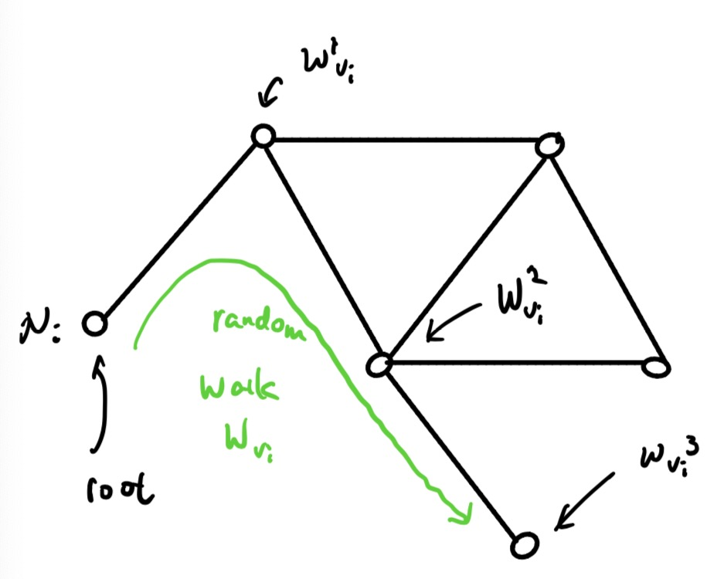
Pre-knowledge(Deepwalk)
What is node representation:
We use word embedding to represent a node to a vector, and random walk to perform the node sequences.

Slide 4
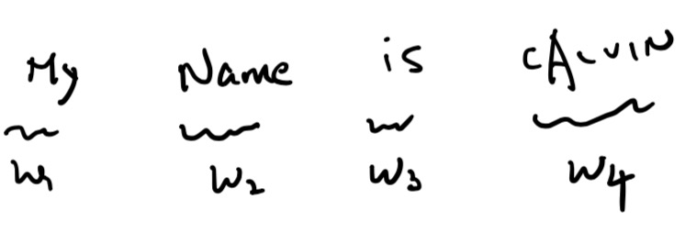
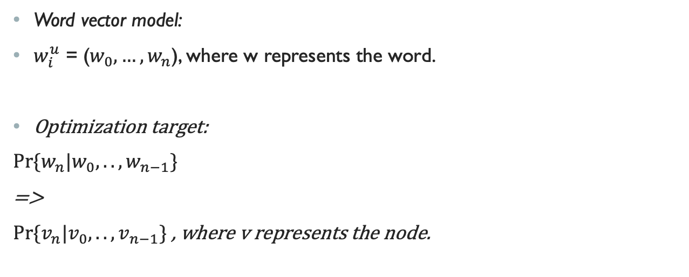
Pre-knowledge(Deepwalk)
Word vector model:
$w_{i}^{u}$ = ($w_{0}, …, w_{n}$), where w represents the word.
Optimization target:
$Pr⁡\{w_{n}|w_{0},..,w_{n−1}\}$
=>
$Pr⁡\{v_{n}|v_{0},..,v_{n−1}\}$ , where v represents the node.

Slide 5
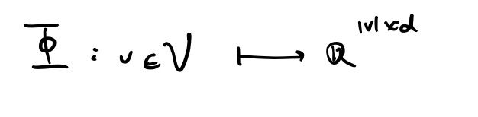
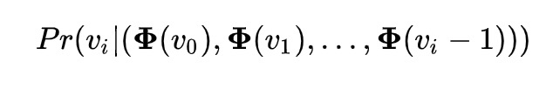
Pre-knowledge(Deepwalk)
Projection:
Final Optimization Target:

Slide 6
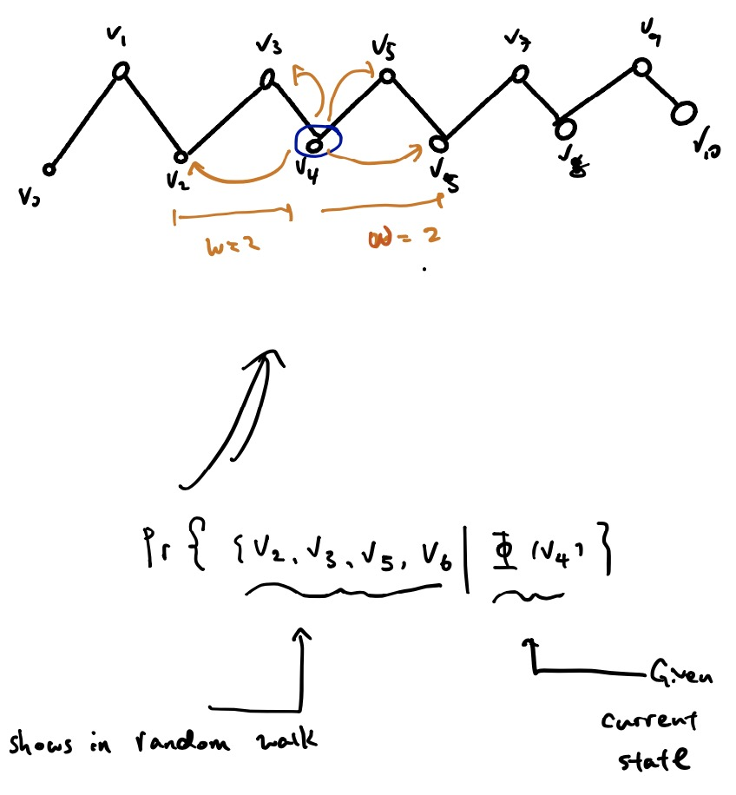
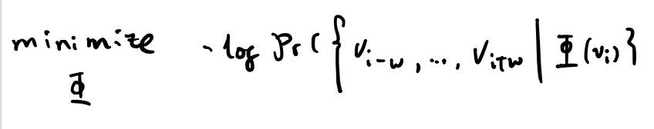
Pre-knowledge(Deepwalk)
SkipGram Model:
It does not use context to predict missing word, but use missing word to predict context.
Considering both left and right windows.
After SkipGram mode, the final optimization target become:

Slide 7
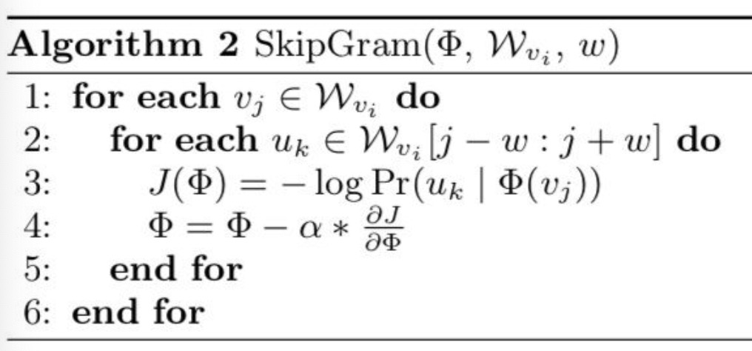
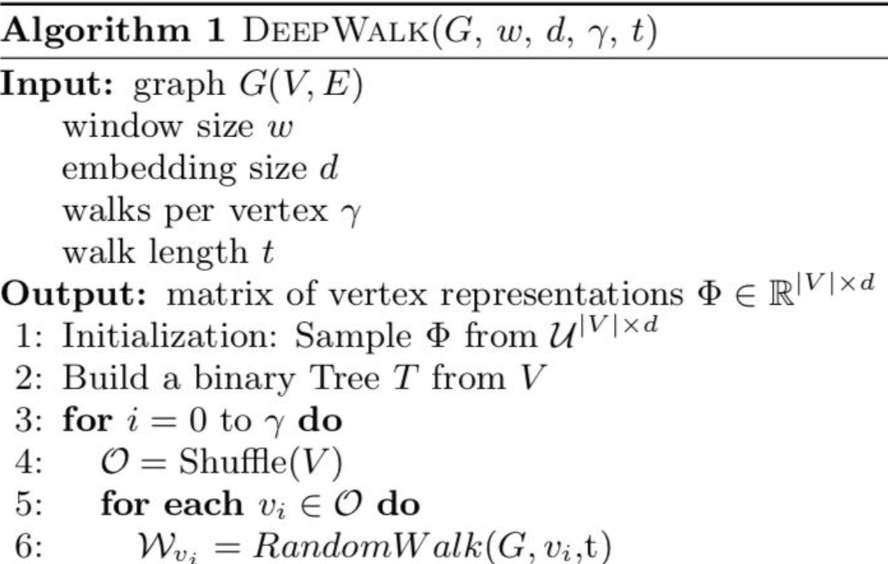
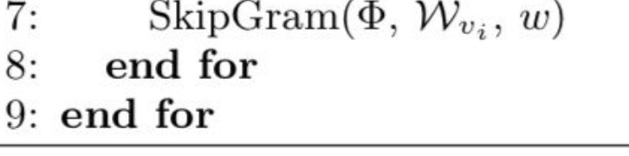
Pre-knowledge(Deepwalk)
SkipGram Algorithm:
DeepWalk Algorithm:

Slide 8
Author2vec
What is the research problem the paper attempts address?
Conventional Method Modern Method
After Improvement
Author2vec
DeepWalk,etc
Suffers from link sparsity

Slide 9
Author2vec
What are the claimed contributions of the paper?
Author proposes a new model called ‘Author2vec’ to learn low-dimensional author representation such that authors who write similar content and share similar network structure are closer in a vector space.

Slide 10
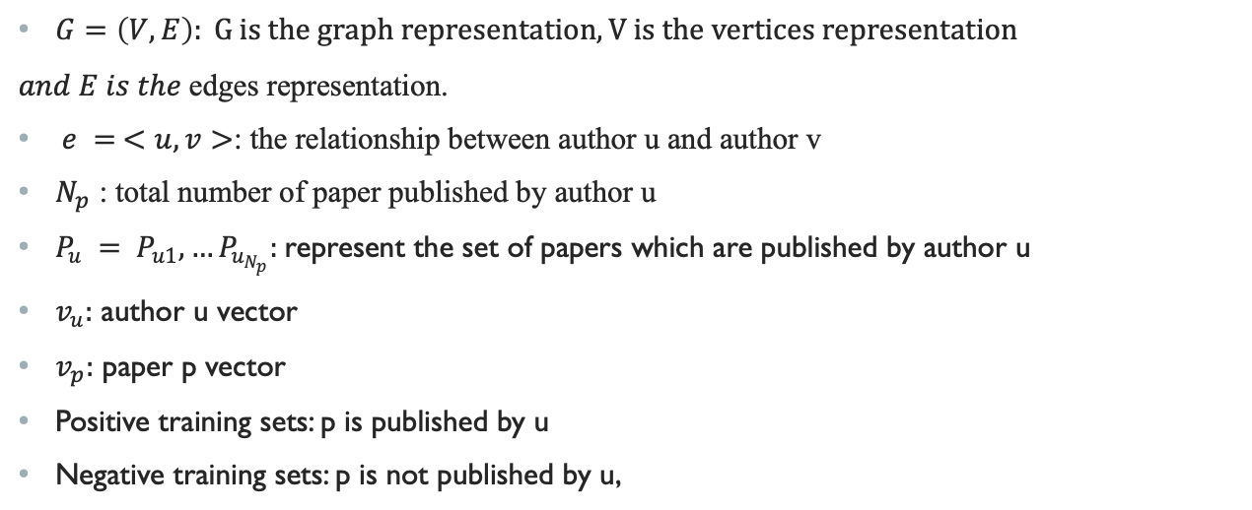
Some variables definition
$G=\left(V,E\right): G is the graph representation, V is the vertices representation$
$and E is the$edges representation.
$e = <u,v>$: the relationship between author u and author v
$N_{p}$ : total number of paper published by author u
$P_{u} = P_{u1},…P_{u_{N_{p}}}:$represent the set of papers which are published by author u
$v_{u}:$ author u vector
$v_{p}:$ paper p vector
Positive training sets: p is published by u
Negative training sets: p is not published by u,

Slide 11
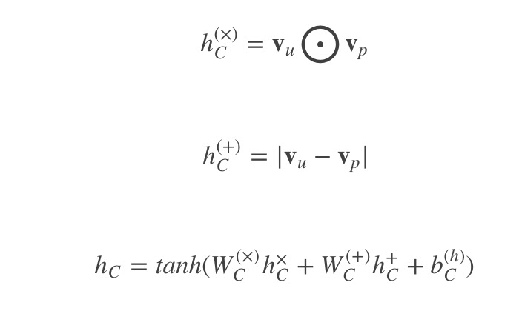
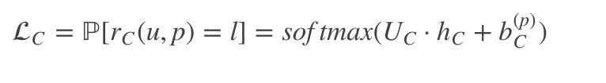
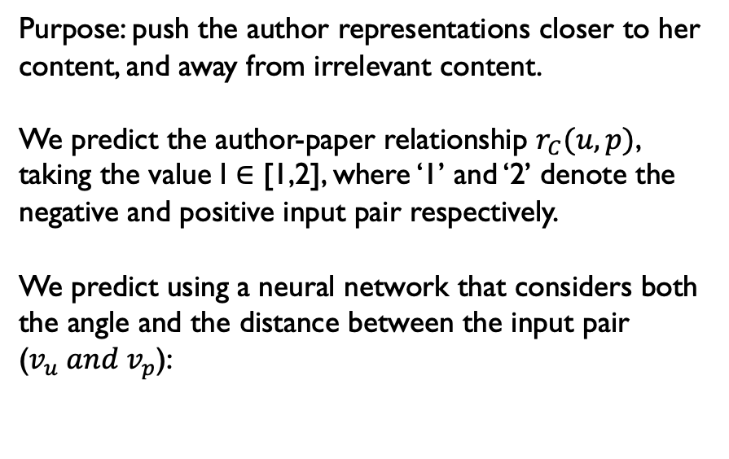
Context-Info Model
Purpose: push the author representations closer to her content, and away from irrelevant content.
We predict the author-paper relationship $r_{C}(u,p)$, taking the value l ∈ [1,2], where ‘1’ and ‘2’ denote the negative and positive input pair respectively.
We predict using a neural network that considers both the angle and the distance between the input pair ($v_{u} and v_{p}$):

Slide 12
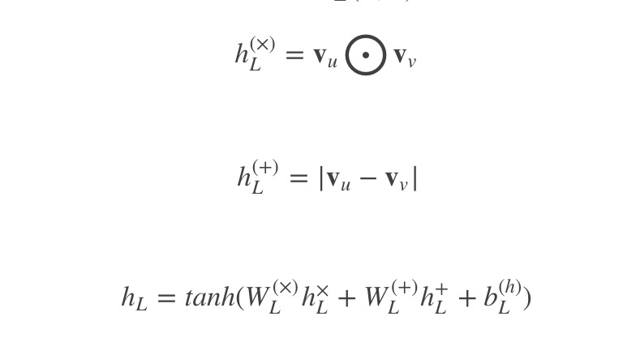

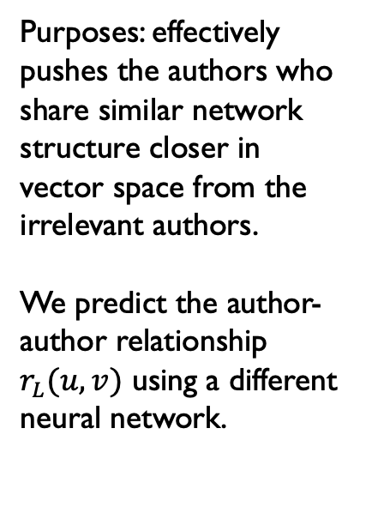
Link-Info Model
Purposes: effectively pushes the authors who share similar network structure closer in vector space from the irrelevant authors.
We predict the author-author relationship $r_{L}(u,v)$ using a different neural network.

Slide 13

Experiment
Data set
Citation Network Dataset (CND)
711810 computer science papers (along with abstracts)
written by a total of 500361 authors
Each paper is tagged with one of the 24 computer science fields.
Task
1. Link Prediction
2. Clustering
Training Details:
Main target function:

Slide 14
Link Prediction
CND data: 1990-2009
Last year is used for testing and the remaining as training.
positive classes: author pairs who co-authored in the training years.
Test set: the pair of authors who did not publish together in the training years, but in the test year.
resulting dataset : 2485764 training pairs + 15342 test pairs
logistic regression: solve this binary classification problem

Slide 15
Clustering
K-Means algorithm (with k=24, denoting the number of computer science fields)
associate a field to each author by picking the field in which the author publishes the most

Slide 16
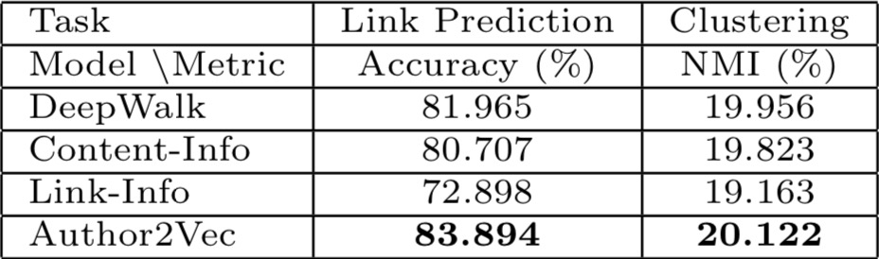
Performance Comparison
Content-info: Lack of link information, not good enough.
Link-Info: Lack of global content view, not good enough.
Author2vec: content view + link view = better result

Slide 17
Thanks!

