Slide 1
Transferable Curriculum for Weakly-Supervised Domain Adaptation
Guanzi Chen
2020/10/27

Slide 2
Outline
Introduction
1.1 Abtract
1.2 Domain Adaptaion
1.3 Curriculum Learning
1.4 Adversarial Architecture
Model
2.1 Overview
2.2 Learning with Transferable Curriculum
2.3 Constructing the Transferable Curriculum
Experiment
3.1 Evaluate with SOTA
3.2 Ablation Study

Slide 3
1. Introduction-Abstract
Problem
Weakly-supervised domain adaptation and two challenges:
distribution shift across domain
sample noises of the source domain
Our work
Transferable Curriculum Learning(TCL)
Adversarial architecture----minimize the distribution shift
Curriculumn learning training method
from easy to hard------eliminate negative influence the noise samples and
from transferable to untransferable---transfer relevant samples

Slide 4






1. Introduction-Domain Adaptation
Domain
Domain adaptation^{[1]}
source domain
target domain
different distribution
goal: knowledge transfer from source domain can improve a target task
Weakly-supervised domain adaptation
normal supervised fully labeled samples
weakly-supervised incomplete or inaccurate labeled samples
unsupervised fully unlabeled samples
feature space
marginal probability distribution
labeled
insufficiently labeled
noisy source samples
[1] Pan,S.J.,andYang,Q.2010.Asurveyontransferlearning.TKDE

Slide 5


1. Introduction-Curriculum Learning
Curriculum Learning
A learning regime imitating the learning process of human
Train the model from easy examples to hard examples
Self-paced Learning^{[2]}
Introduce a latent weight variable to quantify the contribution of each example
Organize a curriculum to yield the opimal weight
our curriculum is based on this
optimization problem
[2] Kumar, M. P.; Packer, B.; and Koller, D. 2010. Self-paced learning for latent variable models. In NIPS.

Slide 6


1. Introduction-Curriculum Learning
Self-paced Learning^{[2]}
optimization problem
altenating minimization algorithm
Fixed w
use SGD to get optimal
Fixed
classic curriculum
optimal weight w
our curriculum is different
and we add the measure of transferability
[2] Kumar, M. P.; Packer, B.; and Koller, D. 2010. Self-paced learning for latent variable models. In NIPS.

Slide 7
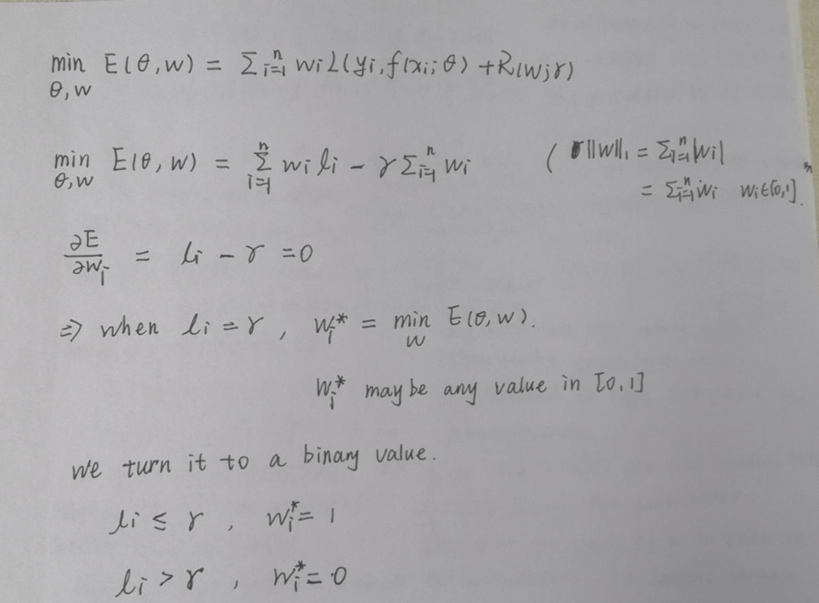

Slide 8




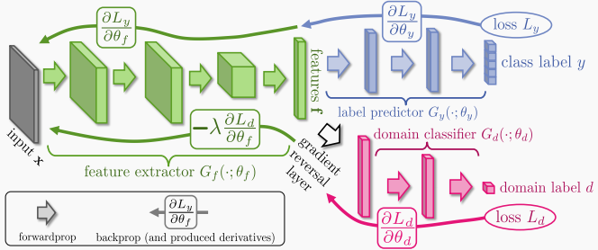

1. Introduction-Adversarial Architecture
Two adversarial models
Feature extractor--- close to ,, so that can't discriminate
Domain discriminator--distinguish f of the source domain from the target domain
counterfeiters
police
feature extractor
label predictor
Result:
extract deep feature very close to
discriminate them with probability of
domain discriminator
The architecture of adversarial learning^{[3]}
our network is based on this
[3] Ganin, Y., and Lempitsky, V. 2015. Unsupervised domain adapta_x0002_tion by backpropagation. In ICML.

Slide 9
Outline
Introduction
1.1 Abtract
1.2 Domain Adaptaion
1.3 Curriculum Learning
1.4 Adversarial Architecture
Model
2.1 Overview
2.2 Learning with Transferable Curriculum
2.3 Constructing the Transferable Curriculum
Experiment
3.1 Evaluate with SOTA
3.2 Ablation Study

Slide 10
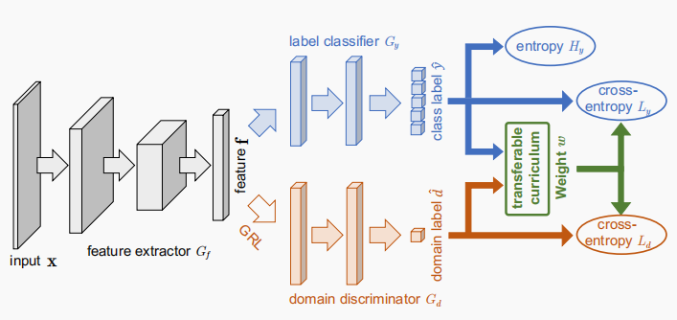
2. Model-Overview
feature extractor
label predictor
The architecture of adversarial learning
Same:
The adversarial architecture
Difference:
Curriculum Learning----Select noiseless and transferable
sources samples for training
Entropy Minimization Principle-----exploit unlabeled
target samples--reduced noise effect
domain classifier
label classifier
feature extractor
The architecture of Trasferable Curriculum Learning (TCL)
domain discriminator

Slide 11
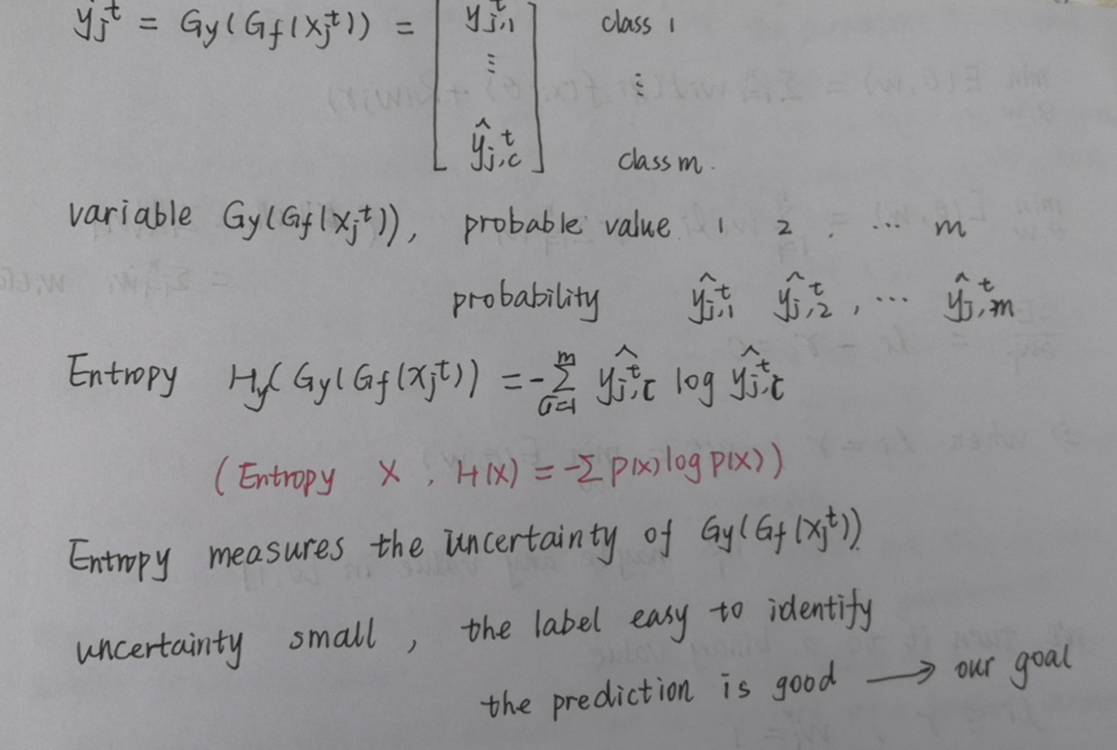

Slide 12

2. Model-Overview
TCL is an alternating optimization framework , two optimization problems:
Learning with a given transferable curriculum
Constructing the desirable tansferable curriculum
Fixed w
find optimal
Fixed
find optimal w
label classifier
feature extractor
domain discriminator

Slide 13
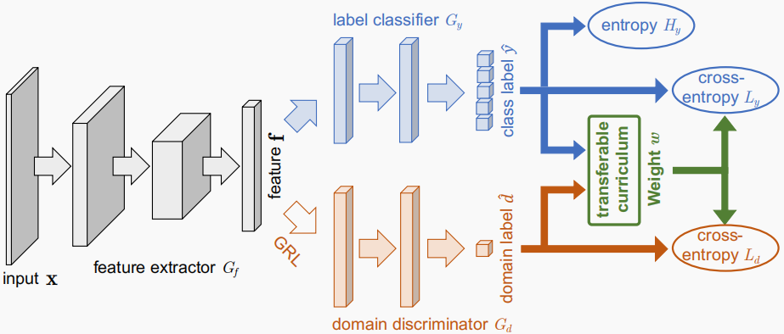
2. Model-Learning with Transferable Curriculum
Fixed w
find optimal
-----Minimize the loss using SGD
source domain
predict its label
input x
predict its domain label
target domain

Slide 14






2. Model-Learning with Transferable Curriculum
Fixed w
labeled
find optimal
-----Minimize the loss using SGD
unlabeled
source sample
target sample

Slide 15
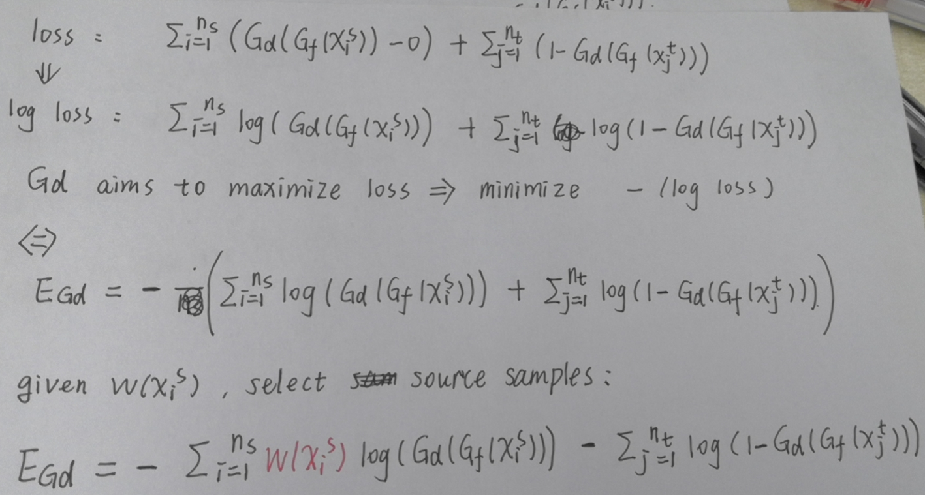

Slide 16


2. Constructing the Transferable Curriculum
Fixed
find optimal w
Goal
Quantify the easiness
Quantify the transferablility
Implement
measure of easiness---the loss of the label classifer
measure of transferability---the similarlity of the source sample to the target domain
tradeoff

Slide 17
2. Constructing the Transferable Curriculum

Slide 18
Outline
Introduction
1.1 Abtract
1.2 Domain Adaptaion
1.3 Curriculum Learning
1.4 Adversarial Architecture
Model
2.1 Overview
2.2 Learning with Transferable Curriculum
2.3 Constructing the Transferable Curriculum
Experiment
3.1 Evaluate with SOTA
3.2 Ablation Study

Slide 19
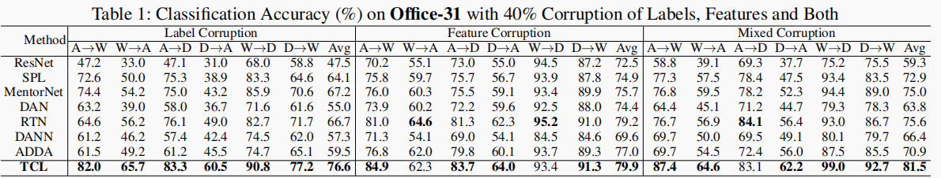
3. Experiment---Evaluate with SOTA
Office-31
Amazon(A)
Webcam(W)
DSLR(D)
Backbone | Deep domain adaptation | Curriculumn Learning | Entropy minimization criterion
ResNet | DAN, DANN, ADDA | SPL, MentorNet | RTN
 | noisy samples | distribution shift | noisy samples, distribution shift

Slide 20
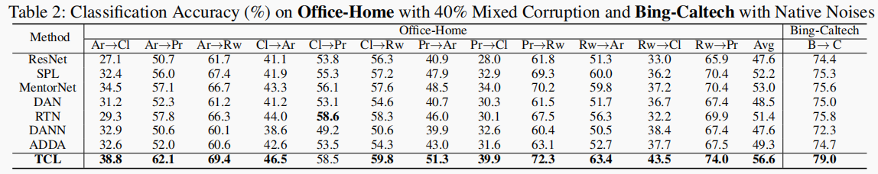
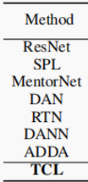
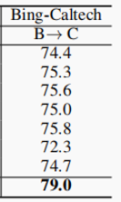
3. Experiment---Evaluate with SOTA
Office-Home
Artistic(Ar)
Clip Art(CI)
Product(Pr)
Real-World(Rw)
real-world dataset: Bing-Caltech

Slide 21
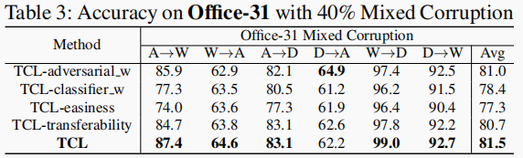
3. Experiment---Ablation Study
Variant
TCL-adversarial_w | removing the curriculum weight w for the source data on the domain discriminator;
TCL-classifier_w | removing the curriculum weight w for the source data on the label classifier
TCL-easiness | removing the easiness term
TCL-transferability | removing the transferability term

Slide 22
Thank you for your attention.
Guanzi Chen
2020/10/27

