Slide 1
Attention Unet
Jingyun Yang
2020/10/06

Slide 2
What is Attention

Slide 3

What is Attention
Attention, in the context of image segmentation, is a way to highlight only the relevant activations during training. Essentially, the network can pay “attention” to certain parts of the image.
Focus All
Focus Parts

Slide 4
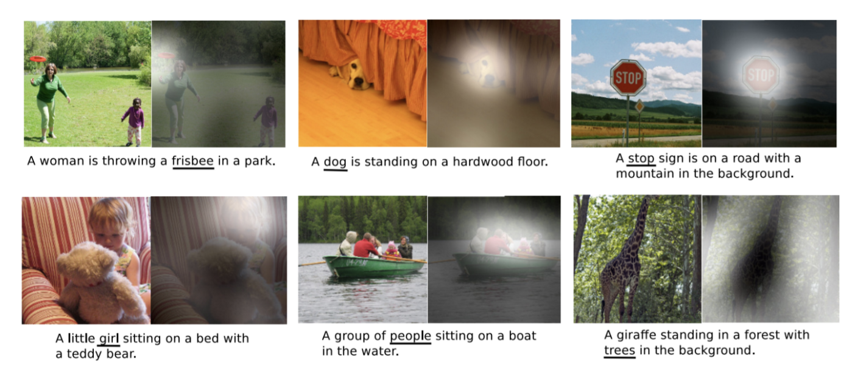
Apply to
Attention models are widespread among multiple areas of deep learning, and the learned weighting schemes can apply to features as diverse as pixels in an image, words in a sentence, nodes in a graph, or even points in a 3D point cloud.

Slide 5
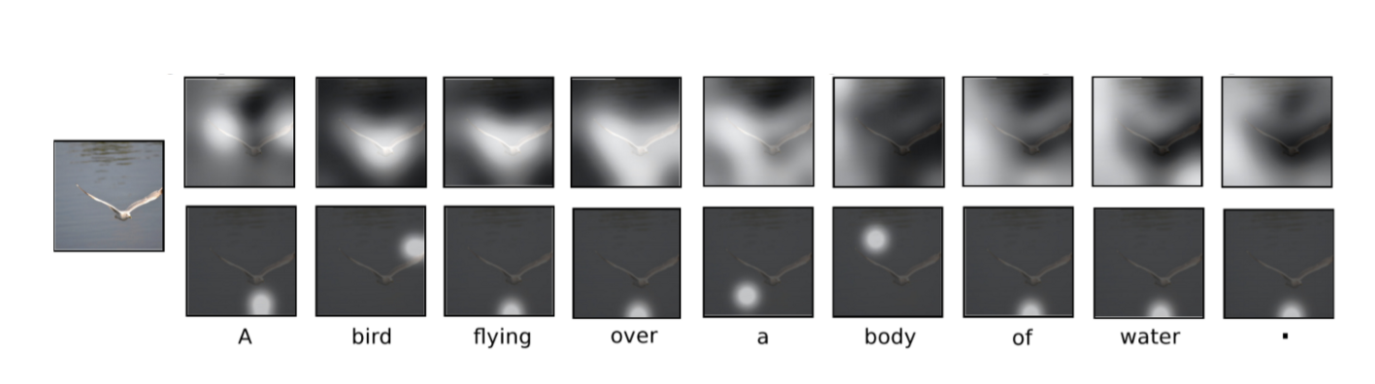
Two forms: Hard & soft
Hard attention works on the basis of highlighting relevant regions by cropping the image or iterative region proposal.
Soft attention works by weighting different parts of the image. Areas of high relevance is multiplied with a larger weight and areas of low relevance is tagged with smaller weights.

Slide 6
Two forms: Hard & soft
Hard attention:
Only picks one patch at a time to pay attention to
Non-differentiable and requires reinforcement learning
Soft attention:
Only Weights are placed on different patches of the image to determine relevance
Differentiable and can be trained with backpropagation
Notes:
1.Since it is non-differentiable, it means that for a given region in an image, the network can either pay “attention” or not, with no in between. As a result, standard backpropagation cannot be done. Considering the accuracy is subject to how well the sampling is done, there is a need for other techniques such as reinforcement learning to make the model effective.
2.it remains differentiable and can be trained with standard backpropagation. As the model is trained, the weighting is also trained such that the model gets better at deciding which parts to pay attention to.

Slide 7
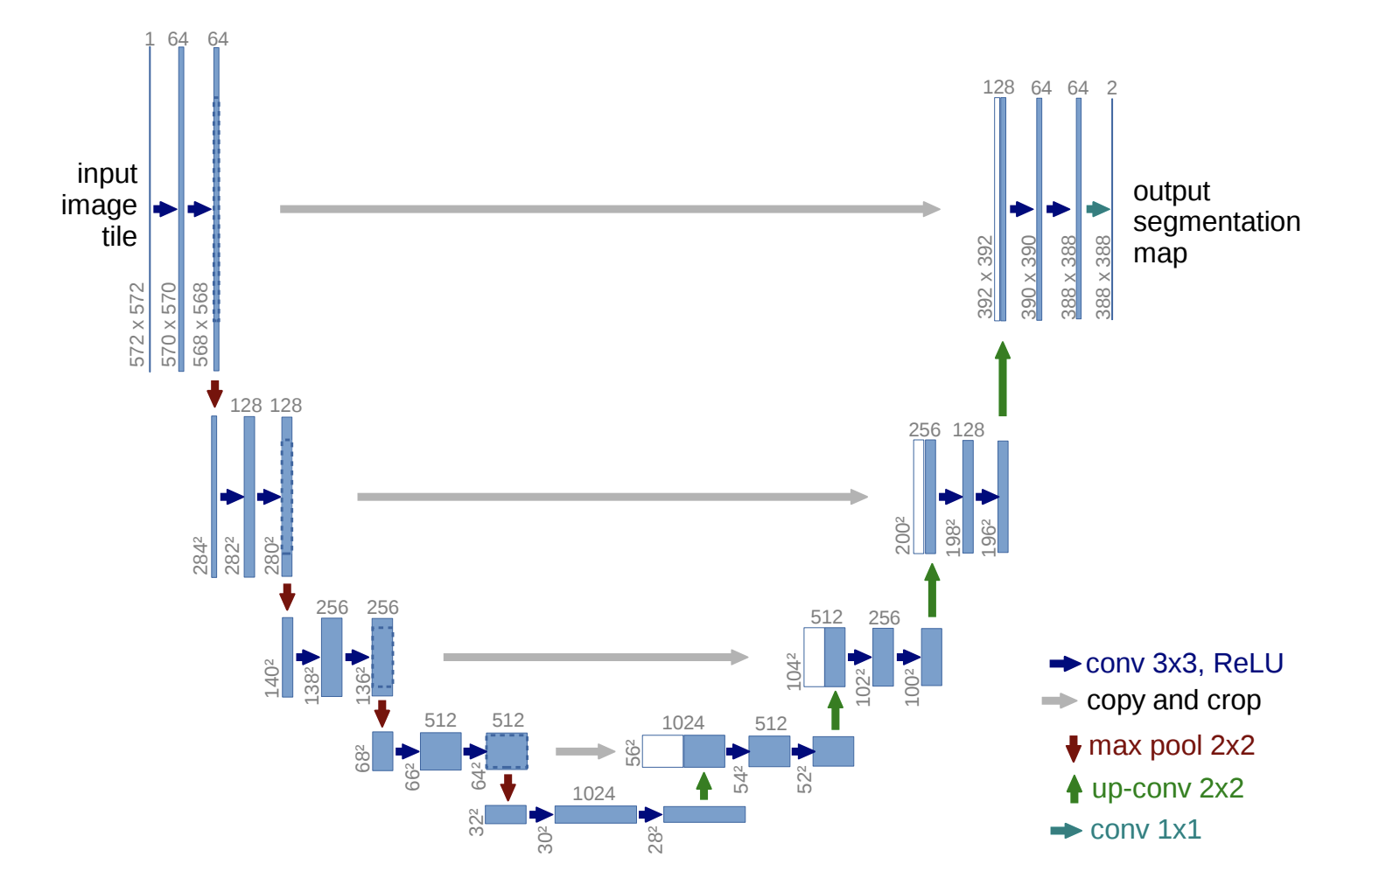
Why is attention needed in U-net
What is Unet
Notes:
The architecture contains two paths. First path is the contraction path (also called as the encoder) which is used to capture the context in the image. The encoder is just a traditional stack of convolutional and max pooling layers. The second path is the symmetric expanding path (also called as the decoder) which is used to enable precise localization using transposed convolutions. Thus it is an end-to-end fully convolutional network (FCN)

Slide 8
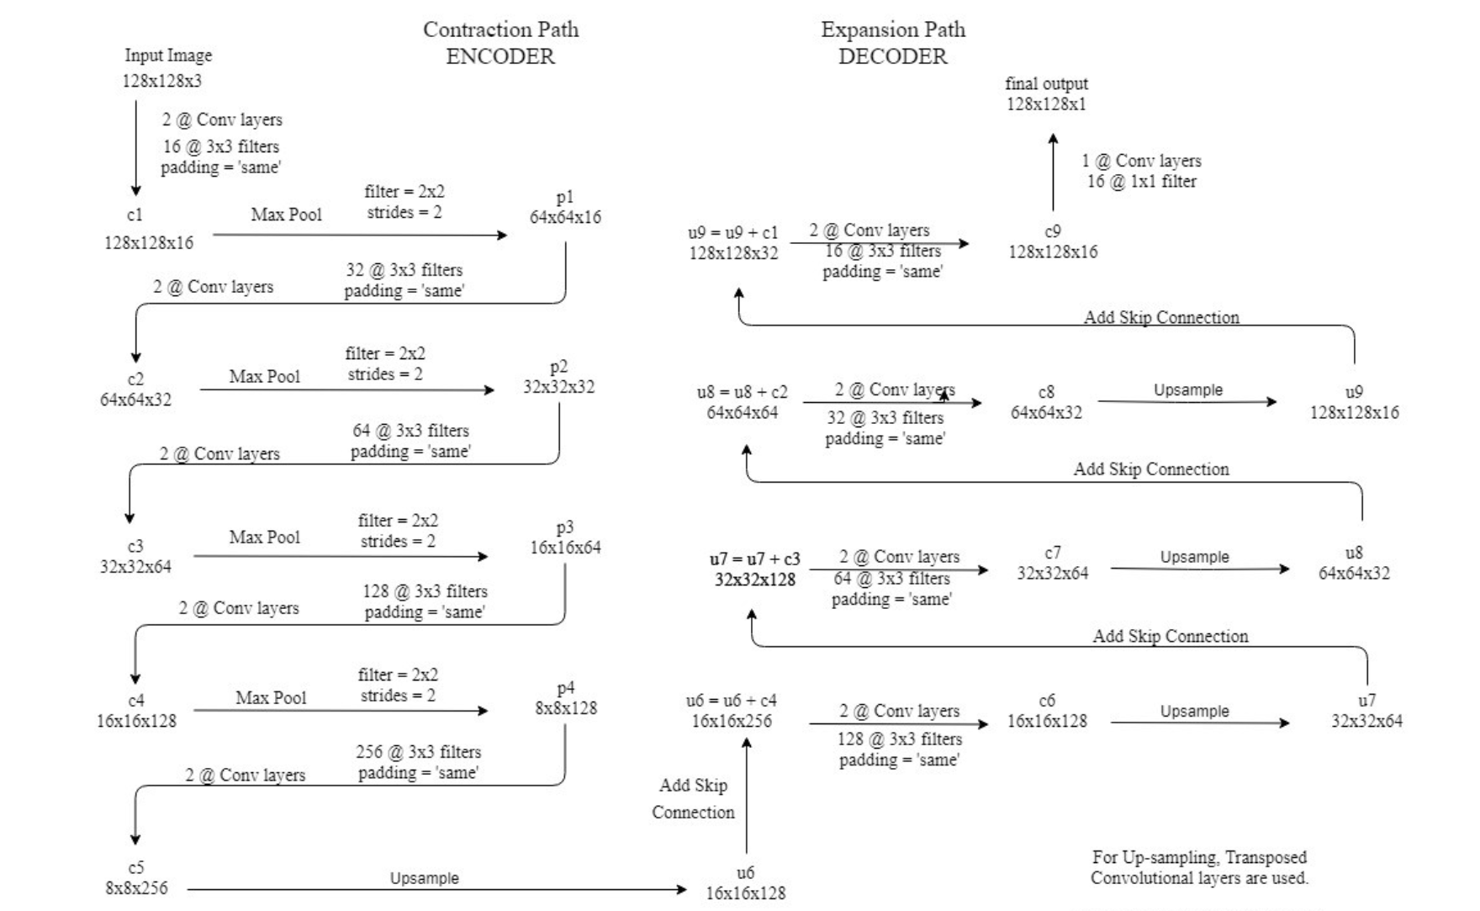
Detailed unet architecture
Notes:
1.2@Conv layers means that two consecutive Convolution Layers are applied
2.c1, c2, …. c9 are the output tensors of Convolutional Layers
p1, p2, p3 and p4 are the output tensors of Max Pooling Layers
u6, u7, u8 and u9 are the output tensors of up-sampling (transposed convolutional) layers
3.The left hand side is the contraction path (Encoder) where we apply regular convolutions and max pooling layers.
4.In the Encoder, the size of the image gradually reduces while the depth gradually increases. Starting from 128x128x3 to 8x8x256
5.This basically means the network learns the “WHAT” information in the image, however it has lost the “WHERE” information
6.The right hand side is the expansion path (Decoder) where we apply transposed convolutions along with regular convolutions
In the decoder, the size of the image gradually increases and the depth gradually decreases. Starting from 8x8x256 to 128x128x1
8.Intuitively, the Decoder recovers the “WHERE” information (precise localization) by gradually applying up-sampling
9.To get better precise locations, at every step of the decoder we use skip connections by concatenating the output of the transposed convolution layers with the feature maps from the Encoder at the same level:
u6 = u6 + c4
10.After every concatenation we again apply two consecutive regular convolutions so that the model can learn to assemble a more precise output
This is what gives the architecture a symmetric U-shape, hence the name UNET
On a high level, we have the following relationship:
Input (128x128x1) => Encoder =>(8x8x256) => Decoder =>Ouput (128x128x1)

Slide 9
Why is attention needed in unet
U-Net uses skip connections that combine spatial information from the downsampling path with the upsampling path. This brings across many redundant low-level feature extractions, as feature representation is poor in the initial layers.
Soft attention implemented at the skip connections will actively suppress activations in irrelevant regions, reducing the number of redundant features brought across.

Slide 10
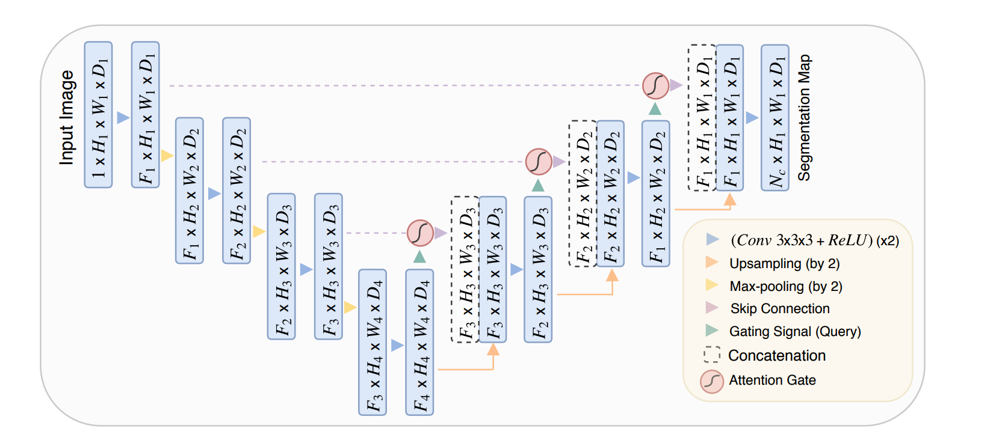
Attention unet

Slide 11
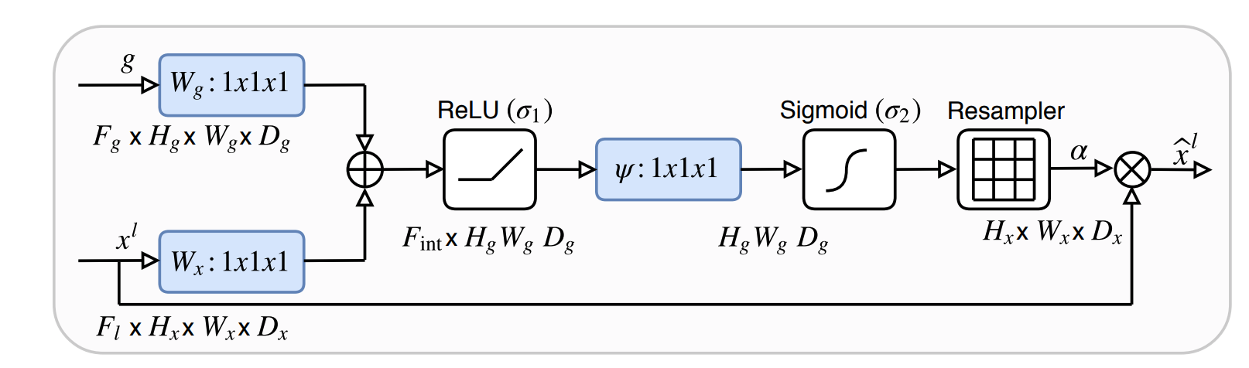
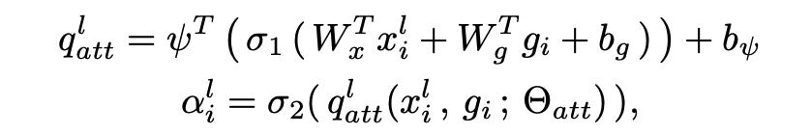
Breakdown of attention gates
Attention gate takes in two input: x and g
The vector, g, is taken from the next lowest layer of the network. The vector has smaller dimensions and better feature representation, given that it comes from deeper into the network.

Slide 12
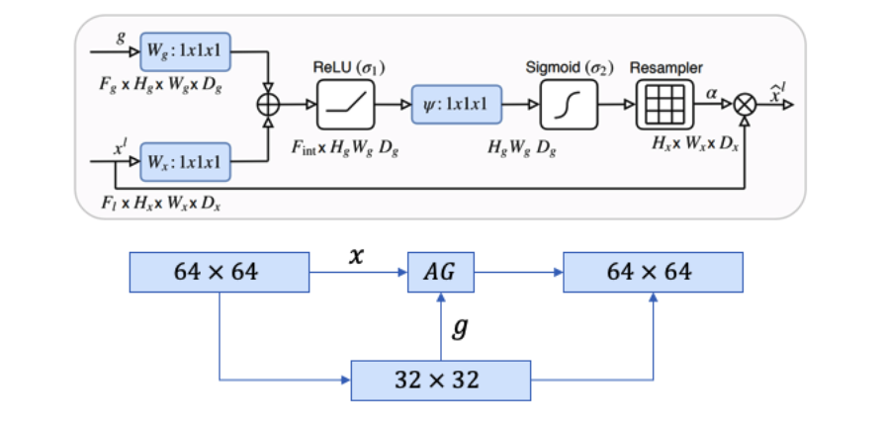
Attention coefficient
Notes:
1.In the example figure above, vector x would have dimensions of 64x64x64 (filters x height x width) and vector g would be 32x32x32.
2.Vector x goes through a strided convolution such that it’s dimensions become 64x32x32 and vector g goes through a 1x1 convolution such that it’s dimensions become 64x32x32.
3.The two vectors are summed element-wise. This process results in aligned weights becoming larger while unaligned weights become relatively smaller.
4.The resultant vector goes through a ReLU activation layer and a 1x1 convolution that collapses the dimensions to 1x32x32.
This vector goes through a sigmoid layer which scales the vector between the range [0,1], producing the attention coefficients (weights), where coefficients closer to 1 indicate more relevant features.
5.The attention coefficients are upsampled to the original dimensions (64x64) of the x vector using trilinear interpolation. The attention coefficients are multiplied element-wise to the original x vector, scaling the vector according to relevance. This is then passed along in the skip connection as normal.

Slide 13
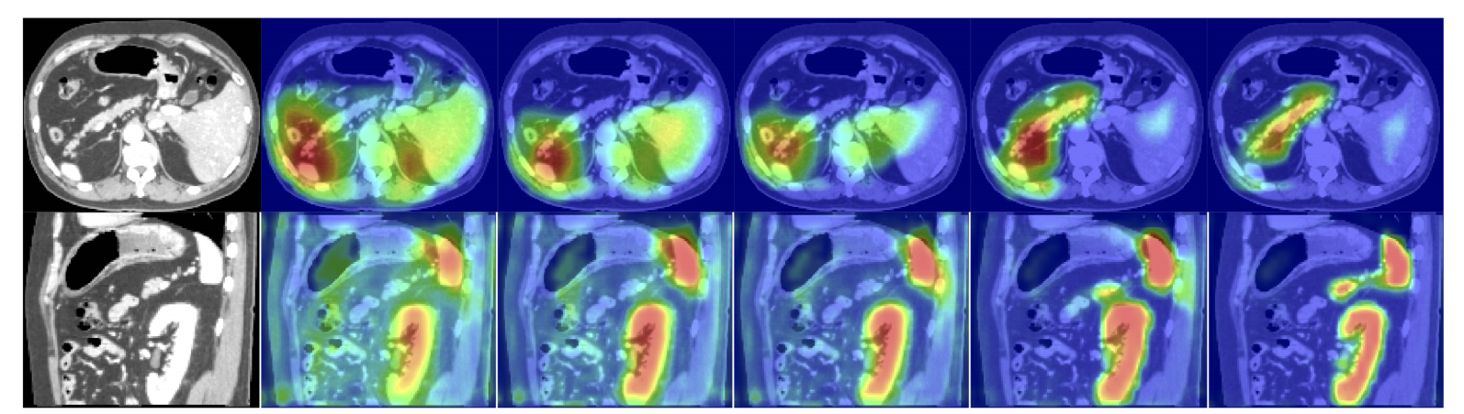
Attention coefficients visualise
The figure shows the attention coefficients across different training epochs (3, 6, 10, 60, 150). The network learns to focus on the desired region as training proceeds. The differentiable nature of the attention gate allows it to be trained during backpropagation, which means the attention coefficients get better at highlighting relevant regions.

Slide 14
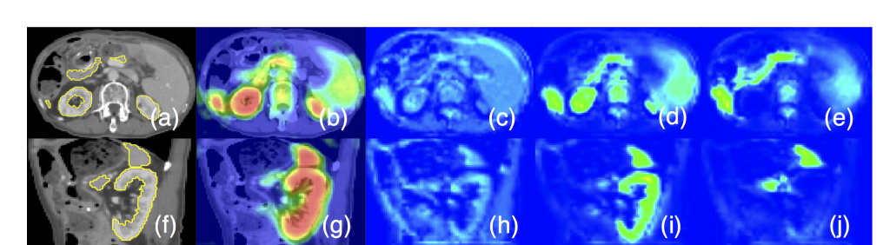
Results
a-e,f-j: Axial and sagittal views of a 3D abdominal CT scan, attention coefficients, feature activations of a skip connection before and after gating. The filtered feature activations (d-e, i-j) are collected from multiple AGs, where a subset of organs is selected by each gate. Activations shown in (d-e, i-j) consistently correspond to specific structures across different scans.

Slide 15
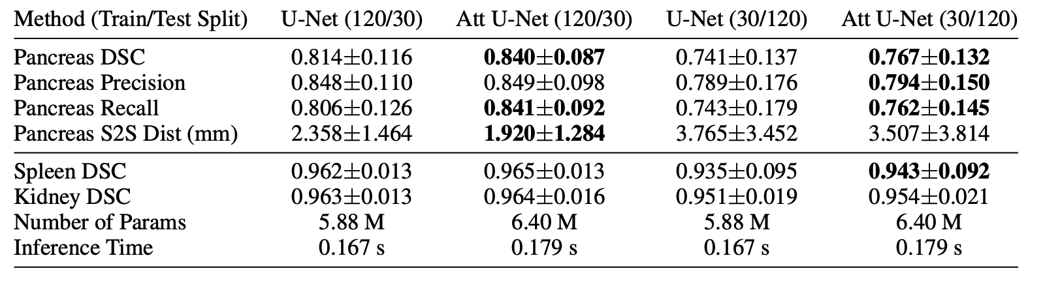
results
Attention U-Net has outperformed a plain U-Net in the overall Dice Coefficient Score by a sizeable margin. While the Attention U-Net has more parameters, it is not significantly more and the inference time is only marginally longer.
Attention gates are a simple way to improve the U-Net consistently in a large variety of datasets without a significant overhead in terms of computational cost.

Slide 16
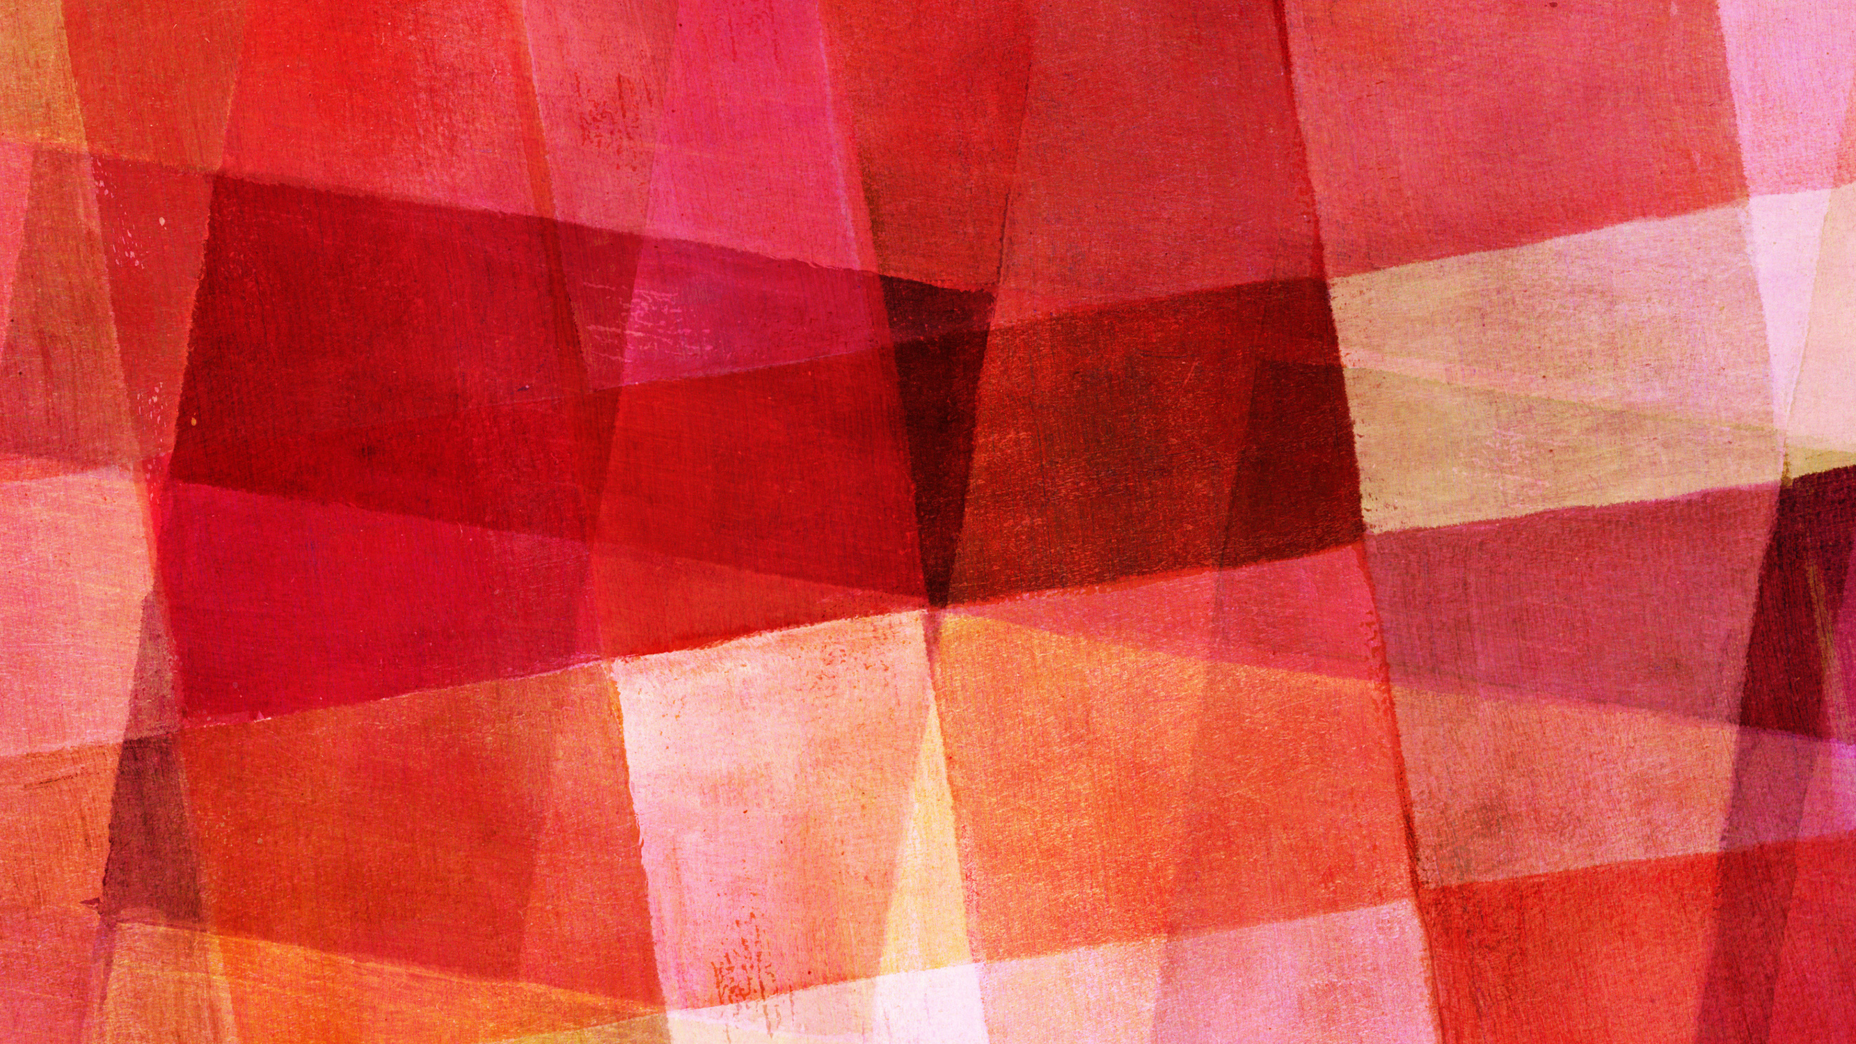
Thanks for listening

