Slide 1


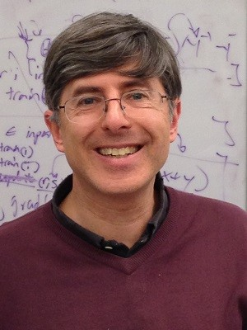

DeepWalk: Online Learning of Social Representations
ACM SIG-KDD
August 26, 2014
Bryan Perozzi, Rami Al-Rfou, Steven Skiena Stony Brook University

Slide 2
Outline
Introduction: Graphs as Features
Language Modeling
DeepWalk
Evaluation: Network Classification
Conclusions

Slide 3
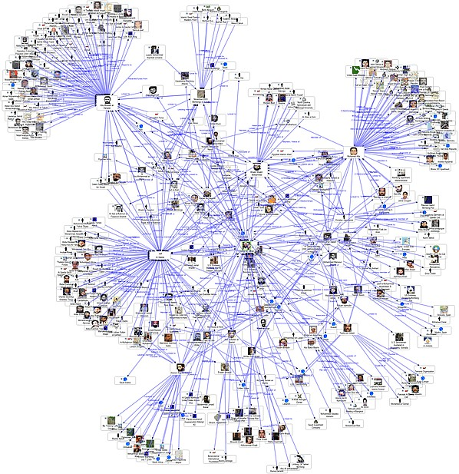
Features From Graphs
A first step in machine learning for graphs is to extract graph features:
node: degree
pairs: # of common neighbors
groups: cluster assignments
  Anomaly Detection
  Attribute Prediction
  Clustering
  Link Prediction
  ...
Adjacency Matrix
|V|

Slide 4
What is a Graph Representation?
We can also create features by transforming the graph into a lower dimensional latent representation.
Latent Dimensions
Anomaly Detection
Attribute Prediction
Clustering
Link Prediction
...
Adjacency Matrix
|V|
d << |V|
Notes:
Another way of creating features in the latent way

Slide 5
DeepWalk
DeepWalk learns a latent representation of adjacency matrices using deep learning techniques developed for language modeling.
Latent Dimensions
Adjacency Matrix
Anomaly Detection
Attribute Prediction
Clustering
Link Prediction
...
DeepWalk
|V|
d << |V|
Notes:
What we are going to talk about today is really LEARN latent representation… Does anyone know about it?
Instead of mixing the label space as part of the feature space, this is an unsupervised method which learns features that capture the graph structure independent of the labels' distribution.

Slide 6
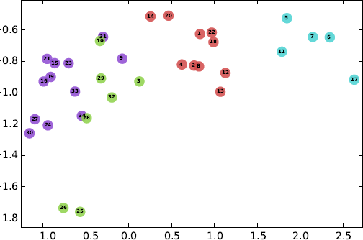
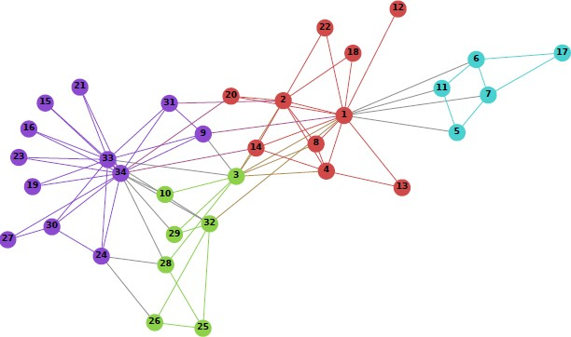
Visual Example
On Zachary’s Karate Graph:
Input
Output
Notes:
This is a social network of a university karate club, described in a paper and later became a popular example of community structure in networks

Slide 7
Advantages of DeepWalk
Scalable - An online algorithm that does not use entire graph at once
Walks as sentences metaphor
Works great!
Implementation available: bit.ly/deepwalk
Latent Dimensions
Adjacency Matrix
Anomaly Detection
Attribute Prediction
Clustering
Link Prediction
...
DeepWalk
|V|
d << |V|

Slide 8
Outline
Introduction: Graphs as Features
Language Modeling
DeepWalk
Evaluation: Network Classification
Conclusions
Notes:
So what is language modeling and why we care about it?

Slide 9
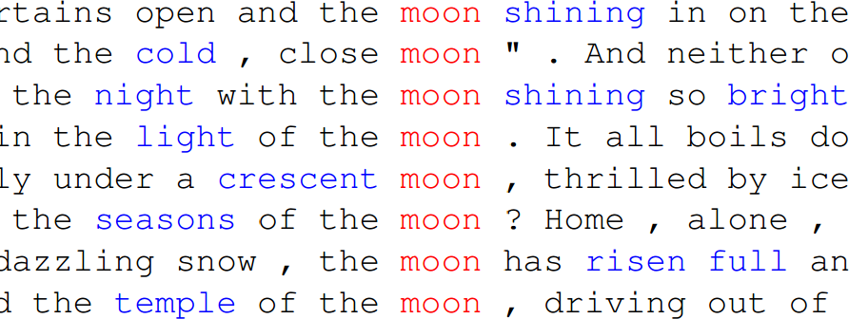

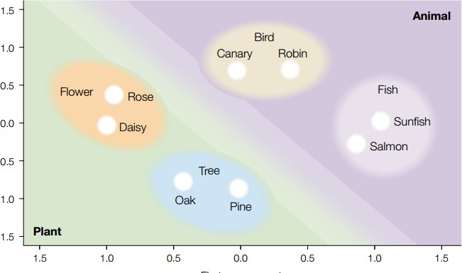
Language Modeling
Learning a representation
means learning a mapping function from word co- occurrence
[Baroni et al, 2009]
We hope that the learned representations capture inherent structure
[Rumelhart+, 2003]
Notes:
We usually do this within a window around the word, counting near words to find the correlations

Slide 10
World of Word Embeddings
This is a very active research topic in NLP.
Importance sampling and hierarchical classification were proposed to speed up training. [F. Morin and Y.Bengio, AISTATS 2005] [Y. Bengio and J. Sencal, IEEENN 2008] [A. Mnih, G. Hinton, NIPS 2008]
NLP applications based on learned representations. [Colbert et al. NLP (Almost) from Scratch, (JMLR), 2011.]
Recurrent networks were proposed to learn sequential representations. [Tomas Mikolov et al. ICASSP 2011]
Composed representations learned through recursive networks were used for parsing, paraphrase detection, and sentiment analysis.
[ R. Socher, C. Manning, A. Ng, EMNLP (2011, 2012, 2013) NIPS (2011, 2012) ACL (2012,
2013) ]
Vector spaces of representations are developed to simplify compositionality. [ T. Mikolov, G. Corrado, K. Chen and J. Dean, ICLR 2013, NIPS 2013]

Slide 11
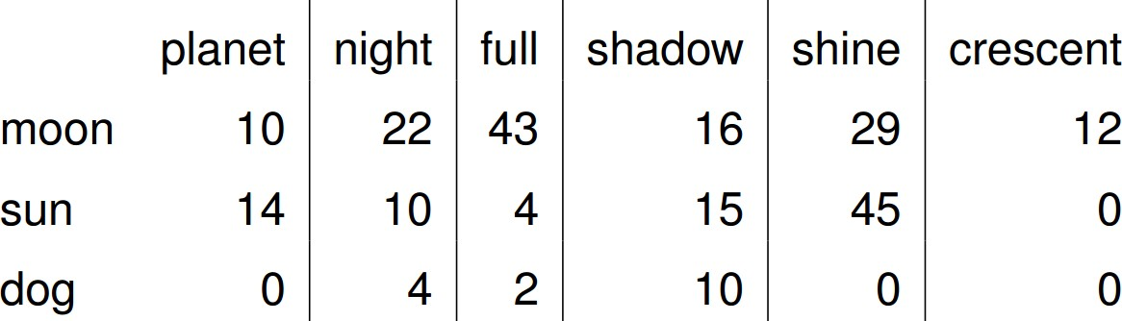
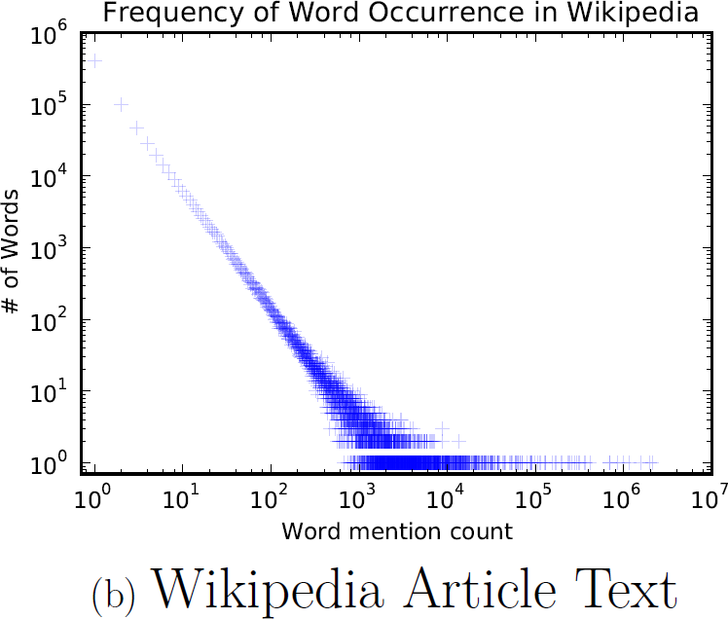
Word Frequency in Natural Language
Co-Occurrence Matrix
Words frequency in a natural language corpus follows a power law.

Slide 12
Connection: Power Laws
Vertex frequency in random walks on scale free graphs also follows a power law.
Notes:
one quantity varies as a power of another.

Slide 13
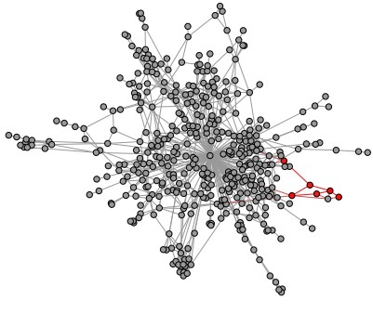
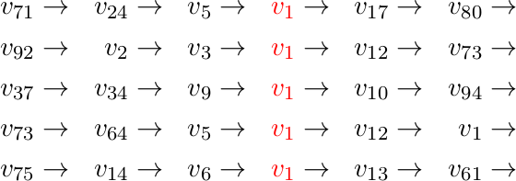
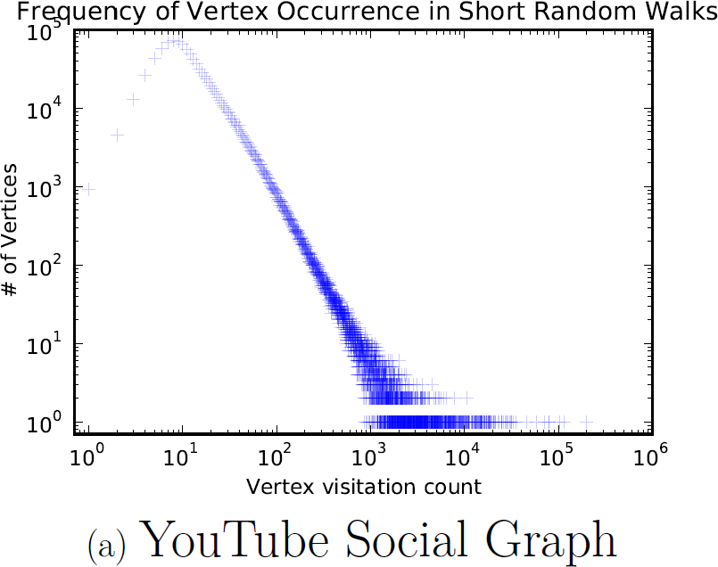
Vertex Frequency in SFG
Scale Free Graph
Short truncated random walks are sentences in an artificial language!
Random walk distance is known to be good features for many problems

Slide 14
The Cool Idea
Short random walks = sentences

Slide 15
Outline
Introduction: Graphs as Features
Language Modeling
DeepWalk
Evaluation: Network Classification
Conclusions
Notes:
So how does deepwalk work?

Slide 16
What do we want?
Adaptability - new social relations should not require repeating the learning process all over again.
Community aware - allows generalization in networks with homophily.
Low dimensional - generalize better when lack of labeled data, and speed up convergence and inference.
Continuous – lead to smooth decision boundaries between communities which allows more robust classification.
Notes:
1 Real social networks are constantly evolving..
2 The distance between latent dimensions should represent a metric for evaluating social similarity between the corresponding members of the network..
4 We require latent representations to model partial community membership in continuous space. continuous representation has

Slide 17
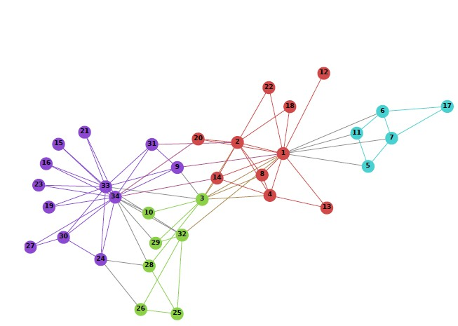
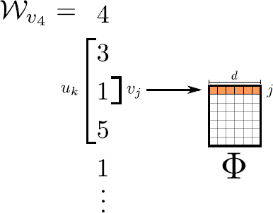
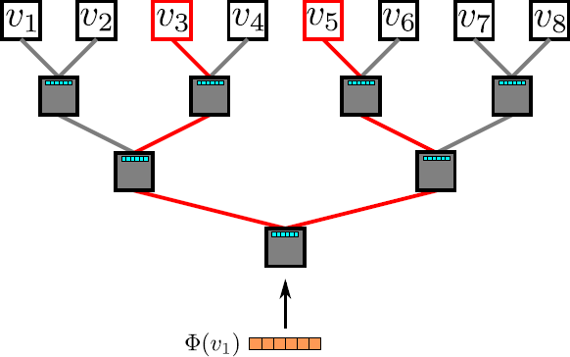
Deep Learning for Networks
2
Random Walks
1
Input: Graph
3 Representation Mapping
4
Hierarchical Softmax
5
Output: Representation

Slide 18
Deep Learning for Networks
2
Random Walks
1 Input: Graph 3 Representation Mapping
4
Hierarchical Softmax
5
Output: Representation
Notes:
So dive into it

Slide 19

Random Walks
We generate random walks for each vertex in the graph.
Each short random walk has length .
Pick the next step uniformly from the vertex neighbors.
Example:

Slide 20
Deep Learning for Networks
2
Random Walks
1
Input: Graph
3 Representation Mapping
4 Hierarchical Softmax
5
Output: Representation

Slide 21





Representation Mapping
Map the vertex under focus ( ) to its representation.
Define a window of size
If = 1 and =
Maximize:

Slide 22
Representation Mapping
Optimization problem:
Vertices which have similar neighborhoods
will acquire similar, and allowing generalization on machine learning tasks.

Slide 23
Deep Learning for Networks
2
Random Walks
1
Input: Graph
3 Representation Mapping
4 Hierarchical Softmax
5
Output: Representation

Slide 24




Hierarchical Softmax
Calculating involves O(V) operations for each update! Instead:
Consider the graph vertices as leaves of a balanced binary tree.
Maximizing
is equivalent to maximizing the probability of the path from the root to the node. specifically, maximizing
C₃
C
2
C₁
Each of {C_{1,} C_{2,} C₃} is a logistic binary classifier.
Notes:
It turns out that is expensive because you won’t want to go over all nodes every pass
So use skipgram as a relaxation, to approximate the possibility

Slide 25
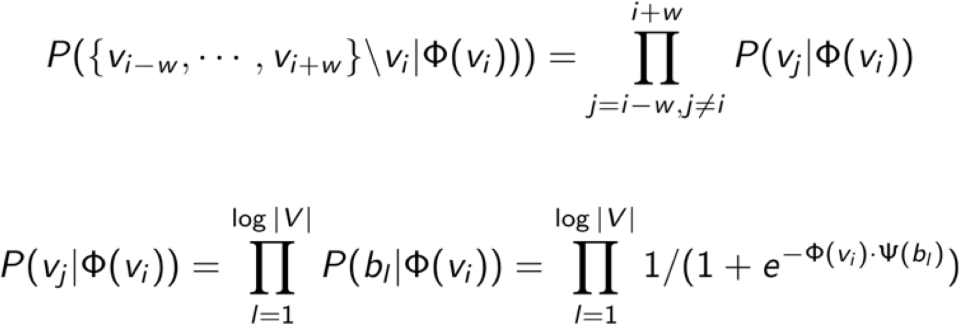
Hierarchical Softmax
Calculating involves O(V) operations for each update! Instead:
Consider the graph vertices as leaves of a balanced binary tree.
Time complexity: O(|V|) -> O(log |V|)
C₃
C
2
C₁
Notes:
So more academically,

Slide 26
Learning
[Mikolov+, 2013]
Learned parameters:
  Vertex representations
  Tree binary classifiers weights
Randomly initialize the representations.
For each {C_{1,} C_{2,} C₃} calculate the loss function.

Slide 27
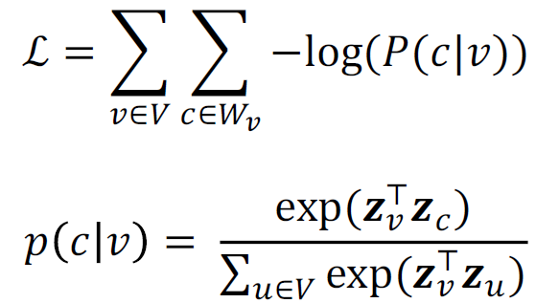
Learning
[Mikolov+, 2013]
Use Stochastic Gradient Descent to update both the classifier weights and the vertex representation simultaneously.

Slide 28
Deep Learning for Networks
2
Random Walks
1
Input: Graph
3 Representation Mapping
4 Hierarchical Softmax
5
Output: Representation

Slide 29
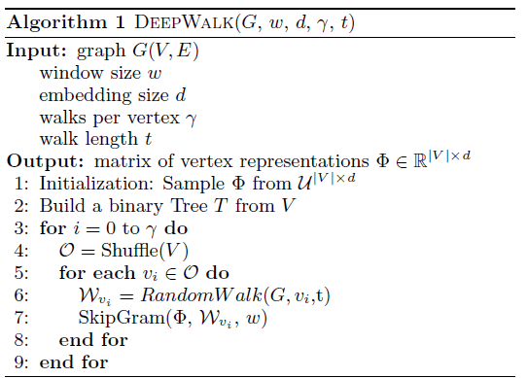
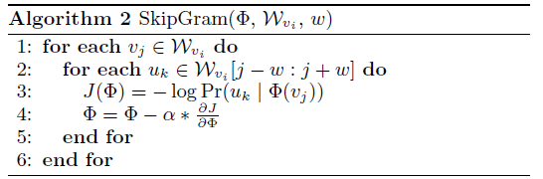
Algorithm Detail
Notes:
Shuffle: random order to travers the vertices. Not required Well-known to speed up SGD

Slide 30
Outline
Introduction: Graphs as Features
Language Modeling
DeepWalk
Evaluation: Network Classification
Conclusions

Slide 31

Attribute Prediction
The Semi-Supervised Network Classification
problem:
Stony Brook students
Googlers
1
4
6
INPUT
A partially labelled graph with node attributes.
5
2
3
OUTPUT
Attributes for nodes which do not have them.
Bryan Perozzi
DeepWalk: Online Learning of Social R
epresentations
Notes:
The labels are usually groups or topic categories in social networks

Slide 32
Baselines
Approximate Inference Techniques:
  weighted vote Relational Neighbor (wvRN)[Macskassy+, ‘03]
Latent Dimensions
  Spectral Methods
    SpectralClustering [Tang+, ‘11]
    MaxModularity [Tang+, ‘09]
  k-means
    EdgeCluster [Tang+, ‘09]
Bryan Perozzi
DeepWalk: Online Learning of Social Representations

Slide 33
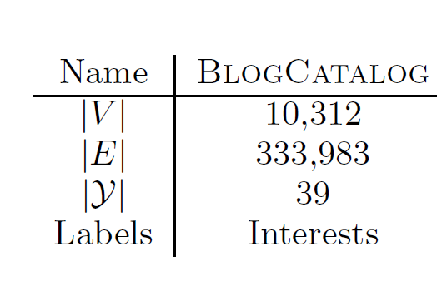
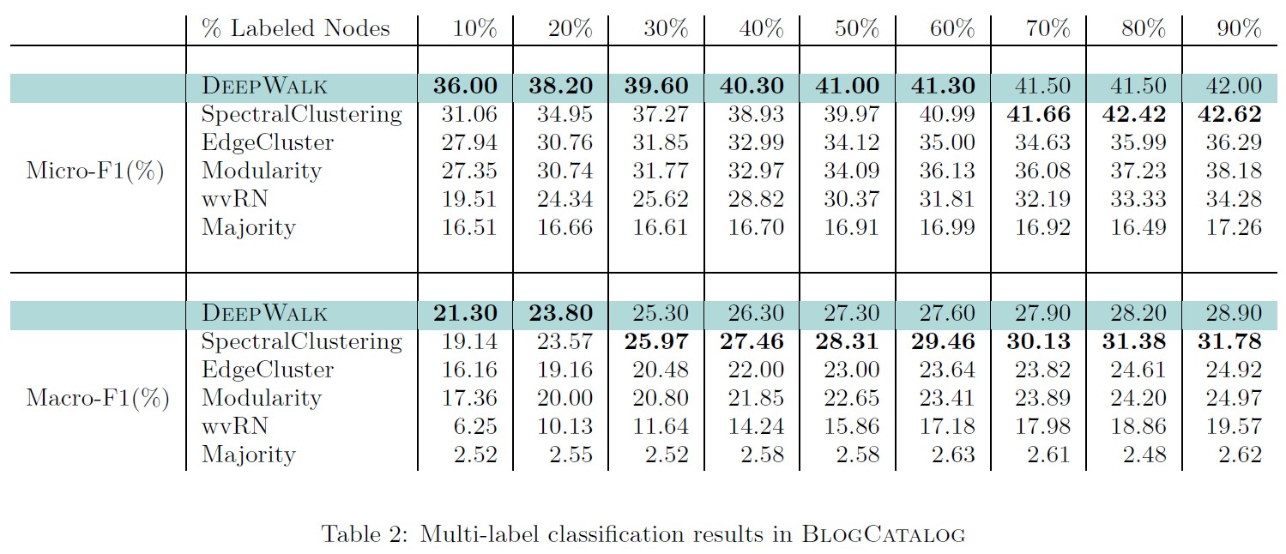
Results: BlogCatalog
DeepWalk performs well, especially when labels are sparse.
Notes:
Randomly sample a portion (TR) of the labeled nodes, and use them as training data. repeat this process 10 times, and report the average performance in terms of both Macro-F1 and Micro-F1.
Numbers in bold represent the highest performance in each column.

Slide 34
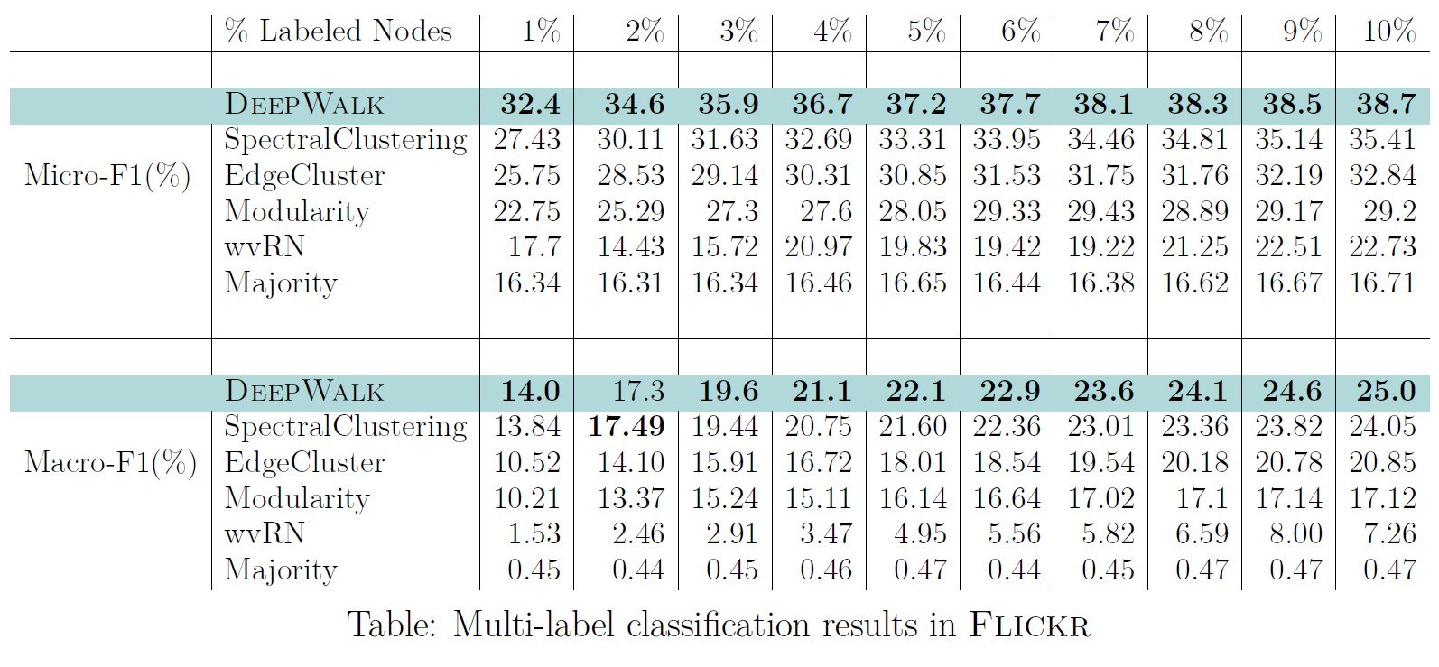
Results: Flickr
Notes:
network of the contacts between users of the photo sharing website. The labels represent the interest groups of the users such as `black and white photos'.

Slide 35
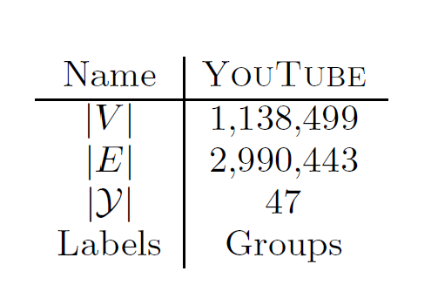
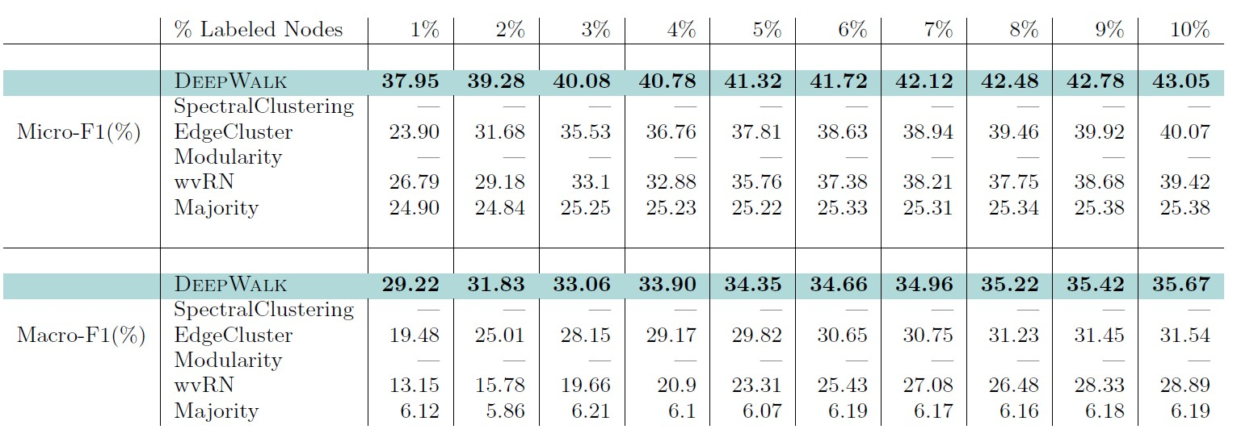
Results: YouTube
Spectral Methods do not scale to large graphs.
Notes:
The graph is larger!

Slide 36
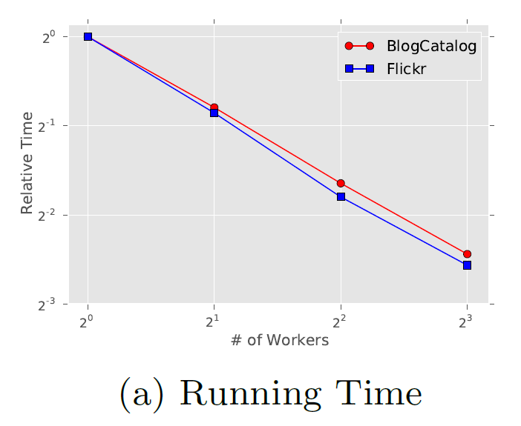
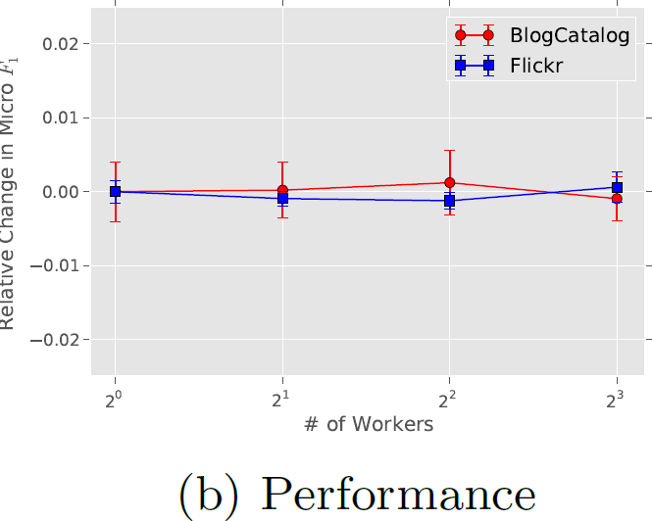
Parallelization
Parallelization doesn’t affect representation quality.
The sparser the graph, the easier to achieve linear scalability. (Feng+, NIPS ‘11)

Slide 37
Outline
Introduction: Graphs as Features
Language Modeling
DeepWalk
Evaluation: Network Classification
Conclusions

Slide 38
Conclusions
Works well
  on multilabel classification tasks
  sometimes even when given less data
Streaming
  No need to ever store entire graph
  Can build & update representation as new data comes in.
Parallelizable
  updates different parts of the model concurrently.
Notes:
learn our latent social representations, instead of computing statistics related to centrality or partitioning

Slide 39
Take-away
Language Modeling techniques can be used for online learning of network representations.

Slide 40
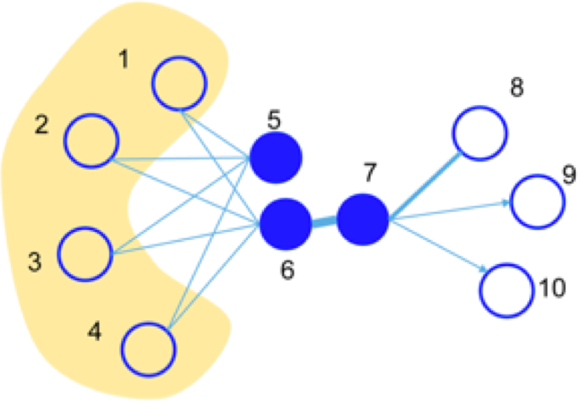
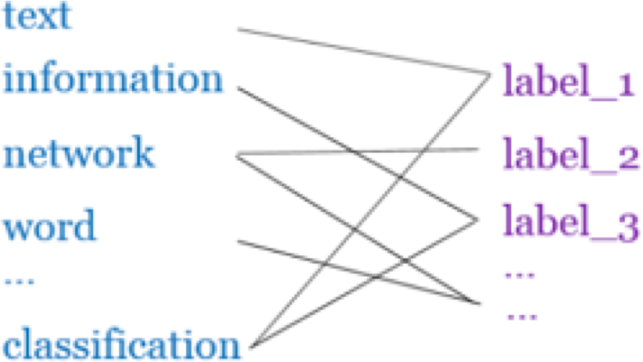
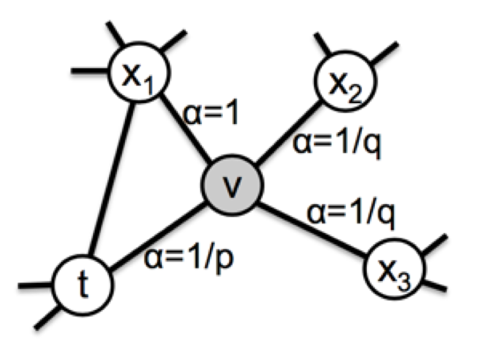
Later…
LINE^{[1]}: explicitly preserves both first-order
and second-order proximities.
PTE^{[2]}: learn heterogeneous text network embedding via a semi-supervised manner.
Node2vec^{[3]}: use a biased random walk to better explore node’s neighborhood.
Metapath2vec^{[4]}: meta-path-based random walks for heterogeneous networks.
GATNE^{[5]}: inductive learning for hetero- geneous networks.
J. Tang, M. Qu, M. Wang, M. Zhang, J. Yan, and Q. Mei. 2015. Line: Large-scale information network embedding. WWW’15, 1067–1077.
J. Tang, M. Qu, and Q. Mei. 2015. Pte: Predictive text embedding through large-scale heterogeneous text networks. KDD’15, 1165–1174.
A. Grover and J. Leskovec. 2016. node2vec: Scalable feature learning for networks. KDD’16, 855–864.
Y. Dong, C. V. Nitesh and S. Ananthram. 2017. metapath2vec: Scalable Representation Learning for Heterogeneous Networks. KDD’14.
Y. Cen, X. Zou, J. Zhang, H. Yang, J. Zhou, and J. Tang. Representation Learning for Attributed Multiplex Heterogeneous Network. KDD’19.

Slide 41
Thanks!
Bryan Perozzi @phanein
bperozzi@cs.stonybrook.edu
DeepWalk available at: http://bit.ly/deepwalk
Presenter: Wanda Li
Notes:
Yes, this version only works for undirected and unweighted graphs. However, it is not very hard to extend DeepWalk to directed and weighted graphs.

