Slide 1

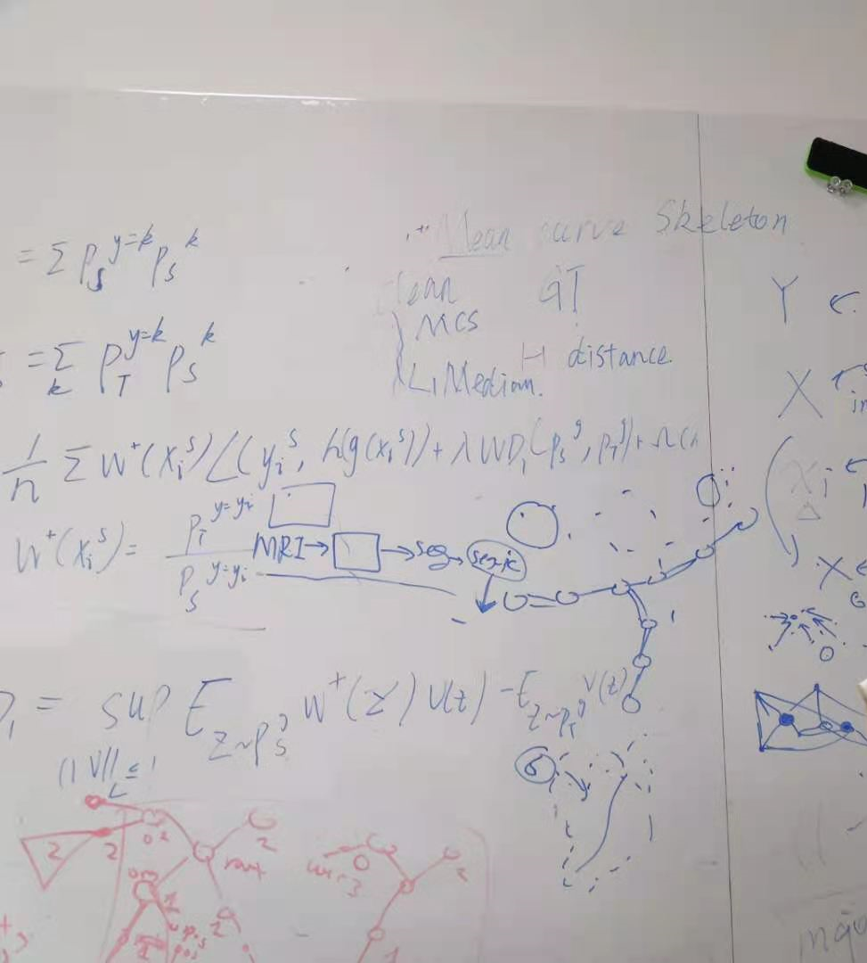
Goal
用skeleton协助进行半监督动脉血管分割

Slide 2
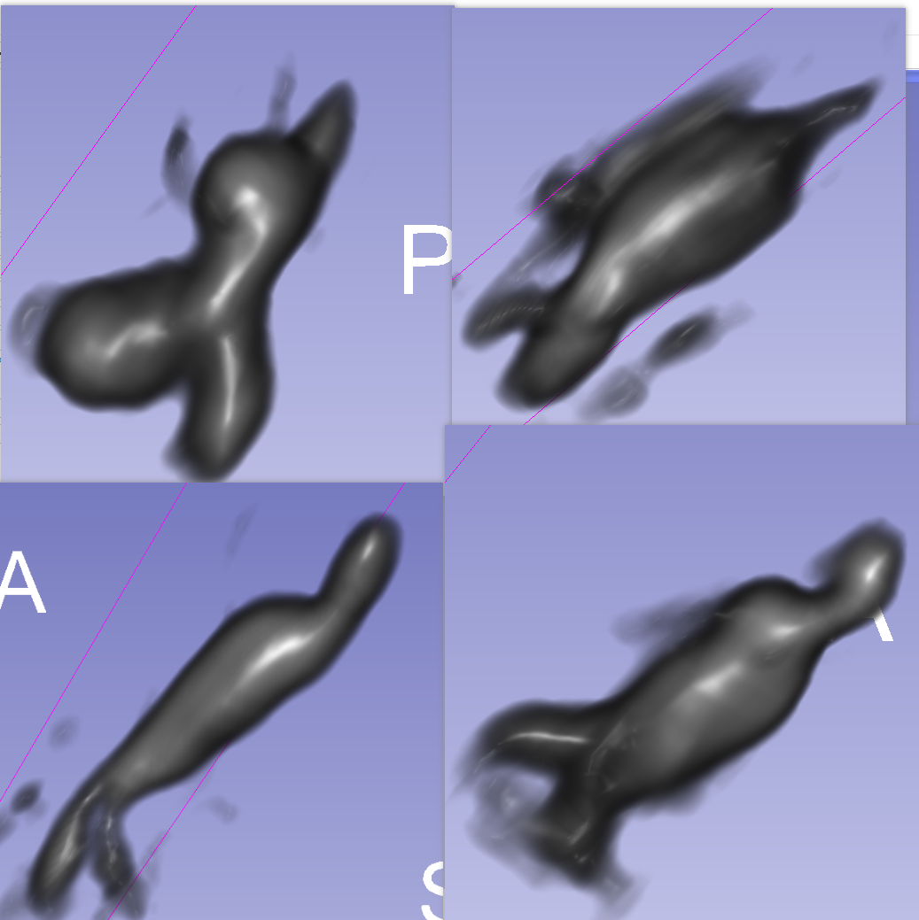
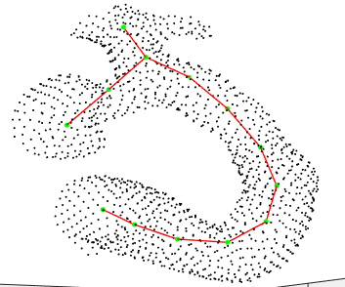
Overview
Using skeleton to help medical segmentation
Evaluation Datasets
  AAA (abdominal aortic aneurysm)
    MRI volume data + a few manual labeled segmentation masks
  CTA (coronary computed tomography angiography)
    Tomography volume data + manually labeled centerlines
3D volume
Notes:
abdominal aortic aneurysm数据集

Slide 3


Overview
Evaluation Datasets
  AAA (abdominal aortic aneurysm)
    MRI volume data + a few manual labeled segmentation masks
  CTA (coronary computed tomography angiography)
    Tomography volume data + manually labeled centerlines
Using skeleton to help blood vessel segmentation
mass skeleton extraction
“skeleton energy”
3D UNet
3D volume
Pred
mask
supervised loss
Progress so far
  Basic segmentation network
  Mass skeleton implementation
  CTA data processing
True
mask
Notes:
abdominal aortic aneurysm数据集

Slide 4
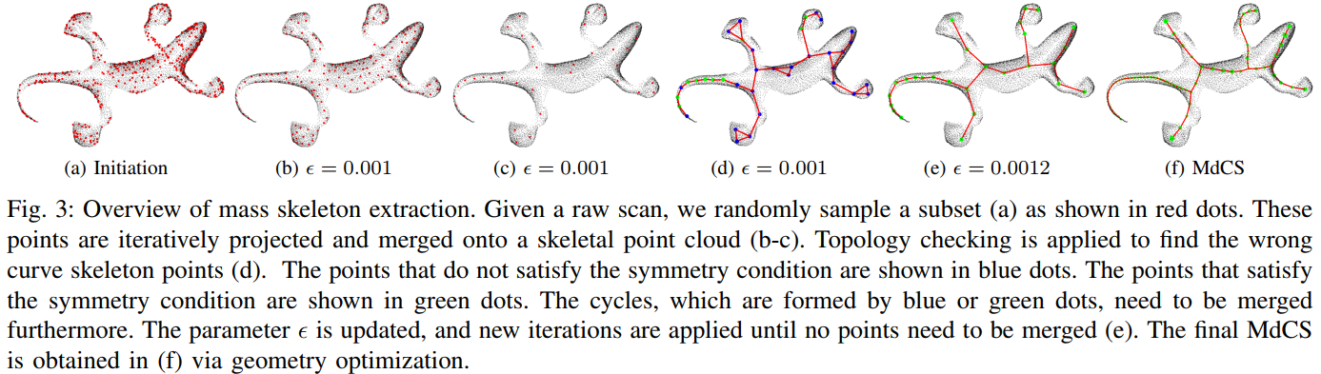
最优传输从点云中提取skeleton
Topology extraction
Topology checking
Geometry optimization
Qin et.al. Mass-driven Topology-aware Curve Skeleton Extraction from Incomplete Point Clouds, 2020
Notes:
14.This is the overview of skeleton extraction. The main algorithm can be viewed as three phases. T
he first three correspond to topology extraction.
Specifically, (a), Given a raw scan, randomly sample a subset as initial skeleton. Through the optimal transport process, these points are iteratively projected and merged onto a skeleton points.
(d) and (e) represent the topology checking, it is to check the symmetric of the skeleton, and merge the incorrect cycles.
The last one is geometry optimization, to obtain a smooth skeleton.

Slide 5
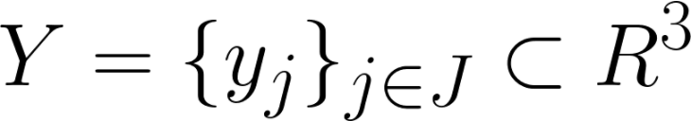

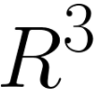
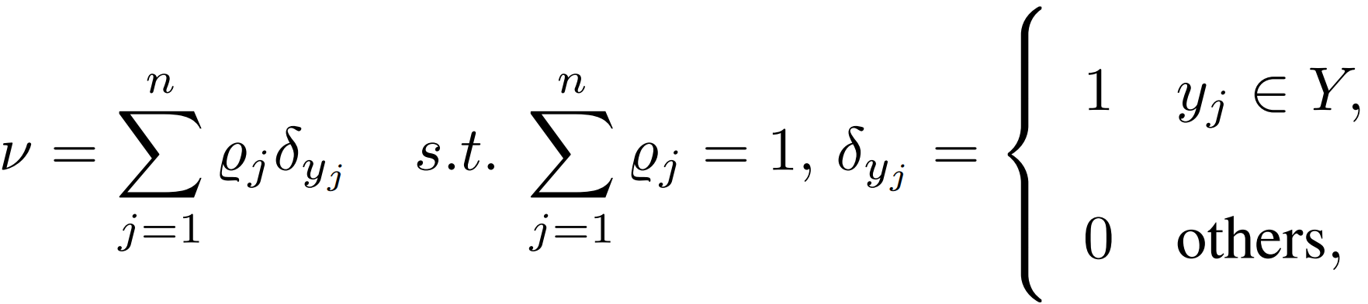
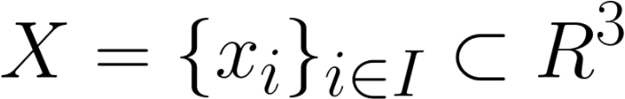

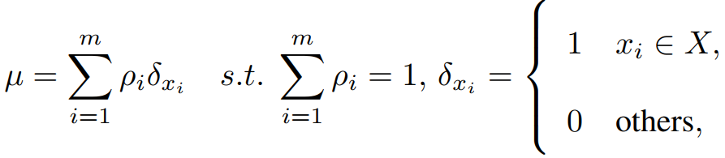

Topology extraction
An unorganized set of points represents a discrete probability measure in
An 1D curve skeleton point set represents another discrete probability measure
Goal: find a few points X in line-like structure with optimal probability measure , to capture the probability measure of input point clouds well.
Output: a MdCS, which is a 1D curve skeleton with mass distribution
and topology connection
optimal transportation
Notes:
15.Then i introduce the topology extraction part.
To extract the curve skeleton is to find a 1D structure to effectively represent the input shape.
The input is a set of points, we give each point a weight, then the input point cloud can be viewed as a discrete probability measure,
and similarily, the 1D curve skeleton can be view as another discrete probability measure,
then our goal can be seen as to find probability measure, to capture input probability measure well,
with optimal X and weights and X in line-like structure.
To match the two distribution, optimal transportation is applied.

Slide 6
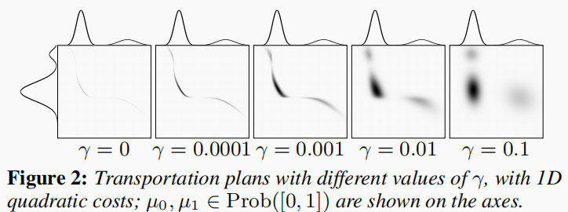
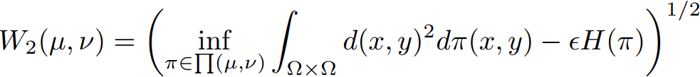

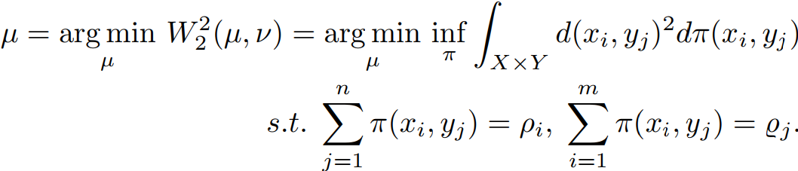

Topology extraction
Further, An entropic regularization term is introduced expand the transport range, to reduce the impact of heavy noise and outlier of point clouds.
The regularized Wasserstein distance:
the optimal transport plan and updated set of points can be obtained by the optimization problem:
Notes:
16.Further, the transportation plan get from the above p-Wasserstein distance is sensitive to the heavy noise and outlier,
an entropic regularization term is introduced to smooth the joint probability, to reduce the impact.
The regularized Wasserstein distance is in this form, we use the 2- Wasserstein and add this term, is the entropic of joint distribution
As this picture shows, adding the entropic regularization term, the transport plan become more smooth. (e is gamma)
Thus an optimal transport plan and updated set of points can be obtained by the optimization problem,
that is minimize the regularized Wasserstein distance.

Slide 7
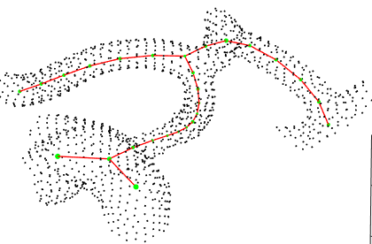
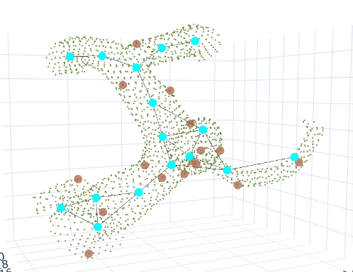

Slide 8
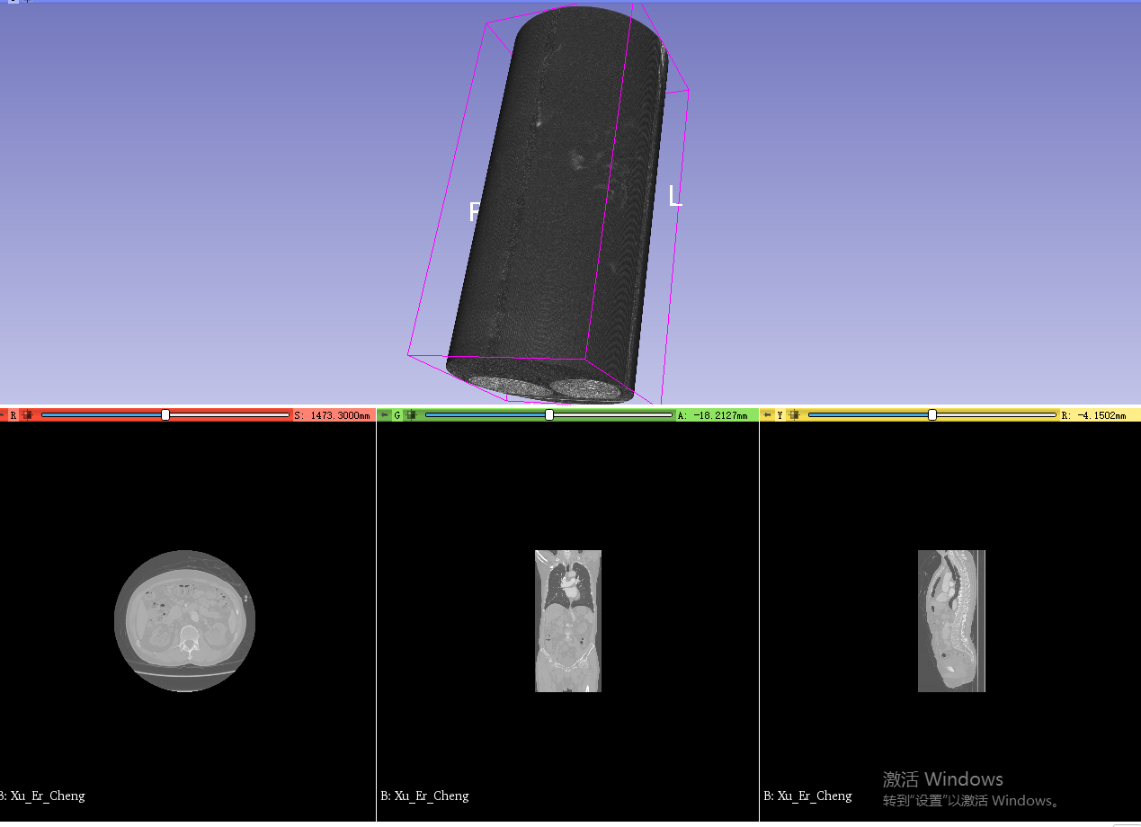
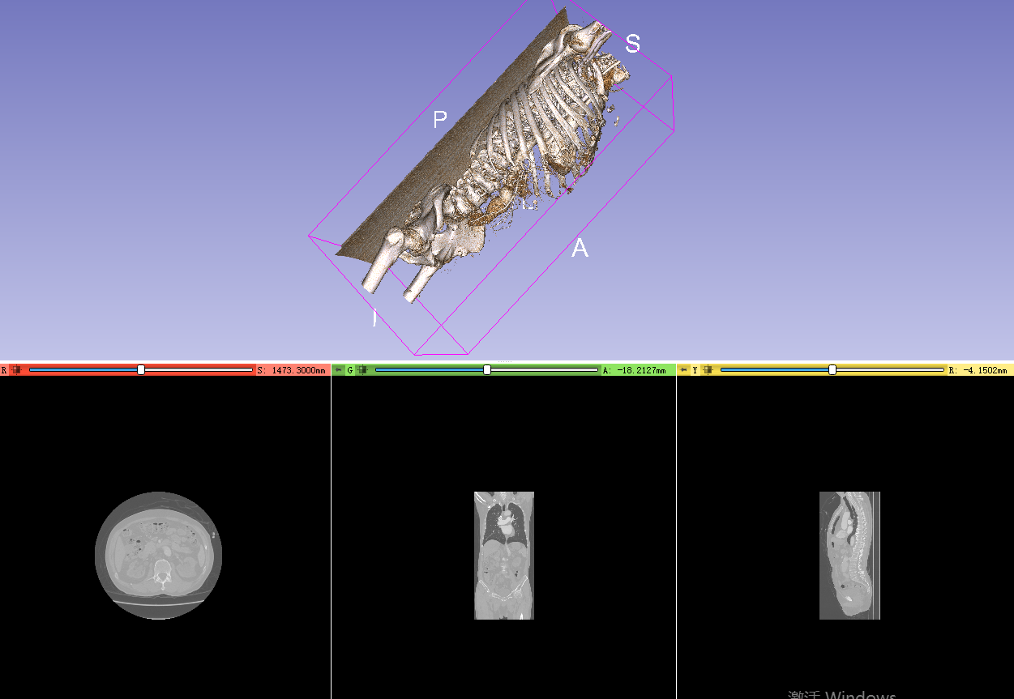
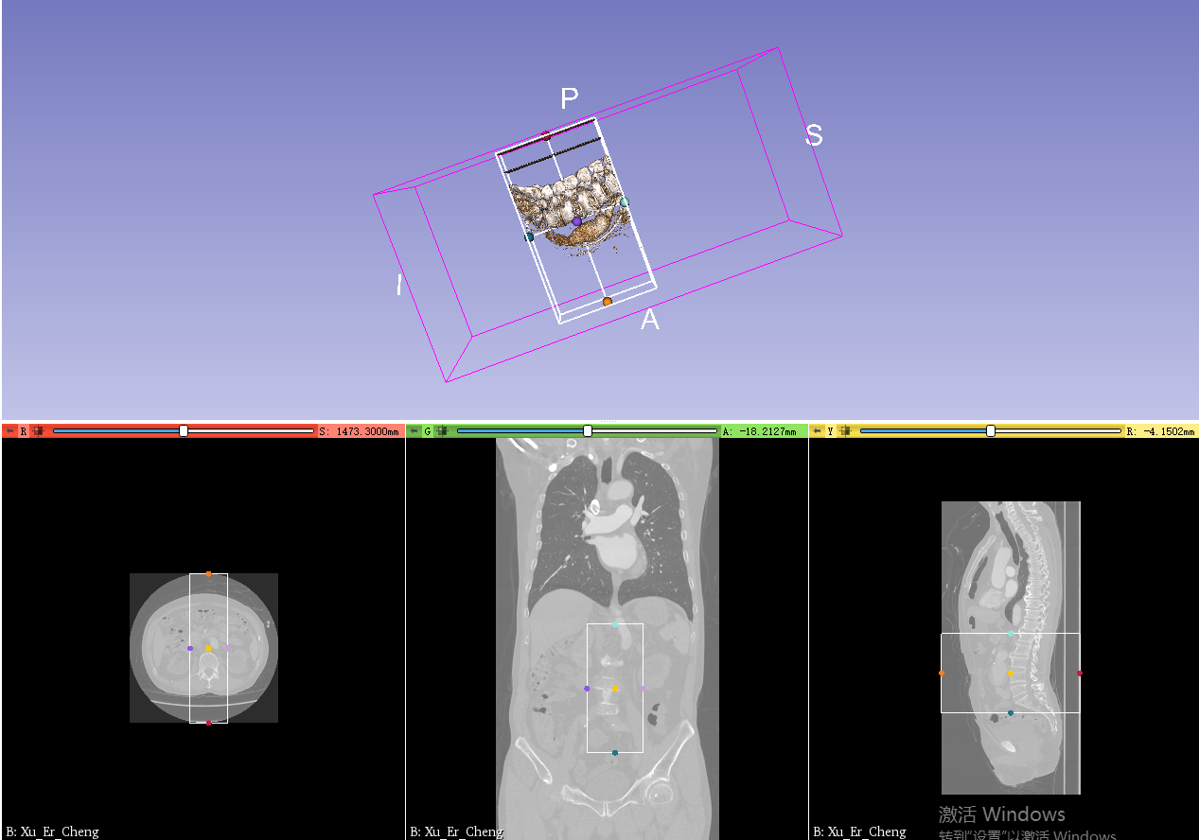
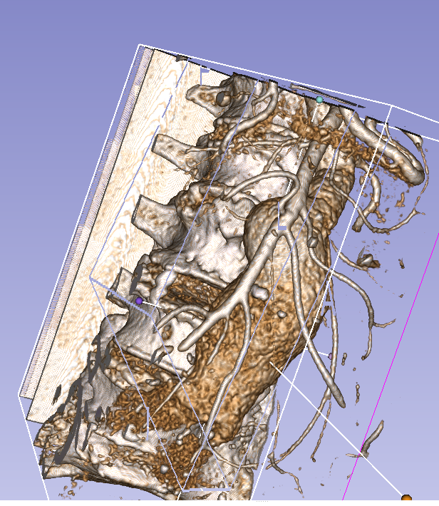
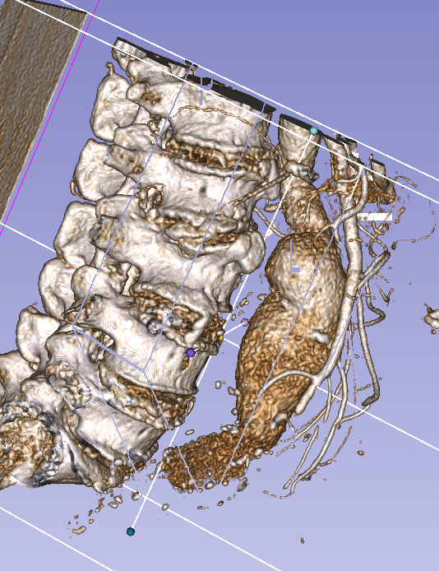
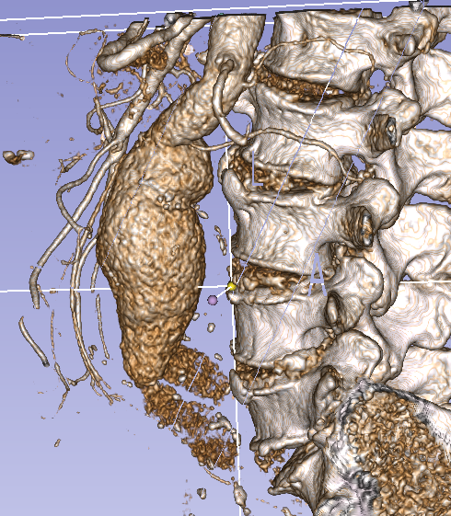
腹主动脉数据集

Slide 9
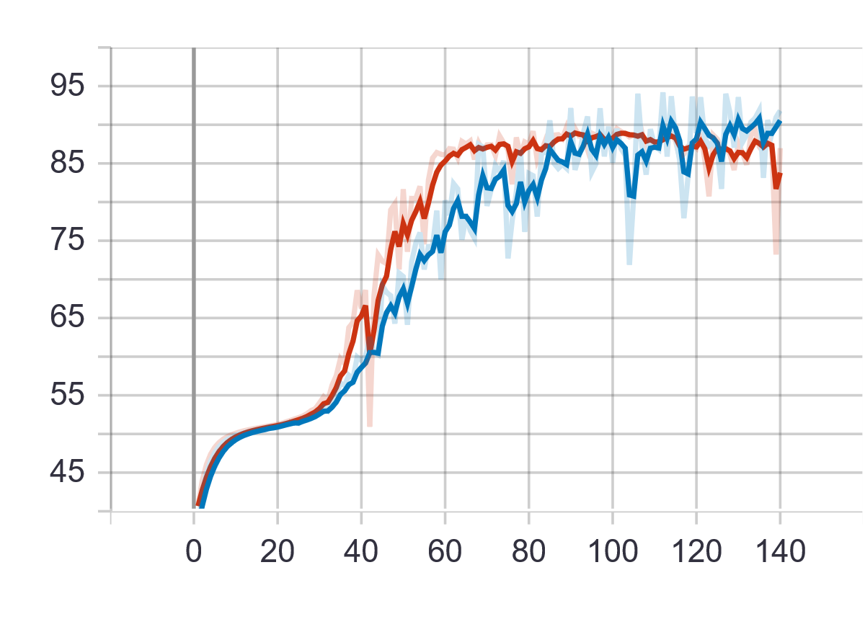
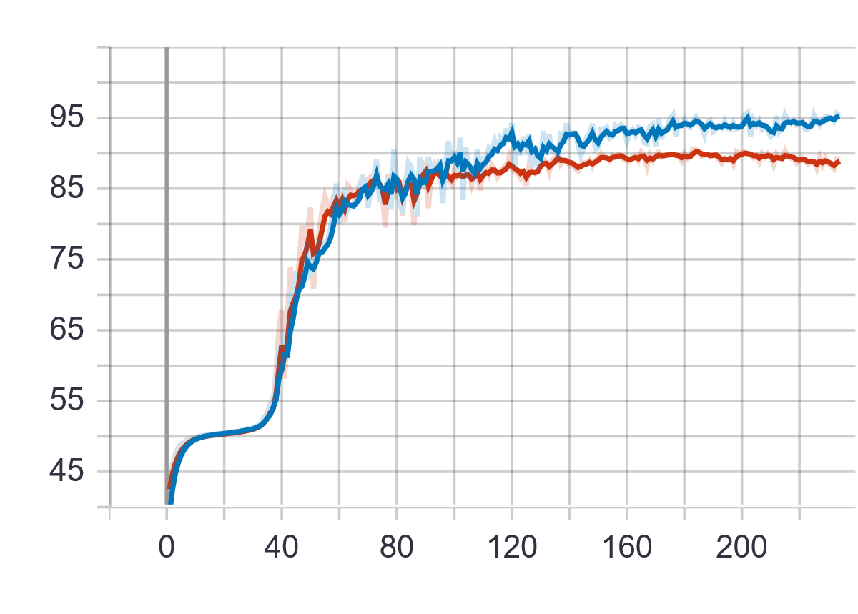
腹主动脉数据集
AAA 17train 1val 2test
data shape (975, 512, 512) (563, 512, 512) (742, 512, 512) 如何处理大小不一样，而且过大问题
try 1 cut (320, 512, 512)-> sample(160,256,256)
但是不完全包含血管， acc 85%-90%
try 2 resize to (256,128,128)
acc 85%-90%
test acc 0.1788 0.4502
OT cost
蓝-val; 红-train

Slide 10
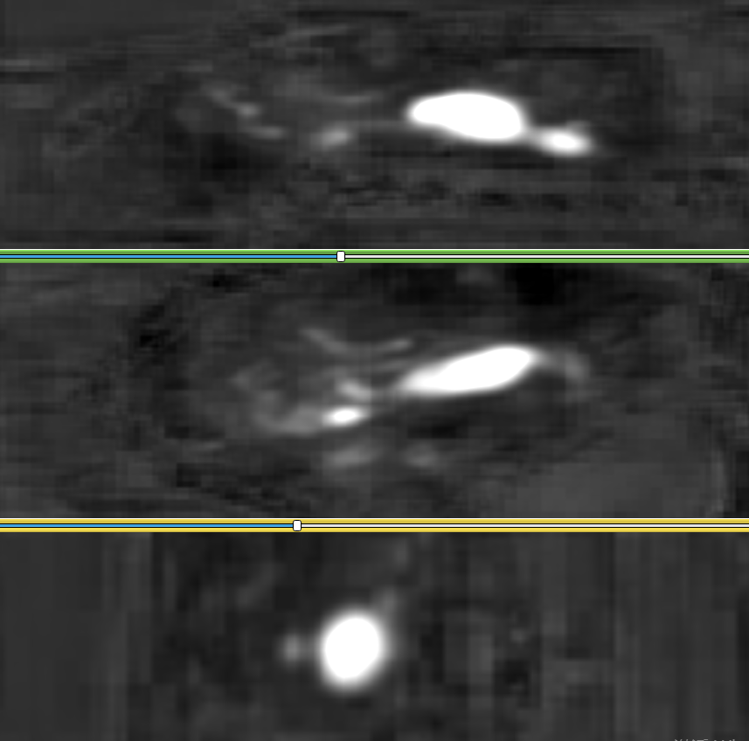
腹主动脉数据集
feature
feature visualization

Slide 11
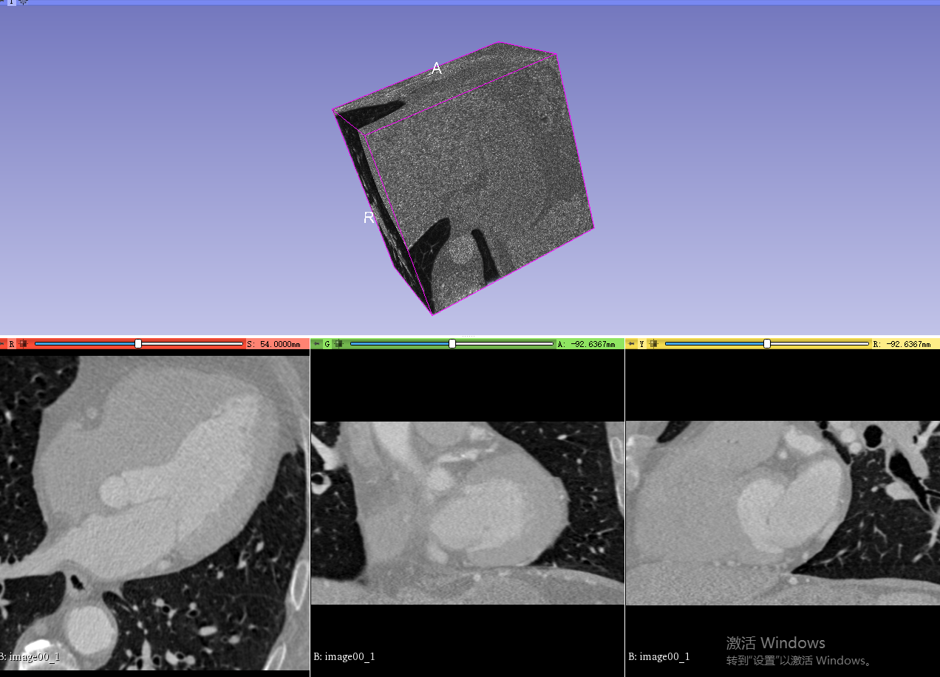
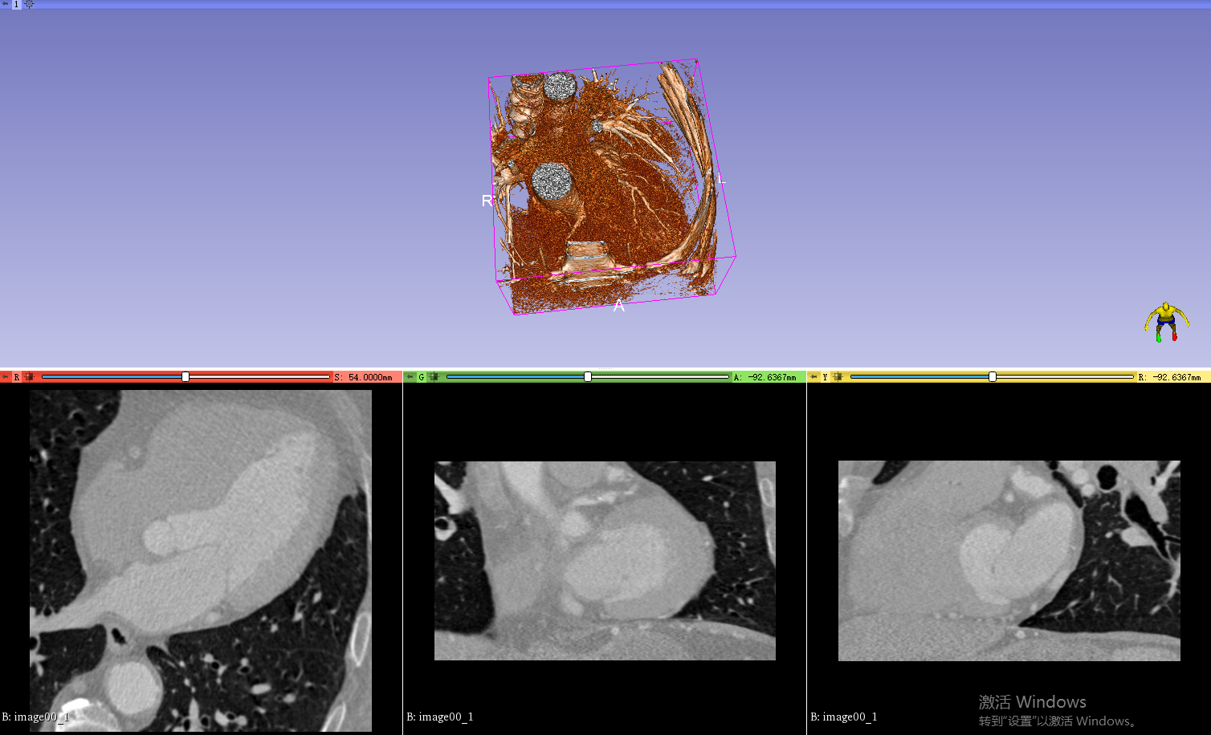
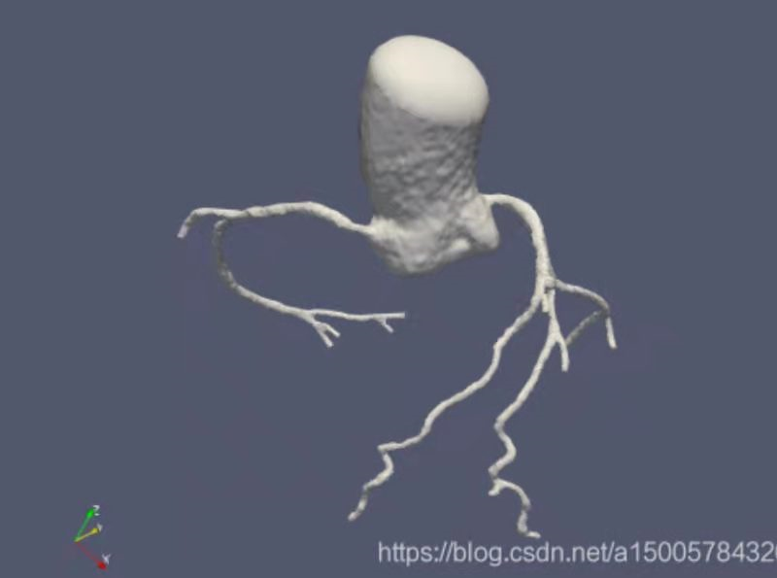
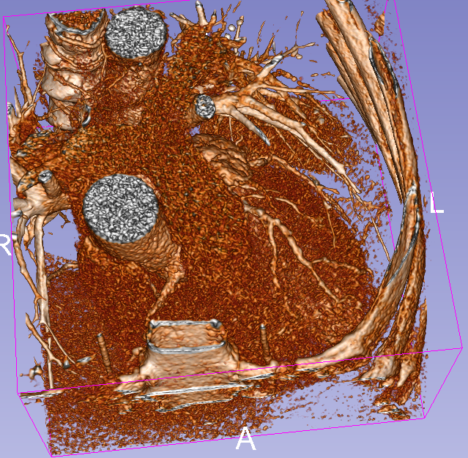
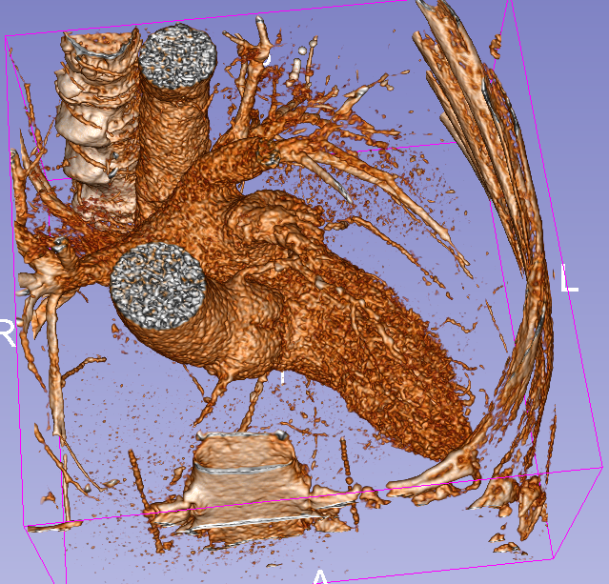
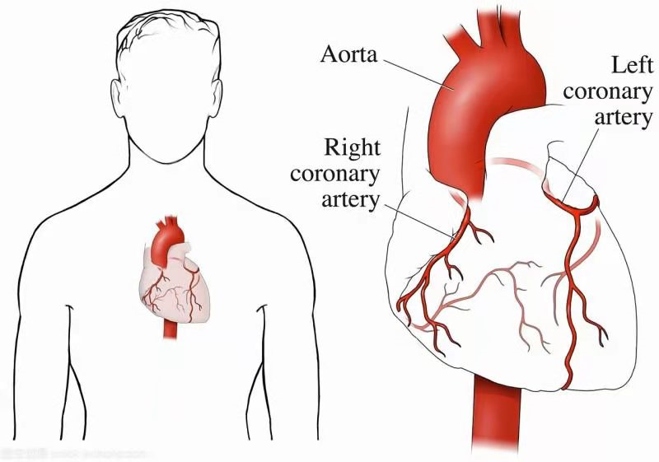
CTA数据集(coronary computed tomography angiography)

Slide 12

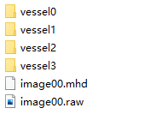
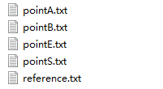
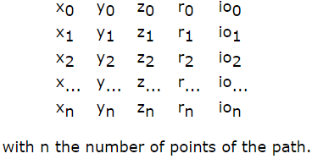
13/6
CTA - centerline 数据集
training dataset00-07 testing dataset08-19
datasetXX:
imageXX.mhd imageXX.raw vessels0 vessels1
vesselsX:
reference.txt--reference standard paths,
x-,y-,z-coordinate of each path point, point A,B,S,E for each vessel
the radius at that point (ri)
the inter-observer variability of that position (ioi)
pointA.txt
A : a point inside the distal part of the vessel
B : a point approximately 3cm (measure along the centerline) distal of the start point of the centerline
S : the start point of the centerline
E : the end point of the cneterline
U : any manually defined point

Slide 13
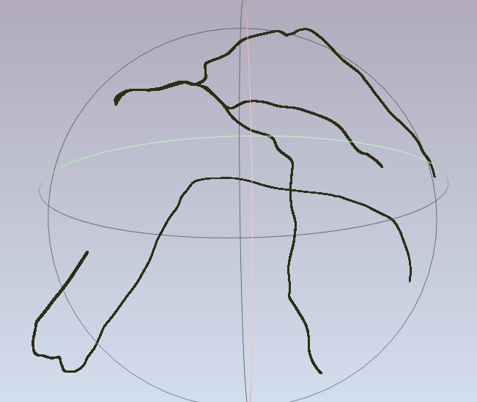
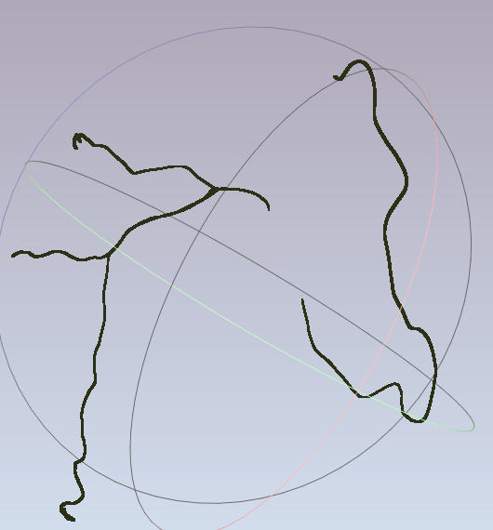
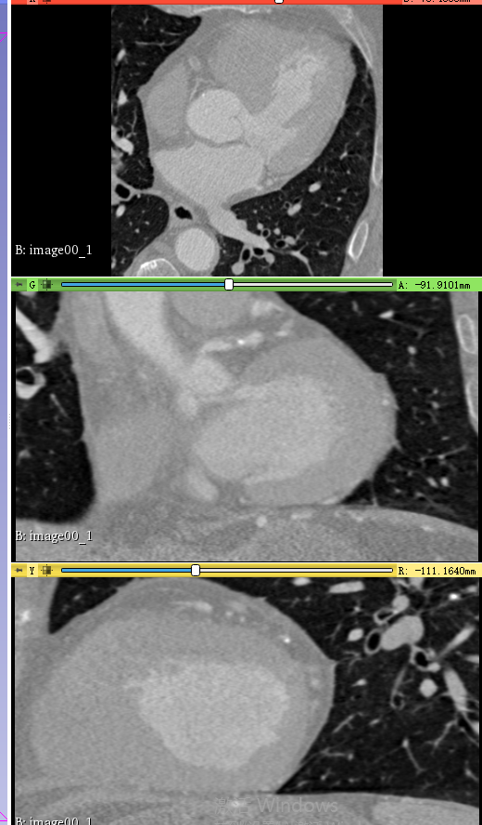
13/6
vesselsX:
reference.txt--reference standard paths,
x-,y-,z-coordinate of each path point, point A,B,S,E for each vessel
the radius at that point (ri)
the inter-observer variability of that position (ioi)

Slide 14
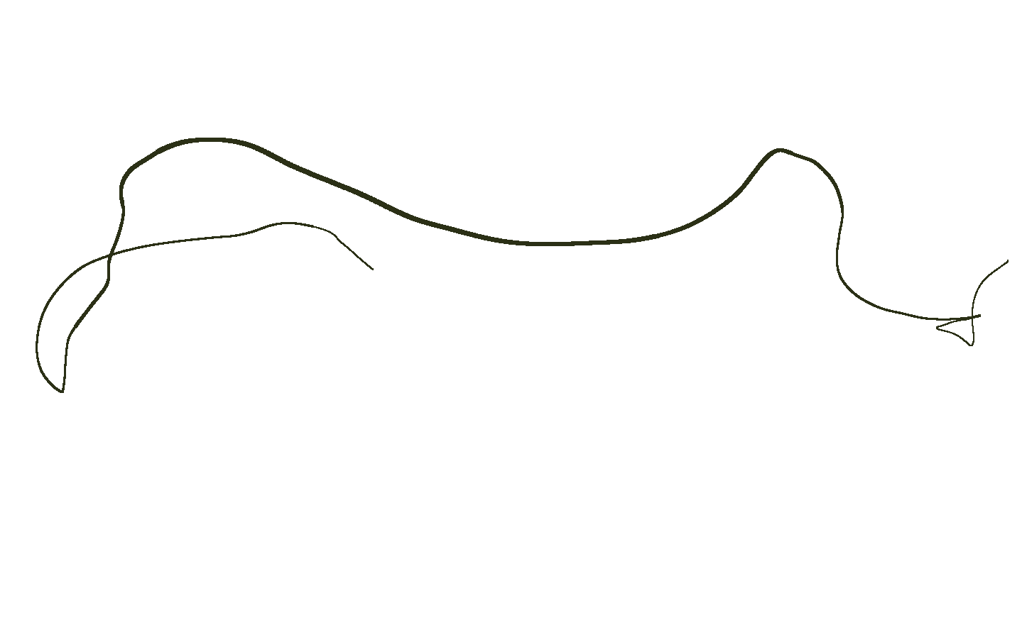
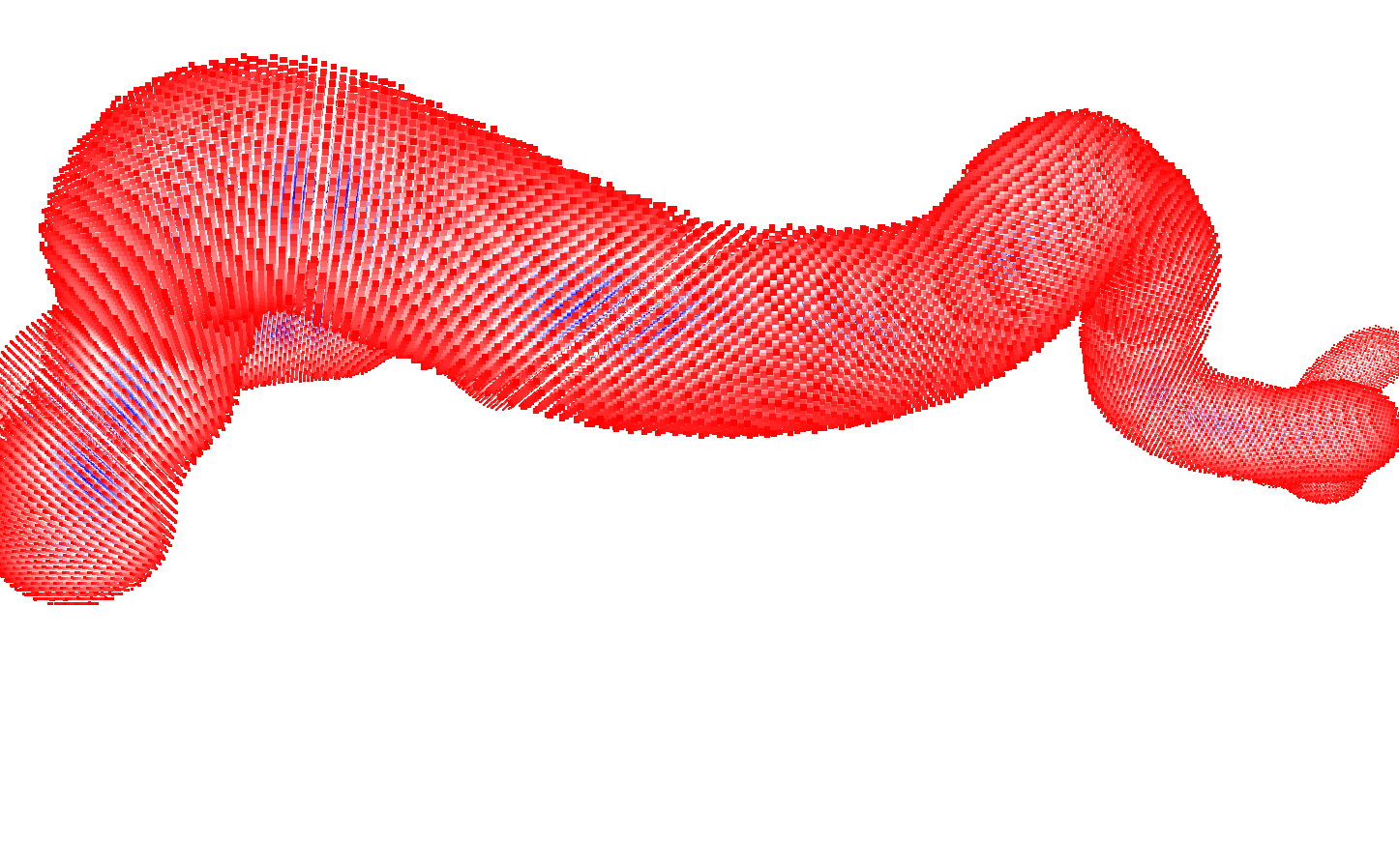
GOAL: From centerline to voxels

Slide 15
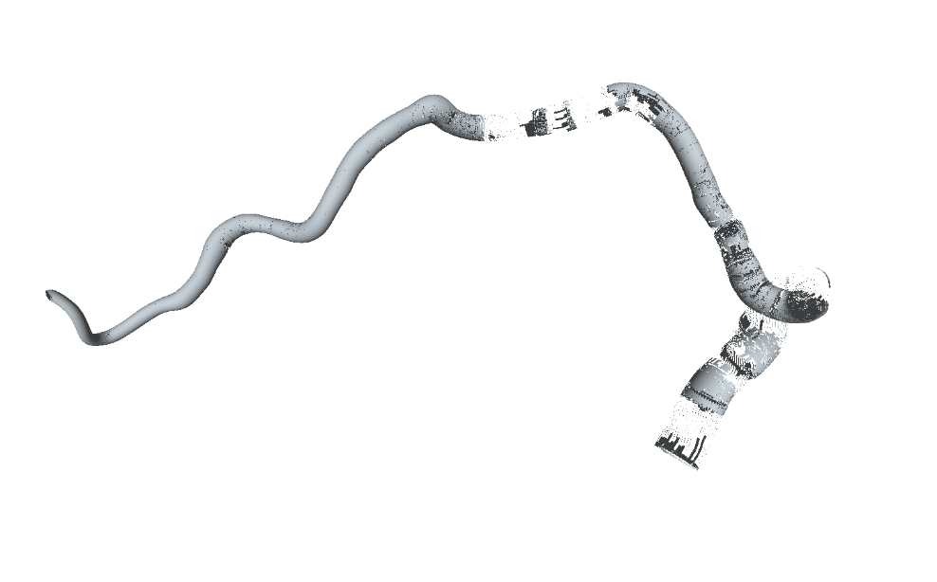
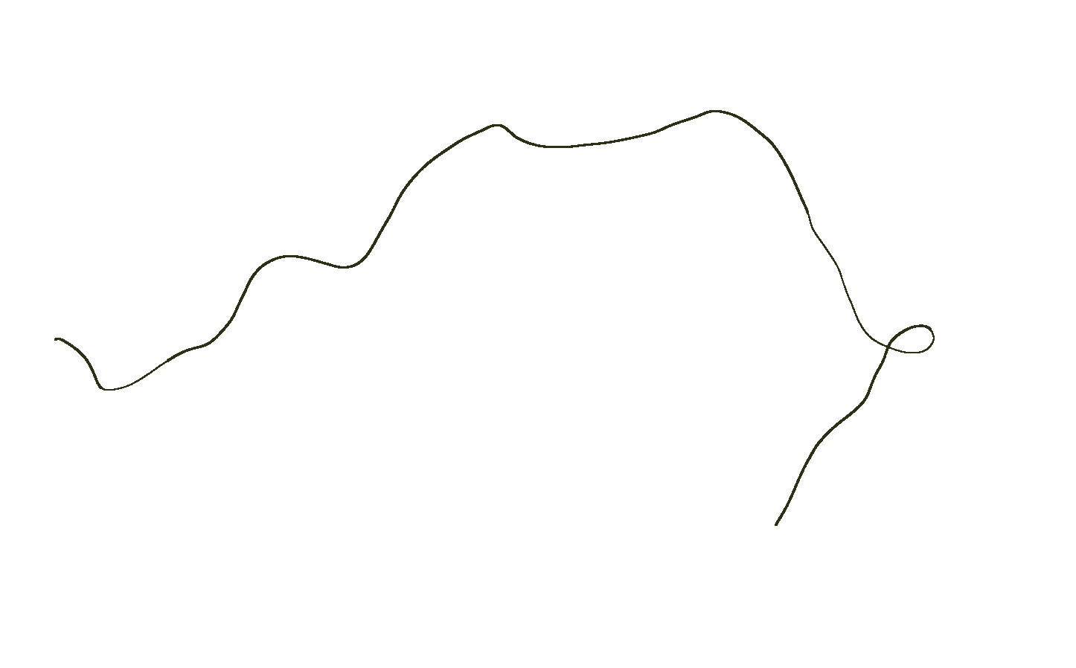
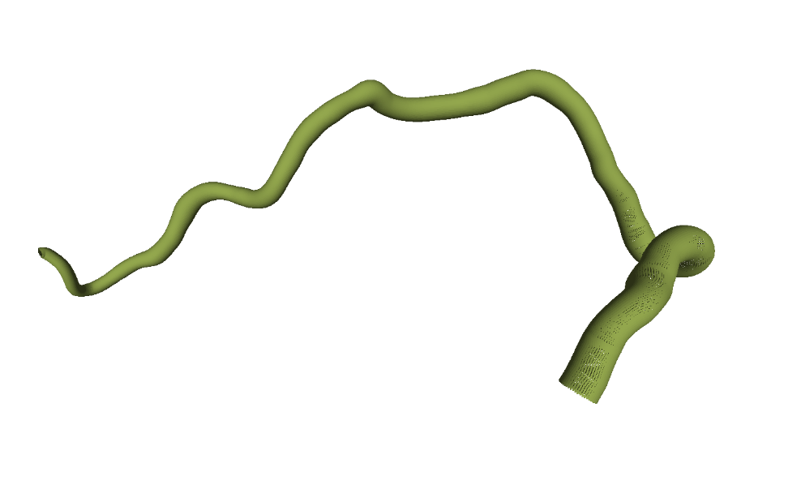
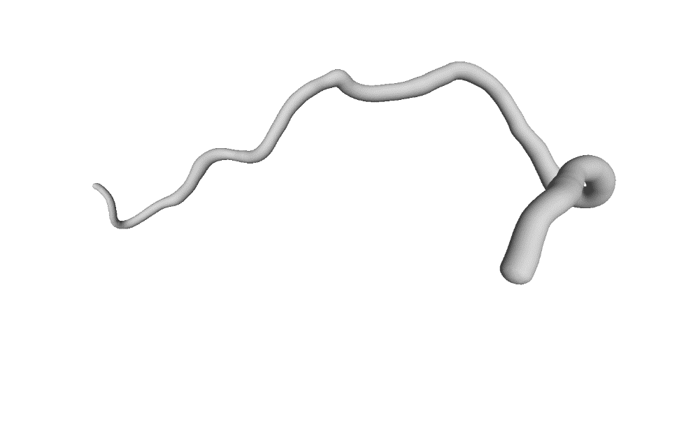
Method 1
Centerline -> Surface Points -> Mesh -> SDF voxel
mesh (ball pivoting)
centerline
surface point cloud (with normal)
mesh (poisson)
Notes:
14.This is the overview of skeleton extraction. The main algorithm can be viewed as three phases. T
he first three correspond to topology extraction.
Specifically, (a), Given a raw scan, randomly sample a subset as initial skeleton. Through the optimal transport process, these points are iteratively projected and merged onto a skeleton points.
(d) and (e) represent the topology checking, it is to check the symmetric of the skeleton, and merge the incorrect cycles.
The last one is geometry optimization, to obtain a smooth skeleton.

Slide 16
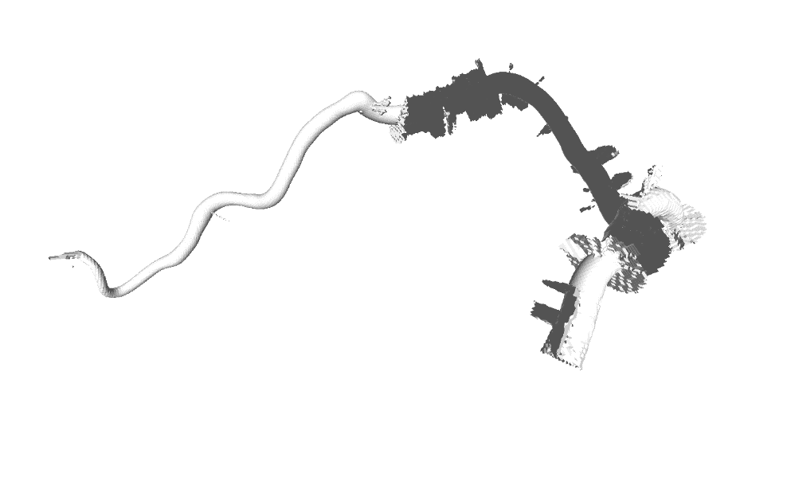
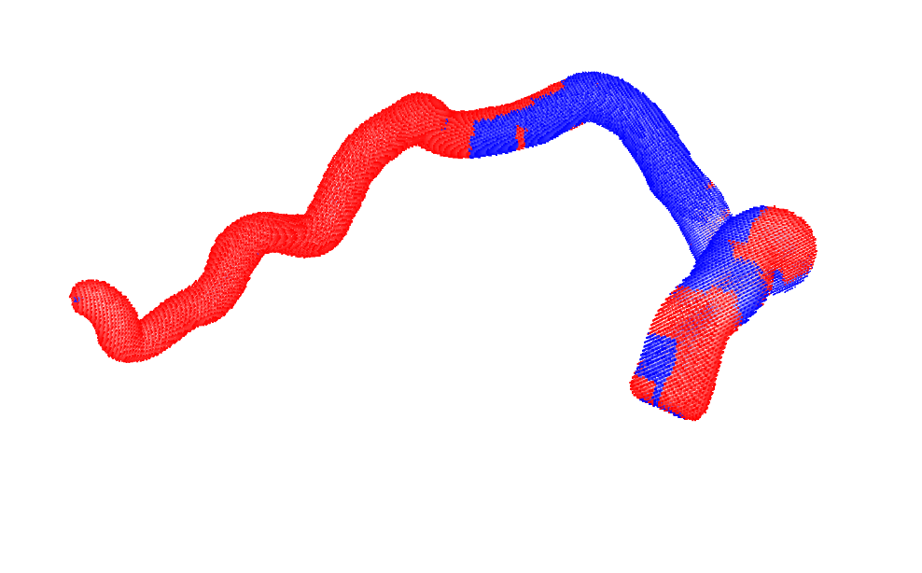
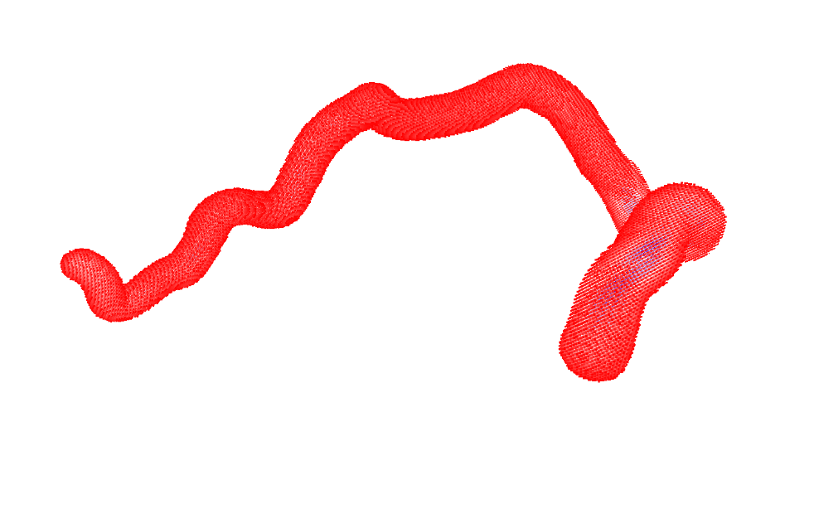
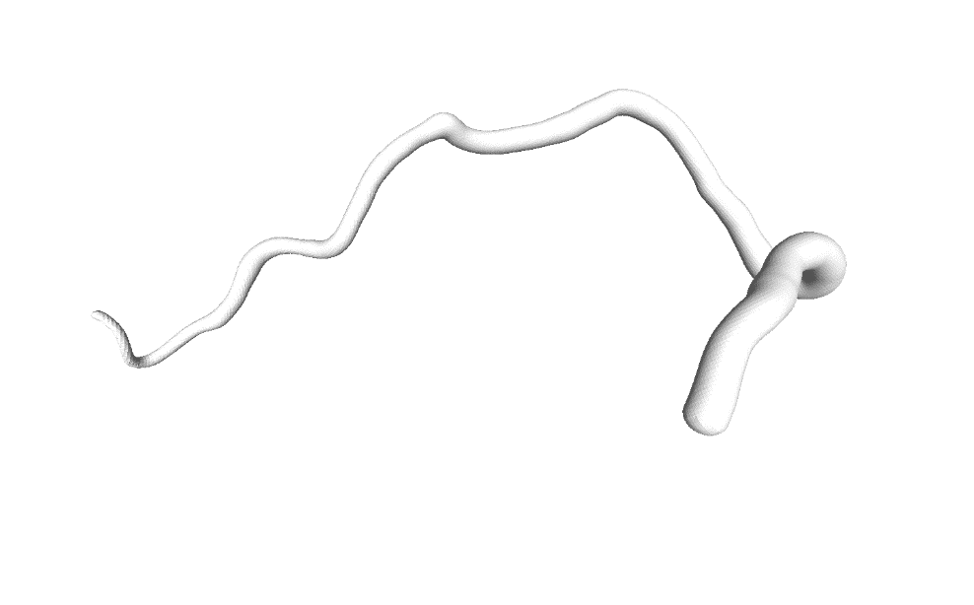
Result
mesh (ball pivoting)
sdf (ball pivoting)
re-generated mesh
mesh (poisson)
sdf (poisson)
re-generated mesh
SDF generation relies on the quality of mesh which is related to surface points.
Notes:
14.This is the overview of skeleton extraction. The main algorithm can be viewed as three phases. T
he first three correspond to topology extraction.
Specifically, (a), Given a raw scan, randomly sample a subset as initial skeleton. Through the optimal transport process, these points are iteratively projected and merged onto a skeleton points.
(d) and (e) represent the topology checking, it is to check the symmetric of the skeleton, and merge the incorrect cycles.
The last one is geometry optimization, to obtain a smooth skeleton.

Slide 17
Method 2
Centerline -> SDF voxel
Each point $p$ that is not on the line $c_{1}c_{2}$ will form a plane with $c_{1}$ and $c_{2}$. This plane will cut the vessel and form a quadrilateral. By Check if p is in the quadrilateral $c_{1}c_{2}p_{2}p_{1}$, we can get the sign of the distance. And the absolute value of distance is the distance between $p$ and line segment $p_{1}p_{2}$.
$$p_{2}$$
$$p_{1}$$
$$p$$
$$c_{1}$$
$$c_{2}$$
Notes:
14.This is the overview of skeleton extraction. The main algorithm can be viewed as three phases. T
he first three correspond to topology extraction.
Specifically, (a), Given a raw scan, randomly sample a subset as initial skeleton. Through the optimal transport process, these points are iteratively projected and merged onto a skeleton points.
(d) and (e) represent the topology checking, it is to check the symmetric of the skeleton, and merge the incorrect cycles.
The last one is geometry optimization, to obtain a smooth skeleton.

Slide 18
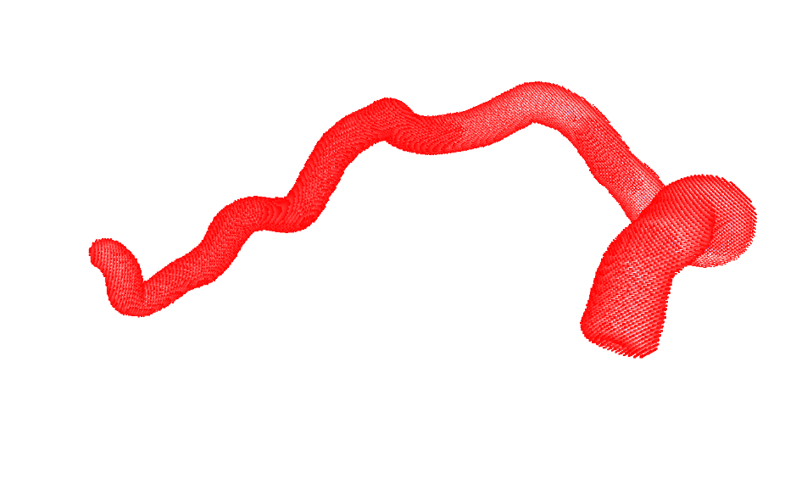
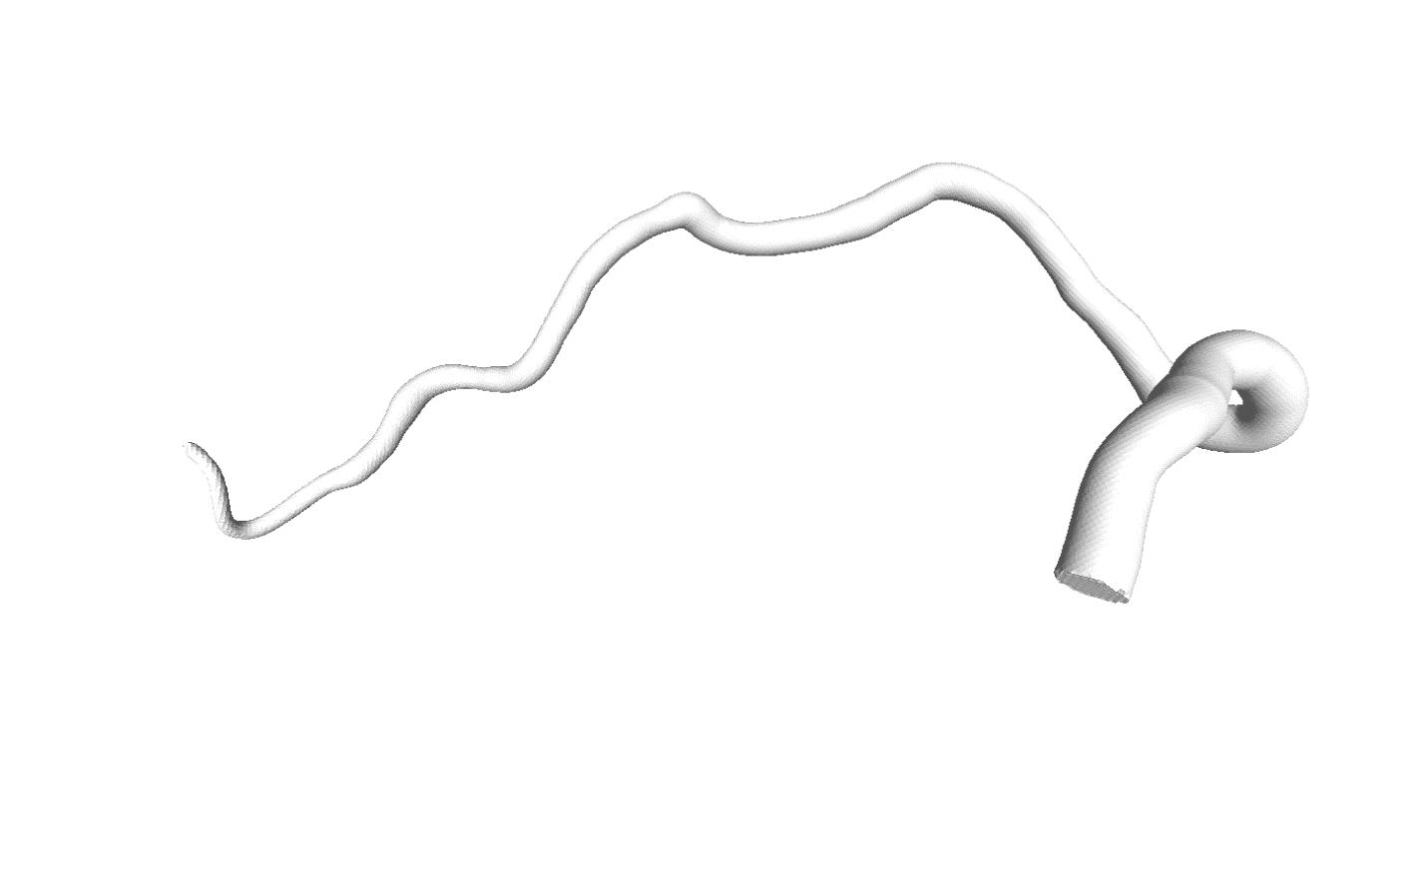
Result
sdf
generated mesh
Easier. Faster. Give the ideal SDF value for each position.
Notes:
14.This is the overview of skeleton extraction. The main algorithm can be viewed as three phases. T
he first three correspond to topology extraction.
Specifically, (a), Given a raw scan, randomly sample a subset as initial skeleton. Through the optimal transport process, these points are iteratively projected and merged onto a skeleton points.
(d) and (e) represent the topology checking, it is to check the symmetric of the skeleton, and merge the incorrect cycles.
The last one is geometry optimization, to obtain a smooth skeleton.

Slide 19
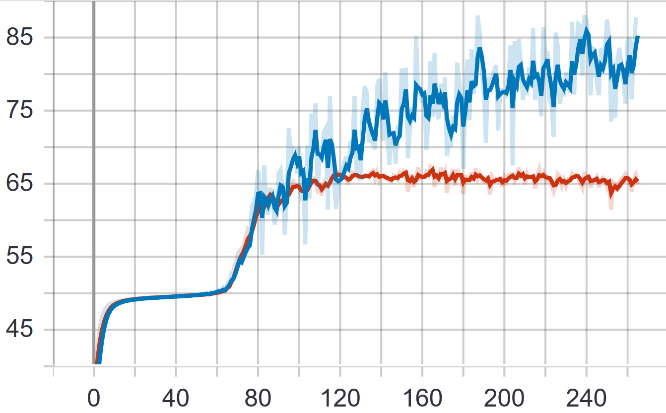
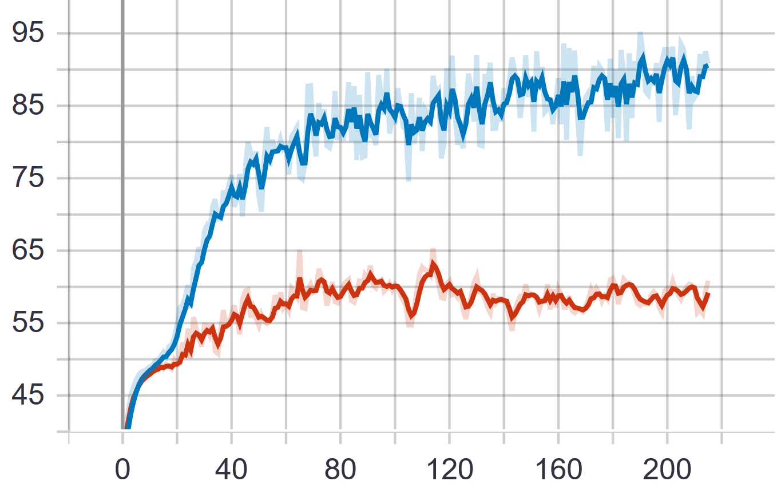
Results on Old CTA Segmentation Masks
CTA 7 train (蓝色) 1 val (红色)
切片128X128X128 10 train, 1 val

