Slide 1
VQA for reasoning:
Graph Neuro Networks & Neuro Symbolic Reasoning
Pre——8/18/2023

Slide 2
Work over the past week
1.Build a Transformer input-head for data loading
2.Survey of some Neuro Structure which can better do VQA reasoning part.

Slide 3
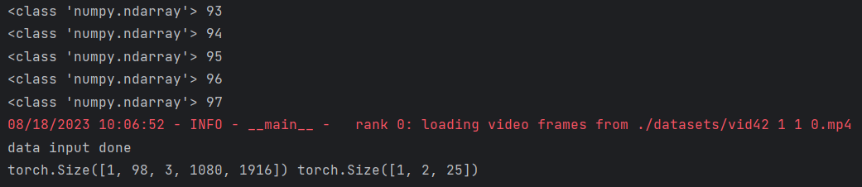
Transformer input-head
In VIOLET(bert-videoswin transformer), img input is a tensor with [B, T, C, H, W] dimension, while txt input is another tensor with [B, M, L] dimension. Fit the dimension to build dataloader.
For internal storage problem, define fixed length for extracting video frame to reduce video-frame input.
Notes:
模型参数根据训练不同，可能有double的情况；如何使其变得更高效。大模型的light-weighted版本；直接提取feature减少存储量；并行计算（auto只适用于全gpu计算）；

Slide 4
VQA for better reasoning
Big picture: expecting VQA for better “question understanding”.
Eg: giving question “How many workers are there wearing helmets?” → “Workers” — “Helmet” → Count_num
As Transformer model is a fully end-to-end model, although there performance well on most dataset, they “are weak in answering questions that emphasize visual relation reasoning, especially the temporal and causal relations which feature video dynamics” (Zhong, Xiao et al. 2022)
Notes:
1.物体轨迹上的reasoning-short time predict 2.经验层面上的reasoning-对activity/motion的理解
论文学习中要看计算层面的论文，需要明白其本质在做什么。
可以从GNN与VisualQA的论文开始，解答自己在前沿论文中的某些疑惑。
Eg:对于GNN而言，是怎么定义“图”的，而不是图中的细节。

Slide 5
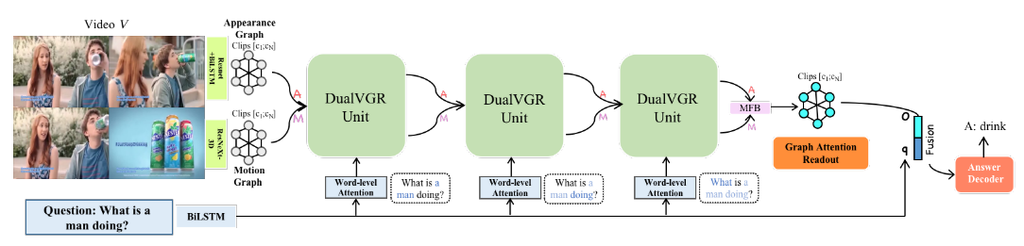
VQA for better reasoning
There are two structures better fitting VQA reasoning work:
1. Graph Neuro Network:
Consider video as “graph”(our understanding is spatial and temporal relation containing in frame nodes). Use GNN for advanced reasoning head.
Eg: DualVGR—GNN model head after Video/txt input

Slide 6
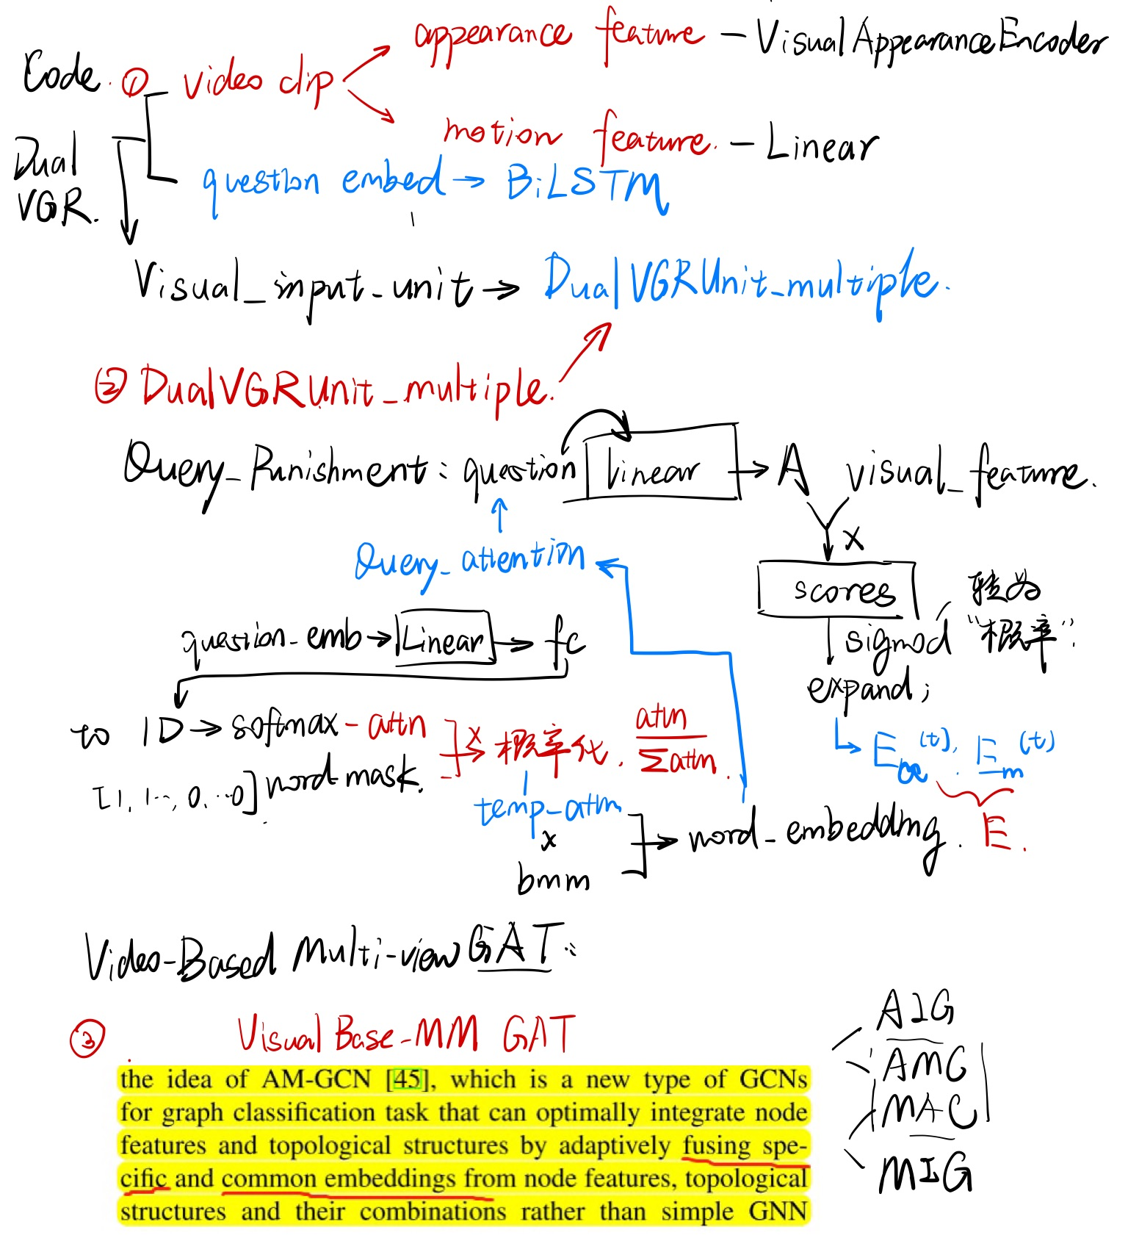
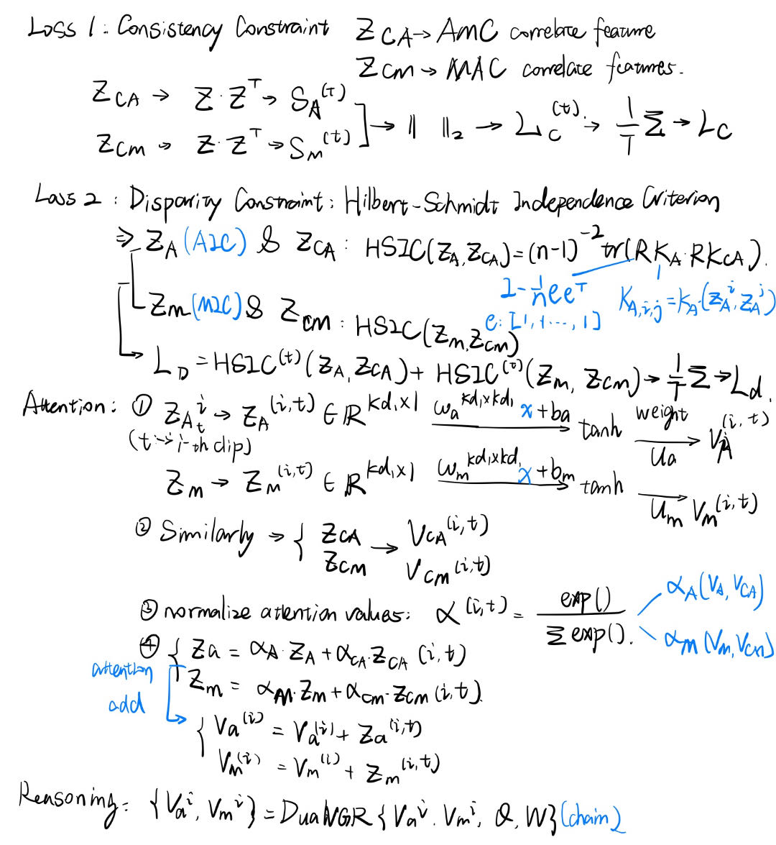
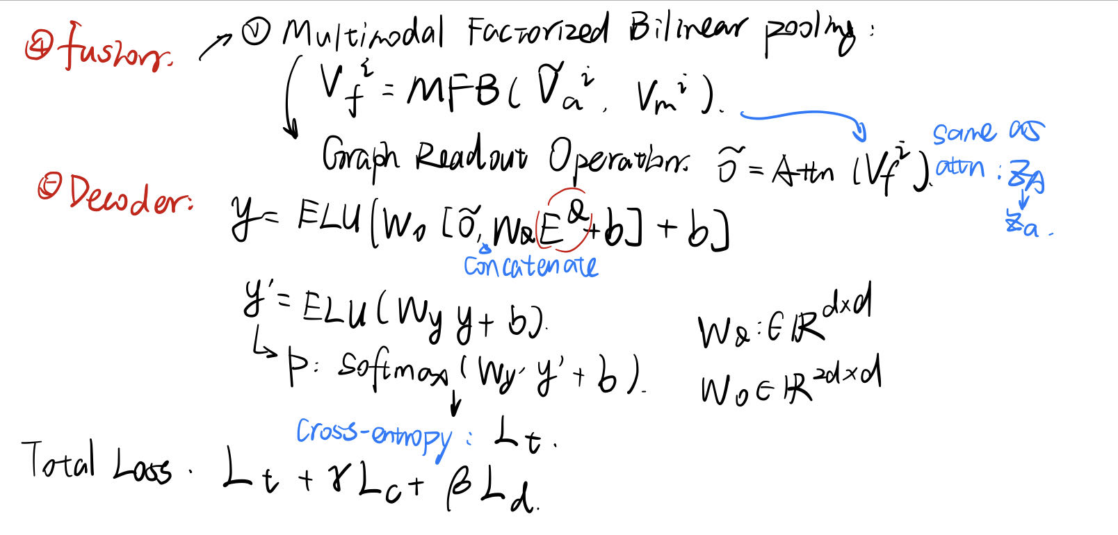

VQA for better reasoning

Slide 7
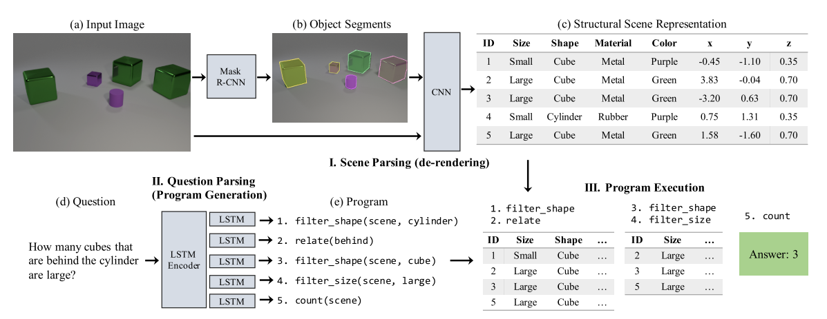
VQA for better reasoning
There are two structures better fitting VQA reasoning work:
2. Neuro Symbolic Reasoning: generate “object-feature” pairs for advanced reasoning.(un end-to-end model!)
Notes:
可能需要担心的前提：人为设计的feature可能无法match problem

Slide 8
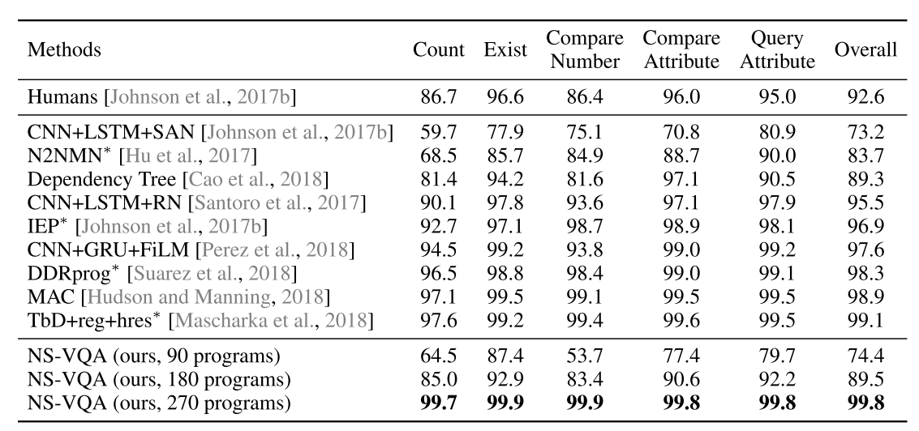
VQA for better reasoning
There are two structures better fitting VQA reasoning work:
2. Neuro Symbolic Reasoning: Dataset--CLEVR

Slide 9
Further work
1. Dealing with calculation problems in Transformer
2. Try to build a GNN or NS module for VideoQA. Test its performance in the situation of constructional sites.
3. Design relevant validation experiment

Slide 10
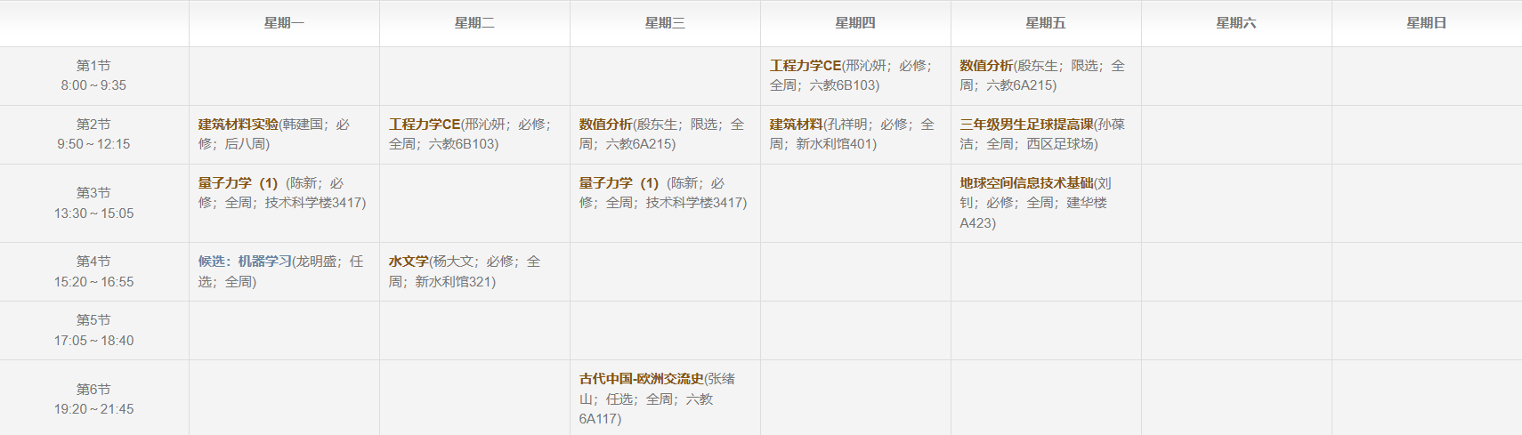
Further arrangement
8/21: accommodation in THUSZ become due, back to Beijing
From 8/28 to 9/16: THU Summer semester
From 9/18: THU Autumn semester
Autumn semester weekly schedule:

Slide 11
Further arrangement
Available on Thursday afternoon, once meeting in two weeks？
If necessary, seek someone to work on this program together
Other questions & suggestions?

