Slide 1
Preparations and basic validation for constructional VQA tasks
Group pre——8/10/2023

Slide 2
Work over the past week
1.collate list of safety in construction sites
2.build a mini-video dataset for fine-tuning/validation
3.valid VQA model and analyze its performance

Slide 3
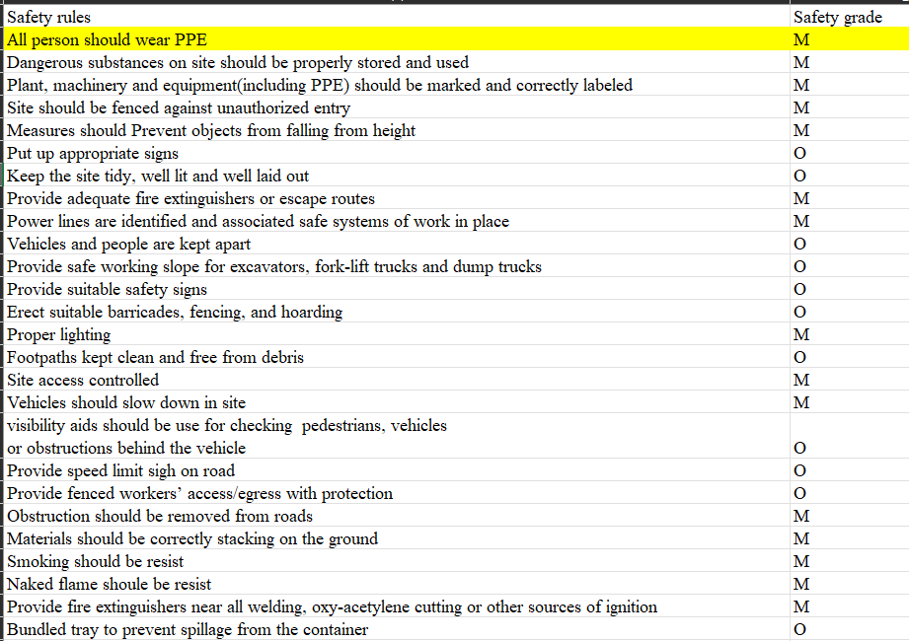

1.Collate list of safety in construction site
Define the word “safety” for advanced methodology
95 safety rules collated, with a classification of safety grade
M:must; O:optional

Slide 4
2.Mini-dataset build for VideoQA
Video of constructional sites download from bilibili
From safety rule list above, choose 3 classic rules:
A. All workers should wear safety helmet (while working).
B. All workers should wear high-visibility vest (while working).
C. Curtain wall should installed out of the building under construction
Clip the video to enlarge the dataset and mark each clip:
For the above rules—
0: No ; 1:Yes ; 2:Irrelavant

Slide 5
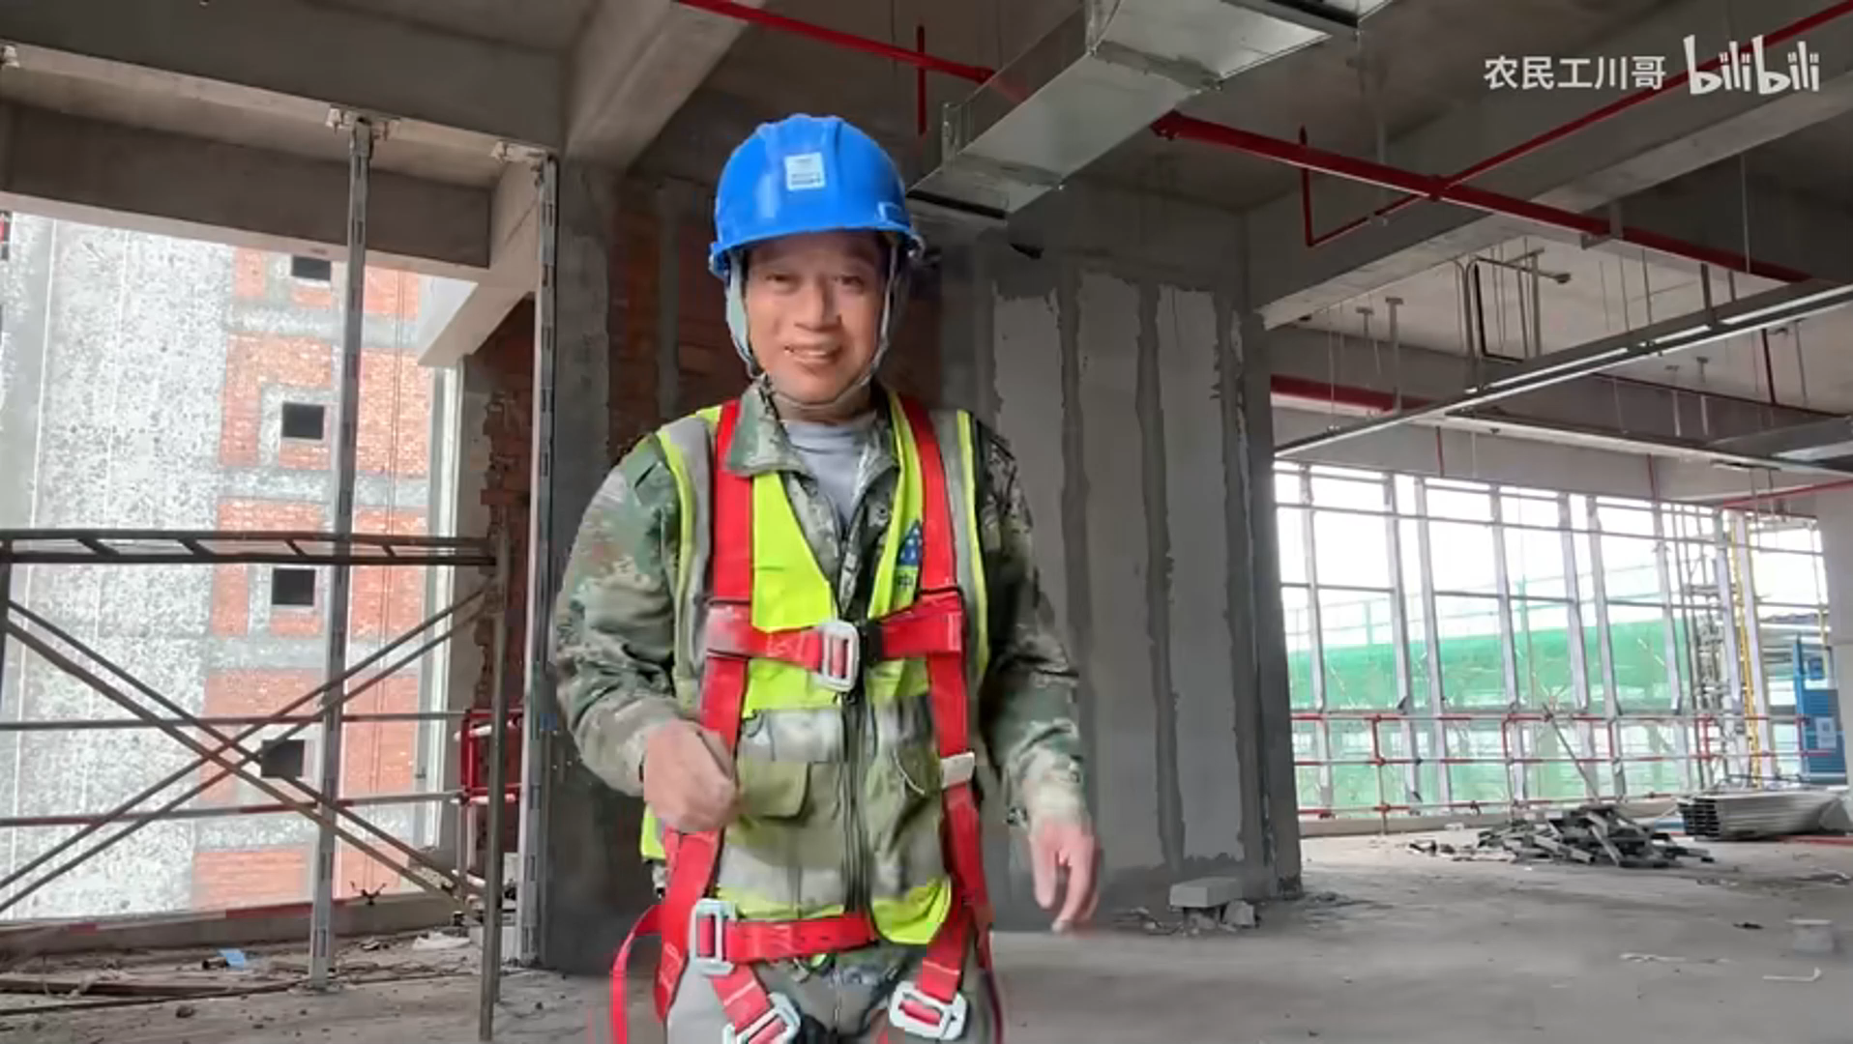
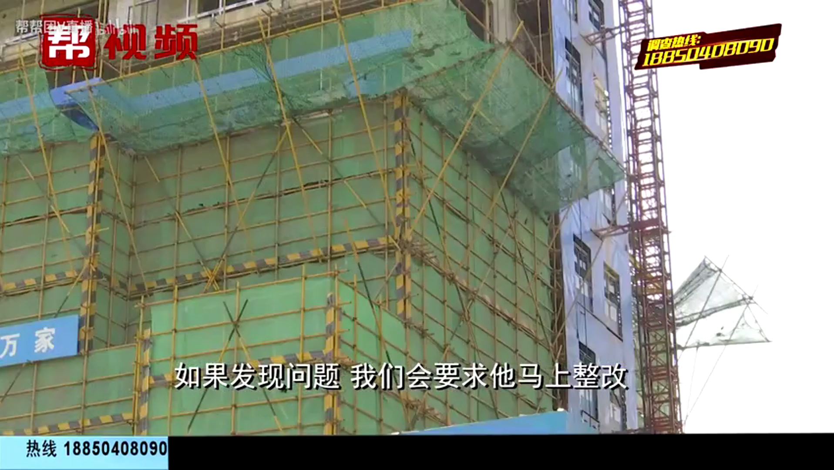
2.Mini-dataset build for VideoQA
124 videoclip which time range from 3 to 30 sec
1 for Helmet
1 for vests
2 for curtain wall (indoors)
2 for Helmet
2 for vests
1 for curtain wall

Slide 6
3.Basic validation of VQA model
Randomly select one frame in each video for validation
VQA model type: ViLT
Advanced Questions:
A. How many people are there?
B. How many people are there wearing helmet?
C. How many people are there wearing high-visible vest?
D. Is there any curtain wall?

Slide 7
3.Basic validation of VQA model
General performance: with 124 frames in total
 | Num_People | Num_helmet | Num_vest | Curtain
NumCorrect | 92 | 86 | 40 | 94
Accuracy | 74.2% | 69.4% | 32.3% | 75.8%

Slide 8
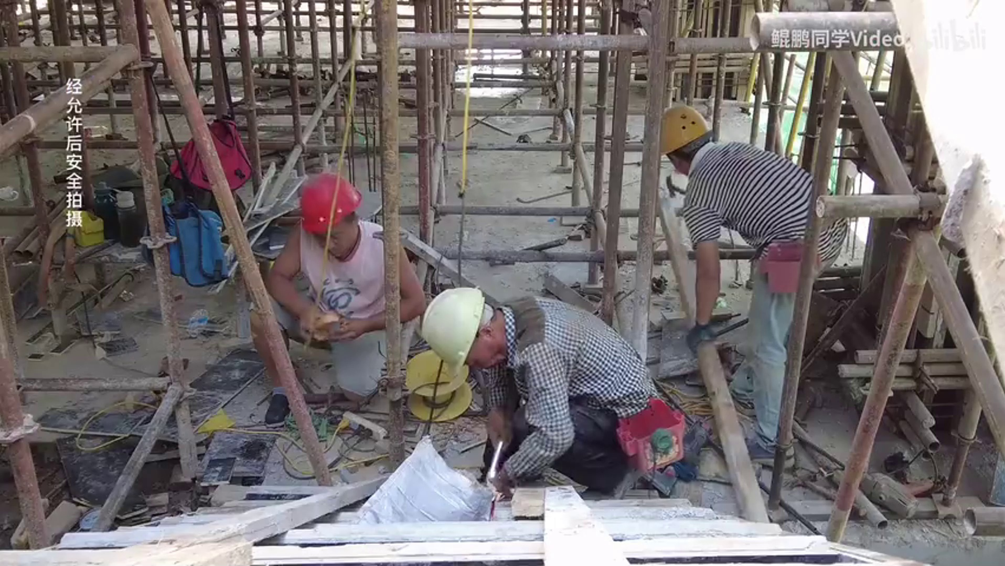
3.Basic validation of VQA model
Detailed analysis:
A. Similarity error
VQA ans:
Num_People: 6
Num_helmet: 3
Curtain: no
Real ans:
Num_People: 3
Num_helmet: 3
Curtain: no

Slide 9
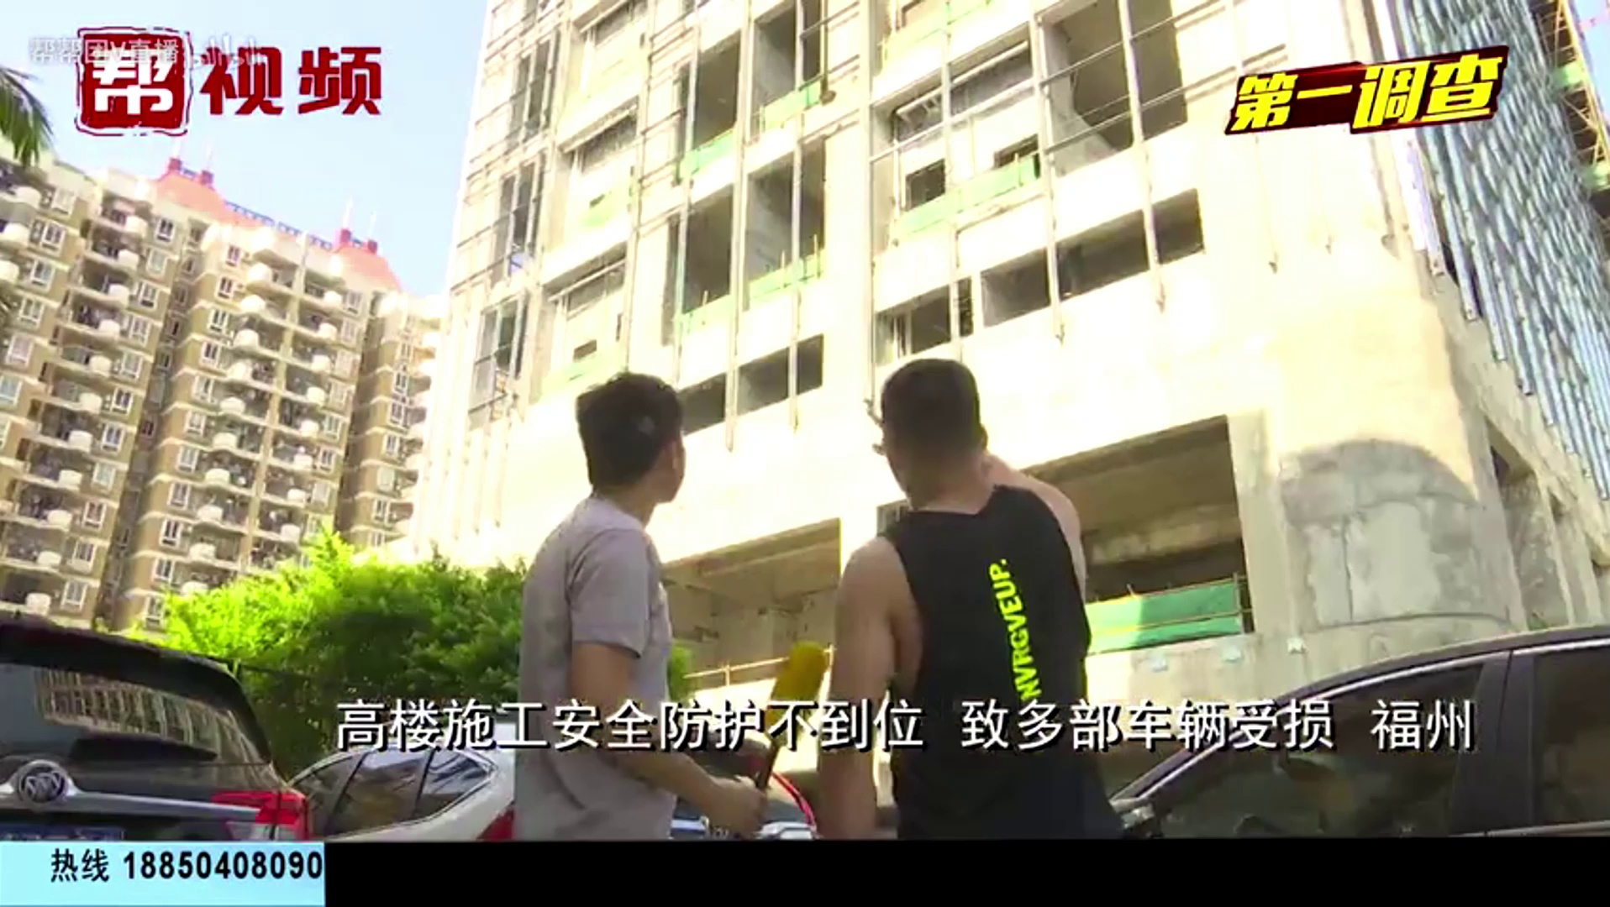
3.Basic validation of VQA model
Detailed analysis:
B. Attention excess
VQA ans:
Num_People: 2
Num_helmet: 0
Curtain: yes
Real ans:
Num_People: 2
Num_helmet: 0
Curtain: no

Slide 10
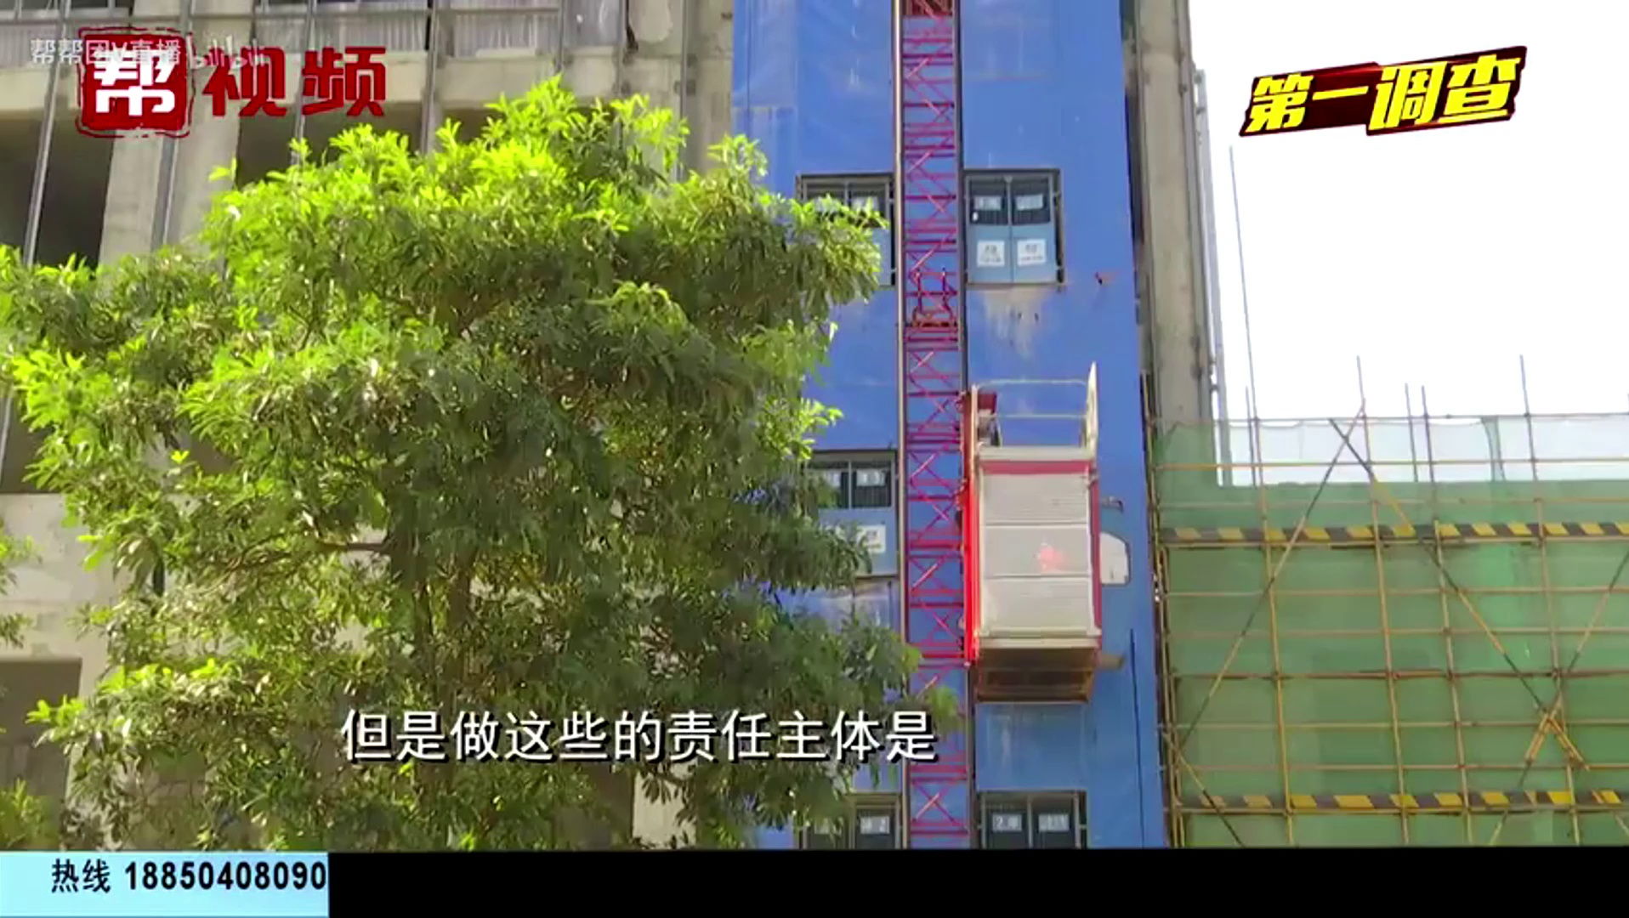
3.Basic validation of VQA model
Detailed analysis:
C. Ambiguous bias
VQA ans:
Num_People: 0
Num_helmet: 0
Curtain: yes
Real ans:
Num_People: 0
Num_helmet: 0
Curtain: no
Notes:
语法问题

Slide 11
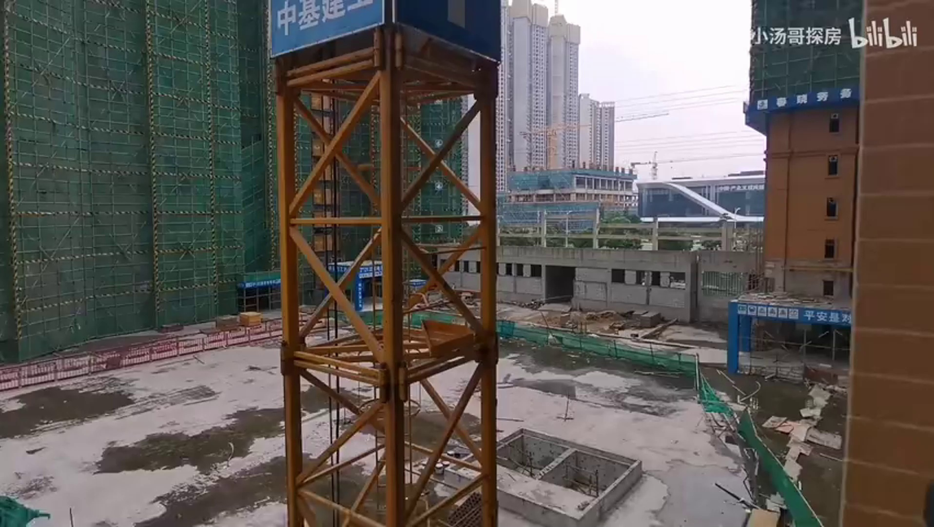
3.Basic validation of VQA model
Detailed analysis:
D. Incomprehension knowledge
(for “high-visibility vest”)
VQA ans:
Num_People: 0
Num_vest: 1
Curtain: yes
Real ans:
Num_People: 0
Num_helmet: 0
Curtain: yes
Notes:
Consistency问题 只看问题：推断出依赖关系—学习逻辑关系进行约束，filter回答；
1.预处理 2.希望vqa可以支持复杂的逻辑，同时用额外的feature extractor强调逻辑关系。可能的方向：问题库之间的逻辑关系，文本-逻辑对？-关系作为额外的输入，简单约束or逻辑关系图？图学习

Slide 12
4.Conclusion & Future work
1.VQA shows potentiality for safety judgement for construction
2.Errors should be fixed by optimizing recognition logic(A,B,C) and model fine-tuning(D)
Future work:
1.Acitivate VIOLETv2 for VideoQA recognition
2.Learning how to fine-tune multimodal
3.Reorganize the question logic to guide model to the correct answer

