Slide 1
New concepts of VideoQA model achieving video understanding with lower-learning cost
Group pre——8/2/2023

Slide 2
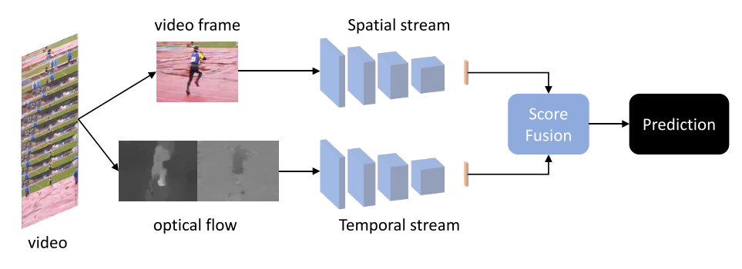
1.How AI learns spatial&temporal information at “one time”?
1.“Two-Stream Networks”: Video frame + optimal flow
Score Calculate:
Averaging prediction scores from both stream
Output size:
H*W*2L

Slide 3
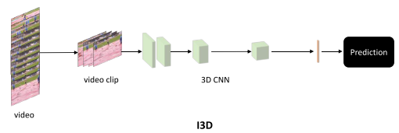
1.How AI learns spatial&temporal information at “one time”?
2.“3D Networks”: 2D for spatial + 1D for temporal
Advantages: learning more positive/negative factors;
less “computationally intensive”&“storage demanding”
Disadvantages: hard to optimize; large dataset
PS: ”3D is not replacing 2-stream networks”
16-32frames

Slide 4
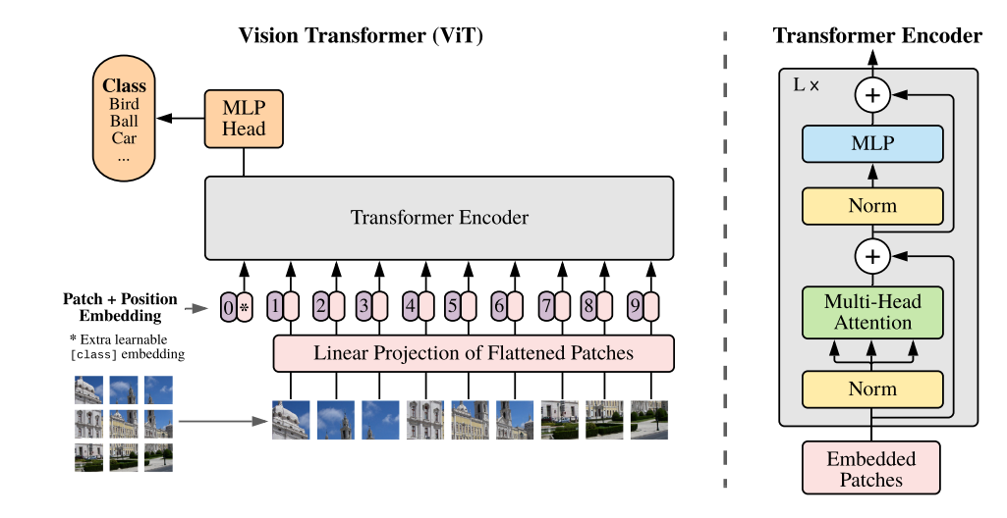
1.How AI learns spatial&temporal information at “one time”?
Motion recognition
3.Multi-modality: Transformer based model
Advantages: push forward “information learning”
from “recognition” to “understanding”
Vision QA
Text2Vision
……

Slide 5
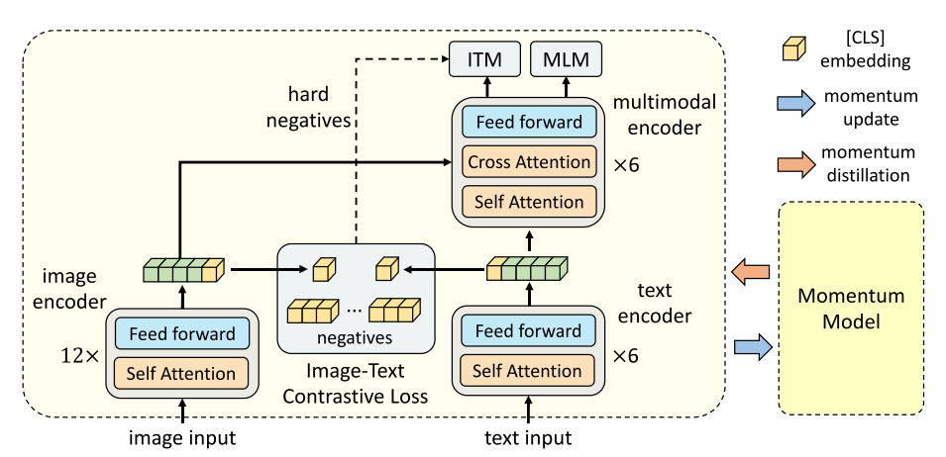
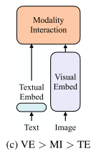
2.Two enlightening works
1.VQA(image recognition): ALBEF(Align before Fuse), provides a possible model structure for low-learning cost.
Conventional
multi-model

Slide 6
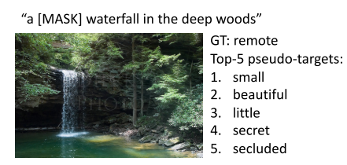
2.Two enlightening works
1.VQA(image recognition): ALBEF(Align before Fuse), provides a possible model structure for noisy dataset.
Red: An optimized encoder structure
Green: Momentum model for distillation
Conventional
multi-model

Slide 7
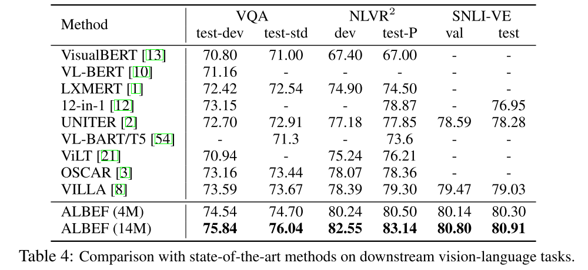
2.Two enlightening works
1.VQA(image recognition): ALBEF(Align before Fuse), provides a possible model structure for noisy dataset.
State-of-art Performance:
Test-dev: debugging&validation\test-std: standard

Slide 8
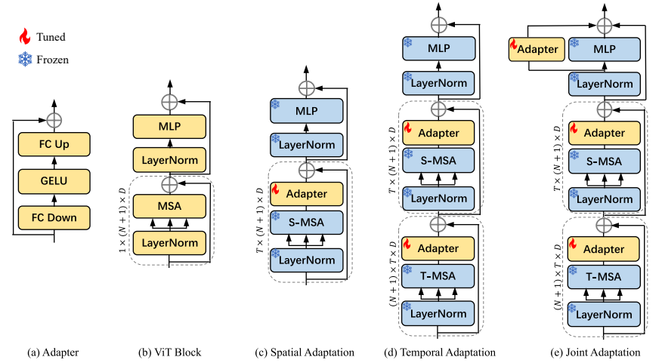
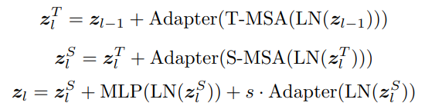


2.Two enlightening works
2.AIM(Video understanding): cues an easier path from image to video
Adapt image-transformer model for video understanding

Slide 9
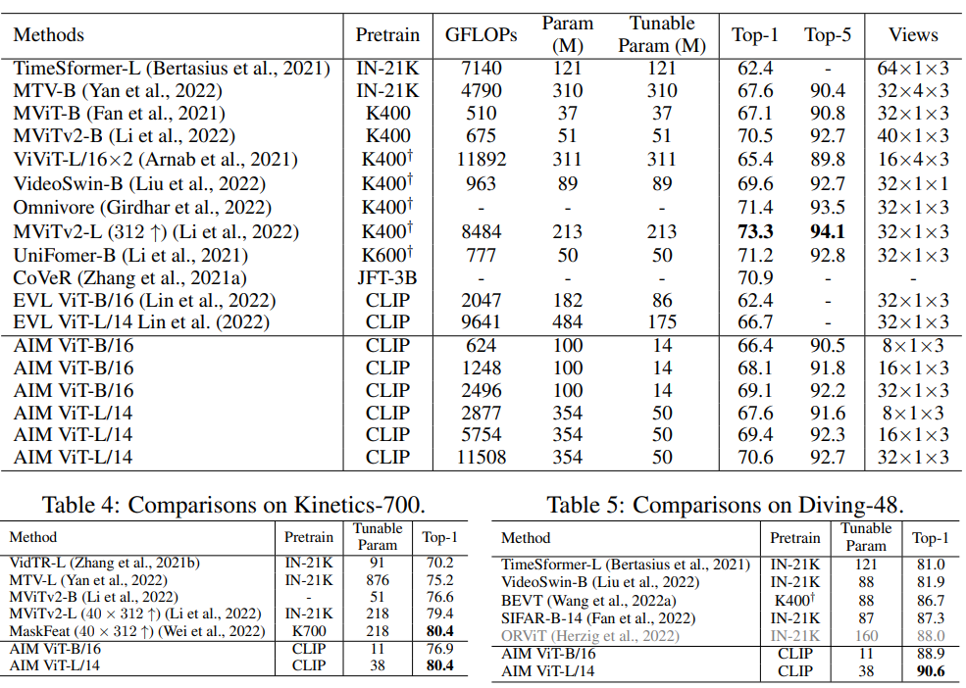
2.Two enlightening works
2.AIM(Video understanding): cues an easier path from image to video
Performance can
be competitive:

Slide 10
3.Further work
1.Fine-tuning a accessible model based on pretrained multi-model: Strong correlation with dataset——not the time
2. New model structure idea:
backward
VTM loss
Video
Input
S-MSA
Multi
Modal
Encoder
MLM loss
Video-Text
Contrastive
loss
LM
Text
Decoder
keywords
LM loss
Video
Input
T-MSA
Text
Encoder
text

Slide 11
4.References
[1]Zhu, Y., et al. (2020). A Comprehensive Study of Deep Video Action Recognition.
[2]Dosovitskiy, A., et al. (2021). An Image is Worth 16x16 Words: Transformers for Image Recognition at Scale.
[3]Li, J., et al. (2021). Align before Fuse: Vision and Language Representation Learning with Momentum Distillation.
[4]Yang, T., et al. (2023). AIM: Adapting Image Models for Efficient Video Action Recognition.

