Slide 1
Safety compliance checking of construction behaviors using visual question answering
Author：Yuexiong Ding/Muyang Liu/Xiaowei Luo
Pre By: 张景皓-清华大学未央书院

Slide 2
1.Introduction
AI for unsafe-behaviors detection mainly based on cross-model
Recent goal: From VisionQA to VideoQA
Method: vision-and-language transformer(ViLT) + fine-tuning with specific dataset
Whole picture: Data preparation → VQA modeling → Safety report generation
Paper’s achievement: (Create an evaluation system for civil-engineer working environment)
Code of this paper is not open sourced.

Slide 3
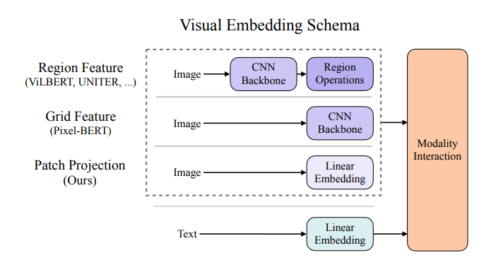
2.Base Model: ViLT
vision-and-language transformer(ViLT)
3 parts in general VLT: image input/text input/modality interaction
Thanks to linear algorism in image input, ViLT scores tens of times faster than previous models.

Slide 4

2.Base Model: ViLT
From Transformer to ViLT(Vision-and-Language transformer)
Transformer: Encoding-Decoding system for word analysis
Multihead self-attention: with Q,K,V mapping from X, calculate attention by EQ:
Doing the calculation multi-times, with different mapping rate Qn Kn and Vn. This is the structure of Multihead self-attention.

Slide 5
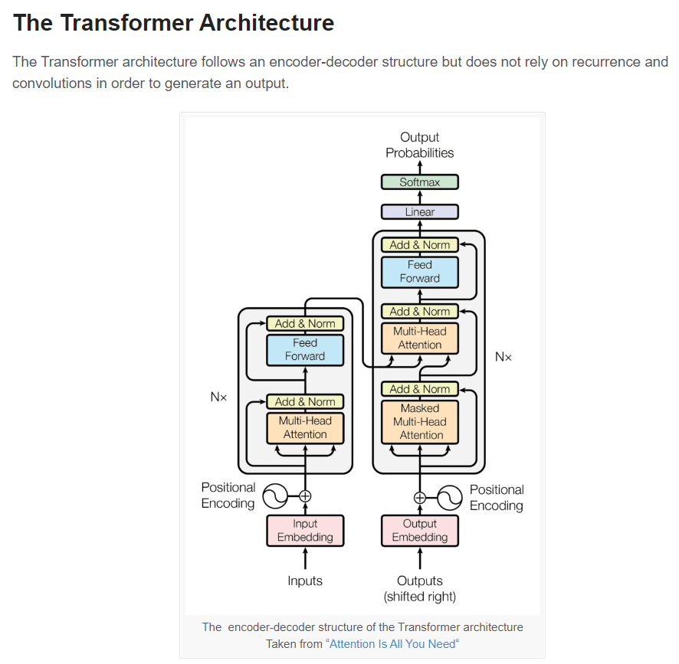
2.Base Model: ViLT

Slide 6


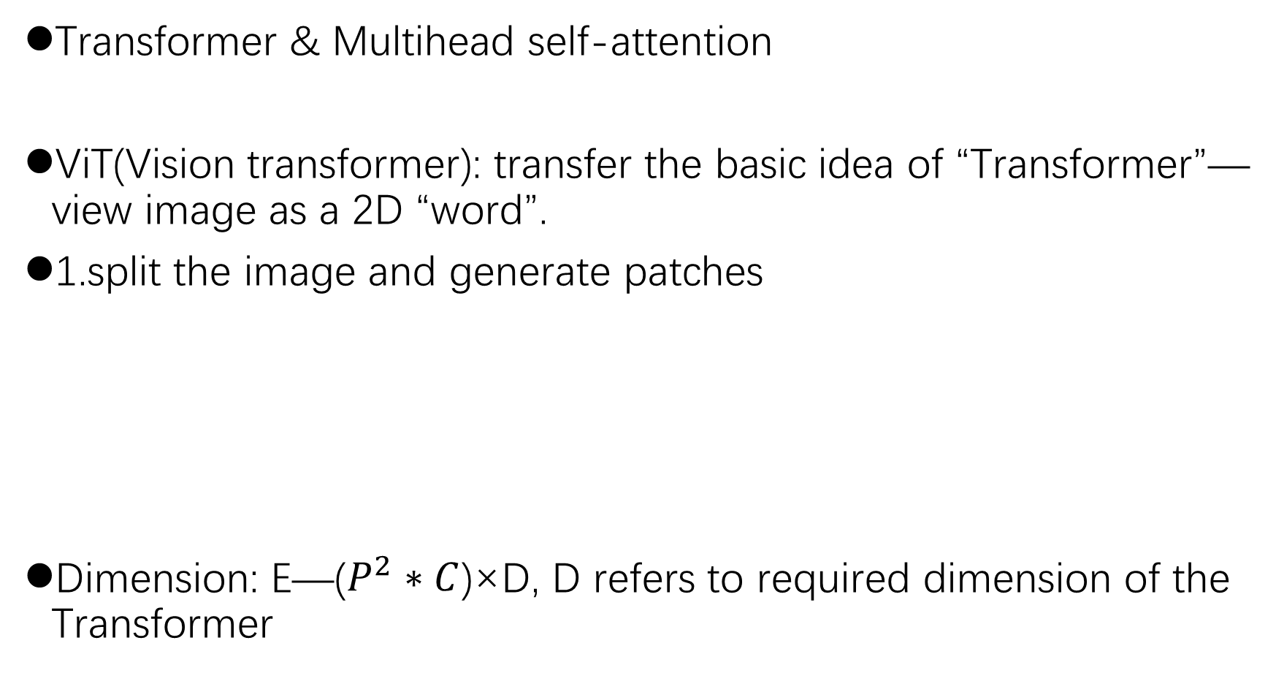
2.Base Model: ViLT
Transformer & Multihead self-attention
ViT(Vision transformer): transfer the basic idea of “Transformer”—view image as a 2D “word”.
1.split the image and generate patches
Dimension: E—($P^{2}∗C$)×D, D refers to required dimension of the Transformer
flattened
Classification of embedding
Position embeddings:

Slide 7
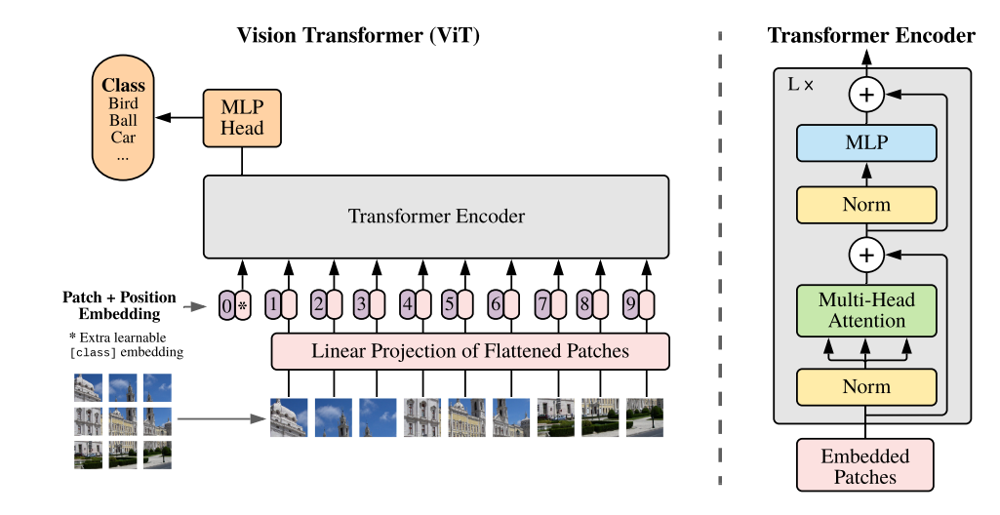
2.Base Model: ViLT
2.Transformer encoder: multihead self-attention + MLP (multi-layer perception) with norm in specific steps
3.ViT has no decoder—type of “classification”, no need to decode

Slide 8
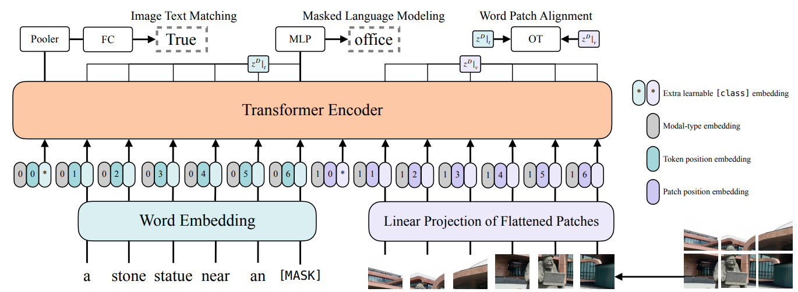
2.Base Model: ViLT
Traits: when trained on small dataset, the result doesn’t stand out
when trained on larger dataset, perform “very favourably”
Need to well fine-tuned when using in specific state.
ViLT(Vision-and-Language Transformer)

Slide 9
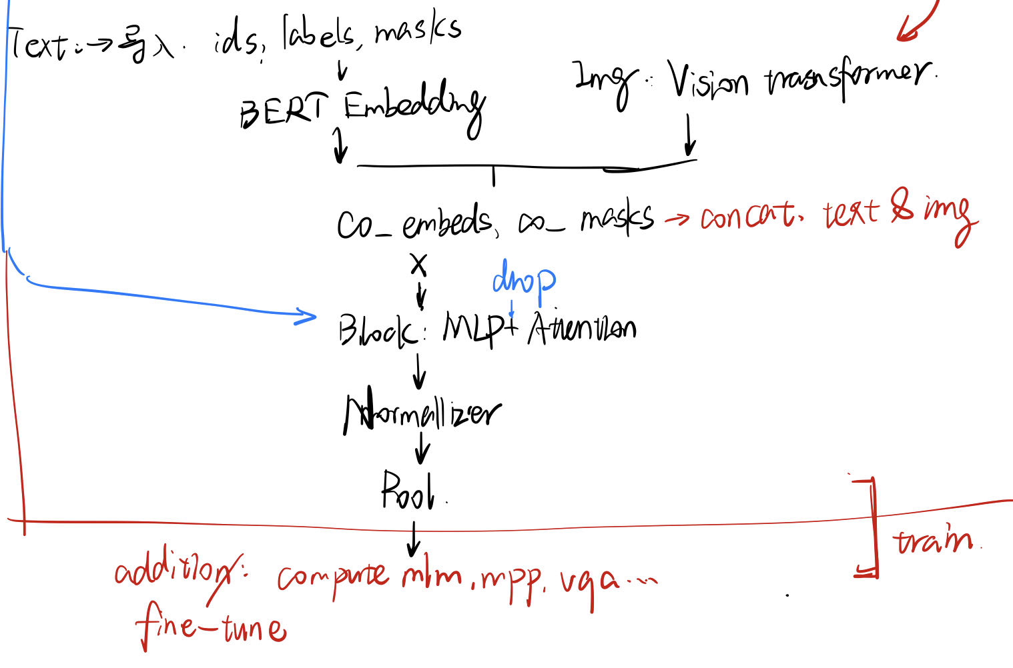
2.Base Model: ViLT
Main structure: Textual Linear Embedding
Image Linear Embedding
More specifically:
The structure of
Project code is on the
Right.
Modality Interaction

Slide 10
2.Base Model: ViLT
Testing examples:

Slide 11
3.From ViLT to “Video-LT”
There is a need to transfer ViLT model to Video-LT, which is the core of our research
we can infer related paper and extract some of the ideas:
1.Building an ATP(Atemporal Probe) model-head while fine-tuning CLIP to make it accessible to VideoQA tasks.
Structure: Video → Single image input → VQA model
Character: Non-temporal

Slide 12
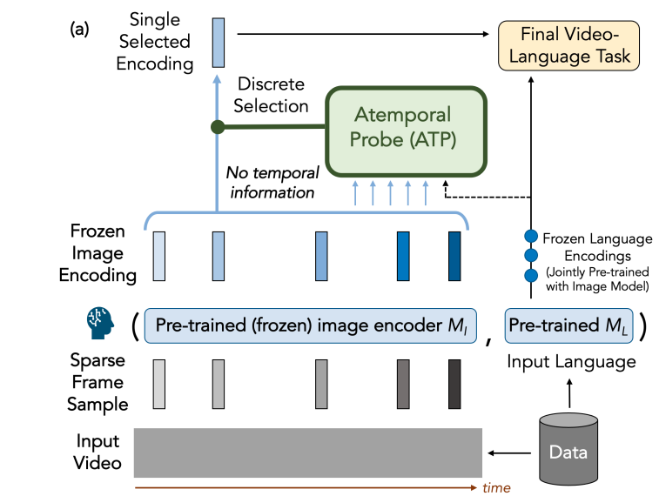
3.From ViLT to “Video-LT”
Related VQA model: CLIP; ViLT…etc.
Image input towards ATP is No temporal (time-disordered)
Random select some frames throughout input video

Slide 13
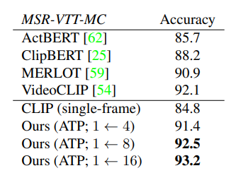
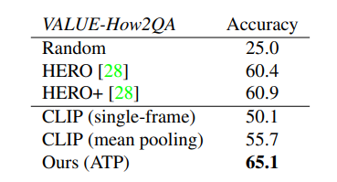
3.From ViLT to “Video-LT”
Results: (left) last three results are the performance on MSR-VTT-MC
(right) last one is the performance on VALUE-How2QA
Some analyze on MSR-VTT-MC: not enough to test “the dimension of time”?

Slide 14
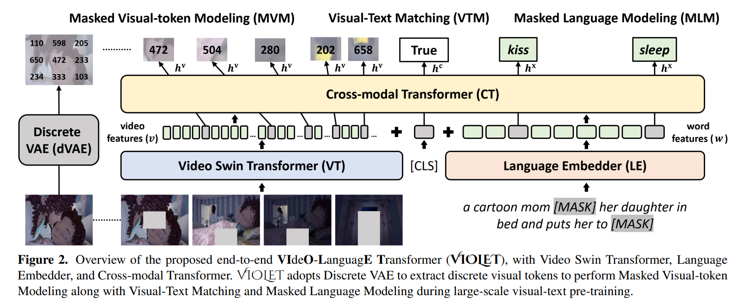
3.From ViLT to “Video-LT”
2. VIdeO-LanguagE Transformer(VIOLET): fully end-to-end Transformer dealing with most Video-Language tasks.

Slide 15




3.From ViLT to “Video-LT”
2. VIdeO-LanguagE Transformer(VIOLET):
Structure: Video Transfomer(VT) + Language Embedder(LE) → Cross-Model Transformer(CT)
VT: Split Video Patches→Linear Project to
→add spatial/temporal attention:
LE: Classical language embedding(with word tokens)
CT: Joint VidL learning by concatenate video embeddings&text embeddings&global VidL representation token
Corperate MVM(masked visual-token modeling) in pretraining task
logP(q|q’)

Slide 16
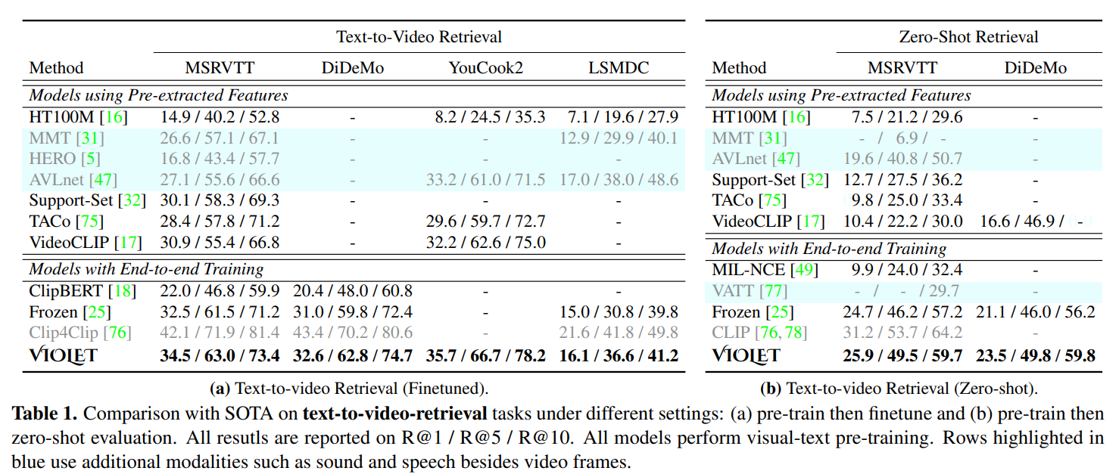
3.From ViLT to “Video-LT”
2. VIdeO-LanguagE Transformer(VIOLET):
Performance:

Slide 17
4.Further Work:
Emergent: Build up an accessible model for unsafe-behaviors detection.(Select one from the following ideas)
1. Build a model-head mapping video file to an (or multiple) “image” metrix which contains spatial & (temporal) information. Put this head on an ViL model.
2. Fine-tuning end-to-end model like VIOLET to serve our needs directly.
Important(long-term):
1. find an optimized algorism to solve the reduction problem from a high-dimension (with spatial and temporal x, t)
2. Building an safety-assessment system (package of AI)

Slide 18
Reference:
[1] Ding, Y., Liu, M., & Luo, X. (2022). Safety compliance checking of construction behaviors using visual question answering. Automation in Construction, 144, 104580.
[2] Kim, W., Son, B., & Kim, I. (2021, July). Vilt: Vision-and-language transformer without convolution or region supervision. In International Conference on Machine Learning (pp. 5583-5594). PMLR.
[3] Zhong, Y., Xiao, J., Ji, W., Li, Y., Deng, W., & Chua, T. S. (2022). Video question answering: Datasets, algorithms and challenges. arXiv preprint arXiv:2203.01225.
[4] Buch, S., Eyzaguirre, C., Gaidon, A., Wu, J., Fei-Fei, L., & Niebles, J. C. (2022). Revisiting the" video" in video-language understanding. In Proceedings of the IEEE/CVF conference on computer vision and pattern recognition (pp. 2917-2927).
[5] Ye, S., Kong, W., Yao, C., Ren, J., & Jiang, X. (2023). Video Question Answering Using CLIP-Guided Visual-Text Attention. arXiv preprint arXiv:2303.03131.
[6] Fu, T. J., Li, L., Gan, Z., Lin, K., Wang, W. Y., Wang, L., & Liu, Z. (2021). Violet: End-to-end video-language transformers with masked visual-token modeling. arXiv preprint arXiv:2111.12681.
[7] Fu, T. J., Li, L., Gan, Z., Lin, K., Wang, W. Y., Wang, L., & Liu, Z. (2023). An empirical study of end-to-end video-language transformers with masked visual modeling. In Proceedings of the IEEE/CVF Conference on Computer Vision and Pattern Recognition (pp. 22898-22909).

