Slide 1
Career Platform Project
Octree & Career network

Slide 2
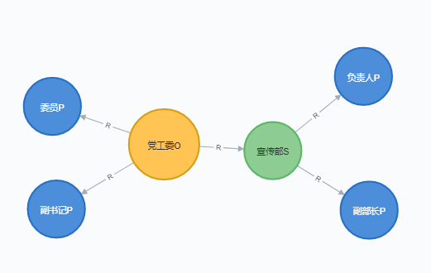
career network computation
（ uid, rid , interval ）
[(1, 16, ‘2001.09—2005.04’),
(2, 20, ‘2000.07—2001.08’),
(3, 20, ‘2000.07—2011.08’),
(4, 20, ‘2002.09—2005.04’)]
自配对
配对
同事关系
('1-16', '18-38', ['2002.06', '2005.04'])
('3-20', '18-38', ['2002.06', '2010.05'])
('4-20', '18-38', ['2002.09', '2005.04'])
[(18, 38, '2002.06—2010.05')]

Slide 3
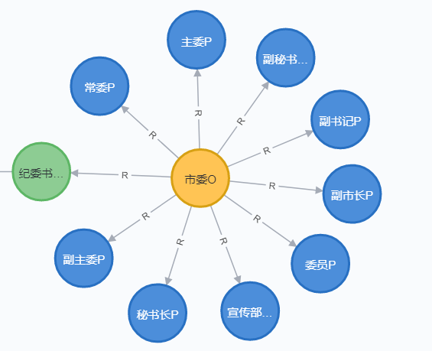
By job level Information
Uid-rid :“19-14”
Interval: "1993.08—2002.11"
Rank:
{'正科级': 40,'副处级': 72}
经历拆分
[['1993.08—1996.12', '正科级'],
['1996.12—2002.11', '副处级']]
无职级：职业名称判断

Slide 4
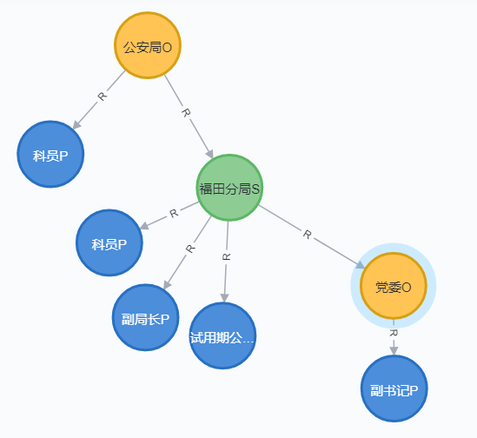
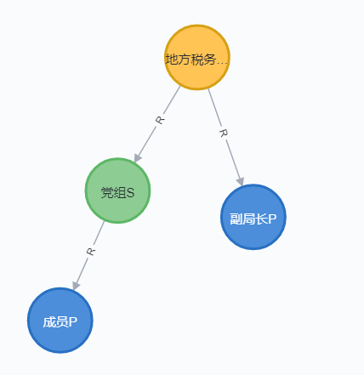
By OCTree Structure (three hop)
两种上下级关系的边，都是通过职级或名称判断

Slide 5
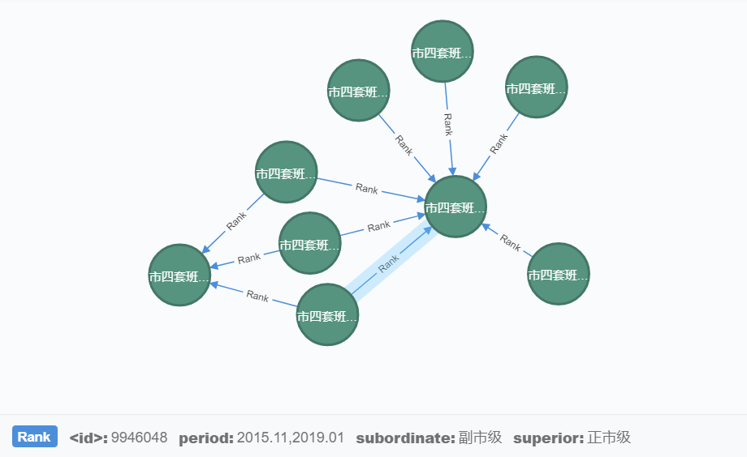

Slide 6
Octree Code Refactoring
Catalog
input
Treelib (dict): build_tree
Export_josn_tree
Compute_csn
Neo4j (database)
Store_octree
Store_csn
user_api
Class Octree(Treelib):
  build_tree()
  Compute_csn()
  Export_josn_tree()
  user_apis()
Class Neo4jAdapter()
Class Octree():
  build_tree()
  Store_octree()
  Compute_csn()
  Export_josn_tree()
  Store_csn()
  user_apis()
  Store_octree()
  Compute_csn()
  Store_csn()
  user_apis()

Slide 7
Plans for next week
导出json格式的octree ( for visualization)
Octree的增量更新和修改操作
Ner 添加bert word embedding

