Slide 1
H-ensemble: an Information Theoretic Approach to Reliable Few-Shot Multi-Source-Free Transfer
Yanru Wu, Jianning Wang, Weida Wang and Yang Li†
Tsinghua-Berkeley Shenzhen Institute,
Tsinghua Shenzhen International Graduation School, Tsinghua University

Slide 2
Contents
Introduction
Multi-Source-Free Transfer
Background & Related Works
Methodology
H-Ensemble Overview
Framework Components
Experiment
Comparison
Ablation Study
Conclusion

Slide 3
Multi-Source-Free Transfer
Introduction
Multi-Source-Free Transfer Setting
Multiple-Source
Transfer with more than one sources
More help to the target
Source-Free
Limited access to source data & model
Rising setting under the trend of decentralization and growing privacy concerns.
Source Data
D
D
D
.
.
.
D
1
2
3
M
θ
θ
θ
.
.
.
θ
1
2
3
M
Source Model
Transfer
Target
Task

Slide 4
Background & Related Works
Introduction
Research Landscape
Growingly important yet little explored
Existing solutions lacking source independency and consideration for the interaction among multiple sources
Additional Goals for Easy Usage
Efficient to implement and compute
Theoretically interpretable
Reducing reliance on source and target task details as much as possible

Slide 5
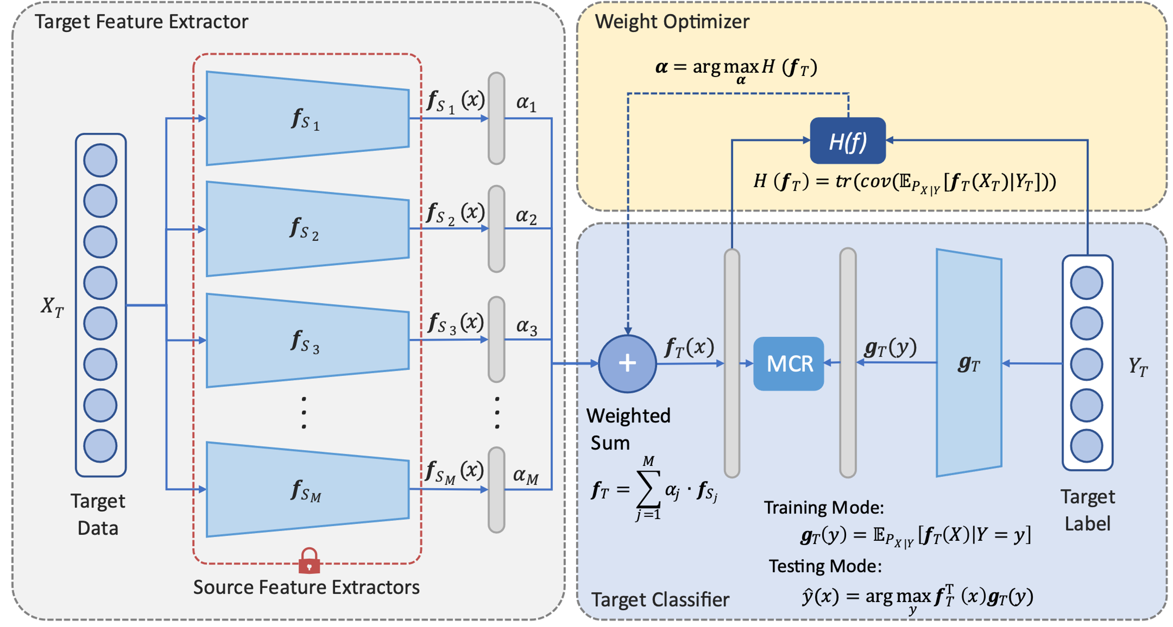
H-ensemble Overview
Methodology
H-ensemble
Core Framework: model ensemble through linear combination
Three Components: Target Feature Extractor; Weight Optimizer; Target Classifier

Slide 6
H-ensemble Framework Components
Methodology
H-ensemble
Target Feature Extractor
The target data $X_{T}$firstly flow into Target Feature Extractor.
We model the target feature extractor $f_{T}$by a weighted combination of source feature extractors $f_{S_{j}}$:

Slide 7
H-ensemble Framework Components
Methodology
H-ensemble
Weight Optimizer
The Weight Optimizer will utilize the outputs of source feature extractors $f_{S_{j}}(x)$ and target label $Y_{T}$ to derive the optimal source weight $α_{j}$, making the parameter in computing target feature $f_{T}(x)$.

Slide 8
H-ensemble Framework Components
Methodology
H-ensemble
Target Classifier
Finally we will train the Target Classifier $g_{T}$ and get the prediction using a generalization of maximal correlation regression (MCR).

Slide 9
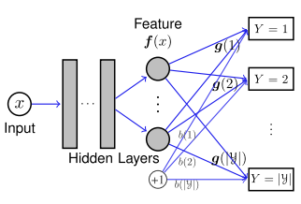
H-ensemble Framework Components
Methodology
H-ensemble
Weight Optimization & Target Classifier – H-Score and MCR
Huang, S.-L.; Makur, A.; Wornell, G. W.; and Zheng, L. 2019a. On universal features for high-dimensional learning and inference. arXiv preprint arXiv:1911.09105.
Bao, Y.; Li, Y.; Huang, S.-L.; Zhang, L.; Zheng, L.; Zamir, A.; and Guibas, L. 2019. An information-theoretic approach to transferability in task transfer learning. In 2019 IEEE international conference on image processing (ICIP), 2309–2313. IEEE.

Slide 10
H-ensemble Framework Overview
Methodology
H-ensemble
Overall Framework

Slide 11
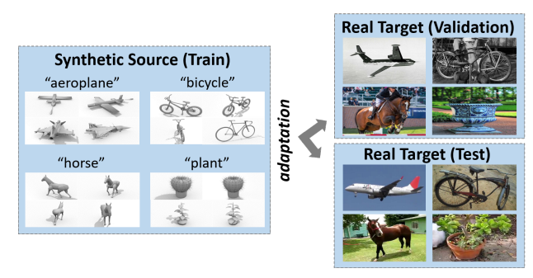
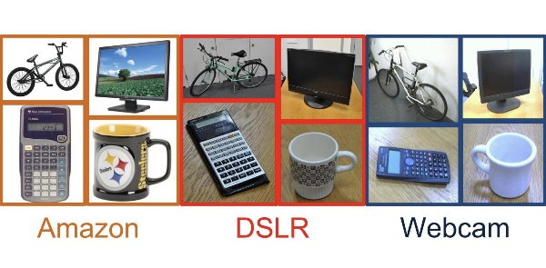
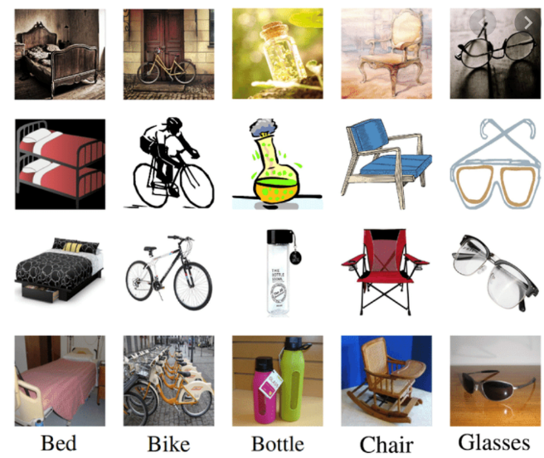
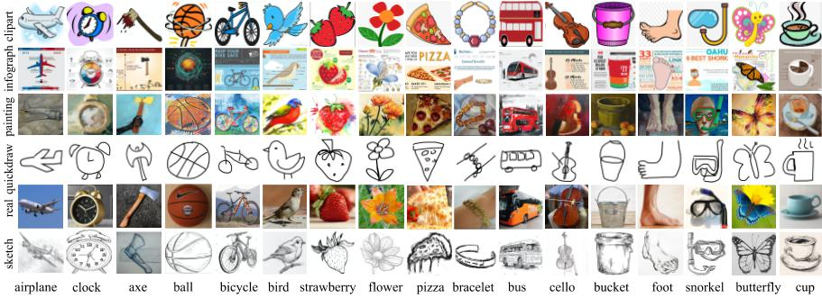
Datasets
Experiment
VisDA-2017
280,000 images, 12 classes, 2 domains
Office Series
Office-31: 4,652 images, 31 classes, 3 domains
Office-Caltech: 2,533 images, 10 classes, 4 domains
Office-Home: 15,599 images, 65 classes, 4 domains
DomainNet
600,000 images, 345 classes, 6 domains

Slide 12
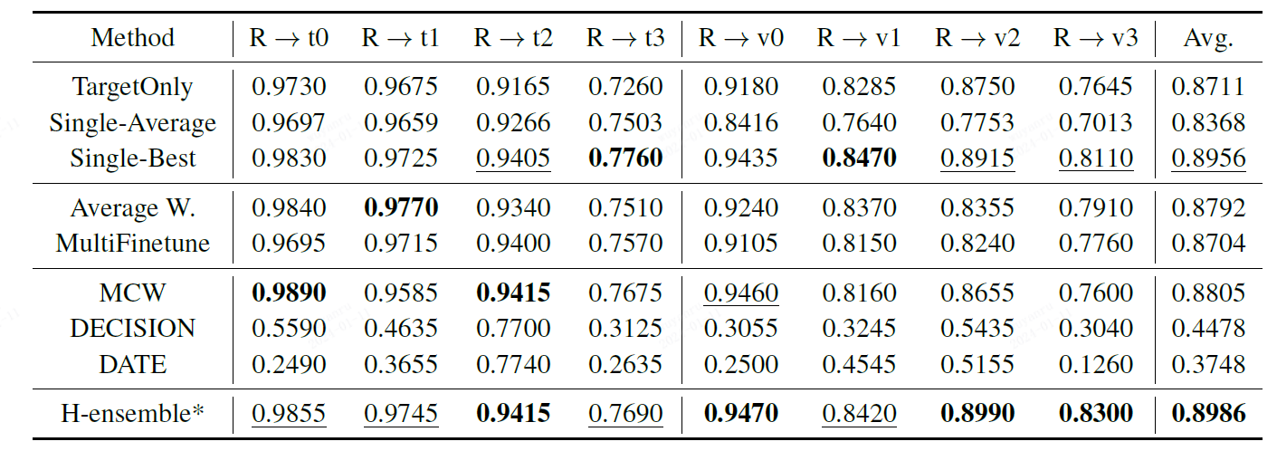
Comparison Experiments – Exp. VisDA-2017(10-shot)
Experiment
Setup: Domain V and T are both further divided into 4 tasks (i.e. v0 - v3 and t0 - t3), each with 3 classes.
Baselines:
Trivial Solutions: Target Only finetunes Imagenet-pretrained model on few-shot target data only; Single-* adapt one source model to target task using MCR and *-Best/Avg. stand for the best/average performance.
Relevant Approaches: Average W. replace the weighted sum in our framework with equal weights. MultiFinetune learns a fully connected classifier with the target extractor learned in Hensemble.
Prior SOTAs: MCW (Lee, Sattigeri, and Wornell 2019), DECISION (Ahmed et al. 2021), DATE (Han et al. 2023)

Slide 13
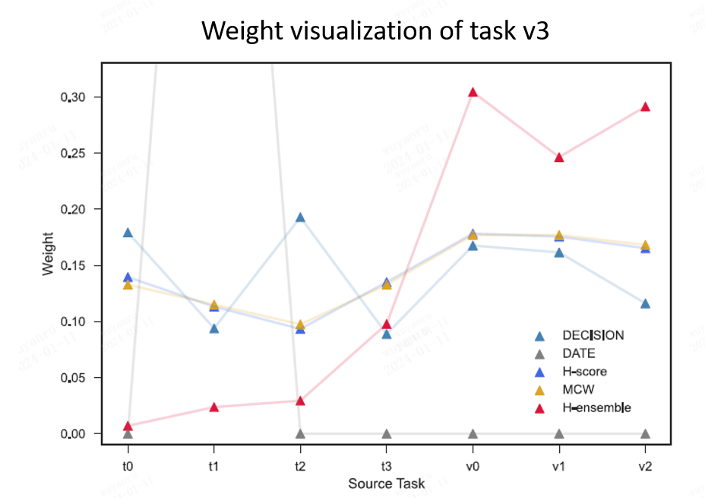
Comparison Experiments – Exp. VisDA-2017(10-shot)
Experiment
Setup: Domain V and T are both further divided into 4 tasks (i.e. v0 - v3 and t0 - t3), each with 3 classes.
Baselines:
Trivial Solutions: Target Only finetunes Imagenet-pretrained model on few-shot target data only; Single-* adapt one source model to target task using MCR and *-Best/Avg. stand for the best/average performance.
Relevant Approaches: Average W. replace the weighted sum in our framework with equal weights. MultiFinetune learns a fully connected classifier with the target extractor learned in Hensemble.
Prior SOTAs: MCW (Lee, Sattigeri, and Wornell 2019), DECISION (Ahmed et al. 2021), DATE (Han et al. 2023)

Slide 14
Ablation Study – Exp. Office Series (8-shot)
Experiment
Ablation Baselines
Single MCR: multi-source → average performance of single-source transfer;
Average W.: weighting strategy → average weights;
MultiFinetune: MCR classifier → finetune classifier.
Accuracy (Mean) on Office Series 8-shot
T-SNE Visualization
(Left: Random W., Mid: Average W., Right: H-ensemble)
Notes:
接下来文章在3个数据集上做了实验，分别是：
第一个是低分辨率图像。第二个是狗种类的图像集。第三个是相对于第二个包含更多类的图像的ImageNet子集。
对每个数据集手动选择了source和target task。
然后对source数据都使用LeNet进行训练。
Test集合测试对比实验，multi source SVM 直接使用一样的target训练数据在倒数第二层训练。
同时也做了single source的svm和MCW的实验。
然后还有一个upper bound baseline 使用LeNet网络，target样本数量和每个source训练样本数量一样。作为performance的一个上界。

Slide 15
Conclusion
As a summary, our work is featured by the following contributions:
Take the lead in providing a mathematical formulation for the multi-source-free transfer scenario
Introduce the H-ensemble framework
Effectively addressing the challenge of multi-source-free transfer, outperforming prior arts in extensive experimental studies
Compute efficiency
Theoretical reliability
Lightweight structure easy to interpret and adapt

Slide 16
Thank You for Listening!
H-ensemble: an Information Theoretic Approach to Reliable Few-Shot Multi-Source-Free Transfer
Yanru Wu, Jianning Wang, Weida Wang and Yang Li†
wu-yr21@mails.tsinghua.edu.cn, wangjianning@stu.hit.edu.cn, wangwd19@mails.tsinghua.edu.cn, yangli@sz.tsinghua.edu.cn
Tsinghua-Berkeley Shenzhen Institute, SIGS, Tsinghua University
Notes:
That’s all ,thank you !

